Slide 1
Defining Senegal's Health Benefits Package
Cost-effectiveness ranking, constrained optimization, and distributional analysis - a first dry run
EasyHealth WP3 | LISER
Notes:
Introduction. Thank you all for being here. Today I'll present the first dry run of the priority-setting method for Senegal's health benefits package: the standard cost-effectiveness logic, constrained optimization, and the distributional analysis (DCEA). The goal today is to walk through the mechanics of the method, share the first results, and open the discussion on next steps to sharpen these results with finer Senegal-specific data.

Slide 2
AGENDA
One priority-setting question, three linked methods
1
Disease burden & interventions
What does Senegal's disease burden look like, and what can address it?
2
Cost-effectiveness (CEA)
Which interventions deliver the most health per dollar spent?
3
Constrained optimization
What can actually be delivered with limited budget and staff?
4
Distributional analysis (DCEA)
Who benefits from this package, and does it narrow inequality?
LISER | EasyHealth WP3 - Senegal HBP
2
Notes:
We'll follow exactly the structure of the written note sent to Marc and Michel: first the disease burden and how it maps onto available interventions, then the standard cost-effectiveness logic, then constrained optimization, then the equity dimension through DCEA. At the end I'll propose concrete next steps.

Slide 3
CONTEXT
A benefits package to define under real resource limits
18.1 million people (2023), growing 2.9% a year
389 candidate interventions listed in the OneHealth Tool
A limited health budget and workforce: choices must be made
A systematic, transparent ranking method is needed
18.1M
population, Senegal 2023
389
candidate interventions (OneHealth Tool)
LISER | EasyHealth WP3 - Senegal HBP
3
Notes:
Senegal needs to define its essential health benefits package under real resource constraints. The question is not what we would like to do, but what can actually be done, and in what order, starting from 389 candidate interventions.

Slide 4
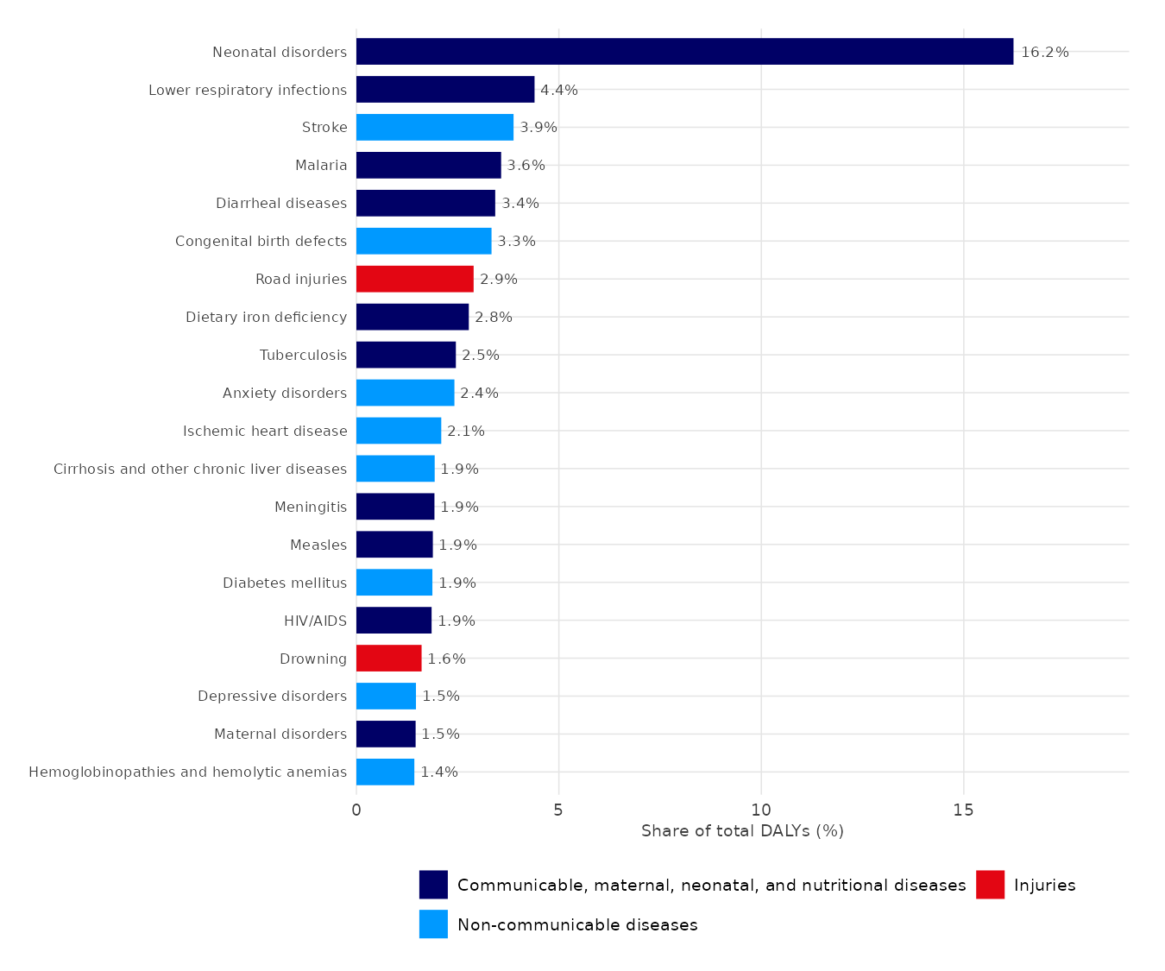
DISEASE BURDEN
6.8 million DALYs, concentrated in four drivers
6.8M DALYs total (GBD 2023, Senegal)
46% CMNN, 44% NCDs, 10% injuries
Top 20 causes = 63% of all DALYs
Neonatal disorders alone: 16% - the single largest driver
NCDs: 18.4% of the top-20 burden (stroke, birth defects, anxiety/depression)
LISER | EasyHealth WP3 - Senegal HBP
4
Notes:
Senegal's disease burden, from the GBD hierarchy, totals 6.8 million DALYs. Communicable, maternal, neonatal and nutritional causes and non-communicable diseases are almost evenly split, at 46% and 44%, with injuries making up the rest. The top 20 causes alone already account for 63% of the entire burden. Neonatal disorders dominate at 16%, nearly as much as all top-ranked NCDs combined, which puts reproductive, maternal, newborn and child health squarely at the top of the priority list.

Slide 5
DISEASE BURDEN MEETS INTERVENTIONS
What the intervention list actually covers
389 interventions in Senegal's OneHealth Tool inventory
382 (98%) matched to a primary GBD cause, covering 60 of 176 distinct causes
Tuberculosis, maternal disorders and HIV/AIDS alone account for 174 of these 382 matches
70%
29.5%
13.1%
of the top-20 DALY causes have a matched intervention (14 of 20)
match rate for the remaining, lower-burden causes (46 of 156)
of total DALYs still uncovered: 6 top-20 causes with no matched intervention
LISER | EasyHealth WP3 - Senegal HBP
5
Notes:
Before ranking interventions, we first check what the OneHealth Tool inventory actually addresses. Of 389 interventions, 382 are matched to a primary GBD cause, covering 60 of 176 distinct causes recognised by GBD. Coverage is deliberately concentrated where the burden is highest: 70% of the top-20 DALY causes have a matched intervention, against only 29.5% for the remaining, lower-burden causes. But six top-20 causes, together 13.1% of the total burden, still have no matched intervention: congenital birth defects, road injuries, cirrhosis, meningitis, drowning, and hemoglobinopathies. That gap is worth flagging on its own, independently of anything cost-effectiveness can tell us. From here, the next steps narrow this list further to build the ranked league table.

Slide 6
METHOD
The overall logic
1. League table
2. Optimization
3. DCEA
Rank interventions by cost-effectiveness ratio (ICER) against a reference threshold (CET)
Choose each intervention's coverage level under budget and workforce constraints
Check who benefits from the resulting package, by wealth quintile and by residence
LISER | EasyHealth WP3 - Senegal HBP
6
Notes:
These three steps build on each other: the league table answers 'is it worth it', optimization answers 'can we actually deliver it with the resources available', and DCEA answers 'who really benefits'. Each step builds directly on the previous one.

Slide 7
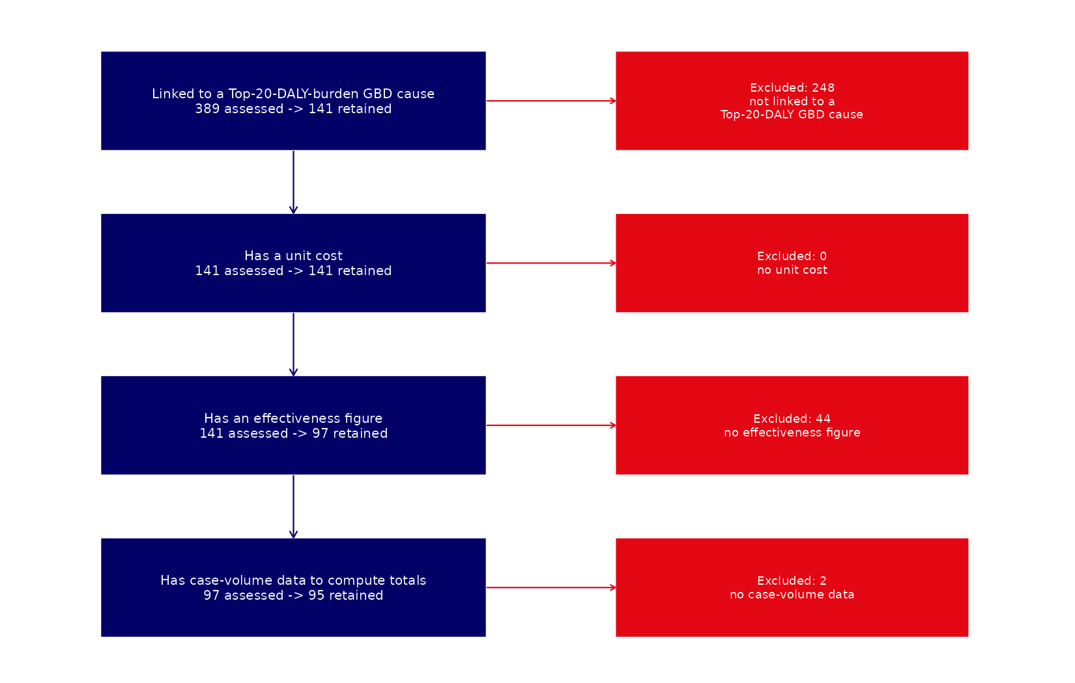
RESULTS - COST-EFFECTIVENESS
389 interventions narrowed to a 95-intervention league table
95
interventions in the final league table
85 / 95
cost-effective at a $485/DALY threshold
Four sequential filters: linked to a top-20 GBD cause, unit cost available, effect measured, case-volume data available.
LISER | EasyHealth WP3 - Senegal HBP
7
Notes:
Starting point: 389 interventions. Four sequential filters narrow that down to 95: linked to one of the 20 leading GBD causes (141 remain), unit cost available (still 141), effect measured in DALYs averted per patient (97 remain), and case-volume data available (95 in the end). At a cost-effectiveness threshold of 485 dollars per DALY averted, 85 of these 95 interventions are individually cost-effective.

Slide 8
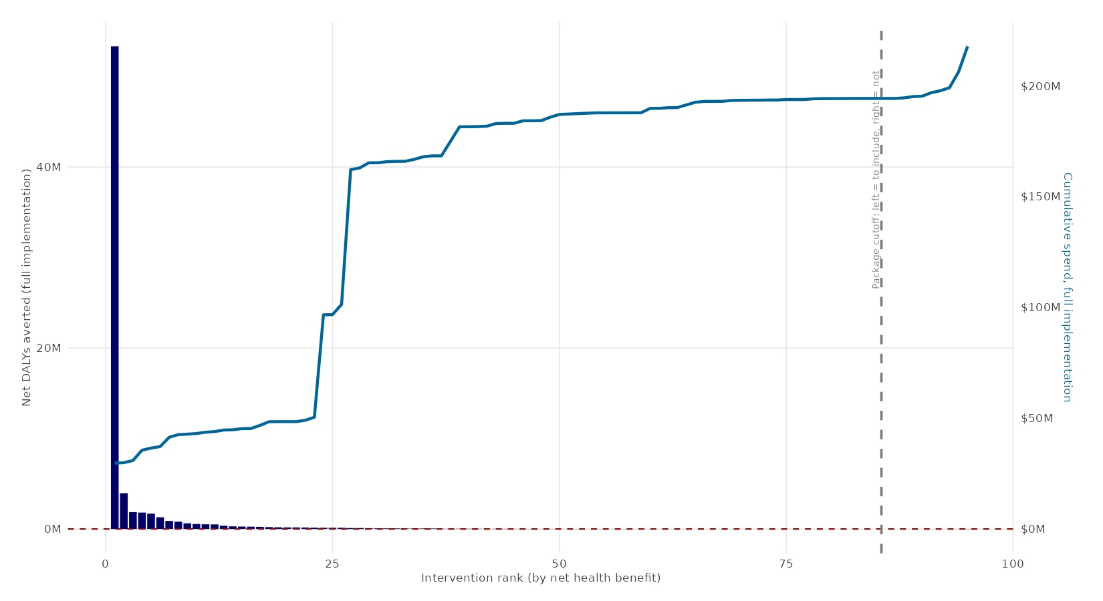
RESULTS - COST-EFFECTIVENESS
Ranking by net health benefit, not cost-effectiveness alone
LISER | EasyHealth WP3 - Senegal HBP
8
Notes:
Interventions aren't ranked only by their cost-effectiveness ratio, but by net health benefit: DALYs averted minus the cost converted into DALY-equivalent terms via the threshold. That ranks interventions by their actual contribution to population health, not just their unit rentability. The blue curve is the set retained under the 485-dollar threshold; red is what exceeds it.

Slide 9
METHOD - CONSTRAINED OPTIMIZATION
Being cost-effective is not enough: can it be delivered?
A linear program chooses each intervention's coverage level to maximize total net health benefit
Financial constraint: available consumables budget
Workforce constraint: available time by cadre (doctors, nurses, pharmacists...)
What this changes in practice
More budget, staff, or a higher CET can bring new interventions into the package
A tighter constraint excludes some, even cost-effective ones
The model identifies exactly which resource binds, and by how much
LISER | EasyHealth WP3 - Senegal HBP
9
Notes:
Being individually cost-effective does not guarantee an intervention can be both financed AND staffed alongside every other one. Constrained optimization solves this jointly: it chooses each intervention's coverage level to maximize total net benefit, subject to a budget constraint and a workforce-time constraint by cadre. It's a direct decision tool: if the budget or staffing changes, we can immediately recompute which package becomes feasible.

Slide 10
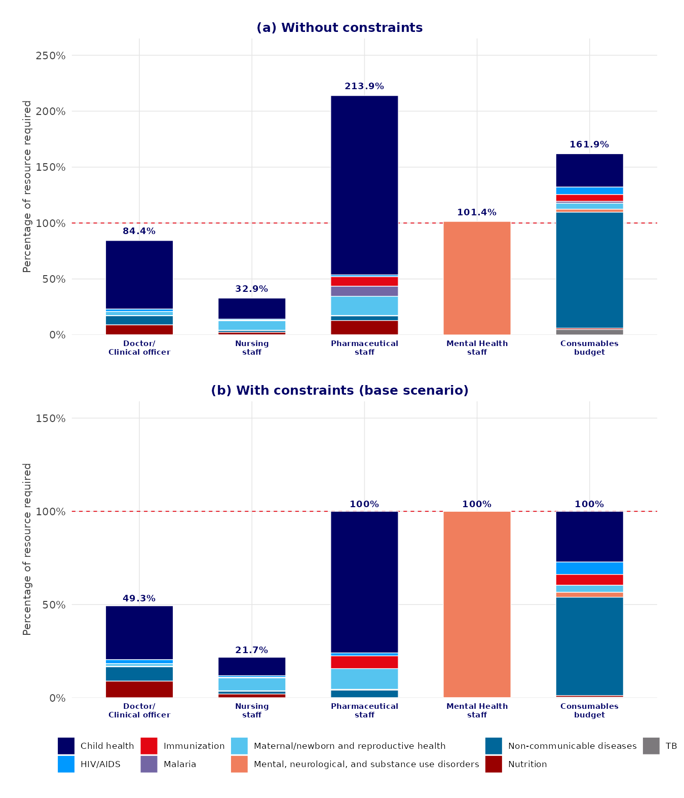
RESULTS - OPTIMIZATION
The real bottleneck: workforce, not the interventions
Without constraints: mental-health staff need would exceed 6x current capacity; consumables budget over 5x
Once constraints apply, the budget uses 100% of its envelope: it is the binding limit
General medical staff retain slack; mental-health services are almost entirely crowded out
LISER | EasyHealth WP3 - Senegal HBP
10
Notes:
This is the most telling figure in this section. On the left, what it would take to treat every cost-effective case with no limit at all: over 600% of current capacity for mental-health staff, over 500% of the consumables budget. On the right, once constraints are actually applied, the budget is the first to saturate at 100%, while general medical staff retain slack. Mental health, on the other hand, is almost entirely excluded from the resulting package, not because it isn't worthwhile, but because it is too staff-intensive relative to the alternatives competing for the same scarce workforce.

Slide 11
RESULTS - OPTIMIZATION
Four scenarios, one explicit trade-off
Scenario
Interventions
Net DALYs
No constraint (CET only)
77 / 95
81.6 M
Budget only ($120M)
75 / 85
71.7 M
Base scenario (budget + workforce)
46 / 68
-
With task-shifting
56 / 68
-
Shifting pharmacy/nutrition tasks to nurses relieves the pharmaceutical bottleneck and brings in 10 more interventions, at the cost of higher doctor/nurse time use.
LISER | EasyHealth WP3 - Senegal HBP
11
Notes:
Four scenarios tested. With no resource constraint at all, 77 interventions clear the cost-effectiveness threshold. Adding the consumables budget already drops that slightly to 75, but total DALYs barely move: the budget only excludes marginal interventions. The real shock comes from workforce constraints: the base scenario retains only 46 of 68 interventions tested. Allowing task-shifting to nurses, which relieves the pharmaceutical bottleneck, brings that back up to 56, at the cost of higher doctor and nurse workload. That's an explicit trade-off that needs a policy-level decision.

Slide 12
METHOD - DCEA
Efficient is not the same as equitable
DCEA splits each intervention's benefit across wealth quintiles and urban/rural residence
An Atkinson index summarizes each group's health in one number (EDE), sensitive to gaps between groups
A parameter (epsilon) sets how harshly inequality is penalized: 10 as reference, tested at 2 and 25 too
Result: the package's impact on inequality, not just on average health
Reading the equity plane
Vertical axis: total net health benefit
Horizontal axis: inequality impact (left = widens the gap, right = narrows it)
Each point is one intervention
LISER | EasyHealth WP3 - Senegal HBP
12
Notes:
DCEA asks a different question from the standard league table: not 'how much more health', but 'who benefits'. We split each intervention's benefit by who actually uses it, by wealth quintile and by residence, then summarize each group's health with an Atkinson index, which penalizes gaps. The epsilon parameter sets that penalty: the higher it is, the more weight is given to the worst-off group. We tested it at 2, 10 and 25 to check robustness.

Slide 13
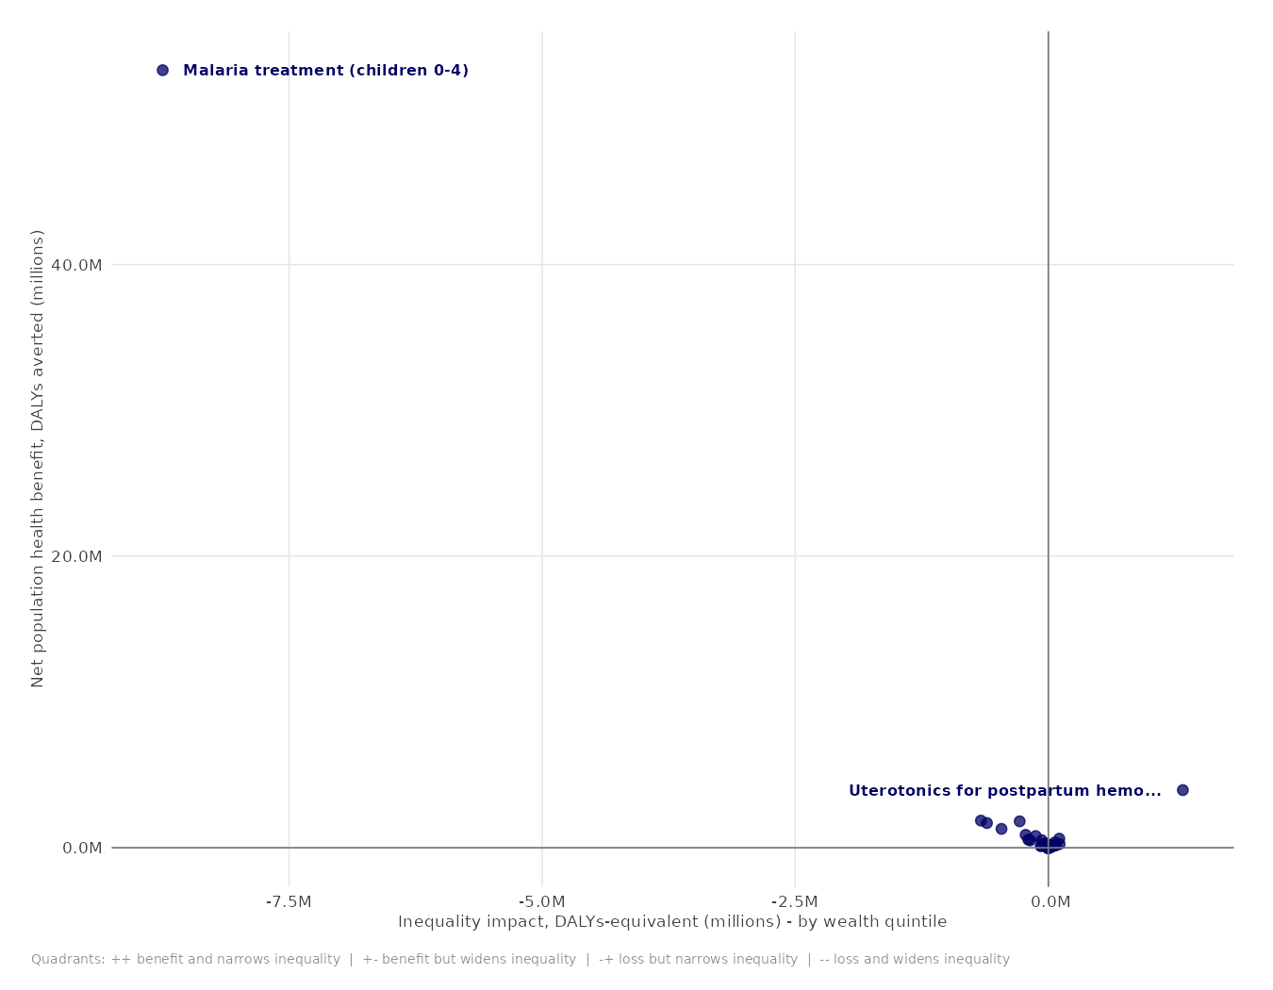
RESULTS - DCEA
One intervention drives most of the equity result
74%
of total net benefit (malaria treatment, children 0-4)
-9.8 M
widening of wealth-quintile inequality (epsilon=10)
+9.7 M
narrowing of the urban/rural gap
LISER | EasyHealth WP3 - Senegal HBP
13
Notes:
This is the equity plane by wealth quintile. Malaria treatment for children under 5 completely dominates the chart: 74% of total net benefit, and 89% of the package's impact on wealth-quintile inequality. This isn't an error: with roughly 4 malaria episodes per child per year across 2.5 million children, the case volume is genuinely enormous. But it also means the whole package's equity profile depends almost entirely on a single intervention. On the urban/rural dimension, though, the package actually narrows inequality rather than widening it, a different signal worth highlighting on its own.

Slide 14
SYNTHESIS
Three takeaways
Cost-effective is not enough
85 of 95 interventions are individually cost-effective, but workforce constraints exclude nearly half of them.
Workforce, not budget, is the real bottleneck
The budget saturates at 100% once constraints apply; mental-health staff is the hardest hit.
Efficiency and equity don't always point the same way
The package slightly widens wealth-quintile inequality while narrowing the urban/rural gap - a trade-off to name explicitly.
LISER | EasyHealth WP3 - Senegal HBP
14
Notes:
Three takeaways from this first iteration. One: being cost-effective is not enough, workforce constraints exclude nearly half of the individually cost-effective interventions. Two: it is workforce, not budget, that is the real bottleneck once constraints are actually applied. Three: efficiency and equity don't always point the same way, which calls for an explicit policy trade-off rather than an implicit one.

Slide 15
NEXT STEPS
What this first iteration already makes possible
Refine the inputs as Senegal-specific data becomes available: DHS Continuous microdata for the DCEA baseline, a confirmed MSAS consumables budget, national workforce data to replace the current reference dataset
Test alternative decisions in minutes: a revised CET, a different budget, another task-shifting assumption - the pipeline recomputes everything automatically
Open the equity-efficiency trade-off discussion with the technical working group, grounded in explicit numbers rather than implicit choices
LISER | EasyHealth WP3 - Senegal HBP
15
Notes:
This first iteration is not an end point, it's an already-operational working tool. Three concrete next steps: first, progressively replace the provisional parameters (budget, workforce data, DCEA parameters) with confirmed Senegal data as it becomes available - the pipeline is built so that takes minutes of recomputation, not a fresh build from scratch. Second, test other policy scenarios (a revised CET, a different budget) just as quickly. Third, use these results to feed an explicit discussion on the equity-efficiency trade-off with the technical working group. I remain available, of course, to keep developing this tool as new data comes in.

Slide 16
Thank you
Questions and discussion
EasyHealth WP3 | LISER
Notes:
Thank you for your attention. I'm happy to take any questions, especially on the methodological choices and the provisional assumptions. And again, I remain fully available to keep developing this work as more data and discussions come in.

