Slide 1
Senegal HBP
Methodology and results - working session
Notes:
This is a working session, not a formal presentation - I'd like to walk through the method end to end, be explicit about what's solid and what's still provisional, and agree on priorities for the next iteration.

Slide 2
AGENDA
Same thread as the written note: burden, cost-effectiveness, optimization, equity.
Disease burden and what the intervention list actually covers
Cost-effectiveness ranking (the league table)
Constrained optimization (budget and workforce)
Distributional analysis (DCEA)
Data quality, traceability, and what's still provisional
Takeaways and what I'd prioritize next
2
Notes:
We'll follow the exact same order as the written note. I've also added a section specifically on data quality and what remains provisional, since I think that's as important to align on as the results themselves.

Slide 3
DISEASE BURDEN
Interventions concentrate where the burden is highest, but six major causes remain uncovered.
6.8M DALYs total (GBD 2023); top 20 causes account for 63% of all DALYs, led by neonatal disorders (16%)
389 candidate interventions; 382 matched to a primary GBD cause, covering 60 of 176 distinct causes
Coverage is deliberately concentrated on high-burden causes: 14 of the top 20 have a matched intervention, against 46 of the remaining 156
Six top-20 causes still have no matched intervention - together 13% of total DALYs (birth defects, road injuries, cirrhosis, meningitis, drowning, hemoglobinopathies)
3
Notes:
Quick recap rather than new information for this room: the burden is concentrated, and so is intervention coverage, which is the right design choice. But I want to flag explicitly that six top-20 causes, 13% of the total burden, currently have no matched intervention on their main cause - that's a gap worth naming, independently of anything cost-effectiveness tells us later.

Slide 4
METHOD
Three linked steps: is it worth it, can we deliver it, and who benefits.
League table: rank interventions by cost-effectiveness ratio against a reference threshold
Optimization: choose each intervention's coverage level under budget and workforce constraints
DCEA: check how the resulting package's benefit is distributed by wealth quintile and residence
4
Notes:
Each step builds on the previous one: the league table answers 'is it worth it', optimization answers 'can we deliver it', and DCEA answers 'who benefits'.

Slide 5
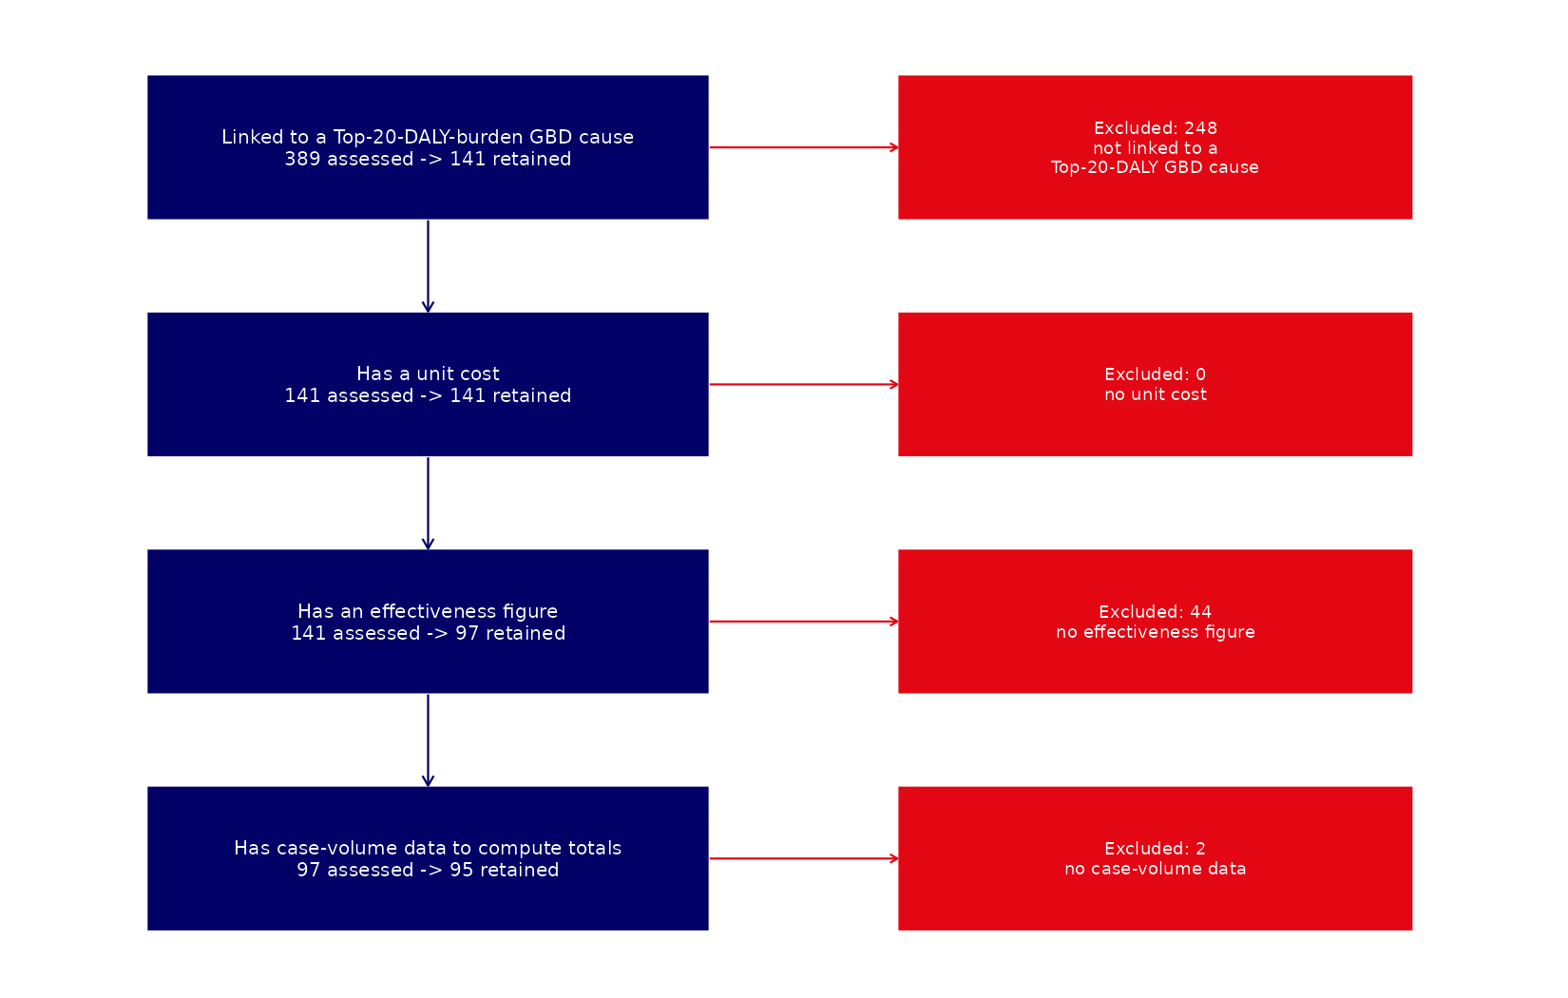
COST-EFFECTIVENESS
Four sequential filters narrow 389 candidates to a 95-intervention league table.
Linked to a top-20 DALY cause: 141 remain
Unit cost available: still 141
Effect measured (DALYs/patient): 97 remain
Case-volume data available: 95 final
85 of 95 are cost-effective at $485/DALY
5
Notes:
Starting from 389, four sequential filters bring us to 95. At a reference threshold of 485 dollars per DALY averted, 85 of these are individually cost-effective.

Slide 6
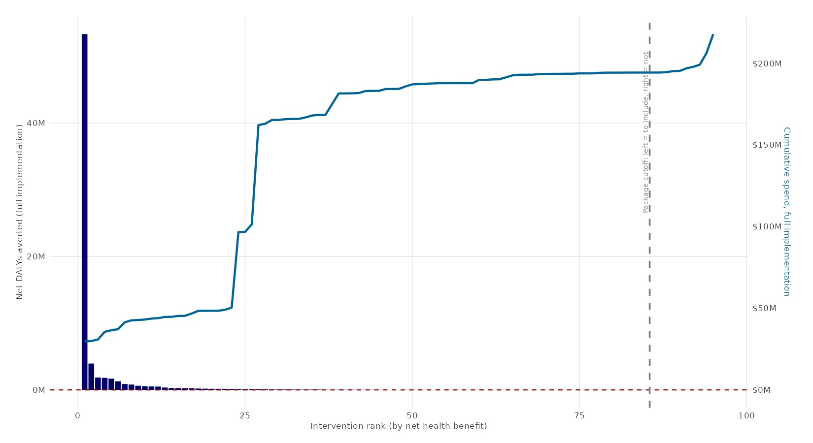
COST-EFFECTIVENESS
Ranking by net health benefit, not the cost-effectiveness ratio alone.
6
Notes:
Interventions are ranked by net health benefit - DALYs averted minus the cost converted into DALY-equivalent terms - so the ranking reflects each intervention's actual contribution to population health, not just its unit cost-effectiveness.

Slide 7
CONSTRAINED OPTIMIZATION
Being cost-effective does not guarantee it can be financed and staffed at the same time.
A linear program chooses each intervention's coverage level to maximize total net health benefit
Two constraints: the consumables budget, and workforce time by cadre
The model identifies exactly which resource binds, and by how much
7
Notes:
This step solves jointly what the league table can't: whether the resources exist to deliver everything that's individually cost-effective, and if not, which resource is the actual limit.

Slide 8
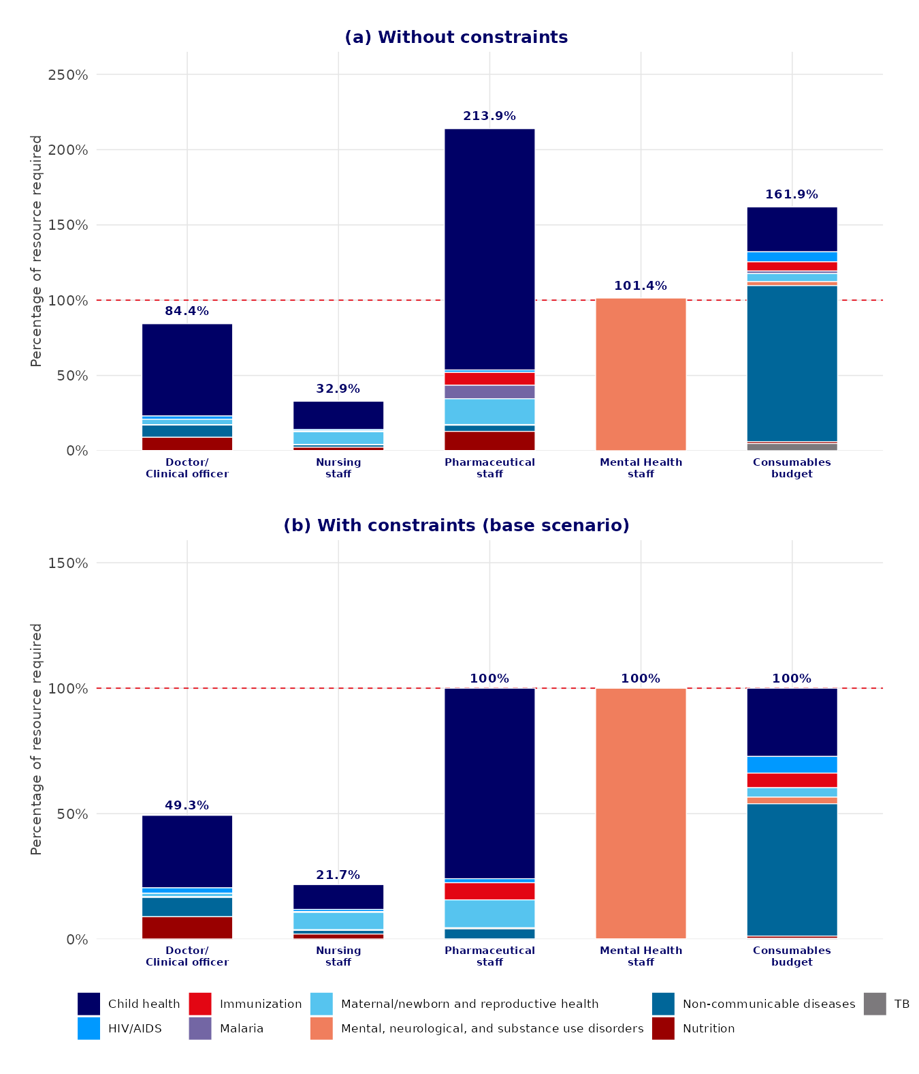
CONSTRAINED OPTIMIZATION - RESULTS
Pharmacy staff, mental-health staff, and the budget bind together - doctors and nurses have slack.
Without any constraint, pharmaceutical-staff need would exceed 2x current capacity (214%); mental-health need would exceed it too (101%)
Once applied, pharmacy, mental health, and the consumables budget all saturate near 100% at the same time
Doctors (49%) and nurses (22%) keep real slack - they are not the binding resource
Caveat: workforce time-per-case and capacity figures are drawn from a reference-country dataset, not yet Senegal-specific
8
Notes:
The pattern is clear even before we have Senegal-specific staffing numbers: it isn't one resource that binds, it's three at once - pharmacy staff, mental-health staff, and the consumables budget all saturate near 100% together, while doctors and nurses retain real slack. I want to be explicit that the workforce data behind this is still a reference-country dataset - the pattern is informative, the exact magnitude is not yet locally validated.

Slide 9
CONSTRAINED OPTIMIZATION - RESULTS
Four scenarios make the budget-versus-workforce trade-off explicit.
Scenario
Interventions
Net DALYs
No constraint (CET only)
77 / 95
81.6 M
Budget only ($120M)
75 / 85
71.7 M
Base (budget + workforce)
46 / 68
-
With task-shifting
56 / 68
-
Task-shifting pharmacy/nutrition duties to nurses relieves the pharmaceutical bottleneck and brings in 10 more interventions.
The 68-intervention base is the subset matched to the reference workforce dataset, not the full 95.
9
Notes:
The budget alone barely changes the total. Workforce constraints are what really bite, cutting the package roughly in half; task-shifting recovers some of that. I want to flag on this slide that the 68-intervention base here is smaller than the full 95-intervention league table, because it's limited to what the reference workforce dataset could match by name.

Slide 10
DISTRIBUTIONAL ANALYSIS (DCEA)
Being efficient is not the same as being equitable.
Each intervention's benefit is split by who actually uses it - by wealth quintile and by residence
An Atkinson index summarizes each group's health in one number, penalizing gaps between groups
The penalty parameter (epsilon) is tested at 2, 10, and 25 to check robustness
10
Notes:
DCEA asks a different question from the league table: not how much health, but who benefits. The Atkinson index lets us summarize that distribution in a single, comparable number per group.

Slide 11
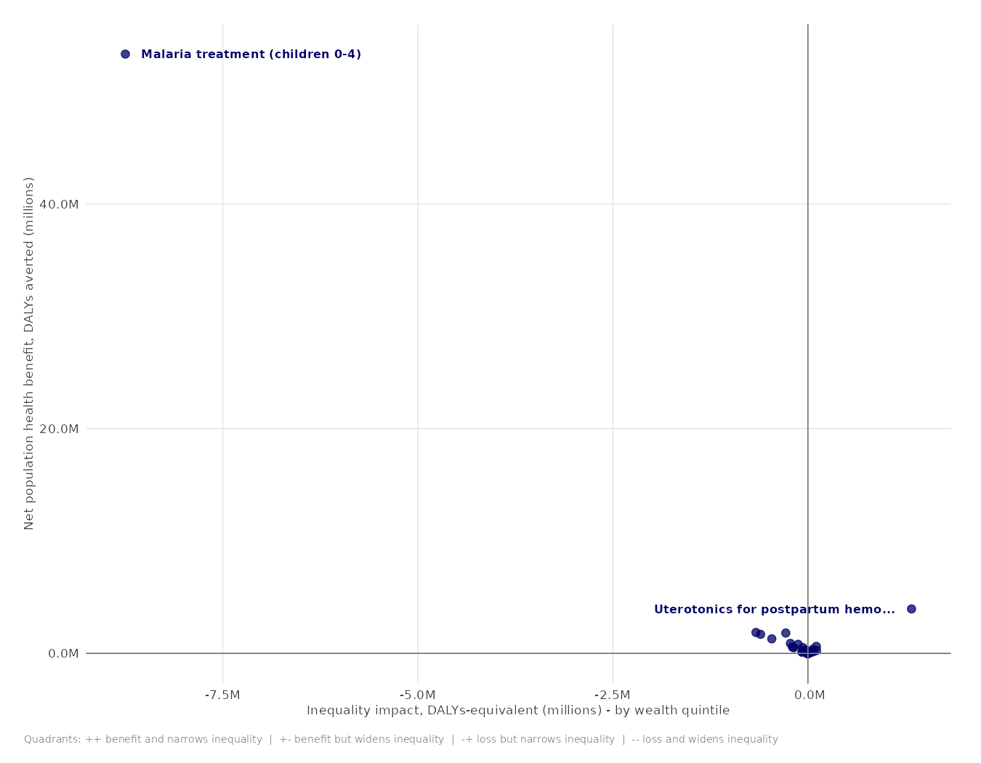
DISTRIBUTIONAL ANALYSIS - RESULTS
The equity result rests heavily on one intervention, and on provisional baseline parameters.
Pediatric malaria treatment alone drives roughly three-quarters of total net benefit
The same intervention accounts for most of the wealth-quintile inequality result
Direction differs by dimension: widens wealth-quintile gaps, narrows the urban/rural gap
Caveat: the baseline health distribution is a simplified proxy, pending Senegal DHS microdata
11
Notes:
One intervention, pediatric malaria treatment, drives most of both the benefit and the inequality result. That's a real finding, but it also means the equity conclusion is currently resting on a narrow base. I also want to be upfront that the baseline health distribution behind this whole analysis is still a simplified proxy - the full method needs DHS sibling-history data we don't have processed yet.

Slide 12
DATA QUALITY AND TRACEABILITY
Every inclusion or exclusion in the pipeline is traceable, and QA already caught one real error.
A mis-attributed data source (six mental-health interventions wrongly linked to an unrelated study) was found and corrected pipeline-wide
Inclusion and exclusion are now tracked at every stage - not just the league table, but the optimization and DCEA steps too, each with a stated reason
One remaining inconsistency (realistic-implementation case volumes for one intervention) is flagged and still being checked
12
Notes:
I want to spend a moment on process, not just results. We found and corrected a real data error during QA. More importantly, the pipeline now tracks why any intervention is in or out at every single stage, which means a future reviewer - or a future me - can audit any number end to end. One smaller inconsistency is still open and I'm tracking it rather than letting it sit unflagged.

Slide 13
ROBUSTNESS
The main conclusions hold across a plausible range of modeling choices.
Inequality result direction is unchanged across epsilon = 2, 10, and 25
The affordable package composition is stable across CET = 50% to 200% of the reference value
None of this substitutes for Senegal-specific data - it shows the framework itself is not fragile to the choices we had to make
13
Notes:
Before bringing this to the room, I stress-tested the headline conclusions against the main modeling choices. They hold in direction. That doesn't replace real Senegal data, but it tells us the conclusions aren't an artifact of an arbitrary parameter choice.

Slide 14
TAKEAWAYS
Three things worth remembering from this iteration.
Cost-effective is not sufficient - workforce constraints exclude nearly half of the individually cost-effective interventions
Several resources bind at once - pharmacy staff, mental-health staff, and the budget - while doctors and nurses keep slack
Efficiency and equity can point in different directions - this needs an explicit, not implicit, policy choice
14
Notes:
Three takeaways: cost-effectiveness alone isn't enough, several resources bind together rather than one single bottleneck, and efficiency and equity don't always agree - which is a decision for the group, not something the model should decide silently.

Slide 15
NEXT STEPS
A prioritized list of what to replace first, and what I'd like to sharpen next.
Priority 1: Senegal-specific workforce data, since it drives the optimization bottleneck result
Priority 2: a confirmed consumables budget, and DHS microdata for the DCEA baseline
Priority 3: a second-source check on the effectiveness figures behind the largest interventions
On the DCEA side specifically, I'd like to get closer to the original method's own specification for the baseline and the equity-efficiency analysis - happy to compare notes with anyone who's implemented this elsewhere
15
Notes:
I've ordered this by expected impact on the conclusions, not by ease of access. Workforce data comes first because it drives the single biggest result in the optimization section. On the DCEA point, I'd genuinely value the chance to validate the baseline construction against how it's done at the source, rather than from the published method alone - if that's ever a natural opening, I'd take it.

Slide 16
DISCUSSION
Over to the group: priorities, sequencing, and any leads on the open items.
16
Notes:
That's the full picture. I'd like to hear which of the priorities on the previous slide matters most to you, and whether either of you has a lead on any of the open items.

