Slide 1
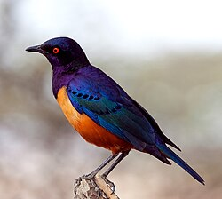
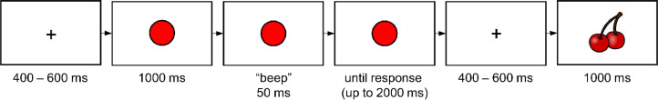
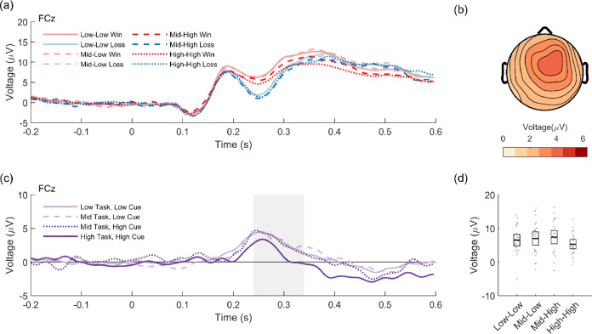
Milestone 1: Team “Starling”
Members: Fang Gu, Qinmengying Yan, Yaoqiao Sha
Dataset: Cameron D. Hassall, Laurence T. Hunt, Clay B. Holroyd,
Task-level value affects trial-level reward processing, NeuroImage,
Vol. 260, 2022, 119456, ISSN 1053-8119,
https://doi.org/10.1016/j.neuroimage.2022.119456
Task overview. After making a left or right button press, participants were shown fruit indicating the outcome (win or loss).
Main research question. Investigate whether and how reward-related ACC activity, as indexed by the RewP, varies with task value.
Main results to be replicated and main analysis we will perform.
ERP analysis. Specifically, quantify the RewP by subtracting the mean loss ERP from the corresponding mean win ERP for each task and cue.

