Slide 1

Milestone 2: Team „Strawbrainy“
Members: Nina Neuron, Basti Brain
Dataset: Gambling Task
Main Research Question
Are we surprised differently, if our visual predictions were created by inferred (that is, internal) information?
Add more rows!!
Step | Authors | Strawbrainy
Bad Channels | Manual inspection | None
Filter | >5Hz & <20Hz | None
50Hz | Notch | Zapline
Artefacts | MARA | IC-Label
---- | --- | ---
Averaging | mean | median
Baseline correction | -100 - 0 | BSL regression
Statistic | T-test on ROI | Permutation tests
Analysis: fill in only as far as already possible

Slide 2
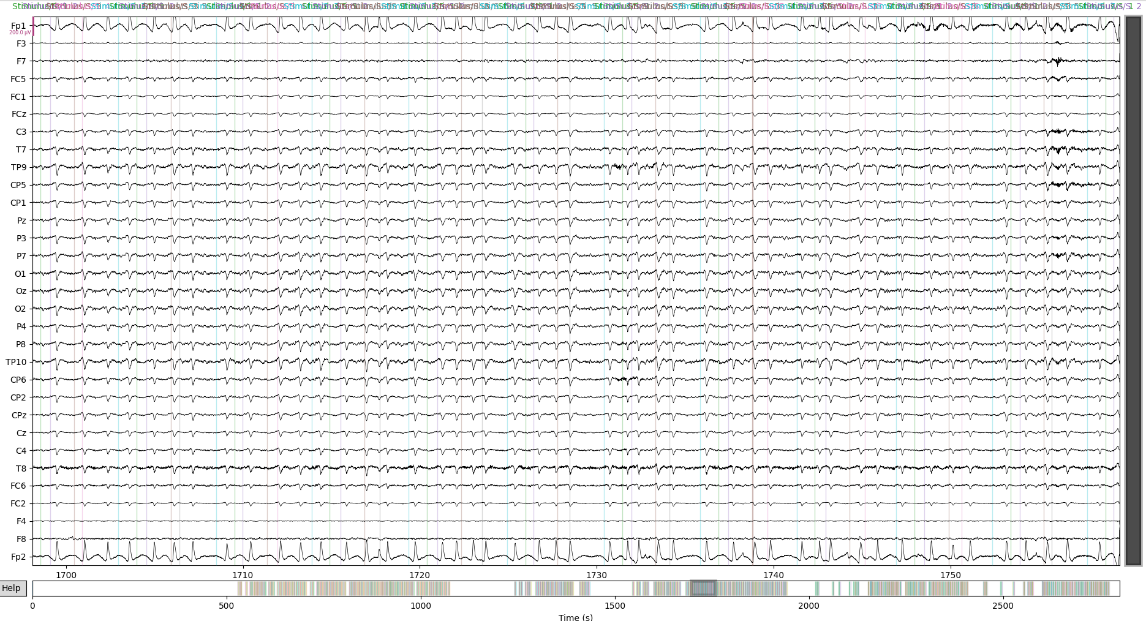
3. Data
Show 1-3 subjects

