Slide 1


Slide 2
Presentation By:
Anas-Bin-Asif
M . Gufran Abdullah

Slide 3
Assembly
Language

Slide 4
MACROS
Presentation Topics
PROCEDURES

Slide 5
What is Macro?
A MACRO is a block of code that has been given a name. The text may consist of instructions, pseudo-ops, comments, or references to other macros.
The MACRO code is inserted into the program, whenever MACRO is called, by the assembler.

Slide 6
Syntax of Macro
<Macro_name> Macro [Arguments List]
;Block of code
ENDM

Slide 7
Macro Calling
Macro is called using:
<Macro_name> [Arguments List]

Slide 8
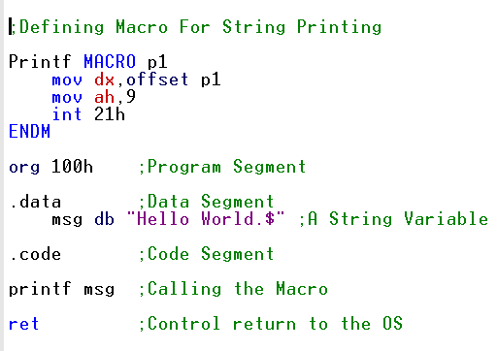
Example

Slide 9
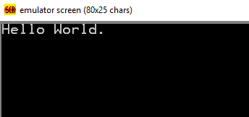
Result of the Example

Slide 10
What is Procedure?
Procedure is a series of instructions is to be executed several times in a program, and called whenever required.
Program control is transferred to the procedure, when CALL instruction is executed at run time.

Slide 11
Syntax of Procedure
<Procedure_name> Proc
;Block of Code
RET
<Procedure_name> ENDP

Slide 12
Procedure Calling
Procedure is called using:
CALL <Procedure_name>

Slide 13
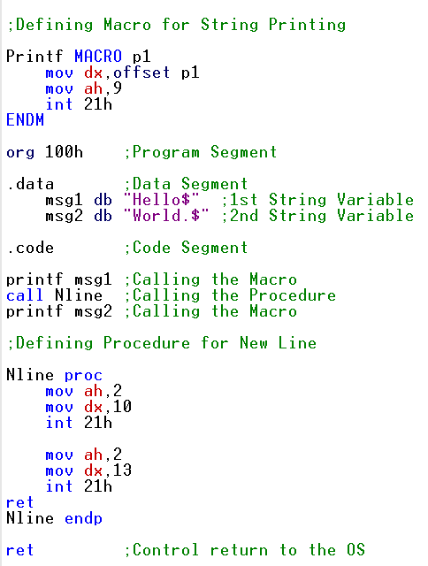
Example

Slide 14
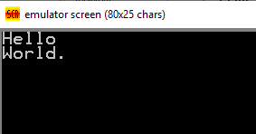
Result of the Example

Slide 15
Car Showroom App
Emu 8086

Slide 16
Any Question
???

Slide 17
Thank You!!!

