Slide 1
Road Condition Monitoring using Deep Learning
Team Members
Ahmed Abul Hasanaath - 201900174
AbuMuhammad Moinuddeen - 201801550
Advisors
Dr. Majid Ali Khan
Dr. Nazeeruddin Mohammed
PRINCE MOHAMMAD BIN FAHD UNIVERSITY
CCES Department

Slide 2
Outline
Introduction
Justification
Detailed work
Our approach
Deep learning approach
Convolutional Neural Networks (CNN)
Application: Road Conditions Assessment System
Conclusion
Future Work
References

Slide 3
Introduction
It is essential that our road infrastructure is well maintained
Bad road conditions cause wear and tear in the mechanical systems of cars, drastically reducing their life span
In Europe, 57% of road fatalities were caused by poor road conditions in 2010
Is of great importance to many stakeholders including the city and town level municipal corporations, transportation departments and the public at large
We built an automated process that continuously monitors road conditions.

Slide 4
Justification
The overarching reason to work on this project is its sheer amount of benefit.
The completed system has various applications:
Navigation applications: classifying roads and assigning weights to them can help navigation applications in determining the best route.
Road Maintenance: having information on the quality of roads can help with maintenance.
Research topic: helps in advancing the conversation on the importance of Artificial Intelligence in the 21st century.

Slide 5
Related Work
[1, 2] collected accelerometer and GPS sensor readings from the smartphones of commuters.
This approach also lacks practicality because it requires that those collecting the data necessarily drive through poor road conditions in order to collect data. Using images solves both of those issues.
[3, 4] worked on damage detection instead of quality classification using a publicly available dataset consisting of 26620 labeled images acquired from smartphone cameras from India, Czech and Japan.
Can be extended further to include a well-defined and relevant set of functionalities
[8] used LiDAR sensors to detect potholes and bumps on roads.

Slide 6
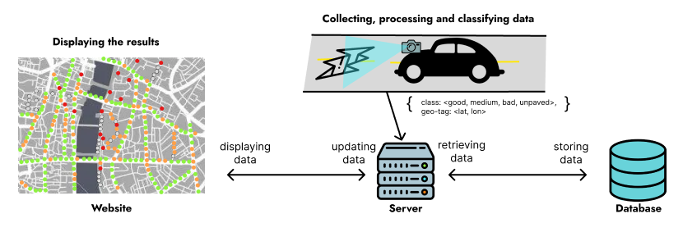
Our Approach

Slide 7
Deep Learning: A Primer

Slide 8
What is Deep Learning?
At the core of our system is the Deep Learning model
Deep learning is a class of machine learning algorithms that uses multiple layers to progressively extract higher-level features from the raw input.
With deep learning, we're still talking about algorithms that learn from data similar to machine learning.
The algorithms or models that do this learning are based loosely on the structure and function of the brain's neural networks.
The neural networks that we use in deep learning aren't actual biological neural network.
They simply share some characteristics with biological neural networks, and for this reason, we call them artificial neural networks.

Slide 9
Artificial Neural Networks (ANN)
ANNs are built using what we call neurons.
Neurons in an ANN are organized into what we call layers.
Layers within an ANN (except the input and output layers) are called hidden layers.
If an ANN has more than one hidden layer, the ANN is said to be a deep ANN.
Each connection between neurons transmits a signal from one neuron to the other.
The receiving neuron processes the signal and signals to downstream neurons connected to it within the network.

Slide 10
Layers
Different layers perform different transformations on their inputs, and some layers are better suited for some tasks than others.
For example, a convolutional layer is usually used in models that are doing work with image data.
Input layers have as many neurons as the dimensions of the input.
Output layers have as many neurons as possible outputs your problem has.

Slide 11
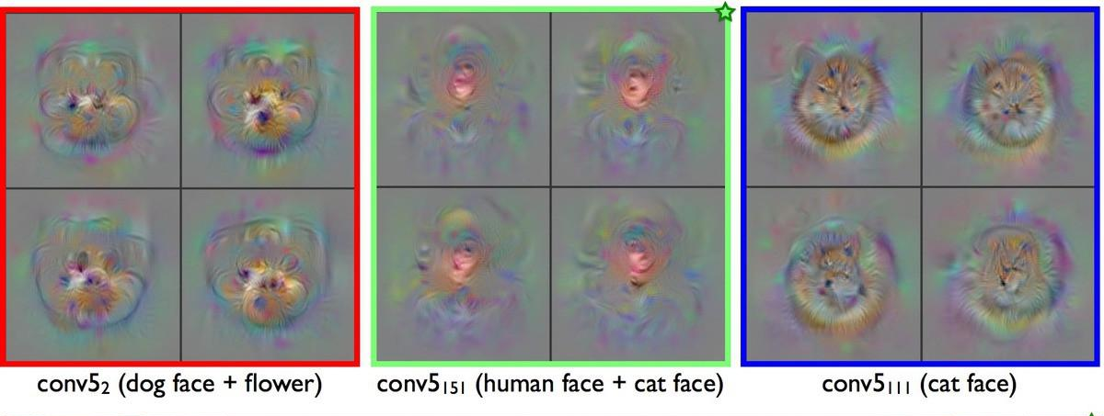
Convolutional Layers
A convolution layer takes a weighted sum of pixels in a certain region.
They reduce the high dimensionality of images without losing its information.
Their main purpose is to extract features from an image.

Slide 12
Max Pooling
In a CNN, Convolutional Layers are usually followed by a Max Pooling layer
Downsamples the input along its spatial dimensions by taking the maximum value over an input window (of size defined by pool_size ) for each channel of the input.
The objective is to down-sample an input representation
Reduces its dimensionality, allowing for features contained in the sub-regions to be ‘extracted’.

Slide 13
Dense layers
The dense layer is a neural network layer that is connected deeply, which means each neuron in the dense layer receives input from all neurons of its previous layer.
The dense layer performs a matrix-vector multiplication. The values used in the matrix are actually parameters that can be trained and updated with the help of backpropagation.

Slide 14
How do Layers Work?
Each connection between two nodes has an associated weight, which is just a number.
Each weight represents the strength of the connection between the two nodes.
When the network receives an input at a given node in the input layer, this input is passed to the next node via a connection, and the input will be multiplied by the weight assigned to that connection.
For each node in the second layer, a weighted sum is then computed with each of the incoming connections. This sum is then passed to an activation function, which performs some type of transformation on the given sum.
As the model learns, the weights at all connections are updated and optimized so that the input data point maps to the correct output prediction class.

Slide 15
Activation Functions
In an artificial neural network, an activation function is a function that maps a neuron’s inputs to its corresponding output.
node output = activation(weighted sum of inputs)
Example of an activation function is the Sigmoid function:
For most negative inputs, sigmoid will transform the input to a number very close to 0.
For most positive inputs, sigmoid will transform the input into a number very close to 1.
For inputs relatively close to 0, sigmoid will transform the input into some number between 0 and 1.
An activation function is biologically inspired by activity in our brains where different neurons fire by different stimuli.
If you smell something pleasant, like freshly baked cookies, certain neurons in your brain will fire and become activated.
If you smell something unpleasant, like spoiled milk, this will cause other neurons in your brain to fire.

Slide 16
What is Training?
When we train a model, we're basically trying to solve an optimization problem.
We're trying to optimize the weights within the model.
Our task is to find the weights that most accurately map our input data to the correct output class.
This mapping is what the network must learn.
The weights are optimized using what we call an optimization algorithm.
When the model is initialized, the network weights are set to arbitrary values.

Slide 17
Convolutional Neural Networks
A convolutional neural network, also known as a CNN or ConvNet, is an artificial neural network that has so far been most popularly used for analyzing images for computer vision tasks.
Most generally, we can think of a CNN as an artificial neural network that has some type of specialization for being able to pick out or detect patterns. This pattern detection is what makes CNNs so useful for image analysis.
What differentiates it from a standard multilayer perceptron or MLP?
CNNs have hidden layers called convolutional layers, and these layers are what make a CNN, well... a CNN!

Slide 18
Building the Deep Learning Model

Slide 19
Building a Dataset
Our dataset was divided into 4 classes: good, medium, bad and unpaved. The categories are characterized as follows:
Good: Top quality, smooth surface, devoid of any damage
Medium: Patches, moderate cracks
Bad: Heavy cracks, potholes, big bumps
Unpaved: Non asphalt roads

Slide 20
Dataset Contd.
The dataset was collected in the greater Eastern Province region of Saudi Arabia.
Initially, videos were recorded on a smartphone attached to a vehicle.
To process and categorize the data, we used a python script:
Video was displayed frame by frame.
Depending on which key was pressed on the keyboard, the script either discarded the image or saved it into one of the 4 directories corresponding to the 4 classes propose in our project.
A total of 4070 images were categorized as good, 4864 as medium, 577 as bad and 1548 as unpaved, bringing the grand total to 11059 images.
In order to balance the dataset, we used different data augmentation techniques.
Horizontal and Vertical Flipping, Brightness and Zoom variations
After augmentation, our dataset had 4070 images classified as good, 4864 as medium, 3899 as bad and 4568 as unpaved, bringing the total to 17400 images.
For preprocessing, we simply re-sized the images to 124x224

Slide 21
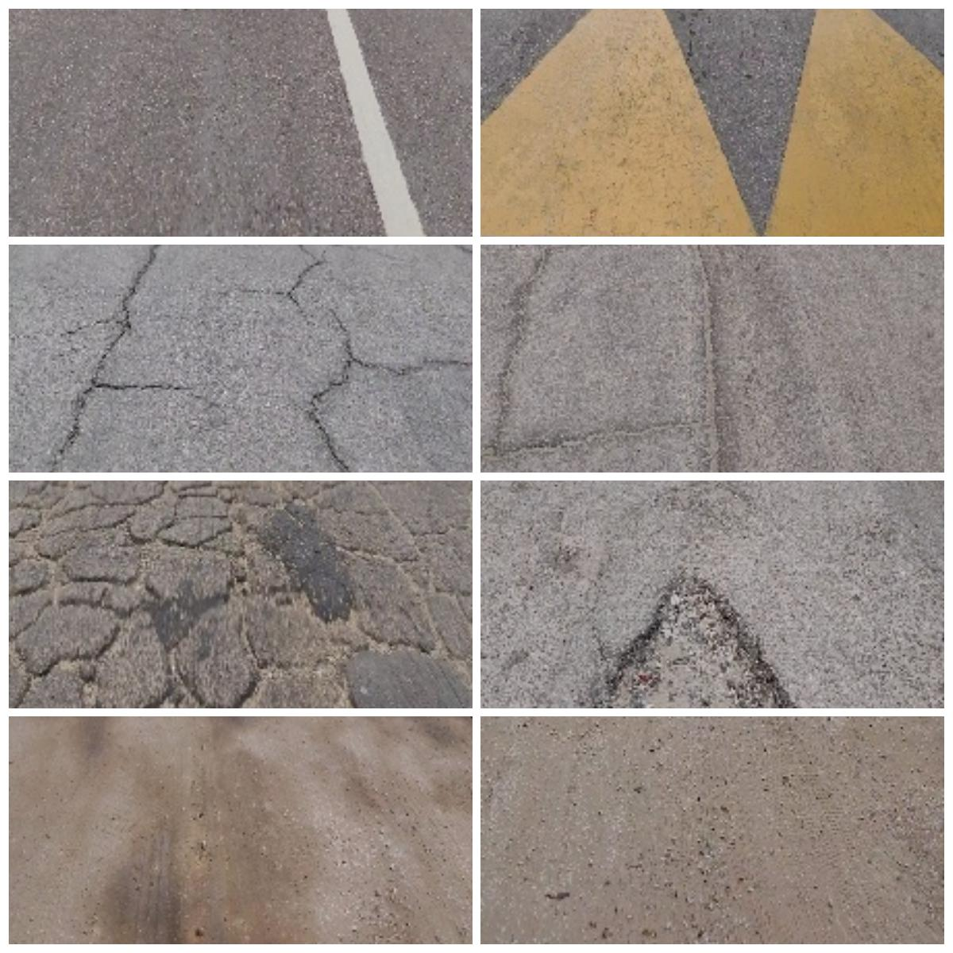
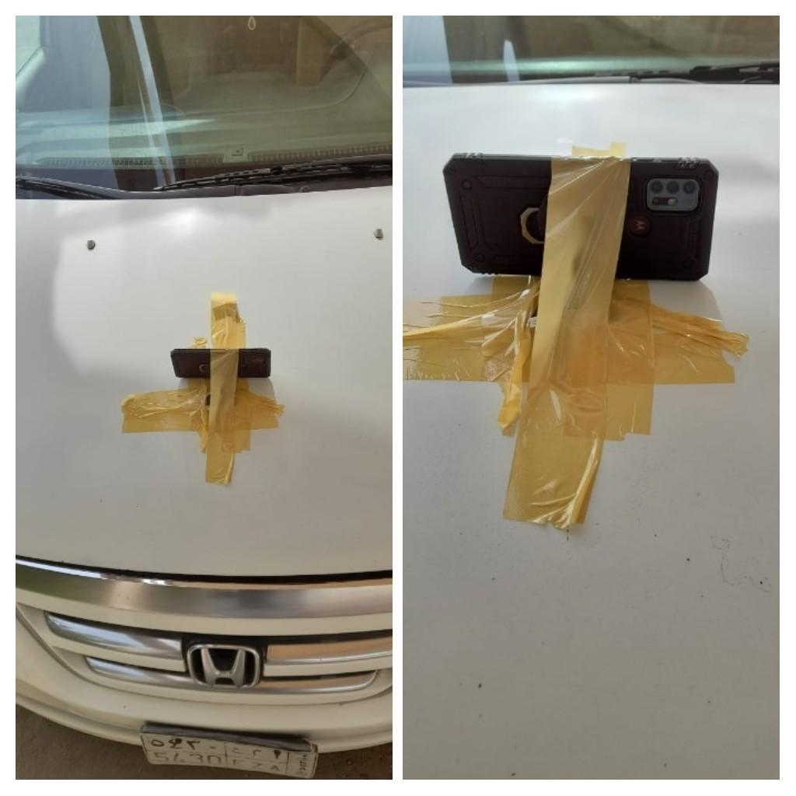
Dataset Contd.

Slide 22
Our Custom CNN
In our custom model, the input images are passed through 4 convolutional layers
with filters of size 5x5.
The number of filters in the first convolutional layer is 32, 64 in the second and 128 in the third.
Padding is applied at each of these layers.
All the strides were set to 2.
A max pooling operation is applied after each convolutional layer
Following the convolutional layers is a Flatten layer, which transforms the multi-dimensional tensors into a uni-dimensional tensor.

Slide 23
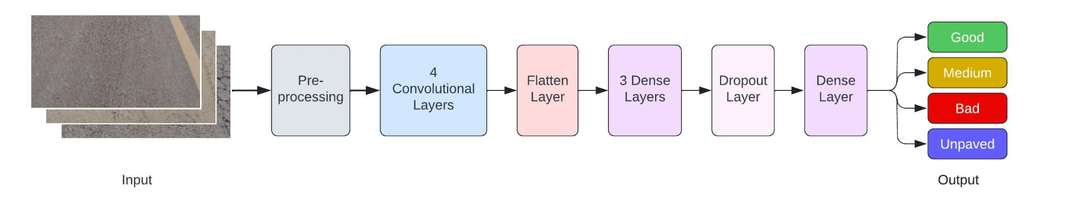
Custom CNN Contd.
The images are passed through three Dense layers, followed by a Dropout layer.
The Dropout layer was included to prevent overfitting.
Finally, a Dense layer with 4 units classifies the images into the 4 classes proposed in our work.
We used the softmax activation function in the final layer because it produces probabilities

Slide 24
Pretrained CNN
A common and highly effective approach to solving deep learning problems is transfer learning.
Transfer learning is an approach that focuses on storing knowledge gained when solving one problem and applying it to a variety of related problems.
We worked with 2 models:
VGG16: The VGG16 architecture serves as a good benchmark due to its architecture.
MobileNetV2: Due to its lightweight nature, the MobileNetV2 model fits perfectly in our system as the classifications need to happen in real time.
In both cases, the fully connected layers were removed from the end of the models. In their place, a Flatten layer was added, followed by a Dense layer with 256 units.
Finally, a Dense layer with 4 units was added, each unit corresponding to one of the classes from our dataset.

Slide 25
Classifier Performance Analysis
Evaluating the performance of machine learning models is essential before deploying them.
Using metrics such as classification accuracy, precision, recall and F1 score is the most common way to evaluate a model.
Classification accuracy is the ratio of the total number of correct predictions to the total number of predictions made.
Precision is the ratio of the total number of true positives to the total number of positives predicted by a classifier
Recall is the ratio of the total number of true positives to the total number of samples.

Slide 26
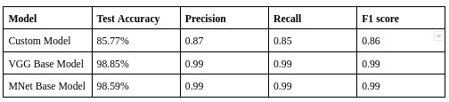
Performance Analysis Contd

Slide 27
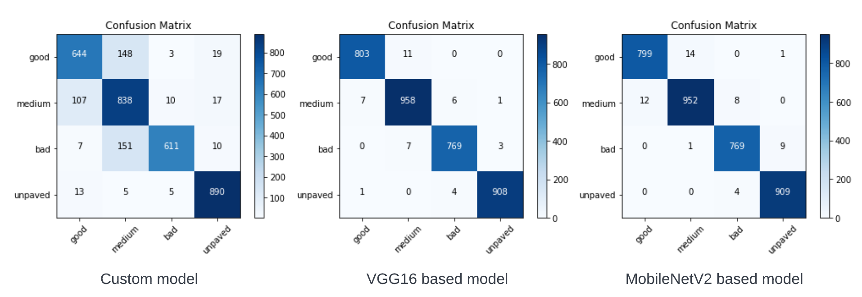
Classifier Error Analysis
A confusion matrix, also known as an error matrix, is a technique that can be used to perform error analysis.

Slide 28
Building the Application

Slide 29
Application: Road Conditions Monitoring System
We built a system around the deep learning model that automates the collection and storage of road quality data.
System constituents:
Mobile Application: collects road quality data and uploads it to a server
Server: houses the model, handles GET and POST requests
Website: displays the road quality data on an interactive map

Slide 30
Mobile Application

Slide 31

Main Page
Camera view ​
Camera control buttons​
Settings button​
Internet connection indicator

Slide 32

Settings Page
Input box for username
Input box for password​
Button for forgot password​
Button for login​

Slide 33
Web Application

Slide 34
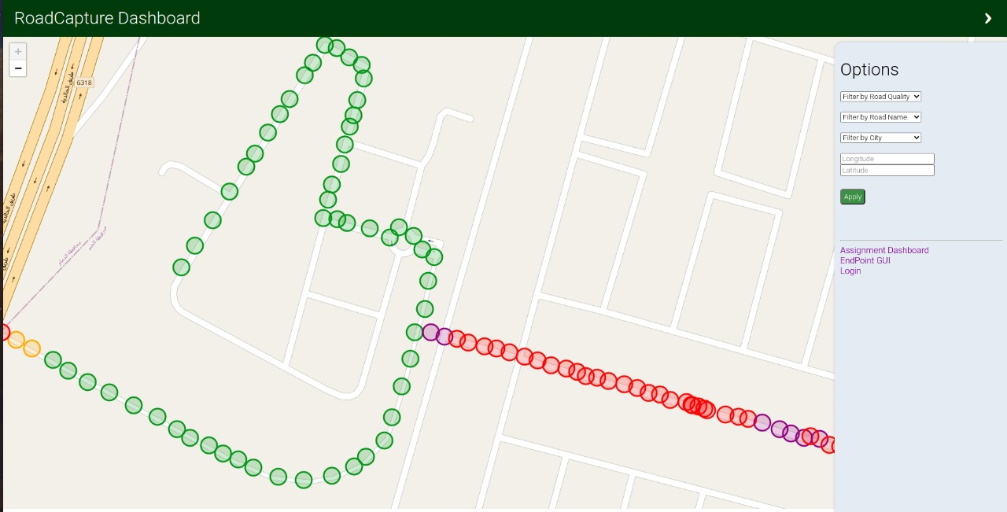
Web Application Dashboard

Slide 35

Web Application Admin Page

Slide 36

Web Application Admin Page

Slide 37
Demo, Conclusion and Future Work

Slide 38
Future Work
Upscaling to city level, the national level and global level
Requires re-exploration of image processing and deep learning concepts
Include more use cases
Classifier Optimization for faster prediction times
Explore other forms of data:
LiDAR sensors (accurate and faster)
Satellite images

Slide 39
THANKS! Any questions/suggestions are welcome!

Slide 40
References
[1] Tiwari, S., Bhandari, R., & Raman, B. (06 2020). RoadCare: A Deep-learning Based Approach to Quantifying Road Surface Quality. 231–242. doi:10.1145/3378393.3402284
[2] Hoffmann, M., Mock, M., & May, M. (01 2013). Road-quality classification and bump detection with bicycle-mounted smartphones. CEUR Workshop Proceedings, 1088, 39–43.
[3] Doshi, K., & Yilmaz, Y. (2020). Road Damage Detection using Deep Ensemble Learning. 2020 IEEE International Conference on Big Data (Big Data), 5540–5544. doi:10.1109/BigData50022.2020.9377774
[4] Lei, X., Liu, C., Li, L., & Wang, G. (2020). Automated Pavement Distress Detection and Deterioration Analysis Using Street View Map. IEEE Access, 8, 76163–76172. doi:10.1109/ACCESS.2020.2989028
[5] Lank, M., & Friedjungová, M. (2022). Road Quality Classification. Στο S. Sclaroff, C. Distante, M. Leo, G. M. Farinella, & F. Tombari (Επιμ.), Image Analysis and Processing -- ICIAP 2022 (σσ. 553–563). Springer

Slide 41
References
[6] Rateke, T., Justen, K. A., & von Wangenheim, A. (2019). Road surface classification with images captured from low-cost camera-road traversing knowledge (RTK) dataset. Revista de Informática Teórica e Aplicada, 26, 50–64. doi:10.22456/2175-2745.91522
[7] Transport, & Department, T. (2014). EU Road Surfaces: Economic and Safety Impact of the Lack of Regular Road Maintenance.
[8] Sudharshan, V. N. R., Ramesh, S., Thamodharan, S., Santhar, M. U. S., & Kamalakannan, M. (2019). Pothole and Hump Recognition using LIDAR Sensor.
[9] Institute, A. N. S. (2016). Safe Use of Lasers Outdoors.
[10] Maddern, W., Pascoe, G., Linegar, C., & Newman, P. (2017). 1 Year, 1000km: The Oxford RobotCar Dataset. The International Journal of Robotics Research (IJRR), 36(1), 3–15. doi:10.1177/0278364916679498

Slide 42
References
[11] Geiger, A., Lenz, P., Stiller, C., & Urtasun, R. (2013). Vision meets Robotics: The KITTI Dataset. International Journal of Robotics Research (IJRR).
[12] Arya, D., Maeda, H., Ghosh, S. K., Toshniwal, D., Mraz, A., Kashiyama, T., & Sekimoto, Y. (12 2021). Deep learning-based road damage detection and classification for multiple countries. Automation in Construction, 132, 103935. doi:10.1016/J.AUTCON.2021.103935
[13] Zanin, M., Messelodi, S., & Modena, C. (04 2013). DIPLODOC road stereo sequence. doi:10.13140/RG.2.1.3681.9929
[14] Jan, Z., Verma, B., Affum, J., Atabak, S., & Moir, L. (2 2019). A Convolutional Neural Network Based Deep Learning Technique for Identifying Road Attributes. International Conference Image and Vision Computing New Zealand, 2018-November. doi:10.1109/IVCNZ.2018.8634743
[15] Šabanovič, E., Žuraulis, V., Prentkovskis, O., & Skrickij, V. (2020). Identification of road‐surface type using deep neural networks for friction coefficient estimation. Sensors (Switzerland), 20. doi:10.3390/s20030612

Slide 43
References
[16] Ochoa-Ruiz, G., Angulo-Murillo, A. A., Ochoa-Zezatti, A., Aguilar-Lobo, L. M., Vega-Fernández, J. A., & Natraj, S. (6 2020). An asphalt damage dataset and detection system based on retinanet for road conditions assessment. Applied Sciences (Switzerland), 10. doi:10.3390/app10113974
[17] Cao, M. T., Tran, Q. V., Nguyen, N. M., & Chang, K. T. (10 2020). Survey on performance of deep learning models for detecting road damages using multiple dashcam image resources. Advanced Engineering Informatics, 46, 101182. doi:10.1016/J.AEI.2020.101182
[18] Egaji, O. A., Evans, G., Griffiths, M. G., & Islas, G. (2021). Real-time machine learning-based approach for pothole detection. Expert Systems with Applications, 184, 115562. doi:10.1016/j.eswa.2021.115562
[19] Choi, W., Heo, J., & Ahn, C. (2021). Development of road surface detection algorithm using cyclegan‐augmented dataset. Sensors, 21. doi:10.3390/s21227769
[20] Dewangan, D. K., & Sahu, S. P. (4 2021). RCNet: road classification of convolutional neural networks for intelligent vehicle systems. Intelligent Service Robotics, 14, 199–214. doi:10.1007/S11370-020-00343-6

