Slide 1
Road Quality Assessment using Deep Learning Models
AbuMuhammad Moinuddeen – 201801550
Ahmed Abul Hasanaath - 201900174

Slide 2
INTRODUCTION
The aim of this project is to create road quality assessment system.
The goal is to employ machine learning techniques to categorize our roads into 4 different classes based on their quality: good, medium, bad and unpaved.
The proposed system is largely beneficial to anyone that uses a road in their daily lives, i.e., everyone.

Slide 3
JUSTIFICATION
The overarching reason to work on this project is its sheer amount of benefit.
The completed system has various applications:
Navigation applications: classifying roads and assigning weights to them can help navigation applications in determining the best route.
Road Maintenance: having information on the quality of roads can help with maintenance.
Research topic: helps in advancing the conversation on the importance of Artificial Intelligence in the 21st century.

Slide 4
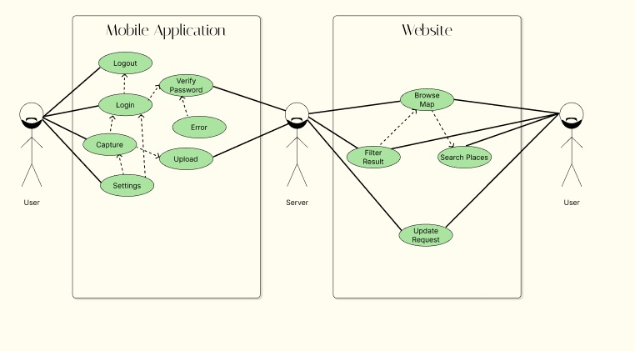
Use Case Diagram

Slide 5
DETAILED REQUIREMENTS
The main major requirements are as follows:
Data collection and Processing
Development of the Machine Learning Model
Development of mobile and web application
Integration of software and hardware components

Slide 6
MOBILE APP FUNCTIONAL REQUIREMENTS
The application requires the user to enter their credentials when they first open the application.
The application authenticates and then logs the user in after valid credentials are entered.
The application should have a password recovery feature.
The application prompts the user to enter their email when the user uses the password recovery feature.
The system sends a password recovery email to the user’s email address.
Each time the user successfully logs in, the user is instructed on how to use the application.
The user can disable the instructions from popping up each time they log in.
When the user chooses to start collecting data the system will prompt the user to select the rate at which the photos will be taken.
The application will classify the images locally and upload the classification along with a geotag, time and user ID.
In case internet connection is not available, the application will store the collected data locally, until connection is established again.
The device should work with both mobile data and a Wi-Fi connection.

Slide 7
WEB APP FUNCTIONAL REQUIREMENTS
The website should display a map that displays the road quality as pointers:
Green for good, yellow for medium, red for bad, purple for unpaved.
The website interface should contain filter options:
Road name, city name, geolocation, road quality.
The website should contain a password protected form for administrators that allows them to update or delete entries in the database.
There should also be a form that allows for adding, updating or deleting user information.

Slide 8
SERVER FUNCTIONAL REQUIREMENTS
The server will handle GET requests from the website dashboard page. It will send road quality data in response.
The server will receive POST request from mobile application containing road data (classification, geotag, time, user ID).
The server will receive POST request from web application in regards to adding, deleting or updating user and/or road data.

Slide 9
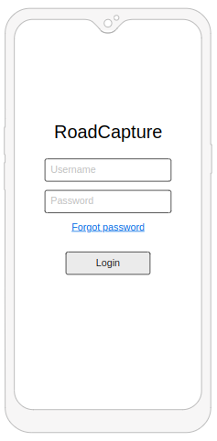
MOBILE APP LOGIN PAGE
Input box for username
Input box for password
Button for forgot password
Button for login

Slide 10
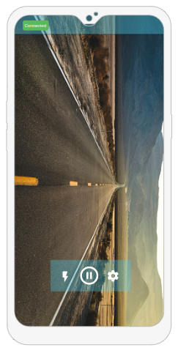
MOBILE APP MAIN PAGE
Camera view
Camera control buttons
Settings button
Internet connection indicator

Slide 11
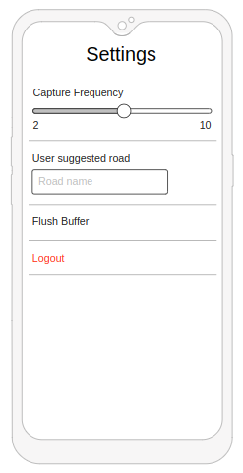
MOBILE APP SETTINGS PAGE
Slider for changing image capture frequency
Input box for suggested road name
Flush buffer button
Logout button

Slide 12
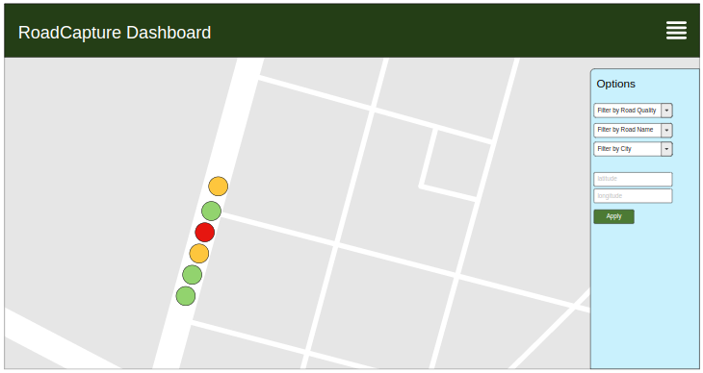
WEBSITE DASHBOARD
Map view that displays road quality.
Filter options

Slide 13
SECURITY REQUIREMENTS
User Authorization and Authentication: for accessing application features.
Password Constraints: 8 characters long and should contain at least 1 special character and 1 number.
Password Hiding: in HTML/UI form and through hashed password sent to the server.

Slide 14
MOBILE APP TECHNICAL CONSTRAINTS
The application should account for unavailable internet connection.
The application should make sure the geotag is within the borders of the road.
The mobile app should reliably send POST requests to the server and should account for image capture delay.
The mobile app should work on all mobile devices with Android 9 or higher and iOS 9 or higher.
The mobile app should work on all mobile devices with camera resolution greater than 5MP.
The application will give the user the option to change the language between Arabic and English.

Slide 15
WEB APP TECHNICAL CONSTRAINTS
System should not fail if user input is invalid.
System should handle session timeouts properly.
The website should work seamlessly on all devices with screen resolution greater than 480x800 pixels.

Slide 16
SERVER TECHNICAL CONSTRAINTS
The server should respond to GET requests in less than 2 seconds.
The server should validate all data received through POST requests before eliciting a response.

Slide 17
PROJECT MANAGEMENT CONSTRAINTS
The system should be complete within 4 months' time
Team members will be trained with required background knowledge on Machine Learning, Web Development and Mobile App Development.

Slide 18
ENVIRONMENTAL CONSTRAINTS
The mobile device should be securely mounted to the vehicle in order to prevent device loss.
The vehicle should be operated by licensed drivers.

Slide 19
RISK ASSESSMENT
Risk(s) | Potential Impact | Risk Mitigation
Unauthorized access by intruders. | System functionality will be compromised. | Provide stronger authentication and authorization.
Mobile device mounted on vehicle may fall off | Equipment loss and compromised operation. | Ensure secure mounting of device.
Camera on mobile device may get damage due to flying debris such as large dust particles and bugs. | System functionality will be affected negatively. | Attach clear transparent shield to the camera and regularly change it.
Vehicle driver may get distracted. | Health hazard and equipment damage. | Driver should have company that helps with everything other than driving.

Slide 20
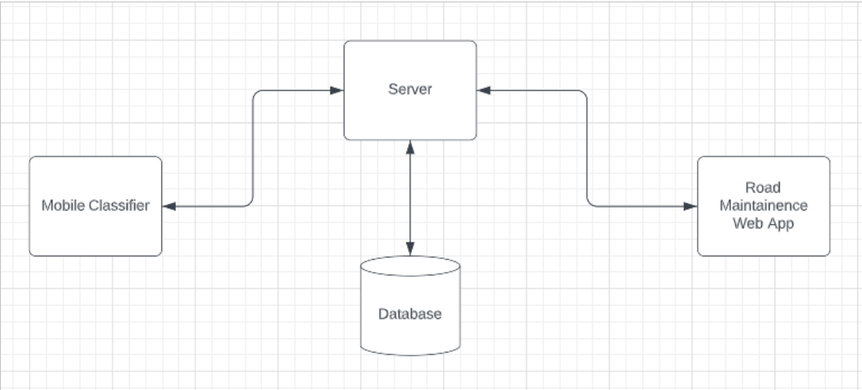
HIGH LEVEL ARCHITECTURE
A machine learning will be loaded onto a smartphone
The mobile device will be mounted on a vehicle.
The device will collect images of roads and classify them into 3 different categories.
The device will geo-tag each classification and upload the information to a server.
The server will store the data in a database.

Slide 21
TOOLS
HARDWARE TOOLS
Smartphone running Android 9/iOS 9 or higher and with camera resolution greater than 5MP should be fine
SOFTWARE TOOLS
Flask
React Native
Tensorflow
OpenCV

Slide 22
PROJECT PLAN
Week 8. Building the web and mobile app
Week 9. Building the web and mobile app cont.
Week 10. Attempt to improve ML model accuracy
Week 11. Rigorous testing
Week 12. Finalizing and presenting demos
Week 13. Final project report and presentation
Week 1. Problem Identification and Requirement Analysis
Week 2. Process Identification and Initial Design
Week 3. Timeline planning and work distribution
Week 4-5. Data gathering, cleaning and processing
Week 6. Building an initial ML model
Week 7. Setting up a server

Slide 23
TEAM RESPONSIBILITIES
Abumuhammad Moinuddeen
Expertise
Python programming
Data processing
ML
Responsibilities
Project management
UI Design
Collaboration on building the ML model
Ahmed Abul Hasanaath
Expertise
Web Programming
Mobile Application Development
ML
Responsibilities
Building a road classifier application on a smartphone
Building the web application
Collaboration on building the ML model

Slide 24
EXPECTED RESULTS
We want to build a fully functional system.
Data collection is difficult and we might not be able to collect a dataset that fully represents the roads of Saudi Arabia.
As a consequence, our ML model may not be able to give accurate classifications in unideal conditions.
We are confident that our system will do well in representing what can be if we could somehow alleviate our limitations.
Our system will also do well in laying the foundations for future improvements.

Slide 25
THANK YOU!!
Any and all questions are welcome!

