Slide 1
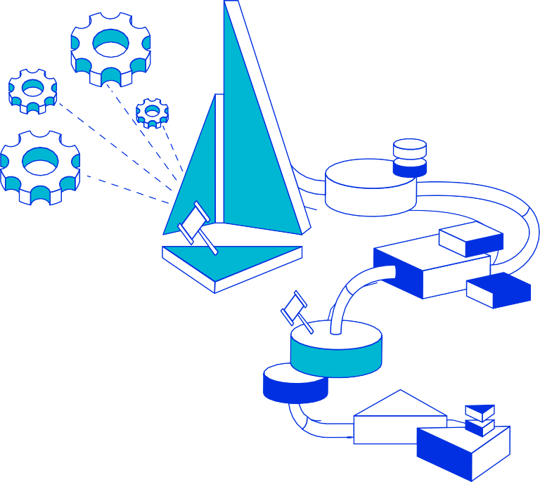

Securing Cloud Native Workloads
With Istio
Gufran Mirza
gufranmirza

Slide 2
Talk Outline
Introduction to Istio
Service Identities
Istio Authentication Policies
Istio Authorization Policies
Q & A

Slide 3

Istio - Ιστίο
Open source service mesh

Slide 4
What is a service mesh
Infrastructure/framework that handles communication between services
Often implemented as network proxies deployed alongside the micro-services
●

Slide 5

Istio features
Secure service-to-service communication
Access controls
Authorization /Authentication
Trafﬁc control (routing rules, retries, timeouts, fault injection, mirroring)
Metcs and traces for trafﬁc

Slide 6
Important Terminology
Workload - anything owning/controlling pods (like a Deployment) or the pods themselves
Service - a microservice / application

Slide 7

Before Istio
Container1
Container2
Routing code
Routing code2
Circuit breaker code
Circuit breaker code2
Business logic code
Business logic code2
POD A
POD B

Slide 8

Pod with Sidecar
Container
Routing code
Sidecar container
Circuit breaker code
Container
Business logic code
Business logic code
POD
POD
No sidecar
With sidecar

Slide 9
Sidecar Proxy
A proxy is deployed in a container next to each instance of micro-service (inside a pod)
Container name: istio-proxy
It is transparent to application code
Envoy open source proxy is currently used

Slide 10
How is the sidecar injected?
●
●
Manually
Automatically injected to pod on creation
kubectl label namespace default istio-injection=enabled

Slide 11

With Istio - sidecar intercepts all traffic
Container
Container
Container
Business
Business
Business
Business
logic code
Container
logic code
logic code
logic code
Sidecar container
Sidecar container
Sidecar container
Envoy
sidecar container
Envoy
sidecar container
Envoy
sidecar container
Sidecar
container
HTTP, TCP, TLS...
HTTP, TCP, TLS...
POD A
POD B
POD C
Conﬁguration is transparent to the services and not part of the code

Slide 12
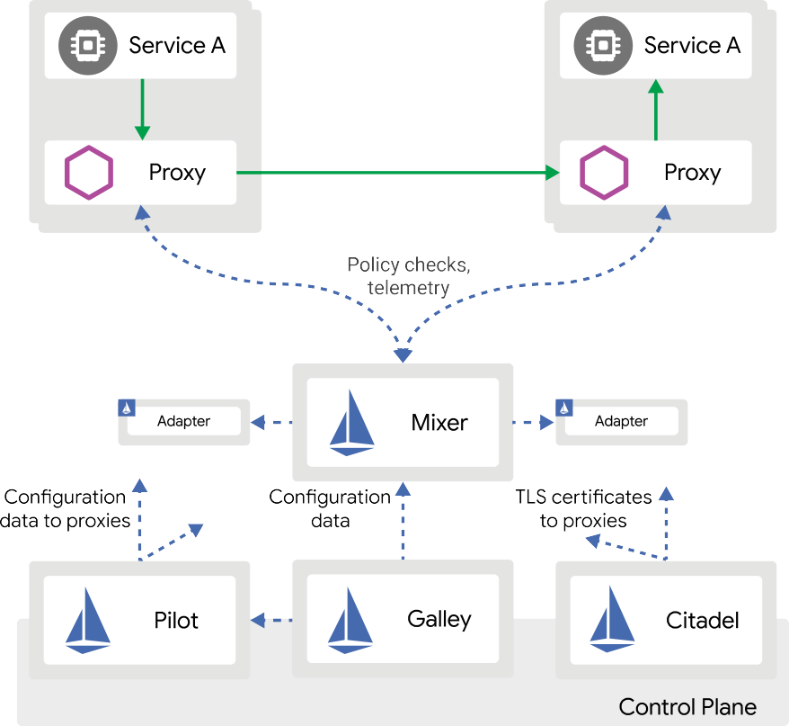

Istio architecture

Slide 13
Service Mesh Security
Authorization & Authentication

Slide 14
Service Identities – The starting point
In a service mesh world, establishing the identity of the workload providing a service is critical. Examples:
Kubernetes: Kubernetes service account
GCP: GCP service account
AWS: AWS IAM user/role account
On-premises (non-Kubernetes): user account, custom service account

Slide 15
Conversion of identity into a certificate
A private key within the workload pod is generated and Made available to the proxy.
A certificate signing request is sent to the control plane.
The control plane provides the proxy a certificate scoped to the identity of the POD (e.g. K8s service-account).
Control plane will manage rotation.
●
●
●

Slide 16
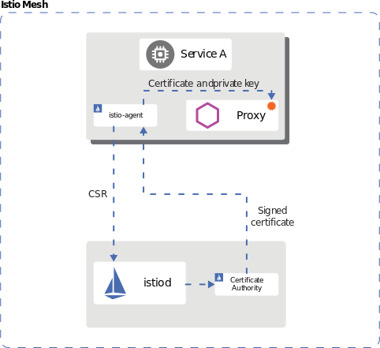
Identity Provisioning Workflow

Slide 17
Authentication
Istio provides two types of authentication
End user authentication (JSON Web Token (JWT))
Service to service authentication (mutual TLS)
PERMISSIVE: Workloads accept both mutual TLS and plain text traffic
STRICT: Workloads only accept mutual TLS traffic.
DISABLE: Mutual TLS is disabled

Slide 18
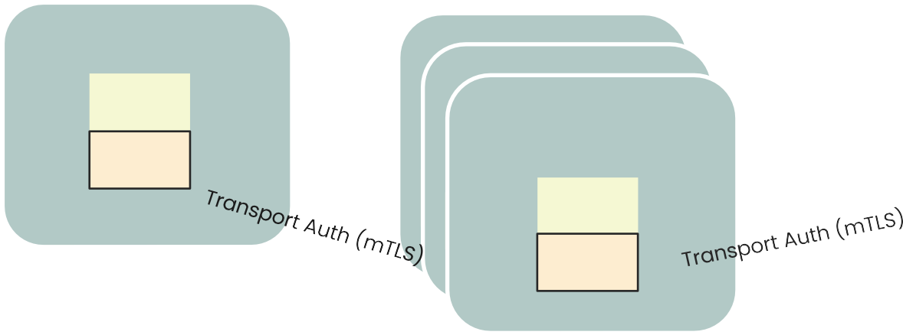
Authentication Flow
Worklod A
Workload C
Origin Auth (JWT)
Proxy
Client
Proxy
Workload B
Proxy
You can specify authentication requirements for workloads receiving requests in an Istio mesh using peer and request authentication policies

Slide 19
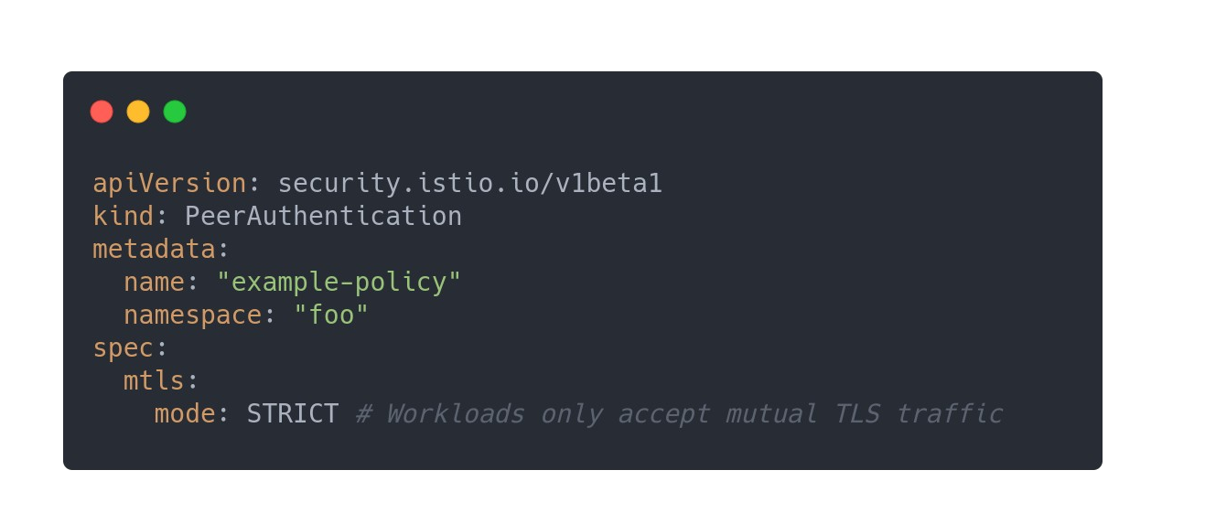
Peer authentication
The following peer authentication policy requires all workloads in namespace foo to use mutual TLS:

Slide 20
Authentication Demo
A picture is worth a thousand yamls

Slide 21
Ingress Gateway
An ingress Gateway describes a load balancer operating at the edge of the mesh
Receives incoming HTTP/TCP connections
Ingress Gateway is a customizable proxy that can route inbound traffic to backend hosts
Ingress Gateway handles all TLS operations (handshake, certs/keys exchange)

Slide 22
Ingress Gateway
TLS modes enforced by the proxy
PASSTHROUGH
SIMPLE
MUTUAL
etc.

Slide 23
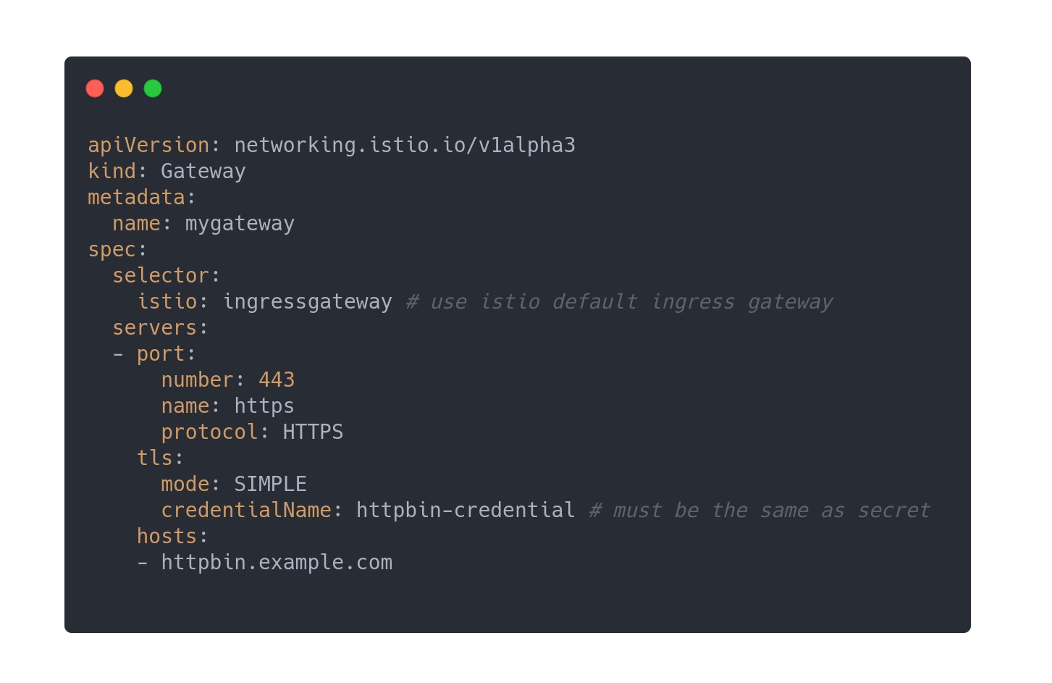
Conﬁguration YAML

Slide 24
Authentication Demo
A picture is worth a thousand yamls

Slide 25
Authorization
Istio’s authorization features provide mesh-, namespace-, and workload-wide access control for your workloads in the mesh
Can service <A> send <this request> to service <B> ?
Authorization policies support ALLOW, DENY and CUSTOM actions
Istio authorization (ALLOW and DENY) is enforced natively on Envoy
It is a good security practice to start with the allow-nothing policy and incrementally add more ALLOW policies to open more access to the workload.

Slide 26
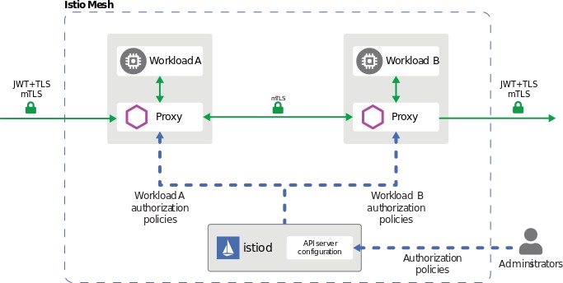
Authorization Flow
Each Envoy proxy runs an authorization engine that authorizes requests at runtime. Authorization engine evaluates the request context and returns the authorization result, either ALLOW or DENY

Slide 27
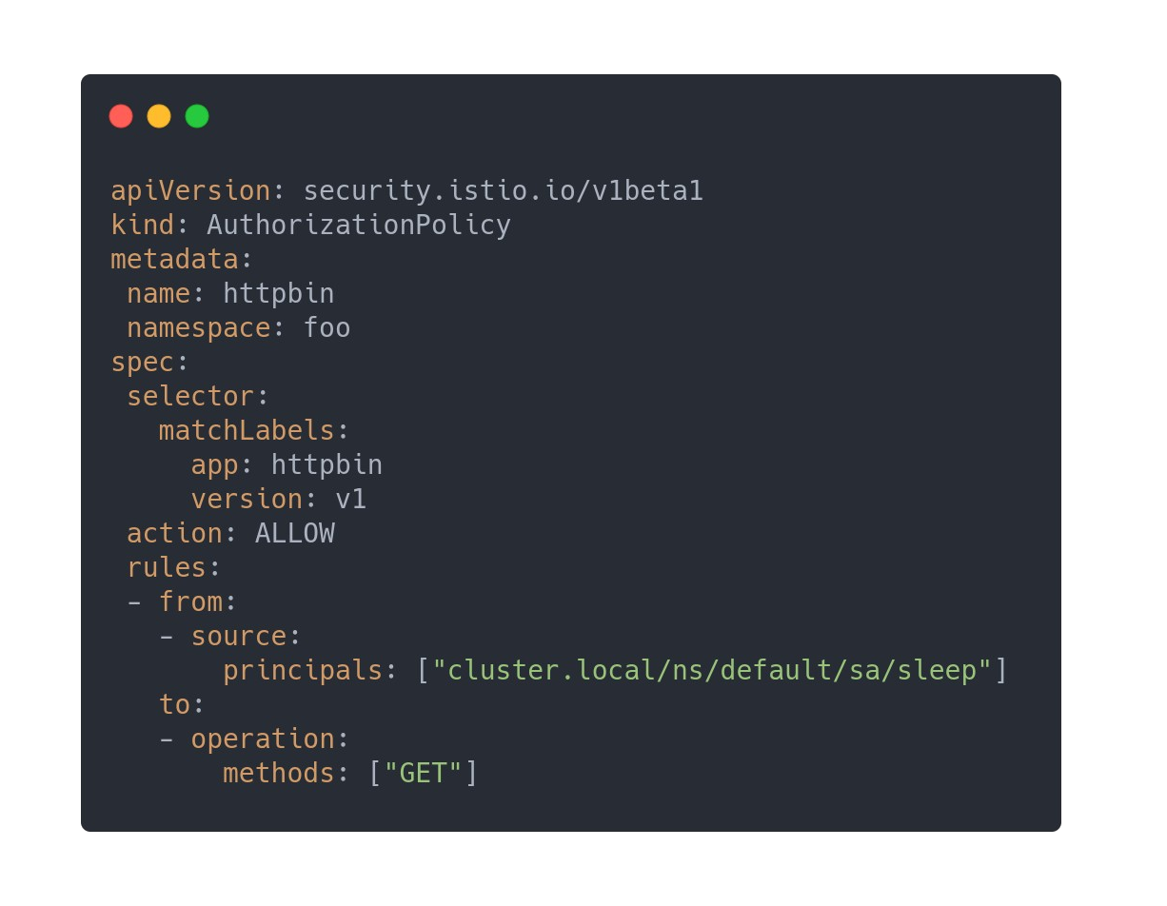
Authorization Policy
authorization policy that allows the cluster.local/ns/default/sa/sleep service account to access the workloads with the app: httpbin

Slide 28
Authorization Demo
A picture is worth a thousand yamls

Slide 29
Q & A

Slide 30

Connect with the community
Istio.io
IstioMesh github.com/istio

Slide 31
Thank You

