Slide 1
A Brief Primer on NLP Chris Tanner

Slide 2



Our digital world is inundated with text. How can we leverage it for useful tasks?
62 billion
pages
500 million tweets/day
360 million user pages
13 million articles

Slide 3


“Play Perfect Duet by Beyoncé”

Slide 4
intent
song
artist
“Play Perfect Duet by Beyoncé”

Slide 5
intent
song
artist
“Play Perfect Duet by Beyoncé”
“Spotify, please play some soft Jazz”

Slide 6
intent
song
artist
“Play Perfect Duet by Beyoncé”
intent
genre
“Spotify, please play some soft Jazz”

Slide 7
intent
song
artist
“Play Perfect Duet by Beyoncé”
intent
genre
“Spotify, please play some soft Jazz”
“Play David Bowie by Phish”

Slide 8
intent
song
artist
“Play Perfect Duet by Beyoncé”
intent
genre
“Spotify, please play some soft Jazz”
intent
artist
“Play David Bowie by Phish”

Slide 9



The red dog is happy → El perro rojo es feliz
El rojo perro es feliz

Slide 10
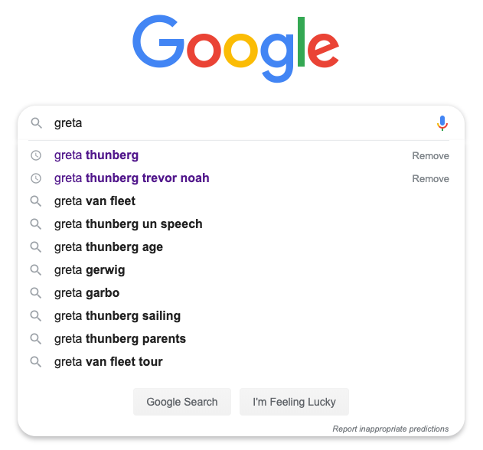

Slide 11
Natural Language Processing (NLP)
How can we use computers to intelligently process and use human language text?

Slide 12
Motivation
Problems
Approaches
Old Days
Modern

Slide 13
Motivation
Problems
Approaches
Old Days
Modern

Slide 14
Syntax
Semantics
Morphology
Word Segmentation
Part-of-Speech Tagging
Parsing
Constituency
Dependency
Sentiment Analysis
Topic Modelling
Named Entity Recognition (NER)
Relation Extraction
Word Sense Disambiguation
Natural Language Understanding (NLU)
Natural Language Generation (NLG)
Machine Translation
Entailment
Question Answering
Discourse
Summarization
Coreference Resolution

Slide 15
Morphology
The study of sub-units of words (e.g., play + ed).
Helps one build a flexible model of a language by making use of the smallest units of meaning.

Slide 16
Word Segmentation
How do you automatically determine word boundaries?
Allows one to know which words we’re working with.
「大型で猛烈」台風１９号、３連休に本州直撃か…ＪＲ東「計画運休含め対応」
2019/10/08 22:53
大型で猛烈な台風１９号は８日午後９時現在、マリアナ諸島付近を時速２０キロで北西へ進んだ。気象庁によると、中心気圧は９１５ヘクト・パスカル、中心付近の最大風速は５５メートル。台風の北上に伴って勢力はやや衰える見込みだが、…

Slide 17
Part-of-Speech Tagging
Determine the POS for each word in a text.
I bank with Chase.
PRP
VBP
IN
NNP
I went to the bank.
PRP
VBD
TO
DT
NN

Slide 18
Constituency Parsing
Determine a grammatically sound parse tree.
<S>
NP
VP
.
.
PRP
VBD
PP
went
I
TO
NP
to
DT
NN
the
bank

Slide 19
Dependency Parsing
Determine which words depend on others. Provides orthogonal, relational information!
<ROOT>
nmod
nsubj
det
I went to the bank
case

Slide 20
Syntax
Semantics
Morphology
Word Segmentation
Part-of-Speech Tagging
Parsing
Constituency
Dependency
Sentiment Analysis
Topic Modelling
Named Entity Recognition (NER)
Relation Extraction
Word Sense Disambiguation
Natural Language Understanding (NLU)
Natural Language Generation (NLG)
Machine Translation
Entailment
Question Answering
Discourse
Summarization
Coreference Resolution

Slide 21
Syntax
Semantics
Morphology
Word Segmentation
Part-of-Speech Tagging
Parsing
Constituency
Dependency
Sentiment Analysis
Topic Modelling
Named Entity Recognition (NER)
Relation Extraction
Word Sense Disambiguation
Natural Language Understanding (NLU)
Natural Language Generation (NLG)
Machine Translation
Entailment
Question Answering
Discourse
Summarization
Coreference Resolution

Slide 22

Summarization
Generate a condensed representation of a given text while maintaining the core meaning (abstractive and extractive approaches).
“Evidence has shown that consuming large quantities of Aspirin and coffee is not effective for lowering anxiety”
PubMed articles

Slide 23
Summarization: Extractive Summarization
Identify the most important sentences in a body of text and return them (e.g., extract them) as being a sufficient summary.
Sentence 1
Sentence 3
summary
Sentence 4

Slide 24
Summarization: Extractive Summarization
Evaluation Metrics issues:
Hinge on looking at the word overlap, which is a very crude idea
Only address the selected/extract content and ignore important concepts like fluency/coherence, grammatical correctness, etc
Inter-annotator agreement is usually low, so the metrics factor this in, which may be wonky (and some training corpora don’t have multiple gold labels/summaries).

Slide 25
Summarization: Extractive Summarization
Approaches (elementary ideas):
Features: placement within the document (earlier sentences are usually more important), length of sentence, # of stopwords/keywords.
Learn importance of each word (e.g., word frequencies, TF-IDF)
Word embeddings or sentence embeddings (could average all word embeddings in a sentence), optionally with feature embeddings, and build a classifier to predict useful or not (1 or 0).

Slide 26
Summarization: Abstractive Summarization
Algorithm “reads” the paragraph, attempts to “understand” it, then generates a summary.
Benefit: has potential to truly summarize via novel, succinct text; could make general statements and include inferences, not just regurgitate select sentences.
Issue: NLP never really “understands” text, we just approximate such with statistical models
Issue: may generate gibberish, non-coherent sentences (e.g., language models)

Slide 27
Summarization: Abstractive Summarization
Starting points:
Seq2seq model
Transformer (Open AI’s GPT-2)
Leverage others’ code
Skim (abstract + intro + conclusion) at least 10 papers and pick one:
http://nlpprogress.com/english/summarization.html
I’m not explicitly endorsing either of these, just giving examples of useful papers:
https://arxiv.org/pdf/1908.08345.pdf
https://arxiv.org/pdf/2002.07767v1.pdf

Slide 28
Summarization: Abstractive Summarization
Key things to remember:
BERT can take a long time to train and test
While BERT is phenomenal at essentially every NLP task, it is not designed to generate text (GPT-2 transformer is). It’s designed to predict masked words and determine which sentence appeared before the other (helps with fluency).
So, generation is non-intuitive and can be tricky.

Slide 29
Coreference Resolution
Determine which words all refer to the same real-world objects or events. Greatly contributes toward “understanding” the text.
Today, Barack Obama announced that he plans to start a new initiative …
The President said that he plans to initiate a pathway for …
Document 1
Document 2

Slide 30
Coreference Resolution
Determine which words all refer to the same real-world objects or events. Greatly contributes toward “understanding” the text.
Today, Barack Obama announced that he plans to start a new initiative …
The President said that he plans to initiate a pathway for …
Document 1
Document 2

Slide 31
Syntax
Semantics
Morphology
Word Segmentation
Part-of-Speech Tagging
Parsing
Constituency
Dependency
Sentiment Analysis
Topic Modelling
Named Entity Recognition (NER)
Relation Extraction
Word Sense Disambiguation
Natural Language Understanding (NLU)
Natural Language Generation (NLG)
Machine Translation
Entailment
Question Answering
Discourse
Summarization
Coreference Resolution

Slide 32
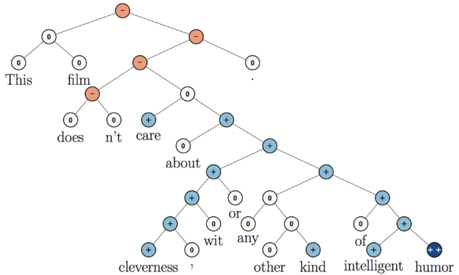
Sentiment Analysis
Determine the overall affect of a given text (e.g, positive, neutral, negative).

Slide 33
Topic Modelling
Estimates: P(W|Z) and P(Z|D)
Determines a distribution of “topics” for each document.

Slide 34
Named Entity Recognition (NER)
Determines the category/type of each named entity mention.
Friday, Pavlos flew to Honolulu, Hawaii for vacation.

Slide 35
Named Entity Recognition (NER)
Determine the named entities then classify the type of each.
Friday, Pavlos flew to Honolulu, Hawaii for vacation.
TIME
PER
LOC

Slide 36
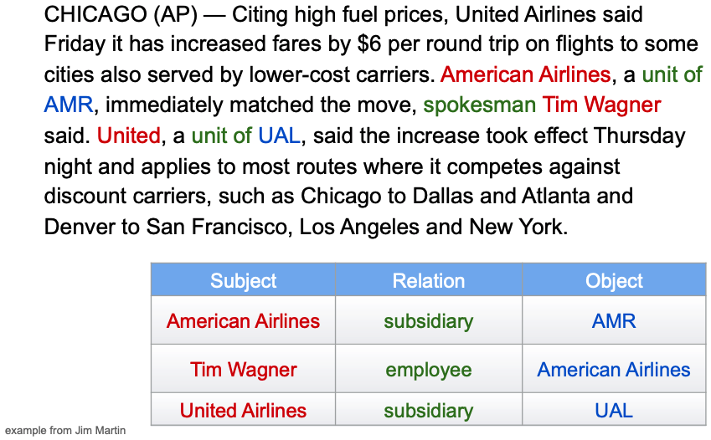
Relation Extraction
Helps figure out the larger events that are taking place.

Slide 37
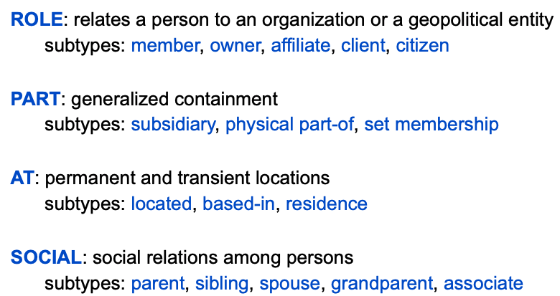
Relation types from ACE 2003

Slide 38
Word Sense Disambiguation
Determines which “version” of the word is being used.
I love Apple.
Please hand me the apple.

Slide 39
Natural Language Understanding (NLU)
Determines what a given user wants (intention plus specifics).
Examples: Siri, Alexa, Spotify

Slide 40
Natural Language Generation (NLG)
Produce new content! Related to abstractive summarization and language modeling.
Use cases: Creating fake user reviews, short stories, homework problems.

Slide 41
Machine Translation (MT)
Convert text from one human language to another.
Use cases: create versions of text for a wider audience, assist in traveling.

Slide 42
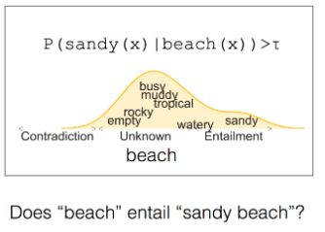
Entailment
Understand textual inferences.
From Ellie Pavlick

Slide 43
Question Answering (QA)
Provides answers to human provided questions.
How tall is Michael Jordan?
What is the capital of Rhode Island?
Is it safe to take Penicillin with alcohol?

Slide 44
Question Answering (QA)
Approaches:
Reading Comprehension: multiple choice
(select relevant words to answer a question) – relies on having labelled data. SQuAD is the canonical dataset.
Close-style: replace a missing word

Slide 45
Question Answering (QA)
Issue: requires supervision (usually)
Benefit: super fun and can be promising

Slide 46
Syntax
Semantics
Morphology
Word Segmentation
Part-of-Speech Tagging
Parsing
Constituency
Dependency
Sentiment Analysis
Topic Modelling
Named Entity Recognition (NER)
Relation Extraction
Word Sense Disambiguation
Natural Language Understanding (NLU)
Natural Language Generation (NLG)
Machine Translation
Entailment
Question Answering
Discourse
Summarization
Coreference Resolution

Slide 47
Motivation
Problems
Approaches
Old Days
Modern

Slide 48
Motivation
Problems
Approaches
Old Days
Modern

Slide 49
Old Days
In the 1960s, approaches relied on hand-written rules
Statistics didn’t exist (for NLP)
Part-of-Speech tagging Machine Translation were amongst the two first tasks
Hidden Markov Models started the trend for using statistics and probability

Slide 50
Modern approaches
Each word can be represented by a continuous-valued vector
King =
.6
.2
.1
-.3
-.5
-.4

Slide 51
Modern approaches
Each word can be represented by a continuous-valued vector
King =
.6
.2
.1
-.3
-.5
-.4
Queen =
.5
.2
.1
-.2
-.6
-.4

Slide 52
Modern approaches
Each word can be represented by a continuous-valued vector
King =
.6
.2
.1
-.3
-.5
-.4
Queen =
.5
.2
.1
-.2
-.6
-.4
Table =
.1
.9
.9
-.8
-.1
.2

Slide 53
Modern approaches
Construct word vectors such that words that are more semantically related have vectors that are appropriately similar.
King – man + Woman ~= queen

Slide 54
Modern approaches
Deep Learning now dominates the field:
Recurrent Neural Networks (RNNs) / LSTMs / GRUs
Convolutional Neural Networks (CNNs)
Attention mechanisms → Transformers
Generative Adversarial Networks (GANs)
(Variational) Autoencoders

Slide 55
My suggestions:
Pre-trained word embeddings: word2vec or GloVe
Open source libraries:
SpaCy
HuggingFace (many deep learning models)
NLTK
Pick an idea/project and run with it.
Don’t over-engineer a fancy model. Start simple. Fail fast.

