Slide 1
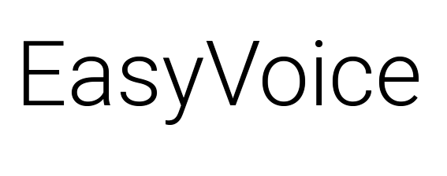

Team U:
Friedger
Guillaume
Vitaliy
Diallo

Slide 2
EasyVoice
Speech Synthesis made accessible
Simple use on the move
Available on smartwatches, smartphones and tablets
Many pre-defined sentences
Very easy to add more
Open Source

Slide 3
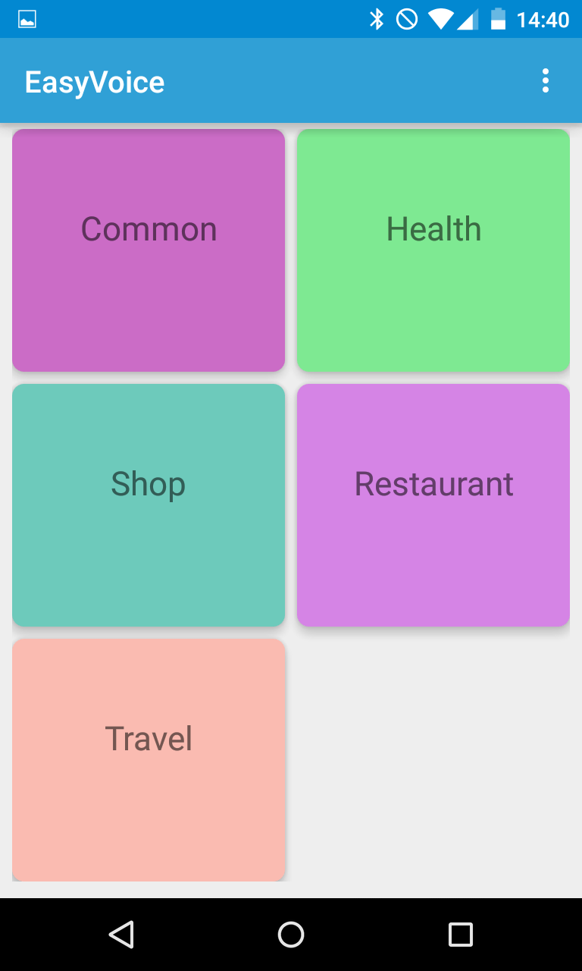
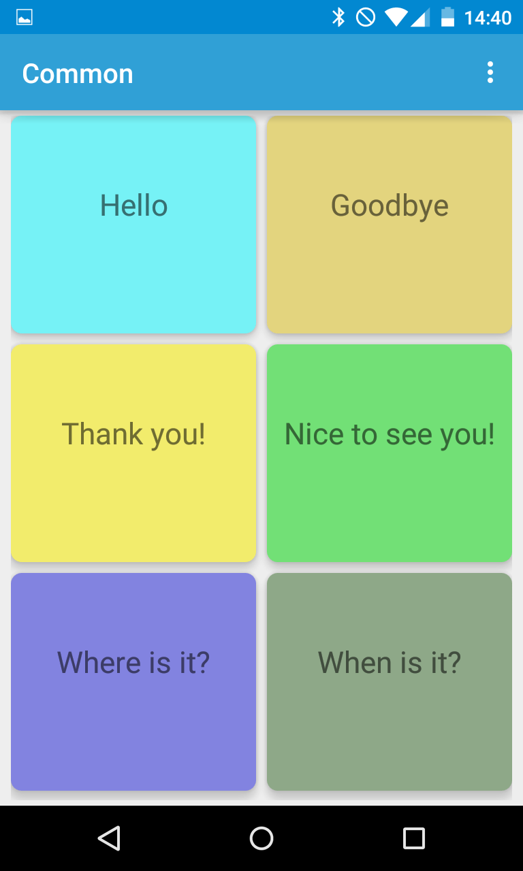
EasyVoice

Slide 4
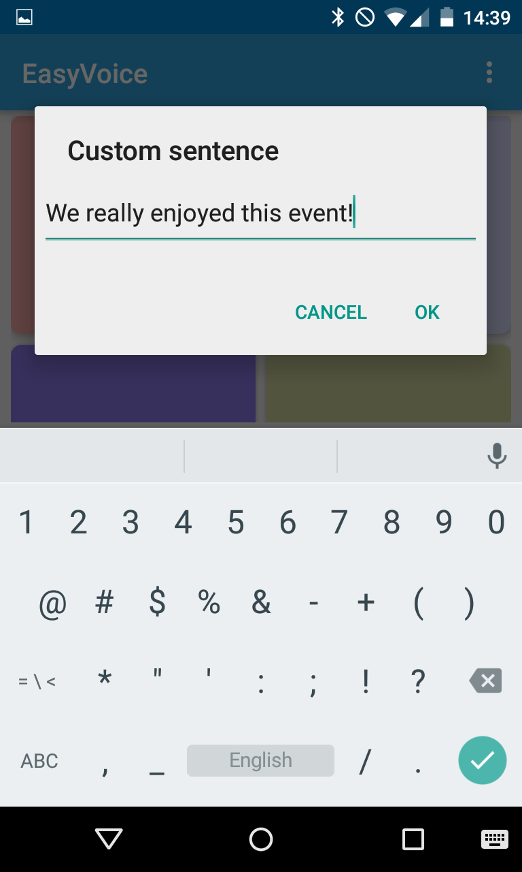
EasyVoice
Add new sentences on
the phone or on a tablet
It then syncs with the
smartwatch

Slide 5
...One more thing :)
“Easy to GO!” by Diallo
Centralize useful information for the disabled
Make the access to public transport easier
In a future monitor their movements to improve the access to common transports station

