Slide 1



TITLE : WEATHER WEBSITE
GUIDED BY: Dr S KALAISELVI
PROJECT BY:
R S GUGAN (22BSR017)

Slide 2
PROJECT FUNCTIONALITIES:
The application allows users to enter their name, Mobile number, Email and Location and then navigates to the weather details page.
It fetches weather data from the OpenWeather Map API, displays a personalized greeting, and allows real-time weather search.
Users can also enter another location, and the application handles errors gracefully.
The layout is designed using CSS for a clean, user-friendly, and responsive interface, including styles for form elements, weather details, and overall layout.

Slide 3
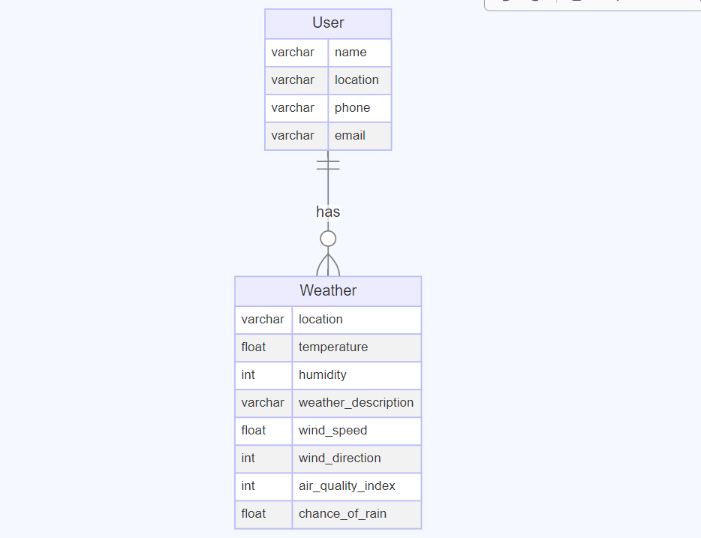
ER-Diagram:

Slide 4
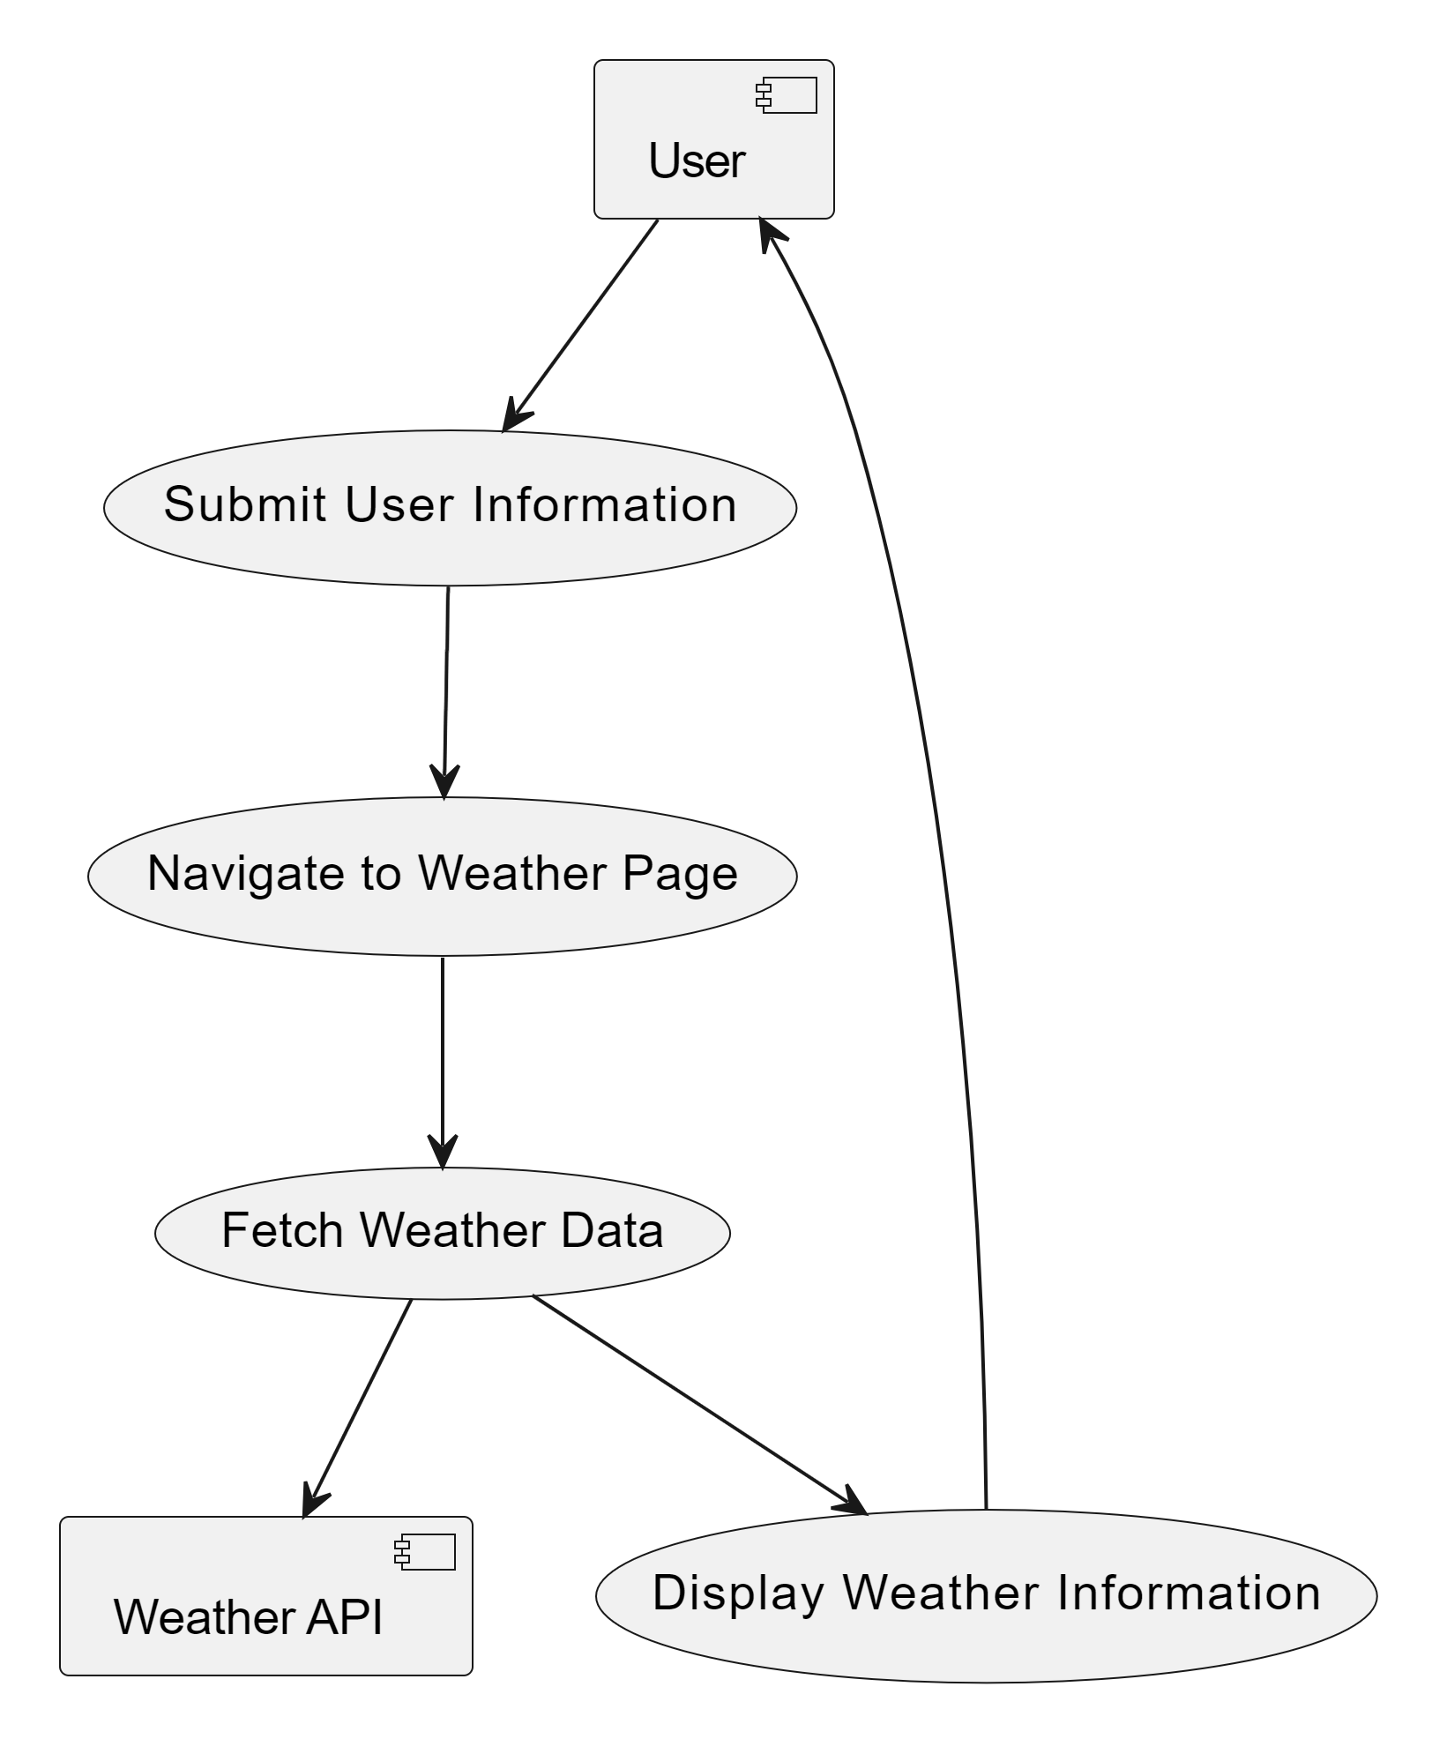
Use Case Diagram:

Slide 5
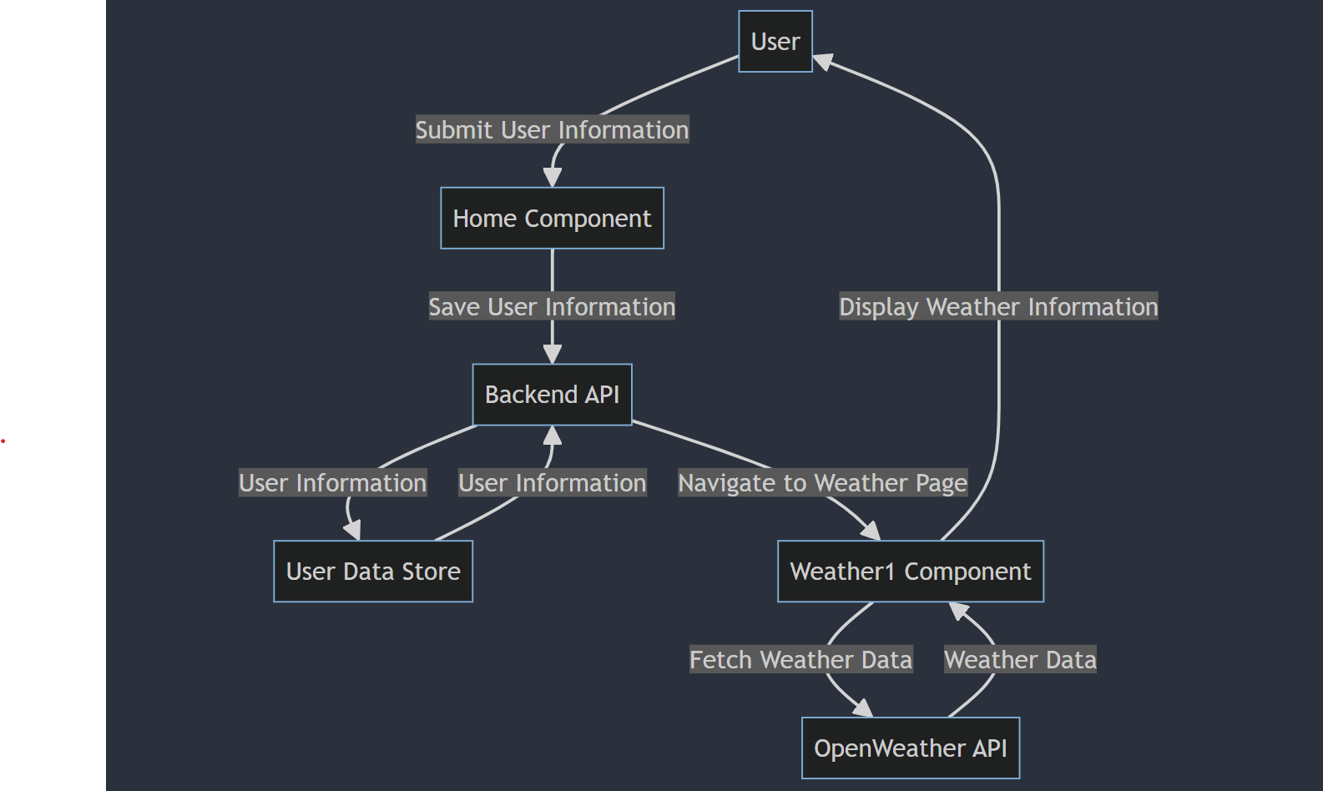
DFD Diagram:

Slide 6
.
FRONTEND LANGUAGES
BACKEND LANGUAGES
In order to accomplish this project, the website will be built using React JS for Front-End design.
In order to accomplish this project, the website will be built using Node.js and Mongodb for Back-End design.

Slide 7
THANK YOU!!!

