Slide 1

Truck Fleet Failure Prediction
Team BrakeGuard
guga-fayrooz-seungdo-vishred

Slide 2
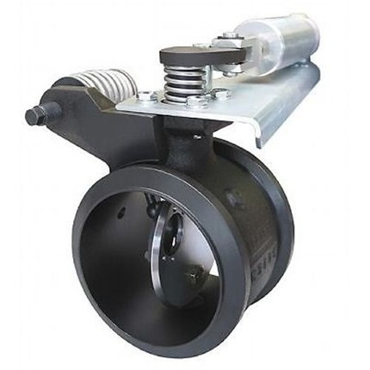
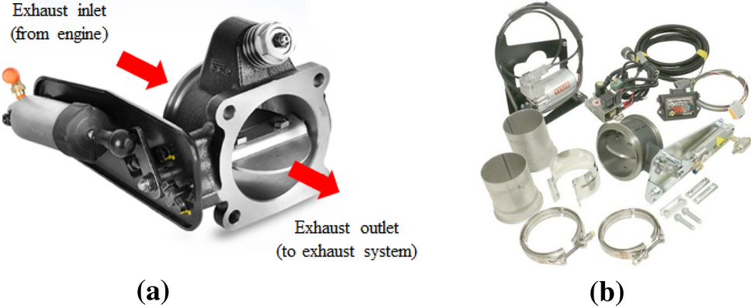
Exhaust Brake
Field Observation
The vehicles in the field were showing a safety problem.
When the driver tries to put the brake, some vehicles do not brake properly.
The exhaust brake reduces the speed of the vehicle. It can be used as a supplementary braking system, which reduces the effort and increases the life of the service brakes by 2 to 3 times.
However, this component valve is sticking.
We have verification of what valves were sticking as of May 2021.
Exhaust Brake Butterfly Valve

Slide 3
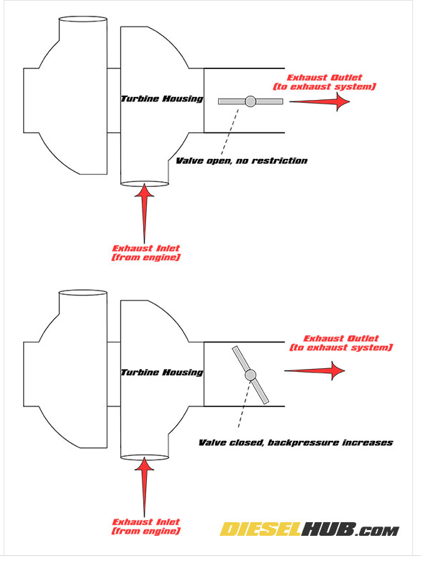
Exhaust Brake Function
During the Braking, this valve should be closed.
If this is stuck open, The exhaust brake does not work.
No exhaust Brake
Exhaust Brake start to work

Slide 4
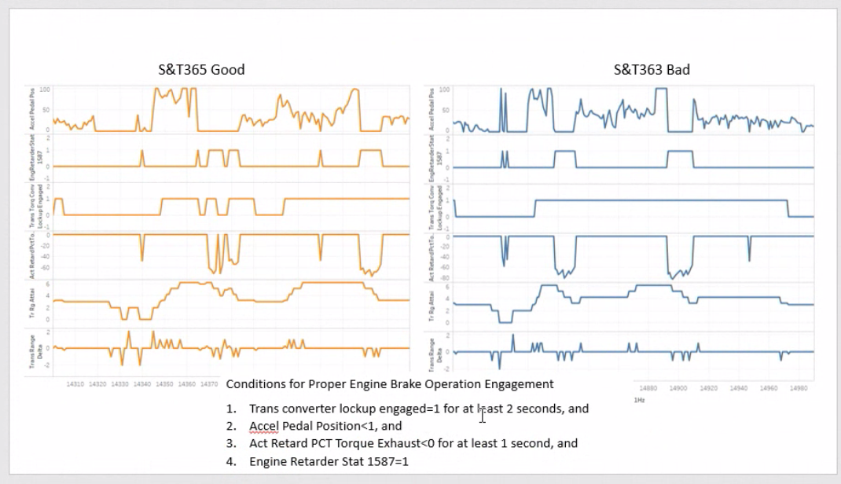
Field Technician’s Feedback on Good vs Bad Brake

Slide 5
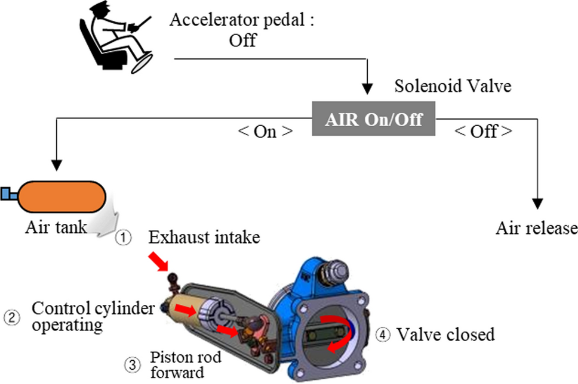
Braking Method

Slide 6
Select the right operating condition for Braking
Use event samples (not raw time series) and filter to rows where:
Driver intent
AccelPedalPos ≤ 2% (or _1587)
EngPctTorq ≤ 5% (or EngDmdPctTorq ≈ 0)
Powertrain state
EngRetarderStat_1587 == 1
TransTorqConvLockupEngaged == 1
Kinematics
EngSpeed ∈ [1400, 2200] RPM
VehSpeedEng ∈ [20, 60] mph
TrRgAttai stable (no gear change in window)
Exclusions
BrakeSwitch == 0 (optional)
ABS flags OFF (ABS_RetCont_1587 == 0, etc.)
This isolates “engine-driven exhaust braking only”

Slide 7
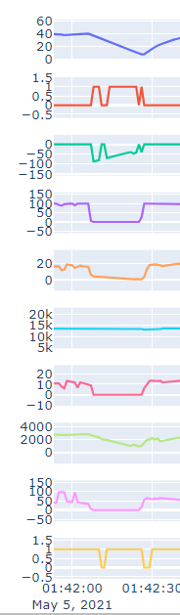
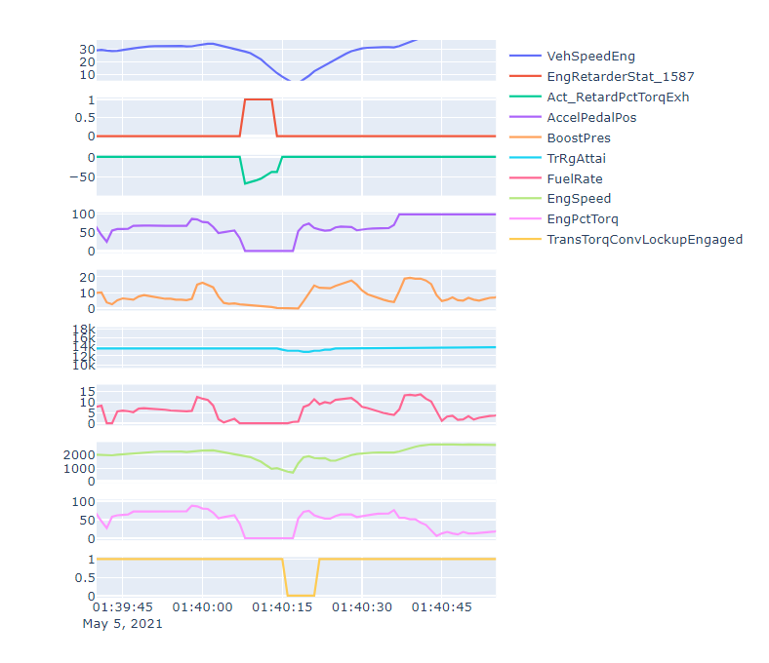
Signals
During the failure of the valve, the change in speed is slower
Especially at 40mph
Engine
Retarder is on
State=1
Exhaust back pressure
Is budling up and then
reduces due to zero fuel
Pedal = 0
Fuel ~ 0
Rpm slows down
Details in this window
of data
Torqe=0

Slide 8
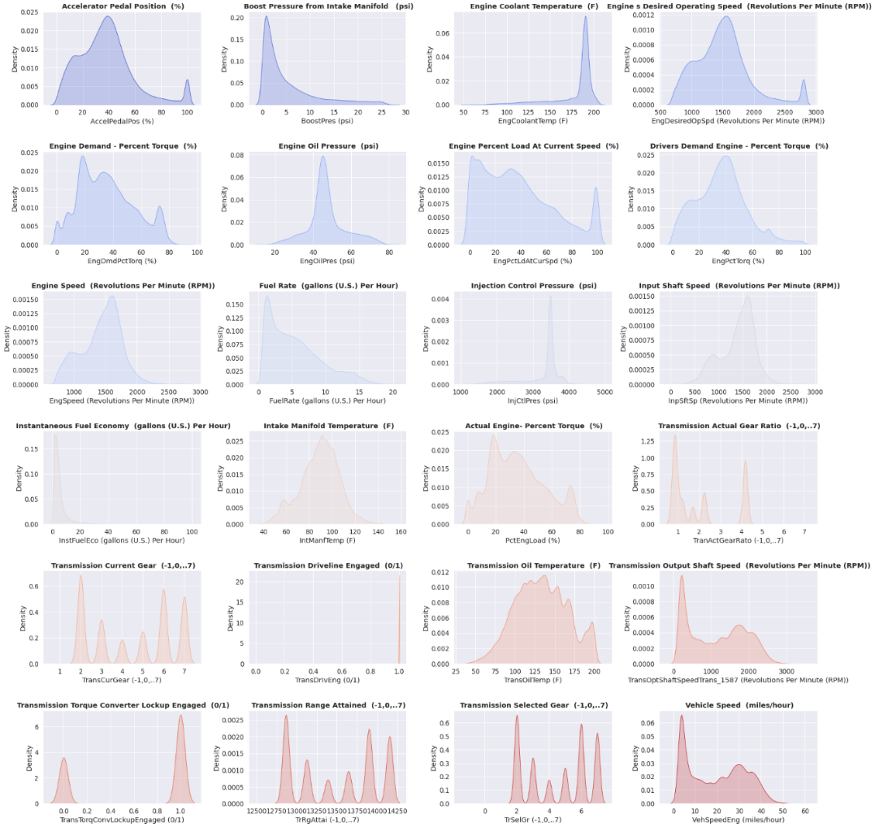
EDA

Slide 9
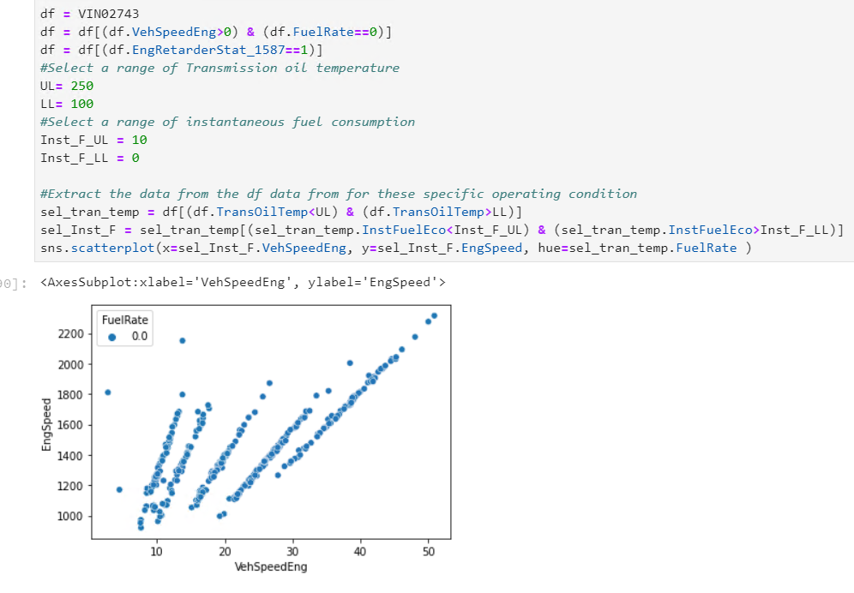
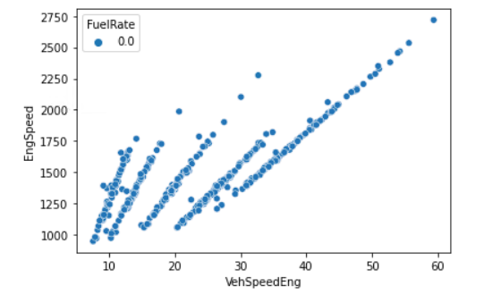
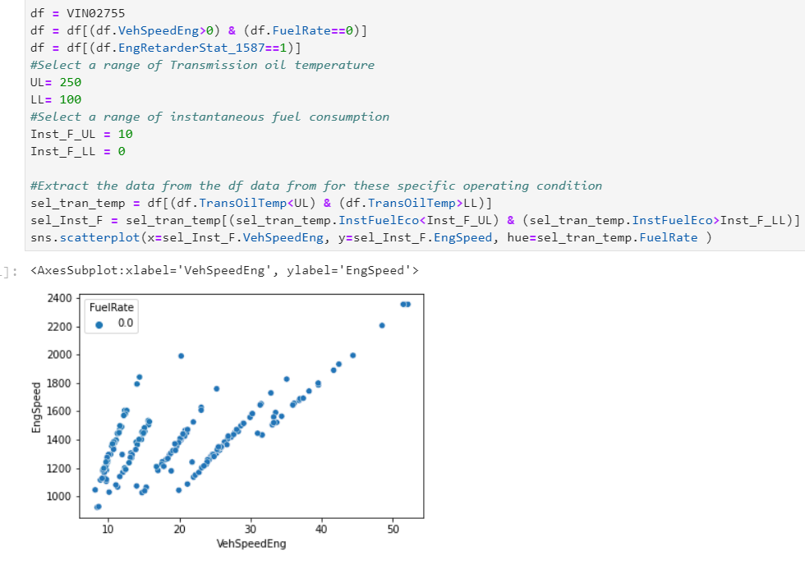
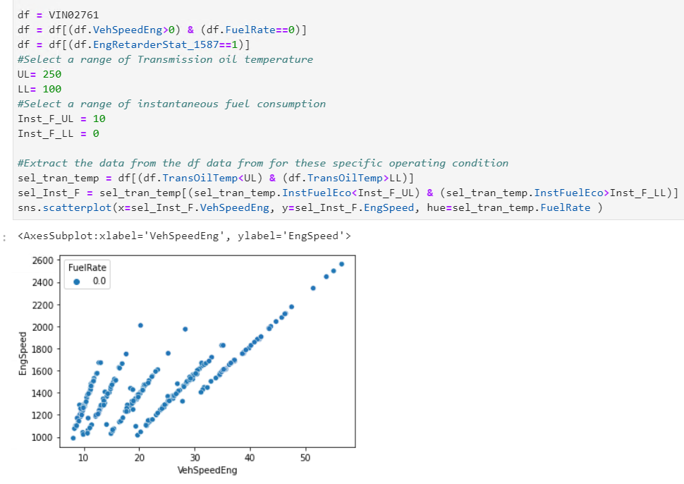
Engine Breaking Issue
EngRetarderStat_1587 ==1
EngRetarderStat_1587 ==1, it should slow down, but the 2744,2761 not slowing down. It is a safety related problem.
2743
2744
2761

Slide 10
What variable actually carries the information?
Best Proxy is
Act_RetardPctTorqExh
This is effectively:
How much negative torque the engine can generate at a given RPM
A healthy system will show strong, predictable dependence on RPM
A degraded system will decouple from RPM.

Slide 11

Key Channel Act_RetardPctTorqExh
-100 % < Act_RetardPctTorqExh < 0%
The key signal is Act_RetardPctTorqExh
The unit is % here. -100% means, all 100% of the exhaust gas is going back into the engine due to closure of the valve. As soon as you close the valve, there will be a high pressure built up in the combustion chamber slowing down the vehicle. Due to lack of fuel for burring, this back pressure will go down to eventually zero.

Slide 12
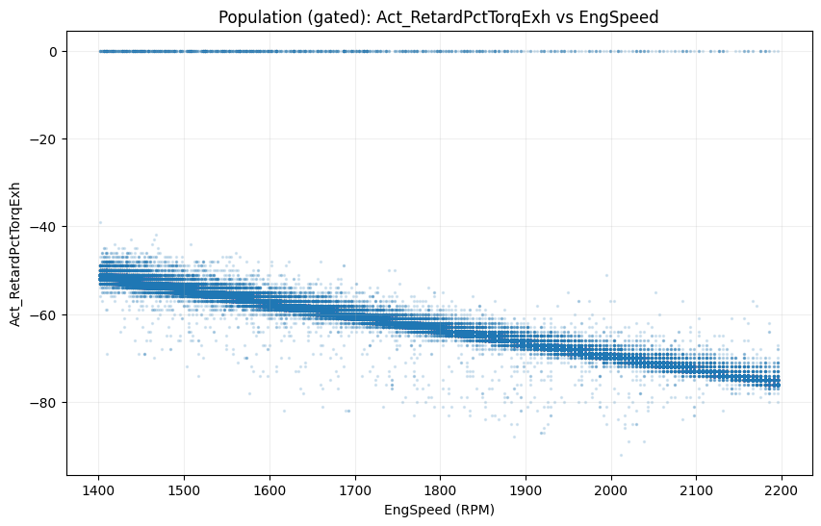
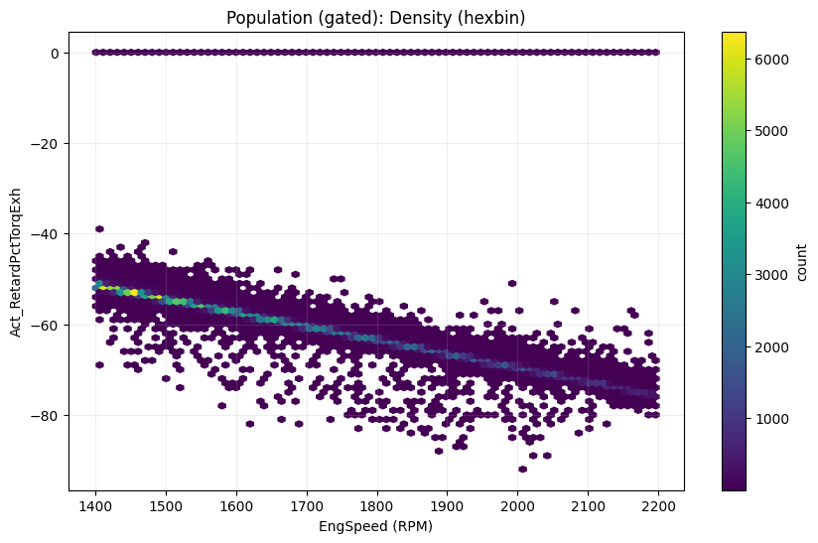

Slide 13
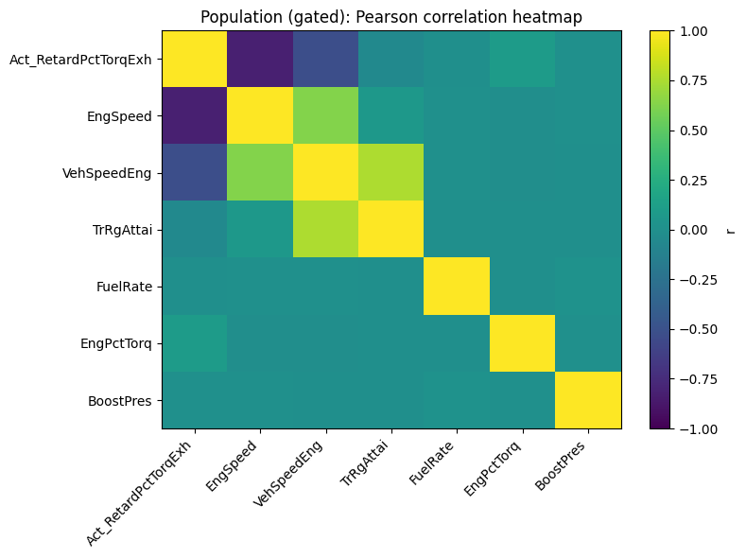

Slide 14
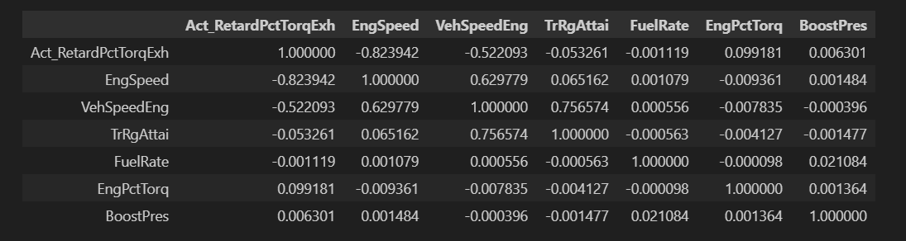

Slide 15
Data

Slide 16
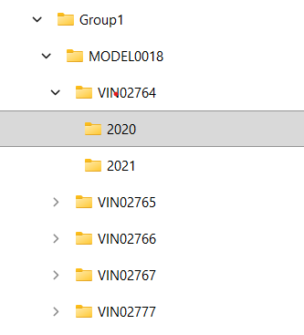
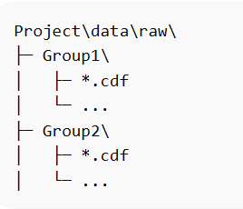
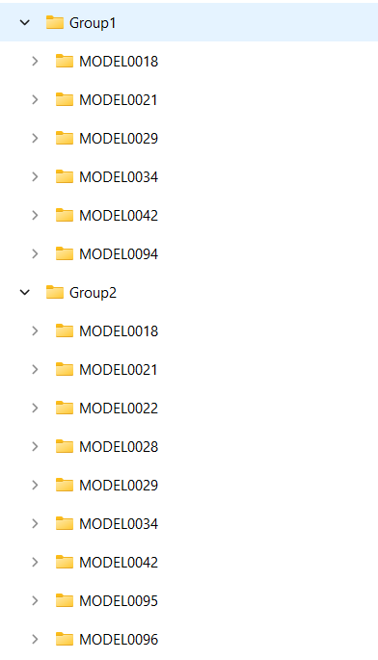
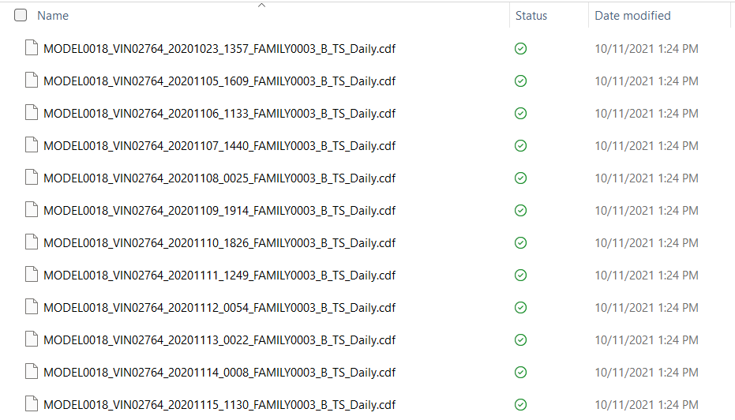
Unzip Zip File

Slide 17
Folder Structure
Project\ │ ├─ myenv\ ← virtual environment (next step) ├─ data\ │ ├─ raw\ ← CDF files go here │ └─ processed\ ← cleaned / derived data ├─ notebooks\ ├─ src\

Slide 18
File Conversion
from spacepy import pycdf

Slide 19
Cdf files
--- Group1 --- ✅ Found 7343 CDF files First file: MODEL0018_VIN02764_20201023_1357_FAMILY0003_B_TS_Daily.cdf Sample path breakdown → group=Group1, model=MODEL0018, vin=VIN02764, year=2020 Variables (152 total): ['UTC_1Hz', 'BrakeSwitch', 'CrankcasePres', 'TrOutShaftSp', 'EngSpeed', 'FuelRate', 'IntManfTemp', 'PTOGovernorSetSwtchEng', 'ASROffRoadSwtchTire', 'PTOResSwtch_1587’]
--- Group2 --- ✅ Found 13981 CDF files First file: MODEL0018_VIN02758_20160203_1612_FAMILY0003_B_TS_Daily.cdf Sample path breakdown → group=Group2, model=MODEL0018, vin=VIN02758, year=2016 Variables (149 total): ['UTC_1Hz', 'BrakeSwitch', 'CrankcasePres', 'TrOutShaftSp', 'PTOCtlSwt_1587', 'EngSpeed', 'FuelRate', 'EngOilPres', 'IntManfTemp', 'PTOGovernorSetSwtchEng'] (myenv) PS C:\Users\ggugaratshan\OneDrive - HBK\Documents\2_SIADS\SIADS699\Project>
Group1: 7,343 CDF files; Group2: 13,981 CDF files

Slide 20
Create a FAST “manifest” of all files (no CDF reading)
group, model, vin, year
date/time parsed from filename
full file path
This will scan filenames and paths and build a table with:
group, model, vin, year
date/time parsed from filename
full file path
src/build_manifest.py
data/processed/cdf_manifest.csv

Slide 21
Extract Signals
Each CDF file has:
a header schema = list of signal names (variables), Schema is set of signal names present in one CDF file
associated metadata (VIN, model, date)
We need to answer three questions:
Within a VIN → Are signal names consistent across time?
Across VINs (same model or group) → Do different VINs have different signal sets?
Over time → Did signal names appear/disappear/change for a VIN (schema drift)?
This is essentially schema versioning & drift detection, which is very common in this type of onboard diagnostic data.

Slide 22
High-level strategy on Signals
Phase 1 — Define the “schema unit” -set of signal names present in one CDF file
Phase 2 — Establish a baseline schema per VIN
Collect all files for the vin
Baseline schema, earliest file, or most common
Phase 3 — Compare every file against the baseline (within VIN)
Missing signals: Signals present in the baseline but absent in this file
New signals: Signals not in baseline but present in this file
Unchanged signals: Intersection
“Are signal names the same across all files for the same VIN?”
Phase 4 — Detect schema drift over time (within VIN) - Now add time awareness:
For each VIN, Sort files by timestamp
Track when:
a signal first appears
a signal disappears permanently
a signal flaps (appears, disappears, reappears)
This produces: drift timelines, version boundaries, and change points
Build a VIN × signal × time presence matrix.
This is where domain knowledge comes in later — but your pipeline should surface the facts cleanly.
Phase 5 — Compare schemas across VINs
Once each VIN is internally consistent (or characterized): We compare VIN-level schemas, VIN A vs VIN B, common signals, VIN-specific signals
This answers: “Are different vehicles instrumented differently?”, We do this, within same MODEL, within same GROUP, across years
Phase 6 — Classify discrepancies (important for interpretation), Not all differences are “errors”.
We can classify signal differences as:
Expected differences
model-specific
optional equipment
year-based upgrades
Potential data quality issues
missing signals mid-life
unexpected renaming
inconsistent availability

Slide 23
Output from the Signal Work
For each VIN: baseline signal list, % of files matching baseline, list of drift events with dates
Across VINs: signals common to all, VIN-specific signals, signals that changed naming over time
This is good for feature engineering, modeling assumptions, explaining results to stakeholders

Slide 24
1st Standup
Team 24: guga-fayrooz-seungdo-vishred
SIADS 699 - Team BrakeGuard – Truck Fleet Failure Prediction

Slide 25
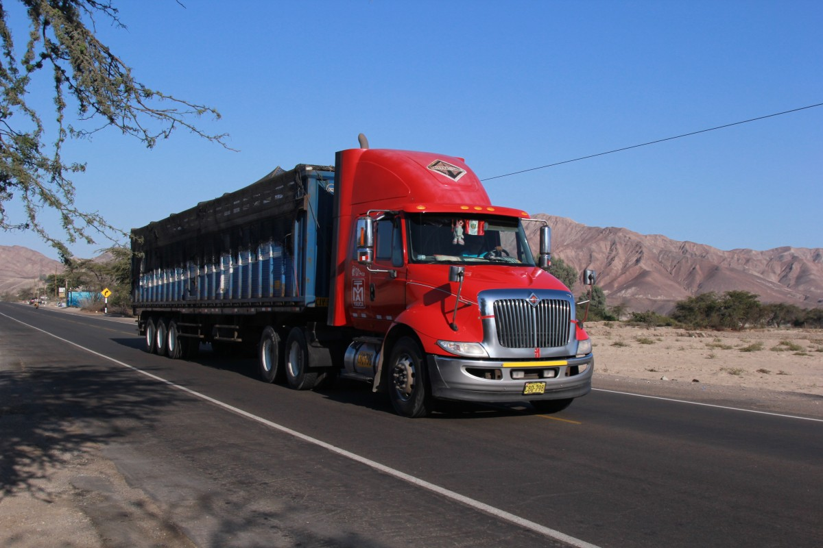

Project Description
Trucks have two types of brake. One is the friction-type brake, similar to our car brakes. Another type of brake is These devices achieve braking force by blocking the exhaust pipe, thereby compressing the exhaust gas and consuming kinetic energy.
Failure of the exhaust brake in trucks are very risky and catastrophic and truck fleet operators want to know if the braking system is going to fail ahead of time to do preventive maintenance.
Early detection of exhaust brake system degradation using onboard sensor telemetry data (onboard sensor and diagnostic data) from a diesel truck fleet.
Can we detect early signs of exhaust brake degradation before a field failure occurs?
How do supervised and unsupervised learning methods compare in identifying anomalous braking behavior?
Can we construct machine learning method or just machine learning methods to enable mask to isolate valid braking events and improve detection accuracy?
How can cost-sensitive modeling better reflect real-world fleet operational risks
https://link.springer.com/article/10.1007/s42835-022-01325-7

Slide 26
What did the team do last week?
Large amount of data
>90 vehicle data multiple years
Worked on
Combining the data
Data cleaning
Data processing
Segmenting data for braking event

Slide 27
Signals
What are we working now?
Engine
Retarder is on
State=1
Exhaust back pressure
Is budling up and then
reduces due to zero fuel
Pedal = 0
During the failure of the valve, the change in speed is slower
Especially at 40mph
Fuel ~ 0
Rpm slows down
Details in this window
of data
Torqe=0

Slide 28
What issues are blocking?
No Blockers
Team is three different time zones?
US, Middle East, Asia
Model training data and data leak
Planning to discuss with the mentor

