Slide 1
Related Work & Novelty
• TREAD (Krause et al., 2025) — token routing for efficient DiT training. Presented purely as an efficiency method; the stochastic-depth training it induces is never analysed.
• Generative Uncertainty in Diffusion (Jazbec et al., 2025) — Bayesian UQ via last-layer Laplace, for U-Net / flow matching. No DiT, no per-timestep profile; aleatoric left as future work.
• HyperDM (Chan et al., NeurIPS 2024) — epistemic + aleatoric via a hyper-network ensemble. Rigorous but computationally heavy; no timestep-resolved analysis.
• Timestep-Aware Block Masking (2025) — different DiT blocks activate at different timesteps, supporting the early-vs-late hypothesis.
• Attention entropy — an established UQ proxy in NLP and ViTs, never applied to the diffusion timestep axis.
OUR GAP
TREAD presents routing as an efficiency mechanism. We are the first to use its routing as an inference-time uncertainty-quantification substrate — combined with attention entropy, resolved per timestep, decomposed into epistemic / aleatoric, and linked to generation quality. Training-free throughout.
+1

Slide 2
Method — the three proxies
All three are inference-time and training-free. D_{θ} is the x̂₀-prediction.
1 · U_{ens}(t, c) = Var_{k} [ D_{θ}( x_{t}^{(k)}, t, c ) ], z^{(1..K)} ~ N(0, I) through the full path
Captures data stochasticity — different noise, different image.
2 · U_{route}(t, c) = Var_{m} [ D_{θ}^{r(m)}( x_{t}, t, c ) | z ], M = 16 random TREAD routes
Captures model / sub-network ambiguity — the only epistemic proxy.
3 · U_{attn}(t, ℓ) = − Σ_{ij} A_{ij}^{(ℓ)} log A_{ij}^{(ℓ)}
We report the mean per-query entropy — bounded by ln N = ln 256 = 5.55, which gives the curve an interpretable ceiling (on the ceiling = attention is uniform = the block selects nothing).
U_{epi} = Var_{r}[ D | z ] U_{ale} = E_{r}[ Var_{z}[ D ] ] (law of total variance)
Seeds alone cannot separate model ambiguity from data stochasticity. Routes + seeds can — that is the whole point of having two independent noise sources.
+2

Slide 3
Experimental setup
Model | DiT-XL/2 — 675 M params, 28 blocks, patch 2 → 256 tokens
Checkpoint | official DiT-XL-2-256x256.pt — inference only, no retraining
VAE | stabilityai/sd-vae-ft-ema, latent 32 × 32 × 4
Sampler | DDPM ancestral, 250 steps
Guidance | cfg_scale = 1.0 — pure conditional
Seeds | K = 16 per class, batched in one reverse pass
Classes | 50, stratified easy / medium / hard
Bins | 20 timestep bins over t ∈ [0, 1000)
Hardware | 1 × RTX 4070 (12 GB) — ≈ 1 min per class
CORRECTION TO SLIDE 3
“Data: ImageNet 256×256” is misleading. No ImageNet images are loaded anywhere. Every proxy is measured on trajectories the model generates from z ~ N(0, I) conditioned on a class label — “50 ImageNet classes” means 50 label integers. The ImageNet-ness lives in the checkpoint’s weights.
+3

Slide 4
Routing variance — the proxy we could not compute
U_{route}(t, c) = Var_{m} [ D_{θ}^{r(m)}( x_{t}, t, c ) | z ]
• It is the only epistemic proxy. The proposal calls it “the linchpin” — the epistemic / aleatoric split in Tasks 3 and 5 is unjustified without it.
• It is only legitimate on a TREAD-trained model: routing variance means something because the network was trained as a distribution over sub-networks. Injecting routes — or MC-Dropout — into a vanilla DiT that never saw them yields uninterpretable variance.
BLOCKER
There is no publicly released TREAD DiT-XL/2 checkpoint. We cannot run it, and we cannot substitute vanilla DiT.
• What is ready: a model-agnostic reference implementation — routing_variance, route_sanity, epi_ale_decomposition — validated on a small TREAD-trained DiT. Swapping in a real checkpoint is a one-function change.
• Decision needed from the curator: obtain a TREAD checkpoint, or train a TREAD DiT-B/2 ourselves? This gates Tasks 2, 3 and 5.
+4

Slide 5
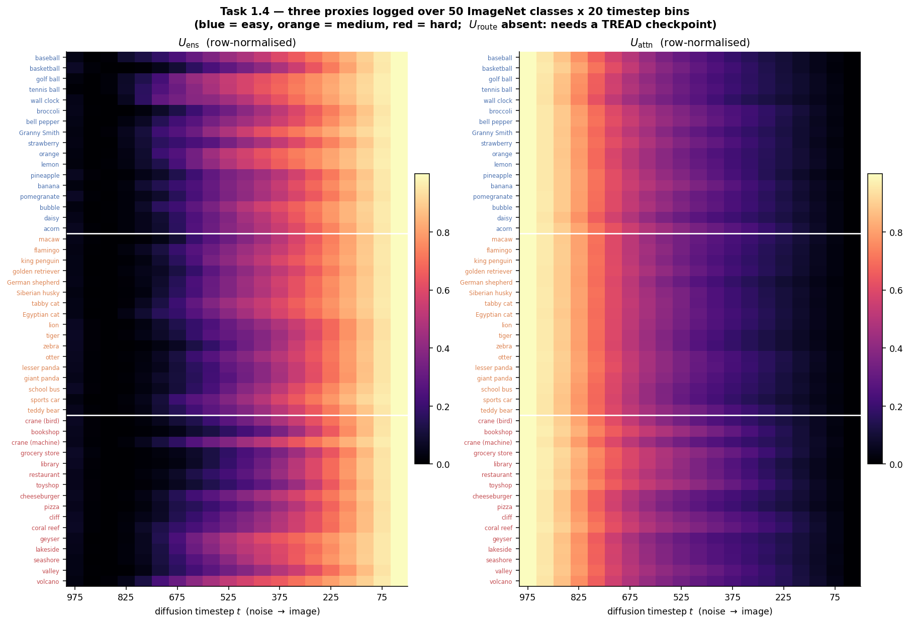
All proxies over 50 ImageNet classes × 20 timestep bins
Row-normalised. Blue = easy, orange = medium, red = hard. U_route column exists in the CSV but is NaN — see the blocker slide.
Stratification — expected difficulty of p(x|c): easy = one canonical object, plain background (lemon, golf ball); medium = real pose / background variation (retriever, zebra); hard = polysemous label or cluttered scene (crane ×2, restaurant, coral reef).
The proposal asks to stratify by expected FID contribution — that needs real ImageNet reference images. We stratify semantically and flag FID-based stratification as future work.
+5

Slide 6
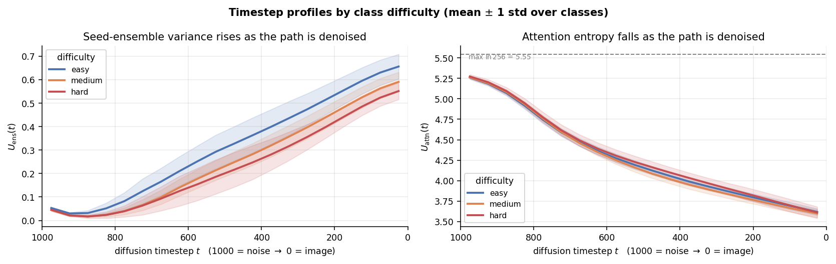
Timestep profiles by class difficulty
Mean ± 1 std over classes.• Left: easy sits cleanly above medium above hard, at every timestep — the anti-correlation, drawn.
• Right: the three attention curves lie on top of each other — the null, drawn.
• U_{attn} decays exactly as the proposal predicts, and it is a clean, low-variance signal — but it is the same signal for every class. It is a property of the denoising schedule, not of the conditioning.
+6

Slide 7
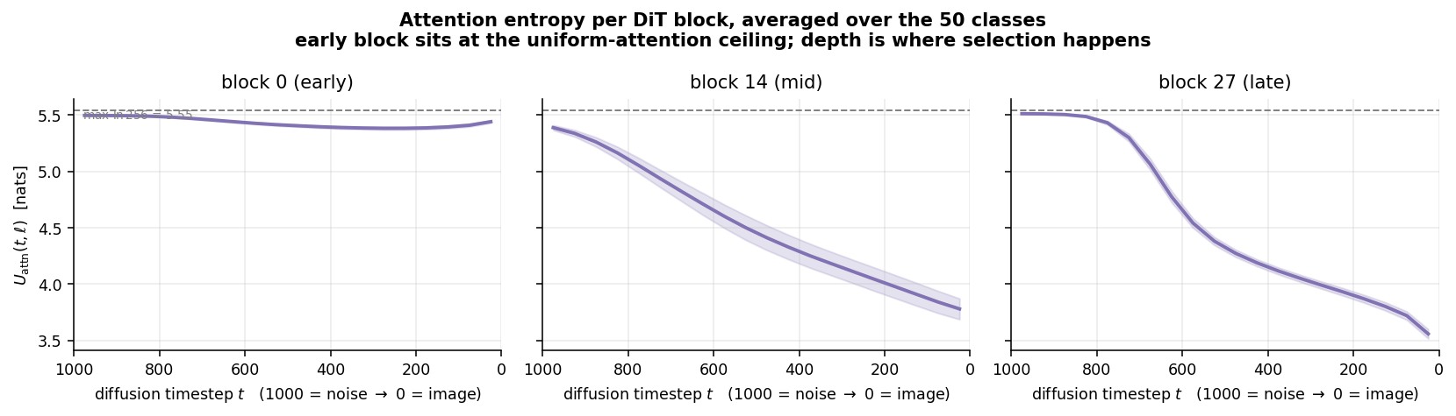
Attention entropy — across all 50 classes
Averaged over all 50 classes, ± 1 std. Dashed line = ln 256 = 5.55, the maximum possible entropy over 256 tokens.• Block 0 sits pinned on the ceiling. Entropy at the maximum means attention is uniform — the early block is not selecting anything, it passes everything through.
• Selection emerges with depth: blocks 14 and 27 fall to ≈3.4 nats as the image resolves. The early-vs-late structure shows up along the block axis as clearly as along the timestep axis.
+7

Slide 8
Key finding (a) — U_ens rises along the denoising path
The proposal predicts the opposite.
Hypothesis: early steps (high σ) = mode selection = high seed variance, decaying late.
Measured: starts at ≈0.03–0.05, dips further around t ≈ 900, then grows monotonically to ≈0.50–0.65 at t → 0. Reproduced independently by two team members on separate code — this is a property of the metric, not a bug.
WHY
At high σ the model resolves nothing and predicts x̂₀ ≈ the conditional mean — “the average lemon” — so all seeds agree. By the end each seed has committed to its own lemon, so they disagree maximally.
CONSEQUENCE
Var_{k}[x̂₀] in latent space measures divergence of the final images, not mode selection. To test the proposal’s actual claim, variance must be taken in a space where “mode” is meaningful — e.g. CLIP / DINO embeddings of x̂₀ — not raw latents.
+8

Slide 9
Key finding (b) — U_ens anti-correlates with class difficulty
Proxy | Spearman | p
U_ens early (t ≥ 800) | −0.62 | <0.001
U_ens late (t ≤ 200) | −0.72 | <0.001
U_attn late | +0.05 | 0.72
Proposal’s key comparison | early | late
lemon — unimodal | 0.0470 | 0.7065
crane, bird — ambiguous | 0.0232 | 0.4618
crane, machine — ambiguous | 0.0304 | 0.4946
Easy classes carry the highest seed variance. Attention entropy carries no class information at all — a clean null. And the proposal’s own key comparison fails in the predicted direction: lemon has ~2× the early variance of either crane.
WHAT IT MEANS
Var[x̂₀] in latent space is dominated by how much the class’s dominant low-frequency layout swings, not by semantic ambiguity. A lemon is one big saturated blob; a coral reef is generic clutter in every sample. Normalising each curve by its own late value shrinks the effect (−0.62 → −0.48) but does not remove it — the shape is genuinely class-dependent.
HONEST CAVEAT
Our difficulty tiers are semantic hand-labels, confounded with “clutter”. To claim anti-correlation with difficulty proper we need per-class FID — which does require real ImageNet reference images. That is the one place in this project where the dataset is genuinely needed.
+9

Slide 10
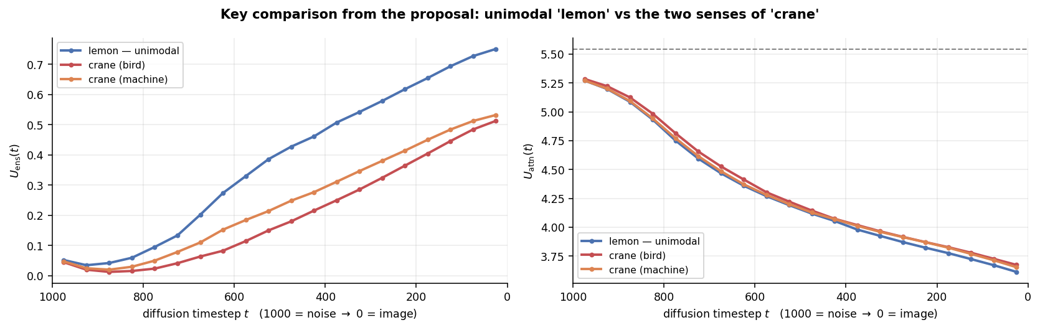
Key finding (b) — lemon vs crane, drawn
Lemon (blue) sits above both cranes at every timestep. The unimodal class — the one the proposal expects to be *least* uncertain early — carries the most seed variance.
Right panel: all three attention-entropy curves coincide. U_{attn} does not distinguish the ambiguous class from the unimodal one either.
+10

Slide 11
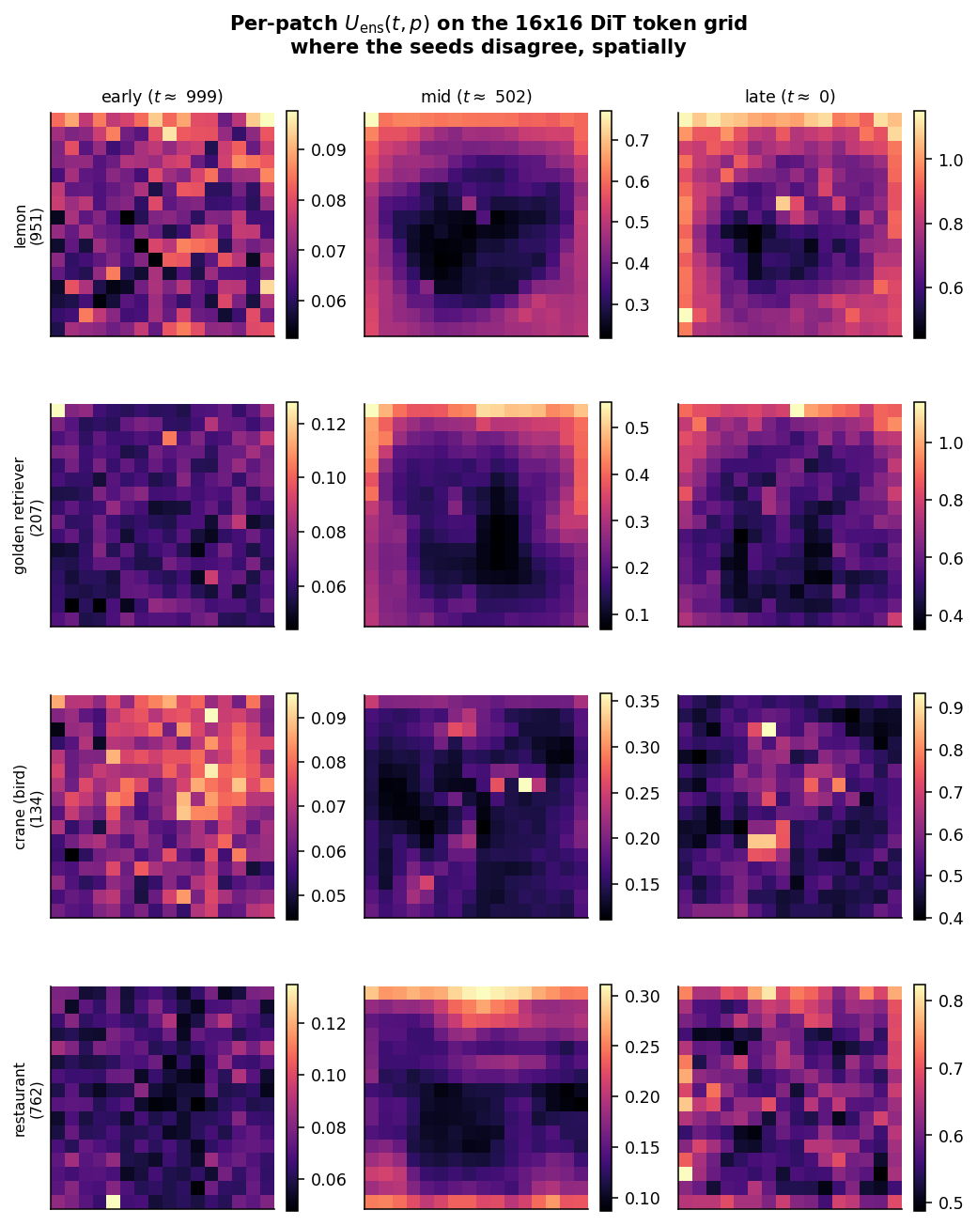
Spatial — where the seeds disagree
Early: uncertainty is diffuse and low — no structure has been committed to. Late: it concentrates on object boundaries and texture. The seeds have agreed on what to draw and now disagree on detail.
Next (Task 4): compare these maps against SAM / DINO masks and test whether high-uncertainty patches co-localise with semantically ambiguous regions.
+11

Slide 12
Roadmap — mapped onto the curator's tasks
DONE — TASK 1
Two of three proxies implemented on pretrained DiT-XL/2, training-free, logged over 50 classes × 20 timestep bins. Two clean negative results.
BLOCKED
U_{route} — needs a TREAD checkpoint. Gates Tasks 2, 3 and 5.
NEXT, PER THE PROPOSAL
• Task 2 — validate U_{route} as epistemic: OOD sensitivity, capacity trend across DiT-B/L/XL, non-redundancy vs U_{ens}, route-sanity ablation.
• Task 3 — epistemic / aleatoric decomposition; locate the mode-transition point t*.
• Task 4 — spatial heatmaps vs SAM / DINO masks.
• Task 5 — link uncertainty to per-sample quality (CLIP, IS contribution, intra-class LPIPS).
• Fix the confound — per-class FID for honest stratification; re-measure variance in a semantic embedding space.
KEEP SLIDE 6 AS IT IS
Slide 6 already proposes uncertainty-adaptive sampling and entropy-guided routing. That stays. This slide sits in front of it, so the deck answers the curator’s brief first and pitches the extension second.
+12

