Slide 1

HOTEL BOOKING
USING CHATBOT IN AWS

Slide 2
TITLE:
Hotel Mangement using Chatbot In Amazon Lex
Objective:
The objective of implementing hotel booking using a chatbot in Amazon Lex can be to create an efficient and user-friendly way for customers to search for, select, and book hotel rooms seamlessly through a conversational interface. This can improve the overall customer experience by providing a convenient and interactive platform for making hotel reservations. Some specific objectives could include

Slide 3
DESCRIPTION:
Implementing a hotel booking chatbot using Amazon Lex involves several key components and steps. Below is a description of how you can create a basic hotel booking chatbot using Amazon Lex:
*Create an Amazon Lex Bot
*Set Up Fulfillment
*Configure Prompts and Responses
*Testing and Iteration
*Deploy and Monitor

Slide 4
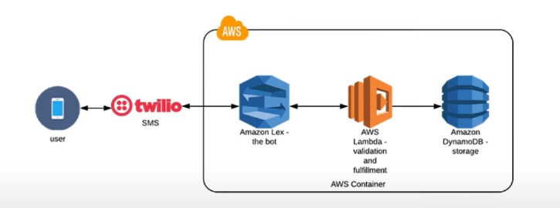
ARCHITECTURE:

Slide 5
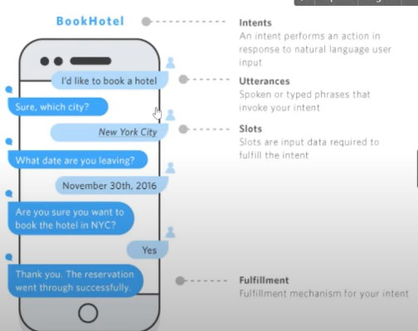
WORK FLOW

Slide 6
CONCLUSION
Amazon Lex: For building conversational interfaces.
Amazon Lambda: For running code in response to chatbot requests.
Amazon S3: For storing data like chat logs or reference information.
Amazon DynamoDB: For database operations if you need to store structured data.

Slide 7


