Slide 1


EXECUTIVE BOARD PROPOSAL
TM Pick n Pay Express
Evolving Click & Collect into Diaspora-to-Door delivery
Prepared for the Executive Board · TM Pick n Pay Zimbabwe & Meikles Limited

Slide 2
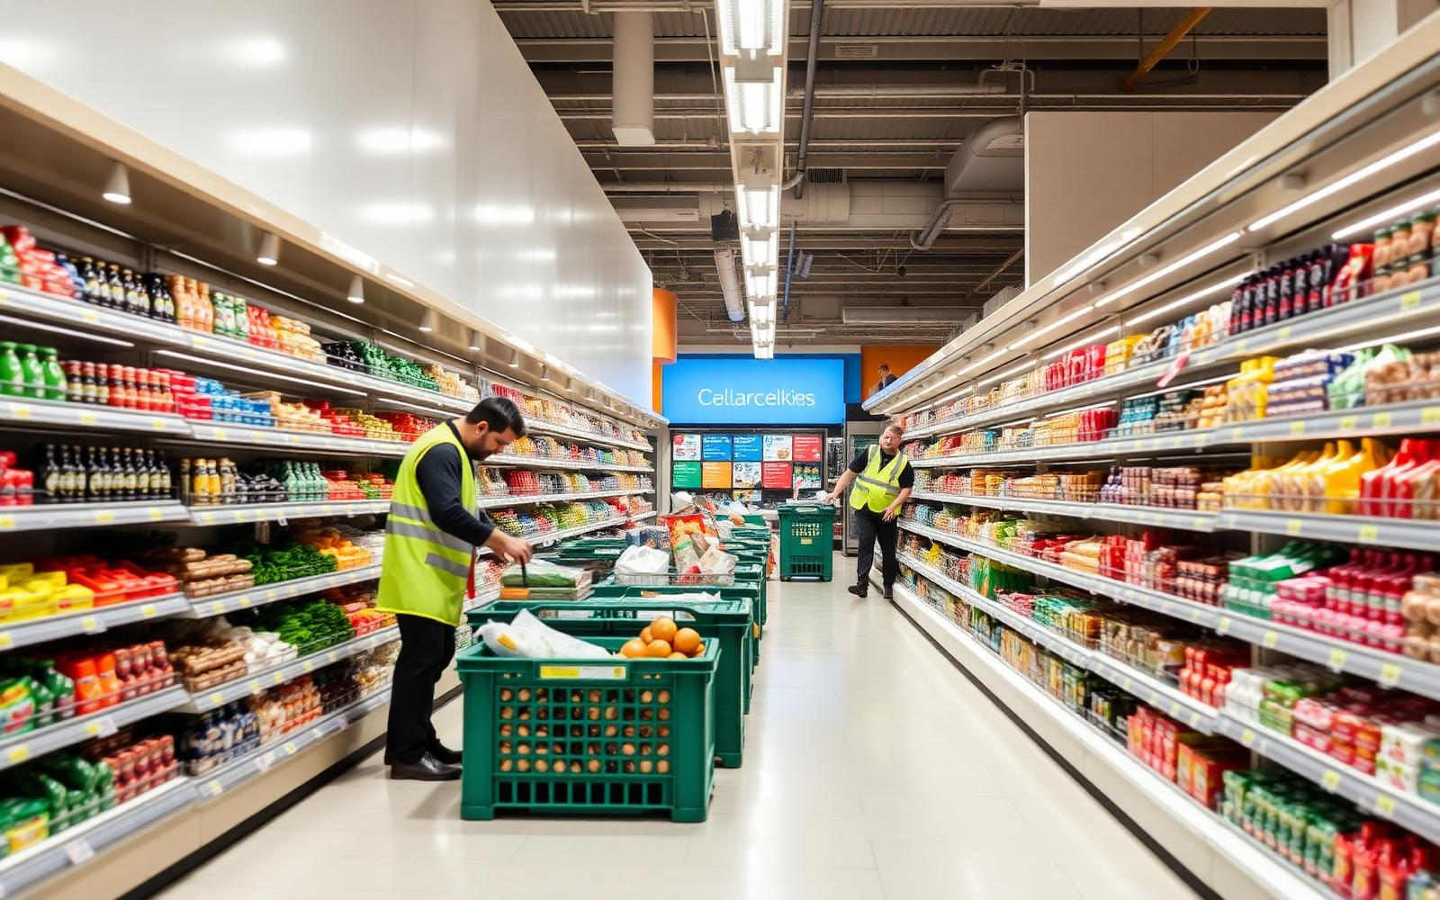
SLIDE 01 · THE OPPORTUNITY
01
Monetising the digital infrastructure you already own
The foundation
The optimization gap
Our value proposition
tmpnponline.co.zw and the dedicated app are already live, running localized Click & Collect across the estate.
Collection demands transport, fuel and time. Diaspora buyers still pay Malayitsha vans purely for doorstep convenience.
A Diaspora UI mode plus a decentralised last-mile network turns 57+ branches into on-demand fulfilment nodes.
TM Pick n Pay Express — Diaspora-to-Door
Confidential · Executive Board Proposal

Slide 3
SLIDE 02 · STATUS QUO VS EVOLUTION
02
Bypassing physical logistics friction
Current system — Click & Collect
Diaspora shopper
Web / app order
Recipient must travel
Urban branches only
The evolution — On-demand diaspora engine
Diaspora shopper
Targeted ads
Pure US$ gateway
Bike courier
Recipient's door
Rural and elderly recipients cannot easily reach a flagship urban branch to collect heavy hampers.
Door-to-door fulfilment adds sponsors who want confirmation that food arrived safely.
TM Pick n Pay Express — Diaspora-to-Door
Confidential · Executive Board Proposal

Slide 4
SLIDE 03 · P&L ASSUMPTIONS
03
Monetising every stage of the cross-border basket
40,000
1.5
US$85
12
Active diaspora customers
Orders per month
Average basket size
Months
ANNUAL GROSS MERCHANDISE VALUE
40,000 customers × 1.5 orders × US$85 × 12 months — migrated from cash remittances and Malayitsha vans into a tracked US$ retail pipeline.
US$61,200,000
TM Pick n Pay Express — Diaspora-to-Door
Confidential · Executive Board Proposal

Slide 5
SLIDE 03 · FIVE REVENUE STREAMS
04
Five stacked revenue streams
1. Retail product margins
2. Last-mile delivery share
3. Cross-border surcharge
Spread captured on goods otherwise bought in South African cash-and-carries. 21% gross margin.
US$4.50 fee within 10km; the platform retains US$1.50 net per drop.
3% checkout fee on international cards originating outside Zimbabwe.
US$12,852,000
US$1,080,000
US$1,836,000
4. Diaspora Priority tiers
5. Retail media network
TOTAL ECOSYSTEM
US$8.99/month for free delivery and recurring staple baskets. 15% adoption.
FMCG brands bid for sponsored placement in front of high-spend diaspora buyers.
US$17,149,680
US$647,280
US$734,400
Projected annual revenue
TM Pick n Pay Express — Diaspora-to-Door
Confidential · Executive Board Proposal

Slide 6
SLIDE 04 · REVENUE BREAKDOWN
05
Projected total ecosystem annual revenue
US$17,149,680
Incremental retail margins
US$12,852,000
21% gross retail margin
Last-mile delivery share
US$1,080,000
US$1.50 net per drop
Cross-border tech surcharge
US$1,836,000
3% on international cards
Diaspora Priority subscriptions
US$647,280
6,000 subscribers @ US$8.99
Supplier-funded retail media
US$734,400
1.2% of platform GMV
TM Pick n Pay Express — Diaspora-to-Door
Confidential · Executive Board Proposal

Slide 7
SLIDE 05 · BUSINESS MODEL OPTIONS 1–2
06
Aligning risk, capital and structure
OPTION 1
Independent Concierge
OPTION 2
White-Label Licensing
We operate as a standalone entity mirroring your catalog via API. Senders pay us in US$; we buy stock at a negotiated wholesale discount and fulfil with our own driver network.
We build the cross-border storefront extension and license it to TM PnP. It integrates into tmpnponline.co.zw, natively branded, fulfilled by third-party Zimbabwean couriers.
SETUP
MONTHLY
REVENUE
SETUP
MONTHLY
REVENUE
US$15,000
US$8,500
5–8% markup + 3–5% rebate
US$25,000
US$2,000
US$40k + US$3.5k/mo or 1.5–2% GMV
TM Pick n Pay Express — Diaspora-to-Door
Confidential · Executive Board Proposal

Slide 8
SLIDE 05 · BUSINESS MODEL OPTIONS 3–4
07
Partnership and hybrid structures
OPTION 3
Tripartite Joint Venture
OPTION 4
Remittance Tokens
PnP + Quatrohaus / Code Virtus + our firm. We provide the cross-border framework, payment tunnels and diaspora marketing; branch staff pick, third-party bike networks deliver.
Diaspora shoppers buy a US$ Eco-Voucher: auto-dispatch a staple hamper by bike courier, or push a secure barcode via SMS/WhatsApp for in-store redemption, bypassing cash-out queues.
SETUP
MONTHLY
REVENUE
SETUP
MONTHLY
REVENUE
US$5,000
Absorbed in IT budget
60 / 20 / 20 net profit split
US$10,000
US$3,000
4–6% commission + float yield
TM Pick n Pay Express — Diaspora-to-Door
Confidential · Executive Board Proposal

Slide 9
SLIDE 06 · CONFIGURATION MATRIX
08
Commercial model comparison
Metric | 1 · Reseller | 2 · White-Label | 3 · Joint Venture | 4 · Voucher Hybrid
Upfront capital | US$15,000 | US$25,000 | US$5,000 | US$10,000
Operational effort | Extremely high | Very low | Low (oversight) | Medium
Time to market | 3–4 months | 4–5 months | 1–2 months | 2 months
Primary revenue | Product markups | Licensing fees | Net profit pool | Commission + float
TM PnP risk tier | Zero risk | Technology buyer | Co-owner | Channel partner
TM Pick n Pay Express — Diaspora-to-Door
Confidential · Executive Board Proposal

Slide 10
SLIDE 07 · CRITICAL INTEGRATIONS
09
Building beyond the current platform
Three new components layer over the existing web framework.
Geo-fenced marketing core
API logistics middleware
Real-time substitution logic
Hyper-targeted social and digital advertising aimed at high-density Zimbabwean pockets — Hillbrow and Randburg in South Africa, London and Leeds in the UK.
A dispatch interface linking the TM PnP back-end to localized courier networks and on-demand e-bike fleets for route optimisation and proof of delivery.
An automated WhatsApp bot lets the sender or recipient approve alternatives instantly when an item goes out of stock during picking.
TM Pick n Pay Express — Diaspora-to-Door
Confidential · Executive Board Proposal

Slide 11
SLIDE 08 · FIRST-MOVER ADVANTAGE
10
A defensive moat against OK Zimbabwe & Choppies
Market leadership
While competitors stay focused on brick-and-mortar or basic localized delivery, TM PnP becomes the definitive cross-border retail pipeline for the diaspora ecosystem.
Maximising group assets
Collection desks convert into high-volume dispatch stations, lifting stock turnover speed across all primary product lines.
TM Pick n Pay Express — Diaspora-to-Door

Slide 12
SLIDE 09 · VALUE PROPOSITION
11
What the platform uniquely delivers
White-label solution
Time-to-market advantage
Robust and secure platform
Bank-agnostic integration
Customizable platform retailers brand as their own, with flexible commercial models — subscription or commission-based.
Leverage existing integrations (API, SIM switch, payments) to launch quickly and capture customers before competitors.
A reliable, scalable and secure system compared to informal, unregulated channels.
Participation across multiple banks, expanding reach and customer access.
Critical mass creation
Hybrid commercial model
Adaptability to market dynamics
Direct-to-Consumer
Support in building user adoption through partnerships with banks and diaspora communities.
Transaction fees, subscription or discounts — flexibility for different business strategies.
Analytics to adjust pricing, packaging and delivery models as consumer behaviour shifts.
Moving beyond brick-and-mortar retail into a direct relationship with the shopper.
TM Pick n Pay Express — Diaspora-to-Door
Confidential · Executive Board Proposal

Slide 13
SLIDE 10 · BENEFITS
12
Benefits to TM Pick n Pay and the market
Faster market entry
Customer convenience
Expanded customer base
Existing developer integrations accelerate rollout.
Digital shift lets diaspora and local customers buy from anywhere.
Diaspora markets plus multiple banks' captured audiences.
Replacement of informal trading
Cross-border resilience
Economies of scale
A legitimate, tax-compliant alternative to unreliable channels.
Bypasses constraints on physical goods movement between countries.
Better prices and smaller packages matched to consumer cash flow.
Increased loyalty & retention
Revenue diversification
Scalability
Secure, reliable delivery builds trust vs informal traders.
Subscriptions, fees or discounts plus wholesale partnerships.
Regional expansion with packaging adapted to local needs.
Convenience-driven adoption
Government alignment
Small daily-use packages fit township and village habits.
Formalized trade supports taxation and regulation.
TM Pick n Pay Express — Diaspora-to-Door
Confidential · Executive Board Proposal

Slide 14
Turn 57+ branches into a diaspora fulfilment network
Recommended next step: select a commercial structure and mandate a 60-day pilot on two flagship Harare branches.
TM Pick n Pay Express
Thank you

