Slide 1


EXECUTIVE BOARD PROPOSAL
TM Pick n Pay Express
Evolving Click & Collect into Diaspora-to-Door delivery
Prepared for the Executive Board · TM Pick n Pay Zimbabwe & Meikles Limited

Slide 2
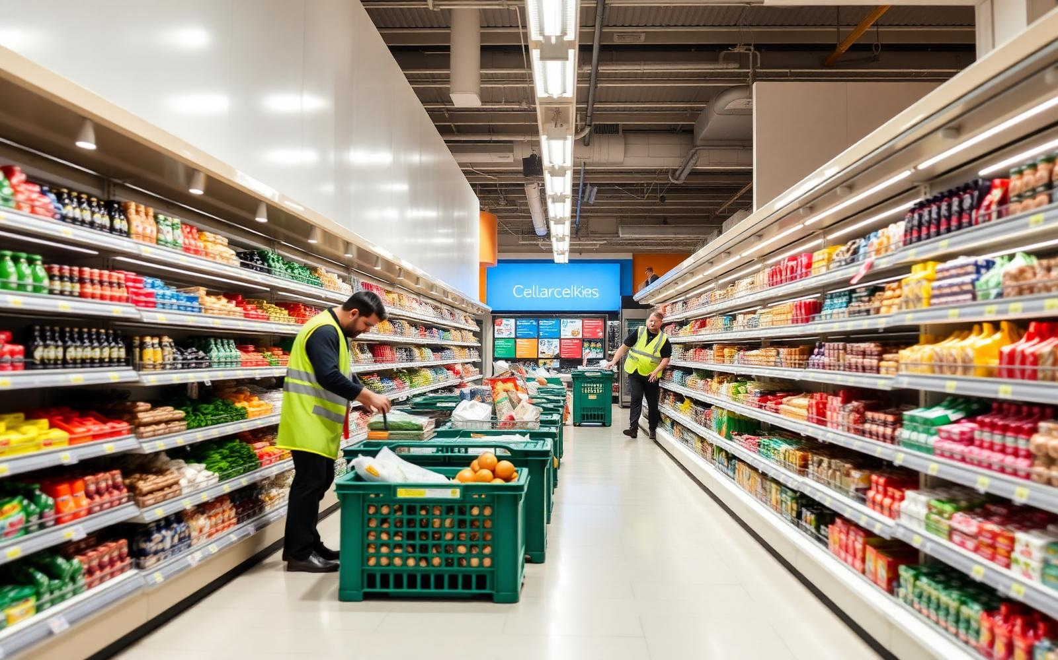
SLIDE 01 · THE OPPORTUNITY
01
Monetising the digital infrastructure you already own
The foundation
The optimization gap
Our value proposition
tmpnponline.co.zw and the dedicated app are already live, running localized Click & Collect across the estate.
Collection demands transport, fuel and time. Diaspora buyers still pay Malayitsha vans purely for doorstep convenience.
A Diaspora UI mode plus a decentralised last-mile network turns 57+ branches into on-demand fulfilment nodes.
TM Pick n Pay Express — Diaspora-to-Door
Confidential · Executive Board Proposal

Slide 3
SLIDE 02 · STATUS QUO VS EVOLUTION
02
Bypassing physical logistics friction
Current system — Click & Collect
Diaspora shopper
Web / app order
Recipient must travel
Urban branches only
The evolution — On-demand diaspora engine
Diaspora shopper
Targeted ads
Pure US$ gateway
Bike courier
Recipient's door
Rural and elderly recipients cannot easily reach a flagship urban branch to collect heavy hampers.
Door-to-door fulfilment adds sponsors who want confirmation that food arrived safely.
TM Pick n Pay Express — Diaspora-to-Door
Confidential · Executive Board Proposal

Slide 4
SLIDE 03 · P&L ASSUMPTIONS
03
Monetising every stage of the cross-border basket
40,000
1.5
US$85
12
Active diaspora customers
Orders per month
Average basket size
Months
ANNUAL GROSS MERCHANDISE VALUE
40,000 customers × 1.5 orders × US$85 × 12 months — migrated from cash remittances and Malayitsha vans into a tracked US$ retail pipeline.
US$61,200,000
TM Pick n Pay Express — Diaspora-to-Door
Confidential · Executive Board Proposal

Slide 5
SLIDE 03 · FIVE REVENUE STREAMS
04
Five stacked revenue streams
1. Retail product margins
2. Last-mile delivery share
3. Cross-border surcharge
Spread captured on goods otherwise bought in South African cash-and-carries. 21% gross margin.
US$4.50 fee within 10km; the platform retains US$1.50 net per drop.
3% checkout fee on international cards originating outside Zimbabwe.
US$12,852,000
US$1,080,000
US$1,836,000
4. Diaspora Priority tiers
5. Retail media network
TOTAL ECOSYSTEM
US$8.99/month for free delivery and recurring staple baskets. 15% adoption.
FMCG brands bid for sponsored placement in front of high-spend diaspora buyers.
US$17,149,680
US$647,280
US$734,400
Projected annual revenue
TM Pick n Pay Express — Diaspora-to-Door
Confidential · Executive Board Proposal

Slide 6
SLIDE 04 · REVENUE BREAKDOWN
05
Projected total ecosystem annual revenue
US$17,149,680
Incremental retail margins
US$12,852,000
21% gross retail margin
Last-mile delivery share
US$1,080,000
US$1.50 net per drop
Cross-border tech surcharge
US$1,836,000
3% on international cards
Diaspora Priority subscriptions
US$647,280
6,000 subscribers @ US$8.99
Supplier-funded retail media
US$734,400
1.2% of platform GMV
TM Pick n Pay Express — Diaspora-to-Door
Confidential · Executive Board Proposal

Slide 7
SLIDE 05 · BUSINESS MODEL OPTIONS 1–2
06
Aligning risk, capital and structure
OPTION 1
Independent Concierge
OPTION 2
White-Label Licensing
We operate as a standalone entity mirroring your catalog via API. Senders pay us in US$; we buy stock at a negotiated wholesale discount and fulfil with our own driver network.
We build the cross-border storefront extension and license it to TM PnP. It integrates into tmpnponline.co.zw, natively branded, fulfilled by third-party Zimbabwean couriers.
SETUP
MONTHLY
REVENUE
SETUP
MONTHLY
REVENUE
US$15,000
US$8,500
5–8% markup + 3–5% rebate
US$25,000
US$2,000
US$40k + US$3.5k/mo or 1.5–2% GMV
TM Pick n Pay Express — Diaspora-to-Door
Confidential · Executive Board Proposal

Slide 8
SLIDE 05 · BUSINESS MODEL OPTIONS 3–4
07
Partnership and hybrid structures
OPTION 3
Tripartite Joint Venture
OPTION 4
Remittance Tokens
PnP + Quatrohaus / Code Virtus + our firm. We provide the cross-border framework, payment tunnels and diaspora marketing; branch staff pick, third-party bike networks deliver.
Diaspora shoppers buy a US$ Eco-Voucher: auto-dispatch a staple hamper by bike courier, or push a secure barcode via SMS/WhatsApp for in-store redemption, bypassing cash-out queues.
SETUP
MONTHLY
REVENUE
SETUP
MONTHLY
REVENUE
US$5,000
Absorbed in IT budget
60 / 20 / 20 net profit split
US$10,000
US$3,000
4–6% commission + float yield
TM Pick n Pay Express — Diaspora-to-Door
Confidential · Executive Board Proposal

Slide 9
SLIDE 06 · CONFIGURATION MATRIX
08
Commercial model comparison
Metric | 1 · Reseller | 2 · White-Label | 3 · Joint Venture | 4 · Voucher Hybrid
Upfront capital | US$15,000 | US$25,000 | US$5,000 | US$10,000
Operational effort | Extremely high | Very low | Low (oversight) | Medium
Time to market | 3–4 months | 4–5 months | 1–2 months | 2 months
Primary revenue | Product markups | Licensing fees | Net profit pool | Commission + float
TM PnP risk tier | Zero risk | Technology buyer | Co-owner | Channel partner
TM Pick n Pay Express — Diaspora-to-Door
Confidential · Executive Board Proposal

Slide 10
SLIDE 07 · CRITICAL INTEGRATIONS
09
Building beyond the current platform
Three new components layer over the existing web framework.
Geo-fenced marketing core
API logistics middleware
Real-time substitution logic
Hyper-targeted social and digital advertising aimed at high-density Zimbabwean pockets — Hillbrow and Randburg in South Africa, London and Leeds in the UK.
A dispatch interface linking the TM PnP back-end to localized courier networks and on-demand e-bike fleets for route optimisation and proof of delivery.
An automated WhatsApp bot lets the sender or recipient approve alternatives instantly when an item goes out of stock during picking.
TM Pick n Pay Express — Diaspora-to-Door
Confidential · Executive Board Proposal

Slide 11
SLIDE 08 · FIRST-MOVER ADVANTAGE
10
A defensive moat against OK Zimbabwe & Choppies
Market leadership
While competitors stay focused on brick-and-mortar or basic localized delivery, TM PnP becomes the definitive cross-border retail pipeline for the diaspora ecosystem.
Maximising group assets
Collection desks convert into high-volume dispatch stations, lifting stock turnover speed across all primary product lines.
TM Pick n Pay Express — Diaspora-to-Door

Slide 12
SLIDE 09 · VALUE PROPOSITION
11
What the platform uniquely delivers
White-label solution
Time-to-market advantage
Robust and secure platform
Bank-agnostic integration
Customizable platform retailers brand as their own, with flexible commercial models — subscription or commission-based.
Leverage existing integrations (API, SIM switch, payments) to launch quickly and capture customers before competitors.
A reliable, scalable and secure system compared to informal, unregulated channels.
Participation across multiple banks, expanding reach and customer access.
Critical mass creation
Hybrid commercial model
Adaptability to market dynamics
Direct-to-Consumer
Support in building user adoption through partnerships with banks and diaspora communities.
Transaction fees, subscription or discounts — flexibility for different business strategies.
Analytics to adjust pricing, packaging and delivery models as consumer behaviour shifts.
Moving beyond brick-and-mortar retail into a direct relationship with the shopper.
TM Pick n Pay Express — Diaspora-to-Door
Confidential · Executive Board Proposal

Slide 13
SLIDE 10 · BENEFITS
12
Benefits to TM Pick n Pay and the market
Faster market entry
Customer convenience
Expanded customer base
Existing developer integrations accelerate rollout.
Digital shift lets diaspora and local customers buy from anywhere.
Diaspora markets plus multiple banks' captured audiences.
Replacement of informal trading
Cross-border resilience
Economies of scale
A legitimate, tax-compliant alternative to unreliable channels.
Bypasses constraints on physical goods movement between countries.
Better prices and smaller packages matched to consumer cash flow.
Increased loyalty & retention
Revenue diversification
Scalability
Secure, reliable delivery builds trust vs informal traders.
Subscriptions, fees or discounts plus wholesale partnerships.
Regional expansion with packaging adapted to local needs.
Convenience-driven adoption
Government alignment
Small daily-use packages fit township and village habits.
Formalized trade supports taxation and regulation.
TM Pick n Pay Express — Diaspora-to-Door
Confidential · Executive Board Proposal

Slide 14
SLIDE 14 · WHY NOW
15
Sell market access and intelligence — not “a diaspora solution”
Brick-and-mortar is no longer defensible
Buyers are price-led, not brand-led
Footfall retail cannot hold share on its own. The defensible asset is the customer relationship, not the store estate.
Households shop the cheapest basket available on the day. Informal channels are winning that comparison by default.
The Malayitsha channel is being constricted
The opening left behind
One-stop border posts, electronic travel authority and tighter vehicle declarations are squeezing the informal cross-border van trade.
Diaspora funding + bank rails + owned delivery + wholesale into the informal channel — a brand that lives in people's homes.
Positioning discipline: the pitch is market access and demand intelligence. Framed as a diaspora product, it reads as a niche remittance play and stalls in committee.
TM Pick n Pay Express — Diaspora-to-Door
Confidential · Executive Board Proposal

Slide 15
SLIDE 15 · DOWNSTREAM INNOVATION
16
The end state is a trading platform, not a single-retailer app
Phase 1 · Entry
Phase 2 · Depth
Phase 3 · End state
TM Pick n Pay value-add
Wholesale and informal channel
Retail-agnostic trading platform
Single-tenant. TM branded, TM catalogue, TM fulfilment. The platform earns its place inside one retailer before anything else is discussed.
TM supplies tuck shops and repackagers through the same rails. Volume grows without adding a competing banner to the storefront.
Shopper asks for cooking oil; the request goes to every participating supplier and the best price wins. Retailers become suppliers on a marketplace.
Multi-tenant has already been prototyped — three banners running in one app — then deliberately pulled back to a single tenant for the entry conversation.
Sequencing is the safeguard: introduce the platform as a TM advantage, without signalling that competitors sit on the same rails on day one.
TM Pick n Pay Express — Diaspora-to-Door
Confidential · Executive Board Proposal

Slide 16
SLIDE 16 · PRICE COMPARISON ENGINE
17
Item-level price comparison is the reason to participate
SHOPPER REQUEST · “COOKING OIL”
Comparison across every participating supplier
Supplier A · 2L cooking oil
US$3.10
Best price · 2.1km
One request fans out to all listed suppliers. The shopper sees price, distance and slot side by side and picks. Price competition, not shelf position, decides the sale.
Supplier B · 2L cooking oil
US$3.45
Faster slot · 0.8km
Supplier C · 2L cooking oil
US$3.60
Bundle offer
AI ranking of most-tradable items
Tuck shop · 500ml repack
US$0.95
The engine ranks demand by item, area and week — a what-to-stock signal feeding order-to-cash: buy the right depth, in the right pack size, before the demand lands.
Local fulfilment
TM Pick n Pay Express — Diaspora-to-Door
Confidential · Executive Board Proposal

Slide 17
SLIDE 17 · THE REVENUE MODEL
18
Anything that allows a subscription is the model
Rider fees
Advertising
Garage services
Scooter rent-to-buy instalments, then a standing platform fee per dollar earned.
Scooter livery, in-app placement and supplier media sold as monthly inventory.
Servicing, parts and accessories on a maintenance plan, not a per-repair invoice.
Tenant fees
Shopper plans
Data products
Each retailer, wholesaler and tuck shop pays a tiered monthly platform fee.
Priority delivery and family basket sharing on a recurring plan.
Demand and price intelligence licensed by subscription to suppliers.
Every line above is bent toward recurring revenue. One-off transaction fees fund a project; recurring fees fund a company and give the valuation a base to stand on.
TM Pick n Pay Express — Diaspora-to-Door
Confidential · Executive Board Proposal

Slide 18
SLIDE 18 · CONSOLIDATED REVENUE MODEL
19
One consolidated revenue model
PHASE 1 · MODELLED TODAY
PHASE 2 · RECURRING LAYER ADDED
Retail product margins
US$12,852,000
Tenant platform fees
21% margin on migrated basket · Transactional
Tiered monthly fee per retailer and tuck shop
Last-mile delivery share
US$1,080,000
Rider plans
US$1.50 net per drop · Transactional
Rent-to-buy instalment, then a standing platform fee
Cross-border surcharge
US$1,836,000
Garage & maintenance plans
3% on international cards · Transactional
Monthly servicing and parts cover, not per repair
Diaspora Priority plans
US$647,280
Data & price intelligence
6,000 subscribers @ US$8.99 · Recurring
Demand and pricing feeds licensed to suppliers
Retail media network
US$734,400
1.2% of platform GMV · Semi-recurring
Shopper plans
Priority delivery and shared family baskets
Total ecosystem
US$17,149,680
Pricing per tier still to be set — annual values [TBC] until tenant and rider counts are agreed.
TM Pick n Pay Express — Diaspora-to-Door
Confidential · Executive Board Proposal

Slide 19
SLIDE 19 · FUTURE REVENUE MIX
20
From transaction-led to subscription-led as the platform goes agnostic
LAUNCH
SCALE
AGNOSTIC
Diaspora-to-door on TM stock
Second and third retailers onboard
Marketplace of retailers and tuck shops
Retail margin, delivery share and the cross-border surcharge carry the model. One recurring line: Diaspora Priority at US$647,280.
Tenant platform fees, rider plans and garage plans start billing monthly. Transaction fees stay, but stop being the whole story.
Subscriptions across tenants, riders, shoppers and data become the base load; commission rides on top as upside.
Same ecosystem, valued differently: transaction fees fund a project, recurring fees fund a company.
TM Pick n Pay Express — Diaspora-to-Door
Confidential · Executive Board Proposal

Slide 20
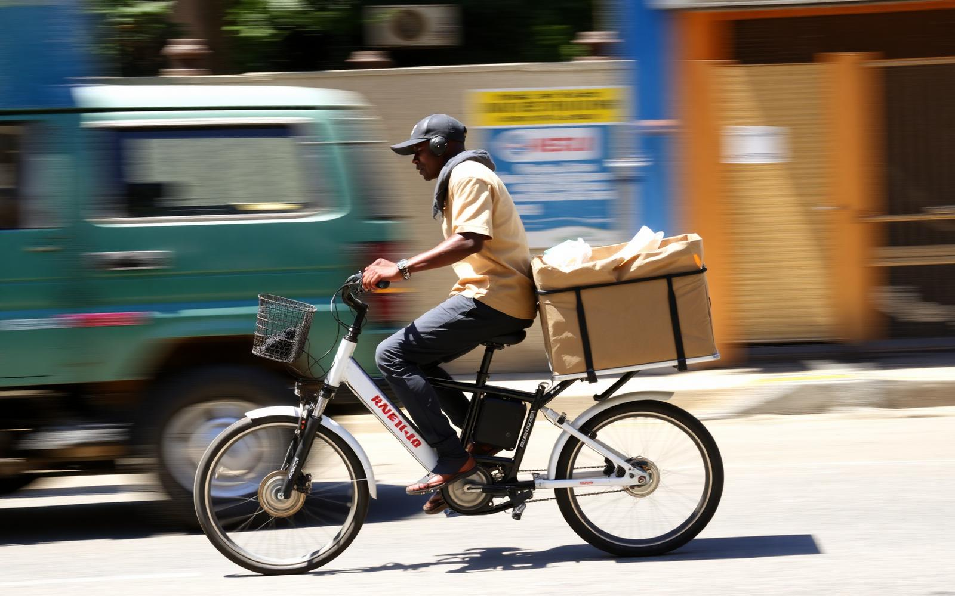
SLIDE 20 · OWNED DELIVERY NETWORK
21
The last mile is owned, not outsourced
500–2,000
12 months
~5 months
~10%
Platform-owned electric scooters
Rent-to-buy, then the rider owns it
Asset pays itself back
Platform fee per dollar earned after ownership
Rent-to-buy
Advertising rights
Own the garage
The rider operates for twelve months and then owns the scooter. The asset repays itself in roughly five months; months six to twelve are margin.
Livery is sold on subscription: 80% reserved for the anchor retailer, 20% open inventory. A moving media network across every delivery route.
Repairs, parts and accessories stay inside the platform on a maintenance plan. Electric tricycles extend the fleet into rural routes, with women riders as the first cohort.
TM Pick n Pay Express — Diaspora-to-Door
Confidential · Executive Board Proposal

Slide 21
SLIDE 21 · LOYALTY & DEVICE MIGRATION
22
Trade US$100 a month for five months — earn the handset
Month 1
Month 2
Month 3
Month 4
Month 5
US$100 traded
US$100 traded
US$100 traded
US$100 traded
5G-lite smartphone awarded
Discovery-Vitality mechanics
Family basket sharing
The real purpose
Consecutive qualifying months unlock the reward. Behaviour is earned, not bought, and the tier resets if trading lapses.
Several household members contribute to one qualifying basket, so families reach the threshold faster and consolidate spend on the platform.
A ~US$50 landed handset with the markup absorbed migrates 2G and 3G users onto the platform. Device cost is customer acquisition, booked as such.
TM Pick n Pay Express — Diaspora-to-Door
Confidential · Executive Board Proposal

Slide 22
SLIDE 22 · PAYMENT RAILS
23
Bank-agnostic by design, multi-bank in practice
What we say to banks
What we say to the retailer
Plug your remittance APIs into the platform and we bring transaction share-of-wallet: recurring diaspora flows landing as retail settlement rather than cash-out.
No exclusivity is requested and none is given. Every rail is one integration among several, so pricing stays competitive and no single institution gates the platform.
Banks bring critical mass. Their diaspora bases are already captured audiences; the platform converts those balances into baskets inside your estate.
Institutions under discussion are prospects at this stage. Nothing is presented in-app as a confirmed partnership until an agreement is signed.
Design rule: no bank-specific logic in the core. Rails are adapters, so adding or dropping an institution is a configuration change, never a rebuild.
TM Pick n Pay Express — Diaspora-to-Door
Confidential · Executive Board Proposal

Slide 23
SLIDE 23 · WHOLESALE & INFORMAL CHANNEL
24
Tuck shops become distribution extensions, not competitors
STEP 1
STEP 2
STEP 3
STEP 4
Aggregate
Fulfil locally
Repackage
Supply
Local orders in a suburb are pooled in the app rather than fragmented across trips.
The nearest tuck shop picks and hands over, cutting distance, fuel and delivery cost.
Bulk stock is broken into the 200g-type pack sizes the market actually buys.
The retailer sells bulk into the channel as a wholesaler and keeps the volume.
Pack size is the unlock
The government argument
Households buy 200g, not 2kg. The retailer sells bulk to the tuck shop, the tuck shop repackages to the price point the street can afford — the small-multipack playbook proven by packaged brands expanding regionally.
Routing informal trade through the platform makes it visible: tax is captured, stock is traceable and counterfeit product is squeezed out. Legitimisation, not enforcement.
TM Pick n Pay Express — Diaspora-to-Door
Confidential · Executive Board Proposal

Slide 24
SLIDE 24 · COMMERCIAL & ENTITY STRUCTURE
25
Hybrid commercial model, two-country structure
White-label
Subscription
Commission
The storefront and app ship under the retailer's brand, licensed rather than sold.
Tiered monthly platform fees per tenant, opening at a 100,000-participant tier.
A thin transaction share on GMV, sitting on top of the recurring base.
South African company
Zimbabwean subsidiary
Holds the platform IP and raises capital where liquidity and investor access are deepest. Contracts with tenants and banks sit here.
Runs logistics, the scooter fleet and local agreements on the ground, with local employment and local regulatory standing.
Directional as at 13 August — structure to be confirmed with tax and legal counsel before any binding term sheet.
TM Pick n Pay Express — Diaspora-to-Door
Confidential · Executive Board Proposal

Slide 25
Turn 57+ branches into a diaspora fulfilment network
Recommended next step: select a commercial structure and mandate a 60-day pilot on two flagship Harare branches.
TM Pick n Pay Express
Thank you

