Slide 1
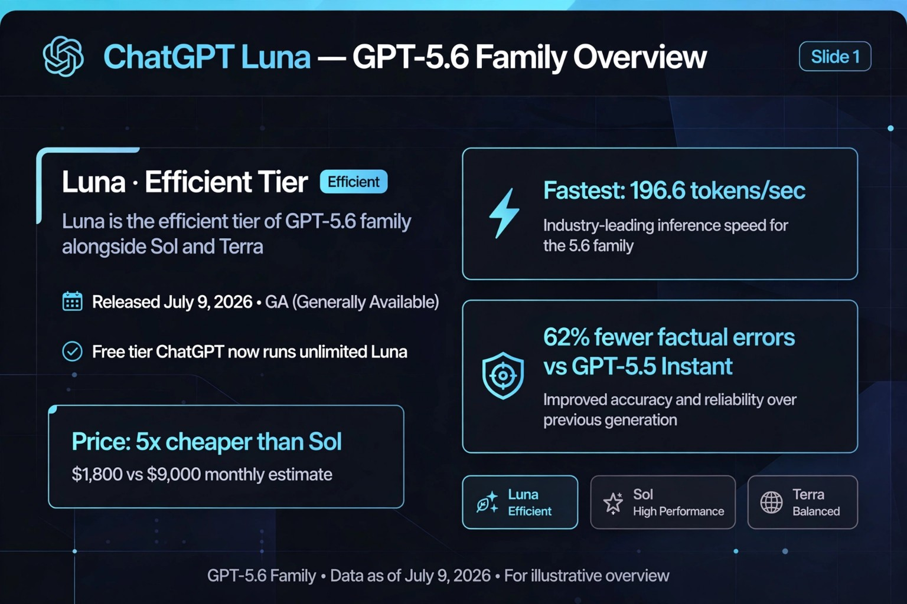

Slide 2
✦
ChatGPT Luna — GPT-5.6 Family Overview
Slide 1
Luna · Efficient Tier
Efficient
ϟ
Fastest: 196.6 tokens/sec
Luna is the efficient tier of GPT-5.6 family
alongside Sol and Terra
Industry-leading inference speed for the 5.6 family
▣ Released July 9, 2026 · GA (Generally Available)
✥
62% fewer factual errors
vs GPT-5.5 Instant
✓ Free tier ChatGPT now runs unlimited Luna
Improved accuracy and reliability over previous generation
Price: 5x cheaper than Sol
✣ Luna
Efficient
★ Sol
High Performance
◎ Terra
Balanced
$1,800 vs $9,000 monthly estimate
GPT-5.6 Family · Data as of July 9, 2026 · For illustrative overview

Slide 3
1. How to Train
How an AI model is prepared before deployment
Large and diverse datasets are used for training.
The model learns language patterns and reasoning from the data.
Human feedback is used to improve the quality of responses.
Testing and safety evaluation are done before deployment.
2

Slide 4
2. Benchmark
Benchmark means testing how well the model performs.
Reasoning
Mathematics
Coding
Knowledge
Model evaluation
Model evaluation
Model evaluation
Model evaluation
Language understanding
Following instructions
Safety
Model evaluation
Model evaluation
Model evaluation
“Benchmarks help us compare the performance of different AI models.”
3

Slide 5
3. Analyst
What ChatGPT 5 Series can do with information
Analyst
ChatGPT 5 Series can analyze large amounts of information, understand user requirements, identify patterns, and provide useful insights.
Analyze
Understand
Insights
Understand information and identify patterns.
Interpret requirements and context.
Provide useful, actionable insights.
4

Slide 6
4. Tasks
Common tasks supported by ChatGPT
Answer questions
Analyze data and documents
Generate text and ideas
AI-assisted task
AI-assisted task
AI-assisted task
Write and explain code
Summarize information
Help with problem solving
AI-assisted task
AI-assisted task
AI-assisted task
5

Slide 7
5. Industrial Applications
Examples across different industries
Healthcare
Education
Banking
Document summarization and administrative support
Tutoring and content creation
Customer support and document analysis
IT
Retail
Manufacturing
Coding and troubleshooting
Product support and customer service
Documentation and process assistance
6

Slide 8
6. Challenges
Important limitations and considerations
It can sometimes give incorrect information.
It may misunderstand complex requirements.
Privacy and data security are important.
Human verification is needed for critical decisions.
Key idea: AI is powerful, but human judgment remains important.
7

Slide 9
Thank You
ChatGPT 5 Series
Train → Benchmark → Analyze → Apply → Verify
Questions?

