Slide 1
Data Model in Memory & Disk

Slide 2
Agenda
Data path on x86 architecture
Cache on CPU
How does disk work
Data models in action

Slide 3
Principle of locality
Programs tend to reuse data and instructions they have used recently, or related storage locations, are frequently accessed.
Types
temporal locality
spatial locality
Optimization techs
caching
prefetching
Relevance
Structure of program
Linear data structure
Use efficiency for memory hierarchy
CPU Registers → L1 CPU cache → L2 CPU cache → L3 CPU cache → Main Memory → Disk

Slide 4
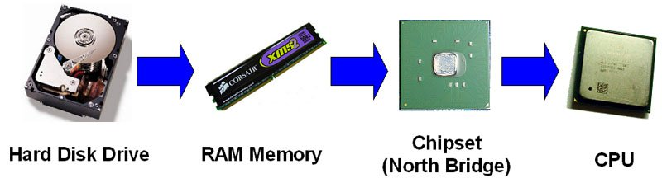
Data Access Model
Data path
Principle of locality
ReadAhead & Prefetch on Disk
Transfer rates of all components differ, that’s the question!
Notes:
The data paths is the path composed of all hardware components that are needed to get the data from the disk drive to the CPU.
It is important to understand the different transfer rates of each component of the server's disk subsystem and of the network. This information helps you to identify potential bottlenecks that can throttle your overall performance.

Slide 5
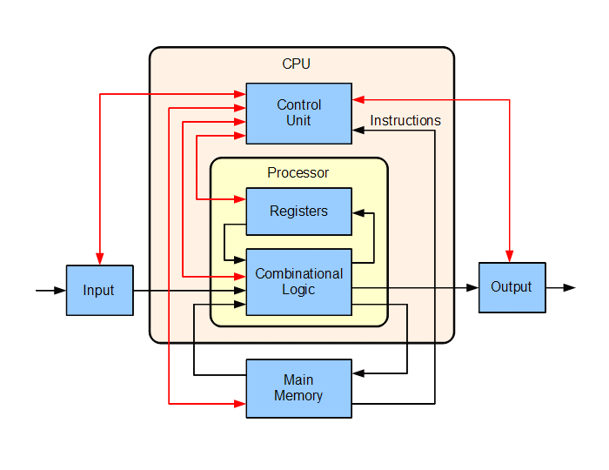
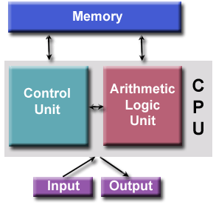
Computer Architecture
von Neumann Architecture

Slide 6
Data Path on x86/x64
read
CPU
write
Processor1
NUMA node1
Processor2
NUMA node2
Core 1
Core 2
Core 3
Core 4
L1
L1
cache
L1
L1
L2
L2
L2
L2
L3
L3
Main Memory
File System
IO Scheduler
DMA
Disk
Notes:
In a write-through cache, every write to the cache causes a write to main memory. Alternatively, in a write-back or copy-back cache, writes are not immediately mirrored to the main memory, and the cache instead tracks which locations have been written over, marking them as dirty. The data in these locations is written back to the main memory only when that data is evicted from the cache. For this reason, a read miss in a write-back cache may sometimes require two memory accesses to service: one to first write the dirty location to main memory, and then another to read the new location from memory.
Cached data from the main memory may be changed by other entities. Communication protocols between the cache managers that keep the data consistent are known as cache coherence protocols.

Slide 7
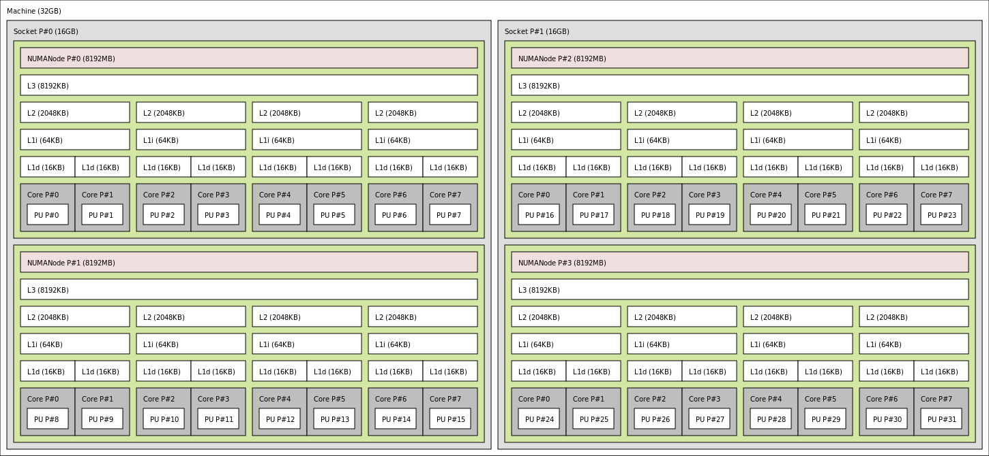
Memory hierarchy of an AMD Bulldozer server

Slide 8
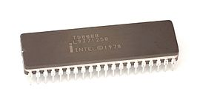
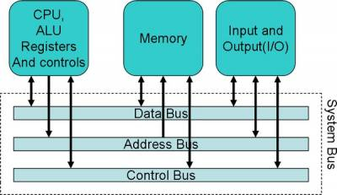
History of cache on chips
Intel 8086, 8088 (1978)
First x86, original 4.77Mhz, no cache.
CPU accesses the memory directly.
Read path:
The CPU puts the address it want to read on the memory bus and assert the read flag.
Memory puts the data on the data bus.
The CPU copies the data from the data bus to its internal registers.

Slide 9
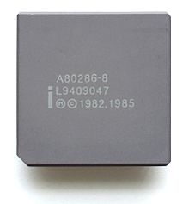
History of cache on chips
80286 (1982)
6-25Mhz, still no cache.
The speed of memory access started to be slower than core. Delay occurred between core and memory (as core 20Mhz).
Read path:
The CPU puts the address on the memory bus and assert the read flag.
Memory starts to put the data on the data bus. The CPU waits
Memory finished getting the data and it is now stable on the data bus
The CPU copies the data from the data bus to its internal registers.
Speed between memory & core mismatched.
That is why we would have cache…

Slide 10
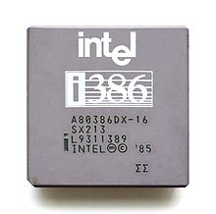
History of cache on chips
80386 (1985)
12-40Mhz, L1 cache on motherboard.
Core runs faster,
RAM gets faster, but not as much faster as CPUs.
Read path:
Check if the data is already in the cache.
If cache hit, read from the much faster cache.
Else, go as 80286.

Slide 11
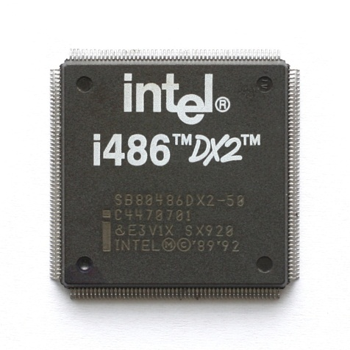
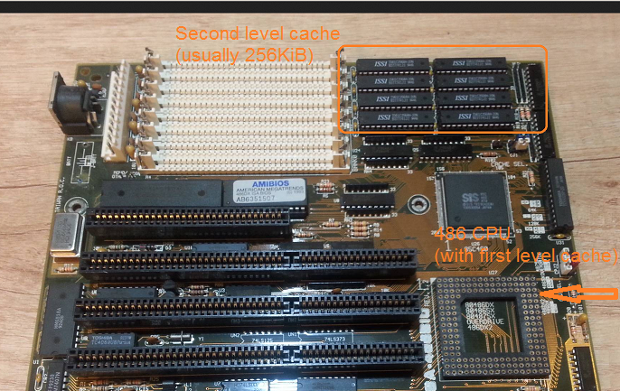
History of cache on chips
80486 (1989)
16-150Mhz, L1 cache on CPU & L2 added.
A 8KB unified cache used for data and instructions.
L1 cache on CPU, L2 cache on motherboard.
Read path:
L1 cache.
L2 cache.
Main memory.

Slide 12

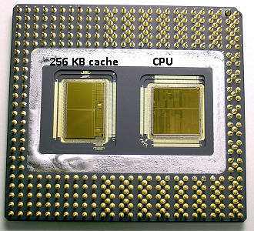
History of cache on chips
80586/Pentium (1993)
60-200Mhz, L1 cache was split(L1d & L1i).
L1: 8 KB each for data and instructions for individually use.
Chip contains two dies. One with the actual core and L1 cache, and a second die with 256KB L2 cache.
Read path:
L1 cache(split by instru & data).
L2 cache.
Main memory.

Slide 13
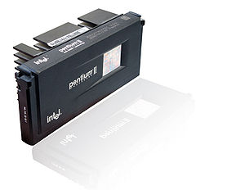
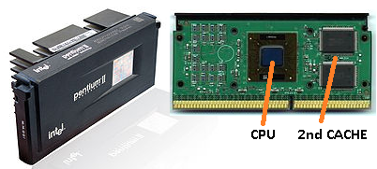
History of cache on chips
Pentium 2 (1997)
66-100Mhz, L2 cache no more on chip.
Components on chip became smaller, financially.
With one L1 cache per CPU core and a larger but slower L2 cache next to the core.
Read path:
L1 cache(split by instru & data).
L2 cache.
Main memory.

Slide 14
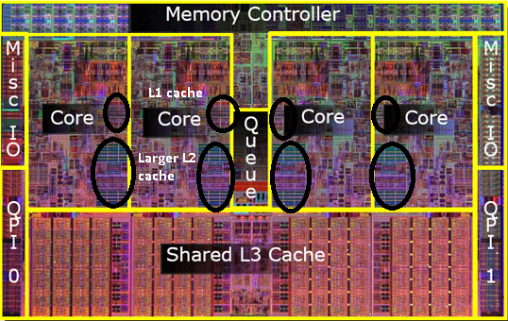
History of cache on chips
Pentium 4 (2000) & later
1.3-3.8Ghz, L3 cache added.
Reach a limit on single CPU’s clock.
How to solve (3 ways):
Make the CPUs more efficient, so they do more work at the same speed.
Use multiple CPUs(multi chips), UMA & SMP.
Use multiple CPUs in the same 'chip‘, NUMA.
A “dual core” CPU occurred, two or more separate CPU cores are build into a single chip.
“NUMA” architecture became famous.
L3 cache(larger and slower) shared with all CPU cores

Slide 15
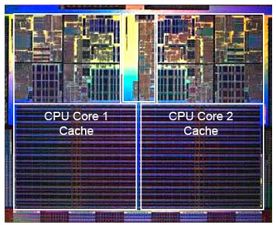
An Example
Intel Intel® Core™ i7 Processor
A 32-KB instruction and 32-KB data first-level cache (L1) for each core
A 256-KB shared instruction/data second-level cache (L2) for each core
8-MB shared instruction/data last-level cache (L3), shared among all cores
Photo of processor chip.
Cache takes significant area on chip

Slide 16
Data Layer
Core in Processor(load instructions & data)
Cache(L1, L2, or L3, blocked by “cache line”)
Main memory(blocked by “page”)
File system(blocked by “file block”)
Disk(blocked by “sector”)
CPU Stalls
Cache hit/miss
Swap in/out
IO await

Slide 17
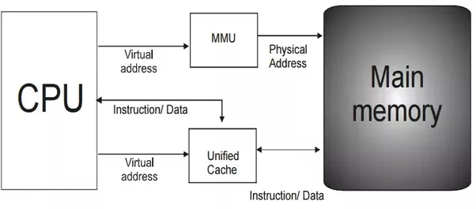

Slide 18
CPU Cache
Cache type
Cache structure
Cache addressing
Cache associativity
Cache policy(write & replacement)
Cache hit/miss
Cache hierarchy in CPU
Notes:
three independent caches: an instruction cache to speed up executable instruction fetch, a data cache to speed up data fetch and store, and a translation lookaside buffer (TLB) used to speed up virtual-to-physical address translation for both executable instructions and data.

Slide 19
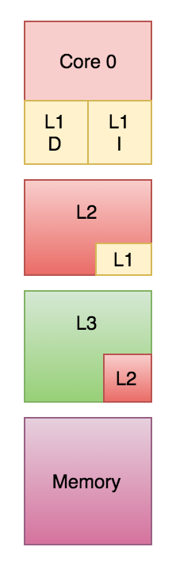
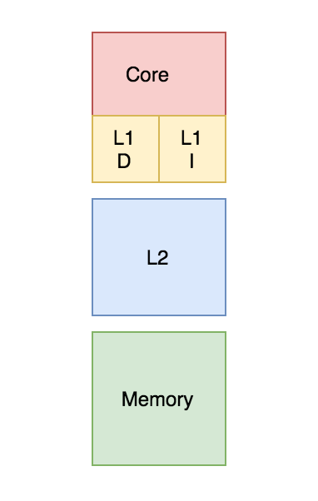
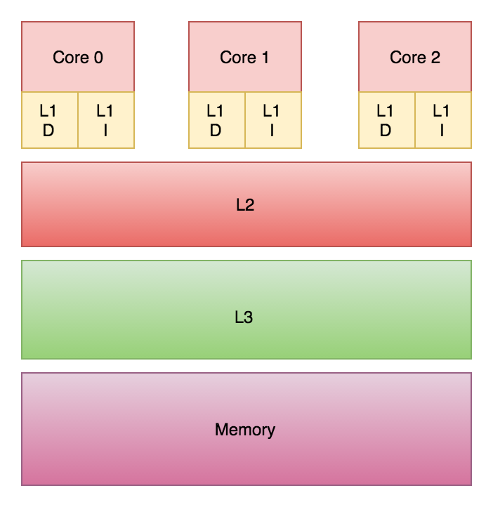

Slide 20
How the cache memory works
Cache structure
Cache address
“Cache Entry”
tag
data block(64 bytes)
flag bits
Containing address of actual data from main memory
“Cache Line”
Containing the actual data fetched from main memory
For instruction: a valid bit
For data: a valid bit & a dirty bit
tag(MSB)
index(LSB)
block offset
The most significant bits of the address from main memory.
The index of cache line that data in.
Index length = cell(log r) bits,
as r is cache lines capacity in cache.
The data offset in cache line.
Offset length = cell(log b) bits,
as b is bytes in data block.
Notes:
The data block (cache line) contains the actual data fetched from the main memory.
The tag contains (part of) the address of the actual data fetched from the main memory.
The Flag bits:
An instruction cache requires only one flag bit per cache row entry: a valid bit.
A data cache typically requires two flag bits per cache line – a valid bit and a dirty bit(have to be written back into main memory).
The index describes which cache row (which cache line) that the data has been put in.
The block offset specifies the desired data within the stored data block within the cache row.
The tag contains the most significant bits of the address, which are checked against the current row (the row has been retrieved by index) to see if it is the one we need or another, irrelevant memory location that happened to have the same index bits as the one we want. The tag length in bits is address_length - index_length - block_offset_length.

Slide 21
Chunk Conception

Slide 22
An example
Pentium 4 processor
4-way set associative L1 cache of 8KB
64-byte size of cache line
32 bits CPU address bus
8KB/64 = 128 cache lines
128/4 = 32 sets
tag | index | block offset
21 | 5 | 6
Notes:
Example
The original Pentium 4 processor had a four-way set associative L1 data cache of 8 KiB in size, with 64-byte cache blocks. Hence, there are 8 KB / 64 = 128 cache blocks. The number of sets is equal to the number of cache blocks divided by the number of ways of associativity, what leads to 128 / 4 = 32 sets, and hence 2⁵ = 32 different indices. There are 2⁶ = 64 possible offsets. Since the CPU address is 32 bits wide, this implies 21 + 5 + 6 = 32, and hence 21 bits for the tag field.
The original Pentium 4 processor also had an eight-way set associative L2 integrated cache 256 KB in size, with 128-byte cache blocks. This implies 17 + 8 + 7 = 32, and hence 17 bits for the tag field.^{[7]}

Slide 23
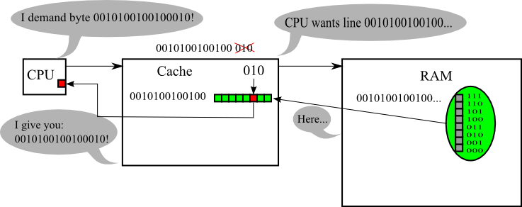
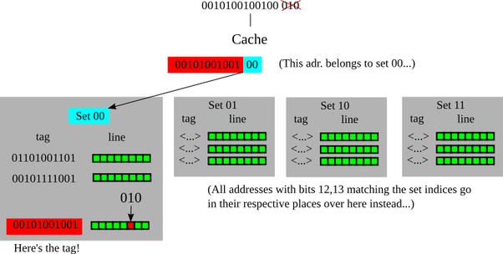
How the cache memory works
Cache addressing
Notes:
Data is transferred between memory and cache in blocks of fixed size, called cache lines or cache blocks. When a cache line is copied from memory into the cache, a cache entry is created. The cache entry will include the copied data as well as the requested memory location (called a tag).
When the processor needs to read or write a location in main memory, it first checks for a corresponding entry in the cache. The cache checks for the contents of the requested memory location in any cache lines that might contain that address. If the processor finds that the memory location is in the cache, a cache hit has occurred. However, if the processor does not find the memory location in the cache, a cache miss has occurred. In the case of a cache hit, the processor immediately reads or writes the data in the cache line. For a cache miss, the cache allocates a new entry and copies data from main memory, then the request is fulfilled from the contents of the cache.

Slide 24
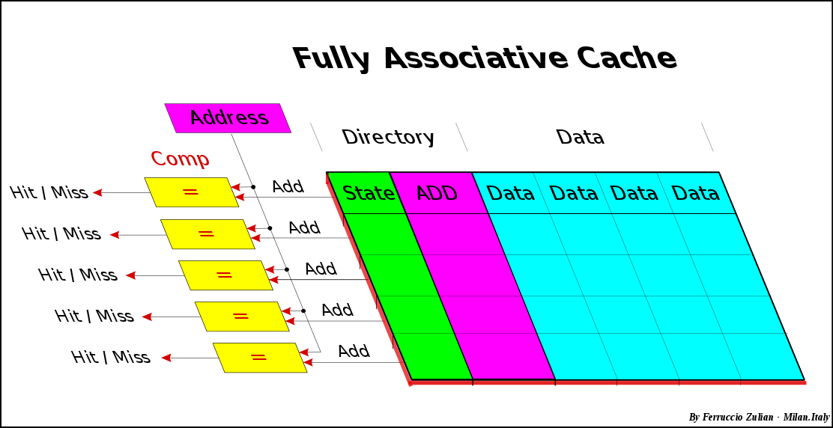
How the cache memory works
Fully associative cache
Any memory block can be stored in any cache location.
Very small and efficient, just used for TLB.

Slide 25
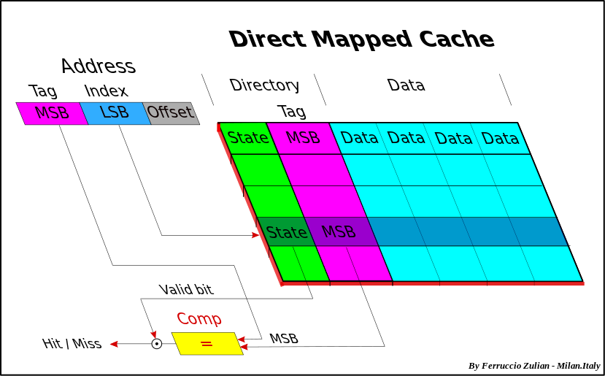
How the cache memory works
Direct mapped cache
Any memory block can be stored in one specific cache entry only.

Slide 26
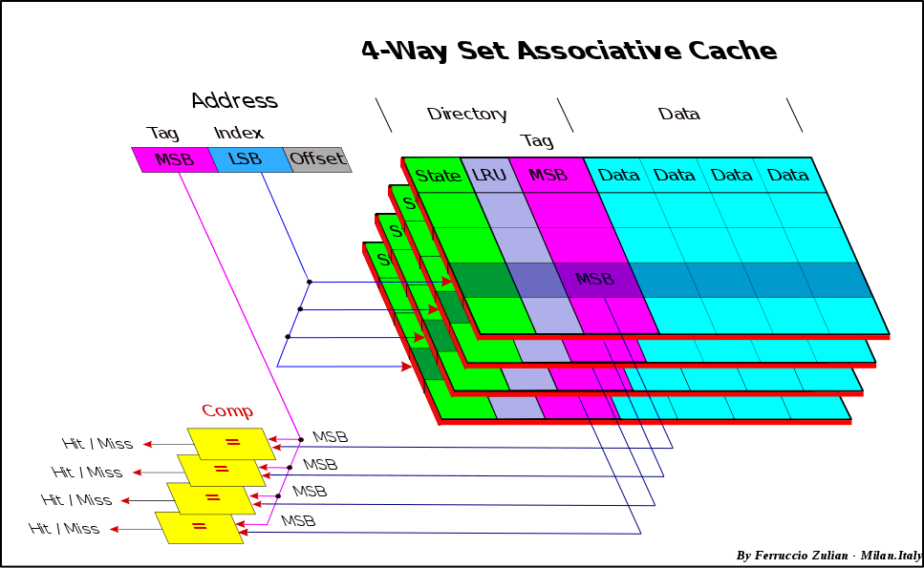
How the cache memory works
Set associative cache(multi-way-direct-mapped)
A combination of the two previous approaches,
Any memory block can be stored in any cache way, but only can be stored in one specific cache entry in that way.

Slide 27
Concurrency programming
Atomicity
Visibility of memory
Shared & mutable variables

Slide 28
Concurrency programming

Slide 29
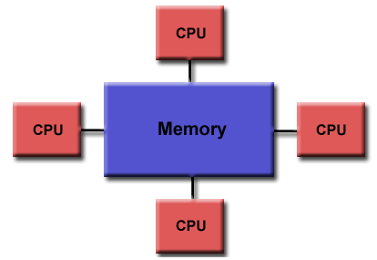
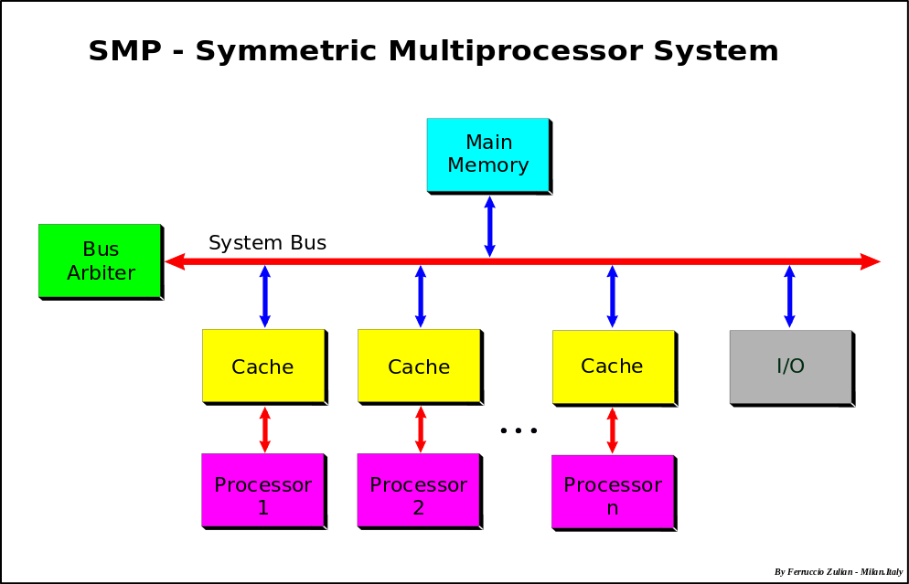
Memory Architectures
Uniform Memory Access (UMA)
Symmetric Multiprocessor (SMP)
Identical processors
Equal access and access times to memory
CC-UMA(Cache Coherent UMA)

Slide 30
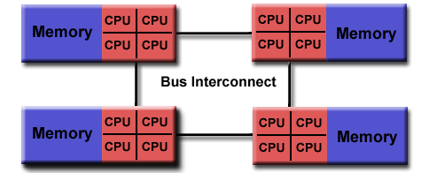
Memory Architectures
Non-Uniform Memory Access (NUMA)
Often made by physically linking two or more SMPs
One SMP can directly access memory of another SMP
Not equal access time to all memories between SMPs
Memory access across bus link is slower
CC-NUMA - Cache Coherent NUMA

Slide 31
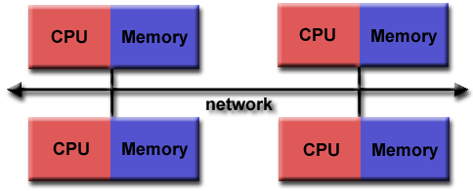
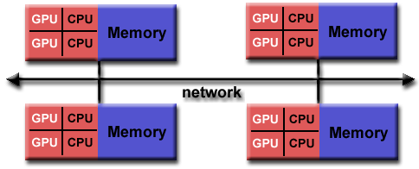
Memory Architectures
Distributed Memory
Distributed system
Based on network
Scalable but access time across nodes slower
Use commodity processor and machine, even hybrid components

Slide 32
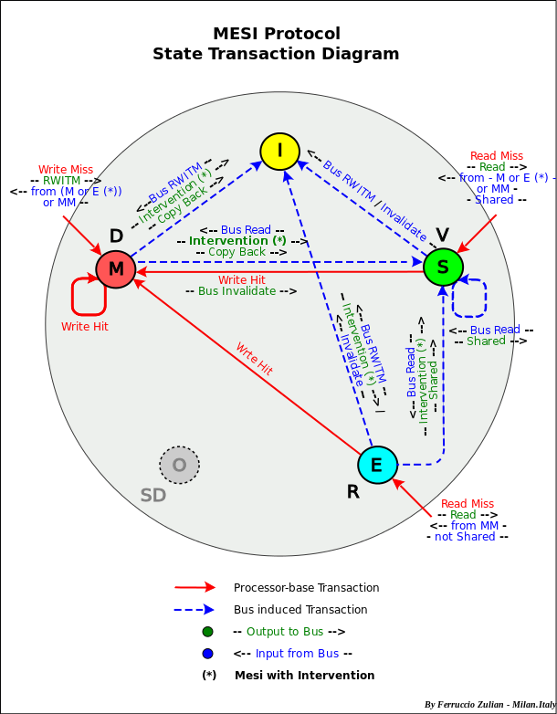
Memory Architectures
Cache coherent
If one processor updates the shared data in cache, all the other processors know about the update.
3 approaches of implementation
Bus watching or Snooping (used for SMP, hardware level)
Directory-based – message-passing (used in NUMA)
Shared cache (used for multi-core, e.g. L3)
Coherency protocols
MESI protocol
MOESI protocol
Based on State, and use of a bus "shared line" to detect "shared" copy in the other caches

Slide 33
Data Store Model
The layout of data in memory,
that is, Data Structure
The layout of data in file,
that is, File Format
The layout of data in network,
that is, Protocol
Notes:
数据在内存中的布局叫做“数据结构”，在文件中的布局叫做“文件格式”

Slide 34
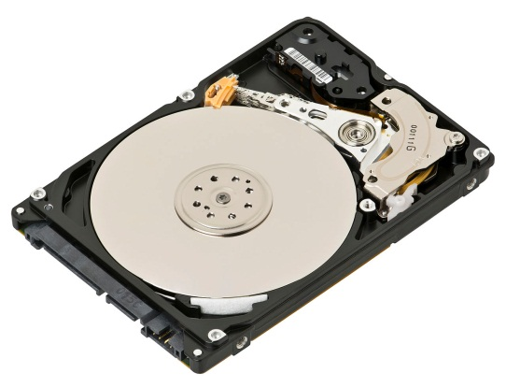
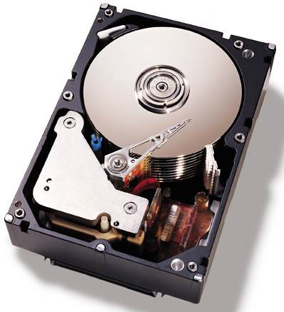
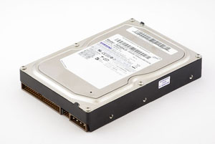
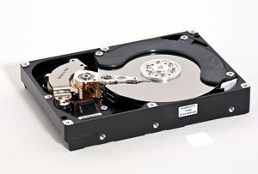
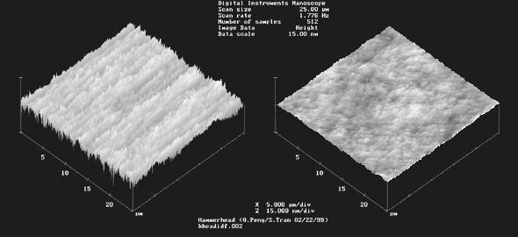
Hard Disk
Notes:
Hard disk platters are very smooth, right? Well, not to a scanning electron microscope! The image on the left is of the surface of an aluminum alloy platter; the one on the right is a glass platter. The images speak for themselves. The scale is in microns..
Principle of Writing and Reading
HDD uses the principle of magnetizing a material and works with two states of information – 0, 1.
Writing - Coil which is under electric current creates a magnetic field which is led through the core of the writing head inside the magnetic layer.
Reading - It is based on the principle of electromagnetic induction. That means that an electric current is inducted inside the coil when the head finds a change from 0 to 1 or vice versa.

Slide 35
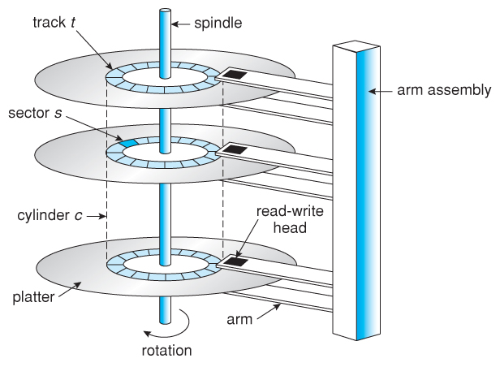
How to work?
Components
platter
side
head
arm
Some terms
Track
Cylinder
Sector (512Bytes)

Slide 36
Data layout on Sector
Sector header
Data area
ECC
Gaps
Read/write head
ECC
Sector gap for head & data
CRC
CHS
Address
512 bytes data
next sector
A total sector
Sector gap
before sector
...
Gap
Header
Data area
ECC
Gap
...
Notes:
error-correcting code (ECC)

Slide 37
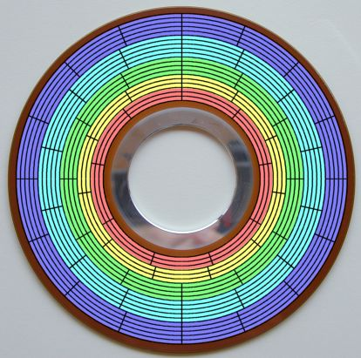
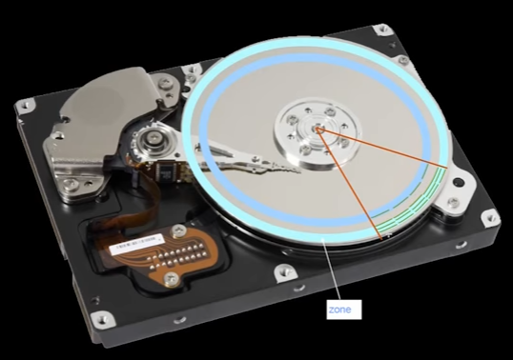
Confusing on bit density of sector
Zone Bit Recording
zone bit recording (ZBR) is a method used by disk drives to store more sectors per track on outer tracks than on inner tracks.
Notes:
bit density
zone bit recording (ZBR) is a method used by disk drives to store more sectors per track on outer tracks than on inner tracks.

Slide 38
How to access?
CHS Addressing
Cylinder (mechanical operation)
Head (electronic choose)
Sector (mechanical rotation, but so fast)
E.g. 1024/16/63 → 10/4/6bits
Cylinder
From outer to inner(mechanical)
Header
Form up to down (electronic)
Sector
From smaller to bigger(so fast)
Notes:
在硬盘里动得最慢的(相对来说)就是传动手臂,
柱面从外到内，磁头从上到下， 扇区从小到大。
数据的读/写按柱面进行，而不按盘面进行，先
系统将数据存储到磁盘上时，按柱面、磁头、扇区的方式进行，即最先是第1磁道的第一磁头下（也就是第1盘面的第一磁道）的所有扇区，然后，是同一柱面的下一磁头，……，一个柱面存储满后就推进到下一个柱面，直到把文件内容全部写入磁盘。

Slide 39
Disk IO Performance
T_{i/o} = t_{seek} + t_{rotate} + n*t_{transfer}
Seek time(0.2-0.8ms)
Rotational latency(5400/7200 rpm)
Data transfer rate
IOPS(Input/Output operations per second)
Sequential Read IOPS
Sequential Write IOPS
Random Read IOPS
Random Write IOPS
Notes:
一次访盘请求（读/写）完成过程由三个动作组成：
1）寻道（时间）：磁头移动定位到指定磁道
2）旋转延迟（时间）：等待指定扇区从磁头下旋转经过
3）数据传输（时间）：数据在磁盘与内存之间的实际传输

Slide 40
Disk/IO Scheduler
It determines the motion of the of disk's arm and head in servicing read and write requests.
IO Scheduler goals
To minimize time wasted by hard disk seeks
To prioritize a certain process' I/O requests
To give a share of the disk bandwidth to each running process
To guarantee that certain requests will be issued before a particular deadline
Scheduler algorithms (choose one according by different workloads)
FIFO (a.k.a. FCFS)
SSTF (Shortest Seek Time First)
SCAN (a.k.a. Elevator Algorithm, LOOK, C-SCAN, C-LOOK)
FSCAN, N-Step-SCAN (prevents "starvation" and "arm stickiness")
CFQ (Completely Fair Queuing, used for desktop system)
AS (Anticipatory Scheduler, replaced by CFQ, some used for web server)
Deadline (often used for database)
NOOP (maybe used for non disk-based block devices, e.g. SSD)
Scheduler implementation
cache/buffer
Read/write requests queue(s)
Notes:
SSTF:
This is a direct improvement upon a first-come first-served (FCFS) algorithm. The drive maintains an incoming buffer of requests, and tied with each request is a cylinder number of the request. Lower cylinder numbers indicate that the cylinder is closer to the spindle, while higher numbers indicate the cylinder is farther away. The shortest seek first algorithm determines which request is closest to the current position of the head, and then services that request next.
SCAN:
This algorithm is named after the behavior of a building elevator, where the elevator continues to travel in its current direction (up or down) until empty, stopping only to let individuals off or to pick up new individuals heading in the same direction.
When a new request arrives while the drive is idle, the initial arm/head movement will be in the direction of the cylinder where the data is stored, either in or out. As additional requests arrive, requests are serviced only in the current direction of arm movement until the arm reaches the edge of the disk. When this happens, the direction of the arm reverses, and the requests that were remaining in the opposite direction are serviced, and so on.
LOOK:
The LOOK algorithm is the same as the SCAN algorithm in that it also honors requests on both sweep direction of the disk head, however, this algorithm "Looks" ahead to see if there are any requests pending in the direction of head movement. If no requests are pending in the direction of head movement, then the disk head traversal will be reversed to the opposite direction and requests on the other direction can be served. In LOOK scheduling, the arm goes only as far as final requests in each direction and then reverses direction without going all the way to the end.
Consider an example, Given a disk with 200 cylinders (0-199), suppose we have 8 pending requests: 98, 183, 37, 122, 14, 124, 65, 67 and that the read/write head is currently at cylinder 53. In order to complete these requests, the arm will move in the increasing order first and then will move in decreasing order after reaching the end. So, the order in which it will execute is 65, 67, 98, 122, 124, 183, 37, 14.
LOOK behaves almost identically to Shortest seek time first (SSTF), but avoids the starvation problem of SSTF. This is because LOOK is biased against the area recently traversed, and heavily favors tracks clustered at the outermost and innermost edges of the platter. LOOK is also biased towards more recently arriving jobs (on average).
C-LOOK (Circular LOOK):
One variant of LOOK is C-LOOK. It is an effort to remove the bias in LOOK for track clusters at the edges of the platter. C-LOOK basically only scans in one direction. Either you sweep from the inside out, or the outside in. When you reach the end, you just swing the head all the way back to the beginning. This actually takes advantage of the fact that many drives can move the read/write head at high speeds if it's moving across a large number of tracks (e.g. the seek time from the last track to track 0 is smaller than one would expect and usually considerably less than the time it would take to seek there one track at a time).
N-Step-SCAN:
It segments the request queue into subqueues of length N. Breaking the queue into segments of N requests makes service guarantees possible. Subsequent requests entering the request queue won't get pushed into N sized subqueues which are already full by the elevator algorithm. As such, starvation is eliminated and guarantees of service within N requests is possible.
Another way to look at N-step SCAN is this: A buffer for N requests is kept. All the requests in this buffer are serviced in any particular sweep. All the incoming requests in this period are not added to this buffer but are kept up in a separate buffer. When these top N requests are serviced, the IO scheduler chooses the next N requests and this process continues. This allows for better throughput and avoids starvation.
Fscan:
During the scan, all of the requests are in the first queue and all new requests are put into the second queue. Thus, service of new requests is deferred until all of the old requests have been processed.
Completely Fair Queuing (CFQ):
CFQ places synchronous requests submitted by processes into a number of per-process queues and then allocates timeslices for each of the queues to access the disk. The length of the time slice and the number of requests a queue is allowed to submit depends on the I/O priority of the given process. Asynchronous requests for all processes are batched together in fewer queues, one per priority.
Deadline scheduler:
The main goal of the Deadline scheduler is to guarantee a start service time for a request.^{[1]} It does so by imposing a deadline on all I/O operations to prevent starvation of requests. It also maintains two deadline queues, in addition to the sorted queues (both read and write). Deadline queues are basically sorted by their deadline (the expiration time), while the sorted queues are sorted by the sector number.
Before serving the next request, the deadline scheduler decides which queue to use. Read queues are given a higher priority, because processes usually block on read operations. Next, the deadline scheduler checks if the first request in the deadline queue has expired. Otherwise, the scheduler serves a batch of requests from the sorted queue. In both cases, the scheduler also serves a batch of requests following the chosen request in the sorted queue.
By default, read requests have an expiration time of 500 ms, write requests expire in 5 seconds.
Anticipatory scheduling:
It seeks to increase the efficiency of disk utilization by "anticipating" future synchronous read operations.
"Deceptive idleness" is a situation where a process appears to be finished reading from the disk when it is actually processing data in preparation of the next read operation. This will cause a normal work-conserving I/O scheduler to switch to servicing I/O from an unrelated process. This situation is detrimental to the throughput of synchronous reads, as it degenerates into a seeking workload.^{[1]} Anticipatory scheduling overcomes deceptive idleness by pausing for a short time (a few milliseconds) after a read operation in anticipation of another close-by read requests.^{[2]}
NOOP scheduler:
The NOOP scheduler inserts all incoming I/O requests into a simple FIFO queue and implements request merging. This scheduler is useful when it has been determined that the host should not attempt to re-order requests based on the sector numbers contained therein. In other words, the scheduler assumes that the host is unaware of how to productively re-order requests.

Slide 41
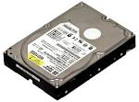

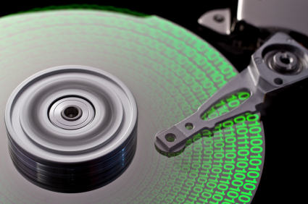

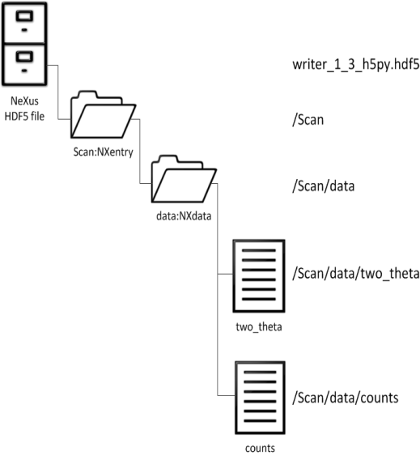
File system on Disk
A 2G file will maintain 4,194,304 sectors(512bytes per sector)
Sectors
Blocks
Files
Directory tree

Slide 42
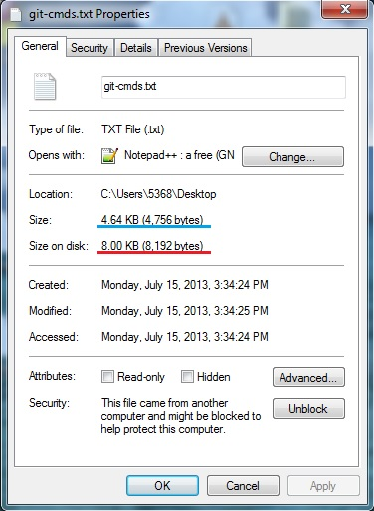
HD Sectors vs. FS Blocks
Sectors vs. Blocks
Physically, data is on disk, unit is sector
Logically, data is on file, unit is block
Initialized by file system format
LBA(Logical Block Addressing)
Logical block number
HD controller maps it to physical CHS
CHS to LBA mapping
A = (c ⋅ N_{heads} + h) ⋅ N_{sectors} + (s − 1),
CHS(0, 0, 1) -> Block0
CHS(0, 0, 2) -> Block1
…
2
3
block | sector
0 | 0,1
1 | 2,3
2 | 4,5
1
4
0
5
Notes:
The concept of a block began as a simple way for physical sectors on disk to be represented logically in the filesystem. Each sector had its own header, data area and ECC which made it the smallest piece of disk that could be independently represented logically.
As time went by, with the advent of caches on the HDD controller it became easier to have logical blocks which were of the size of multiple physical sectors. This way on-disk sequential I/O increased resulting in better throughput.

Slide 43
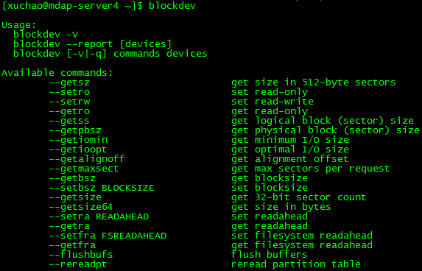
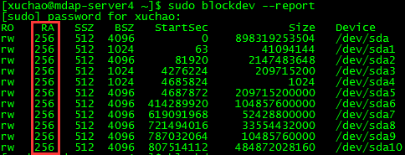
Readahead on disk
Read ahead
Optimization for read performance on disk.
A system call of the Linux kernel that pre-fetches a file's more data into the page cache in case requests later.
Useful for sequential access, but not for random access
Default size 256 sectors(128KB, 2^{n} of page size) on Linux
Read Amplification(if #blockdev --setra size too large)
Notes:
sequential access pre-fetching will reduce time to perform complete operation.
局部性原理与磁盘预读
由于磁盘顺序读取的效率很高（不需要寻道时间，只需很少的旋转时间），因此对于具有局部性的程序来说，预读可以提高I/O效率。
预读的长度一般为页（page）的整倍数。页是计算机管理存储器的逻辑块，硬件及操作系统往往将主存和磁盘存储区分割为连续的大小相等的块，每个存储块称为一页（在许多操作系统中，页得大小通常为4k），主存和磁盘以页为单位交换数据。当程序要读取的数据不在主存中时，会触发一个缺页异常，此时系统会向磁盘发出读盘信号，磁盘会找到数据的起始位置并向后连续读取一页或几页载入内存中，然后异常返回，程序继续运行。

Slide 44
Fragmentation
In blocks
On disk
As file operations(append, update, delete)
Sector(512 bytes)
…
Block(4096 bytes)
file(6144 bytes)
fragment
0 1 2 3 4 5 6 7 8 9 10 11 12 13 14 15
File | blocks
1 | 0,1,2,3,4,5, 18,19
2 | 6,7,8,9, 12,13
3 | 10,11, 14,15, 16,17
4 | 20,21,22,23,24,25
file 1
file 2
file 3
file 4

Slide 45
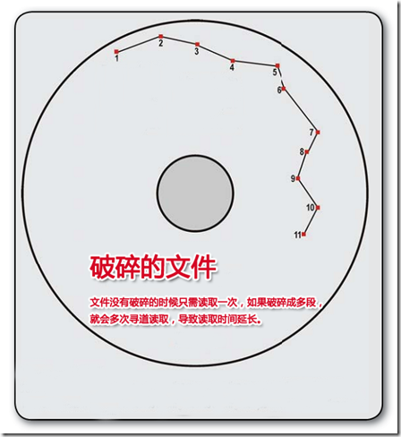
Fragmentation
Fragments In blocks
Can’t avoid
Block size depends on practical scenario
Capacity util% will be less
Fragments On disk
It depends on file system(Fat, Ext2/3/4)
Head has more seek
IO Performance will be slow
Defragmentation will cause Write Amplification
Notes:
On why FAT becomes fragmented:
"When you save a file to a FAT file system, [the file is saved] as close to the start of the disk as possible. When you save a second file, [the file is saved] right after the first file – and so on. When the original files grow in size, they will always become fragmented. There’s no nearby room for them to grow into."
On how EXT2,3,4 allocate files:
"ext2, ext3, and ext4 file systems [...] allocates files in a more intelligent way. Instead of placing multiple files near each other on the hard disk, Linux file systems scatter different files all over the disk, leaving a large amount of free space between them.“
"Modern Linux filesystem(s) keep fragmentation at a minimum by keeping all blocks in a file close together, even if they can't be stored in consecutive sectors. Some filesystems, like ext3, effectively allocate the free block that is nearest to other blocks in a file. Therefore it is not necessary to worry about fragmentation in a Linux system."

Slide 46
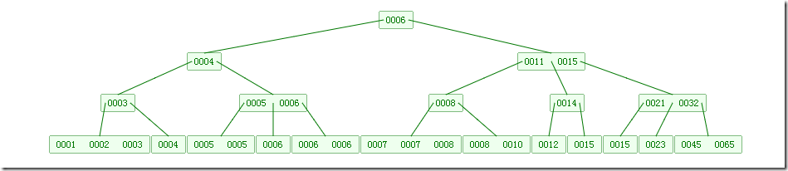
B-tree
An order m B-tree
Every node has at most m children.
Every non-leaf node (except root) has at least ⌈m/2⌉ children.
The root has at least two children if it is not a leaf node.
A non-leaf node with k children contains k−1 keys.
All leaves appear in the same level.
Use and advantages
O(log n) in searches, sequential access, insertions, and deletions
Perfect matched with file system & disk
Each node maps to a page(4KB), full loaded by readahead
Used for file system and database
An order m B-tree having N data:
Each non-leaf node has [m/2 , m] children
The height is (log_{m-1}N, log_{m/2}N)
If N = 62*1000000000, m=1024
then, log_{m/2}N <= 4
That means, we just need ≤4 reads for each operation(search, insert, delete) in 62 billion records.
order=3

Slide 47
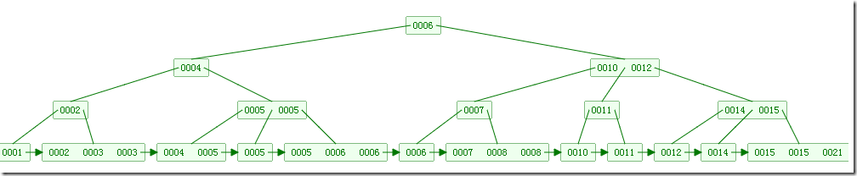
B+ tree
Compare with B-tree
Each internal node contains only keys (not key–value pairs)
An additional level is added at the bottom with linked leaves
Only leaf nodes contain data info
Use and advantages
More efficient for range queries
Each node contains more keys(only leaf nodes contain data)
Very high fanout(typically on the order of 100 or more)
More index keys can be loaded into memory and cache
More balanced(all data on leaf level)
Used for index in RDBMS, metadata indexing, storing directories in file system
order=3

Slide 48
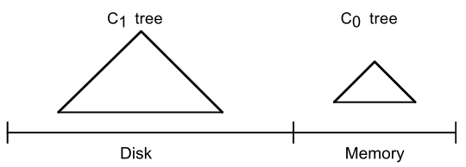
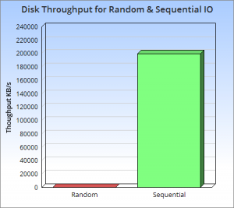
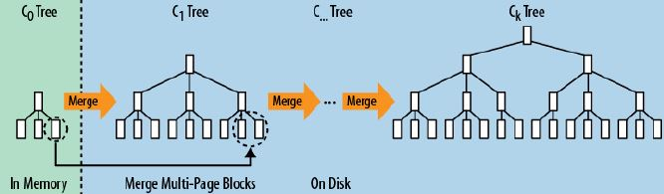
LSM tree
Log-Structured Merge-tree
Sequential IO performance >>> Random IO performance
Maintaining data in two or more tree-like component data structures underlying different storages
Data is wrote back to disk in rolling batches in some latency.
Write ahead log for guarantee data safety
Put and sort in memory temporarily(preventing I/O cost)
Write back to multi-page blocks on disk sequentially
Periodically compact files, split or merge regions
Used for HBase, LevelDB, BigTable, MongoDB, RocksDB, Cassandra

Slide 49
LSM tree
Read/Write path
1. append to wal
WAL log file
operation log
key
2. put & sort in memory
memory
1. read from cache
data record
3. write back to disk block
2. read from disk
Disk
…
file block

Slide 50

SkipList
跳表具有如下性质：
(1) 由很多层结构组成
(2) 每一层都是一个有序的链表
(3) 最底层(Level 1)的链表包含所有元素
(4) 如果一个元素出现在 Level i 的链表中，则它在 Level i 之下的链表也都会出现
(5) 每个节点包含两个指针，一个指向同一链表中的下一个元素，一个指向下面一层的元素
(6) 跳表的节点层数是在插入链表时动态随机确定的，加入了随机特性，可提高搜索效率。

Slide 51

Trie
字典树的性质
根节点（Root）不包含字符，除根节点外的每一个节点都仅包含一个字符；
从根节点到某一节点路径上所经过的字符连接起来，即为该节点对应的字符串；
任意节点的所有子节点所包含的字符都不相同；
例如：字符串集合 ["Joe", "John", "Johnny", "Jane", "Jack"]
Notes:
利用了字符串的共同前缀（Common Prefix）作为存储依据
Trie 的字符串搜索时间复杂度为 O(m)，m 为最长的字符串的长度，其查询性能与集合中的字符串的数量无关
Trie 的应用
特别适用于构建关键词搜索和词频统计等场景
字符串检索：事先将已知的一些字符串（字典）的有关信息保存到 Trie 里，查找另外一些未知字符串是否出现过或者出现频率。
字符串最长公共前缀：Trie 利用多个字符串的公共前缀来节省存储空间，反之，当我们把大量字符串存储到一棵 Trie 上时，我们可以快速得到某些字符串的公共前缀。
排序：Trie 树是一棵多叉树，只要先序遍历整棵树，输出相应的字符串，便是按字典序排序的结果。
作为其他数据结构和算法的辅助结构：如后缀树，AC自动机等。

Slide 52
Suffix Tree

Slide 53
Double Array Trie

Slide 54
Suffix Array

Slide 55

Data model in Lucene

Slide 56



FST
插入“cat”、 “deep”、 “do”、 “dog” 、“dogs” 构建FST（注：必须已排序）。
1）插入“cat”
插入cat，每个字母形成一条边，其中t边指向终点。
2）插入“deep”
与前一个单词“cat”进行最大前缀匹配，发现没有匹配则直接插入，P边指向终点。
3）插入“do”
与前一个单词“deep”进行最大前缀匹配，发现是d，则在d边后增加新边o，o边指向终点。
Notes:
FST有两个优点：1）空间占用小。通过对词典中单词前缀和后缀的重复利用，压缩了存储空间；2）查询速度快。O(len(str))的查询时间复杂度。

Slide 57



FST
插入“cat”、 “deep”、 “do”、 “dog” 、“dogs” 构建FST（注：必须已排序）。
4）插入“dog”
与前一个单词“do”进行最大前缀匹配，发现是do，则在o边后增加新边g，g边指向终点。
5）插入“dogs”
与前一个单词“dog”进行最大前缀匹配，发现是dog，则在g后增加新边s，s边指向终点。
Notes:
FST有两个优点：1）空间占用小。通过对词典中单词前缀和后缀的重复利用，压缩了存储空间；2）查询速度快。O(len(str))的查询时间复杂度。
有向无环图,我们可以将FST当做Key-Value数据结构来进行使用，特别在对内存开销要求少的应用场景。
FST压缩率一般在3倍~20倍之间，相对于TreeMap/HashMap的膨胀3倍，内存节省就有9倍到60倍！（摘自：把自动机用作 Key-Value 存储）
在苹果笔记本（i7处理器）进行的简单测试，性能虽不如TreeMap和HashMap，但也算良好，能够满足大部分应用的需求。

Slide 58
我们的优化手段一般是：
利用数据的局部性原理和磁盘预读机制来减少数据加载时的磁盘IO次数；
利用顺序写/顺序读来降低磁盘的寻道时间；
利用批量写来降低操作系统的IO调用次数，从而降低内核态与用户态之间的上下文切换开销；
利用操作系统的虚拟内存技术，通过内存映射来降低数据在内核态与用户态之间的拷贝开销；

Slide 59
# of Cores(6)
Cores is a hardware term that describes the number of independent central processing units in a single computing component (die or chip).

Slide 60
# of Threads(12)
A Thread, or thread of execution, is a software term for the basic ordered sequence of instructions that can be passed through or processed by a single CPU core.

Slide 61
Processor Base Frequency(2.00 GHz)
Processor Base Frequency describes the rate at which the processor's transistors open and close. The processor base frequency is the operating point where TDP is defined. Frequency is measured in gigahertz (GHz), or billion cycles per second.

Slide 62
Cache(L1, L2, L3)
CPU Cache is an area of fast memory located on the processor. Intel® Smart Cache refers to the architecture that allows all cores to dynamically share access to the last level cache.

Slide 63
Data layout on Sector
Read/write head
ECC
Sector gap for head & data
CRC
CHS Address
next sector
512 bytes data
A total sector
Sector gap
before sector

Slide 64
Reference
https://computing.llnl.gov/tutorials/parallel_comp/
https://en.wikipedia.org/wiki/CPU_cache
https://en.wikipedia.org/wiki/Cache_memory
http://www.hardwaresecrets.com/how-the-cache-memory-works/
https://www.quora.com/How-does-the-cache-memory-in-a-computer-work
http://ark.intel.com/products/64594/Intel-Xeon-Processor-E5-2620-15M-Cache-2_00-GHz-7_20-GTs-Intel-QPI
https://superuser.com/questions/196143/where-exactly-l1-l2-and-l3-caches-located-in-computer
https://en.wikipedia.org/wiki/Disk_sector
https://en.wikipedia.org/wiki/Cylinder-head-sector
https://en.wikipedia.org/wiki/Zone_bit_recording
http://www.tldp.org/LDP/sag/html/hard-disk.html
https://www.youtube.com/watch?v=Cj8-WNjaGuM&list=PLlVZ1eXuYslrb9G6xm4SKV51SO-KAFrCw&index=1&t=12s
http://blog.csdn.net/hguisu/article/details/7408047
http://www.pcguide.com/ref/hdd/geom/tracksZBR-c.html
http://cn.linux.vbird.org/linux_basic/0230filesystem.php
https://www.cs.uic.edu/~jbell/CourseNotes/OperatingSystems/10_MassStorage.html
https://en.wikipedia.org/wiki/Hard_disk_drive_performance_characteristics
https://en.wikipedia.org/wiki/I/O_scheduling
https://www.howtogeek.com/115229/htg-explains-why-linux-doesnt-need-defragmenting/
https://en.wikipedia.org/wiki/Readahead
https://en.wikipedia.org/wiki/B-tree
https://en.wikipedia.org/wiki/B%2B_tree
http://www.cnblogs.com/yangecnu/p/Introduce-B-Tree-and-B-Plus-Tree.html

