Slide 1
Data Model in Memory & Disk

Slide 2
Agenda
Data path on x86
Cache on CPU
How does disk works
Data structures in action

Slide 3
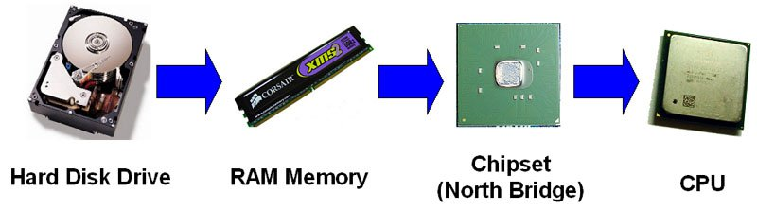
Data Access Model
Data path
Local principle of program
ReadAhead & Prefetch on Disk
Transfer rates of all components differ, that’s the question!
Notes:
The data paths is the path composed of all hardware components that are needed to get the data from the disk drive to the CPU.
It is important to understand the different transfer rates of each component of the server's disk subsystem and of the network. This information helps you to identify potential bottlenecks that can throttle your overall performance.

Slide 4
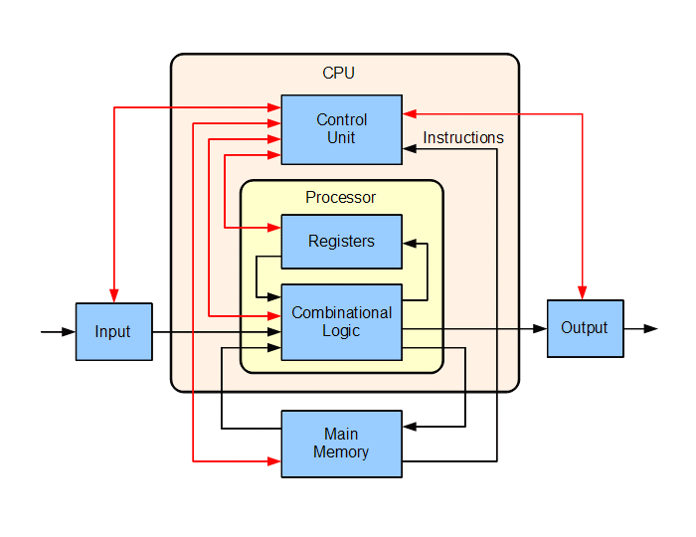
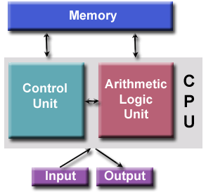
Computer Architecture
von Neumann Architecture

Slide 5
Data Path on x86/x64
read
CPU
write
Processor1
NUMA node1
Processor2
NUMA node2
Core 1
Core 2
Core 3
Core 4
L1
L1
cache
L1
L1
L2
L2
L2
L2
L3
L3
Main Memory
File System
IO Scheduler
DMA
Disk
Notes:
In a write-through cache, every write to the cache causes a write to main memory. Alternatively, in a write-back or copy-back cache, writes are not immediately mirrored to the main memory, and the cache instead tracks which locations have been written over, marking them as dirty. The data in these locations is written back to the main memory only when that data is evicted from the cache. For this reason, a read miss in a write-back cache may sometimes require two memory accesses to service: one to first write the dirty location to main memory, and then another to read the new location from memory.
Cached data from the main memory may be changed by other entities. Communication protocols between the cache managers that keep the data consistent are known as cache coherence protocols.

Slide 6
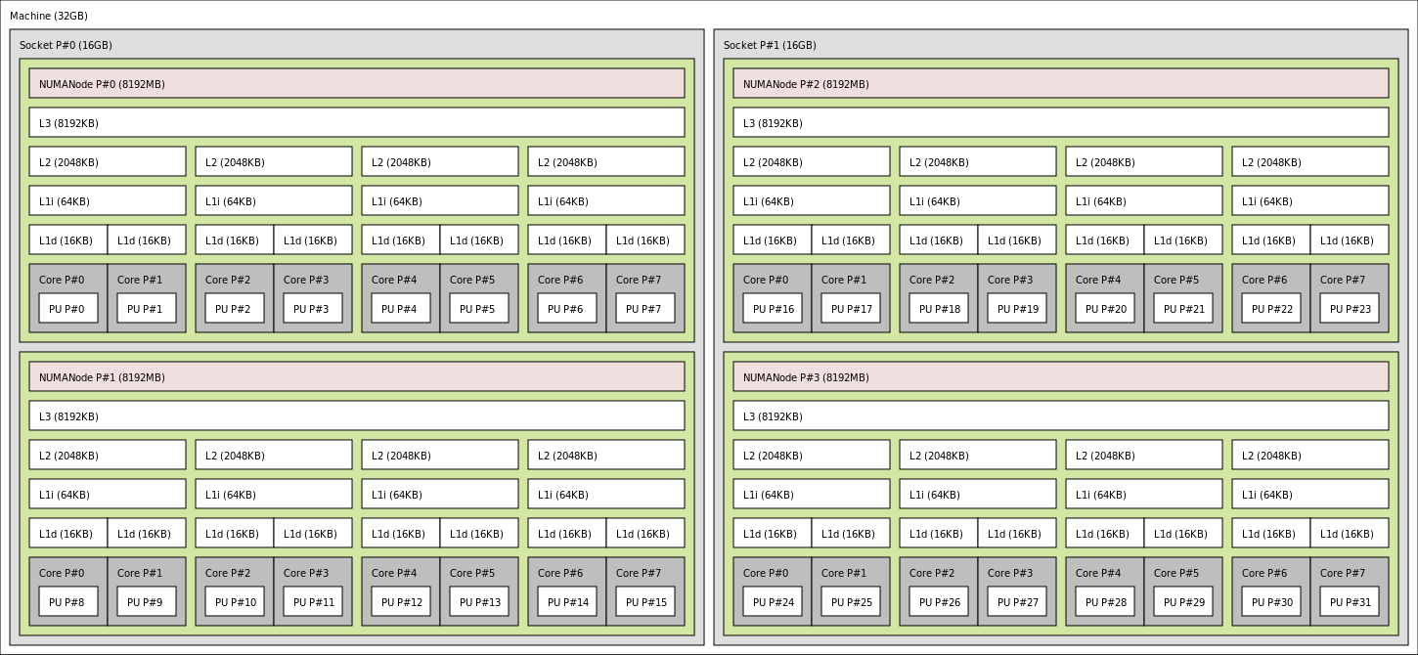
Memory hierarchy of an AMD Bulldozer server

Slide 7
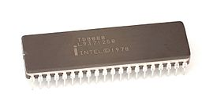
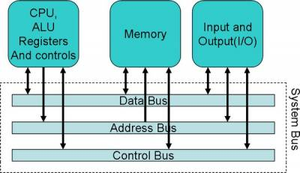
History of cache on chips
Intel 8086, 8088 (1978)
First x86, original 4.77Mhz, no cache.
CPU accesses the memory directly.
Read path:
The CPU puts the address it want to read on the memory bus and assert the read flag.
Memory puts the data on the data bus.
The CPU copies the data from the data bus to its internal registers.

Slide 8
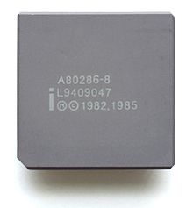
History of cache on chips
80286 (1982)
6-25Mhz, still no cache.
The speed of memory access started to be slower than core. Delay occurred between core and memory (as core 20Mhz).
Read path:
The CPU puts the address on the memory bus and assert the read flag.
Memory starts to put the data on the data bus. The CPU waits
Memory finished getting the data and it is now stable on the data bus
The CPU copies the data from the data bus to its internal registers.
Speed between memory & core mismatched.
That is why we would have cache…

Slide 9
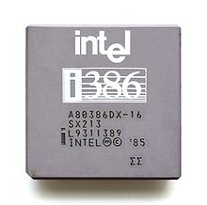
History of cache on chips
80386 (1985)
12-40Mhz, L1 cache on motherboard.
Core runs faster,
RAM gets faster, but not as much faster as CPUs.
Read path:
Check if the data is already in the cache.
If cache hit, read from the much faster cache.
Else, go as 80286.

Slide 10
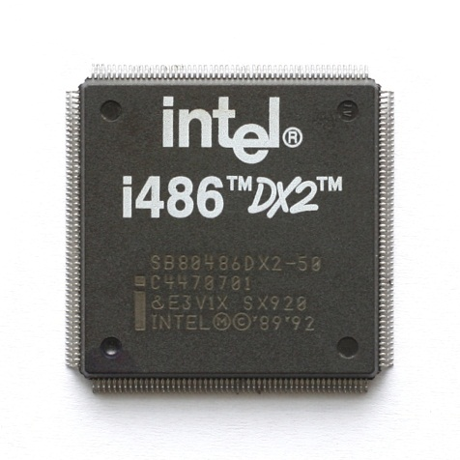
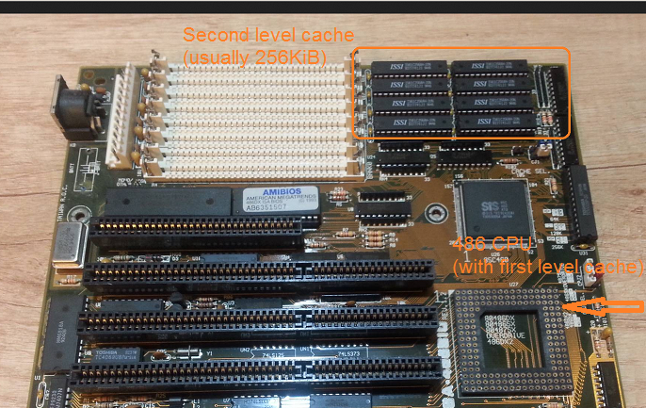
History of cache on chips
80486 (1989)
16-150Mhz, L1 cache on CPU & L2 added.
A 8KB unified cache used for data and instructions.
L1 cache on CPU, L2 cache on motherboard.
Read path:
L1 cache.
L2 cache.
Main memory.

Slide 11

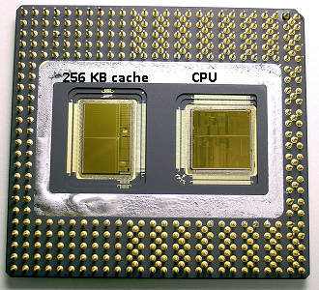
History of cache on chips
80586/Pentium (1993)
60-200Mhz, L1 cache was split(L1d & L1i).
L1: 8 KB each for data and instructions for individually use.
Chip contains two dies. One with the actual core and L1 cache, and a second die with 256KB L2 cache.
Read path:
L1 cache(split by instru & data).
L2 cache.
Main memory.

Slide 12
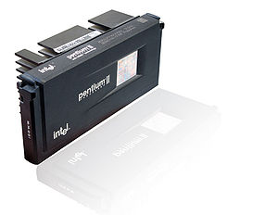
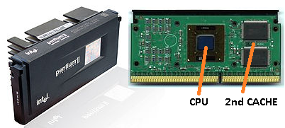
History of cache on chips
Pentium 2 (1997)
66-100Mhz, L2 cache no more on chip.
Components on chip became smaller, financially.
With one L1 cache per CPU core and a larger but slower L2 cache next to the core.
Read path:
L1 cache(split by instru & data).
L2 cache.
Main memory.

Slide 13
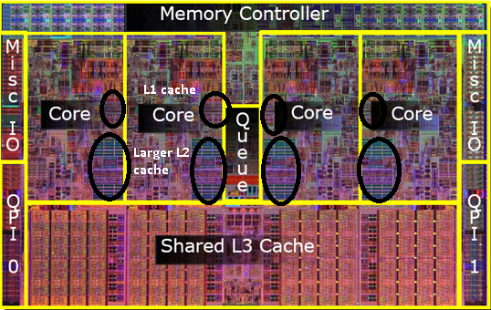
History of cache on chips
Pentium 4 (2000) & later
1.3-3.8Ghz, L3 cache added.
Reach a limit on single CPU’s clock.
How to solve (3 ways):
Make the CPUs more efficient, so they do more work at the same speed.
Use multiple CPUs(multi chips), UMA & SMP.
Use multiple CPUs in the same 'chip‘, NUMA.
A “dual core” CPU occurred, two or more separate CPU cores are build into a single chip.
“NUMA” architecture became famous.
L3 cache(larger and slower) shared with all CPU cores

Slide 14
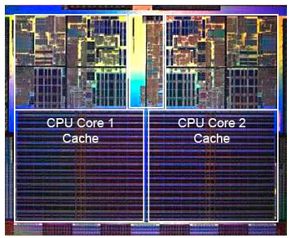
An Example
Intel Intel® Core™ i7 Processor
A 32-KB instruction and 32-KB data first-level cache (L1) for each core
A 256-KB shared instruction/data second-level cache (L2) for each core
8-MB shared instruction/data last-level cache (L3), shared among all cores
Photo of processor chip.
Cache takes significant area on chip

Slide 15
Data Layer
Core in Processor(load instructions & data)
Cache(L1, L2, or L3, blocked by “cache line”)
Main memory(blocked by “page”)
File system(blocked by “file page”)
Disk(blocked by “sector”)
CPU Stalls
Cache hit/miss
Swap in/out
IO await

Slide 16
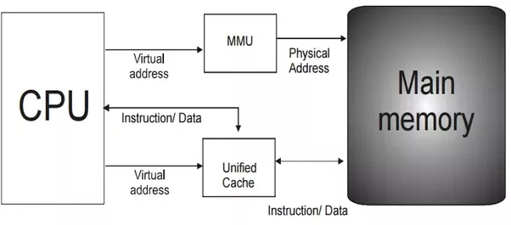

Slide 17
CPU Cache
Cache type
Cache structure
Cache addressing
Cache associativity
Cache policy(write & replacement)
Cache miss
Cache hierarchy in CPU
Notes:
three independent caches: an instruction cache to speed up executable instruction fetch, a data cache to speed up data fetch and store, and a translation lookaside buffer (TLB) used to speed up virtual-to-physical address translation for both executable instructions and data.

Slide 18
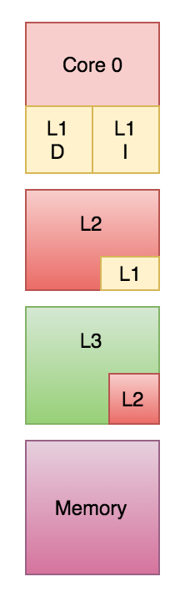
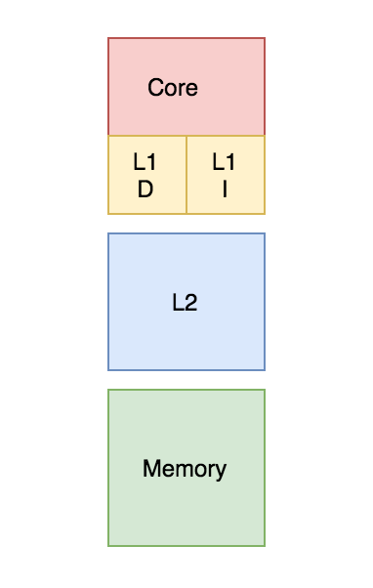
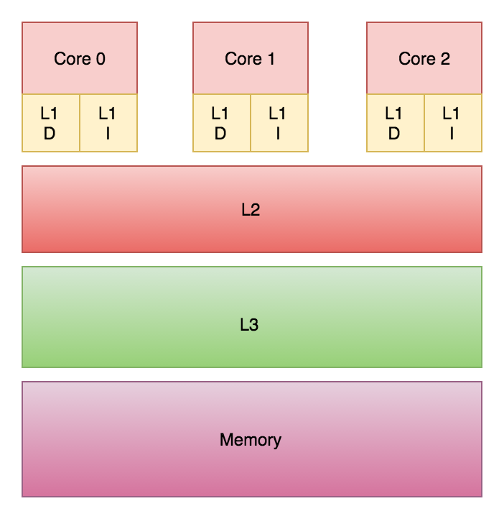

Slide 19
How the cache memory works
Cache structure
Cache address
“Cache Entry”
tag
data block
flag bits
Containing address of actual data from main memory
“Cache Line”
Containing the actual data fetched from main memory
For instruction: a valid bit
For data: a valid bit & a dirty bit
tag(MSB)
index(LSB)
block offset
The most significant bits of the address from main memory.
The index of cache line that data in.
Index length = cell(log r) bits,
as r is cache lines capacity in cache.
The data offset in cache line.
Offset length = cell(log b) bits,
as b is bytes in data block.
Notes:
The data block (cache line) contains the actual data fetched from the main memory.
The tag contains (part of) the address of the actual data fetched from the main memory.
The Flag bits:
An instruction cache requires only one flag bit per cache row entry: a valid bit.
A data cache typically requires two flag bits per cache line – a valid bit and a dirty bit(have to be written back into main memory).
The index describes which cache row (which cache line) that the data has been put in.
The block offset specifies the desired data within the stored data block within the cache row.

Slide 20
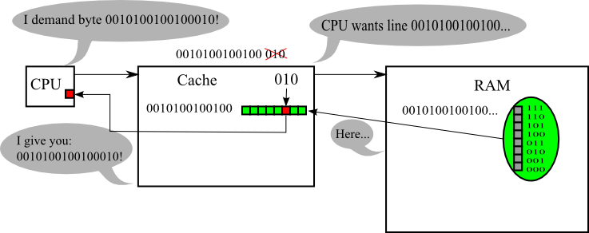
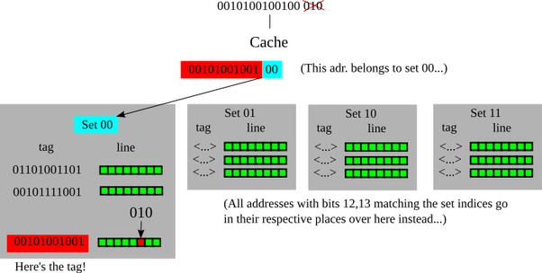
How the cache memory works
Cache addressing

Slide 21
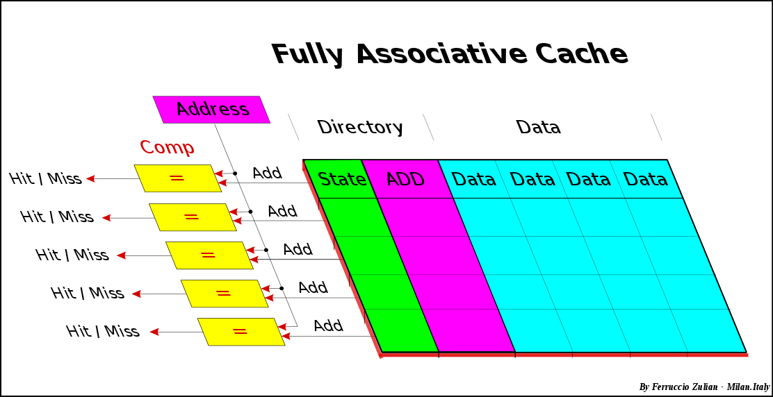
How the cache memory works
Fully associative cache
Any memory block can be stored in any cache location.
Very small and efficient, just used for TLB.

Slide 22
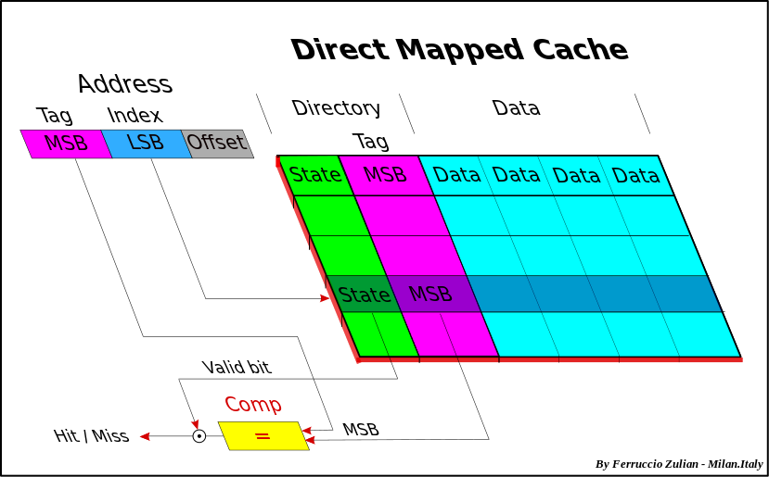
How the cache memory works
Direct mapped cache
Any memory block can be stored in one specific cache entry only.

Slide 23
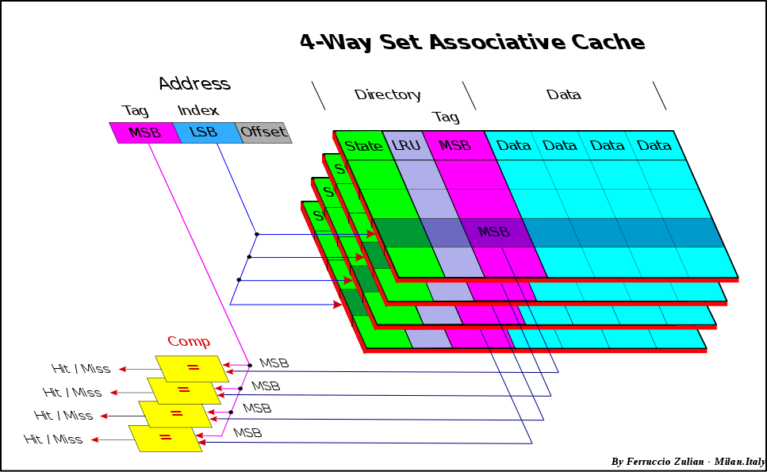
How the cache memory works
Set associative cache(multi-way-direct-mapped)
A combination of the two previous approaches,
Any memory block can be stored in any cache way, but only can be stored in one specific cache entry in that way.

Slide 24
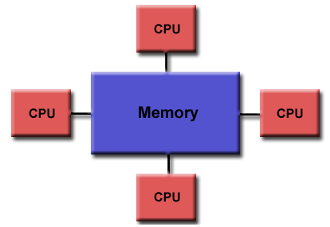
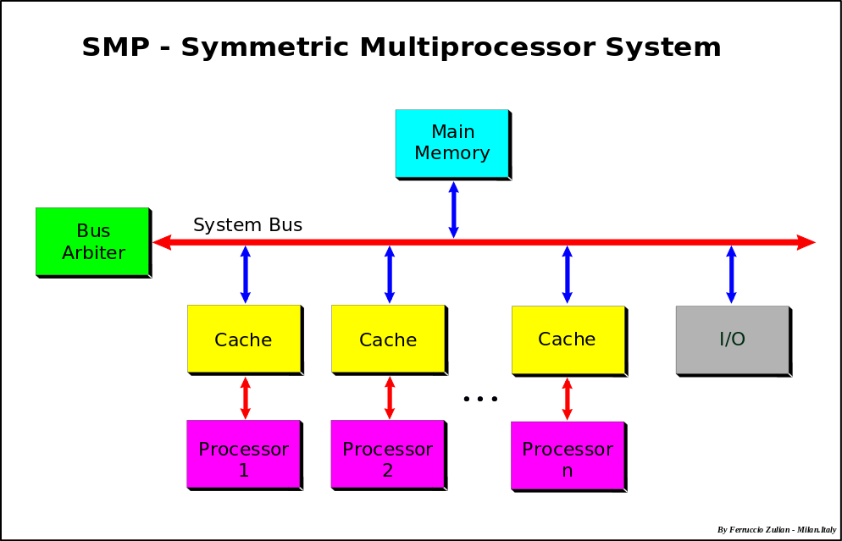
Memory Architectures
Uniform Memory Access (UMA)
Symmetric Multiprocessor (SMP)
Identical processors
Equal access and access times to memory
CC-UMA(Cache Coherent UMA)

Slide 25
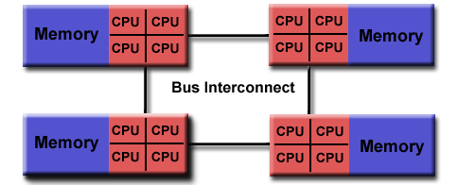
Memory Architectures
Non-Uniform Memory Access (NUMA)
Often made by physically linking two or more SMPs
One SMP can directly access memory of another SMP
Not equal access time to all memories between SMPs
Memory access across bus link is slower
CC-NUMA - Cache Coherent NUMA

Slide 26
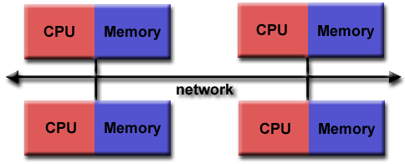
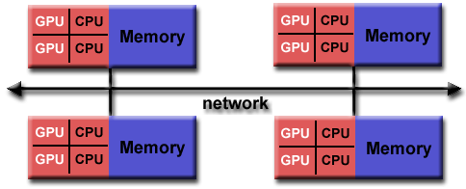
Memory Architectures
Distributed Memory
Distributed system
Based on network
Scalable but access time across nodes slower
Use commodity processor and machine, even hybrid components

Slide 27
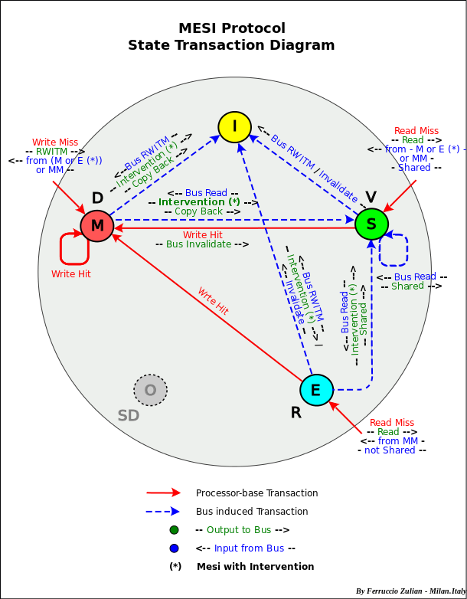
Memory Architectures
Cache coherent
If one processor updates the shared data in cache, all the other processors know about the update.
3 approaches of implementation
Bus watching or Snooping (used for SMP, hardware level)
Directory-based – message-passing (used in NUMA)
Shared cache (used for multi-core, e.g. L3)
Coherency protocols
MESI protocol
MOESI protocol
Based on State, and use of a bus "shared line" to detect "shared" copy in the other caches

Slide 28
Data Store Model
The layout of data in memory,
that is, Data Structure
The layout of data in file,
that is, File Format
The layout of data in network,
that is, Protocol
Notes:
数据在内存中的布局叫做“数据结构”，在文件中的布局叫做“文件格式”

Slide 29
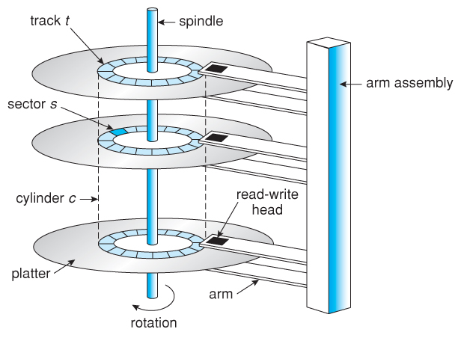
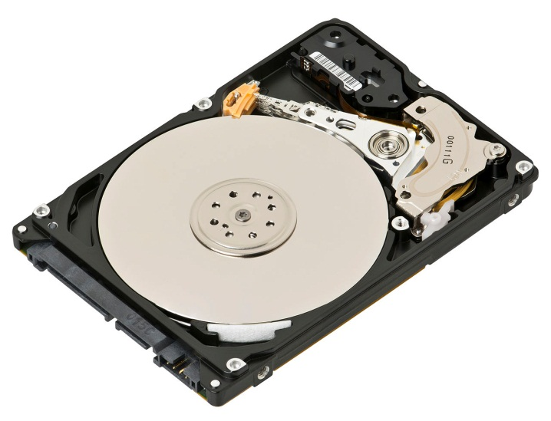
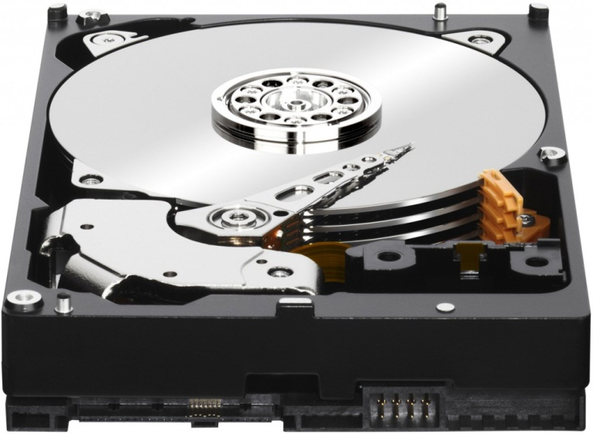
Disk

Slide 30
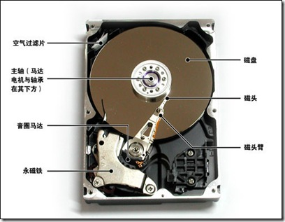
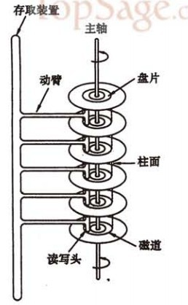
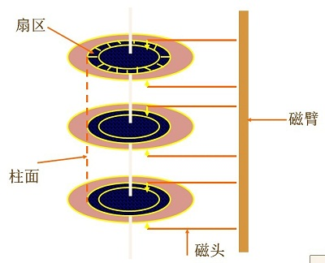
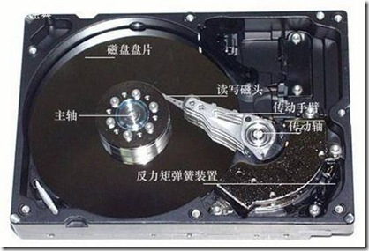
Disk

Slide 31
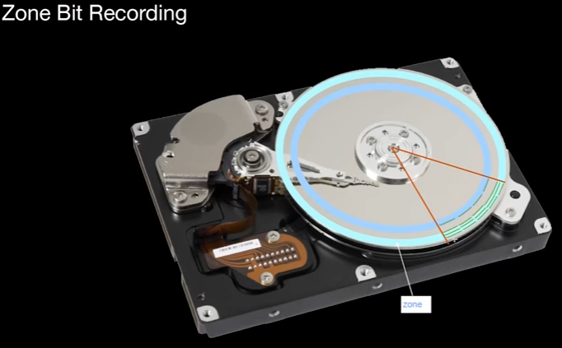
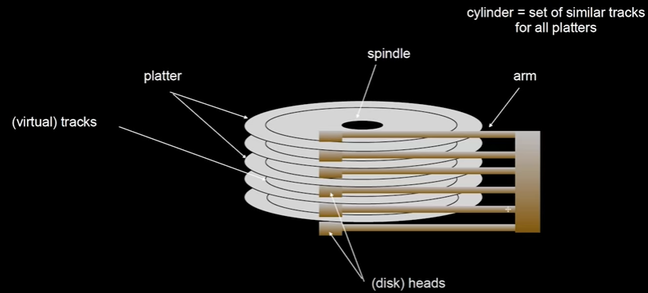
Disk 术语
盘面（side）
磁道（ Track ）
柱面（ Cylinder ）
扇区（ Sector ）
Notes:
硬盘的盘片组在2～14片不等，通常有2～3个盘片，故盘面号（磁头号）为0～3或 0～5。
每一个盘片都有两个盘面（Side），即上、下盘面。每一个这样的有效盘面都有一个盘面号（又叫磁头号），按顺序从上至下从“0”开始依次编号。

Slide 32
CHS Addressing
Cylinder
Head
Sector
E.g. 1024/16/256 → 10/4/9bits

Slide 33
LBA(Logical Block Addressing)
Logical block number
HD controller maps it to physical CHS
0 -> (0, 0, 1)
1 -> (0, 0, 2)
File system format

Slide 34
Fragmentation

Slide 35
Disk磁盘访问
三维寻址空间（柱面号，磁头号，扇区号）
一次访盘请求（读/写）完成过程由三个动作组成：
1）寻道（时间）：磁头移动定位到指定磁道
2）旋转延迟（时间）：等待指定扇区从磁头下旋转经过
3）数据传输（时间）：数据在磁盘与内存之间的实际传输
Notes:
硬盘的盘片组在2～14片不等，通常有2～3个盘片，故盘面号（磁头号）为0～3或 0～5。
每一个盘片都有两个盘面（Side），即上、下盘面。每一个这样的有效盘面都有一个盘面号（又叫磁头号），按顺序从上至下从“0”开始依次编号。

Slide 36
磁盘的读写原理
系统将数据存储到磁盘上时，按柱面、磁头、扇区的方式进行，即最先是第1磁道的第一磁头下（也就是第1盘面的第一磁道）的所有扇区，然后，是同一柱面的下一磁头，……，一个柱面存储满后就推进到下一个柱面，直到把文件内容全部写入磁盘。
（柱面从外到内，磁头从上到下， 扇区从小到大。
数据的读/写按柱面进行，而不按盘面进行，先）
在硬盘里动得最慢的(相对来说)就是传动手臂

Slide 37
Sector
Pyhsical data structure on sector
Sector header
Data area
Error correcting code(ECC)
Gaps

Slide 38
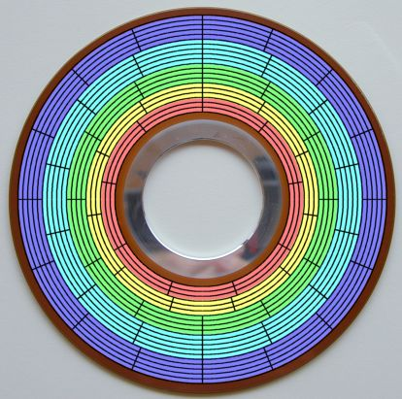
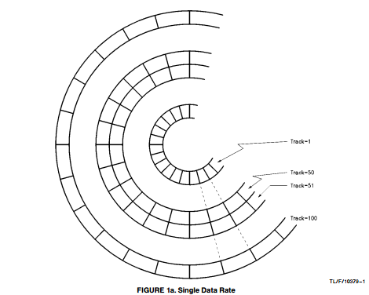
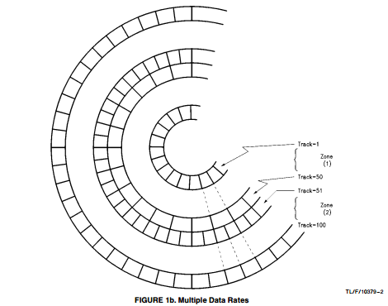
Confusing on sector
Zone Bit Recording
zone bit recording (ZBR) is a method used by disk drives to store more sectors per track on outer tracks than on inner tracks.
Notes:
bit density
zone bit recording (ZBR) is a method used by disk drives to store more sectors per track on outer tracks than on inner tracks.

Slide 39
HD Sectors vs. OS Blocks

Slide 40
B Tree

Slide 41
B+ Tree

Slide 42
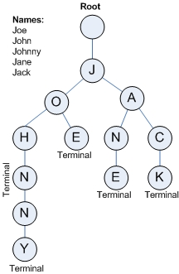
Trie
字典树的性质
根节点（Root）不包含字符，除根节点外的每一个节点都仅包含一个字符；
从根节点到某一节点路径上所经过的字符连接起来，即为该节点对应的字符串；
任意节点的所有子节点所包含的字符都不相同；
例如：字符串集合 ["Joe", "John", "Johnny", "Jane", "Jack"]
Notes:
利用了字符串的共同前缀（Common Prefix）作为存储依据
Trie 的字符串搜索时间复杂度为 O(m)，m 为最长的字符串的长度，其查询性能与集合中的字符串的数量无关
Trie 的应用
特别适用于构建关键词搜索和词频统计等场景
字符串检索：事先将已知的一些字符串（字典）的有关信息保存到 Trie 里，查找另外一些未知字符串是否出现过或者出现频率。
字符串最长公共前缀：Trie 利用多个字符串的公共前缀来节省存储空间，反之，当我们把大量字符串存储到一棵 Trie 上时，我们可以快速得到某些字符串的公共前缀。
排序：Trie 树是一棵多叉树，只要先序遍历整棵树，输出相应的字符串，便是按字典序排序的结果。
作为其他数据结构和算法的辅助结构：如后缀树，AC自动机等。

Slide 43
Suffix Tree

Slide 44
Double Array Trie

Slide 45
Suffix Array

Slide 46
SkipList

Slide 47
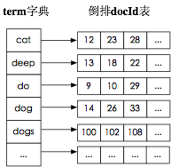
Data model in Lucene

Slide 48

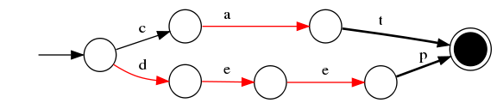
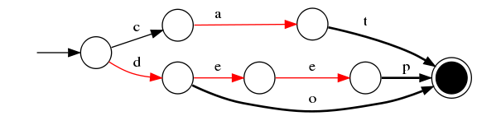
FST
插入“cat”、 “deep”、 “do”、 “dog” 、“dogs” 构建FST（注：必须已排序）。
1）插入“cat”
插入cat，每个字母形成一条边，其中t边指向终点。
2）插入“deep”
与前一个单词“cat”进行最大前缀匹配，发现没有匹配则直接插入，P边指向终点。
3）插入“do”
与前一个单词“deep”进行最大前缀匹配，发现是d，则在d边后增加新边o，o边指向终点。
Notes:
FST有两个优点：1）空间占用小。通过对词典中单词前缀和后缀的重复利用，压缩了存储空间；2）查询速度快。O(len(str))的查询时间复杂度。

Slide 49
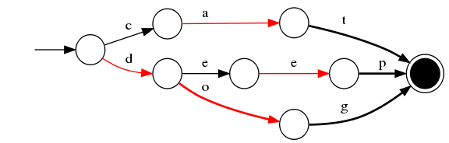
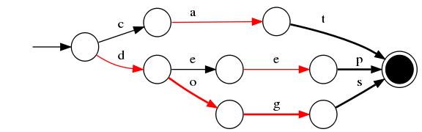

FST
插入“cat”、 “deep”、 “do”、 “dog” 、“dogs” 构建FST（注：必须已排序）。
4）插入“dog”
与前一个单词“do”进行最大前缀匹配，发现是do，则在o边后增加新边g，g边指向终点。
5）插入“dogs”
与前一个单词“dog”进行最大前缀匹配，发现是dog，则在g后增加新边s，s边指向终点。
Notes:
FST有两个优点：1）空间占用小。通过对词典中单词前缀和后缀的重复利用，压缩了存储空间；2）查询速度快。O(len(str))的查询时间复杂度。
有向无环图,我们可以将FST当做Key-Value数据结构来进行使用，特别在对内存开销要求少的应用场景。
FST压缩率一般在3倍~20倍之间，相对于TreeMap/HashMap的膨胀3倍，内存节省就有9倍到60倍！（摘自：把自动机用作 Key-Value 存储）
在苹果笔记本（i7处理器）进行的简单测试，性能虽不如TreeMap和HashMap，但也算良好，能够满足大部分应用的需求。

Slide 50
LSM Tree

Slide 51
# of Cores(6)
Cores is a hardware term that describes the number of independent central processing units in a single computing component (die or chip).

Slide 52
# of Threads(12)
A Thread, or thread of execution, is a software term for the basic ordered sequence of instructions that can be passed through or processed by a single CPU core.

Slide 53
Processor Base Frequency(2.00 GHz)
Processor Base Frequency describes the rate at which the processor's transistors open and close. The processor base frequency is the operating point where TDP is defined. Frequency is measured in gigahertz (GHz), or billion cycles per second.

Slide 54
Cache(L1, L2, L3)
CPU Cache is an area of fast memory located on the processor. Intel® Smart Cache refers to the architecture that allows all cores to dynamically share access to the last level cache.

Slide 55
Reference
https://computing.llnl.gov/tutorials/parallel_comp/
https://en.wikipedia.org/wiki/CPU_cache
https://en.wikipedia.org/wiki/Cache_memory
http://www.hardwaresecrets.com/how-the-cache-memory-works/
https://www.quora.com/How-does-the-cache-memory-in-a-computer-work
http://ark.intel.com/products/64594/Intel-Xeon-Processor-E5-2620-15M-Cache-2_00-GHz-7_20-GTs-Intel-QPI
https://superuser.com/questions/196143/where-exactly-l1-l2-and-l3-caches-located-in-computer
https://en.wikipedia.org/wiki/Disk_sector
https://en.wikipedia.org/wiki/Cylinder-head-sector
https://en.wikipedia.org/wiki/Zone_bit_recording
http://www.tldp.org/LDP/sag/html/hard-disk.html
https://www.youtube.com/watch?v=Cj8-WNjaGuM&list=PLlVZ1eXuYslrb9G6xm4SKV51SO-KAFrCw&index=1&t=12s
http://blog.csdn.net/hguisu/article/details/7408047
http://www.pcguide.com/ref/hdd/geom/tracksZBR-c.html
https://www.cs.uic.edu/~jbell/CourseNotes/OperatingSystems/10_MassStorage.html

