Slide 1
Apache Kafka with Spark Streaming - Real Time Analytics Redefined

Slide 2
Agenda
At the end of this webinar we will be able understand :
What Is Kafka?
Why We Need Kafka ?
Kafka Components
How Kafka Works
Which Companies Are Using Kafka ?
Kafka And Spark Integration
Hands on

Slide 3
Why Kafka ??

Slide 4






Kafka Vs Other Message Broker?
Why Kafka? When we have other messaging systems Aren’t they Good?

Slide 5
They all are Good But not for all use-cases.

Slide 6
So what are my Use-cases…
Transportation of logs
Activity Stream in Real time.
Collection of Performance Metrics
CPU/IO/Memory usage
Application Specific
Time taken to load a web-page.
Time taken by Multiple Services while building a web-page.
No of requests.
No of hits on a particular page/url.

Slide 7
What is Common?
Scalable : Need to be Highly Scalable. A lot of Data. It can be billions of message.
Reliability of messages, What If, I loose a small no. of messages. Is it fine with me ?
Distributed : Multiple Producers, Multiple Consumers
High-throughput : Does not need to have JMS Standards, as it may be an overkill for some use-cases like transportation of logs.
As per JMS, each message has to be acknowledged back.
Exactly one delivery guarantee requires two-phase commit.

Slide 8
Why LinkedIn built Kafka ?
To collect its growing data, LinkedIn developed many custom data pipelines for streaming and queueing data, like :
To flow data into data warehouse
To send batches of data into our hadoop workflow for analytics
To collect and aggregate logs from every service
To collect tracking events like page views
To queue their inmail messaging system
To keep their people search system up to date whenever someone updated their profile
As the site needed to scale, each individual pipeline needed to scale and many other pipelines were needed.
Kafka
The result was development of
Something had to give !!!

Slide 9
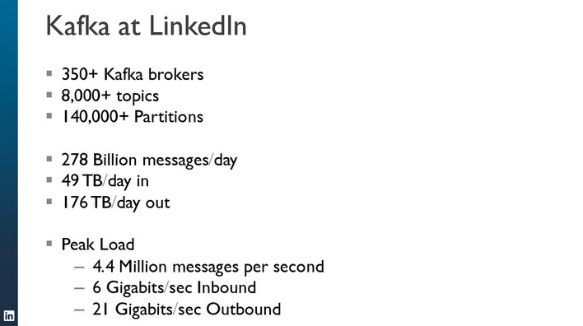
The number has been growing since
Source : confluent

Slide 10
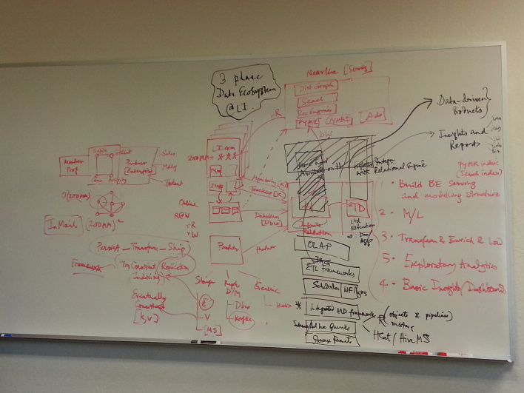
diagram of LinkedIn’s data architecture
A diagram of LinkedIn’s data architecture as of February 2013, including everything from Kafka to Teradata.
http://gigaom.com/2013/12/09/netflix-open-sources-its-data-traffic-cop-suro/

Slide 11
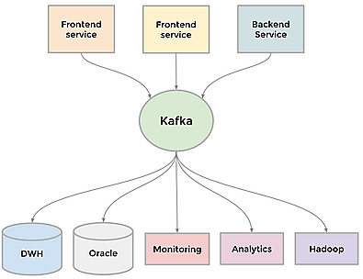
Kafka ?
Kafka is a distributed pub-sub messaging platform
Universal pipeline, built around the concept of a commit log
Built with speed and scalability in mind.
Enabled near real-time access to any data source
Empowered hadoop jobs
Allowed us to build real-time analytics
Vastly improved our site monitoring and alerting capability
Enabled us to visualize and track our call graphs.
Kafka as a universal stream broker
Apache Kafka Hits 1.1 Trillion Messages Per Day (September 2015)

Slide 12
Kafka Benchmarks

Slide 13
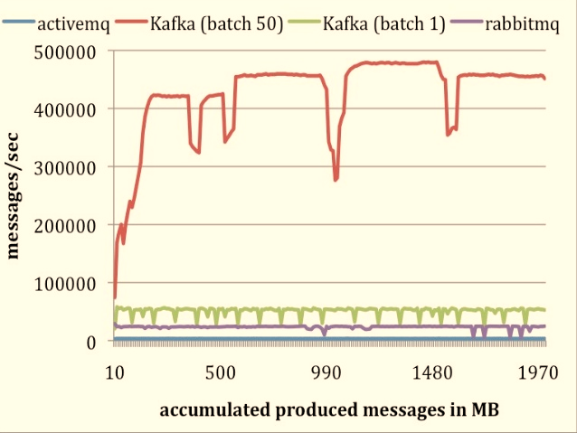
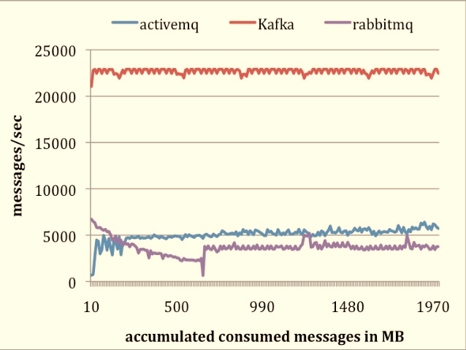
Kafka Producer/Consumer Performance
Processes hundred of thousands of messages in a second

Slide 14
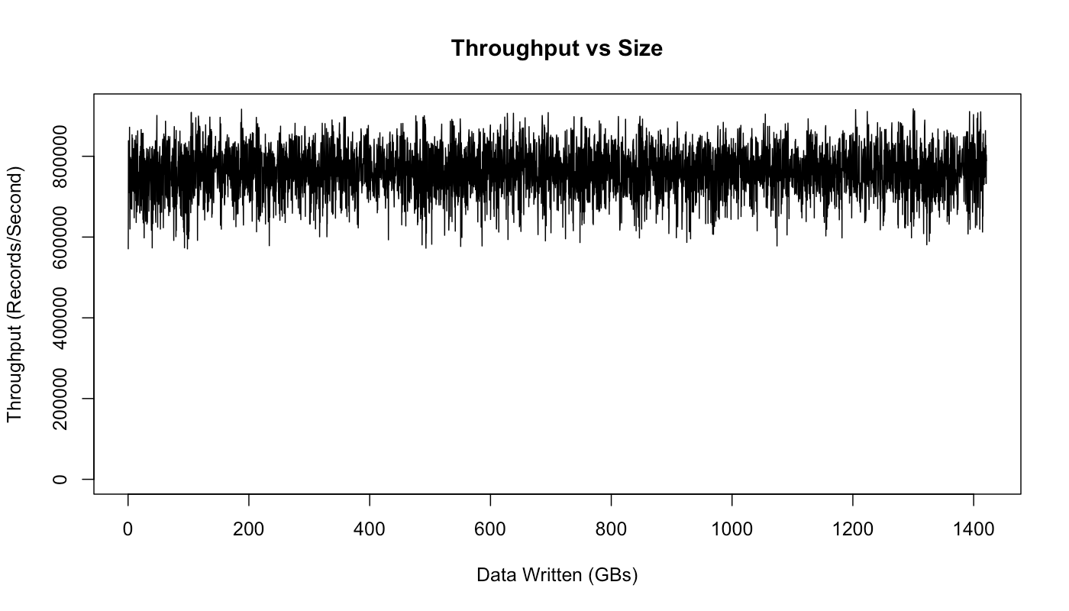
How fast is Kafka?
“Up to 2 million writes/sec on 3 cheap machines”
Using 3 producers on 3 different machines, 3x async replication
Only 1 producer/machine because NIC already saturated
Sustained throughput as stored data grows
Slightly different test config than 2M writes/sec above.
Test setup
Kafka trunk as of April 2013, but 0.8.1+ should be similar.
3 machines: 6-core Intel Xeon 2.5 GHz, 32GB RAM, 6x 7200rpm SATA, 1GigE
http://engineering.linkedin.com/kafka/benchmarking-apache-kafka-2-million-writes-second-three-cheap-machines

Slide 15
Why is Kafka so fast?
Fast writes:
While Kafka persists all data to disk, essentially all writes go to the page cache of OS, i.e. RAM.
Cf. hardware specs and OS tuning (we cover this later)
Fast reads:
Very efficient to transfer data from page cache to a network socket
Linux: sendfile() system call
Combination of the two = fast Kafka!
Example (Operations): On a Kafka cluster where the consumers are mostly caught up you will see no read activity on the disks as they will be serving data entirely from cache.
http://kafka.apache.org/documentation.html#persistence

Slide 16
Why is Kafka so fast?
Example: loggly.com, who run Kafka & Co. on Amazon AWS
“99.99999% of the time our data is coming from disk cache and RAM; only very rarely do we hit the disk.”
“One of our consumer groups (8 threads) which maps a log to a customer can process about 200,000 events per second draining from 192 partitions spread across 3 brokers.”
Brokers run on m2.xlarge Amazon EC2 instances backed by provisioned IOPS
http://www.developer-tech.com/news/2014/jun/10/why-loggly-loves-apache-kafka-how-unbreakable-infinitely-scalable-messaging-makes-log-management-better/

Slide 17
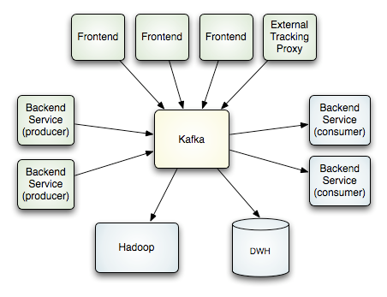
How it works ??

Slide 18
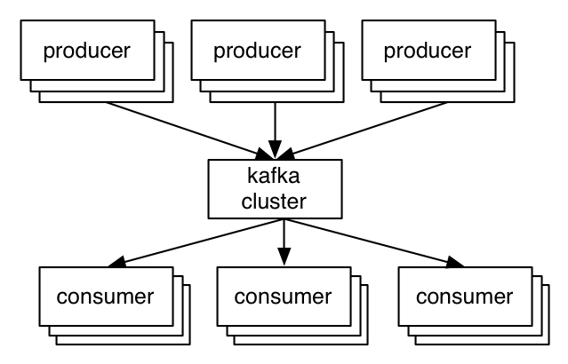
A first look
The who is who
Producers write data to brokers.
Consumers read data from brokers.
All this is distributed.
The data
Data is stored in topics.
Topics are split into partitions, which are replicated.

Slide 19
Topics
Topic: feed name to which messages are published
Example: “zerg.hydra”
Kafka prunes “head” based on age or max size or “key”
Producer A1
Kafka topic
Producer A2
…
…
new
Producer An
Older msgs
Newer msgs
Producers always append to “tail”
(think: append to a file)
Broker(s)

Slide 20
Topics
Consumer group C1
Consumers use an “offset pointer” to
track/control their read progress
(and decide the pace of consumption)
Consumer group C2
Producer A1
Producer A2
…
…
new
Producer An
Older msgs
Newer msgs
Producers always append to “tail”
(think: append to a file)
Broker(s)

Slide 21
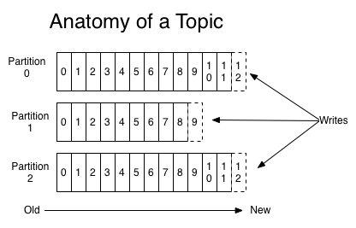
Topics
A topic consists of partitions.
Partition: ordered + immutable sequence of messages that is continually appended

Slide 22
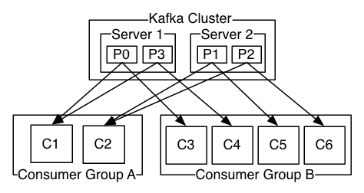
Topics
#partitions of a topic is configurable
#partitions determines max consumer (group) parallelism
Consumer group A, with 2 consumers, reads from a 4-partition topic
Consumer group B, with 4 consumers, reads from the same topic

Slide 23
Topics
Offset: messages in the partitions are each assigned a unique (per partition) and sequential id called the offset
Consumers track their pointers via (offset, partition, topic) tuples
Consumer group C1

Slide 24
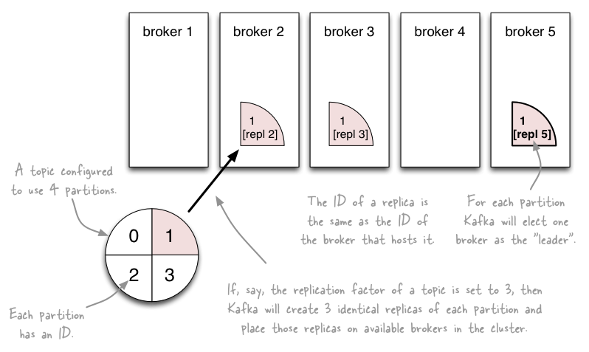
Partition
http://www.michael-noll.com/blog/2013/03/13/running-a-multi-broker-apache-kafka-cluster-on-a-single-node/

Slide 25
Broker
Broker does not Push messages to Consumer, Consumer Polls messages from Broker.
Zookeeper
Update Consumed
Message offset
Consumer1
(Group1)
get Kafka broker address
Queue
Topology
Consumer2
(Group1)
Producer
Kafka Broker
Consumer3
(Group2)
Kafka Broker
Streaming
Topic
Topology
Fetch messages
Consumer4
(Group2)

Slide 26
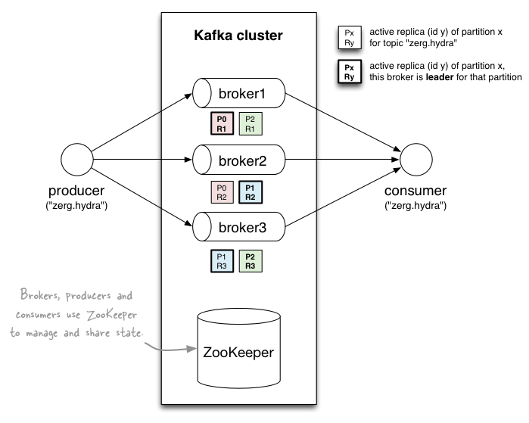
Putting it altogether
http://www.michael-noll.com/blog/2013/03/13/running-a-multi-broker-apache-kafka-cluster-on-a-single-node/

Slide 27
Kafka + Spark = Real Time Analytics

Slide 28
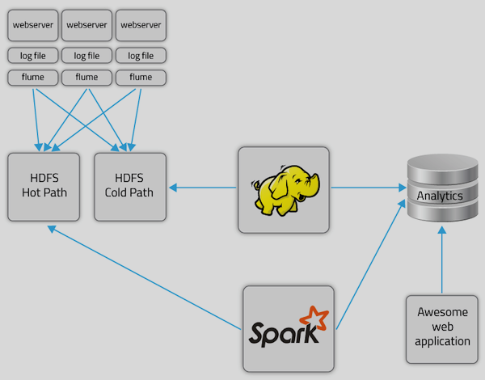
Analytics Flow

Slide 29
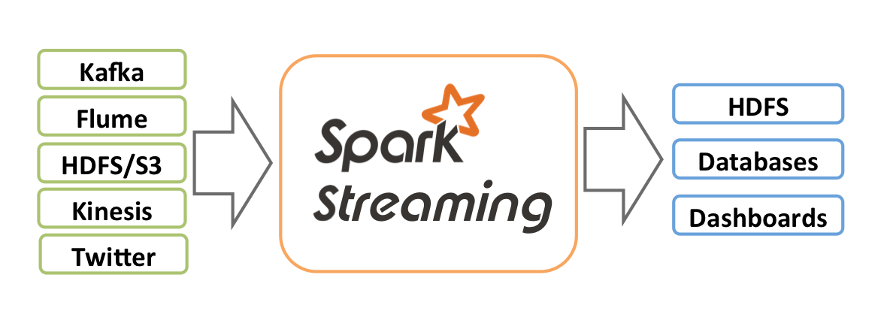
Data Ingestion Source

Slide 30
Real time Analysis with Spark Streaming

Slide 31
Analytics Result Displayed/Stored

Slide 32
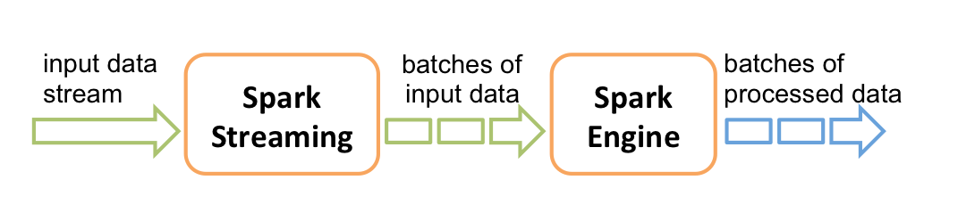
Streaming In Detail
Credit : http://spark.apache.org

Slide 34
Kafka adoption and use cases
LinkedIn : activity streams, operational metrics, data bus
400 nodes, 18k topics, 220B msg/day (peak 3.2M msg/s), May 2014
Netflix : real-time monitoring and event processing
Twitter : as part of their Storm real-time data pipelines
Spotify : log delivery (from 4h down to 10s), Hadoop
Loggly : log collection and processing
Mozilla : telemetry data
Airbnb, Cisco, Gnip, InfoChimps, Ooyala, Square, Uber, …
https://cwiki.apache.org/confluence/display/KAFKA/Powered+By

Slide 36
Survey

