Slide 1
DHCE Project
Tanuj ‘Rick’ Guha

Slide 2
Introduction.
In this presentation we will compare different standards to qualify student promotion to the 4th grade. The first standard is called the Basic Criteria, and the second, the Expanded Criteria.

Slide 3
Criteria Definitions
Here are defitions of the two criteria of student promotion:
Basic Criteria: to be promoted to 4th grade is that a student must obtain a proficiency level of 3 or 4 on the Spring State Test in 3rd grade ELA.
Expanded Criteria: to be promoted to 4th grade a student a student must meet either the basic criteria, or they score at least at the 40th percentile on the 3rd grade Spring ELA screener.

Slide 4
Calculating Retention Rates
## [1] "Retention Rate when using Basic Criteria:"
## [1] 0.2014388
## [1] "Retention Rate when using Expanded Criteria:"
## [1] 0.4334532

Slide 5
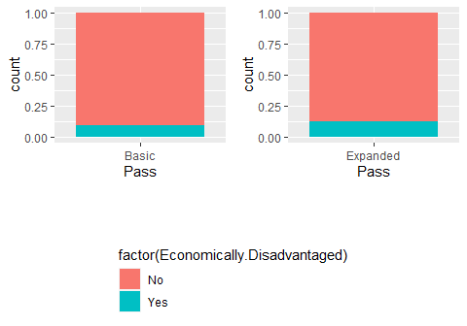
Affect of Expanded Criteria on Disadvantaged Students
Economically disadvantaged students make up a greater proportion of students who passed using the expanded criteria, when compared to students who passed using the basic criteria.

Slide 6
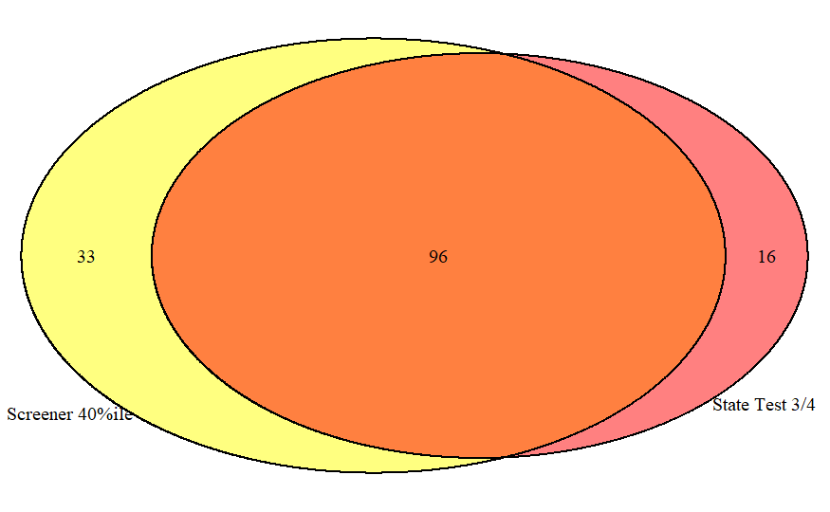
Analysis of Test Performance
Given the expansion criteria, one could ostensibly expect all students who meet 3 or 4 proficiency in the state proficiency should also score above 40 percentile in the screener.
Then, it might be interesting to see students who manage to pass in the state test but fail in the screener.

Slide 7
Final Thoughts
Findings:
The retention Rate when using Basic Criteria is 0.2014388
The retention Rate when using Expanded Criteria is 0.4334532
Expanding the criteria is good for economically disadvantaged students
16 People passed in the state test, but failed the screener.

