Slide 1


Tools for simulating and analysing data sets
Dorothy V. M. Bishop
Professor of Developmental Neuropsychology
University of Oxford
@deevybee

Slide 2
Suggested format of session
9.00 – 9.30: Introduction to p-hacking, data dredging, and HARKing
9.30-10.30 Getting started with simulations in R. Everyone tries one or more of the scripts listed on the next slide – big range of difficulty
Those familiar with R pair up if possible with R newbies
10.45-11.00 We reconvene to discuss what we’ve learned and gather suggestions for new simulations – preferably based on studies you have done or have planned
11.00-11.30 Coffee
11.30-12.30 Further exercises with simulation scripts

Slide 3
Why invent data?
If you can anticipate what your data will look like, you will also anticipate a lot of issues about study design that you might not have thought of
Analysing a simulated dataset can give huge insights into what is optimal analysis/ how the analysis works
Simulated data very useful for power analysis – deciding what sample size to use

Slide 4

The four horsemen of the Apocalypse
HARKing
Low power
P-hacking
Publication bias

Slide 5
P-hacking and HARKing

Slide 6
You run a study investigating how a drug, X, affects anxiety.
Overall symptom improvement does not differ from zero

Slide 7
You look for possible moderators – sex, age, SES. When you plot the results by age, you see this:
P-Hacking
Age x treatment effect, p < .05
Significant improvement in those aged over 36!!

Slide 8
How should you analyse/report this result?
Report that you tested whether X affects anxiety
Report that you tested whether age affects the impact of X on anxiety
Remove data from those aged under 36 as it is not interesting

Slide 9
Close link between p-hacking and HARKing
You are HARKing if you have no prior predictions, but on seeing results you write up paper as if you planned to look at effect of age on drug effect.
This kind of thing is endemic in psychology.
It is OK to say that this association was observed in exploratory analysis, and that it suggests a new hypothesis that needs to be tested in a new sample.
It is NOT OK to pretend that you predicted the association if you didn’t.
And it is REALLY REALLY NOT OK to report only the data that support your new hypothesis (i.e. removing variables/subjects)

Slide 10

Historical timeline: concerns about reproducibility
1956
De Groot
Failure to distinguish between hypothesis-testing and hypothesis-generating (exploratory) research
-> misuse of statistical tests
Acta Psychologica 148, 2014, pp. 188-194
The meaning of “significance” for different types of research [translated and annotated by Eric-Jan Wagenmakers et al. //doi.org/10.1016/j.actpsy.2014.02.001

Slide 11
Key question: Did researcher specifically predict this association?

Slide 12
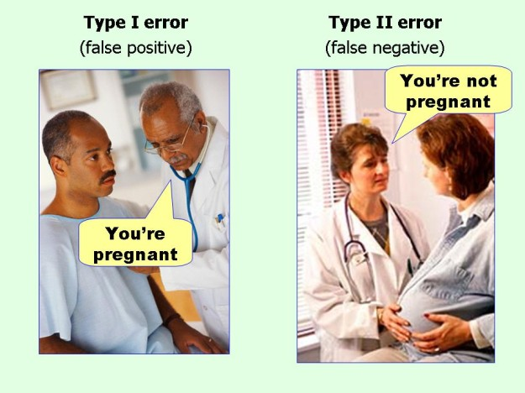
P-hacking -> huge risk of false positives

Slide 13
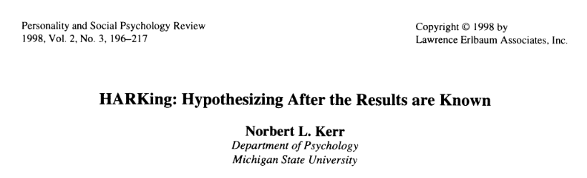

Slide 14
Explicitly advises HARKing!
Writing the Empirical Journal Article
Daryl J. Bem
The Compleat Academic: A Practical Guide for the Beginning Social Scientist, 2nd Edition. Washington, DC: American Psychological Association, 2004.
Which Article Should You Write?
There are two possible articles you can write: (a) the article you planned to write when you designed your study or (b) the article that makes the most sense now that you have seen the results. They are rarely the same, and the correct answer is (b).
re Data Analysis: Examine them from every angle. Analyze the sexes separately. Make up new composite indexes. If a datum suggests a new hypothesis, try to find additional evidence for it elsewhere in the data. If you see dim traces of interesting patterns, try to reorganize the data to bring them into bolder relief. If there are participants you don’t like, or trials, observers, or interviewers who gave you anomalous results, drop them (temporarily). Go on a fishing expedition for something— anything —interesting.
“This book provides invaluable guidance that will help new academics plan, play, and ultimately win the academic career game.”

Slide 15
One solution to protect against HARKing:
Suggested wording in write-up to keep researchers honest
‘We report how we determined our sample size, all data exclusions (if any), all manipulations, and all measures in the study.’
Simmons, J. P., Nelson, L. D., & Simonsohn, U. (2012).
A 21 Word Solution. SPSP Dialogue,26, 2, Fall 2012 issue.

Slide 16
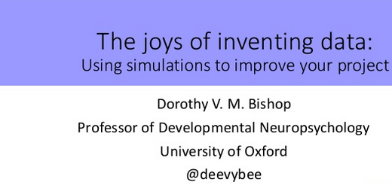
Using simulated datasets to give insight into statistical methods
https://www.slideshare.net/deevybishop/introduction-to-simulating-data-to-improve-your-research

Slide 17
Simulations help us understand problems of multiple testing, i.e. how you can get a ‘significant’ result from random data
Simulations are also useful for the opposite situation: showing how often you can fail to get a significant p-value, even when there is a true effect
This brings us on to the topic of statistical power (covered by Stan Lazic on Thursday)

Slide 18
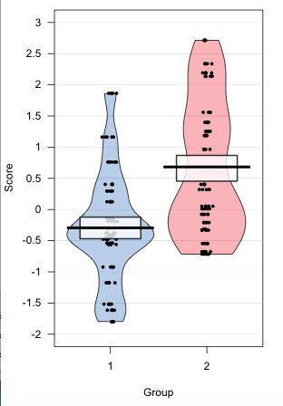
Basic idea
Anything you measure has an effect of interest plus random noise
The goal of research is to find out
(a) whether there is an effect of interest
(b) if yes, how big it is
Classic hypothesis-testing with p-values is simply focuses just on (a) – i.e. have we just got noise or a real effect?
We can simulate most scenarios by generating random noise, with or without a consistent added effect

Slide 19
Repeated sampling from simulated data allows you to see how statistics vary with the play of chance
See Geoff Cumming: Dance of the p-values
https://www.youtube.com/watch?v=5OL1RqHrZQ8

Slide 20
Key point: p-values can only be interpreted in terms of the context in which they are computed
Importance of p < .05 makes sense only in relation to an a-priori hypothesis
Many ways in which ‘hidden multiplicity’ of testing can give false positive (p < .05) results
Data dredging from a large set of variables
Trying various analytic approaches until one ‘works’
Multi-way Anova with many main effects/interactions
Post-hoc division of data into subgroups

Slide 21
Getting started in R
Important to set your working directory – place where R will look for files to read and will save files unless told otherwise.
`Can do this with command setwd()
Mac example: setwd (“/Users/dbishop/Dropbox/repcourse”)
PC example: setwd("C:\\Users\\dorothybishop\\Dropbox\\repcourse")
Easier way in R studio: Session | Set Working Directory
Commands require() and library() are equivalent: they load packages you will need.
Packages need to be installed first; easy way to do this is via Tools|Install Packages. Only need to do that once

Slide 22
Getting started in R (ctd)
General rule #1:if you don't understand something, Google it!
General rule #2: You learn most when something doesn’t work and you have to work out why
General rule #3: you can learn a lot by tweaking a line of script to see what happens, but always make a copy of the original working script first.
If script doesn’t work, scroll back in Console to first (red) error message
When you select Run in taskbar, it only runs highlighted text (cf. Matlab). This means you can work through script line by line to see what it does
This won’t, however work for a line that ends in ‘{‘ as script will pause to wait for ‘}’

Slide 23
R scripts available on : https://osf.io/gupxv/
Simulation_ex1_intro.R
Suitable for R newbies. Demonstrates ‘dance of the p-values’ in a t-test. Bonus, you learn to make pirate plots
Simulation_ex1_multioutput.R takes same basic idea but uses loops to run multiple times.
Simulation_ex2_correlations
Generate correlation matrices from multivariate normal distribution. Bonus, you learn to use ‘grid’ to make nicely formatted tabular outputs.
Simulation_ex3_multiwayAnova.R
Simulate data for a 3-way mixed ANOVA. Demonstrates need to correct for N factors and interactions when doing exploratory multiway Anova.
Simulation_ex4_multipleReg.R
Simulate data for multiple regression.
Simulation_ex5_falsediscovery.R
Simulate data for mixture of null and true effects, to demonstrate that the probability of the data given the hypothesis is different from the probability of the hypothesis given the data.
Two simulations from Daniel Lakens’ Coursera Course – with notes!
1.1 WhichPvaluesCanYouExpect.R; 3.2 OptionalStoppingSim.R
Now even more: See OSF!

Slide 25
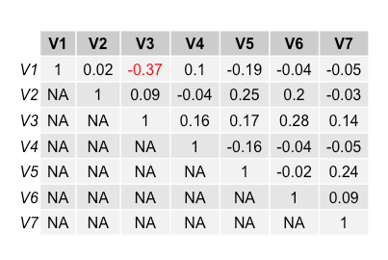
Correlation matrix for run 1
Output from simulation of 7 independent variables, where true correlation = 0
N = 30
Red denotes p < .05 ( r > .31 or < -.31);

Slide 26
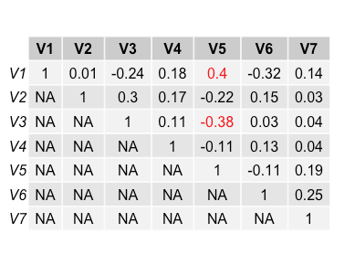
Correlation matrix for run 2
Output from simulation of 7 independent variables, where true correlation = 0
N = 30
Red denotes p < .05 ( r > .31 or < -.31);

Slide 27
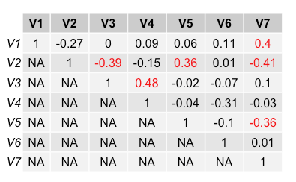
Correlation matrix for run 3
Output from simulation of 7 independent variables, where true correlation = 0
N = 30
Red denotes p < .05 ( r > .31 or < -.31);
There is no relation between variables – why do we have significant values?

Slide 28
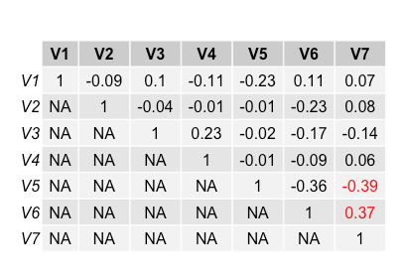
Correlation matrix for run 4
Output from simulation of 7 independent variables, where true correlation = 0
N = 30
Red denotes p < .05 ( r > .31 or < -.31);
Bonferroni corrected p-value is .05/21 = .002, corresponds to r = .51

Slide 29
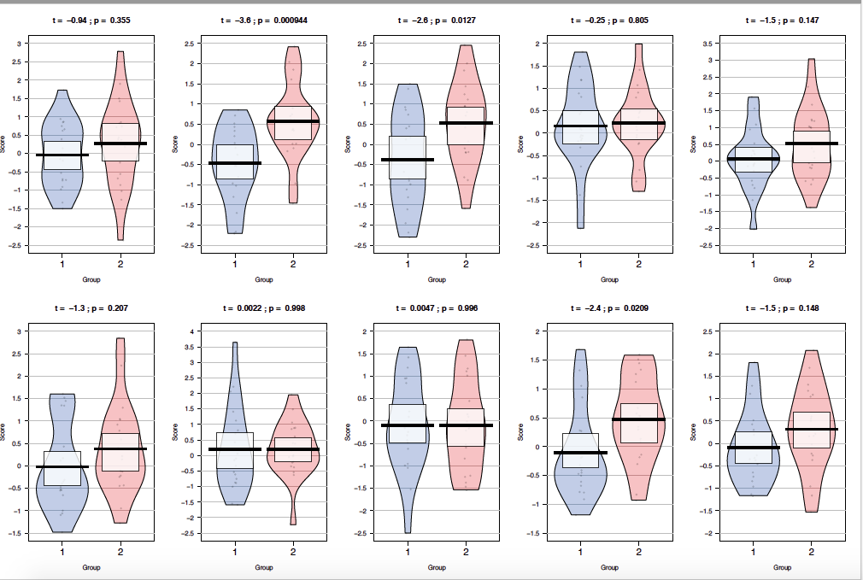
10 runs of simulation with N = 20 per group and effect size (d) = .3
**
*
*

