Slide 1
Final Exam
Department of Computer Science
Hofstra University

Slide 2
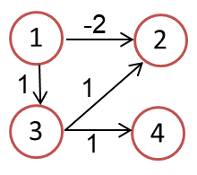

Slide 3
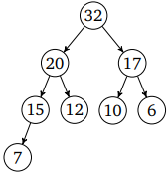
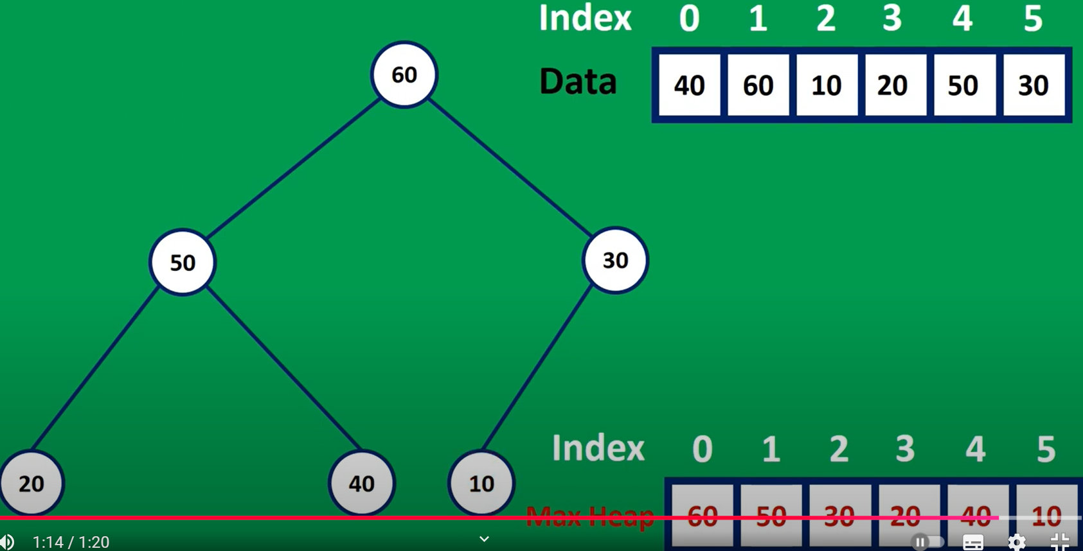
Max Heap
50
40
30
20
10
60
50
30
5
4
20
40
10
4
2
3
2
50
1
3
1
40
30
20
10

Slide 4
32
20
17
15
12
10
6
7
20
15
17
7
12
10
6

Slide 5
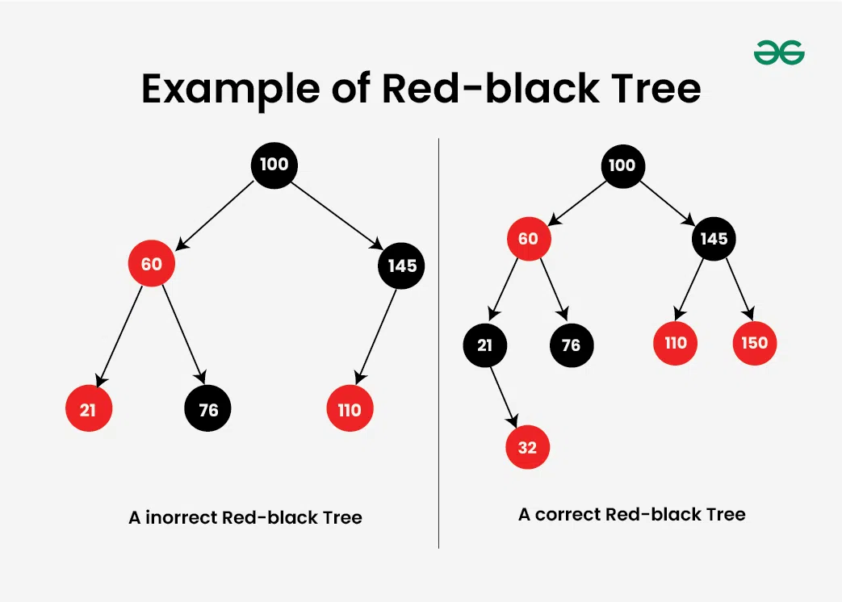

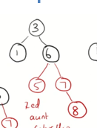
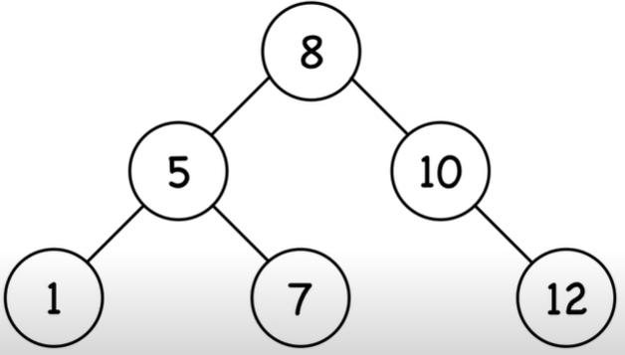
RBT
3
b
3
2
6
b
1
b
5
7
1
5
r
7
8
5
9
12
1
7
12

Slide 6
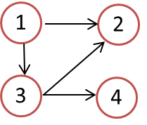
Adjacency List
1 2 3 4
1
2
3
4
0
1
1
1
1 2 3 4
1
2
3
4
1
0
1
1
0
1
1
0
0
1
1
0
0
1
0
1
1
1
0
1
0
0
0
0
0
0
0
0
0
0
0
0
1
1
1
0
0
1
0
1
0
1
0
1
0
0
0
0
0
0
0
0
0
0
0
0
0
0
0
0
1 2 3 4
1
2
3
4
Adjacency list:
1 → {2, 3, 4}
2 → {4}
3 → {2, 4}
4 → {}
1
2
0
1
1
1
0
1
1
1
0
1
0
2
0
0
0
1
0
0
0
1
0
0
0
0
3
4
0
1
0
1
0
1
0
1
0
0
0
1
0
0
0
0
0
0
0
0
0
0
0
0
1 2 3 4
1
2
3
4
Adjacency list:
1 → {2, 3, 4}
2 → {1, 3, 4}
3 → {1, 2, 4}
4 → {1, 2, 3}
1
2
0
1
1
1
0
1
1
1
3
2
2
2
1
0
1
1
1
0
1
1
2
3
2
2
3
4
1
1
0
1
1
1
0
1
2
2
3
2
1
1
1
0
1
1
1
0
2
2
2
3

Slide 7
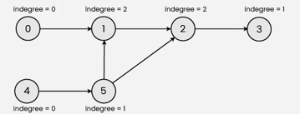
Khan algorithm
0
1
2
3
5
4
0
1
2
2
0
1
3
4
5
3
a
c
e
b
d
f
Notes:
1 → {2, 3}
2 → {}
3 → {2, 4}
4 → {}

Slide 8
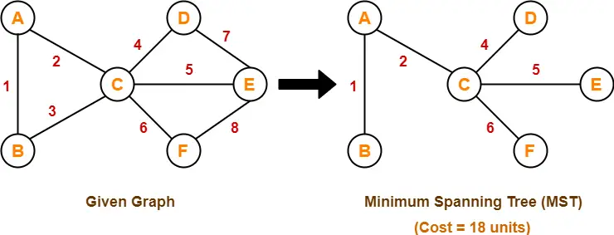
MST Prim Kruskal
AB, AC, CD, CE, CF
a
c
e
b
d
f

Slide 9
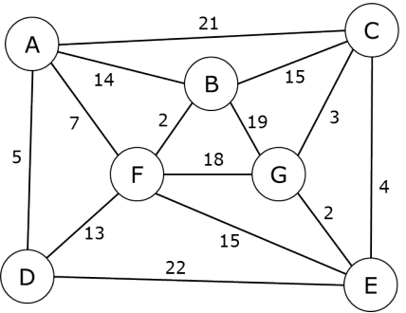
MST Prim Kruskal
1
16

Slide 10
Complete Binary Tree or Not?
Above: complete binary trees
Below: not complete binary trees
Leaf level is not filled from left to right.
Non-leaf level is not completely filled.

Slide 11
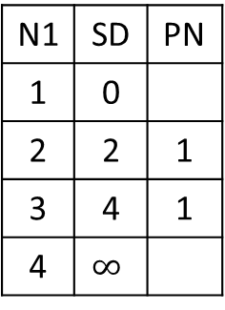
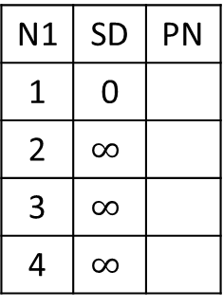
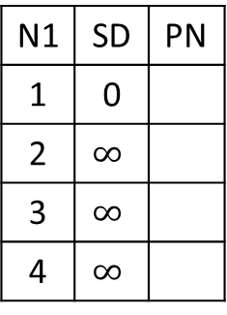
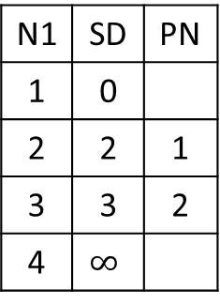
N1 | SD | PN
1 | 0
2 | $$∞$$
3 | $$∞$$
4 | $$∞$$
N1 | SD | PN
1 | 0
2
3
4
N1 | SD | PN
1 | 0
2
3
4
N1 | SD | PN
1 | 0
2
3
4
 | SD | PN
1 | 0
2
3
4
Visit___
Visit___
Visit___
Visit___
1
2
2
4
1
3
1
4
N1 | SD | PN
1 | 0
2 | $$∞$$
3 | $$∞$$
4 | $$∞$$
N1 | SD | PN
1 | 0
2 | 2 | 1
3 | 4 | 1
4 | $$∞$$
N1 | SD | PN
1 | 0
2 | 2 | 1
3 | 3 | 2
4 | $$∞$$
N1 | SD | PN
1 | 0
2 | 2 | 1
3 | 3 | 2
4 | 4 | 3
N1 | SD | PN
1 | 0
2 | 2 | 1
3 | 3 | 2
4 | 4 | 3
Visit 1
Visit 2
Visit 3
Visit 4

Slide 12
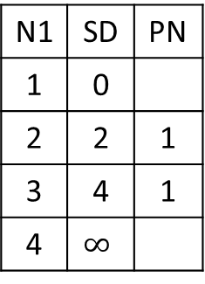
N1 | SD | PN
1 | 0
2 | $$∞$$
3 | $$∞$$
4 | $$∞$$
N1 | SD | PN
1 | 0
2
3
4
N1 | SD | PN
1 | 0
2
3
4
N1 | SD | PN
1 | 0
2
3
4
N1 | SD | PN
1 | 0
2
3
4
Visit___
Visit___
Visit___
Visit___
1
2
2
4
1
3
1
4
N1 | SD | PN
1 | 0
2 | $$∞$$
3 | $$∞$$
4 | $$∞$$
N1 | SD | PN
1 | 0
2 | 2 | 1
3 | 4 | 1
4 | $$∞$$
N1 | SD | PN
1 | 0
2 | 2 | 1
3 | 4 | 1
4 | $$∞$$
N1 | SD | PN
1 | 0
2 | 2 | 1
3 | 4 | 1
4 | 5 | 3
N1 | SD | PN
1 | 0
2 | 2 | 1
3 | 4 | 1
4 | 5 | 3
Visit 1
Visit 2
Visit 3
Visit 4

Slide 13
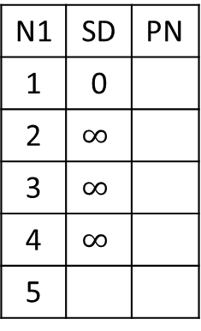
N1 | SD | PN
1 | 0
2 | $$∞$$
3 | $$∞$$
4 | $$∞$$
5
N1 | SD | PN
1 | 0
2
3
4
5
N1 | SD | PN
1 | 0
2
3
4
5
N1 | SD | PN
1 | 0
2
3
4
5
 | SD | PN
1
2
3
4
5
Visit___
Visit___
Visit___
Visit___
1
2
2
4
4
1
5
3
1
4
1

Slide 14
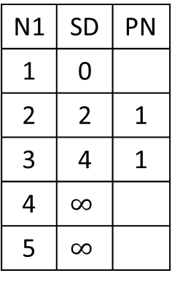
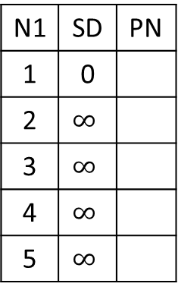
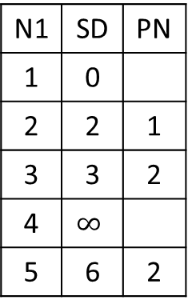
1
2
2
4
4
1
5
3
1
4
1
N1 | SD | PN
1 | 0
2 | $$∞$$
3 | $$∞$$
4 | $$∞$$
5 | $$∞$$
N1 | SD | PN
1 | 0
2 | 2 | 1
3 | 4 | 1
4 | $$∞$$
5 | $$∞$$
N1 | SD | PN
1 | 0
2 | 2 | 1
3 | 3 | 2
4 | $$∞$$
5 | 6 | 2
 | SD | PN
1 | 0
2 | 2 | 1
3 | 3 | 2
4 | 4 | 3
5 | 6 | 2
N1 | SD | PN
1 | 0
2 | 2 | 1
3 | 3 | 2
4 | 4 | 3
5 | 5 | 4
Visit 1
Visit 2
Visit 3
Visit 4
 | SD | PN
1 | 0
2 | 2 | 1
3 | 3 | 2
4 | 4 | 3
5 | 5 | 4
Visit 5

Slide 15
Confusion Entries
 | SD | PN
1 | 0
2 | 2 | 1
3 | 4 | 1
4 | 4 | 3
5 | 5 | 4
 | SD | PN
1 | 0
2 | 2 | 1
3 | 3 | 2
4 | 4 | 3
5 | 6 | 2

Slide 16
N1 | SD | PN
1 | 0
2 | $$∞$$
3 | $$∞$$
4 | $$∞$$
5
N1 | SD | PN
1 | 0
2
3
4
5
N1 | SD | PN
1 | 0
2
3
4
5
N1 | SD | PN
1 | 0
2
3
4
5
N1 | SD | PN
1 | 0
2
3
4
5
Visit___
Visit___
Visit___
Visit___
N1 | SD | PN
1 | 0
2
3
4
5
Visit___
1
2
2
4
4
1
5
3
1
4
1

Slide 17
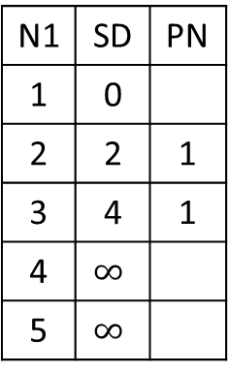
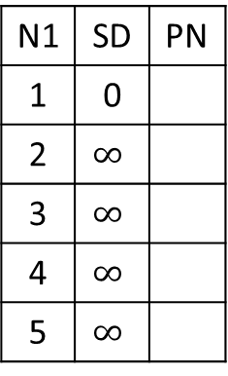
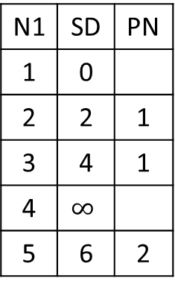
1
2
2
4
4
1
5
3
1
4
1
N1 | SD | PN
1 | 0
2 | $$∞$$
3 | $$∞$$
4 | $$∞$$
5 | $$∞$$
N1 | SD | PN
1 | 0
2 | 2 | 1
3 | 4 | 1
4 | $$∞$$
5 | $$∞$$
N1 | SD | PN
1 | 0
2 | 2 | 1
3 | 4 | 1
4 | $$∞$$
5 | 6 | 2
 | SD | PN
1 | 0
2 | 2 | 1
3 | 4 | 1
4 | 5 | 3
5 | 6 | 2
N1 | SD | PN
1 | 0
2 | 2 | 1
3 | 4 | 1
4 | 5 | 3
5 | 6 | 2
Visit 1
Visit 2
Visit 3
Visit 4
 | SD | PN
1 | 0
2 | 2 | 1
3 | 4 | 1
4 | 5 | 3
5 | 6 | 2
Visit 5

Slide 18


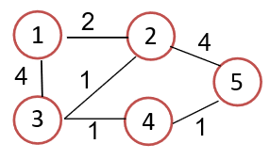
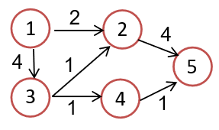

Slide 19
Johnson’s Algorithm 1
H[1]=0
H[2]=-2
H[1]=0
H[2]=-2
-2
-2+0-(-2)=0
1
2
1
2
0
1
2
1
1
1+0-0=1
1+0-(-2)=3
1
3
3
1
4
3
4
H[3]=0
H[4]=0
3
1
4
1+0-0=1
H[3]=0
H[4]=0

Slide 20
Johnson’s Algorithm 2
0 –(0-(-2))=-2
1-(0-0)=1
1 – (0-(-1))=0
 | SD | PN
1 | 0
2 | 0 | 1
3 | 1 | 1
4 | 1 | 3
 | SD | PN
1 | 0
2 | -2 | 1
3 | 1 | 1
4 | 0 | 3
1
0
2
1
3
3
0
4
h[1]=0
h[2]=-2
h[1]=0
h[2]=-2
-2+0-(-2)=0
1
-2
2
1
2
1
1
1+0-0=1
1+0-(-2)=3
3
4
3
4
-1
-1+0-(-1)=0
h[3]=0
h[4]=-1
h[3]=0
h[4]=-1

Slide 21
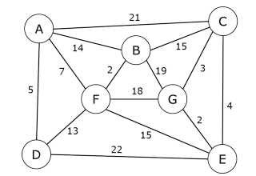
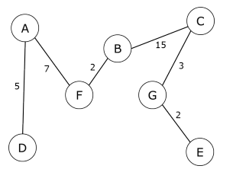
MST
A
21
C
14
15
7
B
3
2
19
F
18
G

Slide 22
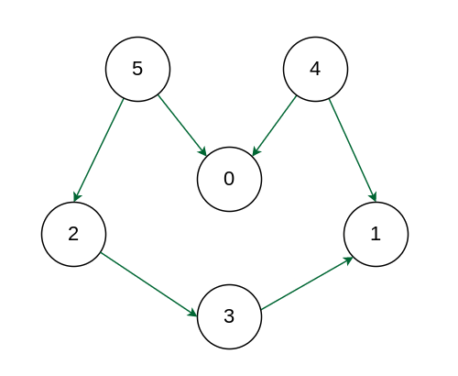
5
4
2
0
1
3

Slide 23
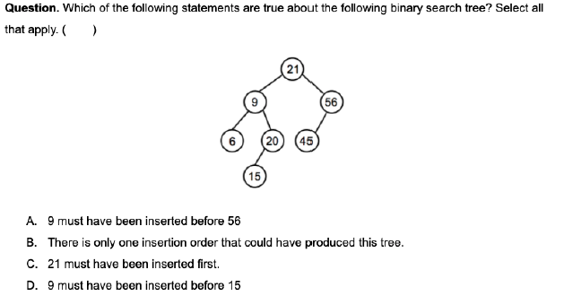
21
9
56
6
20
45
15

Slide 24
Heap complete binary trees

Slide 25
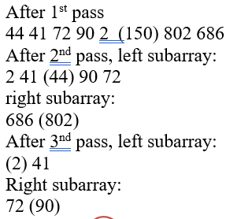
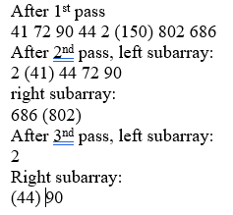
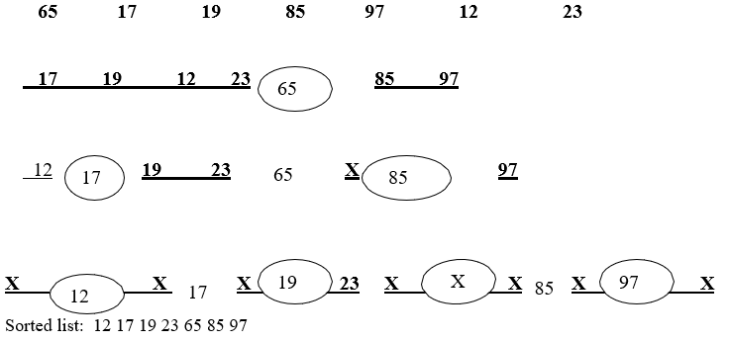
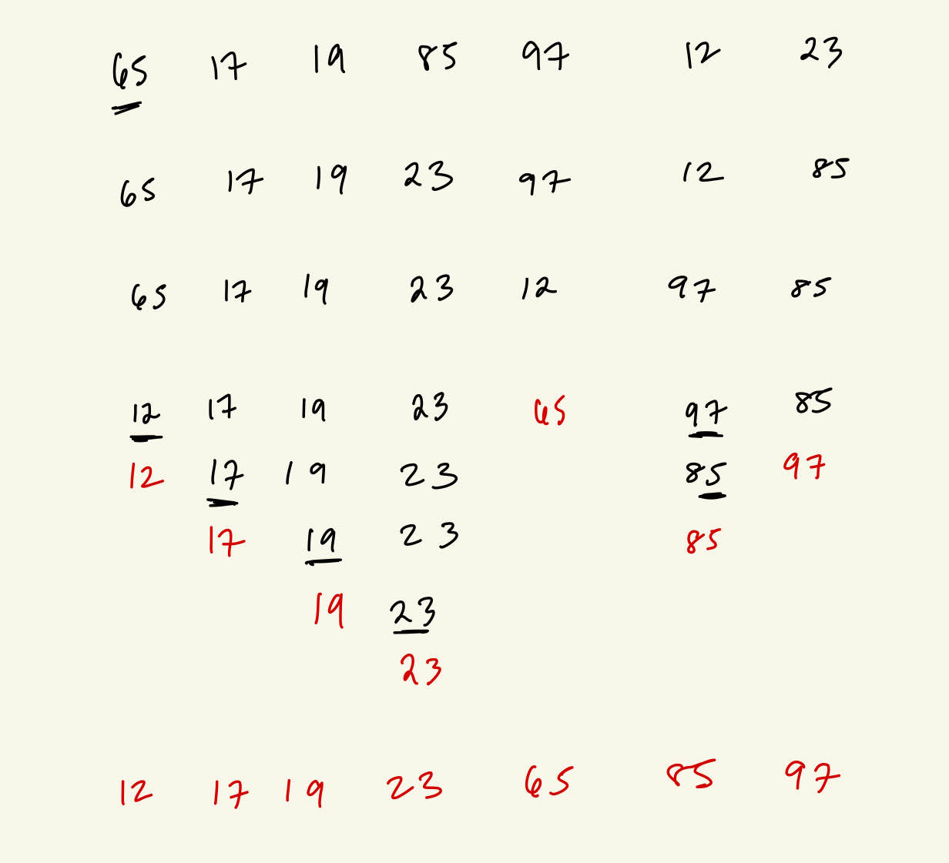
Quicksort
65
150
12
97
44
802
17
85
12 17 19 23 (65) 97 85
Left part: (12) 17 19 23
(17) 19 23
(19) 23
Right part: 85 (97)
19
2
90
686
41
72
23
44

Slide 26
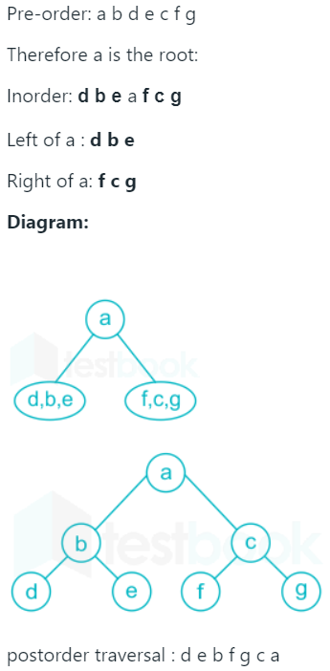
Binary Tree Traversal
Preorder abdcfg
Inorder dbafcg
e
a, b, c, d
f, g
a
a
b
c
d, b, e
f, c, g
abcd
a
d
e
e
b
c
b
f
d
g
f
g
a
c
g
d
ajohn
b
c
d
f
g

Slide 27
CSC175

Slide 28
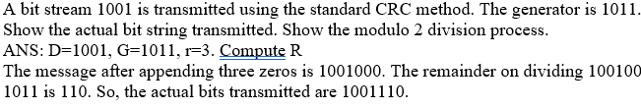
1
1
0
1
1
0
1
1
1 0 1 1
1 1 1 1 0 0
0
1 0 1 1
1 1 1 1 1 1
1
1 0 1 1
1 0 1 1
1 0 0 0
1 0 0 1
1 0 1 1
1 0 1 1
1 1 0 0
1 0 1 1
1 0 1 1
1 0 1 1
1 1 1
1 1 1

Slide 29
Plain | 000 | 001 | 010 | 011 | 100 | 101 | 110 | 111
Cipher | 110 | 111 | 101 | 100 | 011 | 010 | 000 | 001
Plain | 000 | 001 | 010 | 011 | 100 | 101 | 110 | 111
Cipher | 110 | 111 | 101 | 100 | 011 | 010 | 000 | 001

Slide 30
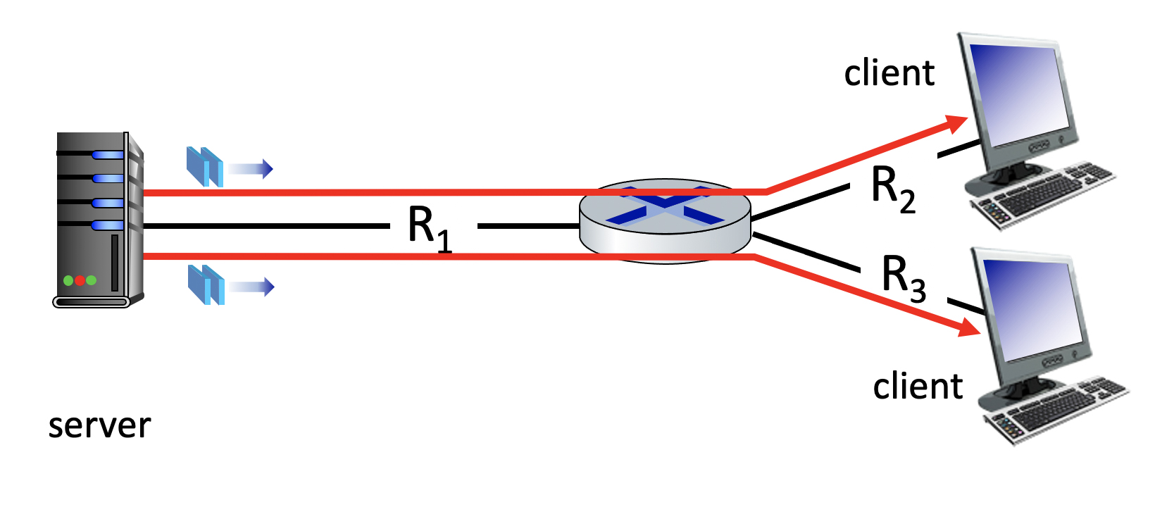
25 Mbps
10 Mbps
50 Mbps

Slide 31
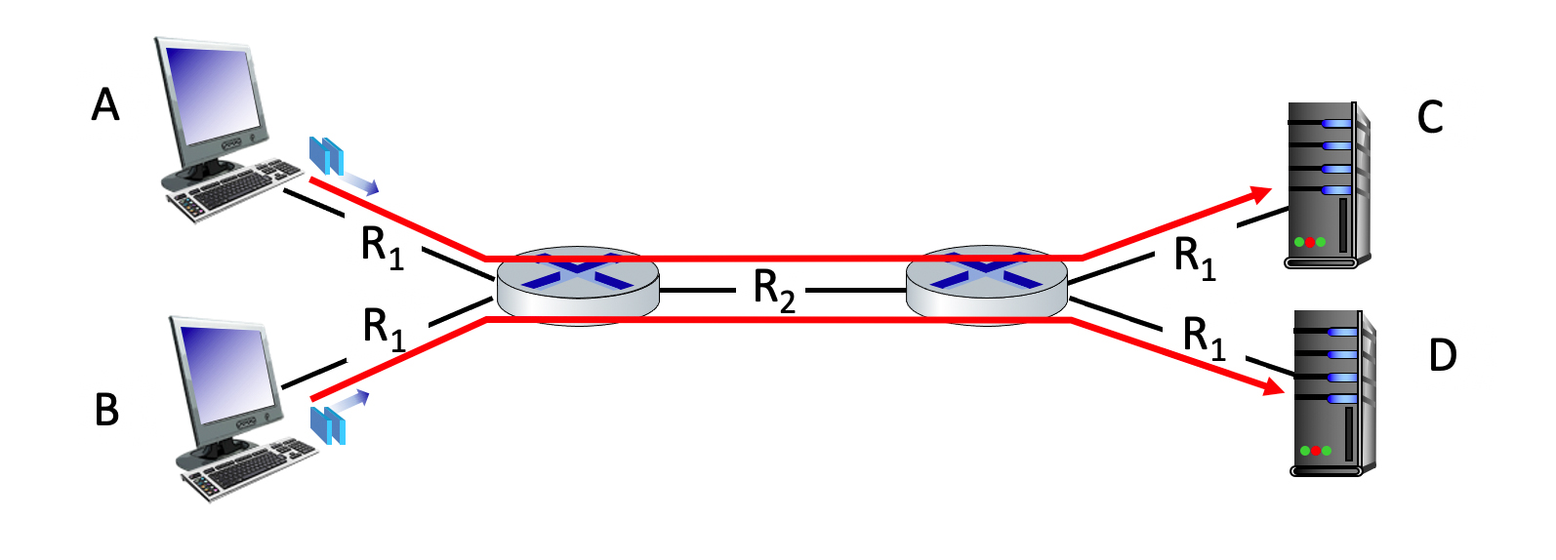
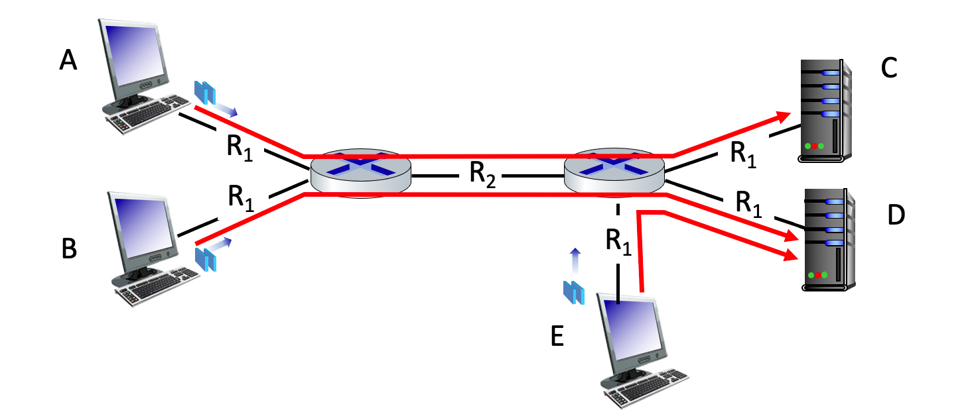
100 Mbps
100 Mbps
150 Mbps
100 Mbps
100 Mbps
100 Mbps
100 Mbps
150 Mbps
100 Mbps
100 Mbps
100 Mbps

Slide 32
1 0 1 0 1
1
1 1 1 1 0
0
0 1 1 1 0
1
0 0 1 0 1
0
1 0 1 0 1
1
1 1 1 1 0
0
1 0 1 0 0 0
parity
error
0 1 1 1 0
1
1 0 1 1 0 1
parity
error
0 0 1 0 1
0
0 1 1 1 1 0
parity
error
0 1 1 0 1 0
parity
error

