Slide 1
Final Exam
Department of Computer Science
Hofstra University

Slide 2
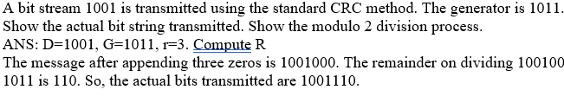
1
1
0
1
1
0
1
1
1 0 1 1
1 1 1 1 0 0
0
1 0 1 1
1 1 1 1 1 1
1
1 0 1 1
1 0 1 1
1 0 0 0
1 0 0 1
1 0 1 1
1 0 1 1
1 1 0 0
1 0 1 1
1 0 1 1
1 0 1 1
1 1 1
1 1 1

Slide 3
Plain | 000 | 001 | 010 | 011 | 100 | 101 | 110 | 111
Cipher | 110 | 111 | 101 | 100 | 011 | 010 | 000 | 001
Plain | 000 | 001 | 010 | 011 | 100 | 101 | 110 | 111
Cipher | 110 | 111 | 101 | 100 | 011 | 010 | 000 | 001

Slide 4
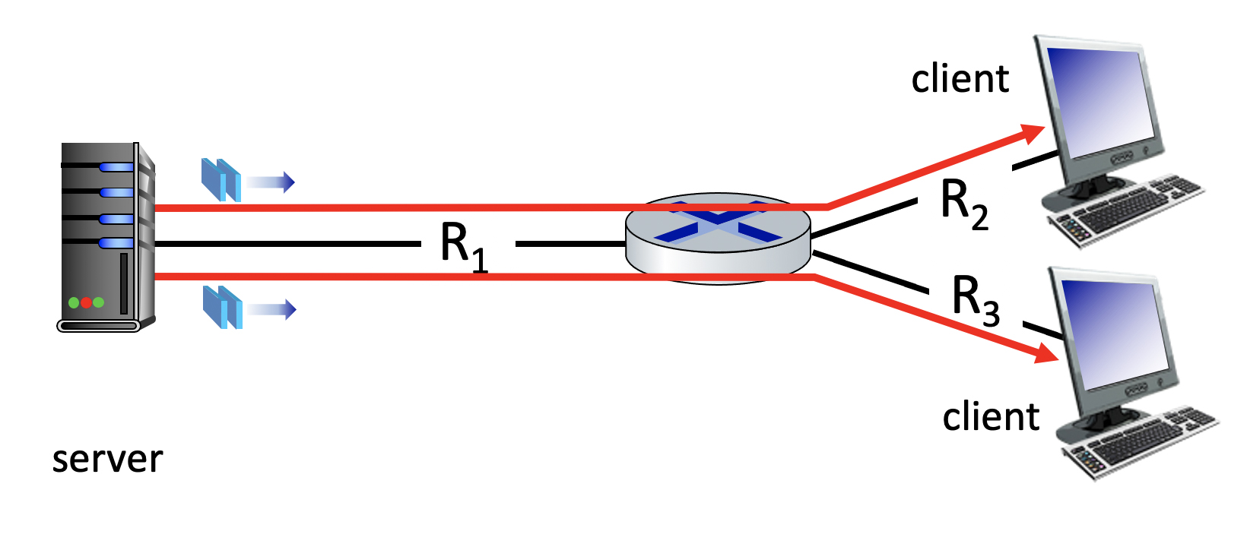
25 Mbps
10 Mbps
50 Mbps

Slide 5
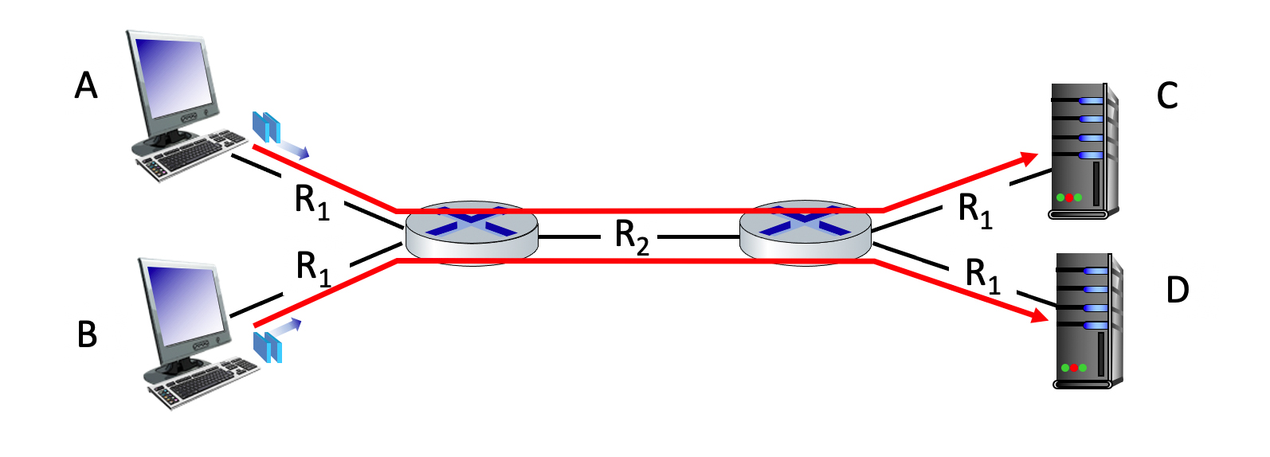
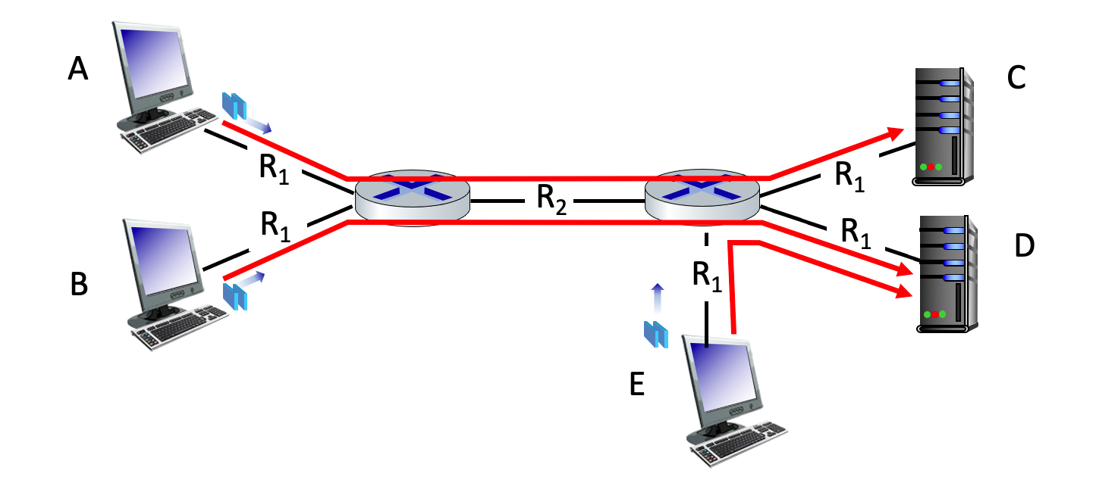
100 Mbps
100 Mbps
150 Mbps
100 Mbps
100 Mbps
100 Mbps
100 Mbps
150 Mbps
100 Mbps
100 Mbps
100 Mbps

Slide 6
1 0 1 0 1
1
1 1 1 1 0
0
0 1 1 1 0
1
0 0 1 0 1
0
1 0 1 0 1
1
1 1 1 1 0
0
1 0 1 0 0 0
parity
error
0 1 1 1 0
1
1 0 1 1 0 1
parity
error
0 0 1 0 1
0
0 1 1 1 1 0
parity
error
0 1 1 0 1 0
parity
error

Slide 7
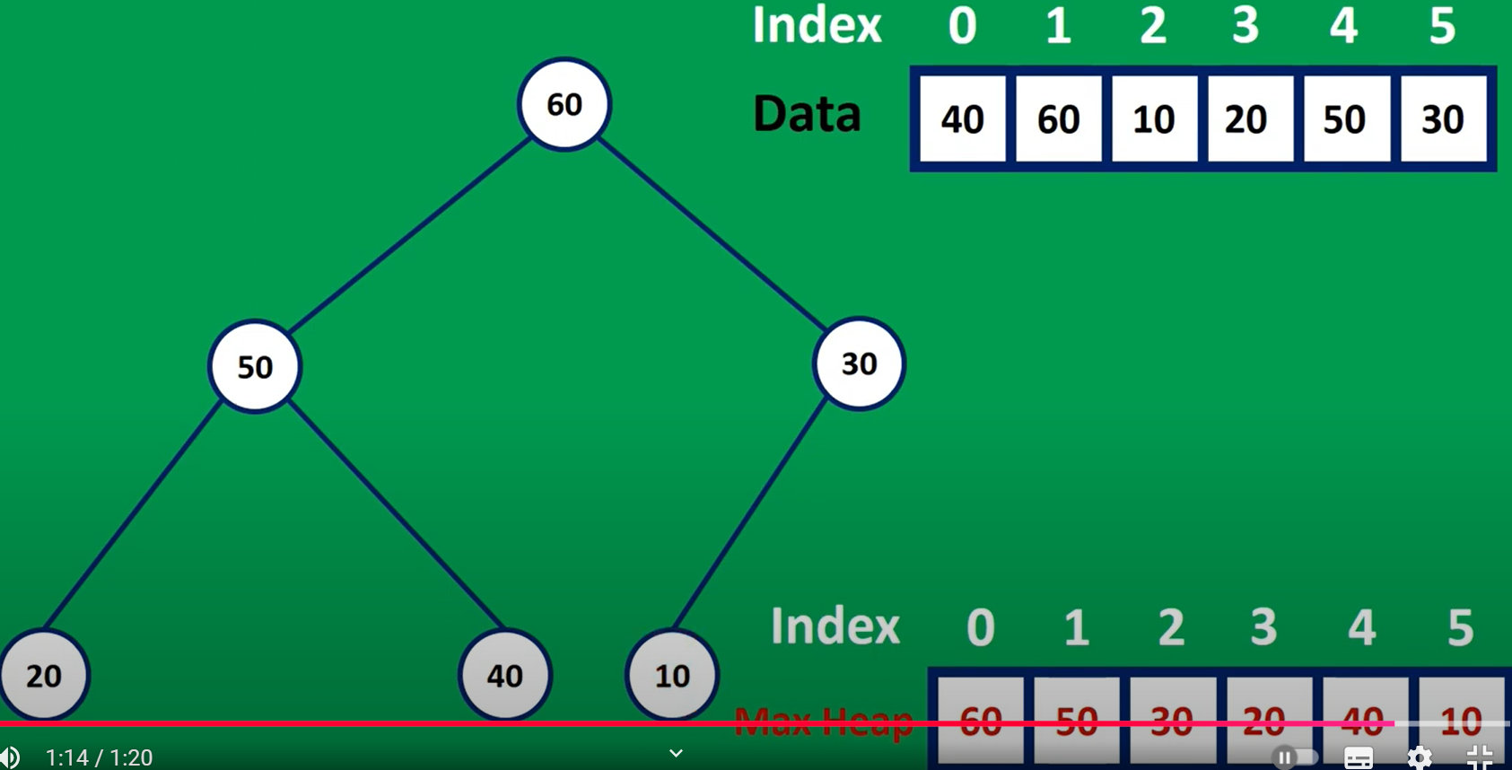
60
50
30
50
20
40
10
40
30
20
10

Slide 8

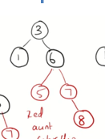
b
3
b
3
b
1
b
5
b
1
b
6
r
7
r
5
r
7

Slide 9
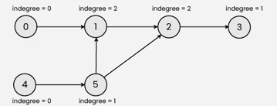
0
1
2
3
0 → {1, 2}
1
2
1 → {3}
2 → {1, 3}
3
4
3 → null
5
4
0
1
2
1 2 3 4
2
0
1
3
4
5
1
2
3
4
0
1
1
0
0
1
1
0
0
1
0
1
0
0
0
0
0
0
0
0
0
0
0
0
3
0
1
0
1
0
1
0
1
0
0
0
0
0
0
0
0
0
0
0
0
0
0
0
0
Notes:
1 → {2, 3}
2 → {}
3 → {2, 4}
4 → {}

Slide 10
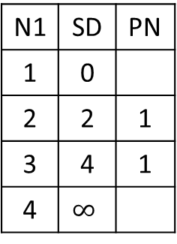
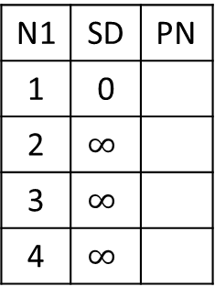
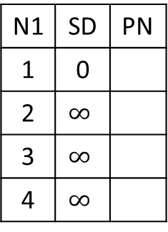
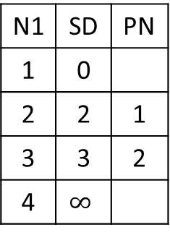
N1 | SD | PN
1 | 0
2 | $$∞$$
3 | $$∞$$
4 | $$∞$$
N1 | SD | PN
1 | 0
2
3
4
N1 | SD | PN
1 | 0
2
3
4
N1 | SD | PN
1 | 0
2
3
4
N1 | SD | PN
1 | 0
2
3
4
Visit___
Visit___
Visit___
Visit___
1
2
2
4
1
3
1
4
N1 | SD | PN
1 | 0
2 | $$∞$$
3 | $$∞$$
4 | $$∞$$
N1 | SD | PN
1 | 0
2 | 2 | 1
3 | 4 | 1
4 | $$∞$$
N1 | SD | PN
1 | 0
2 | 2 | 1
3 | 3 | 2
4 | $$∞$$
N1 | SD | PN
1 | 0
2 | 2 | 1
3 | 3 | 2
4 | 4 | 3
N1 | SD | PN
1 | 0
2 | 2 | 1
3 | 3 | 2
4 | 4 | 3
Visit 1
Visit 2
Visit 3
Visit 4

Slide 11
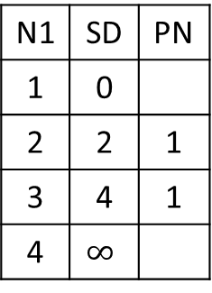
N1 | SD | PN
1 | 0
2 | $$∞$$
3 | $$∞$$
4 | $$∞$$
N1 | SD | PN
1 | 0
2
3
4
N1 | SD | PN
1 | 0
2
3
4
N1 | SD | PN
1 | 0
2
3
4
N1 | SD | PN
1 | 0
2
3
4
Visit___
Visit___
Visit___
Visit___
1
2
2
4
1
3
1
4
N1 | SD | PN
1 | 0
2 | $$∞$$
3 | $$∞$$
4 | $$∞$$
N1 | SD | PN
1 | 0
2 | 2 | 1
3 | 4 | 1
4 | $$∞$$
N1 | SD | PN
1 | 0
2 | 2 | 1
3 | 4 | 1
4 | $$∞$$
N1 | SD | PN
1 | 0
2 | 2 | 1
3 | 4 | 1
4 | 5 | 3
N1 | SD | PN
1 | 0
2 | 2 | 1
3 | 4 | 1
4 | 5 | 3
Visit 1
Visit 2
Visit 3
Visit 4

Slide 12
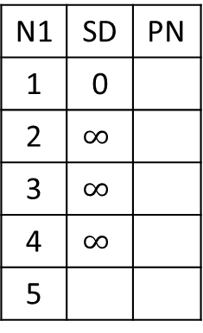
N1 | SD | PN
1 | 0
2 | $$∞$$
3 | $$∞$$
4 | $$∞$$
5
N1 | SD | PN
1 | 0
2
3
4
5
N1 | SD | PN
1 | 0
2
3
4
5
N1 | SD | PN
1 | 0
2
3
4
5
N1 | SD | PN
1 | 0
2
3
4
5
Visit___
Visit___
Visit___
Visit___
1
2
2
4
4
1
5
3
1
4
1

Slide 13
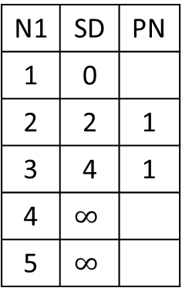
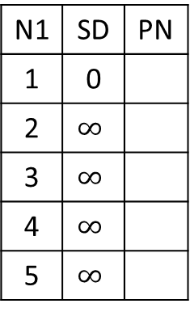
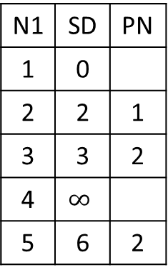
1
2
2
4
4
1
5
3
1
4
1
N1 | SD | PN
1 | 0
2 | $$∞$$
3 | $$∞$$
4 | $$∞$$
5 | $$∞$$
N1 | SD | PN
1 | 0
2 | 2 | 1
3 | 4 | 1
4 | $$∞$$
5 | $$∞$$
N1 | SD | PN
1 | 0
2 | 2 | 1
3 | 3 | 2
4 | $$∞$$
5 | 6 | 2
 | SD | PN
1 | 0
2 | 2 | 1
3 | 3 | 2
4 | 4 | 3
5 | 6 | 2
N1 | SD | PN
1 | 0
2 | 2 | 1
3 | 3 | 2
4 | 4 | 3
5 | 5 | 4
Visit 1
Visit 2
Visit 3
Visit 4
 | SD | PN
1 | 0
2 | 2 | 1
3 | 3 | 2
4 | 4 | 3
5 | 5 | 4
Visit 4

Slide 14
Confusion Entries
 | SD | PN
1 | 0
2 | 2 | 1
3 | 4 | 1
4 | 4 | 3
5 | 5 | 4
 | SD | PN
1 | 0
2 | 2 | 1
3 | 3 | 2
4 | 4 | 3
5 | 6 | 2

Slide 15
N1 | SD | PN
1 | 0
2 | $$∞$$
3 | $$∞$$
4 | $$∞$$
5
N1 | SD | PN
1 | 0
2
3
4
5
N1 | SD | PN
1 | 0
2
3
4
5
N1 | SD | PN
1 | 0
2
3
4
5
N1 | SD | PN
1 | 0
2
3
4
5
Visit___
Visit___
Visit___
Visit___
N1 | SD | PN
1 | 0
2
3
4
5
Visit___
1
2
2
4
4
1
5
3
1
4
1

Slide 16
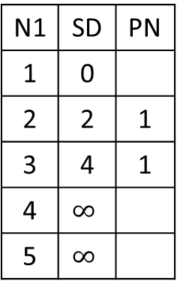
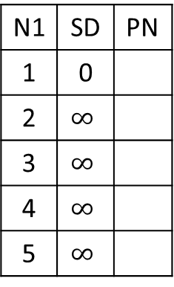
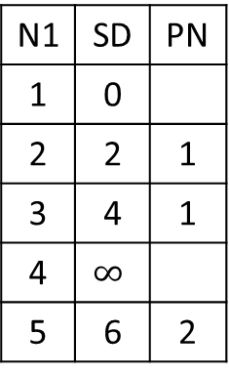
1
2
2
4
4
1
5
3
1
4
1
N1 | SD | PN
1 | 0
2 | $$∞$$
3 | $$∞$$
4 | $$∞$$
5 | $$∞$$
N1 | SD | PN
1 | 0
2 | 2 | 1
3 | 4 | 1
4 | $$∞$$
5 | $$∞$$
N1 | SD | PN
1 | 0
2 | 2 | 1
3 | 4 | 1
4 | $$∞$$
5 | 6 | 2
 | SD | PN
1 | 0
2 | 2 | 1
3 | 4 | 1
4 | 5 | 3
5 | 6 | 2
N1 | SD | PN
1 | 0
2 | 2 | 1
3 | 4 | 1
4 | 5 | 3
5 | 6 | 2
Visit 1
Visit 2
Visit 3
Visit 4
 | SD | PN
1 | 0
2 | 2 | 1
3 | 4 | 1
4 | 5 | 3
5 | 6 | 2
Visit 5

Slide 17


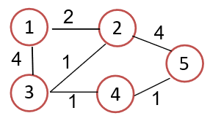
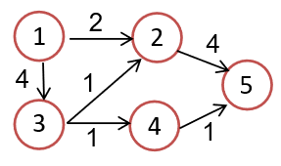

Slide 18
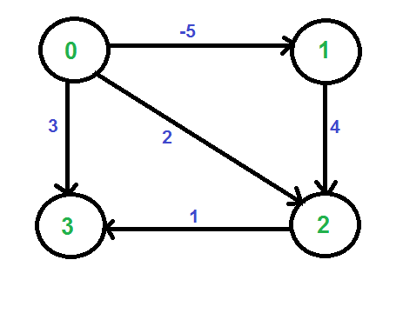
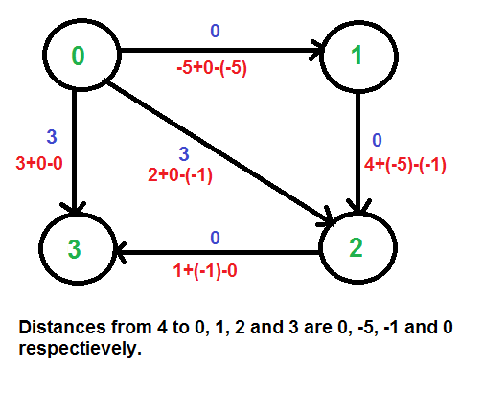
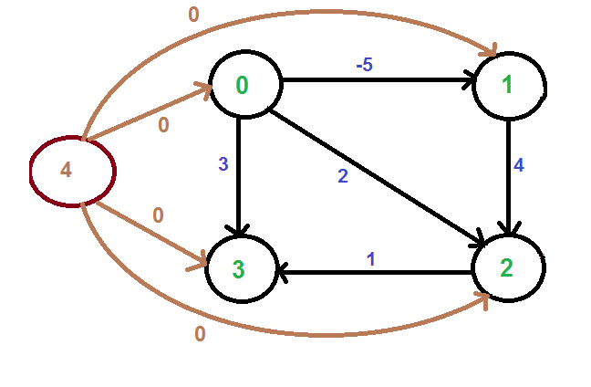
§
H[0]=0
H[1]=-5
d
H[3]=0
H[2]=-1
H[1]=0
H[2]=-2
-2
-2+0-(-2)=0
1
2
1
2
1
1
1+0-0=1
1+0-(-2)=3
3
1
4
3
4
1
H[3]=0
H[4]=0
1+0-0=1

Slide 19
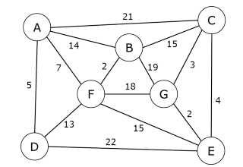
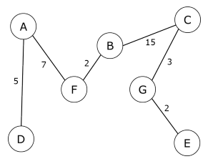
A
21
C
14
15
7
B
3
2
19
F
18
G

Slide 20
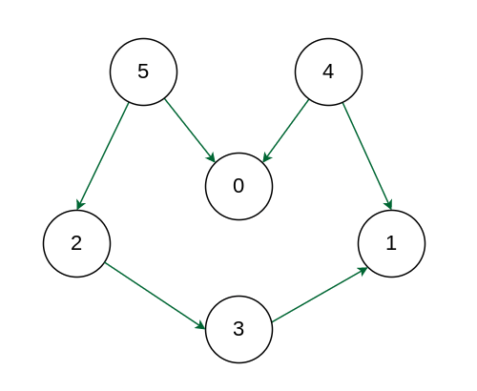
5
4
2
0
1
3

Slide 21
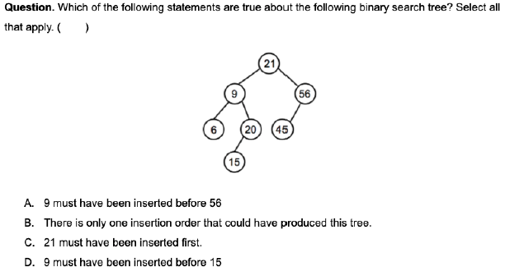
21
9
56
6
20
45
15

Slide 23
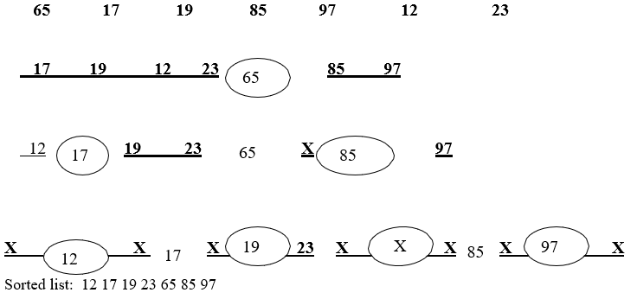
65
17
85
12
19
97
23

Slide 24
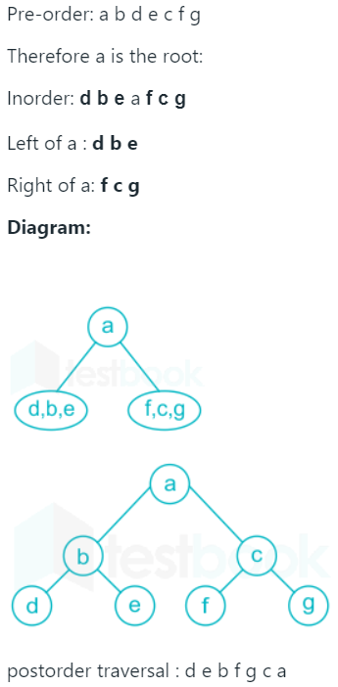
e
a, b, c, d
f, g
a
d, b, e
f, c, g
abcd
e
b
f
a
c
g
a
d
b
c
d
e
f
g

