Slide 1
Lecture 11 Shortest Paths
Department of Computer Science
Hofstra University

Slide 2
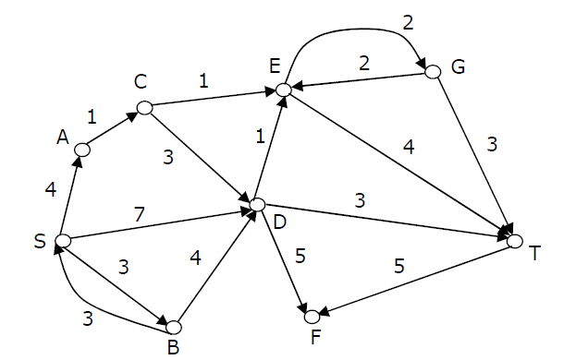
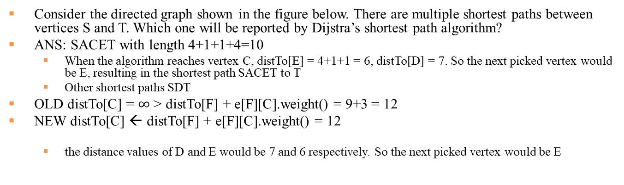
Quiz: Dijstra’s Algorithm
Consider the directed graph shown in the figure below. There are multiple shortest paths between vertices S and T. Which one will be reported by Dijstra’s shortest path algorithm?
ANS: SACET with length 4+1+1+4=10
When the algorithm reaches vertex C, distTo[E] = 4+1+1 = 6, distTo[D] = 7. So the next picked vertex would be E, resulting in the shortest path SACET to T
Other shortest paths SDT
OLD distTo[C] = $∞$ > distTo[F] + e[F][C].weight() = 9+3 = 12
NEW distTo[C] ← distTo[F] + e[F][C].weight() = 12
the distance values of D and E would be 7 and 6 respectively. So the next picked vertex would be E

