Slide 1
CSEP 521 Applied Algorithms
Richard Anderson
Winter 2013
Lecture 4

Slide 2
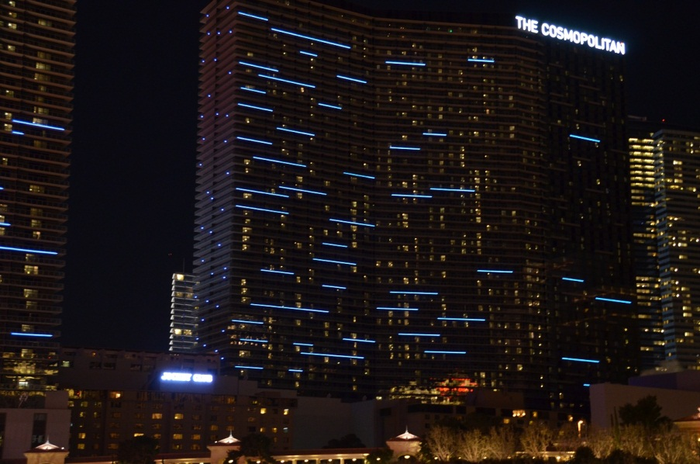
Announcements
Reading
For today, sections 4.5, 4.7, 4.8, 5.1, 5.2
Interval Scheduling

Slide 3

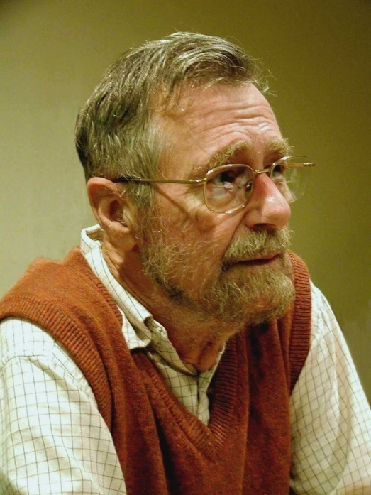
Highlights from last lecture
Greedy Algorithms
Dijkstra’s Algorithm

Slide 4
Today
Minimum spanning trees
Applications of Minimum Spanning trees
Huffman codes
Homework solutions
Recurrences

Slide 5
Minimum Spanning Tree
Introduce Problem
Demonstrate three different greedy algorithms
Provide proofs that the algorithms work

Slide 6
Minimum Spanning Tree
15
t
a
6
9
14
3
4
e
10
13
c
s
11
20
5
17
2
7
g
b
8
u
f
22
1
12
16
v

Slide 7
Greedy Algorithms for Minimum Spanning Tree
[Prim] Extend a tree by including the cheapest out going edge
[Kruskal] Add the cheapest edge that joins disjoint components
[ReverseDelete] Delete the most expensive edge that does not disconnect the graph
4
b
c
20
5
11
8
a
d
7
22
e

Slide 8
Greedy Algorithm 1 Prim’s Algorithm
Extend a tree by including the cheapest out going edge
15
t
a
6
14
3
9
4
e
10
13
c
s
11
20
5
Construct the MST with Prim’s algorithm starting from vertex a
Label the edges in order of insertion
17
2
7
g
b
8
u
f
22
1
12
16
v

Slide 9
Greedy Algorithm 2 Kruskal’s Algorithm
Add the cheapest edge that joins disjoint components
15
t
a
6
14
3
9
4
e
10
13
c
s
11
20
5
17
2
7
Construct the MST with Kruskal’s algorithm
Label the edges in order of insertion
g
b
8
u
f
22
1
12
16
v

Slide 10
Greedy Algorithm 3 Reverse-Delete Algorithm
Delete the most expensive edge that does not disconnect the graph
15
t
a
6
14
3
9
4
e
10
13
c
s
11
20
5
17
2
7
Construct the MST with the reverse-delete algorithm
Label the edges in order of removal
g
b
8
u
f
22
1
12
16
v

Slide 11
Why do the greedy algorithms work?
For simplicity, assume all edge costs are distinct

Slide 12
Edge inclusion lemma
Let S be a subset of V, and suppose e = (u, v) is the minimum cost edge of E, with u in S and v in V-S
e is in every minimum spanning tree of G
Or equivalently, if e is not in T, then T is not a minimum spanning tree
e
S
V - S

Slide 13
Proof
e is the minimum cost edge between S and V-S
Suppose T is a spanning tree that does not contain e
Add e to T, this creates a cycle
The cycle must have some edge e₁ = (u₁, v₁) with u₁ in S and v₁ in V-S
T₁ = T – {e₁} + {e} is a spanning tree with lower cost
Hence, T is not a minimum spanning tree
S
V - S
e

Slide 14
Optimality Proofs
Prim’s Algorithm computes a MST
Kruskal’s Algorithm computes a MST
Show that when an edge is added to the MST by Prim or Kruskal, the edge is the minimum cost edge between S and V-S for some set S.

Slide 15
Prim’s Algorithm
S = { }; T = { };
while S != V
choose the minimum cost edge e = (u,v), with u in S, and v in V-S
add e to T
add v to S

Slide 16
Prove Prim’s algorithm computes an MST
Show an edge e is in the MST when it is added to T

Slide 17
Dijkstra’s Algorithm for Minimum Spanning Trees
S = {}; d[s] = 0; d[v] = infinity for v != s
While S != V
Choose v in V-S with minimum d[v]
Add v to S
For each w in the neighborhood of v
d[w] = min(d[w], c(v, w))
y
3
4
1
u
2
4
a
3
s
x
1
1
2
v
5
3
b
4
z

Slide 18
Kruskal’s Algorithm
Let C = {{v₁}, {v₂}, . . ., {v_{n}}}; T = { }
while |C| > 1
Let e = (u, v) with u in C_{i} and v in C_{j} be the minimum cost edge joining distinct sets in C
Replace C_{i} and C_{j} by C_{i} U C_{j}
Add e to T

Slide 19
Prove Kruskal’s algorithm computes an MST
Show an edge e is in the MST when it is added to T

Slide 20
Reverse-Delete Algorithm
Lemma: The most expensive edge on a cycle is never in a minimum spanning tree

Slide 21
Dealing with the assumption of no equal weight edges
Force the edge weights to be distinct
Add small quantities to the weights
Give a tie breaking rule for equal weight edges

Slide 22
Application: Clustering
Given a collection of points in an r-dimensional space, and an integer K, divide the points into K sets that are closest together

Slide 23
Distance clustering
Divide the data set into K subsets to maximize the distance between any pair of sets
dist (S₁, S₂) = min {dist(x, y) | x in S₁, y in S₂}

Slide 24
Divide into 2 clusters

Slide 25
Divide into 3 clusters

Slide 26
Divide into 4 clusters

Slide 27
Distance Clustering Algorithm
Let C = {{v₁}, {v₂},. . ., {v_{n}}}; T = { }
while |C| > K
Let e = (u, v) with u in C_{i} and v in C_{j} be the minimum cost edge joining distinct sets in C
Replace C_{i} and C_{j} by C_{i} U C_{j}

Slide 28
K-clustering

Slide 29
Huffman Codes
Given a set of symbols of known frequency, encode in binary to minimize the average length of a message
S = {a, b, c, d}, f(a) = .4, f(b) = .3, f(c) = .2, f(d) = .1

Slide 30
Prefix codes
A code is a prefix code, if there is no pair of code words X and Y, where X is a prefix of Y
A prefix code can be decoded with a left to right scan
A binary prefix code can be represented as a binary tree

Slide 31
Optimal prefix code
Given a set of symbols with frequencies for the symbols, design a prefix code with minimum average length
ABL(Code): Average Bits per Letter

Slide 32
Properties of optimal codes
The tree for an optimal code is full
If f(x) ≤ f(y) then depth(x) ≥ depth(y)
The two nodes of lowest frequency are at the same level
There is an optimal code where the two lowest frequency words are siblings

Slide 33
Huffman Algorithm
Pick the two lowest frequency items
Replace with a new item with there combined frequencies
Repeat until done

Slide 34
Correctness proof (sketch)
Let y, z be the lowest frequency letters that are replaced by a letter w
Let T be the tree constructed by the Huffman algorithm, and T’ be the tree constructed by the Huffman algorithm when y, z are replaced by w
ABL(T’) = ABL(T) – f(w)

Slide 35
Correctness proof (sketch)
Proof by induction
Base case, n = 2
Suppose Huffman algorithm is correct for n symbols
Consider an n+1 symbol alphabet . . .

Slide 36
Homework problems

Slide 37
Exercise 8, Page 109
Prove that for any c, there is a graph G such that Diag(G) ≥ c APD(G)

Slide 38
Exercise 12, Page 112
Given info of the form P_{i} died before P_{j} born and P_{i} and P_{j} overlapped, determine if the data is internally consistent

Slide 39
Programming Problem

Slide 40
Random out degree one graph
Question:
What is the cycle structure as N gets large?
How many cycles?
What is the cycle length?

Slide 41
Topological Sort Approach
Run topological sort
Determine cycles
Order vertices on branches
Label vertices on the cycles
Label vertices on branches computing cycle weight

Slide 42
Pointer chasing algorithm
Label vertices with the number of their cycle
Pick a vertex, follow chain of pointers
Until a labeled vertex is reached
Until a new cycle is discovered
Follow chain of vertices a second time to set labels

Slide 43
The code . . .
void MarkCycle(int v,
CycleStructure cycles,
bool[] mark,
sbyte[] cycle) {
if (mark[v] == true)
return;
int y = v;
int x;
do {
x = y;
y = next[x];
mark[x] = true;
}
while (mark[y] == false);
int cycleID;
if (cycle[y] == -1) {
cycleID = cycles.AddCycle();
for (int a = y; a != x; a = next[a]) {
cycle[a] = (sbyte) cycleID;
cycles.AddCycleVertex(cycleID);
}
cycle[x] = (sbyte) cycleID;
cycles.AddCycleVertex(cycleID);
}
else
cycleID = cycle[y];
for (int a = v; cycle[a] == -1; a = next[a]) {
cycle[a] = (sbyte) cycleID;
cycles.AddBranchVertex(cycleID);
}
}

Slide 44
Results from Random Graphs
What is the length of the longest cycle?
How many cycles?

Slide 45
Recurrences

Slide 46
Divide and Conquer
Recurrences, Sections 5.1 and 5.2
Algorithms
Counting Inversions (5.3)
Closest Pair (5.4)
Multiplication (5.5)
FFT (5.6)

Slide 47
Divide and Conquer
Array Mergesort(Array a){
n = a.Length;
if (n <= 1)
return a;
b = Mergesort(a[0 .. n/2]);
c = Mergesort(a[n/2+1 .. n-1]);
return Merge(b, c);
}

Slide 48
Algorithm Analysis
Cost of Merge
Cost of Mergesort

Slide 49
T(n) <= 2T(n/2) + cn; T(1) <= c;

Slide 50
Recurrence Analysis
Solution methods
Unrolling recurrence
Guess and verify
Plugging in to a “Master Theorem”

Slide 51
Unrolling the recurrence

Slide 52
Substitution
Prove T(n) <= cn (log₂n + 1) for n >= 1
Induction:
Base Case:
Induction Hypothesis:
T(n/2) <= c(n/2) log₂(n/2)

Slide 53
A better mergesort (?)
Divide into 3 subarrays and recursively sort
Apply 3-way merge
What is the recurrence?

Slide 54
Unroll recurrence for T(n) = 3T(n/3) + dn

Slide 55
Recurrence Examples
T(n) = 2 T(n/2) + cn
O(n log n)
T(n) = T(n/2) + cn
O(n)
More useful facts:
log_{k}n = log₂n / log₂k
k ^{log n} = n ^{log k}

Slide 56
T(n) = aT(n/b) + f(n)

Slide 57
Recursive Matrix Multiplication
Multiply 2 x 2 Matrices:
| r s | | a b| |e g|
| t u| | c d| | f h|
r = ae + bf
s = ag + bh
t = ce + df
u = cg + dh
A N x N matrix can be viewed as a 2 x 2 matrix with entries that are (N/2) x (N/2) matrices.
The recursive matrix multiplication algorithm recursively multiplies the (N/2) x (N/2) matrices and combines them using the equations for multiplying 2 x 2 matrices
=

Slide 58
Recursive Matrix Multiplication
How many recursive calls are made at each level?
How much work in combining the results?
What is the recurrence?

Slide 59
What is the run time for the recursive Matrix Multiplication Algorithm?
Recurrence:

Slide 60
T(n) = 4T(n/2) + cn

Slide 61
T(n) = 2T(n/2) + n²

Slide 62
T(n) = 2T(n/2) + n^{1/2}

Slide 63
Recurrences
Three basic behaviors
Dominated by initial case
Dominated by base case
All cases equal – we care about the depth

Slide 64
What you really need to know about recurrences
Work per level changes geometrically with the level
Geometrically increasing (x > 1)
The bottom level wins
Geometrically decreasing (x < 1)
The top level wins
Balanced (x = 1)
Equal contribution

Slide 65
Classify the following recurrences (Increasing, Decreasing, Balanced)
T(n) = n + 5T(n/8)
T(n) = n + 9T(n/8)
T(n) = n² + 4T(n/2)
T(n) = n³ + 7T(n/2)
T(n) = n^{1/2} + 3T(n/4)

Slide 66
Strassen’s Algorithm
Multiply 2 x 2 Matrices:
| r s | | a b| |e g|
| t u| | c d| | f h|
Where:
p₁ = (b + d)(f + g)
p₂= (c + d)e
p₃= a(g – h)
p₄= d(f – e)
p₅= (a – b)h
p₆= (c – d)(e + g)
p₇= (b – d)(f + h)
=
r = p₁ + p₄ – p₅ + p₇
s = p₃ + p₅
t = p₂ + p₅
u = p₁ + p₃ – p₂ + p₇

Slide 67
Recurrence for Strassen’s Algorithms
T(n) = 7 T(n/2) + cn²
What is the runtime?

