Slide 1
Final Exam
Department of Computer Science
Hofstra University

Slide 2
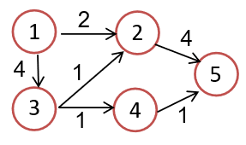
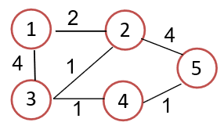
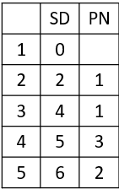
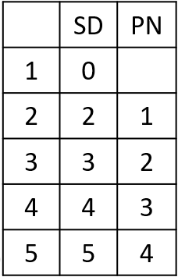

Slide 3
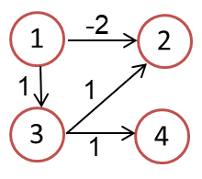

Slide 4
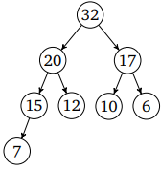
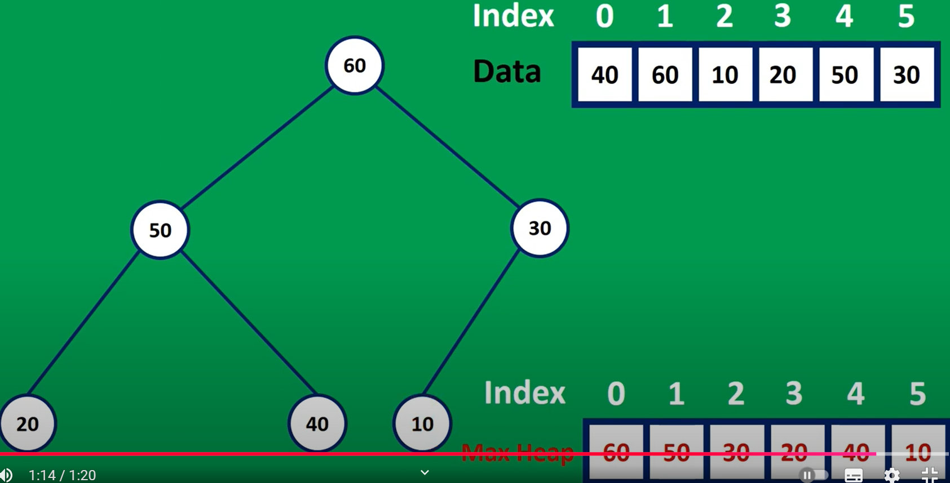
Max Heap
50
40
30
20
10
60
50
30
5
4
20
40
10
4
2
3
2
50
1
3
1
40
30
20
10

Slide 5
32
20
17
15
12
10
6
7
20
15
17
7
12
10
6

Slide 6
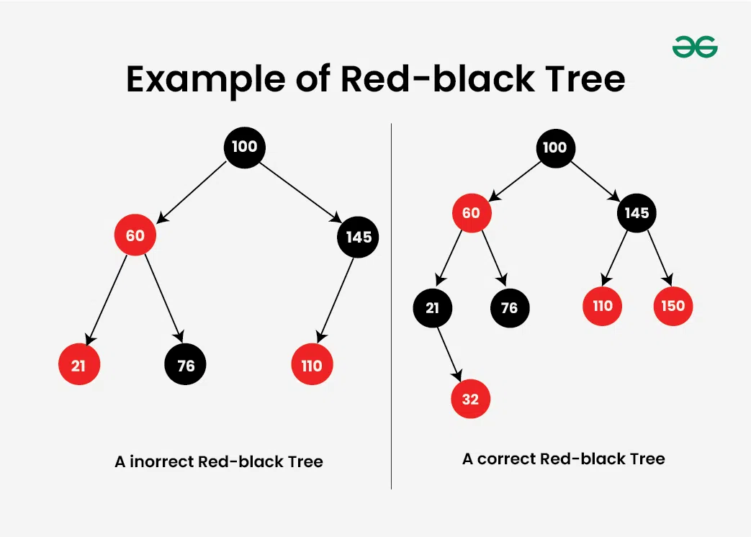

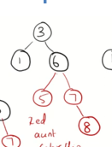
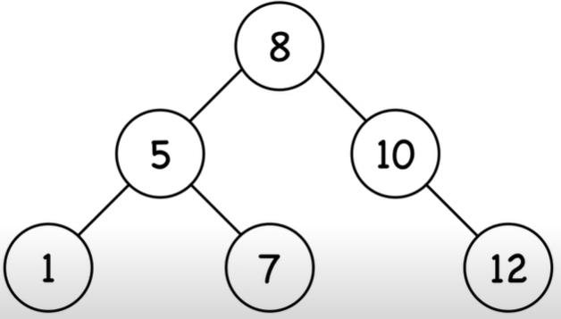
RBT
3
b
3
2
6
b
1
b
5
7
1
5
r
7
8
5
9
12
1
7
12

Slide 7
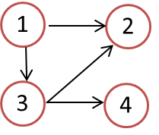
Adjacency List
1 2 3 4
1
2
3
4
0
1
1
1
1 2 3 4
1
2
3
4
1
0
1
1
0
1
1
0
0
1
1
0
0
1
0
1
1
1
0
1
0
0
0
0
0
0
0
0
0
0
0
0
1
1
1
0
0
1
0
1
0
1
0
1
0
0
0
0
0
0
0
0
0
0
0
0
0
0
0
0
1 2 3 4
1
2
3
4
Adjacency list:
1 → {2, 3, 4}
2 → {4}
3 → {2, 4}
4 → {}
1
2
0
1
1
1
0
1
1
1
0
1
0
2
0
0
0
1
0
0
0
1
0
0
0
0
3
4
0
1
0
1
0
1
0
1
0
0
0
1
0
0
0
0
0
0
0
0
0
0
0
0
1 2 3 4
1
2
3
4
Adjacency list:
1 → {2, 3, 4}
2 → {1, 3, 4}
3 → {1, 2, 4}
4 → {1, 2, 3}
1
2
0
1
1
1
0
1
1
1
3
2
2
2
1
0
1
1
1
0
1
1
2
3
2
2
3
4
1
1
0
1
1
1
0
1
2
2
3
2
1
1
1
0
1
1
1
0
2
2
2
3

Slide 8
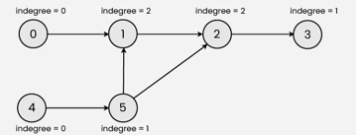
Khan algorithm
0
1
2
3
5
4
0
1
2
2
0
1
3
4
5
3
a
c
e
b
d
f
Notes:
1 → {2, 3}
2 → {}
3 → {2, 4}
4 → {}

Slide 9
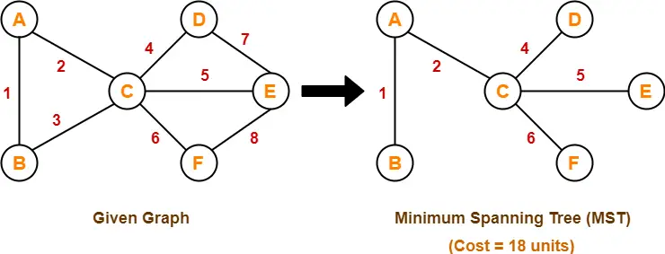
MST Prim Kruskal
AB, AC, CD, CE, CF
a
c
e
b
d
f

Slide 10
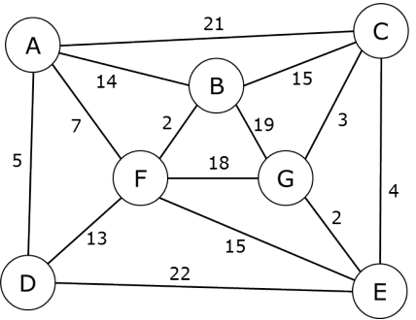
MST Prim Kruskal
1
16

Slide 11
MST Prim
AD, AF, BF, BC, CG. CE
1
16

Slide 12
MST Kruskal
EG, BF, CG, AD, AF, BC
1
16

Slide 13
Complete Binary Tree or Not?
Above: complete binary trees
Below: not complete binary trees
Leaf level is not filled from left to right.
Non-leaf level is not completely filled.

Slide 14
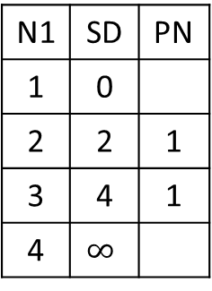
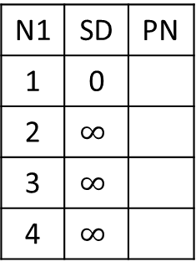
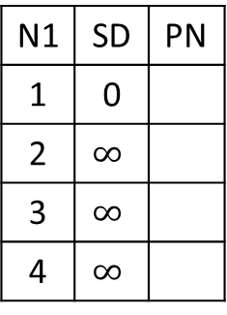
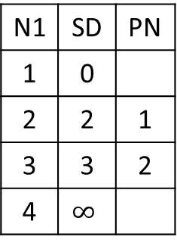
N1 | SD | PN
1 | 0
2 | $$∞$$
3 | $$∞$$
4 | $$∞$$
N1 | SD | PN
1 | 0
2
3
4
N1 | SD | PN
1 | 0
2
3
4
N1 | SD | PN
1 | 0
2
3
4
 | SD | PN
1 | 0
2
3
4
Visit___
Visit___
Visit___
Visit___
1
2
2
4
1
3
1
4
N1 | SD | PN
1 | 0
2 | $$∞$$
3 | $$∞$$
4 | $$∞$$
N1 | SD | PN
1 | 0
2 | 2 | 1
3 | 4 | 1
4 | $$∞$$
N1 | SD | PN
1 | 0
2 | 2 | 1
3 | 3 | 2
4 | $$∞$$
N1 | SD | PN
1 | 0
2 | 2 | 1
3 | 3 | 2
4 | 4 | 3
N1 | SD | PN
1 | 0
2 | 2 | 1
3 | 3 | 2
4 | 4 | 3
Visit 1
Visit 2
Visit 3
Visit 4

Slide 15
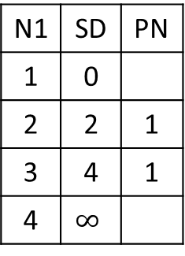
N1 | SD | PN
1 | 0
2 | $$∞$$
3 | $$∞$$
4 | $$∞$$
N1 | SD | PN
1 | 0
2
3
4
N1 | SD | PN
1 | 0
2
3
4
N1 | SD | PN
1 | 0
2
3
4
N1 | SD | PN
1 | 0
2
3
4
Visit___
Visit___
Visit___
Visit___
1
2
2
4
1
3
1
4
N1 | SD | PN
1 | 0
2 | $$∞$$
3 | $$∞$$
4 | $$∞$$
N1 | SD | PN
1 | 0
2 | 2 | 1
3 | 4 | 1
4 | $$∞$$
N1 | SD | PN
1 | 0
2 | 2 | 1
3 | 4 | 1
4 | $$∞$$
N1 | SD | PN
1 | 0
2 | 2 | 1
3 | 4 | 1
4 | 5 | 3
N1 | SD | PN
1 | 0
2 | 2 | 1
3 | 4 | 1
4 | 5 | 3
Visit 1
Visit 2
Visit 3
Visit 4

Slide 16
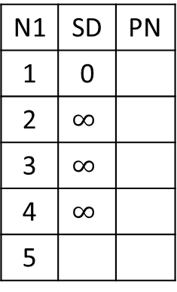
N1 | SD | PN
1 | 0
2 | $$∞$$
3 | $$∞$$
4 | $$∞$$
5
N1 | SD | PN
1 | 0
2
3
4
5
N1 | SD | PN
1 | 0
2
3
4
5
N1 | SD | PN
1 | 0
2
3
4
5
 | SD | PN
1
2
3
4
5
Visit___
Visit___
Visit___
Visit___
1
2
2
4
4
1
5
3
1
4
1

Slide 17
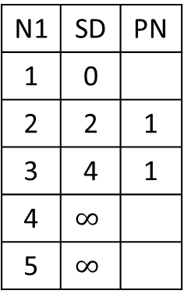
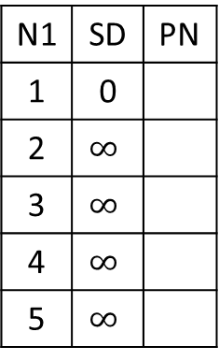
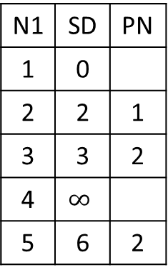
1
2
2
4
4
1
5
3
1
4
1
N1 | SD | PN
1 | 0
2 | $$∞$$
3 | $$∞$$
4 | $$∞$$
5 | $$∞$$
N1 | SD | PN
1 | 0
2 | 2 | 1
3 | 4 | 1
4 | $$∞$$
5 | $$∞$$
N1 | SD | PN
1 | 0
2 | 2 | 1
3 | 3 | 2
4 | $$∞$$
5 | 6 | 2
 | SD | PN
1 | 0
2 | 2 | 1
3 | 3 | 2
4 | 4 | 3
5 | 6 | 2
N1 | SD | PN
1 | 0
2 | 2 | 1
3 | 3 | 2
4 | 4 | 3
5 | 5 | 4
Visit 1
Visit 2
Visit 3
Visit 4
 | SD | PN
1 | 0
2 | 2 | 1
3 | 3 | 2
4 | 4 | 3
5 | 5 | 4
Visit 5

Slide 18
Confusion Entries
 | SD | PN
1 | 0
2 | 2 | 1
3 | 4 | 1
4 | 4 | 3
5 | 5 | 4
 | SD | PN
1 | 0
2 | 2 | 1
3 | 3 | 2
4 | 4 | 3
5 | 6 | 2

Slide 19
N1 | SD | PN
1 | 0
2 | $$∞$$
3 | $$∞$$
4 | $$∞$$
5
N1 | SD | PN
1 | 0
2
3
4
5
N1 | SD | PN
1 | 0
2
3
4
5
N1 | SD | PN
1 | 0
2
3
4
5
N1 | SD | PN
1 | 0
2
3
4
5
Visit___
Visit___
Visit___
Visit___
N1 | SD | PN
1 | 0
2
3
4
5
Visit___
1
2
2
4
4
1
5
3
1
4
1

Slide 20
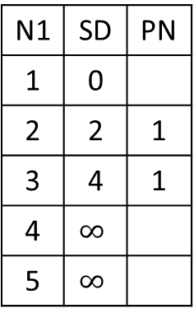
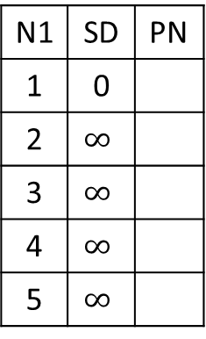
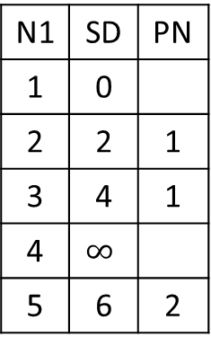
1
2
2
4
4
1
5
3
1
4
1
N1 | SD | PN
1 | 0
2 | $$∞$$
3 | $$∞$$
4 | $$∞$$
5 | $$∞$$
N1 | SD | PN
1 | 0
2 | 2 | 1
3 | 4 | 1
4 | $$∞$$
5 | $$∞$$
N1 | SD | PN
1 | 0
2 | 2 | 1
3 | 4 | 1
4 | $$∞$$
5 | 6 | 2
 | SD | PN
1 | 0
2 | 2 | 1
3 | 4 | 1
4 | 5 | 3
5 | 6 | 2
N1 | SD | PN
1 | 0
2 | 2 | 1
3 | 4 | 1
4 | 5 | 3
5 | 6 | 2
Visit 1
Visit 2
Visit 3
Visit 4
 | SD | PN
1 | 0
2 | 2 | 1
3 | 4 | 1
4 | 5 | 3
5 | 6 | 2
Visit 5

Slide 21



Slide 22
Johnson’s Algorithm 1
H[1]=0
H[2]=-2
H[1]=0
H[2]=-2
-2
-2+0-(-2)=0
1
2
1
2
0
1
2
1
1
1+0-0=1
1+0-(-2)=3
1
3
3
1
4
3
4
H[3]=0
H[4]=0
3
1
4
1+0-0=1
H[3]=0
H[4]=0

Slide 23
Johnson’s Algorithm 2
0 –(0-(-2))=-2
1-(0-0)=1
1 – (0-(-1))=0
 | SD | PN
1 | 0
2 | 0 | 1
3 | 1 | 1
4 | 1 | 3
 | SD | PN
1 | 0
2 | -2 | 1
3 | 1 | 1
4 | 0 | 3
1
0
2
1
3
3
0
4
h[1]=0
h[2]=-2
h[1]=0
h[2]=-2
-2+0-(-2)=0
1
-2
2
1
2
1
1
1+0-0=1
1+0-(-2)=3
3
4
3
4
-1
-1+0-(-1)=0
h[3]=0
h[4]=-1
h[3]=0
h[4]=-1

Slide 24
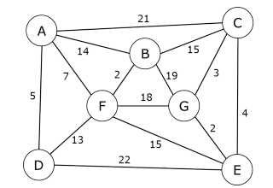
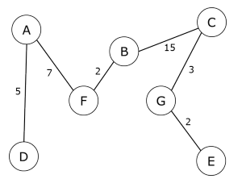
MST
A
21
C
14
15
7
B
3
2
19
F
18
G

Slide 25
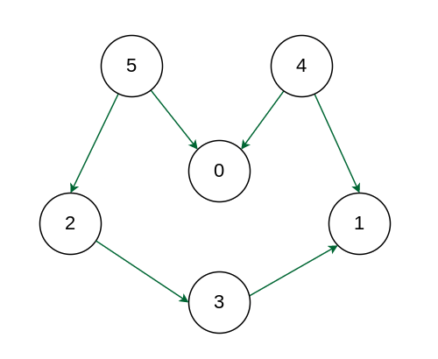
5
4
2
0
1
3

Slide 26
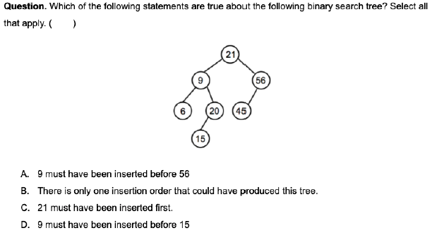
21
9
56
6
20
45
15

Slide 27
Heap complete binary trees

Slide 28
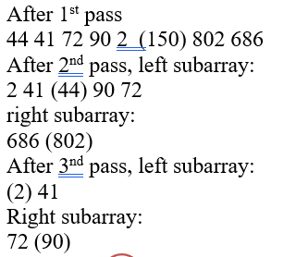
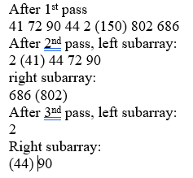
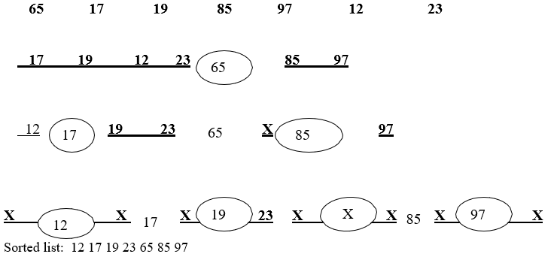
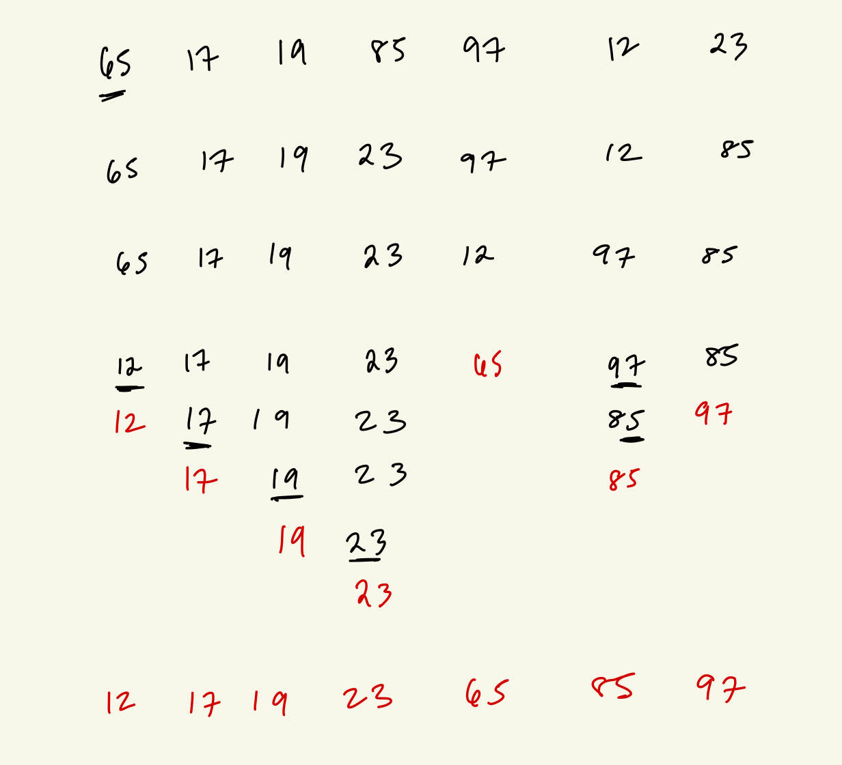
Quicksort
65
150
12
97
44
802
17
85
12 17 19 23 (65) 97 85
Left part: (12) 17 19 23
(17) 19 23
(19) 23
Right part: 85 (97)
19
2
90
686
41
72
23
44

Slide 29
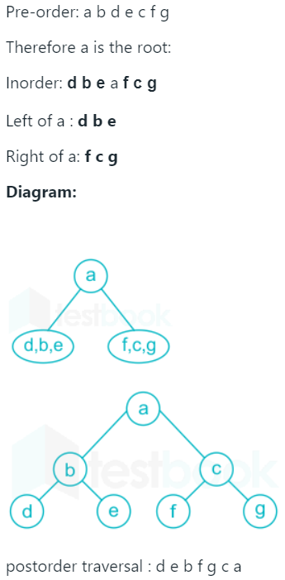
Binary Tree Traversal
e
a, b, c, d
f, g
a
b
c
abcd
a
d
e
e
b
c
b
f
d
g
f
g
a
c
g
d

Slide 30
Binary Tree Traversal
Preorder dbafcg
Inorder abdcfg
Postorder abcgfd
d
b
f
d
a
c
g
a, b
c, f, g

Slide 31
CSC175

Slide 32
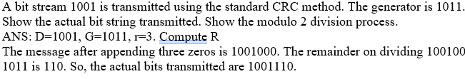
1
1
0
1
1
0
1
1
1 0 1 1
1 1 1 1 0 0
0
1 0 1 1
1 1 1 1 1 1
1
1 0 1 1
1 0 1 1
1 0 0 0
1 0 0 1
1 0 1 1
1 0 1 1
1 1 0 0
1 0 1 1
1 0 1 1
1 0 1 1
1 1 1
1 1 1

Slide 33
Plain | 000 | 001 | 010 | 011 | 100 | 101 | 110 | 111
Cipher | 110 | 111 | 101 | 100 | 011 | 010 | 000 | 001
Plain | 000 | 001 | 010 | 011 | 100 | 101 | 110 | 111
Cipher | 110 | 111 | 101 | 100 | 011 | 010 | 000 | 001

Slide 34
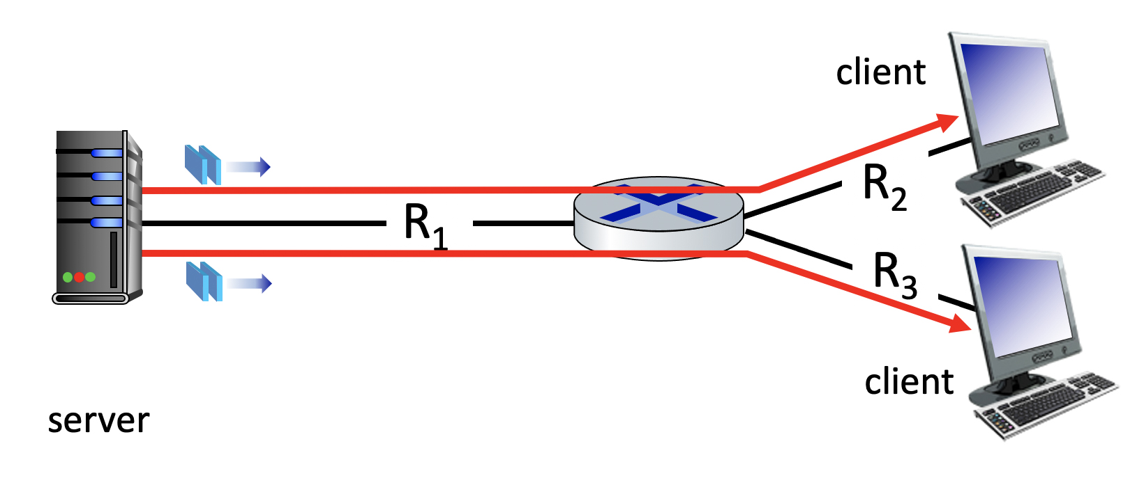
25 Mbps
10 Mbps
50 Mbps

Slide 35
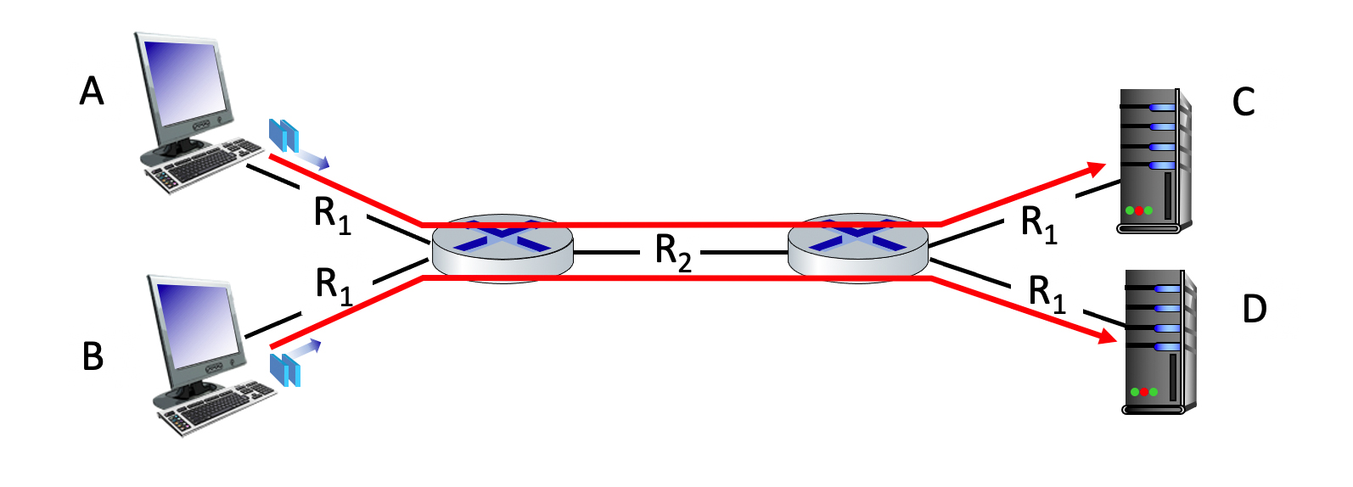
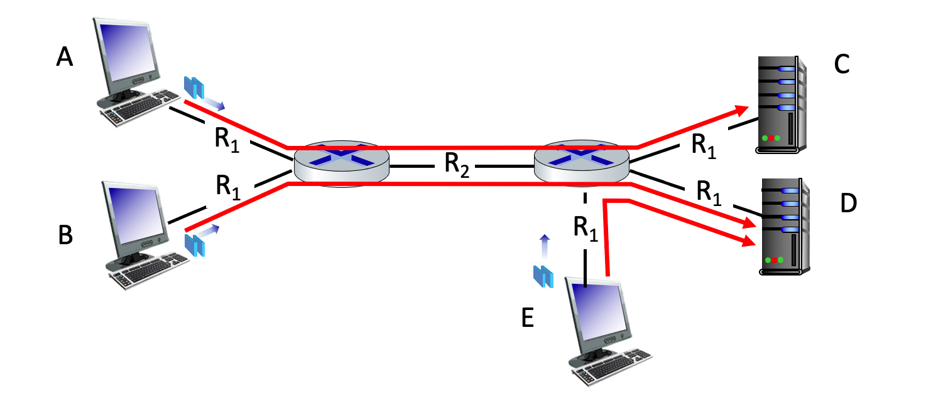
100 Mbps
100 Mbps
150 Mbps
100 Mbps
100 Mbps
100 Mbps
100 Mbps
150 Mbps
100 Mbps
100 Mbps
100 Mbps

Slide 36
1 0 1 0 1
1
1 1 1 1 0
0
0 1 1 1 0
1
0 0 1 0 1
0
1 0 1 0 1
1
1 1 1 1 0
0
1 0 1 0 0 0
parity
error
0 1 1 1 0
1
1 0 1 1 0 1
parity
error
0 0 1 0 1
0
0 1 1 1 1 0
parity
error
0 1 1 0 1 0
parity
error

