Slide 1
Final Exam
Department of Computer Science
Hofstra University

Slide 2
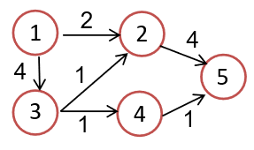
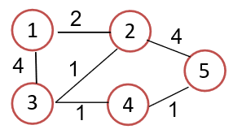
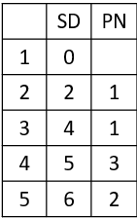
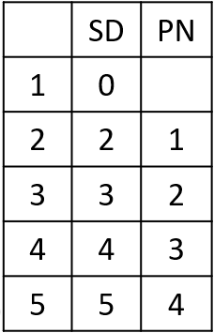

Slide 3
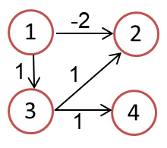

Slide 4
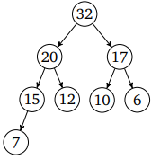
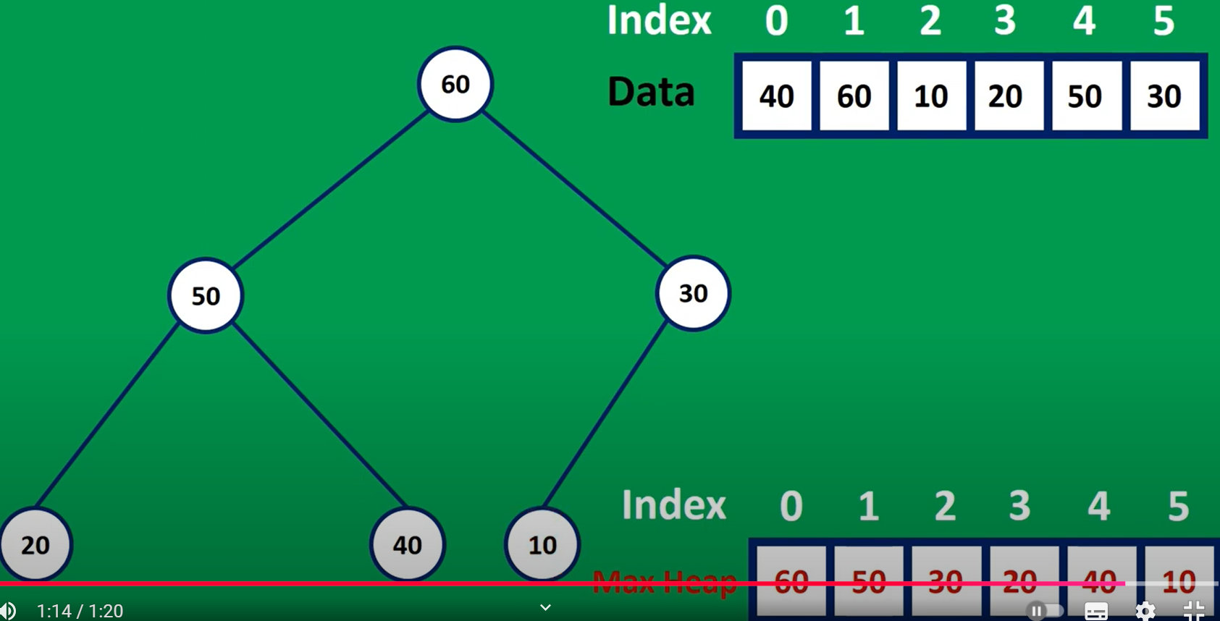
Max Heap
50
40
30
20
10
60
50
30
5
4
20
40
10
4
2
3
2
50
1
3
1
40
30
20
10

Slide 5
32
20
17
15
12
10
6
7
20
15
17
7
12
10
6

Slide 6
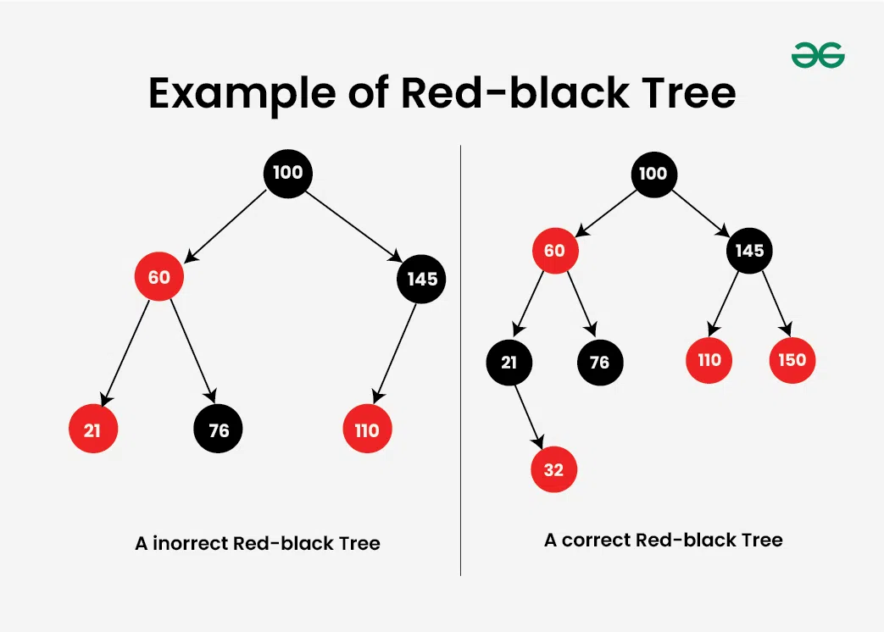

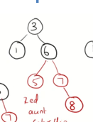
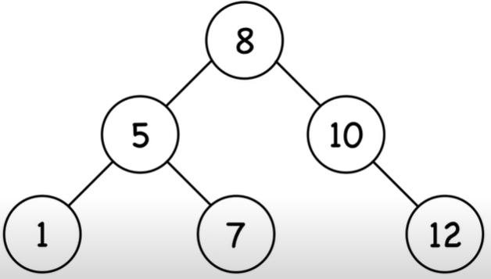
RBT
3
b
3
2
6
b
1
b
5
7
1
5
r
7
8
5
9
12
1
7
12

Slide 7
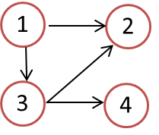
Adjacency List
1 2 3 4
1
2
3
4
0
1
1
1
1 2 3 4
1
2
3
4
1
0
1
1
0
1
1
0
0
1
1
0
0
1
0
1
1
1
0
1
0
0
0
0
0
0
0
0
0
0
0
0
1
1
1
0
0
1
0
1
0
1
0
1
0
0
0
0
0
0
0
0
0
0
0
0
0
0
0
0
1 2 3 4
1
2
3
4
Adjacency list:
1 → {2, 3, 4}
2 → {4}
3 → {2, 4}
4 → {}
1
2
0
1
1
1
0
1
1
1
0
1
0
2
0
0
0
1
0
0
0
1
0
0
0
0
3
4
0
1
0
1
0
1
0
1
0
0
0
1
0
0
0
0
0
0
0
0
0
0
0
0
1 2 3 4
1
2
3
4
Adjacency list:
1 → {2, 3, 4}
2 → {1, 3, 4}
3 → {1, 2, 4}
4 → {1, 2, 3}
1
2
0
1
1
1
0
1
1
1
3
2
2
2
1
0
1
1
1
0
1
1
2
3
2
2
3
4
1
1
0
1
1
1
0
1
2
2
3
2
1
1
1
0
1
1
1
0
2
2
2
3

Slide 8
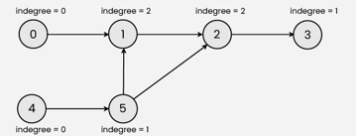
Khan algorithm
0
1
2
3
5
4
0
1
2
2
0
1
3
4
5
3
a
c
e
b
d
f
Notes:
1 → {2, 3}
2 → {}
3 → {2, 4}
4 → {}

Slide 9
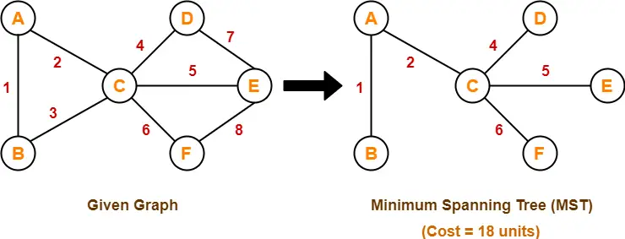
MST Prim Kruskal
AB, AC, CD, CE, CF
a
c
e
b
d
f

Slide 10
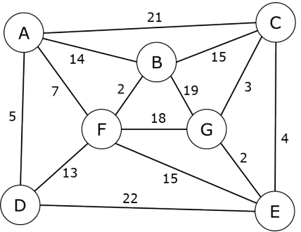
MST Prim Kruskal
1
16

Slide 11
Complete Binary Tree or Not?
Above: complete binary trees
Below: not complete binary trees
Leaf level is not filled from left to right.
Non-leaf level is not completely filled.

Slide 12
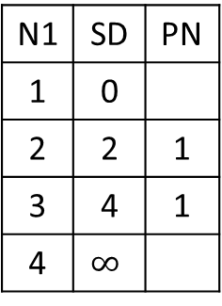
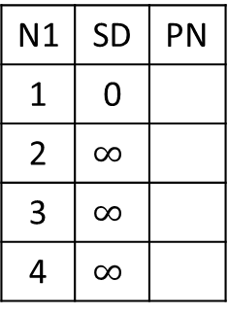
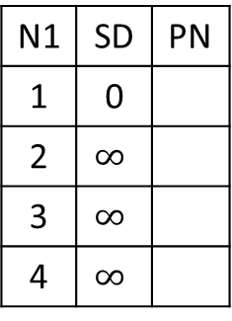
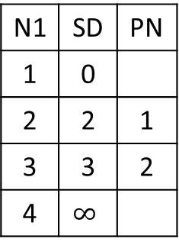
N1 | SD | PN
1 | 0
2 | $$∞$$
3 | $$∞$$
4 | $$∞$$
N1 | SD | PN
1 | 0
2
3
4
N1 | SD | PN
1 | 0
2
3
4
N1 | SD | PN
1 | 0
2
3
4
 | SD | PN
1 | 0
2
3
4
Visit___
Visit___
Visit___
Visit___
1
2
2
4
1
3
1
4
N1 | SD | PN
1 | 0
2 | $$∞$$
3 | $$∞$$
4 | $$∞$$
N1 | SD | PN
1 | 0
2 | 2 | 1
3 | 4 | 1
4 | $$∞$$
N1 | SD | PN
1 | 0
2 | 2 | 1
3 | 3 | 2
4 | $$∞$$
N1 | SD | PN
1 | 0
2 | 2 | 1
3 | 3 | 2
4 | 4 | 3
N1 | SD | PN
1 | 0
2 | 2 | 1
3 | 3 | 2
4 | 4 | 3
Visit 1
Visit 2
Visit 3
Visit 4

Slide 13
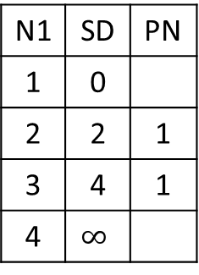
N1 | SD | PN
1 | 0
2 | $$∞$$
3 | $$∞$$
4 | $$∞$$
N1 | SD | PN
1 | 0
2
3
4
N1 | SD | PN
1 | 0
2
3
4
N1 | SD | PN
1 | 0
2
3
4
N1 | SD | PN
1 | 0
2
3
4
Visit___
Visit___
Visit___
Visit___
1
2
2
4
1
3
1
4
N1 | SD | PN
1 | 0
2 | $$∞$$
3 | $$∞$$
4 | $$∞$$
N1 | SD | PN
1 | 0
2 | 2 | 1
3 | 4 | 1
4 | $$∞$$
N1 | SD | PN
1 | 0
2 | 2 | 1
3 | 4 | 1
4 | $$∞$$
N1 | SD | PN
1 | 0
2 | 2 | 1
3 | 4 | 1
4 | 5 | 3
N1 | SD | PN
1 | 0
2 | 2 | 1
3 | 4 | 1
4 | 5 | 3
Visit 1
Visit 2
Visit 3
Visit 4

Slide 14
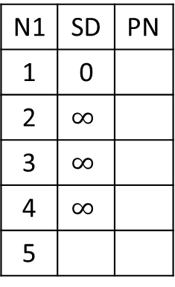
N1 | SD | PN
1 | 0
2 | $$∞$$
3 | $$∞$$
4 | $$∞$$
5
N1 | SD | PN
1 | 0
2
3
4
5
N1 | SD | PN
1 | 0
2
3
4
5
N1 | SD | PN
1 | 0
2
3
4
5
 | SD | PN
1
2
3
4
5
Visit___
Visit___
Visit___
Visit___
1
2
2
4
4
1
5
3
1
4
1

Slide 15
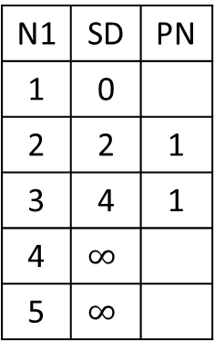
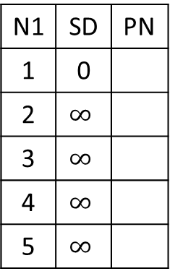
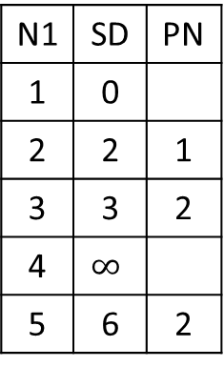
1
2
2
4
4
1
5
3
1
4
1
N1 | SD | PN
1 | 0
2 | $$∞$$
3 | $$∞$$
4 | $$∞$$
5 | $$∞$$
N1 | SD | PN
1 | 0
2 | 2 | 1
3 | 4 | 1
4 | $$∞$$
5 | $$∞$$
N1 | SD | PN
1 | 0
2 | 2 | 1
3 | 3 | 2
4 | $$∞$$
5 | 6 | 2
 | SD | PN
1 | 0
2 | 2 | 1
3 | 3 | 2
4 | 4 | 3
5 | 6 | 2
N1 | SD | PN
1 | 0
2 | 2 | 1
3 | 3 | 2
4 | 4 | 3
5 | 5 | 4
Visit 1
Visit 2
Visit 3
Visit 4
 | SD | PN
1 | 0
2 | 2 | 1
3 | 3 | 2
4 | 4 | 3
5 | 5 | 4
Visit 5

Slide 16
Confusion Entries
 | SD | PN
1 | 0
2 | 2 | 1
3 | 4 | 1
4 | 4 | 3
5 | 5 | 4
 | SD | PN
1 | 0
2 | 2 | 1
3 | 3 | 2
4 | 4 | 3
5 | 6 | 2

Slide 17
N1 | SD | PN
1 | 0
2 | $$∞$$
3 | $$∞$$
4 | $$∞$$
5
N1 | SD | PN
1 | 0
2
3
4
5
N1 | SD | PN
1 | 0
2
3
4
5
N1 | SD | PN
1 | 0
2
3
4
5
N1 | SD | PN
1 | 0
2
3
4
5
Visit___
Visit___
Visit___
Visit___
N1 | SD | PN
1 | 0
2
3
4
5
Visit___
1
2
2
4
4
1
5
3
1
4
1

Slide 18
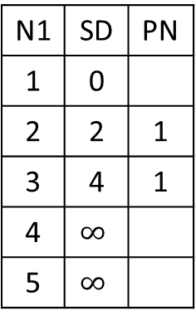
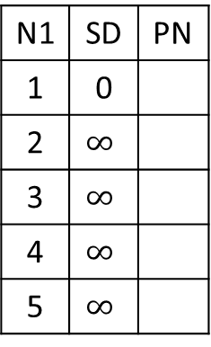
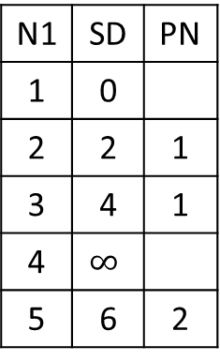
1
2
2
4
4
1
5
3
1
4
1
N1 | SD | PN
1 | 0
2 | $$∞$$
3 | $$∞$$
4 | $$∞$$
5 | $$∞$$
N1 | SD | PN
1 | 0
2 | 2 | 1
3 | 4 | 1
4 | $$∞$$
5 | $$∞$$
N1 | SD | PN
1 | 0
2 | 2 | 1
3 | 4 | 1
4 | $$∞$$
5 | 6 | 2
 | SD | PN
1 | 0
2 | 2 | 1
3 | 4 | 1
4 | 5 | 3
5 | 6 | 2
N1 | SD | PN
1 | 0
2 | 2 | 1
3 | 4 | 1
4 | 5 | 3
5 | 6 | 2
Visit 1
Visit 2
Visit 3
Visit 4
 | SD | PN
1 | 0
2 | 2 | 1
3 | 4 | 1
4 | 5 | 3
5 | 6 | 2
Visit 5

Slide 19



Slide 20
Johnson’s Algorithm 1
H[1]=0
H[2]=-2
H[1]=0
H[2]=-2
-2
-2+0-(-2)=0
1
2
1
2
0
1
2
1
1
1+0-0=1
1+0-(-2)=3
1
3
3
1
4
3
4
H[3]=0
H[4]=0
3
1
4
1+0-0=1
H[3]=0
H[4]=0

Slide 21
Johnson’s Algorithm 2
0 –(0-(-2))=-2
1-(0-0)=1
1 – (0-(-1))=0
 | SD | PN
1 | 0
2 | 0 | 1
3 | 1 | 1
4 | 1 | 3
 | SD | PN
1 | 0
2 | -2 | 1
3 | 1 | 1
4 | 0 | 3
1
0
2
1
3
3
0
4
h[1]=0
h[2]=-2
h[1]=0
h[2]=-2
-2+0-(-2)=0
1
-2
2
1
2
1
1
1+0-0=1
1+0-(-2)=3
3
4
3
4
-1
-1+0-(-1)=0
h[3]=0
h[4]=-1
h[3]=0
h[4]=-1

Slide 22
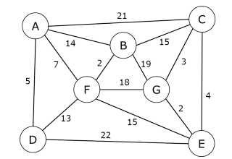
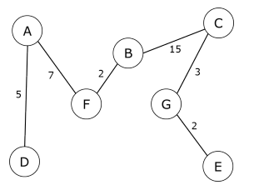
MST
A
21
C
14
15
7
B
3
2
19
F
18
G

Slide 23
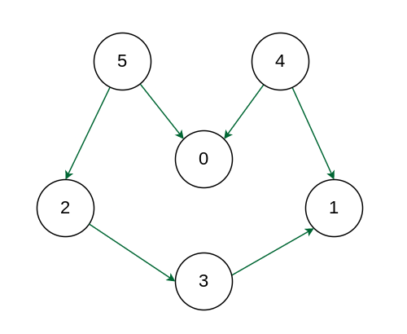
5
4
2
0
1
3

Slide 24
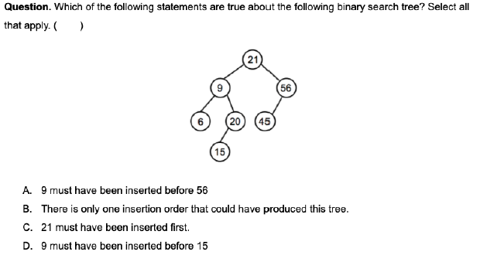
21
9
56
6
20
45
15

Slide 25
Heap complete binary trees

Slide 26
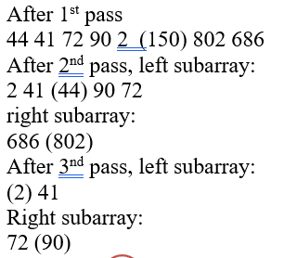
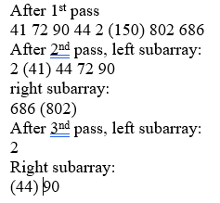
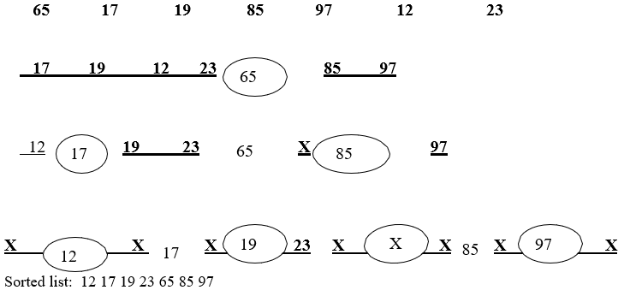
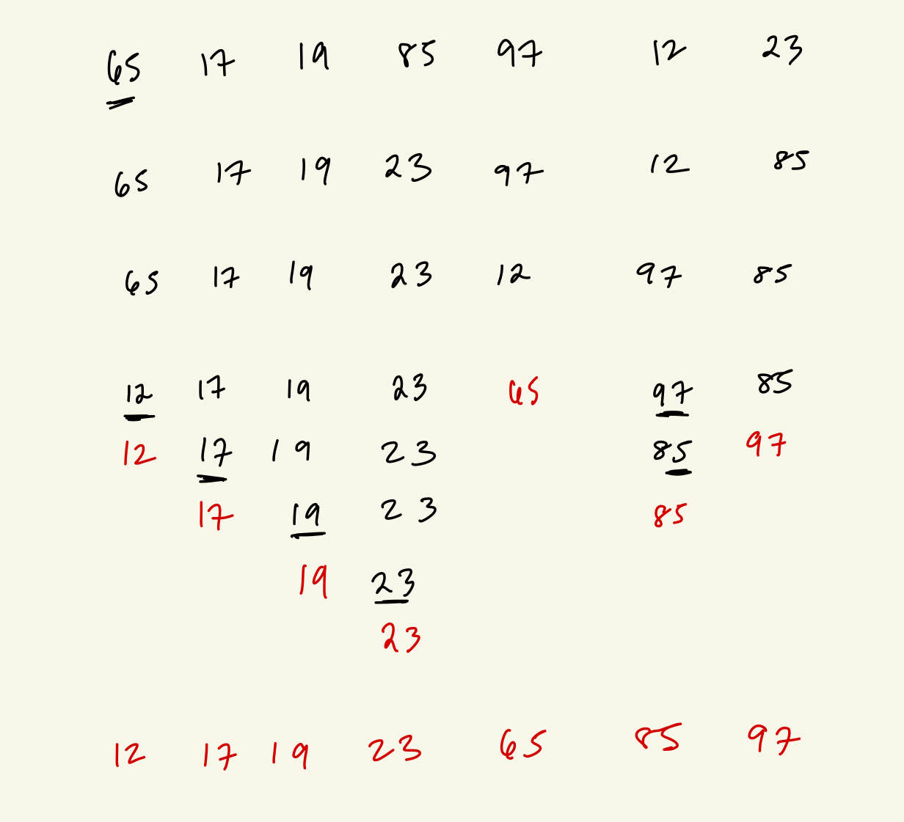
Quicksort
65
150
12
97
44
802
17
85
12 17 19 23 (65) 97 85
Left part: (12) 17 19 23
(17) 19 23
(19) 23
Right part: 85 (97)
19
2
90
686
41
72
23
44

Slide 27
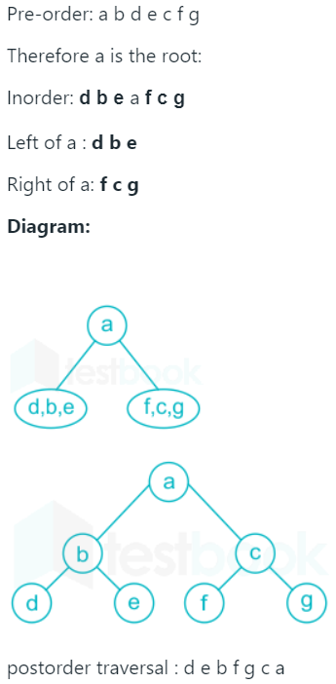
Binary Tree Traversal
Preorder abdcfg
Inorder dbafcg
e
a, b, c, d
f, g
a
a
b
c
d, b, e
f, c, g
abcd
a
d
e
e
b
c
b
f
d
g
f
g
a
c
g
d
ajohn
b
c
d
f
g

Slide 28
CSC175

Slide 29
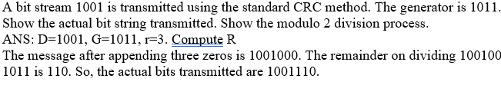
1
1
0
1
1
0
1
1
1 0 1 1
1 1 1 1 0 0
0
1 0 1 1
1 1 1 1 1 1
1
1 0 1 1
1 0 1 1
1 0 0 0
1 0 0 1
1 0 1 1
1 0 1 1
1 1 0 0
1 0 1 1
1 0 1 1
1 0 1 1
1 1 1
1 1 1

Slide 30
Plain | 000 | 001 | 010 | 011 | 100 | 101 | 110 | 111
Cipher | 110 | 111 | 101 | 100 | 011 | 010 | 000 | 001
Plain | 000 | 001 | 010 | 011 | 100 | 101 | 110 | 111
Cipher | 110 | 111 | 101 | 100 | 011 | 010 | 000 | 001

Slide 31
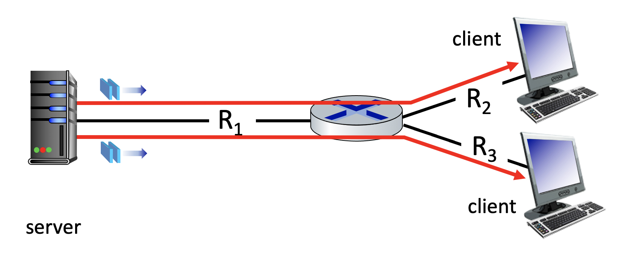
25 Mbps
10 Mbps
50 Mbps

Slide 32
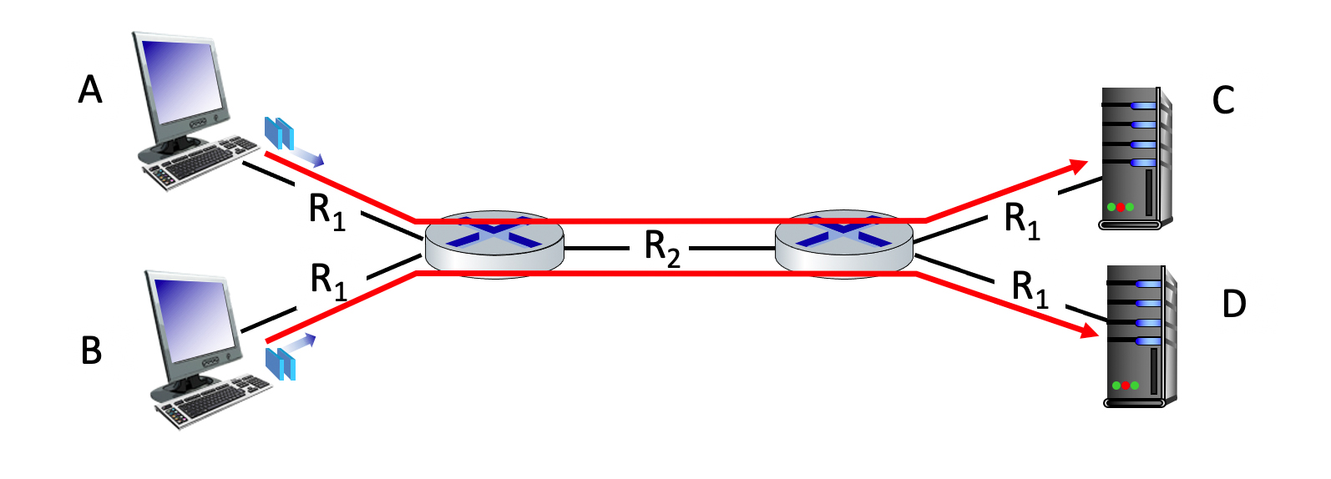
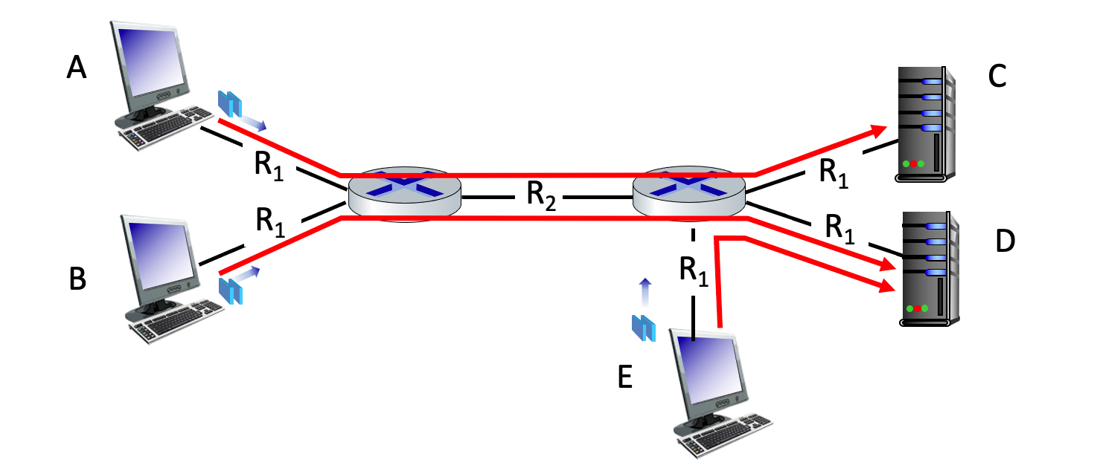
100 Mbps
100 Mbps
150 Mbps
100 Mbps
100 Mbps
100 Mbps
100 Mbps
150 Mbps
100 Mbps
100 Mbps
100 Mbps

Slide 33
1 0 1 0 1
1
1 1 1 1 0
0
0 1 1 1 0
1
0 0 1 0 1
0
1 0 1 0 1
1
1 1 1 1 0
0
1 0 1 0 0 0
parity
error
0 1 1 1 0
1
1 0 1 1 0 1
parity
error
0 0 1 0 1
0
0 1 1 1 1 0
parity
error
0 1 1 0 1 0
parity
error

