Slide 1
Final Exam
Department of Computer Science
Hofstra University

Slide 2
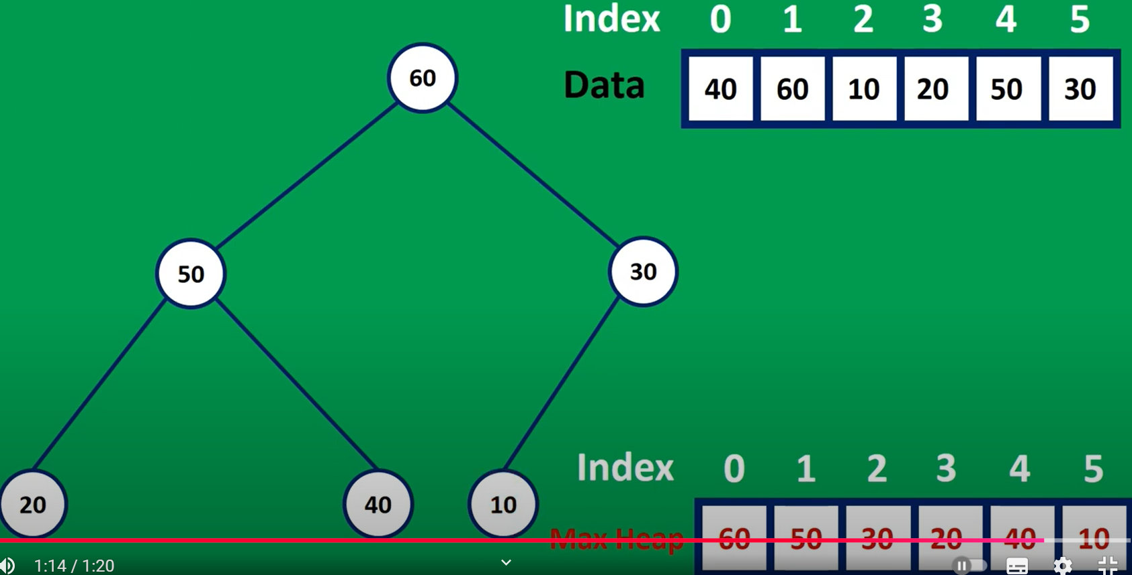
60
50
30
50
20
40
10
40
30
20
10

Slide 3

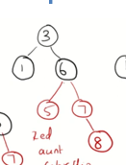
b
3
b
3
b
1
b
5
b
1
b
6
r
7
r
5
r
7

Slide 4
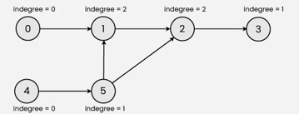
0
1
2
3
0 → {1, 2}
1
2
1 → {3}
2 → {1, 3}
3
4
3 → null
5
4
0
1
2
1 2 3 4
2
0
1
3
4
5
1
2
3
4
0
1
1
0
0
1
1
0
0
1
0
0
0
0
0
0
0
0
0
0
0
0
0
0
3
0
1
0
1
0
1
0
1
0
0
0
0
0
0
0
0
0
0
0
0
0
0
0
0
Notes:
1 → {2, 3}
2 → {}
3 → {2, 4}
4 → {}

Slide 5
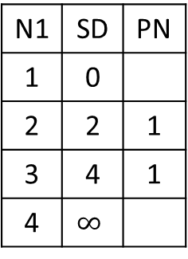
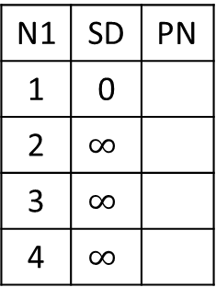
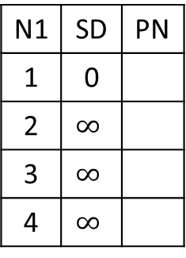
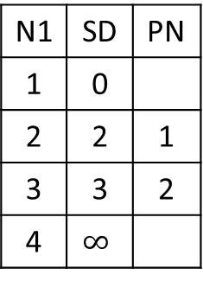
N1 | SD | PN
1 | 0
2 | $$∞$$
3 | $$∞$$
4 | $$∞$$
N1 | SD | PN
1 | 0
2
3
4
N1 | SD | PN
1 | 0
2
3
4
N1 | SD | PN
1 | 0
2
3
4
N1 | SD | PN
1 | 0
2
3
4
Visit
Visit
Visit
Visit
1
2
2
4
1
3
1
4
N1 | SD | PN
1 | 0
2 | $$∞$$
3 | $$∞$$
4 | $$∞$$
N1 | SD | PN
1 | 0
2 | 2 | 1
3 | 4 | 1
4 | $$∞$$
N1 | SD | PN
1 | 0
2 | 2 | 1
3 | 3 | 2
4 | $$∞$$
N1 | SD | PN
1 | 0
2 | 2 | 1
3 | 3 | 2
4 | 4 | 3
N1 | SD | PN
1 | 0
2 | 2 | 1
3 | 3 | 2
4 | 4 | 3
Visit 1
Visit 2
Visit 3
Visit 4

Slide 6
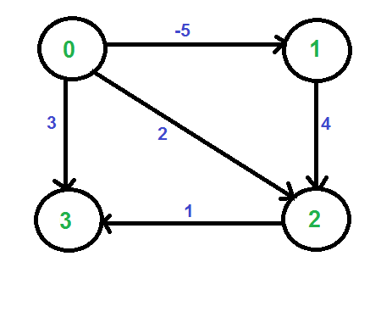
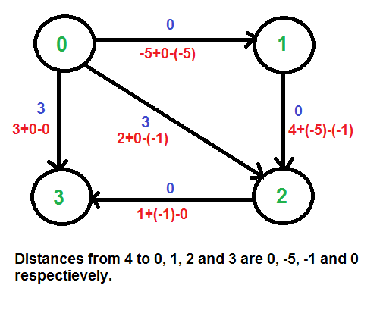
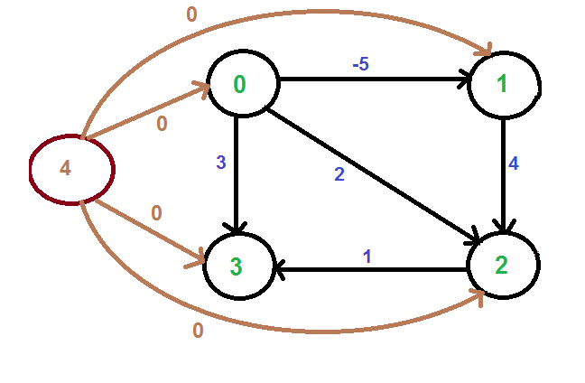
§
H[0]=0
H[1]=-5
d
H[3]=0
H[2]=-1
H[1]=0
H[2]=-2
-2
-2+0-(-2)=0
1
2
1
2
1
1
1+0-0=1
1+0-(-2)=3
3
1
4
3
4
1
H[3]=0
H[4]=0
1+0-0=1

Slide 7
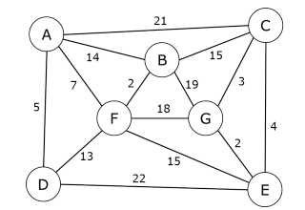
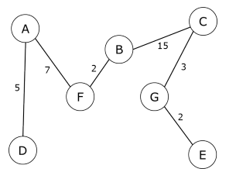
A
21
C
14
15
7
B
3
2
19
F
18
G

Slide 8
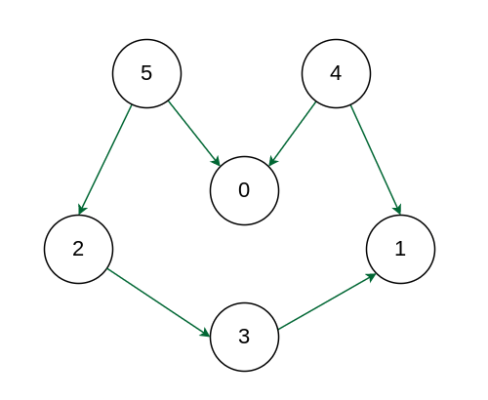
5
4
2
0
1
3

Slide 9
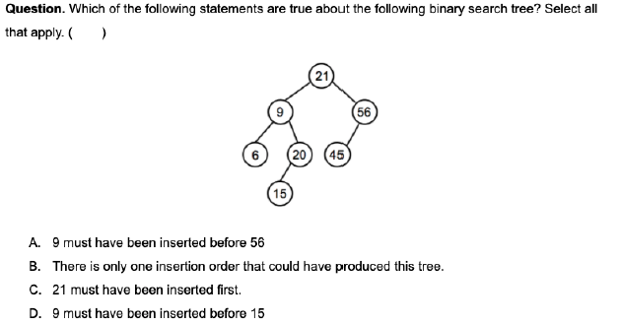
21
9
56
6
20
45
15

Slide 11
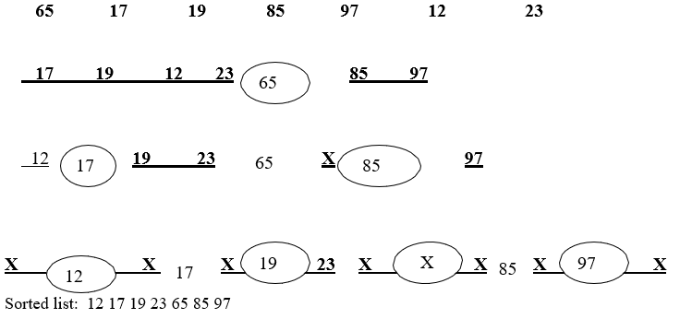
65
17
85
12
19
97
23

