Slide 1
Dr. Yifeng Zhu Electrical and Computer Engineering University of Maine
Embedded Systems with ARM Cortex-M Microcontrollers in Assembly Language and C
Chapter 12
Fixed-point and Floating-point Arithmetic
Spring 2020

Slide 2
Fixed-point Format: Q Notation
UQm.n for unsigned fixed-point
Integer Part
Fractional Part
m bits
n bits
Radix Point
Qm.n for signed fixed-point
Integer Part
Fractional Part
sign bit
m bits
n bits
Radix Point
m + n + 1 bits

Slide 3
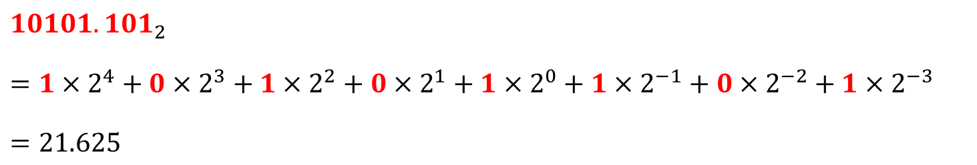
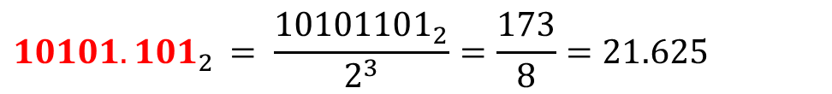
Converting Fixed-point UQ5.3 to Float
2⁴ | 2³ | 2² | 2¹ | 2⁰ | 2⁻¹ | 2⁻² | 2⁻³
1 | 0 | 1 | 0 | 1 | 1 | 0 | 1
Integer Part
Radix
Point
Fractional Part
$$10101.101_{2 }$$
$$=1×2^{4}+0×2^{3}+1×2^{2}+0×2^{1}+1×2^{0}+1×2^{−1}+0×2^{−2}+1×2^{−3}$$
$$=21.625$$
$$10101.101_{2 }= \frac{{10101101}_{2}}{2^{3}}=\frac{173}{8}=21.625$$

Slide 4
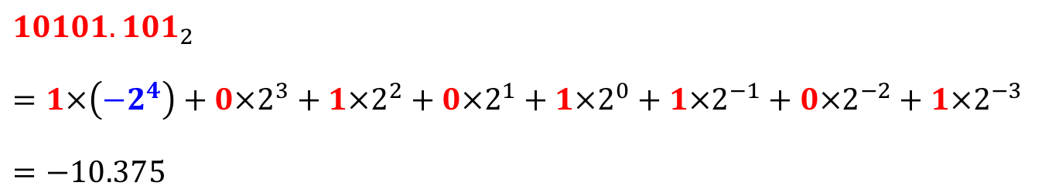
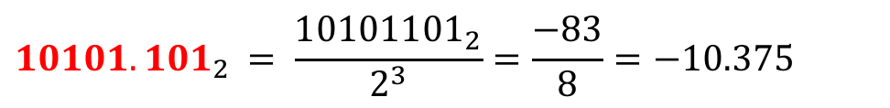
Converting Fixed-point Q4.3 to Float
-2⁴ | 2³ | 2² | 2¹ | 2⁰ | 2⁻¹ | 2⁻² | 2⁻³
1 | 0 | 1 | 0 | 1 | 1 | 0 | 1
Signed
Bit
Integer Part
Radix
Point
Fractional Part
$$10101.101_{2 }$$
$$=1×\left(−2^{4}\right)+0×2^{3}+1×2^{2}+0×2^{1}+1×2^{0}+1×2^{−1}+0×2^{−2}+1×2^{−3}$$
$$=−10.375$$
$$10101.101_{2 }= \frac{{10101101}_{2}}{2^{3}}=\frac{−83}{8}=−10.375$$

Slide 5
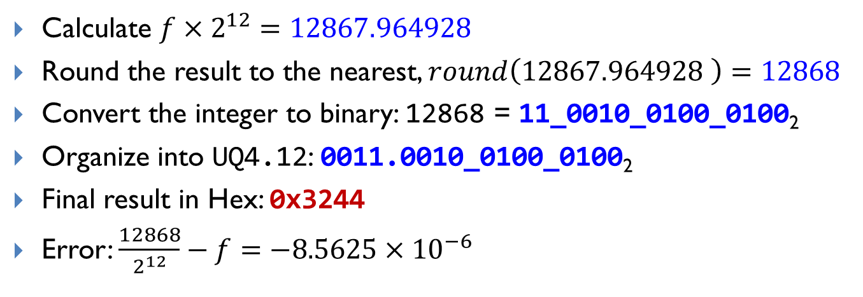

Convert Float to Fixed-point UQ4.12
UQm.n for unsigned fixed-point
$$Representation=round(float × 2^{n})$$
Example: Convert $f = 3. 141593$ to UQ4.12
Calculate $f×2^{12}=12867.964928$
Round the result to the nearest, $round\left(12867.964928 \right)=12868$
Convert the integer to binary: 12868 = 11_0010_0100_0100₂
Organize into UQ4.12: 0011.0010_0100_0100₂
Final result in Hex: 0x3244
Error: $\frac{12868}{2^{12}}−f=−8.5625×{10}^{−6}$

Slide 6
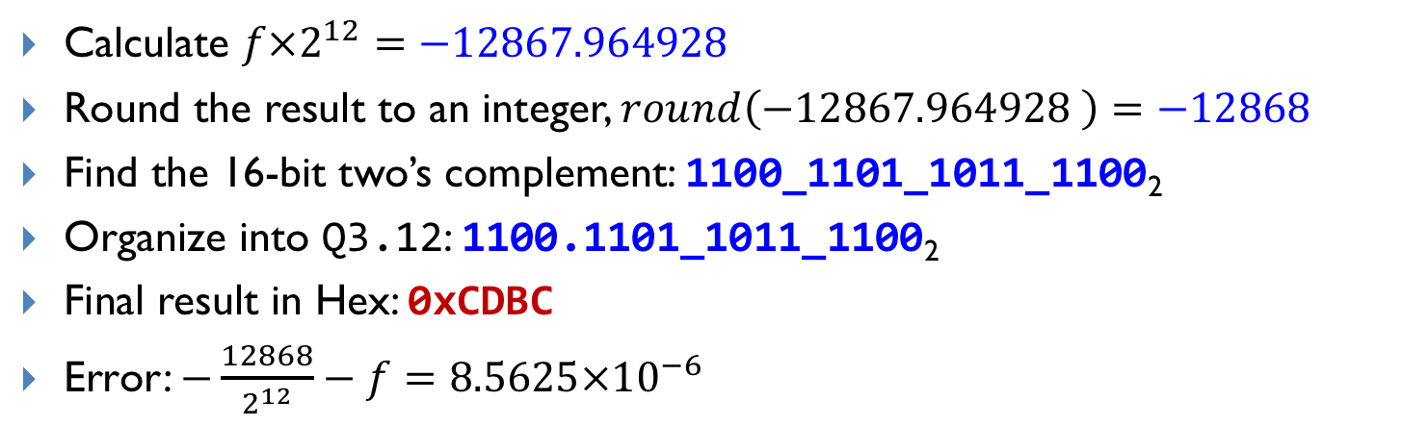

Convert Float to Fixed-point Q3.12
Qm.n for signed fixed-point
$$Representation=round(float × 2^{n})$$
Example: Convert $f = −3. 141593$ to Q3.12
Calculate $f×2^{12}=−12867.964928$
Round the result to an integer, $round\left(−12867.964928 \right)=−12868$
Find the 16-bit two’s complement: 1100_1101_1011_1100₂
Organize into Q3.12: 1100.1101_1011_1100₂
Final result in Hex: 0xCDBC
Error: $−\frac{12868}{2^{12}}−f=8.5625×{10}^{−6}$

Slide 7
Why use fixed-point?
Floating Point
Shorter Development Time
Wide Dynamic Range
Fixed Point
Higher Performance
Lower Product Cost
More bits for precision

Slide 8
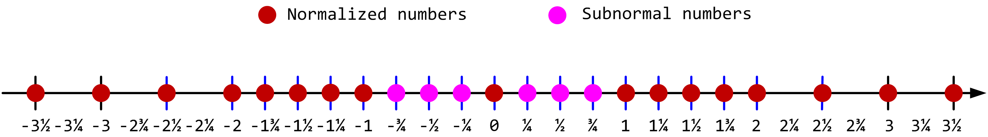
Tradeoff between Range and Precision
A simplified 5-bit floating-point (IEEE 754 style)
Floating-Point
Resolution: difference between two neighbor numbers
Precision decreases as the magnitude increases
Fixed-Point
Numbers are evenly distributed among the representable range
Precision is fixed

Slide 9
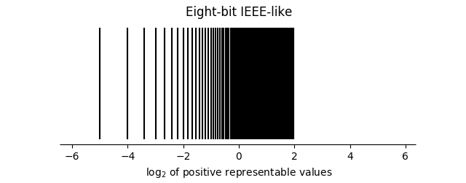
Tradeoff between Range and Precision
Distribution of 8-bit IEEE-like positive representable numbers on a log scale
https://www.johndcook.com/blog/2018/04/15/eight-bit-floating-point/

Slide 10
Fixed-point Addition and Subtraction
Add/subtract two fixed-point numbers with the same format
Simply treat them as integers, and
Add/subtract using standard integer addition/subtraction
; r0 and r1 hold a UQ16.16
ADD r2, r0, r1 ; Simply use integer add
SUB r3, r0, r1 ; Simply use integer sub
r0
Integer Part
Fractional Part
+
r1
+
Integer Part
Fractional Part
r2
Integer Part
Fractional Part
imaginary radix point

Slide 11
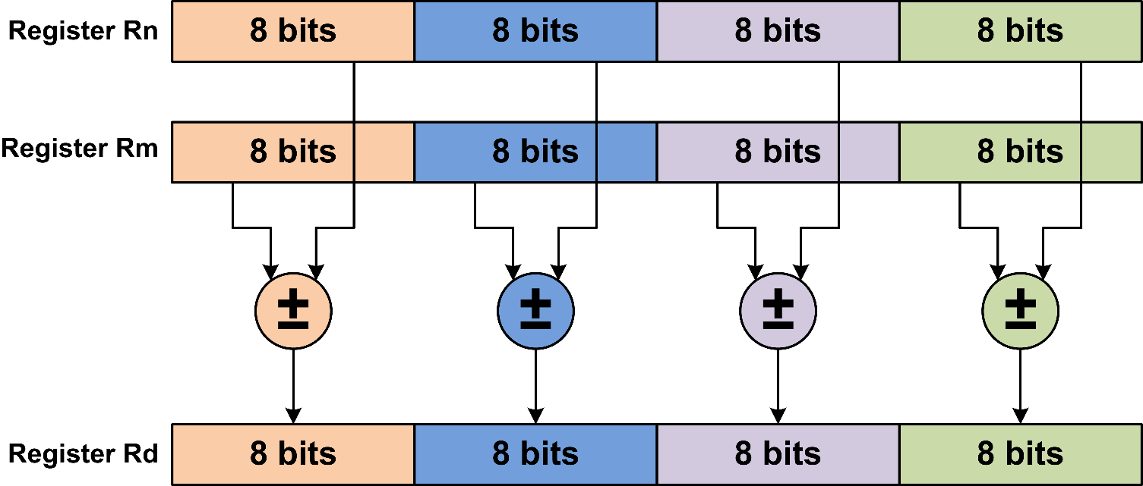
Parallel 8-bit Add and Subtract
SADD8 Rd, Rn, Rm
UADD8 Rd, Rn, Rm

Slide 12
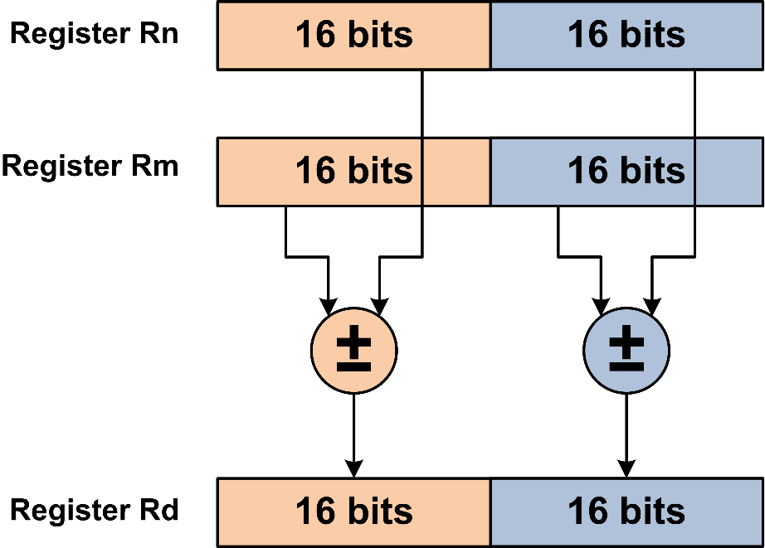
Parallel 8-bit Add and Subtract
SADD16 Rd,Rn,Rm
UADD16 Rd,Rn,Rm

Slide 13
Fixed-point Multiplication in UQ16.16 or Q15.16
16 bits
16 bits
f_{A}
Integer Part
Fractional Part
f_{B}
Integer Part
Fractional Part
f_{C} = f_{A} x f_{B}
Integer Part[15:0]
Fractional Part [31:16]
A x B
Integer Part [31:0]
Fractional Part [31:0]
32 bits
32 bits

Slide 14


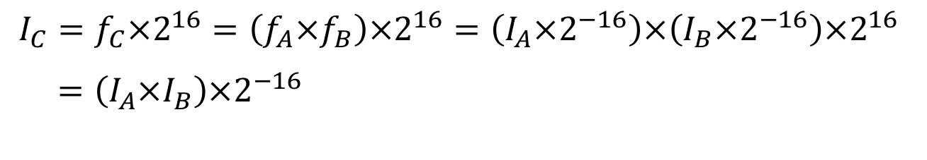


Fixed-point Multiplication in UQ16.16 or Q15.16
f_{C} = f_{A} x f_{B}
Integer Part[15:0]
Fractional Part [31:16]
A x B
Integer Part [31:0]
Fractional Part [31:0]
32 bits
32 bits
$$f_{A}=I_{A}×2^{−16}$$
$$f_{C}=I_{C}×2^{−16}$$
$$f_{B}=I_{B}×2^{−16}$$
$$f_{C}=f_{A}×f_{B}$$
$$I_{C}=f_{C}×2^{16}=\left(f_{A}×f_{B}\right)×2^{16}=\left(I_{A}×2^{−16}\right)×\left(I_{B}×2^{−16}\right)×2^{16}$$
$$=\left(I_{A}×I_{B}\right){×2}^{−16}$$

Slide 15
Fixed-point Multiplication in UQ16.16
r3
Integer Part [31:0]
r2
Fractional Part [31:0]
shift left 16 bits
shift right 16 bits
r3
Integer Part[15:0]
0000 0000 0000 0000
r2
0000 0000 0000 0000
Fractional Part [31:16]
bitwise OR
r0
Integer Part[15:0]
Fractional Part [31:16]
MUL_UQ16xUQ16 PROC
UMULL r2, r3, r0, r1 ; Unsigned long multiply, 64-bit result in r3:r2
LSLS r3, r3, #16 ; Shift left the upper word r3
LSRS r2, r2, #16 ; Shift right the lower word r2
ORR r0, r2, r3 ; Pack two halfwords into a word
BX LR ; Return
ENDP

Slide 16
Fixed-point Multiplication in Q15.16
r3
Integer Part [31:0]
r2
Fractional Part [31:0]
shift left 16 bits
shift right 16 bits
r3
Integer Part[15:0]
0000 0000 0000 0000
r2
0000 0000 0000 0000
Fractional Part [31:16]
bitwise OR
r0
Integer Part[15:0]
Fractional Part [31:16]
MUL_Q16xQ16 PROC
SMULL r2, r3, r0, r1 ; Signed long multiply, 64-bit result in r3:r2
LSLS r3, r3, #16 ; Shift left the upper word r3
LSRS r2, r2, #16 ; Shift right the lower word r2
ORR r0, r2, r3 ; Pack two halfwords into a word
BX LR
ENDP

Slide 17
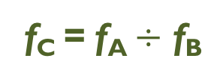
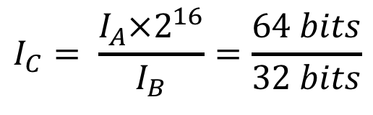
Fixed-point Division in UQ16.16
16 bits
16 bits
f_{A}
Integer Part
Fractional Part
s = sign
f_{A}
ssss ssss ssss ssss
Integer Part
Fractional Part
0000 0000 0000 0000
64 bits
f_{B}
Integer Part
Fractional Part
f_{C} = f_{A} $÷$ f_{B}
Integer Part
Fractional Part
$$I_{C}= \frac{I_{A}×2^{16}}{I_{B}}=\frac{64 bits}{32 bits}$$

Slide 18
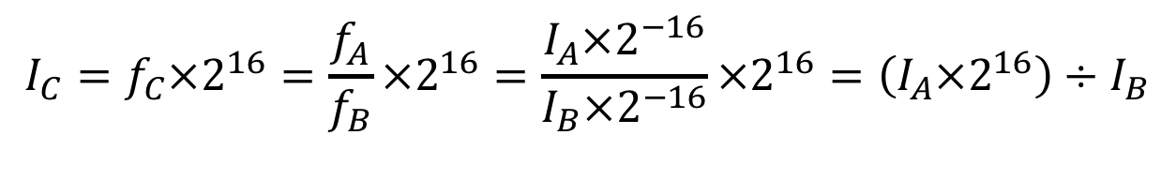




Fixed-point Division in UQ16.16
16 bits
16 bits
f_{A}
Integer Part
Fractional Part
s = sign
f_{A}
ssss ssss ssss ssss
Integer Part
Fractional Part
0000 0000 0000 0000
64 bits
$$f_{A}=I_{A}×2^{−16}$$
$$f_{C}=I_{C}×2^{−16}$$
$$f_{B}=I_{B}×2^{−16}$$
$$f_{C}=f_{A}÷f_{B}$$
$$I_{C}=f_{C}×2^{16}=\frac{f_{A}}{f_{B}}×2^{16}=\frac{I_{A}×2^{−16}}{I_{B}×2^{−16}}×2^{16}=\left(I_{A}×2^{16}\right)÷I_{B}$$

Slide 19
Fixed-point Division in UQ16.16 or Q15.16
f_{A}
r0
Integer Part
Fractional Part
f_{A}
ssss ssss ssss ssss
Integer Part
Fractional Part
0000 0000 0000 0000
DIV_UQ16xUQ16 PROC
PUSH {LR}
ASRS r1, r0, #31 ; r1[31:0] = sign bits of A
LSLS r1, r1, #16 ; put sign bits in upper half word
ORR r1, r1, r0, LSR #16
LSLS r0, r0, #16 ; [r1:r0] stores sign extended A
ASRS r3, r2, #31 ; [r4:r3] stores sign extended B
BL division_64_bits ; Take four input register (r0:r1, r2:r3)
; division_64_bits places result in r0
POP {pc}
ENDP

Slide 21
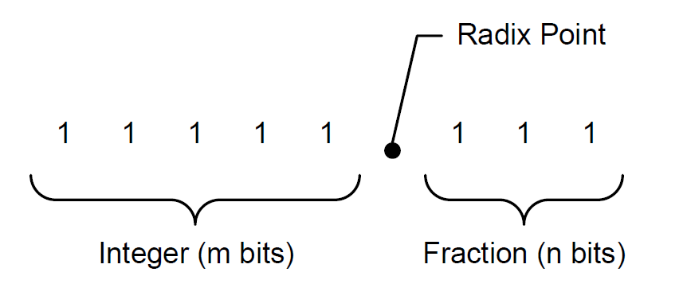




Q Notation: UQm.n
$$f=A_{h}+A_{l}×2^{−n}$$
$$10101.101_{2 }= A_{h}+A_{l}×2^{−3}$$
$$=21+5×2^{−3}$$
$$=21.625$$

Slide 22
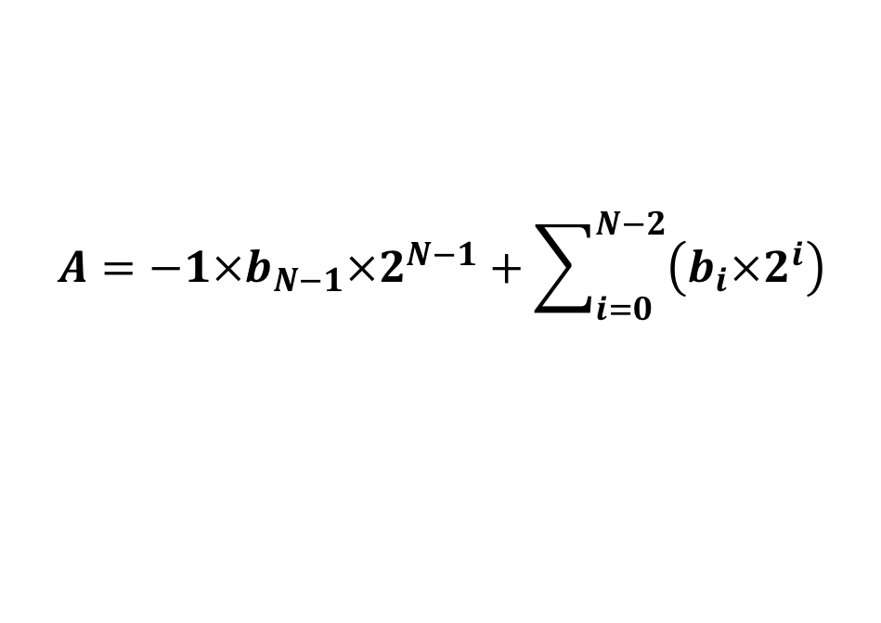
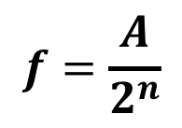
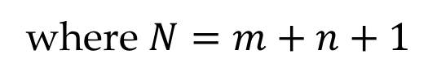
Signed Fixed-point Representation Qm.n
$$A=−1×b_{N−1}×2^{N−1}+\sum_{i=0}^{N−2}{\left(b_{i}×2^{i}\right)}$$
$$f=\frac{A}{2^{n}}$$
where $N=m+n+1$

Slide 23
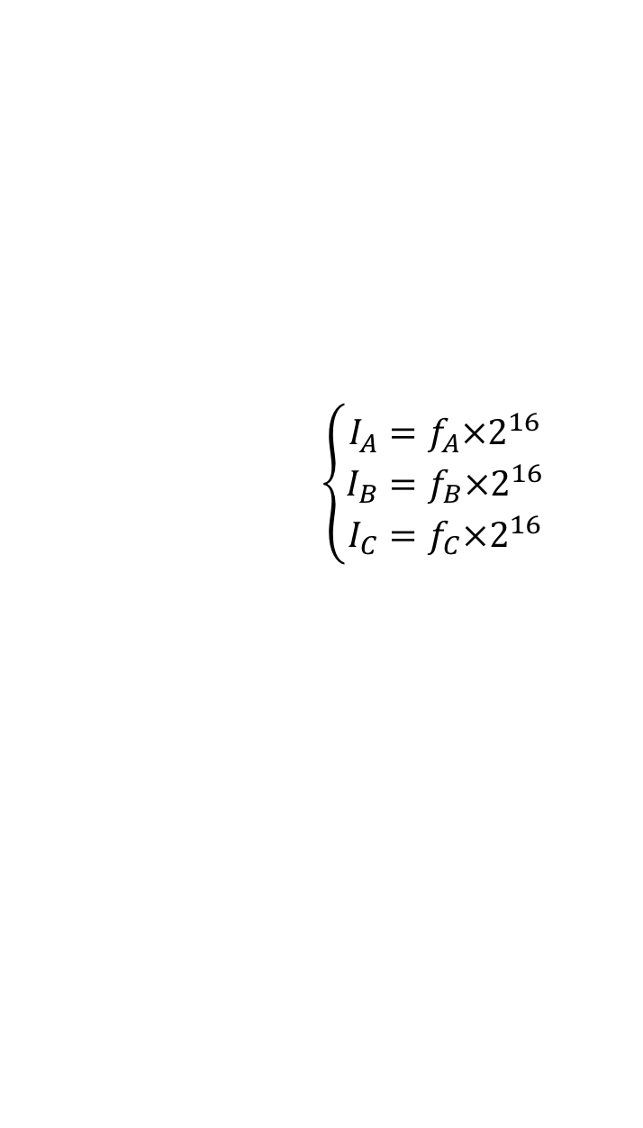



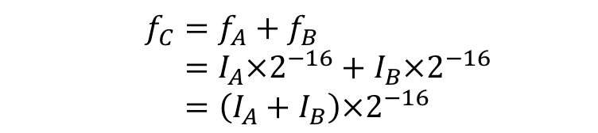
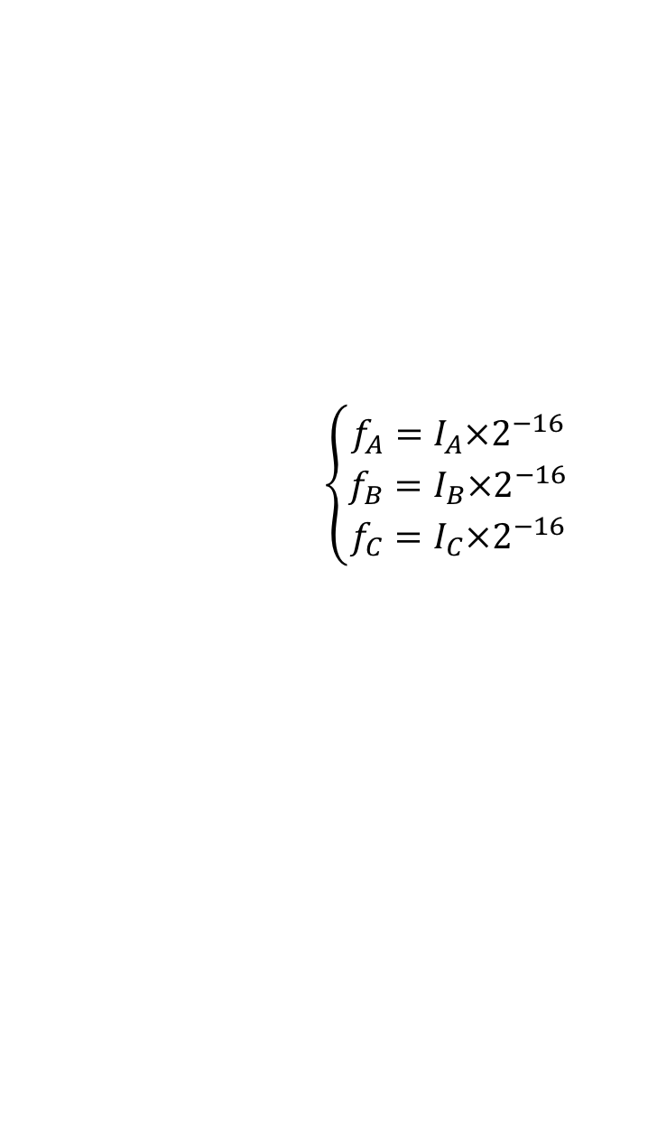
Addition and Subtraction in UQ16.16 or Q15.16
Assume UQ16.16
$$f_{C}=f_{A}+f_{B}$$
$$\left\{\begin{matrix}I_{A}=f_{A}×2^{16} \\ I_{B}=f_{B}×2^{16} \\ I_{C}=f_{C}×2^{16}\end{matrix}\right.$$
$$\left\{\begin{matrix}f_{A}=I_{A}×2^{−16} \\ f_{B}=I_{B}×2^{−16} \\ f_{C}=I_{C}×2^{−16}\end{matrix}\right.$$
$$f_{C}=f_{A}+f_{B} \\ =I_{A}×2^{−16}+I_{B}×2^{−16} \\ =\left(I_{A}+I_{B}\right)×2^{−16}$$
$$I_{C}×2^{−16}=\left(I_{A}+I_{B}\right)×2^{−16}$$
$$I_{C}=I_{A}+I_{B}$$

Slide 24


Addition and Subtraction in UQ16.16 or Q15.16
$$f_{C}=f_{A}+f_{B}$$
$$I_{C}=I_{A}+I_{B}$$
; r0 = fixed-point number fa ; r1 = fixed-point number fb ; r2 = fixed-point number fc add r2, r0, r1 ; fc = fa + fb sub r2, r0, r1 ; fc = fa - fb

Slide 25
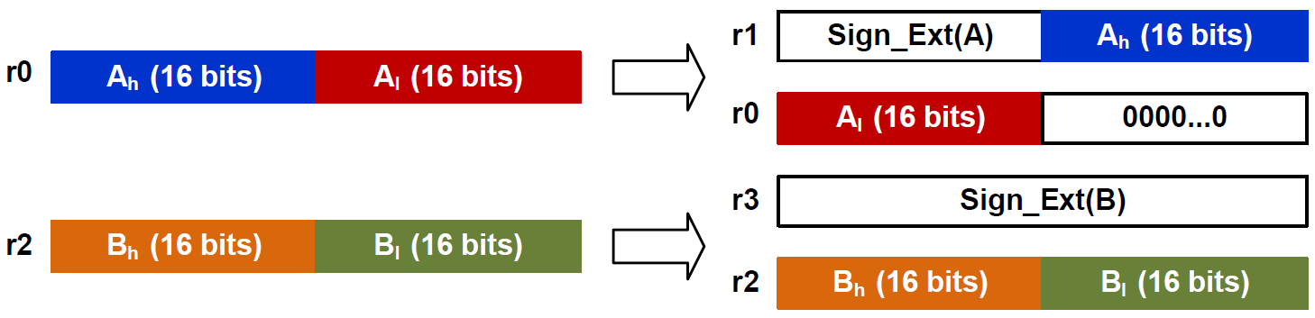
Fixed-point Division in UQ16.16 or Q15.16
r4 = fixed-point quotient = A ÷ B
ASRS r1, r0, #31 ; r1[31:0] = sign bits of A
LSLS r1, r1, #16 ; put sign bits in upper half word
ORR r1, r1, r0, LSR #16
LSLS r0, r0, #16 ; [r1:r0] stores sign extended A
ASRS r3, r2, #31 ; [r4:r3] stores sign extended B
BL division_64_bits ; Take four input register (r0:r1, r3:r4)
MOV r4, r0 ; division_64_bits places result in r0

