Slide 1
Dr. Yifeng Zhu Electrical and Computer Engineering University of Maine
Embedded Systems with ARM Cortex-M Microcontrollers in Assembly Language and C
Chapter 12
Fixed-point and Floating-point Arithmetic
Spring 2020

Slide 2
Precision/Resolution
There's no sense in being precise when you don't even know what you're talking about.
John von Neumann
mathematician, computer scientist

Slide 3
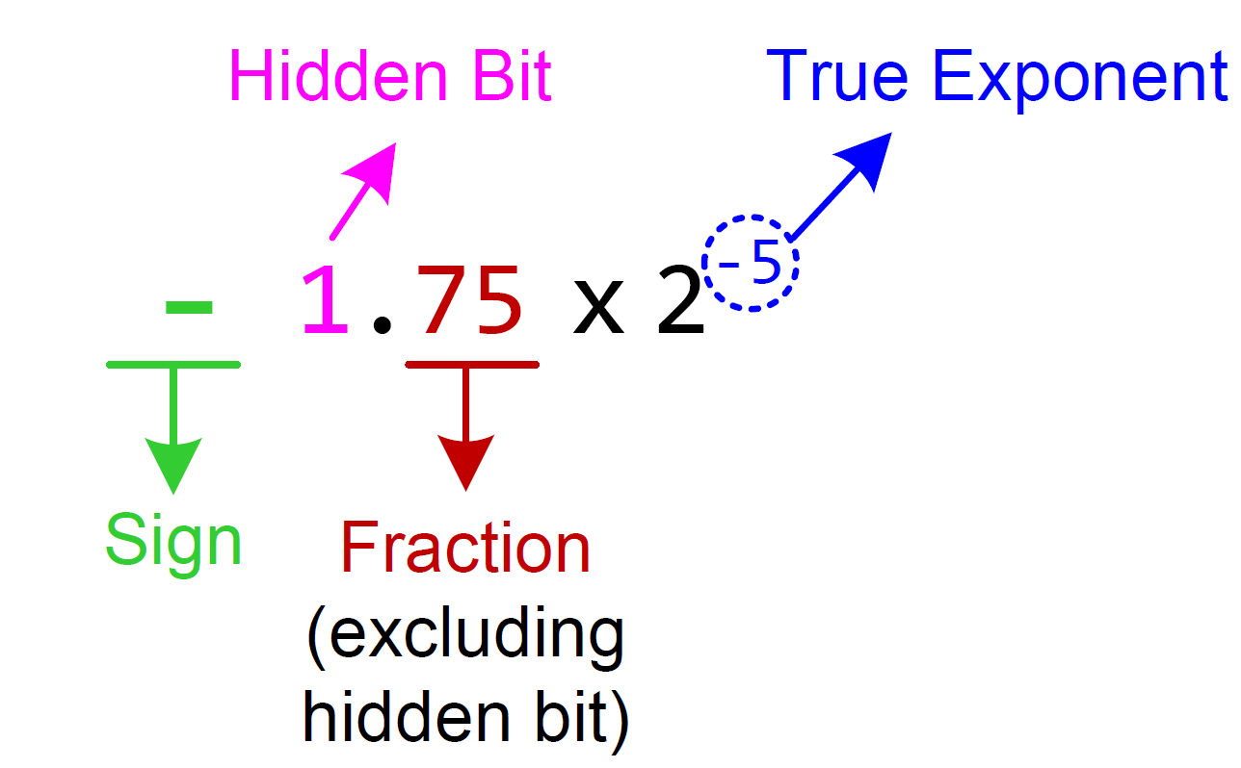
Normalization
We can convert 10.746×2⁶ to normalized format as follows:

Slide 4
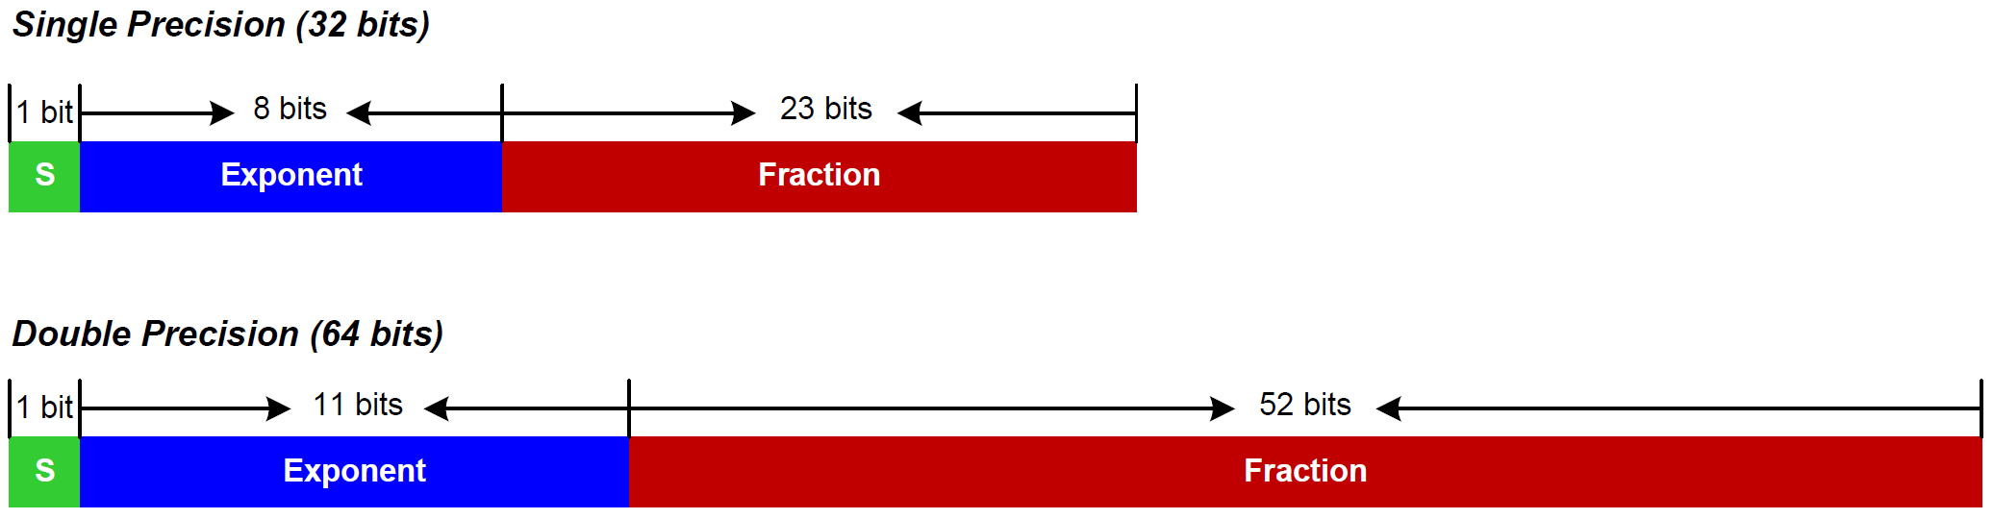
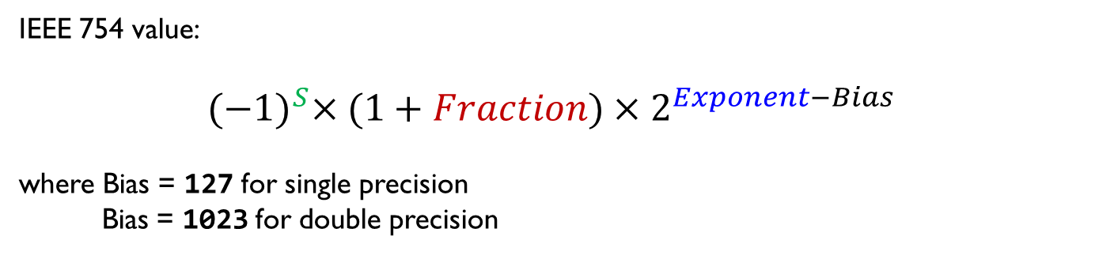
IEEE Standard 754
IEEE 754 value:
$${(−1)}^{S}×(1+Fraction)×2^{Exponent−Bias}$$
where Bias = 127 for single precision
Bias = 1023 for double precision

Slide 5
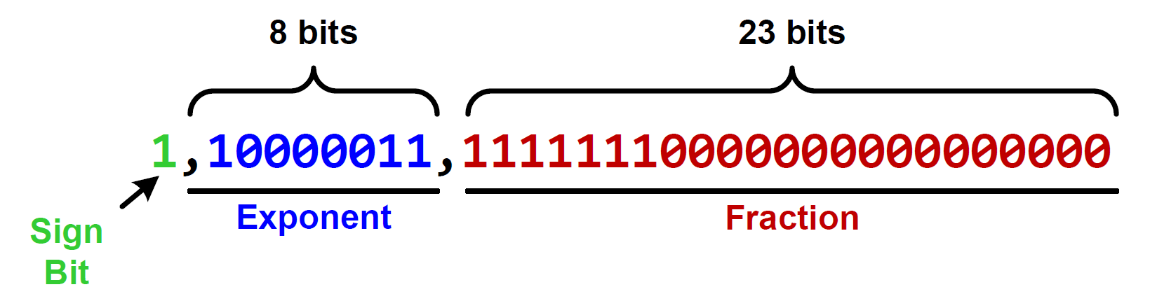
Decoding 0xC1FF0000 into a floating-point number

Slide 6
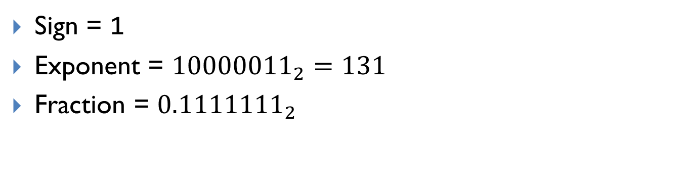
Decoding 0xC1FF0000 into a floating-point number
Sign = 1
Exponent = ${10000011}_{2}=131$
Fraction = ${0.1111111}_{2}$

Slide 7
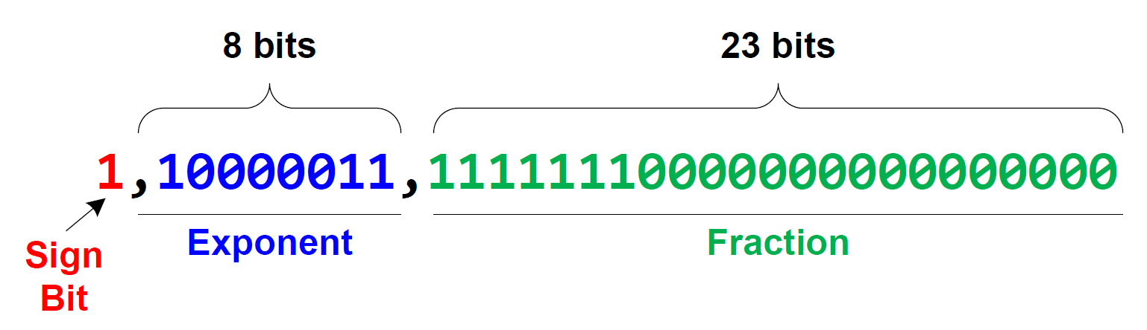
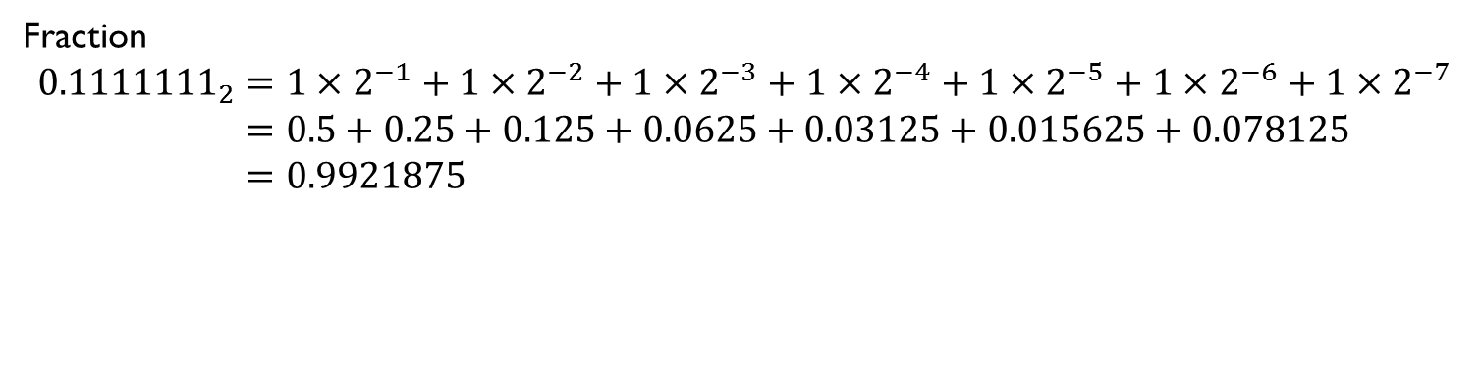
Decoding 0xC1FF0000 into a floating-point number
Fraction
$${0.1111111}_{2}=1×2^{−1}+1×2^{−2}+1×2^{−3}+1×2^{−4}+1×2^{−5}+1×2^{−6}+1×2^{−7} \\ =0.5+0.25+0.125+0.0625+0.03125+0.015625+0.078125 \\ =0.9921875$$

Slide 8
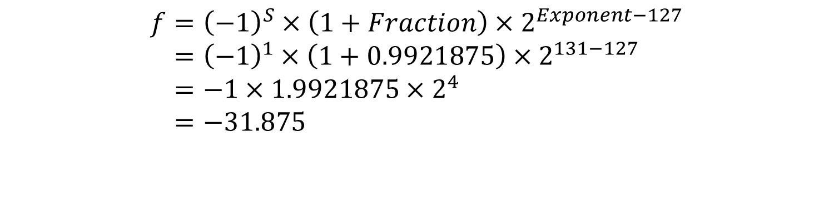
Decoding 0xC1FF0000 into a floating-point number
0.9921875
$$f={\left(−1\right)}^{S}×\left(1+Fraction\right)×2^{Exponent−127} \\ ={\left(−1\right)}^{1}×\left(1+0.9921875\right)×2^{131−127} \\ =−1×1.9921875×2^{4} \\ =−31.875$$

Slide 9
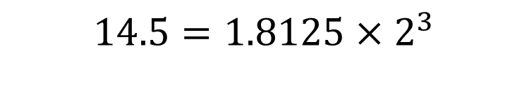
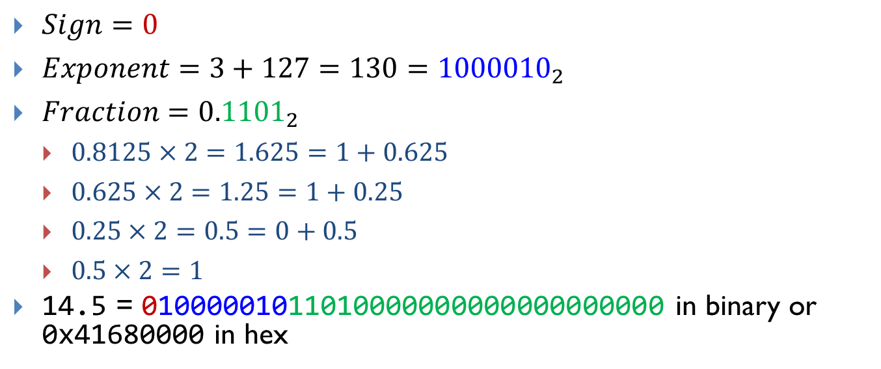

Encoding 14.5 into IEEE Std 754 Single-Precision
Normalization:
$$14.5=1.8125×2^{3}$$
$$=(1+0.8125)×2^{3}$$
$Sign=0$
$Exponent=3+127=130={1000010}_{2}$
$Fraction={0.1101}_{2}$
$0.8125×2=1.625=1+0.625$
$0.625×2=1.25=1+0.25$
$0.25×2=0.5=0+0.5$
$0.5×2=1$
14.5 = 01000001011010000000000000000000 in binary or 0x41680000 in hex

Slide 10
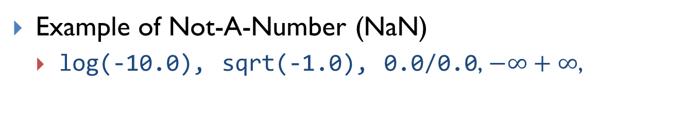
Special Values
Exponents 00000000 and 111111111 are reserved.
Example of Not-A-Number (NaN)
log(-10.0), sqrt(-1.0), 0.0/0.0, $−∞+∞$,

Slide 11

Subnormalized Float Number
To represent numbers between 0 and the minimum positive number that the normalized format can represent.
Normalized Format
Sub-normalized Format
$${\left(−1\right)}^{S}×(1+Fraction)×2^{Exponent−127}$$
$${\left(−1\right)}^{S}×Fraction×2^{−126}$$

Slide 12
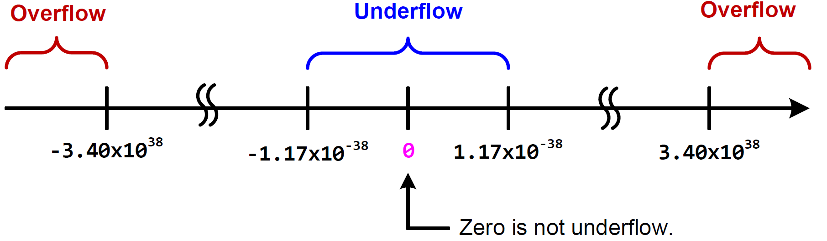
Overflow and Underflow
Numbers closest to zero
$${(−1)}^{S}×\left(1+0\right)×2^{1−127}=±2^{−126}≈±1.18×{10}^{−38}$$

Slide 13
Overflow and Underflow
Numbers farthest from zero
$${(−1)}^{S}×\left(1+\left(1−2^{−23}\right)\right)×2^{254−127}=±\left(2^{128}−2^{104}\right)≈±3.40×{10}^{38}$$

Slide 14
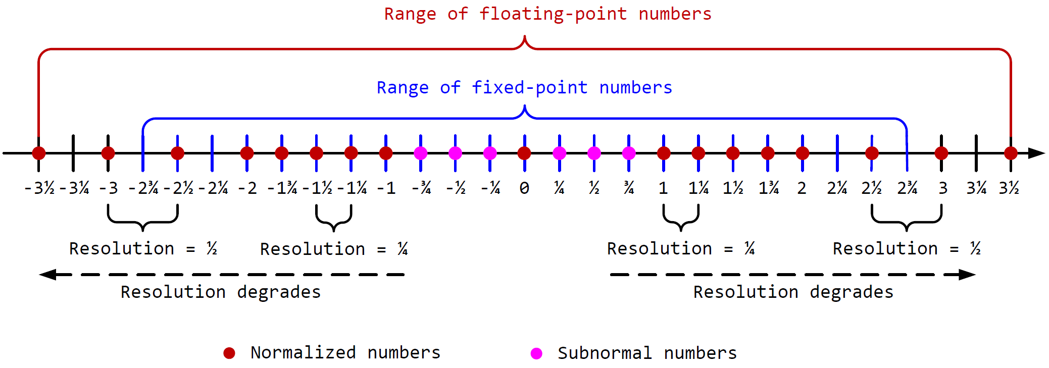
Resolution
Consider a hypothetical five-bit floating-point system (similar to the IEEE 754 standard).
the sign bit, an exponent (2 bits), and a fraction (2 bits)

Slide 15
Rounding
IEEE 754 defines four different rounding rules:
round to the nearest value,
round toward zero (truncation),
round toward plus infinity (rounding up), and
round toward negative infinity (rounding down).
Assume only 5 digits are allowed after the decimal point
Rounding Rule | Data | Rounded Result
Nearest | +0.123456 | +0.12346
 | -0.123456 | -0.12346
Truncate | +0.123456 | +0.12345
 | -0.123456 | -0.12345
Rounding up | +0.123456 | +0.12346
 | -0.123456 | -0.12345
Rounding down | +0.123456 | +0.12345
 | -0.123456 | -0.12346

Slide 16
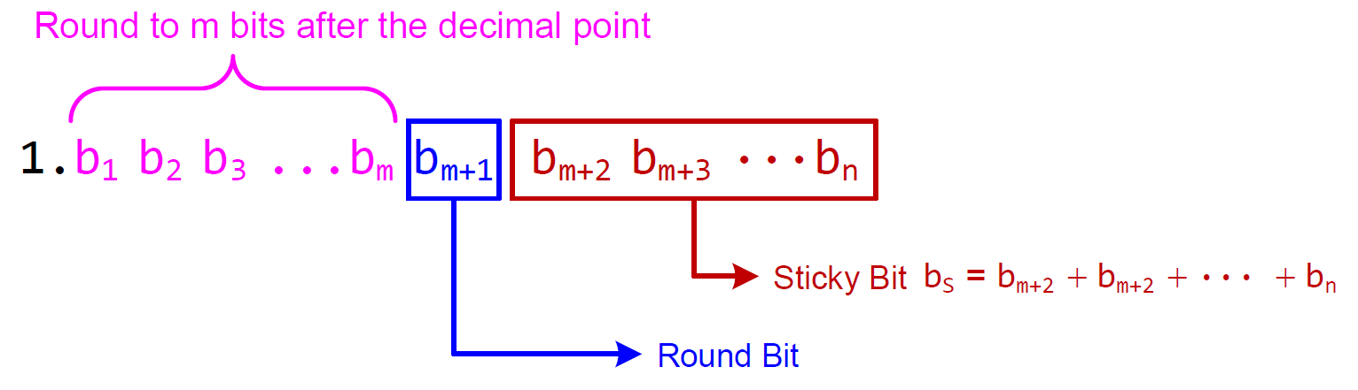
Rounding
If b_{m+1} = 0, directly truncate and remove bits b_{m+1}b_{m+2}b_{m+2}···b_{n}
If b_{m+1} = 1 and b_{S} = 1, round up
If b_{m+1} = 1 and b_{S} = 0, round to even
If b_{m} = 0, directly truncate and remove b_{m+1}b_{m+2}b_{m+2}···b_{n}
If b_{m} = 1, round up

Slide 17
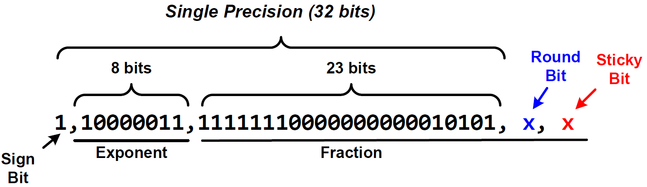
Single-precision Rounding Example
Fraction of result has 25 bits.
Rounded to 23 bits by removing round bit and sticky bit
Example: –1.999999761581421 + (- 0.50000006)
23-bit fraction
1,01111111,11111111111111111111110
+ 1,01111101,00000000000000000000001

Slide 18

Single-precision Rounding Example
$${(−1)}^{S}×(1+Fraction)×2^{Exponent−Bias}$$
Example: –1.999999761581421 + (- 0.50000006)
8 bit exponent
23-bit fraction
1,01111111,11111111111111111111110
+ 1,01111101,00000000000000000000001
1.11111111111111111111111×2¹²⁷⁻¹²⁷
+ 1.00000000000000000000001×2¹²⁶⁻¹²⁷
1.11111111111111111111110×2⁰
+ 1.00000000000000000000001×2⁻¹
1.11111111111111111111110×2⁰
+ 0.100000000000000000000001×2⁰
Shift Right to Align
10.011111111111111111111101×2⁰
1.00111111111111111111111101×2¹
Re-normalize
25 bits

Slide 19
Single-precision Rounding Example
Fraction of result has 25 bits.
Rounded to 23 bits by removing round bit and sticky bit
-1.00111111111111111111111 1 0
round
bit
sticky
bit
23-bit fraction
If round bit = 1 and sticky bit = 0, round to even
If b_{m} = 0, truncate
If b_{m} = 1, round up
-1.01000000000000000000000
23-bit fraction

Slide 20
Single-precision Rounding Example
Example: –1.999999761581421 + (- 0.50000006)
8 bit exponent
23-bit fraction
1,01111111,11111111111111111111110
+ 1,01111101,00000000000000000000001
1.00111111111111111111111101×2¹
1.010000000000000000000000×2¹
Single precision representation
1,10000000,01000000000000000000000
Single precision:
–1.999999761581421 + (- 0.50000006) = -2.5
If infinite precision:
–1.999999761581421 + (- 0.50000006) = -2.499999821581421
Rounding error: 1.784185790221216 × 10⁻⁷

