Slide 1
Z. Gu
Embedded Systems with ARM Cortex-M Microcontrollers in Assembly Language and C
Chapter 5
Memory Access
Fall 2025
Acknowledgement: Lecture slides based on Embedded Systems with ARM Cortex-M Microcontrollers in Assembly Language and C, University of Maine https://web.eece.maine.edu/~zhu/book/

Slide 2
Overview
How data is organized in memory?
Big-Endian vs Little-Endian
How data is addressed?
Register offset
LDR r1, [r0, r3] ; offset = r3
LDR r1, [r0, r3, LSL #2] ; offset = r3 * 4
Immediate offset
Pre-index: LDR r1, [r0, #4]
Post-index: LDR r1, [r0], #4
Pre-index with update: LDR r1, [r0, #4]!

Slide 3
Logic View of Memory
By grouping bits together we can store more values
8 bits = 1 byte
16 bits = 2 bytes = 1 halfword
32 bits = 4 bytes = 1 word
From software perspective, memory is an addressable array of bytes.
The byte stored at the memory address 0x20000004 is 0b10000100
8 bits
High Address
0x20000007
01110010
0x20000006
00100101
0x20000005
11100010
0x20000004
10000100
0x20000003
01100001
0x20000002
10001111
0b10000100
0x84
132
0x20000001
00010010
Binary
Hexadecimal
Decimal
0x20000000
10010100
Computer memory is byte-addressable!
Low Address
Notes:
By grouping bits together we can store more values
8 bits = 1 byte
16 bits = 2 bytes = 1 halfword
32 bits = 4 bytes = 1 word
From software perspective, memory is an addressable array of bytes.
The byte stored at the memory address 0x20000004 is 0b10000100
A word can only be stored at an address that‘s divisible by 4 （Word-address mod 4 = 0, binary address ends with 00）
Memory address of a word is the lowest address of all 4 bytes in that word.
A halfword can only be stored at an address that‘s divisible by 2 （Halfword-address mod 2 = 0, binary address ends with 0）
Memory address of a halfword is the lowest address of all 2 bytes in that word.

Slide 4
Logic View of Memory
When we refer to memory locations by address, we can only do so in units of bytes, halfwords or words
Words
32 bits = 4 bytes = 1 word = 2 halfwords
A word can only be stored at an address that‘s divisible by 4 (Word-address mod 4 = 0, binary address ends with 00)
Memory address of a word is the lowest address of all four bytes in that word.
Two words at addresses: 0x20000000 and 0x20000004
A halfword can only be stored at an address that‘s divisible by 2 (Halfword-address mod 2 = 0, binary address ends with 0)
Memory address of a halfword is the lowest address of all 2 bytes in that word.
8 bits
High Address
0x20000007
01110010
0x20000006
00100101
0x20000005
11100010
0x20000004
10000100
0x20000003
01100001
0x20000002
10001111
0x20000001
00010010
0x20000000
10010100
Low Address
Notes:
By grouping bits together we can store more values
8 bits = 1 byte
16 bits = 2 bytes = 1 halfword
32 bits = 4 bytes = 1 word
From software perspective, memory is an addressable array of bytes.
The byte stored at the memory address 0x20000004 is 0b10000100
A word can only be stored at an address that‘s divisible by 4 （Word-address mod 4 = 0, binary address ends with 00）
Memory address of a word is the lowest address of all 4 bytes in that word.
A halfword can only be stored at an address that‘s divisible by 2 （Halfword-address mod 2 = 0, binary address ends with 0）
Memory address of a halfword is the lowest address of all 2 bytes in that word.

Slide 5
Logic View of Memory
Halfwords
16 bits = 2 bytes = 1 halfword
The right diagram has four halfwords at addresses of:
0x20000000
0x20000002
0x20000004
0x20000006
8 bits
High Address
0x20000007
01110010
0x20000006
00100101
0x20000005
11100010
0x20000004
10000100
0x20000003
01100001
0x20000002
10001111
0x20000001
00010010
0x20000000
10010100
Low Address

Slide 6
Quiz
Memory
0015
High
Address
0014
Offset = ???
X[3]
0013
uint32_t X[4];
0012
0011
0010
What are their memory address offsets?
Offset = ???
X[2]
0009
0008
0007
X[1]
0006
Offset = ???
0005
0004
0003
Offset = ???
0002
X[0]
0001
0000
Low
Address
Offset of bytes
1 byte

Slide 7
Quiz ANS
Memory
0015
0014
Offset = 12
X[3]
0013
uint32_t X[4];
0012
0011
What are their memory address offsets?
0010
Offset = 8
X[2]
0009
0008
0007
X[1]
0006
If the array starts at address pAddr = 0000,
Memory address of X[0] is pAddr = 0000
Memory address of X[1] is pAddr + 4 = 0004
Memory address of X[2] is pAddr + 8 = 0008
Memory address of X[3] is pAddr + 12 = 0012
Offset = 4
0005
0004
0003
Offset = 0
0002
X[0]
Sequential words are at addresses incrementing by 4, since each array element of type uint32_t is 4 bytes (32 bits)
0001
0000
Offset of bytes
1 byte

Slide 8
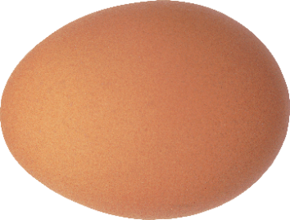

Endianess
High address
MSB
LSB
Little-Endian
Big-Endian
byte 3
byte 2
byte 1
LSB
MSB
byte 0
LSB is at lower address
MSB is at lower address
Low address
Gulliver’s Travels (by Jonathan Swift, published in 1726):
Two religious sects of Lilliputians
The Little-Endians crack open their eggs from the little end
The Big-Endians break their on the big end

Slide 9
Endianess
Endian: byte order, not bit order!
High address
MSB
LSB
Little-Endian
Big-Endian
byte 3
byte 2
byte 1
LSB
MSB
byte 0
LSB is at lower address
MSB is at lower address
Low address
Little-Endian
uint32_t a = 0x87654321
Big-Endian
High address
High address
Reading from the top
0x87
byte 3 byte 2 byte 1 byte 0
0x21
0x65
0x87
0x65
0x43
0x21
0x43
0x43
0x65
0x21
byte 0 byte 1 byte 2 byte 3
0x87
Reading from the bottom
Low address
Low address

Slide 10
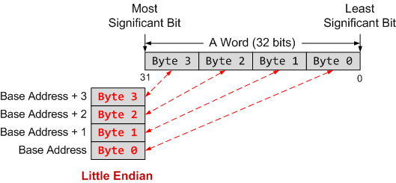
Endianess
Little-Endian
Least significant byte (LSB) is stored at least address of a word
Reading from
the top

Slide 11
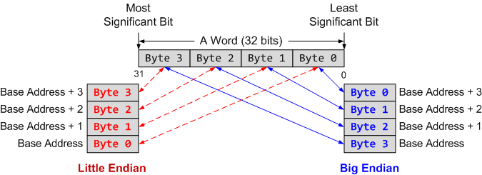
Endianess
Little-Endian
Least significant byte (LSB) is stored at lowest (least) address of a word
Big-Endian
Most significant byte (MSB) is stored at lowest (least) address of a word
Regardless of endianness, the address of a word is defined as the lowest address of all bytes it occupies.
ARM is Little-Endian by default.
It can be made Big-Endian by configuration.
Reading from
the top
Reading from
the bottom
Notes:
Two possible byte orderings:
Little-endian: the LSB (Least Significant Byte) is stored at the lowest address.
Big-endian: the LSB (Least Significant Byte) is stored at the highest address.
Intel processors use Little-Endian; ARM processors can be configured as either Little- or Big-endian; STM32 microcontrollers based on ARM Cortex-M3 use little-endian

Slide 12
Endianness Example
Little-Endian
LSB is at lower address
For uint8_t a and b, each with size of 1 Byte: No difference
Little-endian:
For uint16_t c with size of 2 Bytes: LSB FF is at lower address and MSB 00 is at higher address
For uint32_t d with size of 4 Bytes: LSB 78 is at lower address and MSB 12 is at higher address.
Big-endian:
For uint16_t c with size of 2 Bytes: LSB FF is at higher address and MSB 00 is at lower address
For uint32_t d with size of 4 Bytes: LSB 78 is at higher address and MSB 12 is at lower address.
Memory Value
Offset (LSB) (MSB)
====== ===========
uint8_t a = 1; 0x0000 01 02 FF 00
uint8_t b = 2;
uint16_t c = 255; // 0x00FF
uint32_t d = 0x12345678; 0x0004 78 56 34 12
Big-Endian
MSB is at lower address
Memory Value
Offset (LSB) (MSB)
====== ===========
uint8_t a = 1; 0x0000 01 02 00 FF
uint8_t b = 2;
uint16_t c = 255; // 0x00FF
uint32_t d = 0x12345678; 0x0004 12 34 56 78
Notes:
the LSB (Least Significant Byte) is stored at the lowest address.
Big-endian: the LSB (Least Significant Byte) is stored at the highest address.
Intel processors use Little-Endian; ARM processors can be configured as either Little- or Big-endian; STM32 microcontrollers based on ARM Cortex-M3 use little-endian

Slide 13
Example
If Big-Endian is used, the word stored at address 0x20008000 is
Memory Address | Memory Data
0x20008003 | 0xA7
0x20008002 | 0x90
0x20008001 | 0x8C
0x20008000 | 0xEE
If Little-Endian is used, the word stored at address 0x20008000 is
Notes:
Halfword access and signed halfword/byte accesses were added to the architecture in v4T, this is the reason the offset field is not as flexible as the normal word/byte load/store - not a problem because these accesses are less common.
Link: diagram on next slide

Slide 14
Example
Endianness specifies byte order, not bit order in a byte!
If Big-Endian is used, the word stored at address 0x20008000 is
Memory Address | Memory Data
0x20008003 | 0xA7
0x20008002 | 0x90
0x20008001 | 0x8C
0x20008000 | 0xEE
0xEE8C90A7
If Little-Endian is used, the word stored at address 0x20008000 is
0xA7908CEE
Notes:
Halfword access and signed halfword/byte accesses were added to the architecture in v4T, this is the reason the offset field is not as flexible as the normal word/byte load/store - not a problem because these accesses are less common.
Link: diagram on next slide

Slide 15
Data Alignment
Assume a byte-addressable memory with a data bus that is 32 bits (4 bytes) wide
Consider 16 bytes of memory (addresses 0 to 15) arranged as four 32-bit words (4 bytes each)
Well-aligned: each word begins on a mod-4 address, which can be read in a single memory cycle
Ill-aligned: a word begins on address 6, not a mod-4 address, which can be read in 2 memory cycles
The first read cycle would retrieve 4 bytes from addresses 4 through 7; of these, the bytes from addresses 4 and 5
are discarded, and those from addresses 6 and 7 are moved to the far right;
The second read cycle retrieves 4 bytes from addresses 8 through 11; the bytes from addresses 10 and 11 are discarded, and those from addresses 8 and 9 are moved to the far left;
Finally, the two halves are combined to form the desired 32-bit operand.

Slide 16
Load-Modify-Store
C statement
x = x + 1;
Assume variable X resides in memory and is a 32-bit integer
; Assume the memory address of x is stored in r1
LDR r0, [r1] ; load value of x from memory
ADD r0, r0, #1 ; x = x + 1
STR r0, [r1] ; store x into memory
Notes:
Assume x is a 32-bit integer stored in the memory

Slide 17
3 Steps: Load, Modify, Store
Registers
ALU
2
Modify
x = x + 1;
Load
Store
1
3
Variable x resides in memory!
ALU cannot directly operate memory data!
Memory

Slide 18
Load Instructions
LDR rt, [rs]
Read from memory
Mnemonic: LoaD to Register (LDR)
rs specifies the memory address
rt holds the 32-bit value fetched from memory
For Example:
; Assume r0 = 0x08200004
; Load a word:
LDR r1, [r0] ; r1 = Memory.word[0x08200004]

Slide 19
Store Instructions
STR rt, [rs]
Write into memory
Mnemonic: STore from Register (STR)
rs specifies memory address
Save the content of rt into memory
For Example:
; Assume r0 = 0x08200004
; Store a word
STR r1, [r0] ; Memory.word[0x08200004] = r1

Slide 20
Load/Store a Byte, Halfword, Word
LDRxxx R0, [R1]
; Load data from memory into a 32-bit register
LDR | Load Word | uint32_t/int32_t | unsigned or signed int
LDRB | Load Byte | uint8_t | unsigned char
LDRH | Load Halfword | uint16_t | unsigned short int
LDRSB | Load Signed Byte | int8_t | signed char
LDRSH | Load Signed Halfword | int16_t | signed short int
STRxxx R0, [R1]
; Store data extracted from a 32-bit register into memory
STR | Store Word | uint32_t/int32_t | unsigned or signed int
STRB | Store Lower Byte | uint8_t/int8_t | unsigned or signed char
STRH | Store Lower Halfword | uint16_t/int16_t | unsigned or signed short

Slide 21
Load a Byte, Half-word, Word (Little-Endian)
Load a Byte
LDRB r1, [r0]
0x00
0x00
0x00
0xE1
0x02000003
0x87
0x02000002
0x65
31
0
0xE3
0x02000001
0x02000000
0xE1
Load a Halfword
LDRH r1, [r0]
Little-Endian
Assume
r0 = 0x02000000
0x00
0x00
0xE3
0xE1
31
0
LDRH "Load Register Halfword“: it loads a 16-bit halfword value from the memory address pointed to by register r0 into register r1. The loaded 16-bit value is zero-extended to fill the 32-bit register r1. This means the upper 16 bits of r1 will be set to zero regardless of the halfword data.
LDRB "Load Register Byte“: it loads 8-bit byte value from the memory address pointed to by register r0 into register r1, and zero-extends it.
Load a Word
LDR r1, [r0]
0x87
0x65
0xE3
0xE1
31
0

Slide 22
Sign Extension (Little-Endian)
Load a Signed Byte
LDRSB r1, [r0]
0xFF
0xFF
0xFF
0xE1
0x20000003
0x87
0x20000002
0x65
31
0
0xE3
0x20000001
0x20000000
0xE1
Load a Signed Halfword
LDRSH r1, [r0]
Little-Endian
Assume
r0 = 0x02000000
0xFF
0xFF
0xE3
0xE1
31
0
LDRSH "Load Register Signed Halfword“
LDRSB "Load Register Signed Byte“
Similar to LDRH and LDRB, except each sign-extends the value to fill the 32-bit register, not zero-extend. Facilitate subsequent 32-bit signed arithmetic.
Notes:
different from LDRH, which loads a halfword as unsigned and fills the upper bits with zeros, regardless of sign

Slide 23
Address Modes: Offset in Register
Address accessed by LDR/STR is specified by a base register plus an offset
Offset can be hold in a register
LDR r0,[r1,r2]
Base memory address hold in register r1
Offset hold r2
Target address = r1 + r2
LDR r0,[r1,r2,LSL #2]
Base memory address hold in register r1
Offset = r2, LSL #2
Target address = r1 + r2 * 4

Slide 24
Address Modes: Immediate Offset
Address accessed by LDR/STR is specified by a base register plus an offset
Offset can be an immediate value
LDR r0,[r1,#8]
Base memory address hold in register r1
Offset is an immediate value
Target address = r1 + 8
Three modes for immediate offset:
Pre-index,
Post-index,
Pre-index with Update

Slide 25
Addressing Mode: Pre-index vs Post-index
Pre-index
LDR r1, [r0, Offset]
Post-index
LDR r1, [r0], Offset
Pre-index with Update
LDR r1, [r0, Offset]!
The table assumes r0 = 0x100, offset = 4 bytes (#4)
Mode | Address used for Load | Base register update | Example (r0=0x100)
Pre-index LDR r1, [r0, #4] | r0 + offset (0x104) | No | r1 = data[0x104]; r0 = 0x100
Post-index LDR r1, [r0], #4 | r0 (0x100) | Yes, after load | r1 = data[0x100]; r0 = 0x104
Pre-index w/ Update LDR r1, [r0, #4]! | r0 + offset (0x104) | Yes, before load | r1 = data[0x104]; r0 = 0x104

Slide 26
Pre-index
Pre-Index: LDR r1, [r0, #4]
Assume: r0 = 0x20008000
Offset: range is -255 to +255
Calculates address by adding the offset (here, #4) to the base register (r0) before the load. Loads data from the resulting address r0+4 into r1. The base register (r0) is not updated.
Example: instruction accesses memory at r0 + 4 = 0x20008004, but r0 remains to be 0x20008000 after execution.
Memory Address | Memory Data
0x20008007 | 0x88
0x20008006 | 0x79
0x20008005 | 0x6A
0x20008004 | 0x5B
0x20008003 | 0x4C
0x20008002 | 0x3D
0x20008001 | 0x2E
0x20008000 | 0x1F

Slide 27
Pre-index
Pre-Index: LDR r1, [r0, #4]
Assume: r0 = 0x20008000
Offset: range is -255 to +255
Memory Address | Memory Data
0x20008007 | 0x88
0x20008006 | 0x79
0x20008005 | 0x6A
0x20008004 | 0x5B
0x20008003 | 0x4C
0x20008002 | 0x3D
0x20008001 | 0x2E
0x20008000 | 0x1F
r0
0x20008000

Slide 28
Pre-index
Pre-Index: LDR r1, [r0, #4]
Assume: r0 = 0x20008000
Offset: range is -255 to +255
Memory Address | Memory Data
0x20008007 | 0x88
0x20008006 | 0x79
0x20008005 | 0x6A
0x20008004 | 0x5B
0x20008003 | 0x4C
0x20008002 | 0x3D
0x20008001 | 0x2E
0x20008000 | 0x1F
r0 + offset
0x20008004
offset=4
r0
0x20008000

Slide 29
Pre-index
Pre-Index: LDR r1, [r0, #4]
Assume: r0 = 0x20008000
Offset: range is -255 to +255
Memory Address | Memory Data
0x20008007 | 0x88
0x20008006 | 0x79
0x20008005 | 0x6A
0x20008004 | 0x5B
0x20008003 | 0x4C
0x20008002 | 0x3D
0x20008001 | 0x2E
0x20008000 | 0x1F
r1
0x88796A5B
r0 + offset
Assume Little-Endian
0x20008004
offset=4
r0
0x20008000

Slide 30
Accessing an Array
C code
uint32_t array[10];
array[0] += 5;
array[1] += 5;
Assume the memory address of the array starts at 0x20008000.
Pre-index
Assume r0 = 0x20008000.
LDR r1, [r0] ; Read array[0]
ADD r1, r1, #5
STR r1, [r0] ; Write to array[0]
LDR r1, [r0, #4] ; Read array[1]
ADD r1, r1, #5
STR r1, [r0, #4] ; Write to array[1]

Slide 31
Post-index
Post-Index: LDR r1, [r0], #4
Assume: r0 = 0x20008000
Offset: range is -255 to +255
Loads data from the address currently in r0 into r1. After the load, updates the base register (r0) by adding the offset (#4).
Example: instruction accesses memory at r0 = 0x20008000, then increments r0 by the offset of 4 to r0 + 4 = 0x20008004 after execution.
Memory Address | Memory Data
0x20008007 | 0x88
0x20008006 | 0x79
0x20008005 | 0x6A
0x20008004 | 0x5B
0x20008003 | 0x4C
0x20008002 | 0x3D
0x20008001 | 0x2E
0x20008000 | 0x1F

Slide 32
Post-index
Post-Index: LDR r1, [r0], #4
Assume: r0 = 0x20008000
Offset: range is -255 to +255
Memory Address | Memory Data
0x20008007 | 0x88
0x20008006 | 0x79
0x20008005 | 0x6A
0x20008004 | 0x5B
0x20008003 | 0x4C
0x20008002 | 0x3D
0x20008001 | 0x2E
0x20008000 | 0x1F
r0
0x20008000

Slide 33
Pre-index
Pre-Index: LDR r1, [r0, #4]
Assume: r0 = 0x20008000
Offset: range is -255 to +255
Memory Address | Memory Data
0x20008007 | 0x88
0x20008006 | 0x79
0x20008005 | 0x6A
0x20008004 | 0x5B
0x20008003 | 0x4C
0x20008002 | 0x3D
0x20008001 | 0x2E
0x20008000 | 0x1F
r1
0x4C3D2E1F
r0
0x20008000
Assume Little-Endian

Slide 34
Pre-index
Pre-Index: LDR r1, [r0, #4]
Assume: r0 = 0x20008000
Offset: range is -255 to +255
Memory Address | Memory Data
0x20008007 | 0x88
0x20008006 | 0x79
0x20008005 | 0x6A
0x20008004 | 0x5B
0x20008003 | 0x4C
0x20008002 | 0x3D
0x20008001 | 0x2E
0x20008000 | 0x1F
Update r0 after
reading memory
r0 = r0 + offset
r1
0x4C3D2E1F
r0
0x20008004
Assume Little-Endian

Slide 35
Pre-index with Update
Pre-Index with Update: LDR r1, [r0, #4]!
Assume: r0 = 0x20008000
Offset: range is -255 to +255
First, adds the offset (#4) to the base register (r0), then loads from this updated address r0 + 4. Base register r0 is set to r0 + 4 afterwards.
Example: instruction accesses memory at r0 + 4 = 0x20008004, and also sets r0 to 0x20008004 after execution.
Memory Address | Memory Data
0x20008007 | 0x88
0x20008006 | 0x79
0x20008005 | 0x6A
0x20008004 | 0x5B
0x20008003 | 0x4C
0x20008002 | 0x3D
0x20008001 | 0x2E
0x20008000 | 0x1F
Notes:
First, adds the offset (#4) to the base register (r0), then loads from this updated address.
Updates the base register: r0 is set to r0 + 4 after execution.
Example:
If r0 = 0x100, instruction accesses memory at 0x104 and also sets r0 to 0x104 afterward.

Slide 36
Pre-index
Pre-Index with Update: LDR r1, [r0, #4]!
Assume: r0 = 0x20008000
Offset: range is -255 to +255
Memory Address | Memory Data
0x20008007 | 0x88
0x20008006 | 0x79
0x20008005 | 0x6A
0x20008004 | 0x5B
0x20008003 | 0x4C
0x20008002 | 0x3D
0x20008001 | 0x2E
0x20008000 | 0x1F
r1
0x88796A5B
r0 + offset
Assume Little-Endian
0x20008004
r0
0x20008000

Slide 37
Pre-index
Pre-Index with Update: LDR r1, [r0, #4]!
Assume: r0 = 0x20008000
Offset: range is -255 to +255
Memory Address | Memory Data
0x20008007 | 0x88
0x20008006 | 0x79
0x20008005 | 0x6A
0x20008004 | 0x5B
0x20008003 | 0x4C
0x20008002 | 0x3D
0x20008001 | 0x2E
0x20008000 | 0x1F
r1
0x88796A5B
r0 + offset
Assume Little-Endian
0x20008004
Update r0 after
reading memory
r0
0x20008004

Slide 38
Summary of Pre-index and Post-index
Index Format | Example | Equivalent
Pre-index | LDR r1, [r0, #4] | r1 ← memory[r0 + 4], r0 is unchanged
Pre-index with update | LDR r1, [r0, #4]! | r1 ← memory[r0 + 4] r0 ← r0 + 4
Post-index | LDR r1, [r0], #4 | r1 ← memory[r0] r0 ← r0 + 4
In ARM Cortex‑M/Thumb instruction set, for halfword and signed byte/halfword load/store instructions, the offset is an unsigned 8‑bit immediate (0–255), and the U bit selects addition or subtraction, yielding an effective signed range of [−255, +255] around the base register.
In ARM (A32) instruction set, for word and unsigned byte LDR/STR, the immediate is typically a 12‑bit unsigned value (0–4095, with an effective signed range of [−4095, +4095]
Notes:
Halfword access and signed halfword/byte accesses were added to the architecture in v4T, this is the reason the offset field is not as flexible as the normal word/byte load/store - not a problem because these accesses are less common.
Link: diagram on next slide

Slide 39
Example (Little-Endian ordering)
LDRH r1, [r0]
; r0 = 0x20008000
Memory Address | Memory Data
0x20008003 | 0x89
0x20008002 | 0xAB
0x20008001 | 0xCD
0x20008000 | 0xEF
r1 before load
0x12345678
r1 after load
Notes:
Halfword access and signed halfword/byte accesses were added to the architecture in v4T, this is the reason the offset field is not as flexible as the normal word/byte load/store - not a problem because these accesses are less common.
Link: diagram on next slide

Slide 40
Example ANS (Little-Endian ordering)
LDRH r1, [r0]
; r0 = 0x20008000
Memory Address | Memory Data
0x20008003 | 0x89
0x20008002 | 0xAB
0x20008001 | 0xCD
0x20008000 | 0xEF
r1 before load
0x12345678
r1 after load
0x0000CDEF
Notes:
Halfword access and signed halfword/byte accesses were added to the architecture in v4T, this is the reason the offset field is not as flexible as the normal word/byte load/store - not a problem because these accesses are less common.
Link: diagram on next slide

Slide 41
Example (Endianness does not matter for single byte)
LDRSB r1, [r0]
; r0 = 0x20008000
Memory Address | Memory Data
0x20008003 | 0x89
0x20008002 | 0xAB
0x20008001 | 0xCD
0x20008000 | 0xEF
r1 before load
0x12345678
r1 after load
Notes:
Halfword access and signed halfword/byte accesses were added to the architecture in v4T, this is the reason the offset field is not as flexible as the normal word/byte load/store - not a problem because these accesses are less common.
Link: diagram on next slide

Slide 42
Example ANS (Endianness does not matter for single byte)
LDRSB r1, [r0]
; r0 = 0x20008000
Memory Address | Memory Data
0x20008003 | 0x89
0x20008002 | 0xAB
0x20008001 | 0xCD
0x20008000 | 0xEF
r1 before load
0x12345678
r1 after load
0xFFFFFFEF
Notes:
Halfword access and signed halfword/byte accesses were added to the architecture in v4T, this is the reason the offset field is not as flexible as the normal word/byte load/store - not a problem because these accesses are less common.
Link: diagram on next slide

Slide 43
Example (Little-Endian ordering)
STR r1, [r0, #4]
; r0 = 0x20008000, r1=0x76543210
Memory Address | Memory Data
0x20008007 | 0x00
0x20008006 | 0x00
0x20008005 | 0x00
0x20008004 | 0x00
0x20008003 | 0x00
0x20008002 | 0x00
0x20008001 | 0x00
0x20008000 | 0x00
r0 before the store
0x20008000
r0 after the store
r0
Notes:
Halfword access and signed halfword/byte accesses were added to the architecture in v4T, this is the reason the offset field is not as flexible as the normal word/byte load/store - not a problem because these accesses are less common.
Link: diagram on next slide

Slide 44
Example ANS (Little-Endian ordering)
STR r1, [r0, #4]
; r0 = 0x20008000, r1=0x76543210
Memory Address | Memory Data
0x20008007 | 0x76
0x20008006 | 0x54
0x20008005 | 0x32
0x20008004 | 0x10
0x20008003 | 0x00
0x20008002 | 0x00
0x20008001 | 0x00
0x20008000 | 0x00
r0 before store
0x20008000
r0 after store
0x20008000
r0
Notes:
Halfword access and signed halfword/byte accesses were added to the architecture in v4T, this is the reason the offset field is not as flexible as the normal word/byte load/store - not a problem because these accesses are less common.
Link: diagram on next slide

Slide 45
Example (Little-Endian ordering)
STR r1, [r0], #4
; r0 = 0x20008000, r1=0x76543210
Memory Address | Memory Data
0x20008007 | 0x00
0x20008006 | 0x00
0x20008005 | 0x00
0x20008004 | 0x00
0x20008003 | 0x00
0x20008002 | 0x00
0x20008001 | 0x00
0x20008000 | 0x00
r0 before store
0x20008000
r0 after store
r0

Slide 46
Example ANS (Little-Endian ordering)
STR r1, [r0], #4
; r0 = 0x20008000, r1=0x76543210
Memory Address | Memory Data
0x20008007 | 0x00
0x20008006 | 0x00
0x20008005 | 0x00
0x20008004 | 0x00
0x20008003 | 0x76
0x20008002 | 0x54
0x20008001 | 0x32
0x20008000 | 0x10
r0 before store
0x20008000
r0 after store
r0
0x20008004
Notes:
Halfword access and signed halfword/byte accesses were added to the architecture in v4T, this is the reason the offset field is not as flexible as the normal word/byte load/store - not a problem because these accesses are less common.
Link: diagram on next slide

Slide 47
Example
STR r1, [r0, #4]!
; r0 = 0x20008000, r1=0x76543210
Memory Address | Memory Data
0x20008007 | 0x00
0x20008006 | 0x00
0x20008005 | 0x00
0x20008004 | 0x00
0x20008003 | 0x00
0x20008002 | 0x00
0x20008001 | 0x00
0x20008000 | 0x00
r0 before store
0x20008000
r0 after store
r0
Notes:
Halfword access and signed halfword/byte accesses were added to the architecture in v4T, this is the reason the offset field is not as flexible as the normal word/byte load/store - not a problem because these accesses are less common.
Link: diagram on next slide

Slide 48
Example
STR r1, [r0, #4]!
; r0 = 0x20008000, r1=0x76543210
Memory Address | Memory Data
0x20008007 | 0x76
0x20008006 | 0x54
0x20008005 | 0x32
0x20008004 | 0x10
0x20008003 | 0x00
0x20008002 | 0x00
0x20008001 | 0x00
0x20008000 | 0x00
r0 before store
0x20008000
r0 after store
r0
0x20008004
Notes:
Halfword access and signed halfword/byte accesses were added to the architecture in v4T, this is the reason the offset field is not as flexible as the normal word/byte load/store - not a problem because these accesses are less common.
Link: diagram on next slide

Slide 49
Addressing Modes for Load/Store Multiple Registers
STMxx rn{!}, {register_list}
LDMxx rn{!}, {register_list}
xx = IA, IB, DA, or DB
Addressing Modes | Description | Instructions
IA | Increment After | STMIA, LDMIA
IB | Increment Before | STMIB, LDMIB
DA | Decrement After | STMDA, LDMDA
DB | Decrement Before | STMDB, LDMDB
IA: address is incremented by 4 after a word is loaded or stored.
IB: address is incremented by 4 before a word is loaded or stored.
DA: address is decremented by 4 after a word is loaded or stored.
DB: address is decremented by 4 before a word is loaded or stored.

Slide 50
Load/Store Multiple Registers
The following are synonyms.
STM = STMIA (Increment After) = STMEA (Empty Ascending)
LDM = LDMIA (Increment After) = LDMFD (Full Descending)
The order in which registers are listed does not matter
For STM/LDM, the lowest-numbered register is stored/loaded at the lowest memory address.
Notes:
FD = Full Descending
STMFD/LDMFD = STMDB/LDMIA
ED = Empty Descending
STMED/LDMED = STMDA/LDMIB
FA = Full Ascending
STMFA/LDMFA = STMIB/LDMDA
EA = Empty Ascending
STMEA/LDMEA = STMIA/LDMDB

Slide 51
Store Multiple Registers

Slide 52
Load Multiple Registers

Slide 53
Cortex-M3 & Cortex-M4 Memory Map
32-bit Memory Address
2³² bytes of memory space (4 GB)
Harvard architecture: physically separated instruction memory and data memory
0xFFFFFFFF
Vendor Specific
0.5GB
External Peripheral Bus
0xE0100000
Internal Peripheral Bus
0xE0040000
0xE0000000
1GB
External Device
0xA0000000
1GB
External RAM
Peripheral
0x60000000
0.5GB
0x40000000
0.5GB
SRAM
0x20000000
0.5GB
Code
0x00000000

Slide 54
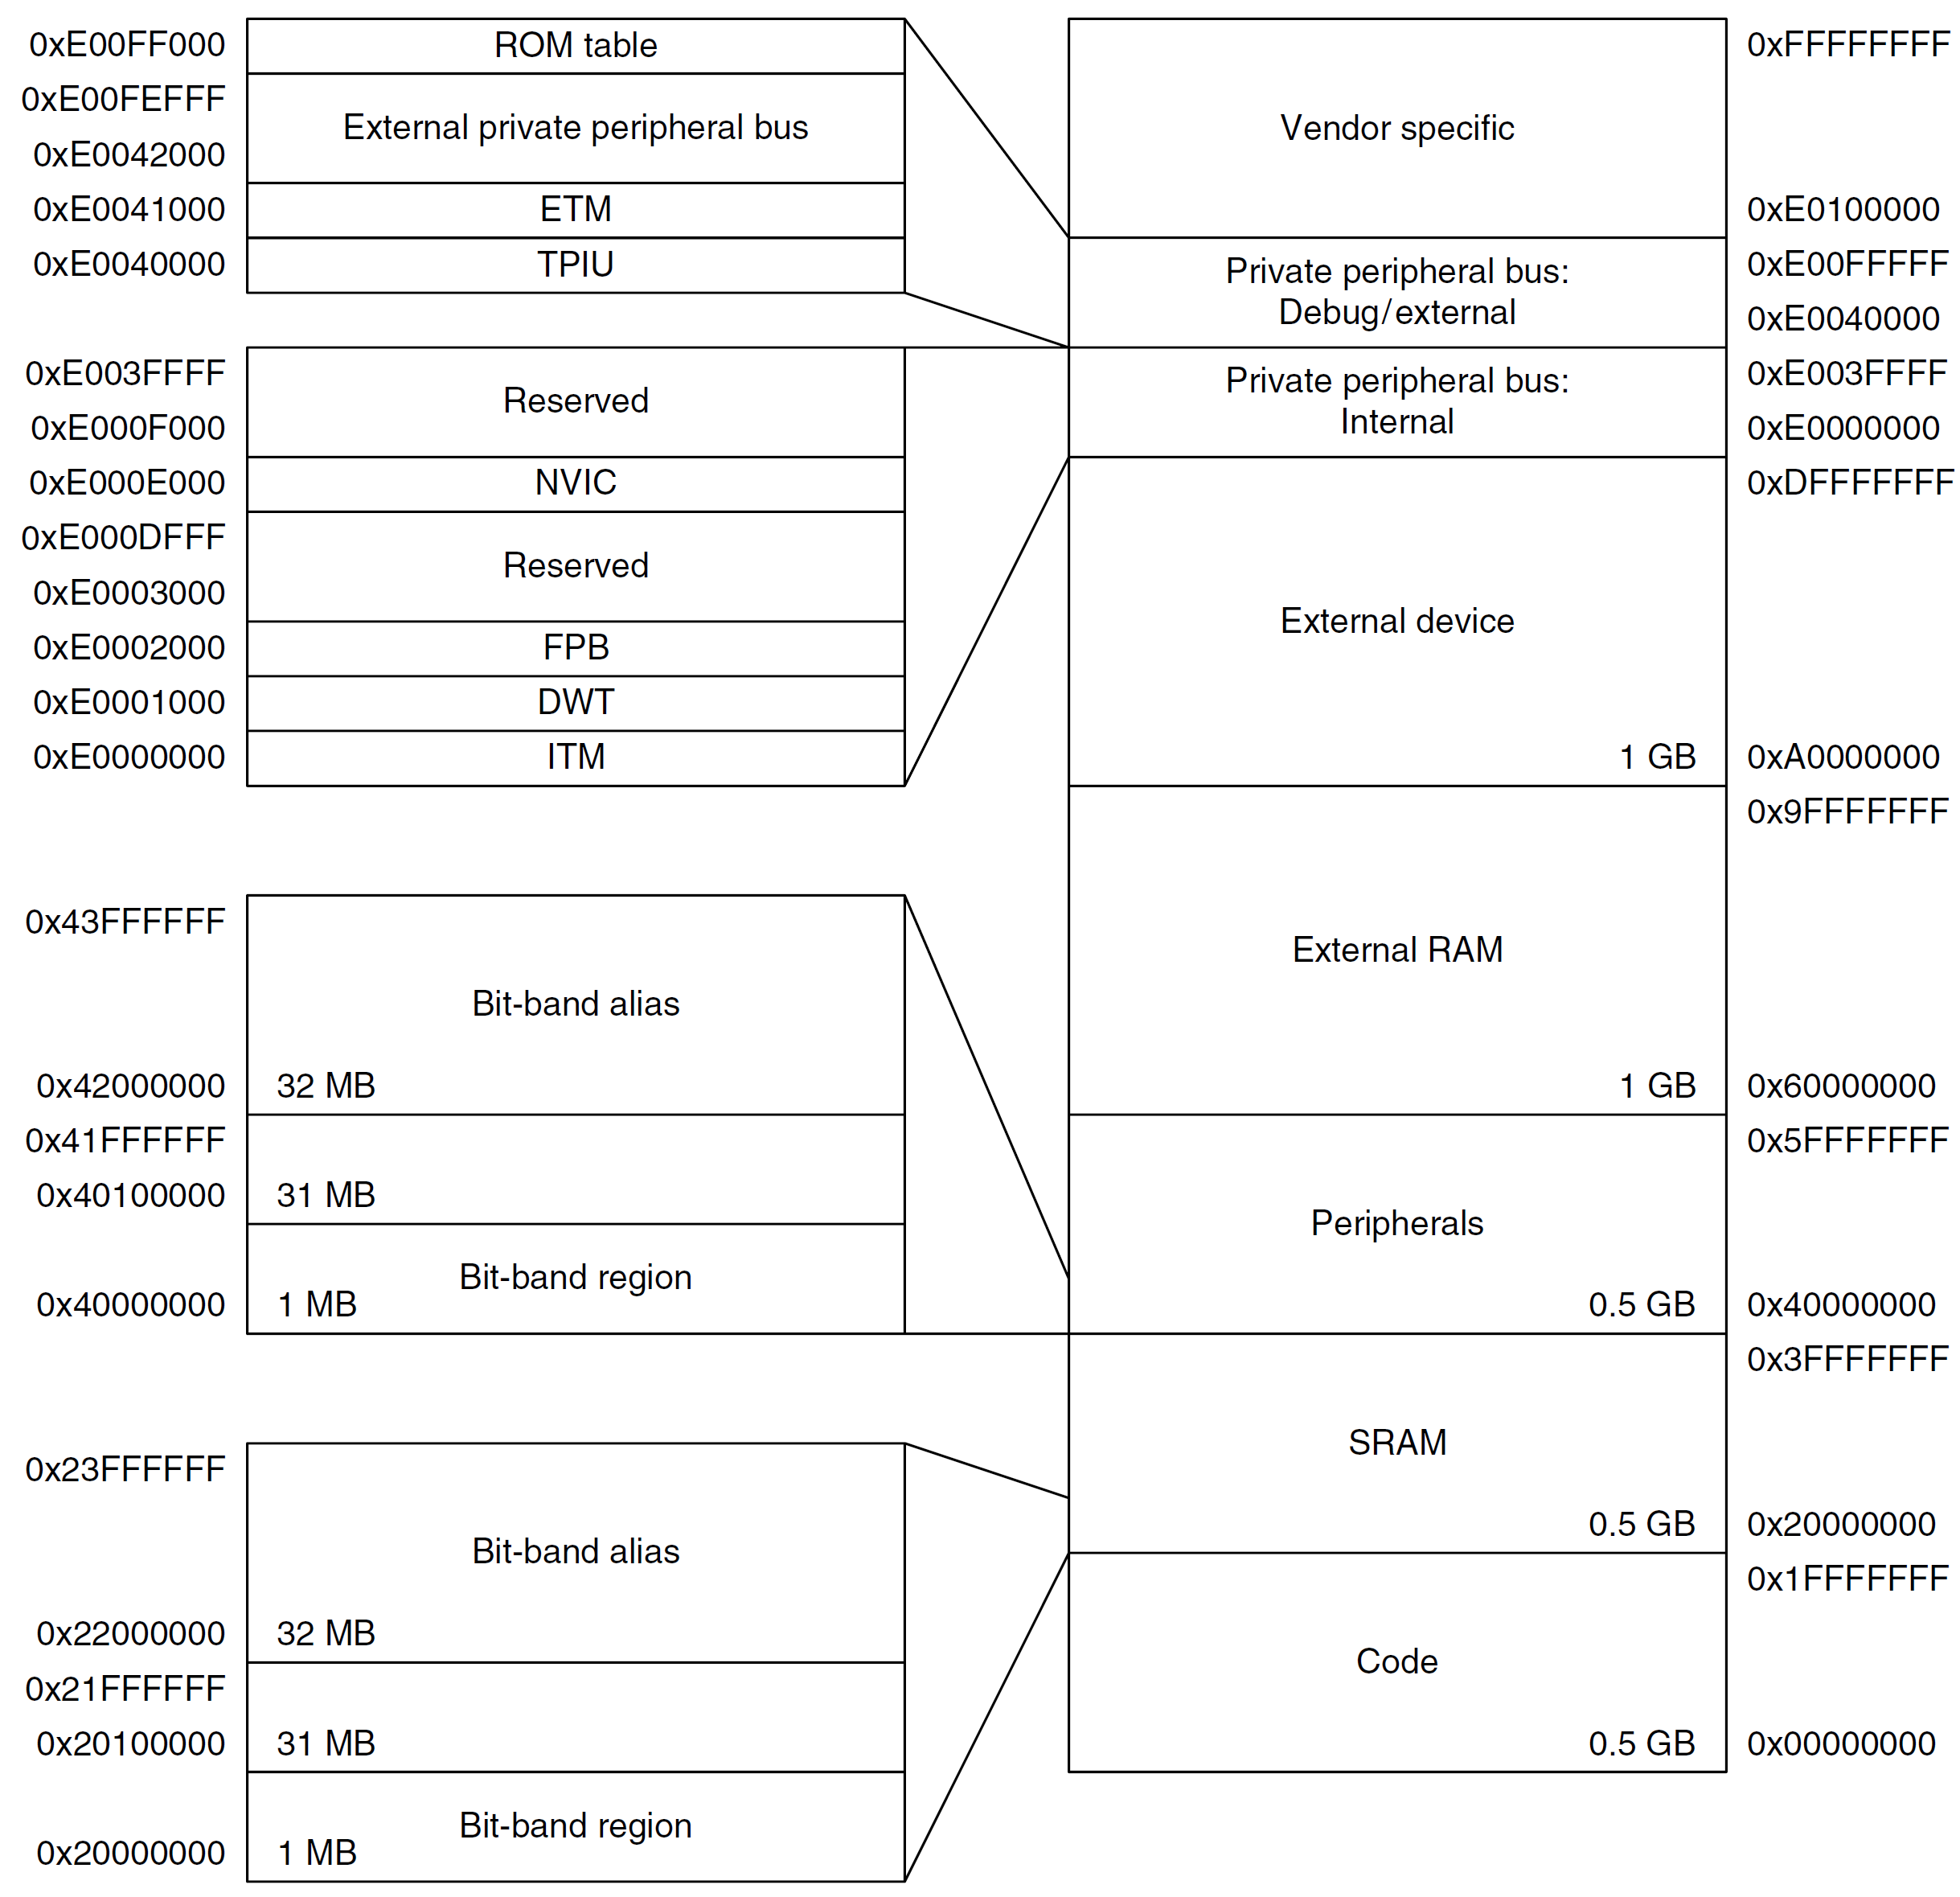
Cortex-M3 Fixed Memory Map

Slide 55
Cortex-M4 Fixed Memory Map

Slide 56
Pseudo-instructions
Pseudo instruction: available to use in an assembly program, but not directly supported by hardware.
Pseudo → not real
Compilers translate it to one or multiple actual machine instructions
Pseudo instructions are provided for the convenience of programmers.

Slide 57
LDR Pseudo-instruction
LDR Rt, =expr
LDR Rt, =label
If the value of expr can be loaded with MOV, MVN (16-bit instruction) or MOVW (32-bit instruction), the assembler uses that instruction.
MOV supports all 8-bit immediate numbers ranging in [0 – 255]. For numbers out of this range, some patterns can be encoded.
If a valid MOV, MVN, MOVW instruction cannot be used (due to out of range), or if the label_expr syntax is used, the assembler places the constant in a literal pool and generates a PC-relative LDR instruction that reads the constant from the literal pool.
LDR r1,=0xFF0 ; loads 0xFF0 into R1
; => MOV r1,#0xFF0
LDR r2,=0xFFF ; loads 0xFFF into R2
; => MOVW r2, #0xFFF
LDR r3,=array ; loads the address of array into R3
; => LDR r3,[pc, offset_to_litpool]
; ...
; litpool DCD array
Software uses this pseudo instruction to set a register to some value without worrying about the size of the value.
Notes:
MOV supports all 8-bit immediate numbers
Range of 8-bit immediate number: 0 – 255
Numbers out of this range but with some patterns can be encoded. Refer to the Slide Summary of Pre-index and Post-index

Slide 58
Summary
Memory address is always in terms of bytes.
How data is organized in memory?
How data is addressed?
Addressing Format | Example | Equivalent
Pre-index | LDR r1, [r0, #4] | r1 ← memory[r0 + 4], r0 is unchanged
Pre-index with update | LDR r1, [r0, #4]! | r1 ← memory[r0 + 4] r0 ← r0 + 4
Post-Index | LDR r1, [r0], #4 | r1 ← memory[r0] r0 ← r0 + 4

Slide 59
References
Lecture 22. Big-Endian and Little-Endian
https://www.youtube.com/watch?v=T1C9Kj_78ek&list=PLRJhV4hUhIymmp5CCeIFPyxbknsdcXCc8&index=22
Lecture 23. Load and Store Instructions
https://www.youtube.com/watch?v=CtfV3HsHwk4&list=PLRJhV4hUhIymmp5CCeIFPyxbknsdcXCc8&index=23
Lecture 24. Addressing mode: pre-index, post-index, and pre-index with update
https://www.youtube.com/watch?v=zgkxPdPkxa8&list=PLRJhV4hUhIymmp5CCeIFPyxbknsdcXCc8&index=24

