Slide 1
Z. Gu
Embedded Systems with ARM Cortex-M Microcontrollers in Assembly Language and C
Chapter 4
ARM Arithmetic and Logic Instructions
Exercises
Fall 2025
Acknowledgement: Lecture slides based on Embedded Systems with ARM Cortex-M Microcontrollers in Assembly Language and C, University of Maine https://web.eece.maine.edu/~zhu/book/

Slide 2
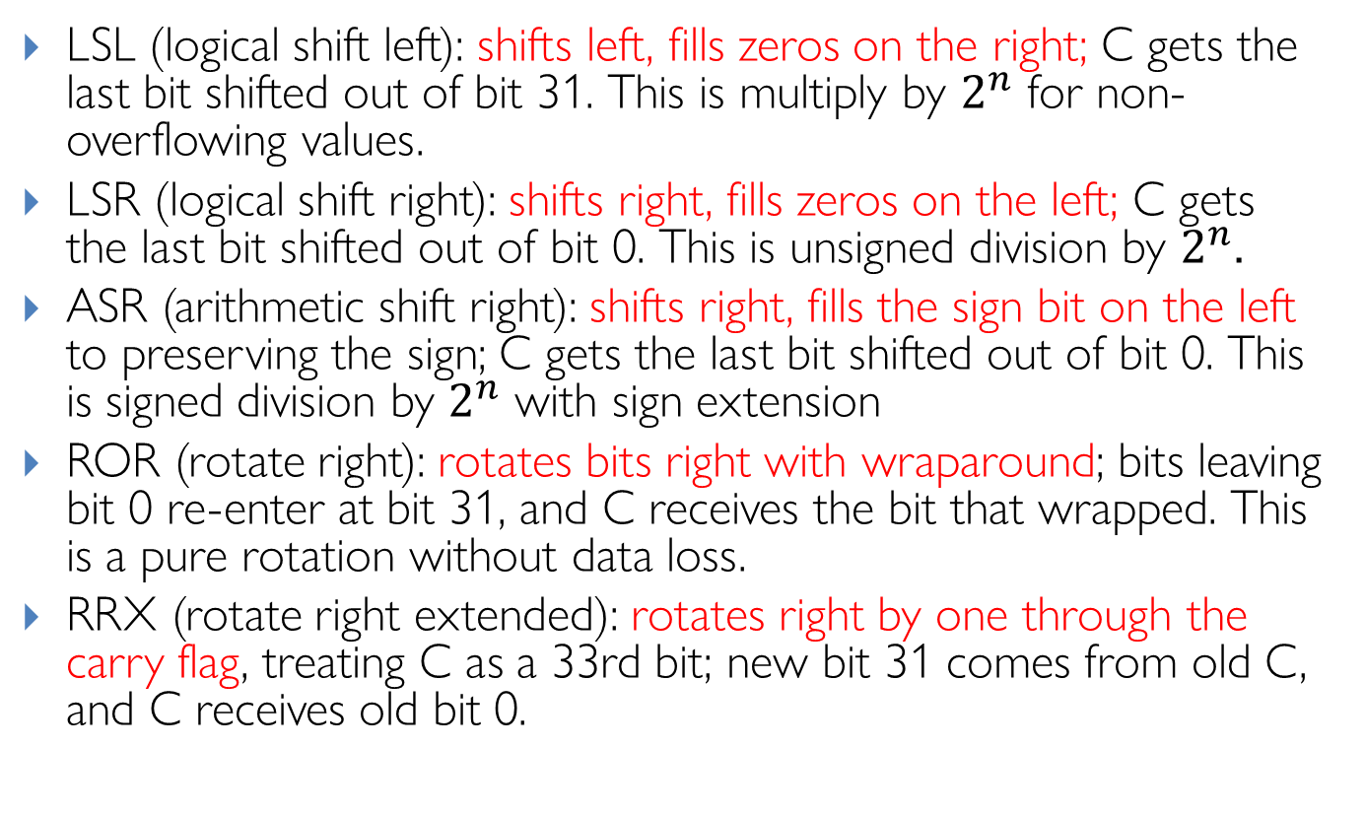
Barrel Shifter: Explanations
Review
LSL (logical shift left): shifts left, fills zeros on the right; C gets the last bit shifted out of bit 31. This is multiply by $2^{n}$ for non-overflowing values.
LSR (logical shift right): shifts right, fills zeros on the left; C gets the last bit shifted out of bit 0. This is unsigned division by $2^{n}$.
ASR (arithmetic shift right): shifts right, fills the sign bit on the left to preserving the sign; C gets the last bit shifted out of bit 0. This is signed division by $2^{n}$ with sign extension
ROR (rotate right): rotates bits right with wraparound; bits leaving bit 0 re-enter at bit 31, and C receives the bit that wrapped. This is a pure rotation without data loss.
RRX (rotate right extended): rotates right by one through the carry flag, treating C as a 33rd bit; new bit 31 comes from old C, and C receives old bit 0.
Notes:
Useful for multiword shifts and certain crypto/bit-manip patterns
LSR (used here): Always fills with zeros, converting the negative value to a large positive number
ASR: Would preserve the sign bit, maintaining the negative value (-4096)

Slide 3
Carry and Overflow Flags w/ Arithmetic Instructions
Review
Carry flag C = 1 (Borrow flag = 0) upon an unsigned addition if the answer is wrong (true result > 2^{n}-1)
Carry flag C = 0 (Borrow flag = 1) upon an unsigned subtraction if the answer is wrong (true result < 0)
Overflow flag V =1 upon a signed addition or subtraction if the answer is wrong (true result > 2^{n-1}-1 or true result < -2^{n-1})
Overflow may occur when adding 2 operands with the same sign, or subtracting 2 operands with different signs; Overflow cannot occur when adding 2 operands with different signs or when subtracting 2 operands with the same sign.
Tip: Convert subtraction to addition with Two’s complement. If two operands have same sign, and the result has opposite sign, then V = 1; else V = 0
 | Unsigned Addition | Unsigned Subtraction | Signed Addition or Subtraction
Carry flag | true result > 2^{n}-1 ➔ Carry flag=1 Borrow flag=0 (Result incorrect) | true result < 0 ➔ Carry flag=0 Borrow flag=1 (Result incorrect) | N/A
Overflow flag | N/A | N/A | true result > 2^{n-1}-1 or true result < -2^{n-1} Overflow flag=1 (Result incorrect)
3
Notes:
Convert subtraction to addition with Two’s complement. If two operands have same sign, and the result has opposite sign, then V = 1; else V = 0.”
convert subtraction to addition with Two’s complement. If two operands have same sign, and the result has opposite sign, then V = 1; for all other cases, V = 0
C is cleared upon an unsigned subtract if the answer is wrong
The carry flag (CF) is set differently for unsigned addition and subtraction:
When adding or subtracting two signed numbers in an n-bit system, an overflow occurs if the true result is larger than the maximum signed integer (i.e. $2^{n−1}−1$) or smaller than the minimum signed integer (i.e. ${−2}^{n−1}$) that can be represented
Overflow may occur when adding 2 operands with the same sign, or subtracting 2 operands with different signs, including:
adding two positive numbers
adding two negative numbers
subtracting a positive number from a negative number
subtracting a negative number from a positive number
Overflow cannot occur when adding 2 operands with different signs or when subtracting 2 operands with the same sign.
Why?
Unsigned Addition:
The carry flag is set to 1 if there is a carry out from the most significant bit (MSB) during the addition.
This means the sum exceeds the maximum value that can be represented in the given number of bits.
Example: Adding two 8-bit numbers resulting in a value greater than 255 will set CF = 1.
Unsigned Subtraction:
The carry flag acts as a borrow indicator for subtraction.
CF is cleared (set to 0) if a borrow is needed (i.e., if the minuend is less than the subtrahend).
CF is set to 1 if no borrow is needed, meaning the subtraction did not underflow.
Summary:
For unsigned addition, CF = 1 means an overflow beyond the MSB (carry out).
For unsigned subtraction, CF = 0 means a borrow (underflow), CF = 1 means no borrow.
The carry flag thus helps detect unsigned overflow or underflow conditions.
This behavior contrasts with signed arithmetic, where the overflow flag (OF) signals signed overflow, and the carry flag is generally not used.
References from teaching and documentation explain this clearly: The carry flag signals actual carry for addition and borrow for subtraction in unsigned arithmetic scenarios.

Slide 4
Bit Manipulations
Compute register values after each instruction
MOV R0, #0xABC
MOV R1, #0xDEF
AND R2, R0, R1
ORR R3, R0, R1
EOR R4, R0, R1
ORN R5, R0, R1
BIC r6, R0, R1

Slide 5
Bit Manipulations
Find the Register Value to Complement, CLEAR & SET 5th, 7th, 12th bit of the given value and also find the result: 0xDECB.

Slide 6
Clearing a Register
What are the different ways by which all bits in register r12 can be cleared? No other register is to be used.

Slide 7
Set bits
Write an instruction that sets bits 0, 4, and 12 in register r6 and leave the remaining bits unchanged
Write an instruction that clears bits 0, 4, and 12 in register r6 and leave the remaining bits unchanged

Slide 8
Add two 128-bit numbers
Add two 128-bit numbers, assuming one number is stored in r4, r5, r6, r7 registers and the other stored in r8, r9, r10, r11. Store the result in r0, r1, r2, r3.

Slide 9
Absolute value
Write a program to calculate the absolute value of a number by using only two instructions (HINT: Check CMP and RSB)

Slide 10
Arithmetic with Shifts
Assuimg 32-bit registers:
Q1:
LDR r0, =0x00000007
MOV r0, r0, LSL 7
Q2:
LDR r0, =0x00000400
MOV r0, r0, LSR 2
Q3:
LDR r0, =0xFFFFC000
MOV r0, r0, LSR 2
Q4:
LDR r0, =0xFFFFC000
MOV r0, r0, ASR 2
Q5:
LDR r0, =0x00000007
MOV r0, r0, ROR 2

Slide 11
Assembly Programming
Write ARMv7 assembly for pseudocode
r1 = (r0 >> 4) & 15

Slide 12
Shift LSL
Compute register values:
LDR R1, =0X11223344
MOV R2, R1, LSL #4
MOV R3, R1, LSL #8
MOV R4, R1, LSL #16
MOV R5, R1, LSL #6

Slide 13
Shift LSLS
Compute register values, and NZCV flags after execution of each instruction, assuming all flags are initially 0.
LDR R1, =0x11223344
MOV R2, R1, LSLS #4
MOV R3, R1, LSLS #8
MOV R4, R1, LSLS #16

Slide 14
Shift ASR
Compute register values:
LDR R1, =0x81223344
MOV R2, R1, ASR #4
MOV R3, R1, ASR #8
MOV R4, R1, ASR #16

Slide 15
Shift LSR ASR
Compute register values:
LDR R1, =0X11223344
MOV R2, R1, LSR #4
MOV R3, R1, LSR #8
MOV R4, R1, LSR #16
MOV R5, R1, ASR #4
MOV R6, R1, ASR #8
MOV R7, R1, ASR #16
Notes:
R2 = 0x01122334, R3 = 0x00112233, R4 = 0x00001122, R5 = 0x01122334, R6 = 0x00112233, R7 = 0x00001122.

Slide 16
Shift LSRS ASR
Compute register values, and NZCV flags after execution of each instruction, assuming all flags are initially 0-
LDR R1, =0X11223344
MOV R2, R1, LSRS #4
MOV R3, R1, LSRS #8
MOV R4, R1, LSRS #16
MOV R5, R1, ASRS #4
MOV R6, R1, ASRS #8
MOV R7, R1, ASRS #16
Notes:
R2 = 0x01122334, R3 = 0x00112233, R4 = 0x00001122, R5 = 0x01122334, R6 = 0x00112233, R7 = 0x00001122.

Slide 17
Multiply without MUL
Without using MUL instruction, give instructions that multiply a register, r3 by
135
153
255
18
16384

Slide 18
Count number of ones
Write a program to count the number of ones in a 32-bit register r0.

Slide 19
Count the number of zeros
Based on the program that counts 1’s, modify it to count the number of zeros a 32-bit register r0.
Notes:
ANS: count ones, then subtract from 32
Or Invert r0 to get r4, then count 0’s in r4

Slide 20
Flags ANDS
What are value of r2, and NZCV flags after execution, assuming all flags are initially 0.
LDR r0, =0xFFFFFFF00
LDR r1, =0x00000001
ANDS r2, r1, r0, LSL #1

Slide 21
Flags ADDS
What are value of r2, and NZCV flags after execution, assuming all flags are initially 0.
LDR r0, =0xFFFFFFF00
LDR r1, =0x00000001
ADDS r2, r1, r0, LSL #1

Slide 22
Flags
r0 | 0xffffffff
r1 | 0x00000001
r2 | 0x00000003
r3 | 0xfffffff0
Suppose registers have the following values:
What are value of r4, and NZCV flags after execution, assuming all flags are initially 0. (Each instruction runs individually.)
(a) ADD r4, r0, r2, ASR #3
(b) ADDS r4, r0, r1
(c) LSRS r4, r0, #1
(d) ANDS r4, r0, r3
(e) CMP r2, #3
Notes:
r0 = 0xffffffff
r1 = 0x00000001
r2 = 0x00000003
r3 = 0xfffffff0
The N, Z, C, and V flags start out as zero.
After the execution of the following instructions, fill in the flag values.

Slide 23
Flags
r0 | 0xFFFFFFFF
r1 | 0x00000001
r2 | 0x00000000
Suppose registers have the following values:
What are value of r3, and NZCV flags after execution, assuming all flags are initially 0. (Assume each instruction runs individually, not sequentially.)
ADD r3, r0, r2
SUBS r3, r0, r0
ADDS r3, r0, r2
LSL r3, r0, #1
LSRS r3, r1, #1
ANDS r3, r0, r2
Notes:
Suppose
r0 = 0xFFFFFFFF, r1 = 0x00000001, r2 = 0x00000000,
NZCV = 0000 initially

