Slide 1
Data Structures for Strings
Chapter 8

Slide 2
Introduction
Numbers as key values: are data items of constant size, and can be compared in constant time.
In real applications, text processing is more important than the processing of numbers
We need different structures for strings than for numeric keys.

Slide 3
Motivating Example
Example: 112 < 467 , Numerical comparison in O(1).
Compare Strings lexicographically does not reflect the similarity of strings.
Western > Eastern , Strings comparison in O(min(|s1|,|s2|)). where |s| denotes the length of the string s
Text fragments have a length; they are not elementary objects that the computer can process in a single step.
Pneumonoultramicroscopicsilicovolcanoconiosis !!!

Slide 4
Applications
Bioinformatics
(DNA/RNA or protein sequence data).
Search Engines.
Spill checker.

Slide 5
8.1 Tries & Compressed Tries

Slide 6
Tries
The basic tool for string data structures, similar in role to the balanced binary search tree, is called “trie”
Derive from “retrieval.” (Pronounced either try or tree)
In this tree, the nodes are not binary. They contain potentially one outgoing edge for each possible character, so the degree is at most the alphabet size |A| .

Slide 7
Tries cont.
Prefix Vs. Suffix.
Ex. “computer”.
Prefix:(c, co, com).
Suffix: (r, er, ter)
Each node in this tree structure corresponds to a prefix of some strings of the set.
If the same prefix occurs several times, there is only one node to represent it.
The root of the tree structure is the node corresponding to the empty prefix.

Slide 8
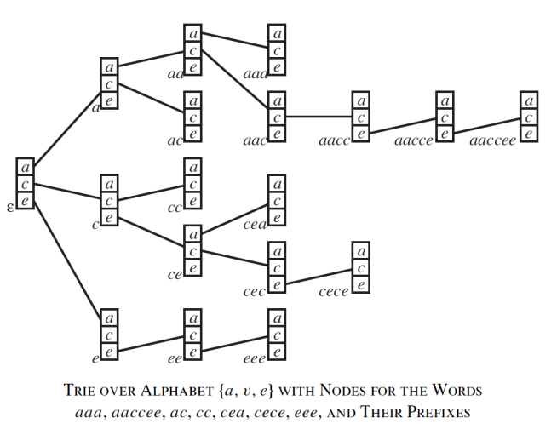
Tries Example

Slide 9
A = {a, c, e}
Strings:
aaa
aaccee
ac
cc
cea
cece
eee
e
a
c
A
A
A
cc
ce
aa
ee
ac
A
A
A
A
A
cec
cea
aac
aaa
eee
A
A
A
A
A
ceca
aacc
A
A
aacce
A
aaccee
A

Slide 10
Tries Example
Example: standard trie for the set of strings
S = { bear, bell, bid, bull, buy, sell, stock, stop }

Slide 11
Prefix-free
What if a “Whole” string is
a prefix of other string?
car
card
Are not a prefix-free.
c
a
r
d

Slide 12
String Termination
Strings are sequences of characters from some alphabet. But for use in the computer, we need an important further information: how to recognize where the string ends.
There are two solutions for this:
We can have an explicit termination character, which is added at the end of each string, but may not occur within the string “\0” (ASCII code 0) , or
We can store together with each string its length.

Slide 13
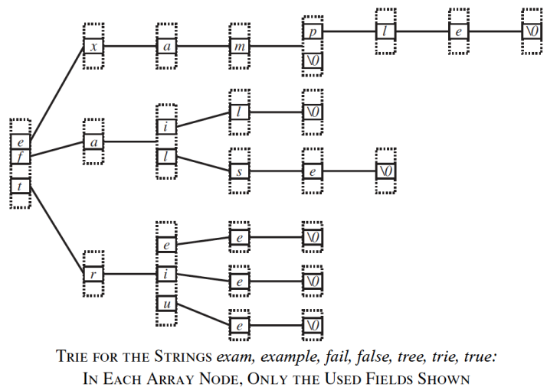
Termination Example

Slide 14
Strings:
exam
example
fail
false
tree
trie
true
t
f
e
r
a
x
u
i
e
l
i
a
e
e
e
s
l
m
\0
\0
\0
e
\0
\0
p
\0
l
e
\0

Slide 15
String Termination
The use of the special termination character ’\0’ has a number of advantages in simplifying code.
It has the disadvantage of having one reserved character in the alphabet that may not occur in strings.
There are many nonprintable ASCII codes that should never occur in a text and ’\0’ is just one of them.
There are also many applications in which the strings do not represent text, but, for example, machine instructions.

Slide 16
Find, Insert and Delete
To perform a find operation in this structure:
Start in the node corresponding to the empty prefix.
Read the query string, following for each read character the outgoing pointer corresponding to that character to the next node.
After we read the query string, we arrived at a node corresponding to that string as prefix.
If the query string is contained in the set of strings stored in the trie, and that set is prefix-free, then this node belongs to that unique string.

Slide 17
Find, Insert and Delete
To perform an insert operation in this structure:
Perform find
Any time we encounter a nil pointer we create a new node.
Example:
Insert “extra”
e
x
t
a
r
m
a
\0
\0

Slide 18
Find, Insert and Delete
To perform a delete operation in this structure:
Perform find
Delete all nodes on the path from ‘\0’ to the root of the
tree unless we reach a node with more than 1 child
Example:
Delete “extra”
e
x
t
a
r
m
a
\0
\0

Slide 19
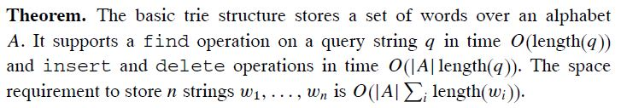
Performance
Find: All the characters in the word = O(|q|) where q: query string
Insert: first find then insert an array of length |A| as a node = O(|q|.|A|)
Delete: first find then delete an array of length |A| as a node = O(|q|.|A|)
We can get rid of the |A| dependence in the delete operation by using
reference counts.
All new nodes must be initialized with NULL pointers,
so the |A| dependence in the insert operation does not disappear.

Slide 20
Alphabet Size
The problem here is the dependence on the size of the alphabet which determines the size of the nodes.
There are several ways to reduce or avoid the problem of the alphabet size.
A simple method, is to replace the big nodes by linked lists of all the entries that are really used.

Slide 21
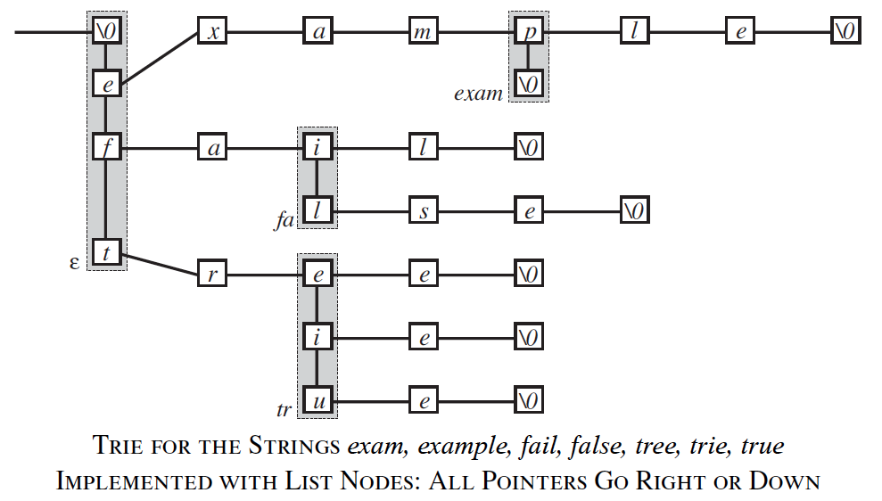
List Example

Slide 22
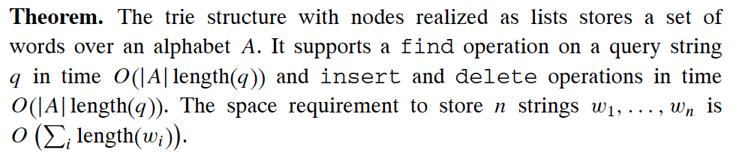
Lists Performance
Find, Insert and delete: O(|q|.|A|)

Slide 23

Alphabet Size
Another way to avoid the problem with the alphabet size |A| is alphabet reduction.
We can represent the alphabet A as set of k -tuples from some direct product
By this each string gets longer by a factor of k , but the alphabet size can be reduced to

Slide 24
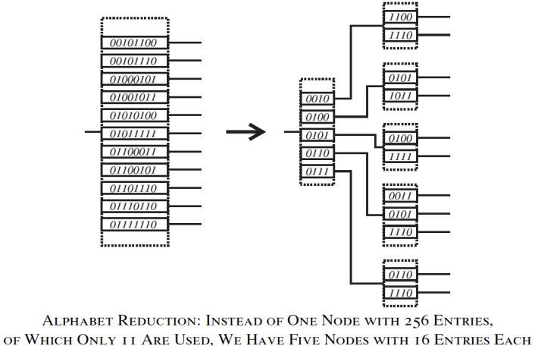
Alphabet Reduction Example
For the standard ASCII codes, we can break each 8-bit character by two 4-bit characters, which reduces the node size from 256 pointers to 16 pointers

Slide 25
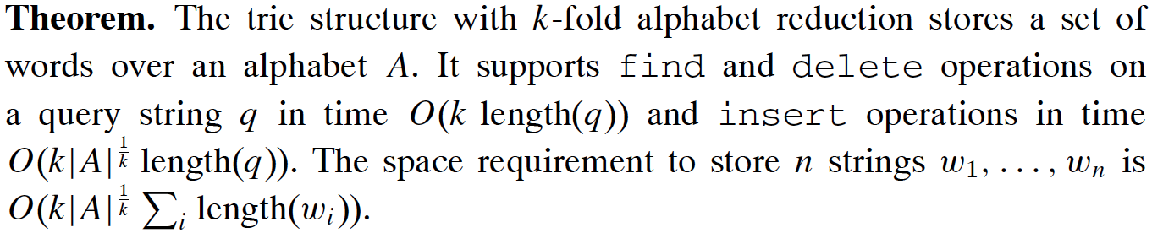
Reduction Performance

Slide 26



Other Reduction Techniques
The trie structure with balanced search trees as nodes:
Find, insert and delete Time:
Space:
The ternary trie structure: nodes are arranged in a manner similar to a binary search tree, but with up to three children. each node contains one character as key and one pointer each for query characters that are smaller, larger, or equal
Find time:
Space:

Slide 27
Patricia Tree
“Practical Algorithm To Retrieve information Coded in Alphanumeric.”
A path compression trie.
Instead of explicitly storing nodes with just one outgoing edge, we skip these nodes and keep track of the number of skipped characters.
The path compressed trie contains only nodes with at least two outgoing edges.

Slide 28
Patricia Tree
It contains a number, which is the number of characters that should be skipped before the next relevant character is looked at.
This reduces the required number of nodes from the total length of all strings to the number of words in our structure.
We need in each access a second pass over the string to check all those skipped characters of the found string against the query string.
this technique to reduce the number of nodes is justified only if the alphabet is large.

Slide 29
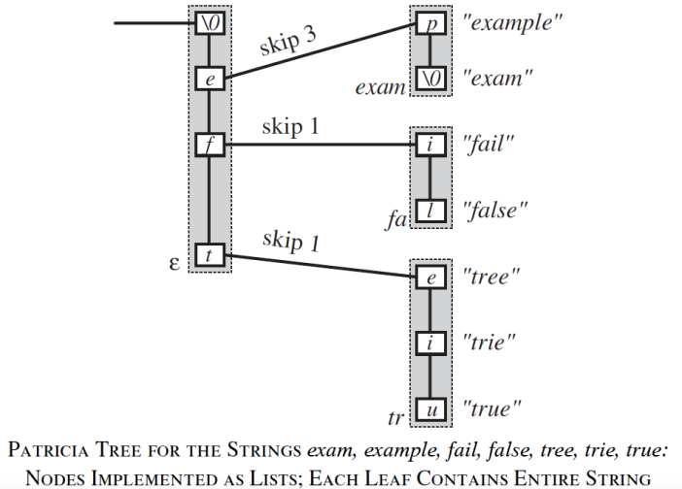
Patricia Tree: Example

Slide 30
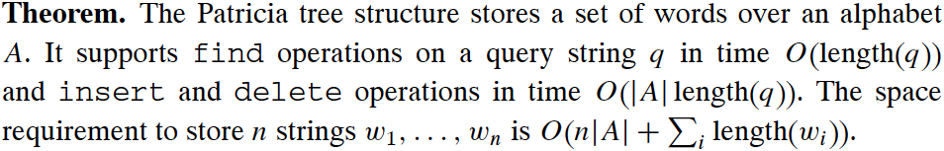
Patricia Tree: Insert & Delete
The insertion and deletion operations create significant difficulties.
We need to find where to insert a new branching node, but this requires that we know the skipped characters.
One (clumsy) solution would be a pointer to one of the strings in the subtrie reached through that node, for there we have that skipped substring already available.

Slide 31
THANK YOU

Slide 32
8.2 Dictionaries Allowing Errors in Queries

Slide 33
The Problem of exact match(1)
Tries essentially mirror the lexicographic order of the strings.
The trie-based structures find only exact matches; if the query string contains an error, for example, a word is misspelled or a typing or transmission error happened, the correct string will not be found.
It would be highly desirable to have a dictionary structure that keeps track of a set of strings and finds all strings that differ only in (d) characters from the query string.

Slide 34
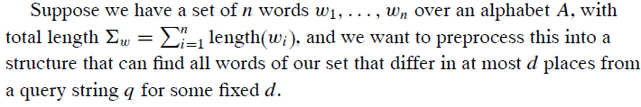
The Problem of exact match(2)
Ex: if d = 1 and w₁= “Computer”, then we may have :
Komputer, Aomputer, Bomputer, Domputer, … etc.
Camputer, Cbomputer, ….etc.

Slide 35


Trivial solutions
1- Generate for each word (w_{i}) all the words that differ in at most (d) places from it and store all these word variants in a trie.
For each w, there are (|A|^{d} length(wi )^{d} ) of variants
The size of the underlying structure increases
From to
The query time stays O(length(q)).
The structure size becomes a problem.

Slide 36
Trivial solutions
2- We could use just a standard trie for the words, but generate for each query string q all the words that differ in at most ( d ) places, and perform all these queries on the trie.
For each q, there are (|A|^{d} length(qi )^{d} ) of variants
The size of the underlying structure will not changed.
The query time for each one stays (length(q)).
Θ
Total time for all queries will be (length(q)) * (|A|^{d} length(qi )^{d} )
Θ
The query time becomes a problem.
Both of the above are useless at least for d >= 2.

Slide 37
Minor Improvements
Improvement 1:
Because there are too many leaves, path compression could help in reducing the exponent from d+1 to d. But, this is not obvious how to construct the structure in that time.
*Example of compression is already seen in previous slides.
Improvement 2:
Use a trie with list-based nodes, which would remove one |A| factor.
*Example of list-based nodes is already seen in previous slides.
Improvement 3:
Combine the above solutions.
Still, useless, but essentially the best we have for d ≥ 2.

Slide 38
The remarkable achievement of Brodal and Gasieniec (1996)
The structure consists of Double-Trie and a balanced search tree.
The idea of this double-trie structure is to build one trie for all words wi and a second trie for the words written backward w_{i} ^{reversed}
b
r
l
e
a
l
a
l
e
e
r
l
b
b

Slide 39
The remarkable achievement of Brodal and Gasieniec (1996)
For each word w_{i} we look at all pairs of (prefix, suffix ) that are separated by a single character, so as to have different ways to write w_{i} = πcσ, where c is a character. σ is suffix, and π is prefix.
For example:
If w = bear, π = {be }, σ = {r}, c= any character, then we may have
“beer”, “bebe”, “bece”, ….etc.
If w = bear, π = {bea}, σ = { }, c= any character, then we may have
“beaa”, “beab”, “bead”…etc.
In general,
Possible words have the following components:
(Prefix) π | c | (suffix) σ

Slide 40
Example
Suppose that we have the following set of words:
{abcyz, abxuz, atxyz}, and a query abxyz
a
z
b
y
t
u
c
x
c
x
x
x
abx
ab
a
…..
…..
abcyz
abxuz
abxyz
y
u
b
t
y
b
z
z
a
a
z
a
Prefix trie
Suffix trie
Prefix Stack
Candidates

Slide 41
Example Cont.
The used technique:
Unless the exact match was not take place, then,
Go through prefix trie up to the max matched prefix. Each visited node will be pushed into a stack.
Go to suffix trie, and travers up to one character before the maximum prefix.
Then, concatenate each visited node in suffix trie with the stack entries.
Now, all candidate words are generated, and they will be used in find operation
over the already built search-tree.

Slide 42
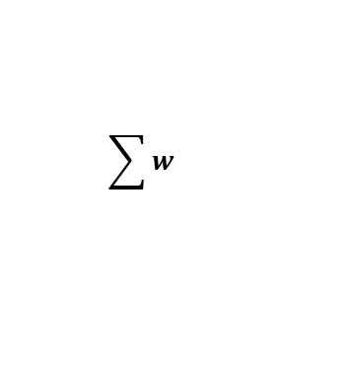
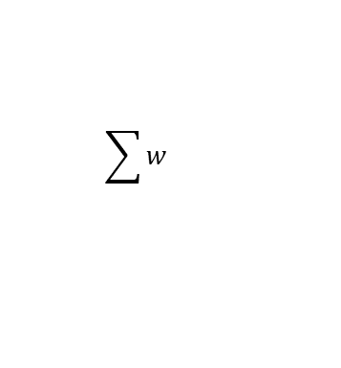
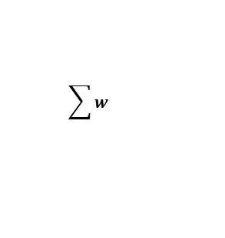
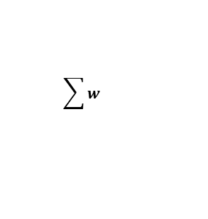
Times Complexities
Building the structure :
a) For a given word w_{i}, we can generate all the node pairs in time
So, for all words (w_{n}), we can generate all node pairs in time .
b) finding in the search-tree costs only O(Log )
c) Total time = O( Log )
For each query, the worst case will be:
$$\sum{w}$$
$$\sum{w}$$
$$\sum{w}$$
$$\sum{w}$$
What is the best case?

Slide 43
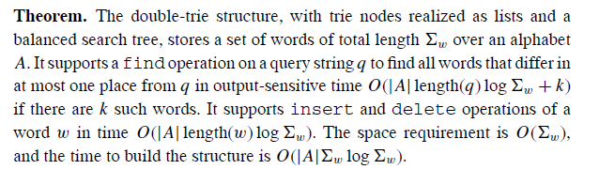
Theorem:Brodal and Gasieniec (1996)

Slide 44
Double-trie structure with more general models
Not only one character might be exchanged, but also one character could be
inserted or deleted. This corresponds to using the edit distance instead of the Hamming distance.
NO change in total complexity, but more words will be added to the tries.
Example of Hamming distance of equal length is the number of positions at which the corresponding symbols are different:
Western Vs. Eastern = 2
Edit distance: minimum number of editing operations (Insertion, deletion, substitution) needed to transform one string into another.
Ex: West ➔ Western = 3 add operations.

Slide 45
8.3 Suffix Trees

Slide 46
Definition
The suffix tree is a static structure that preprocesses a long string s and answers
for a query string q, if and where it occurs in the long string.
Each substring of s is prefix of a suffix of s.
If we construct a trie that stores all suffixes of the long string s, then its nodes correspond to the substrings of s, and we can decide for any query q in
O(length(q)) whether it is a substring of s.
This structure would use O(length(s)²) nodes.

Slide 47
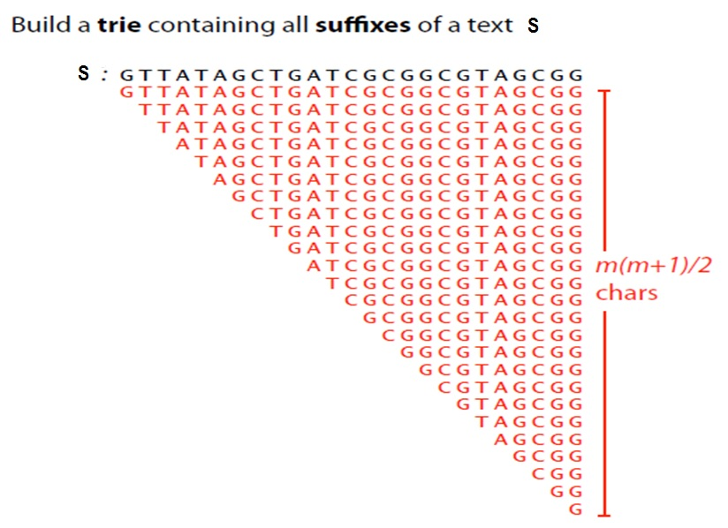

Why O(length(s)²)?
$\sum_{i=1}^{n}{n−i+1= \frac{n(n+1)}{2}}$ nodes

Slide 48
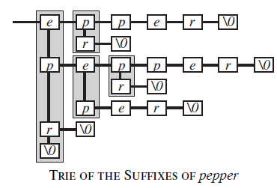
Suffix tree

Slide 49
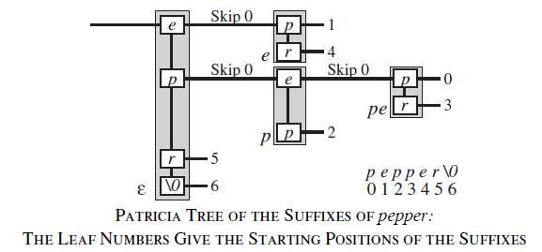
A more Compact Representation
No need to store all suffixes explicitly, but can encode each by a beginning and end address in the long string S. ➔ O(length(s)) nodes representation.

Slide 50
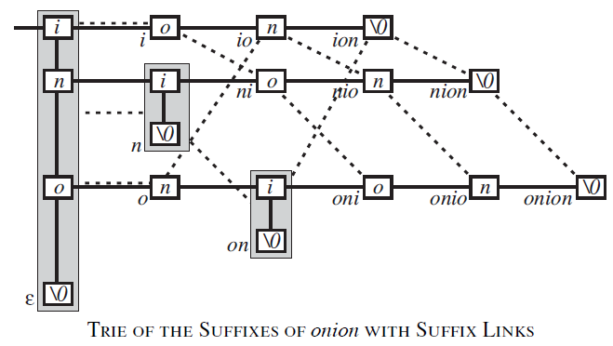
Suffix Links
The suffix link is an extra pointer which points from a node representing a string
a0 . . .ak to the node representing the string a1 . . . ak, that is, its suffix after deleting
the first character.

Slide 51
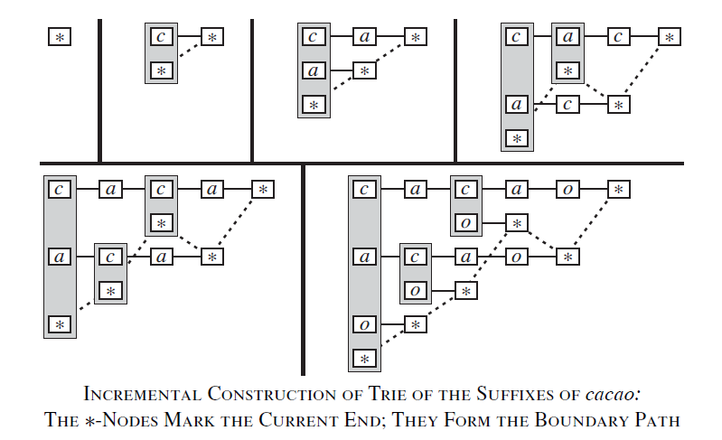
Building the Structure

Slide 52
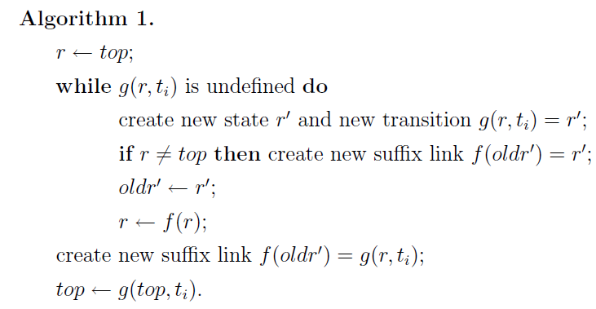
Building the Structure Algorithm
It takes O(n^2), but It could be O(n) if compressed path used.
For more details, please see the original paper “On-line construction of suffix trees.”.(Esko Ukkonen)

Slide 53
8.4 Suffix Arrays

Slide 54
Definition
The suffix array is an alternative structure to the suffix tree that was developed
by Manber and Myers (1993). It preprocesses a long string and then answers for
a query string whether it occurs as substring in the preprocessed string.
Possible Advantages:
Its size does not depend on the size of the alphabet.
It offers a quite different tool to attack the same type of string problems.
straightforward implementation and it is said to be smaller than suffix trees

Slide 55
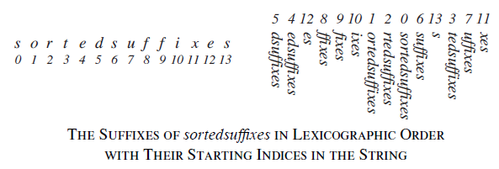
The Underlying Idea
To consider all suffixes of the preprocessed string s in lexicographic order and perform binary search on them to find a given query string.

Slide 56
Time Complexity (1)
We need O(log length(s)) lexicographic comparisons between q and some suffix of s. Without additional information, each comparison takes O(length(q)) time for a total of O(length(q) log length(s)).
Can we do better??

Slide 57
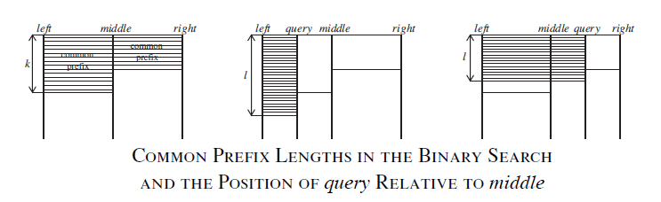
Using Longest Common Prefix (LCP)

Slide 58
Using Longest Common Prefix (LCP)
if left and q share the first l characters, with l < k, then the query string cannot
be between left and middle. And by the same argument, if l > k, then middle
cannot be between left and q.
So if we have the numbers k and l, we can decide the outcome of the comparison
in that step of binary search without looking at the string q unless l = k.
If l = k, we compare and update the value of ( l ) up to length (q) of times.

Slide 59
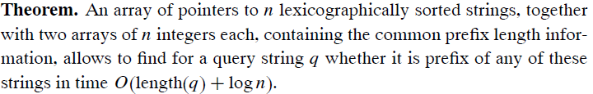
Time Complexity (2)
BUT, How can we build the structure?

Slide 60
Building the structure
Construct the suffix array A 12 of the suffixes starting at positions i (mod 3) = 0.
This is done by a recursive call of the skew algorithm for a string of two thirds the
length.
Construct the suffix array A0 of the remaining suffixes.
3. Merge the two suffix arrays into one.
Full example at :
http://www.mi.fu-berlin.de/wiki/pub/ABI/SS13Lecture3Materials/script.pdf

Slide 61
Building the structure
This example shows the general idea:
Let us say S = CSWESTERN , 9 Characters.
0 | 1 | 2 | 3 | 4 | 5 | 6 | 7 | 8
C | S | W | E | S | T | E | R | N
Group 0 : if (i mod 3= = 0), Group 1: if (i mod 3==1), and Group 2: if (i mod 3= =2)
GROUP 0 | CSW (i=0) | EST (i=3) | ERN (i=6)
GROUP 1 | SWE (i=1) | STE (i=4) | RN$ (i=7)
GROUP 2 | WES (i=2) | TER (i=5) | N$$ (i=8)

Slide 62
Building the structure
Take two part; Group 1 and Group 2, handle them recursively.
BY using Radix Sort, we have ordered list of group 12 suffixes.
GROUP 0 | CSW | EST | ERN
GROUP 12 | N$$ | RN$ | STE
 | SWE | TER | WES
Construct the suffix array of Group 12.
Construct the suffix array of Group 0.
Then, merge.

Slide 63
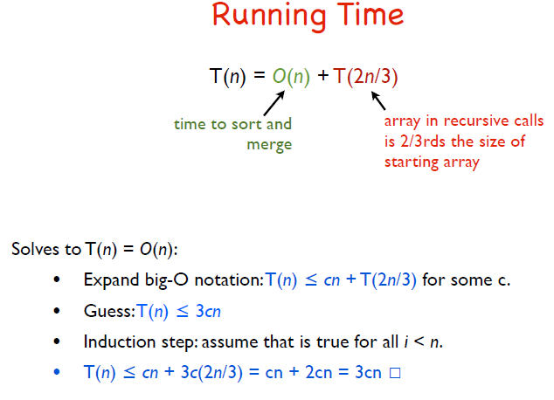
Time Complexity of Building

Slide 64
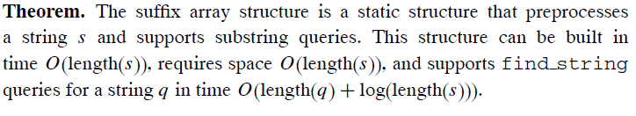
Suffix Arrays in Few Words

Slide 65
THANK YOU

