Slide 1

Lecture 20: Introduction to Sorting II
Answer the Warm Up:
PollEv.com/champk
CSE 373: Data Structures and Algorithms

Slide 2
Warm Up
Answer the Warm Up:
PollEv.com/champk
What sorting algorithm do the following steps represent. The steps are not necessarily consecutive but they are in the correct sequence
Sort 1
Sort 2
[23, 37, 48, 34, 11, 34, 37, 34, 23, 39, 41, 47]
[2, 27, 18, 12, 14, 43, 8, 5, 41, 32, 48, 10, 37]
[11, 37, 48, 34, 23, 34, 37, 34, 23, 39, 41, 47]
[2, 27, 12, 18, 14, 43, 8, 5, 41, 32, 48, 10, 37]
[11, 23, 24, 34, 48, 34, 37, 34, 44, 39, 41, 47]
[2, 8, 12, 14, 18, 27, 43, 5, 41, 32, 48, 10, 37]
[11, 23, 24, 34, 34, 37, 48, 44, 37, 39, 41, 47]
[2, 8, 12, 14, 18, 27, 43, 5, 10, 32, 37, 41, 48]
https://visualgo.net/en/sorting

Slide 3
Announcements
Final Exam Friday March 1st in class
Topics
Classes Week 5 - Week 8
Heaps
Graphs
Graph Modeling
BFS/DFS
Topological Sort
Dijkstra’s
MSTs
Disjoint Sets
Sorting Algorithms
All previous analysis, ADT, Data Structures
Question Thread

Slide 4
Intro to Sorting
Selection Sort
Insertion Sort
Merge Sort
Quick Sort

Slide 5
Divide and Conquer
There’s more than one way to divide!
Mergesort
Split into two arrays.
Elements that just happened to be on the left and that happened to be on the right.
Quicksort
Split into two arrays.
Roughly, elements that are “small” and elements that are “large”
How to define “small” and “large”? Choose a “pivot” value in the array that will partition the two arrays!

Slide 6
Quick Sort (v1)
https://www.youtube.com/watch?v=ywWBy6J5gz8
Divide
0 | 1 | 2 | 3 | 4 | 5 | 6 | 7
8 | 2 | 91 | 22 | 55 | 1 | 7 | 6
PIVOT
Choose a “pivot” element, partition array relative to it!
0 | 1 | 2 | 3
2 | 1 | 7 | 6
0
8
0 | 1 | 2
91 | 22 | 55
…
Conquer
Again, no extra conquer step needed!
0
1
0
2
0
6
0
7
0
55
0
8
0
91
0
22
Combine
…
0 | 1 | 2 | 3
1 | 2 | 6 | 7
0
8
0 | 1 | 2 | 3
1 | 6 | 7 | 55
Simply concatenate the now-sorted arrays!
0 | 1 | 2 | 3 | 4 | 5 | 6 | 7
1 | 2 | 6 | 7 | 8 | 22 | 55 | 91

Slide 7
Quick Sort (v1): Divide Step
Divide
0 | 1 | 2 | 3 | 4 | 5 | 6 | 7
8 | 2 | 91 | 22 | 55 | 1 | 7 | 6
PIVOT
Recursive Case:
Choose a “pivot” element
Partition: linear scan through array, add smaller elements to one array and larger elements to another
Recursively partition
0 | 1 | 2 | 3
2 | 1 | 7 | 6
0
8
PIVOT
0 | 1 | 2
91 | 22 | 55
PIVOT
0
1
0 | 1
22 | 55
0
91
0
2
0 | 1
7 | 6
PIVOT
PIVOT
Base Case:
When array hits size 1, stop dividing
0
6
0
7
0
22
0
55

Slide 8
Quick Sort (v1): Combine Step
0
6
0
7
0
22
Combine
0
55
0
1
0
2
0
91
0 | 1
6 | 7
0 | 1
22 | 55
Simply concatenate the arrays that were created earlier! Partition step already left them in order ☺
0 | 1 | 2 | 3
1 | 2 | 6 | 7
0
8
0 | 1 | 2
22 | 55 | 91
0 | 1 | 2 | 3 | 4 | 5 | 6 | 7
1 | 2 | 6 | 7 | 8 | 22 | 55 | 91

Slide 9
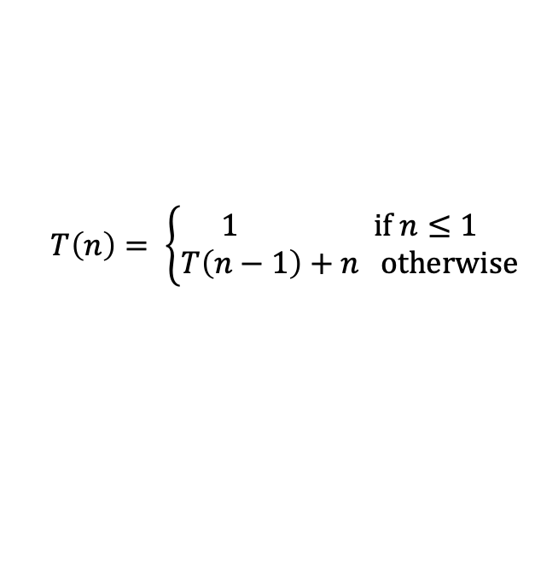

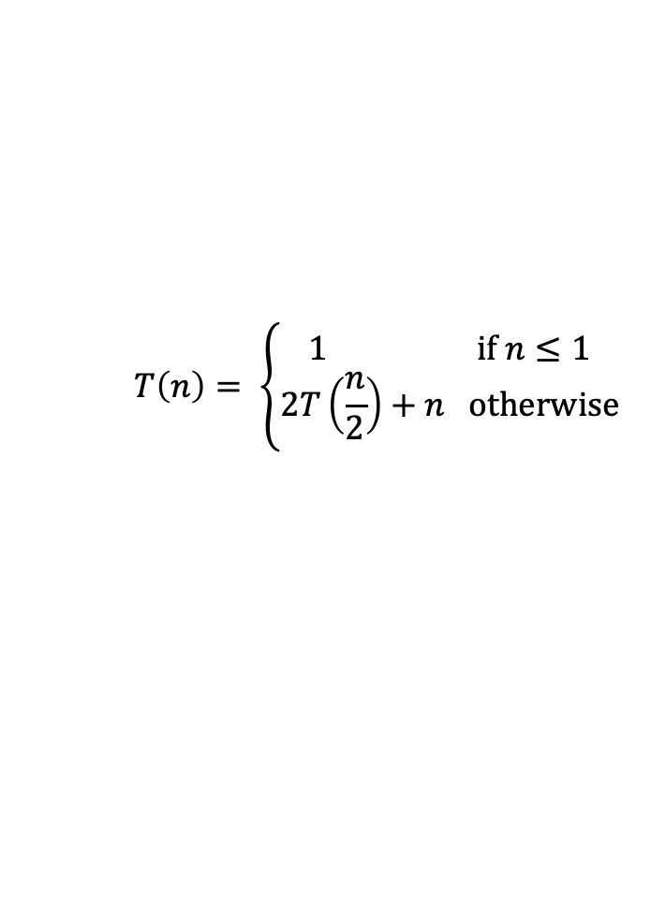


Quick Sort (v1)
Worst case: Pivot only chops off one value
Best case: Pivot divides each array in half
0 | 1 | 2 | 3
2 | 1 | 7 | 6
quickSort(list) {
if (list.length == 1):
return list
else:
pivot = choosePivot(list)
smallerHalf = quickSort(getSmaller(pivot, list))
largerHalf = quickSort(getBigger(pivot, list))
return smallerHalf + pivot + largerHalf
}
PIVOT
0
1
0
2
0 | 1
7 | 6
PIVOT
0
6
0
7
Worst case runtime?
Best case runtime?
In-practice runtime?
Stable?
In-place?
Useful for:
0 | 1
6 | 7
No
0 | 1 | 2 | 3
1 | 2 | 6 | 7
Can be done!
Fast sorting of primitives!
(This is what Java uses for Primitives)

Slide 10
Can we do better?
How to avoid hitting the worst case?
It all comes down to the pivot. If the pivot divides each array in half, we get better behavior
Here are four options for finding a pivot. What are the tradeoffs?
Just take the first element
Take the median of the full array
Take the median of the first, last, and middle element
Pick a random element

Slide 11

Strategies for Choosing a Pivot
Just take the first element
Very fast!
But has worst case: for example, sorted lists have Ω(n²) behavior
Take the median of the full array
Can actually find the median in O(n) time (google QuickSelect). It’s complicated
O(n log n) even in the worst case… but the constant factors are awful. No one does quicksort this way.
Take the median of the first, last, and middle element
Makes pivot slightly more content-aware, at least won’t select very smallest/largest
Worst case is still Ω(n²) , but on real-world data tends to perform well!
Pick a random element
Get O(n log n) runtime with probability at least 1-1/n²
No simple worst-case input (e.g. sorted, reverse sorted)
Most commonly used

Slide 12
Quick Sort (v2: In-Place)
Divide
0 | 1 | 2 | 3 | 4 | 5 | 6 | 7 | 8 | 9
8 | 1 | 4 | 9 | 0 | 3 | 5 | 2 | 7 | 6
PIVOT!
PIVOT?
PIVOT?
PIVOT?
Select a pivot
0 | 1 | 2 | 3 | 4 | 5 | 6 | 7 | 8 | 9
6 | 1 | 4 | 9 | 0 | 3 | 5 | 2 | 7 | 8
Move pivot out of the way
Bring low and high pointers together, swapping elements if needed
Low
X < 6
High
X >= 6
0 | 1 | 2 | 3 | 4 | 5 | 6 | 7 | 8 | 9
6 | 1 | 4 | 2 | 0 | 3 | 5 | 9 | 7 | 8
Meeting point is where pivot belongs; swap in. Now recurse on smaller portions of same array!
Low
X < 6
High
X >= 6
0 | 1 | 2 | 3 | 4 | 5 | 6 | 7 | 8 | 9
5 | 1 | 4 | 2 | 0 | 3 | 6 | 9 | 7 | 8

Slide 13
Heap Sort
Bucket Sort
Radix Sort
Sorting Summary

Slide 14



Heap Sort
https://www.youtube.com/watch?v=Xw2D9aJRBY4
1. run Floyd’s buildHeap on your data
2. call removeMin n times
public void heapSort(input) {
E[] heap = buildHeap(input)
E[] output = new E[n]
for (n)
output[i] = removeMin(heap)
}
Worst case runtime?
Best case runtime?
In-practice runtime?
Stable?
In-place?
No
If we get clever…

Slide 15
Principle 3
Selection sort:
After k iterations of the loop, the k smallest elements of the array are (sorted) in indices 0, … , k-1
Runs in Θ(n²) time no matter what
Using data structures
Speed up our existing ideas
If only we had a data structure that was good at getting the smallest item remaining in our dataset…
We do!

Slide 16
In Place Heap Sort
0 | 1 | 2 | 3 | 4 | 5 | 6 | 7 | 8 | 9
1 | 4 | 2 | 14 | 15 | 18 | 16 | 17 | 20 | 22
Heap
Sorted Items
Current Item
0 | 1 | 2 | 3 | 4 | 5 | 6 | 7 | 8 | 9
22 | 4 | 2 | 14 | 15 | 18 | 16 | 17 | 20 | 1
percolateDown(22)
Heap
Sorted Items
Current Item
0 | 1 | 2 | 3 | 4 | 5 | 6 | 7 | 8 | 9
2 | 4 | 16 | 14 | 15 | 18 | 22 | 17 | 20 | 1
Heap
Sorted Items
Current Item

Slide 17



In Place Heap Sort
0 | 1 | 2 | 3 | 4 | 5 | 6 | 7 | 8 | 9
15 | 17 | 16 | 18 | 20 | 22 | 14 | 4 | 2 | 1
Heap
Sorted Items
Current Item
public void inPlaceHeapSort(input) {
buildHeap(input) // alters original array
for (n : input)
input[n – i - 1] = removeMin(heap)
}
Worst case runtime?
Best case runtime?
In-practice runtime?
Stable?
In-place?
Complication: final array is reversed! Lots of fixes:
Run reverse afterwards O(n)
Use a max heap
Reverse compare function to emulate max heap
No
Yes

Slide 18
Heap Sort
Bucket Sort
Radix Sort
Sorting Summary

Slide 19
Bucket Sort (aka Bin Sort)
If all values are ints known to be in the range of 1 - K
Create array of size K and put each element in its proper bucket (“scatter”)
If elements are only ints simply store count of ints in each bucket
Output results via linear pass through array of buckets (“gather”)
[5, 1, 3, 4, 3, 2, 1, 1, 5, 4, 5]
1 | 3
2 | 1
3 | 2
4 | 4
5 | 3
O(K + n)
O(n)
[1, 1, 1, 2, 3, 3, 4, 4, 5, 5, 5]
Total Runtime: O(K + n)

Slide 20
Bucket Sort with Data
Bucket Sort Example Video
Instead of using int counts, make buckets of array of lists
put items into bucket, use insertion sort to sort individual buckets
[0.78, 0.17, 0.39, 0.26, 0.72, 0.94, 0.21, 0.12, 0.23, 0.68]
0
1
2
3
4
5
6
7
8
9
0
1
2
3
4
5
6
7
8
9
0.17
0.12
0.12
0.17
O(n)
0.26
0.21
0.23
0.21
0.23
0.26
0.39
0.39
worst: O(K + n²)
best: O(K)
O(K + n)
0.68
0.68
0.78
0.72
0.72
0.78
[0.12, 0.17, 0.21, 0.23, 0.26, 0.39, 0.68, 0.72, 0.78, 0.94]
0.94
0.94

Slide 21
Bucket Sort
function bucketSort(array, k) is
buckets ← new array of k empty lists
M ← 1 + the maximum key value in the array
for i = 0 to length(array) do
insert array[i] into buckets[floor(k × array[i] / M)]
for i = 0 to k do
nextSort(buckets[i])
return the concatenation of buckets[0], ...., buckets[k]
Worst case runtime?
Best case runtime?
In-practice runtime?
Stable?
In-place?
Useful for:
O(K + n) for ints
O(K + n²) for data if insertion sort is used
O(n)
O(n) if K ≅ n, always for ints, and if values are evenly distributed for data
Can be because insertion sort
No
When range, K, is smaller or not much larger than n (not many duplicates)
Not good when K >> N, wasted space

Slide 22
Heap Sort
Bucket Sort
Radix Sort
Sorting Summary

Slide 23
Moving away from comparison sorts
So far we’ve learned about comparison sorts
work on any comparable object
have a best case lower bound of Ω(nlogn)
This is because to sort using comparisons requires all elements to be compared against one another
n runtime to process all values into some ordered structure (tree)
logn runtime to remove items from structure in sorted order
What if we didn’t need to compare each element, what if we built a sort based on inherent knowledge about the ordering of specific data types ie numbers

Slide 24
Specialized Sorts (“Niche Sorts”)
Sorting algorithms that only work on data types with ordering already known to computer logic: numbers
Bucket Sort for ints
Radix Sort

Slide 25
Radix Sort
Radix = “the base of a number system”
We will use “10” as we are comfortable with 10 based systems
Could use any value, such as 128 for ASCII strings
Idea
Bucket sort on one digit at a time
Only works on sequences of countable data: ints, doubles, stings
Number of buckets = radix
Start with least significant digit, do one pass of bucket sort per digit
Fun fact: invented in 1890 as part of US census
Input:
[170, 45, 75, 90, 802, 24, 2, 66]
ones:
[170, 90, 802, 2, 24, 45, 75, 66]
tens:
[802, 2, 24, 45, 66, 170, 75, 90]
hundreds:
[2, 24, 45, 66, 75, 90, 170, 802]
Example Walk Through Video

Slide 26
Radix Sort
[478, 537, 9, 721, 3, 38, 143, 67]
[721, 3, 143, 537, 67, 478, 38, 9]
[3, 9, 721, 537, 38, 143, 67, 478]
0
1 | 721
2
3 | 3, 143
4
5
6
7 | 537, 67
8 | 478, 38
9 | 9
0 | 03, 09
1
2 | 721
3 | 537, 38
4 | 143
5
6 | 67
7 | 478
8
9
0 | 003, 009, 038, 067
1 | 143
2
3
4 | 478
5 | 537
6
7 | 721
8
9
O(n)
O(n)
O(n)
O(n)
O(n)
O(n)
[3, 9, 38, 67, 143, 478, 537, 721]

Slide 27
Radix Sort
Worst case runtime?
Best case runtime?
In-practice runtime?
Stable?
In-place?
Useful for:
O(n)
O(n)
O(n)
Yes
No
Sorting ints

Slide 28
Heap Sort
Bucket Sort
Radix Sort
Sorting Summary

Slide 29
Sorting: Summary
What does Java do?
Actually uses a combination of 3 different sorts:
If objects: use Merge Sort* (stable!)
If primitives: use Dual Pivot Quick Sort
If “reasonably short” array of primitives: use Insertion Sort
Researchers say 48 elements
Key Takeaway: No single sorting algorithm is “the best”!
Different sorts have different properties in different situations
The “best sort” is one that is well-suited to your data
 | Best-Case | Worst-Case | Space | Stable
Selection Sort | O(n²) | O(n²) | O(1) | No
Insertion Sort | O(n) | O(n²) | O(1) | Yes
Heap Sort | O(nlogn) | O(nlogn) | O(n) | No
In-Place Heap Sort | O(nlogn) | O(nlogn) | O(1) | No
Merge Sort | O(nlogn) | O(nlogn) | O(nlogn) O(n)* optimized | Yes
Quick Sort | O(nlogn) | O(n²) | O(n) | No
In-place Quick Sort | O(nlogn) | O(n²) | O(1) | No
Bucket Sort | O(n) | O(n²) | O(K+n) | Yes
Radix | O(n) | O(n) | O(n) | Yes
* They actually use Tim Sort, which is very similar to Merge Sort in theory, but has some minor details different

Slide 30
What Else is There?
Can we do better than n log n?
For comparison sorts, NO. A proven lower bound!
Intuition: n elements to sort, no faster way to find “right place” than log n
However, niche sorts can do better in specific situations!
Many cool niche sorts beyond the scope of 373!
Counting Sort (Wikipedia)
External Sorting Algorithms (Wikipedia) - For big data™

Slide 32
That’s all!

