Slide 1
Z. Gu
Embedded Systems with ARM Cortex-M Microcontrollers in Assembly Language and C
Chapter 4
ARM Arithmetic and Logic Instructions
Exercises
Fall 2025
Acknowledgement: Lecture slides based on Embedded Systems with ARM Cortex-M Microcontrollers in Assembly Language and C, University of Maine https://web.eece.maine.edu/~zhu/book/

Slide 2
Bit Manipulations
Compute register values after each instruction
MOV R0, #0xABC
MOV R1, #0xDEF
AND R2, R0, R1
ORR R3, R0, R1
EOR R4, R0, R1
ORN R5, R0, R1
BIC r6, R0, R1

Slide 3
Bit Manipulations
Find the Register Value to Complement, CLEAR & SET 5th, 7th, 12th bit of the given value and also find the result: 0xDECB.

Slide 4
Clearing a Register
What are the different ways by which all bits in register r12 can be cleared? No other register is to be used.

Slide 5
Set bits
Write an instruction that sets bits 0, 4, and 12 in register r6 and leave the remaining bits unchanged
Write an instruction that clears bits 0, 4, and 12 in register r6 and leave the remaining bits unchanged

Slide 6
Add two 128-bit numbers
Add two 128-bit numbers, assuming one number is stored in r4, r5, r6, r7 registers and the other stored in r8, r9, r10, r11. Store the result in r0, r1, r2, r3.

Slide 7
Absolute value
Write a program to calculate the absolute value of a number by using only two instructions (HINT: Check CMP and RSB)

Slide 8
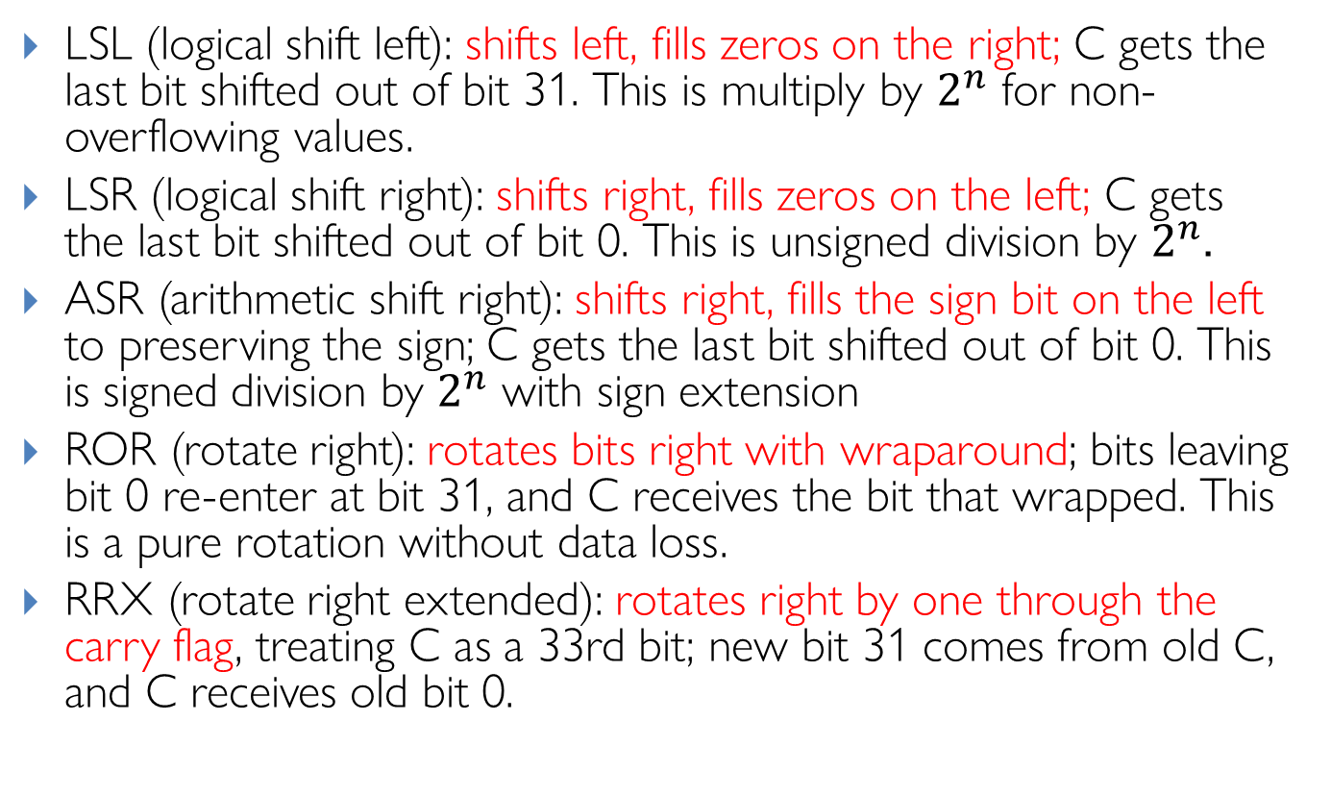
Barrel Shifter: Explanations
Review
LSL (logical shift left): shifts left, fills zeros on the right; C gets the last bit shifted out of bit 31. This is multiply by $2^{n}$ for non-overflowing values.
LSR (logical shift right): shifts right, fills zeros on the left; C gets the last bit shifted out of bit 0. This is unsigned division by $2^{n}$.
ASR (arithmetic shift right): shifts right, fills the sign bit on the left to preserving the sign; C gets the last bit shifted out of bit 0. This is signed division by $2^{n}$ with sign extension
ROR (rotate right): rotates bits right with wraparound; bits leaving bit 0 re-enter at bit 31, and C receives the bit that wrapped. This is a pure rotation without data loss.
RRX (rotate right extended): rotates right by one through the carry flag, treating C as a 33rd bit; new bit 31 comes from old C, and C receives old bit 0.
Notes:
Useful for multiword shifts and certain crypto/bit-manip patterns
LSR (used here): Always fills with zeros, converting the negative value to a large positive number
ASR: Would preserve the sign bit, maintaining the negative value (-4096)

Slide 9
Arithmetic with Shifts
Assuimg 32-bit registers:
Q1:
LDR r0, =0x00000007
MOV r0, r0, LSL 7
Q2:
LDR r0, =0x00000400
MOV r0, r0, LSR 2
Q3:
LDR r0, =0xFFFFC000
MOV r0, r0, LSR 2
Q4:
LDR r0, =0xFFFFC000
MOV r0, r0, ASR 2
Q5:
LDR r0, =0x00000007
MOV r0, r0, ROR 2

Slide 10
Assembly Programming
Write ARMv7 assembly for pseudocode
r1 = (r0 >> 4) & 15

Slide 11
Shift LSL
Compute register values:
LDR R1, =0X11223344
MOV R2, R1, LSL #4
MOV R3, R1, LSL #8
MOV R4, R1, LSL #16
MOV R5, R1, LSL #6

Slide 12
Shift ASR
Compute register values:
LDR R1, =0x81223344
MOV R2, R1, ASR #4
MOV R3, R1, ASR #8
MOV R4, R1, ASR #16

Slide 13
Multiply without MUL
Without using MUL instruction, give instructions that multiply a register, r3 by
135
153
255
18
16384

Slide 14
Count number of ones
Write a program to count the number of ones in a 32-bit register r0.

Slide 15
Count the number of zeros
Based on the program that counts 1’s, modify it to count the number of zeros a 32-bit register r0.
Notes:
ANS: count ones, then subtract from 32
Or Invert r0 to get r4, then count 0’s in r4

Slide 16
Summary of Carry and Overflow Flags
Review
Bit | Name | Meaning after add or sub
N | negative | result is negative
Z | zero | result is zero
V | overflow | signed overflow
C | carry | unsigned overflow
Carry flag C = 1 upon an unsigned addition if the answer is wrong (true result > 2^{n}-1)
Carry flag C = 0 (Borrow flag = 1) upon an unsigned subtraction if the answer is wrong (true result < 0)
Overflow flag V =1 upon a signed addition if the answer is wrong (true result > 2^{n-1}-1 or true result < -2^{n-1})
31
0
N
Z
C
V
16
CPSR (Current Program Status Register)
Notes:
C is cleared upon an unsigned subtract if the answer is wrong

Slide 17
References
Review
Lecture 2: Carry flag for unsigned addition and subtraction
https://www.youtube.com/watch?v=MxGW2WurKuM&list=PLRJhV4hUhIymmp5CCeIFPyxbknsdcXCc8&index=2
Lecture 3: Overflow flag for signed addition and subtraction
https://www.youtube.com/watch?v=BIn6iyYIGio&list=PLRJhV4hUhIymmp5CCeIFPyxbknsdcXCc8&index=3

Slide 18
Flags ANDS
What are value of r2, and NZCV flags after execution, assuming all flags are initially 0.
LDR r0, =0xFFFFFFF00
LDR r1, =0x00000001
ANDS r2, r1, r0, LSL #1

Slide 19
Flags ADDS
What are value of r2, and NZCV flags after execution, assuming all flags are initially 0.
LDR r0, =0xFFFFFFF00
LDR r1, =0x00000001
ADDS r2, r1, r0, LSL #1

Slide 20
Flags
r0 | 0xffffffff
r1 | 0x00000001
r2 | 0x00000003
r3 | 0xfffffff0
Suppose registers have the following values:
What are value of r4, and NZCV flags after execution, assuming all flags are initially 0. (Each instruction runs individually.)
(a) ADD r4, r0, r2, ASR #3
(b) ADDS r4, r0, r1
(c) LSRS r4, r0, #1
(d) ANDS r4, r0, r3
(e) CMP r2, #3
Notes:
r0 = 0xffffffff
r1 = 0x00000001
r2 = 0x00000003
r3 = 0xfffffff0
The N, Z, C, and V flags start out as zero.
After the execution of the following instructions, fill in the flag values.

