Slide 1
Dr. Yifeng Zhu Electrical and Computer Engineering University of Maine
Embedded Systems with ARM Cortex-M Microcontrollers in Assembly Language and C
Chapter 15
General-purpose Timers
Spring 2020

Slide 2
Timer
Free-run counter (independent of processor)
Functions
Input capture
Output compare
Pulse-width modulation (PWM) generation
One-pulse mode output

Slide 3

Timer: Clock
UIF: Update Interrupt Flag
UIE: Update Interrupt Enable
Auto-Reload Register (ARR)
Reload
trigger
f_{CL_PSC}
f_{CL_CNT}
TIMx_SR
Timer
Counter
event
PSC
UIF
interrupt
clock
&
Prescaler
UIE
Counter is incremented/decremented once per cycle.
TIMx_DIER
$$f_{CK_CNT}=\frac{f_{CL_PSC}}{PSC+1}$$
Frequency:
Software can change the prescaler (PSC) to allow the timer clocked at desired rate.
Notes:
A timer is a hardware component in ARM Cortex-M microprocessor. Each timer has a special register, which is called the timer counter. The counter runs freely. If enabled, it automatically counts upwards or downwards, under the driven of a clock source. Pay attention. It is hardware, not software, which keeps repeatedly incrementing or decrementing the counter value. For each rising edge in the clock signal, the value of the counter increments or decrements by one automatically. That is why, we say the counter of a timer, is the free-running counter.
By updating the PSC register, we set the timer to be clocked at the rate we desire. The PSC register holds the frequency pre-scaler value, or the frequency divider. The frequency of the clock source is divided by a constant integer, PSC plus 1, before the input clock is fed to the counter. The prescaler enables a tradeoff between timer resolution and timer range. High timer resolution requires a high clock rate. However, high clock rates cause the timer to overflow or underflow more quickly.

Slide 4
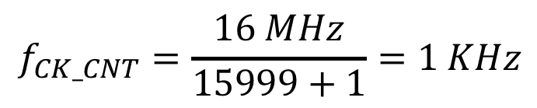
Timer: Clock
Auto-Reload Register (ARR)
Reload
trigger
16MHz
f_{CL_CNT}
TIMx_SR
PSC
15,999
Timer
Counter
event
UIF
interrupt
clock
&
Prescaler
1KHz
Counter is incremented/decremented once per cycle.
UIE
TIMx_DIER
$$f_{CK_CNT}=\frac{16 MHz}{15999+1}=1 KHz$$

Slide 5
Timer: Output
Auto-Reload Register (ARR)
Reload
trigger
f_{CL_PSC}
f_{CL_CNT}
TIMx_SR
Timer
Counter
event
PSC
UIF
interrupt
clock
&
Prescaler
UIE
TIMx_DIER
=
Timer Output
(OCREF)
Compare & Capture Register (CCR)
Notes:
When a timer is configured to generate an output signal, hardware constantly compares the freely-running counter, with a value stored in the compare and capture register (CCR). The output of the timer, OCREF, can be high or low, depending on the timer settings. Note that, when the function of a timer is output, the CCR register is used only for compare.

Slide 6
Timer: Input Capture
Auto-Reload Register (ARR)
Reload
trigger
f_{CL_PSC}
f_{CL_CNT}
TIMx_SR
Timer
Counter
event
PSC
UIF
interrupt
clock
&
Prescaler
UIE
TIMx_DIER
Compare & Capture Register (CCR)
Notes:
A timer can also be used for input capture. When a specific external event occurs, such as a rising edge of an external signal on a G P I O pin, hardware automatically copies, the current value of the timer counter, to the compare and capture register (CCR). We can use such an ability to measure the timing information of a signal event, such as rising edge, or falling edge. By calculating the difference between two recorded CCR values, we can measure the period, or the pulse width of input signals. In this lecture, I will focus only on the output function, instead of the input capture. Specifically, I will show how to program the timer to generate a PWM signal.

Slide 7
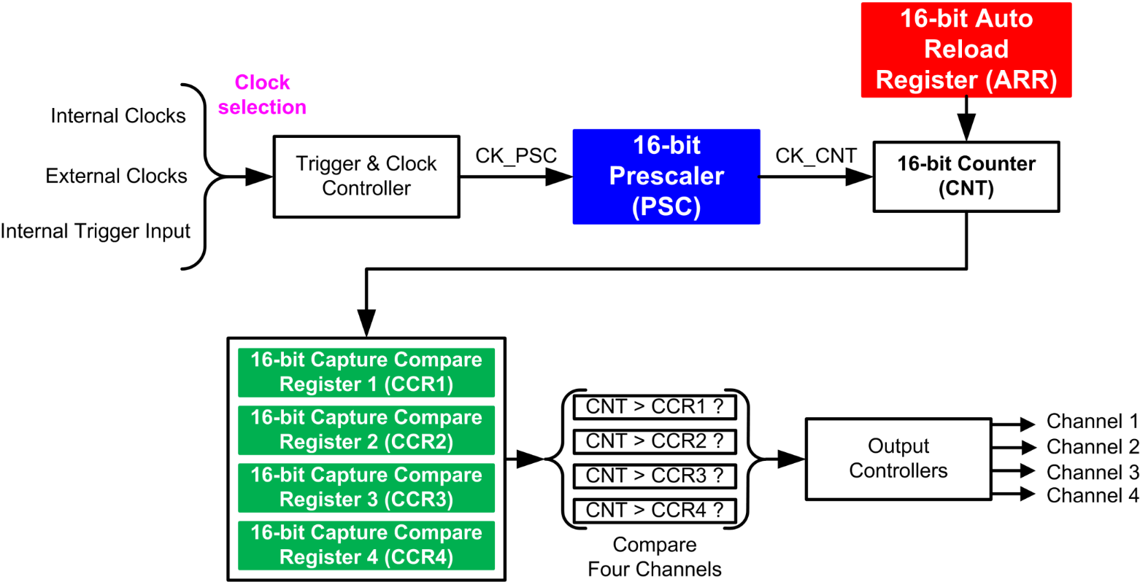
Multi-Channel Outputs
Notes:
{{Pause=2}} Typically, a single timer can generate, up to 4 PWM signals, with independent duty cycles, and identical frequency. Each timer has four channels. Each channel has its own Compare and Capture Register. CCR1, CCR2, CCR3, CCR4. These four channels share the timer counter, and the auto-reload register (ARR). Therefore, these PWM outputs have exactly the same period. However, their duty cycle can be different, because the value of these CCR registers can differ from each other.

Slide 8
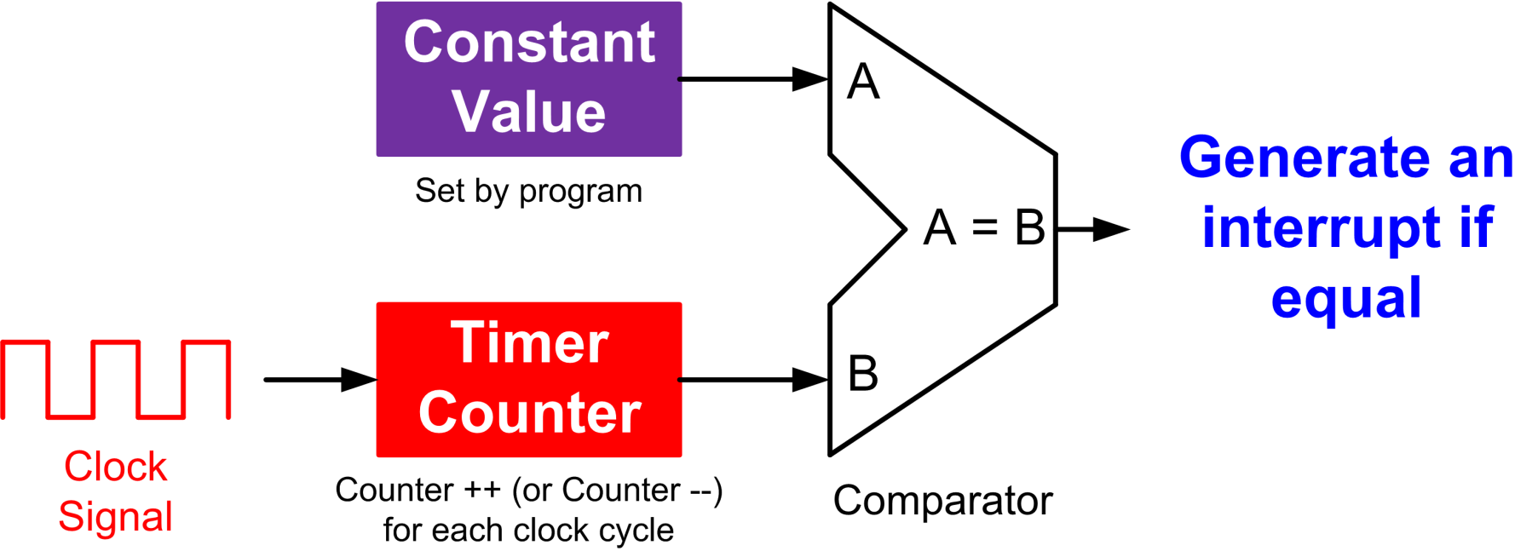
Output Compare
Output Compare Mode (OCM) | Timer Output (OCREF)
000 | Frozen
001 | High if CNT == CCR
010 | Low if CNT == CCR
011 | Toggle if CNT == CCR
100 | Forced low (always low)
101 | Forced high (always high)

Slide 9
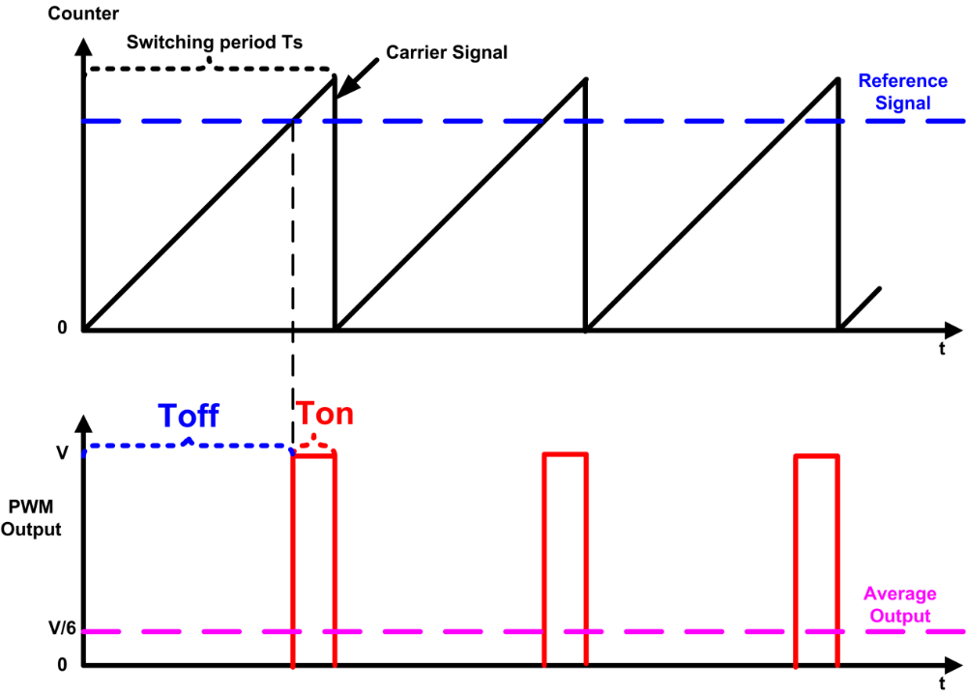
PWM Mode
Mode | Counter < Reference | Counter ≥ Reference
PWM mode 1 (Low True) | Active | Inactive
PWM mode 2 (High True) | Inactive | Active

Slide 10
Edge-aligned Mode (Up-counting)
ARR = 6, RCR = 0
clock
6
6
6
6
5
Counter overflow
5
Counter overflow
5
Counter overflow
5
4
4
4
4
counter
3
3
3
3
2
2
2
2
1
1
1
1
0
0
0
0
Counter overflow
Update event (UEV)
Period = (1 + ARR) * Clock Period
= 7 * Clock Period
Clock Period = 1/f_{CNT}
f_{CNT} = f_{SOURCE}/(1 + PSC)
Notes:
We can configure the timer to repeatedly count up, count down, or, count up and down. Let’s first take a look at the up-counting mode. The auto-reload register (ARR) holds the maximum counter value, which is also called the auto-reload value. The counter counts from 0 to the auto-reload value, then restarts from 0, and generates a counter overflow event. This figure shows an example of the counter behavior when ARR is 6, and the repetition counter is not used. In the up-counting mode, the counter rolls over and is reset when it exceeds 6. When the counter resets, it triggers a counter overflow and an update event (UEV). After that, a new period starts. The counting period is determined by the auto-reload value, as well as the clock period.

Slide 11
Edge-aligned Mode (down-counting)
ARR = 6, RCR = 0
Clock
6
6
6
6
5
5
5
5
4
4
4
4
Counter
3
3
3
3
2
Counter underflow
2
Counter underflow
2
Counter underflow
2
1
1
1
1
0
0
0
0
Counter underflow
Update event (UEV)
Period = (1 + ARR) * Clock Period
= 7 * Clock Period
Notes:
In the down-counting mode, the counter counts from the auto-reloaded value down to 0. After the counter has reached 0, hardware automatically reloads the counter with the auto-reloaded value, and generate a counter underflow event and an update event (UEV). The counting period of the down-counting mode is exactly the same as the counting period of the up-counting mode.

Slide 12
Center-aligned Mode
ARR = 6, RCR = 0
Clock
6
6
5
5
5
5
4
4
4
4
Counter
3
3
3
3
2
2
2
2
1
1
1
1
0
0
0
Counter overflow
Counter underflow
Counter overflow
Counter underflow
Update event (UEV)
Period = 2 * ARR * Clock Period
= 12 * Clock Period
Notes:
In center-aligned mode, the counter counts from 0 to the auto-reload value minus 1, generates a counter overflow event, then counts from the auto-reload value down to 1 and generates a counter underflow event. Then it restarts counting
from 0. In this mode, the counting direction changes automatically on counter overflow and underflow.

Slide 13
PWM Mode 1 (Low-True)
Mode 1
High if counter < CCR
Timer Output (OCREF) =
Low if counter ≥ CCR
Upcounting mode, ARR = 6, CCR = 3, RCR = 0
Clock
6
6
6
6
5
5
5
5
CCR = 3
4
4
4
4
Counter
3
3
3
3
2
2
2
2
1
1
1
1
0
0
0
0
OCREF
CCR
Duty Cycle =
Period = (1 + ARR) * Clock Period
= 7 * Clock Period
ARR + 1
3
=
7
Notes:
A single timer can generate up to 4 PWM signals with independent duty cycles and identical frequency. When multiple PWM signals are generated by the same timer, all rising edges occur at the same time. That is why it is called edge-aligned.

Slide 14
PWM Mode 2 (High-True)
Mode 2
Low if counter < CCR
Timer Output (OCREF) =
High if counter ≥ CCR
Upcounting mode, ARR = 6, CCR = 3, RCR = 0
Clock
6
6
6
6
5
5
5
5
CCR = 3
4
4
4
4
Counter
3
3
3
3
2
2
2
2
1
1
1
1
0
0
0
0
OCREF
CCR
Duty Cycle = 1 -
Period = (1 + ARR) * Clock Period
= 7 * Clock Period
ARR + 1
4
=
7

Slide 15
PWM Mode 2 (High-True)
Mode 2
Low if counter < CCR
Timer Output (OCREF) =
High if counter ≥ CCR
Upcounting mode, ARR = 6, CCR = 3, RCR = 0
Clock
CCR = 5
6
6
6
6
5
5
5
5
4
4
4
4
Counter
3
3
3
3
2
2
2
2
1
1
1
1
0
0
0
0
OCREF
CCR
Duty Cycle = 1 -
Period = (1 + ARR) * Clock Period
= 7 * Clock Period
ARR + 1
2
=
7

Slide 16
PWM Mode 2 (High-True)
Mode 2
Low if counter < CCR
Low if counter < CCR
Timer Output =
Timer Output (OCREF) =
High if counter ≥ CCR
High if counter ≥ CCR
Center-aligned mode, ARR = 6, CCR = 3, RCR = 0
Clock
6
6
5
5
5
5
CCR = 3
4
4
4
4
Counter
3
3
3
3
2
2
2
2
1
1
1
1
0
0
0
OCREF
CCR
Duty Cycle = 1 -
Period = 2 * ARR * Clock Period
= 12 * Clock Period
ARR
1
=
2

Slide 17
PWM Mode 2 (High-True)
Mode 2
Low if counter < CCR
Timer Output (OCREF) =
High if counter ≥ CCR
Center-aligned mode, ARR = 6, CCR = 3, RCR = 0
Clock
6
6
5
5
5
5
4
4
4
4
Counter
3
3
3
3
2
2
2
2
CCR = 1
1
1
1
1
0
0
0
OCREF
CCR
Duty Cycle = 1 -
Period = 2 * ARR * Clock Period
= 12 * Clock Period
ARR
5
=
6

Slide 18
Auto-Reload Register (ARR)
Auto-Reload Preload Enable (ARPE) bit in TIMx_CR1
ARPE = 1 (Syn Update)
Write to ARR
Preload Register
Auto-reload Register (ARR)
Read from ARR
If UDIS bit in TIMx_CR1 is 1, UEV event is disabled.
Triggered by Update Event (UEV)
ARPE = 0 (Asyn Update)
Write to ARR
Auto-reload Register (ARR)
Read from ARR
Notes:
{{Pause=2}} The auto-reload register (ARR) can be updated synchronously, or asynchronously. If the A R P E bit in the timer CR1 register is 1, ARR will be updated synchronously. An update to ARR will be buffered in a register, named the pre load register. The contents of the pre load register, are transferred into ARR, when the next update event occurs. This update mechanism is synchronous to timer’s input clock, and timer’s output period. It prevents software from updating the output frequency or period, when the timer is still performing comparison operations. {{Pause=1}} On the other hand, if the auto-reload {{Pause=0.1}} pre load enable bit (A R P E), is 0, any updates to ARR will immediately take effect. This update mechanism is asynchronous, because the update does not take the clock timing information into considerations.

Slide 19
Repetition Counter Register (RCR)
Notes:
The update event (UEV) is generated with respect to the counter overflows and underflows. In fact, update events are only generated when the repletion counter has reached zero. When the repetition counter register (PCR) is zero, an update event is generated with respect to each overflow or underflow.

Slide 20
Repetition Counter Register (RCR)
Notes:
When the repetition counter register (PCR) is one, in Center aligned mode, the update event occurs either on the overflow or on the underflow depending on, when the RCR register was written, and when the counter was launched. If the RCR was written before launching the counter, the UEV occurs on the overflow. If the RCR was written after launching the counter, the UEV occurs on the underflow. In the upcounting mode, an UEV event is generated with respect to every other overflow. Similarly, an UEV event is generated every other underflow in the down-counting mode.

Slide 21
Repetition Counter Register (RCR)
Notes:
This shows the generation of UEV events when the repetition counter register (PCR) is two.

Slide 22
Repetition Counter Register (RCR)
Notes:
These are the UEV events when the repetition counter register (PCR) is three. An UEV is generated each 4th overflow or underflow event depending on when the RCR was written.

Slide 23
Repetition Counter Register (RCR)

Slide 24
PWM Output Polarity
Mode | Counter < CCR | Counter ≥ CCR
PWM mode 1 (Low True) | Active | Inactive
PWM mode 2 (High True) | Inactive | Active
Output Polarity:
Software can program the CCxP bit in the TIMx_CCER register
 | Active | Inactive
Active High | High Voltage | Low Voltage
Active Low | Low Voltage | High Voltage
Notes:
{{Pause=2}} Software can program the polarity of PWM signals. Each timer has two PWM modes, mode 1 and mode 2. These two modes are complementary to each other. However, software can select the output polarity by writing the CCxP bit in the C C E R register. {{Pause=1}} Software can select either active high or active low. If it is active high, the output is high voltage for the active state, and low voltage for the inactive state. {{Pause=1}} On the other hand, for active low, the output is low voltage for the active state, and high voltage for the inactive state.

Slide 25
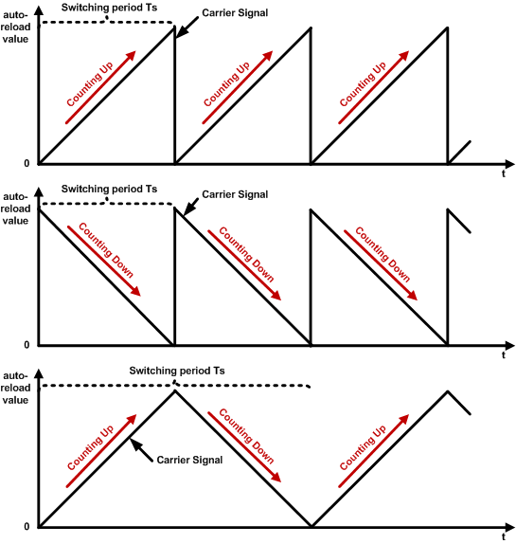
Counting up, down, center

Slide 26
Up-Counting: Left Edge-aligned
Upcounting mode, ARR = 6, CCR = 3, RCR = 0
Clock
CCR = 6
5
6
5
6
5
6
5
6
CCR = 3
3
4
3
4
3
4
3
4
Counter
2
2
2
2
0
1
0
1
0
1
0
1
CCR = 3
OC1REF
CCR = 6
OC2REF
Left-aligned
All rising edges occur at the same time!
PWM Period
Notes:
{{Pause=2}} In the up-counting mode, when multiple PWM signals are generated by the same timer, all rising edges occur at the same time. {{Pause=1}} That is why the up-counting mode is edge-aligned. This example shows the PWM output when CCR is 3 and 6. All rising edges of the PWM signals are aligned with the overflow events of the timer counter. {{Pause=1}} More specifically, the PWM outputs are left edge aligned, because all pulses are aligned to the left side of the PWM period. The outputs go to their active state at the beginning of the period, {{Pause=0.5}} stay on, for an amount of time determined by their duty cycle, {{Pause=0.5}} then turn off for the remainder of the period. After that, this process repeats. {{Pause=0.5}} In summary, If a timer is configured to count up, its PWM signals are edge-aligned, and more specifically, left-aligned.

Slide 27
PWM Mode 2: Right Edge-aligned
Upcounting mode, ARR = 6, CCR = 3, RCR = 0
Clock
CCR = 5
5
6
5
6
5
6
5
6
CCR = 3
3
4
3
4
3
4
3
4
Counter
2
2
2
2
0
1
0
1
0
1
0
1
OC1REF
CCR = 3
OC2REF
CCR = 5
All falling edges occur at the same time!
Right-aligned
PWM Period
Notes:
{{Pause=2}} When multiple PWM signals are generated by the same timer in mode 2, all falling edges occur at the same time. That is why mode 2 is edge-aligned. This example shows the PWM output when CCR is 3, and 5. {{Pause=1}} All falling edges of the PWM signals are aligned with the overflow events. {{Pause=1.5}} More specifically, the PWM outputs are right edge aligned, because all pulses are aligned to the right side of the PWM period.

Slide 28
PWM Mode 2: Center Aligned
Low if counter < CCR
Timer Output =
High if counter ≥ CCR
Center-aligned mode, ARR = 6, CCR = 3, RCR = 0
Clock
5
6
5
5
6
5
CCR = 3
3
4
3
4
3
4
3
4
Counter
2
2
2
2
CCR = 1
0
1
0
1
1
0
1
OC1REF
CCR = 3
CCR = 1
OC2REF
PWM signals are center aligned!
Center-aligned
PWM Period
Notes:
{{Pause=2}} When a timer generates multiple PWM signals, the centers of the PWM pulses are aligned with, the peak value of the timer counter. In other words, the active pulse of, all output channels, are placed at the center of each PWM period. {{Pause=2}} Center-aligned PWM signals are often used in electronic circuits, such as motor control and power supplies. The signals are symmetrical and thus have less harmonics. It helps reduce noise interference and power consumption.

Slide 29
The devil is in the detail
Timer output control
Enable Timer Output
MOE: Main output enable
OSSI: Off-state selection for Idle mode
OSSR: Off-state selection for Run mode
CCxE: Enable of capture/compare output for channel x
CCxNE: Enable of capture/compare complementary output for channel x
Notes:
{{Pause=2}} The output of a timer is enabled by a combination of the following control bits: M O E (Main output enable bit), O S S I (Off-state selection for Idle mode), O S S R (Off-state selection for Run mode), C C x E (Enable of capture/compare output for channel x), and, C C x N E (Enable of capture/compare complementary output for channel x). {{Pause=0.5}} These control bits are located in the timer register C C E R, and register B D T R. {{Pause=1}} For example, in order to enable the output (O C) for channel x, we need to set the M O E bit to 1 in register B D T R. {{Pause=1}} Based on the need of software application, we can choose one of these three configurations.

Slide 30
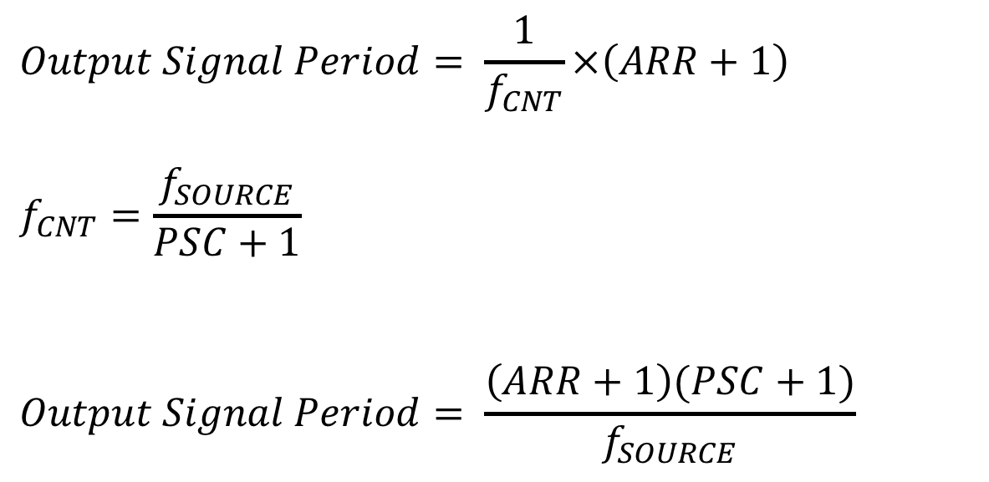
Summary: Timer Output
Up-counting or Down-counting:
$$Output Signal Period= \frac{1}{f_{CNT}}×\left(ARR+1\right)$$
$$f_{CNT}=\frac{f_{SOURCE}}{PSC+1}$$
$$Output Signal Period= \frac{\left(ARR+1\right)(PSC+1)}{f_{SOURCE}}$$

