Slide 1
Z. Gu
Embedded Systems with ARM Cortex-M Microcontrollers in Assembly Language and C
Chapter 13
Fixed-point Numbers
Fall 2025
Acknowledgement: Lecture slides based on Embedded Systems with ARM Cortex-M Microcontrollers in Assembly Language and C, University of Maine https://web.eece.maine.edu/~zhu/book/

Slide 2
Fixed-point Format: Q Notation
UQm.n for unsigned fixed-point
Integer Part
Fractional Part
m bits
n bits
Radix Point
Qm.n for signed fixed-point
Integer Part
Fractional Part
sign bit
m bits
n bits
Radix Point
m + n + 1 bits

Slide 3
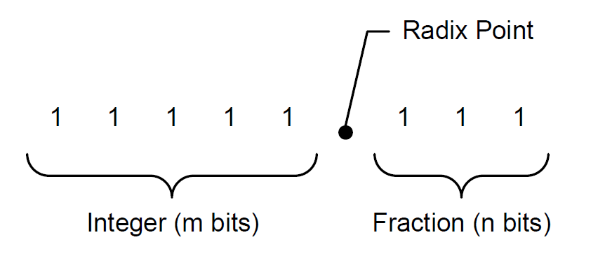




Q Notation: UQm.n
$$f=A_{h}+A_{l}×2^{−n}$$
$$10101.101_{2 }= A_{h}+A_{l}×2^{−3}$$
$$=21+5×2^{−3}$$
$$=21.625$$

Slide 4
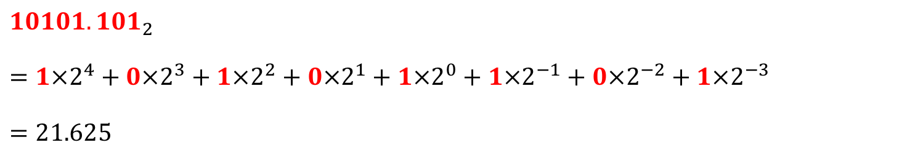
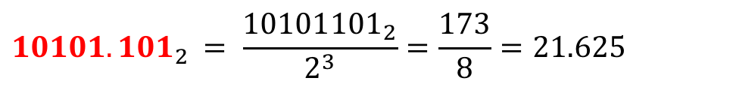
Converting Fixed-point UQ5.3 to Float
2⁴ | 2³ | 2² | 2¹ | 2⁰ | 2⁻¹ | 2⁻² | 2⁻³
1 | 0 | 1 | 0 | 1 | 1 | 0 | 1
Integer Part
Radix
Point
Fractional Part
$$10101.101_{2 }$$
$$=1×2^{4}+0×2^{3}+1×2^{2}+0×2^{1}+1×2^{0}+1×2^{−1}+0×2^{−2}+1×2^{−3}$$
$$=21.625$$
$$10101.101_{2 }= \frac{{10101101}_{2}}{2^{3}}=\frac{173}{8}=21.625$$

Slide 5
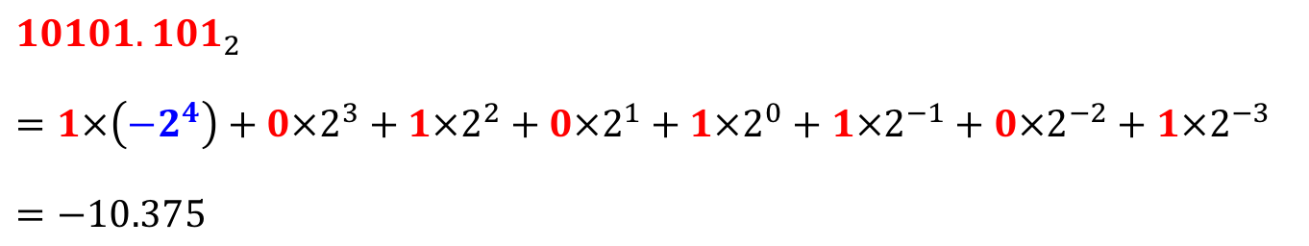

Converting Fixed-point Q4.3 to Float
-2⁴ | 2³ | 2² | 2¹ | 2⁰ | 2⁻¹ | 2⁻² | 2⁻³
1 | 0 | 1 | 0 | 1 | 1 | 0 | 1
Signed
Bit
Integer Part
Radix
Point
Fractional Part
$$10101.101_{2 }$$
$$=1×\left(−2^{4}\right)+0×2^{3}+1×2^{2}+0×2^{1}+1×2^{0}+1×2^{−1}+0×2^{−2}+1×2^{−3}$$
$$=−10.375$$
$$10101.101_{2 }= \frac{{10101101}_{2}}{2^{3}}=\frac{−83}{8}=−10.375$$

Slide 6








U5.3 vs. Q4.3
Unsigned Fixed-point Representation Um.n
$$f=A_{h}+A_{l}×2^{−n}$$
$$10101.101_{2 }= A_{h}+A_{l}×2^{−3}$$
$$=21+5×2^{−3}$$
$$=21.625$$
Signed Fixed-point Representation Qm.n
$$f=A_{h}+A_{l}×2^{−n}$$
$$10101.101_{2 }= A_{h}+A_{l}×2^{−3}$$
$$=−11+5×2^{−3}$$
$$=−10.375$$

Slide 7
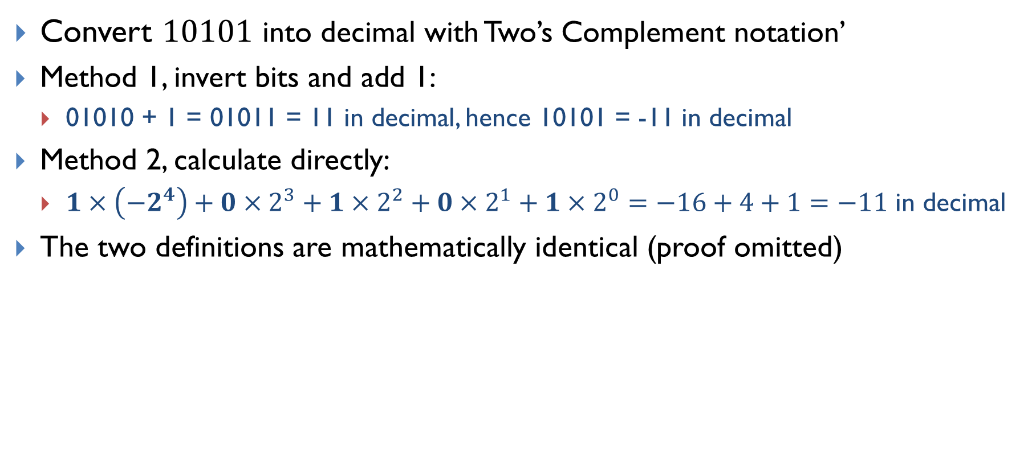
Two Ways of Calculating Two’s Complement (integer)
Convert $10101$ into decimal with Two’s Complement notation’
Method 1, invert bits and add 1:
01010 + 1 = 01011 = 11 in decimal, hence 10101 = -11 in decimal
Method 2, calculate directly:
$1×\left(−2^{4}\right)+0×2^{3}+1×2^{2}+0×2^{1}+1×2^{0}=−16+4+1=−11$ in decimal
The two definitions are mathematically identical (proof omitted)

Slide 8
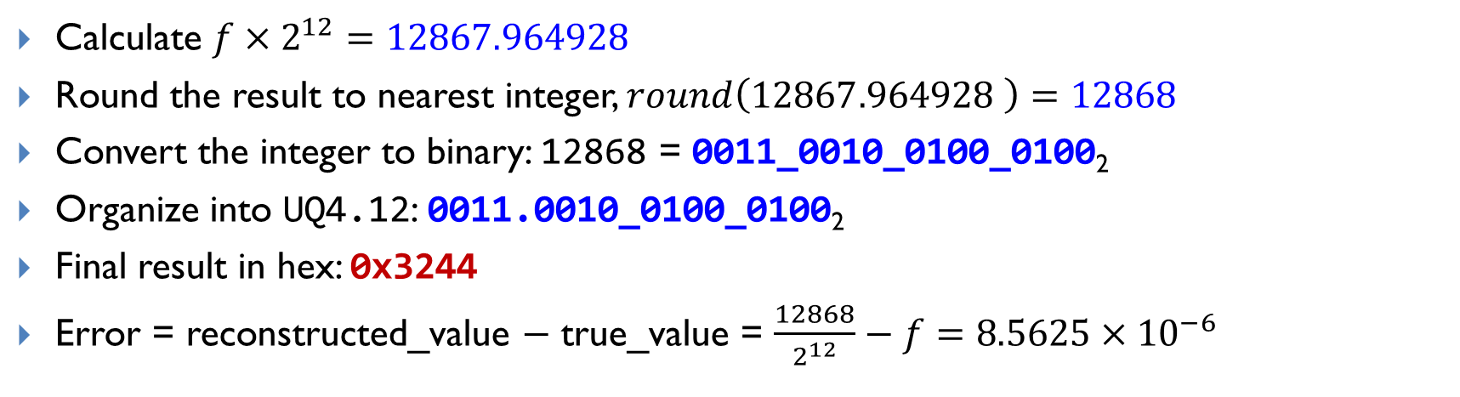

Convert Float to Fixed-point UQ4.12
UQm.n for unsigned fixed-point
$$Representation=round(float × 2^{n})$$
Example: Convert $f = 3. 141593$ to UQ4.12 (4 bits integer, 12 bits fraction)
Calculate $f×2^{12}=12867.964928$
Round the result to nearest integer, $round\left(12867.964928 \right)=12868$
Convert the integer to binary: 12868 = 0011_0010_0100_0100₂
Organize into UQ4.12: 0011.0010_0100_0100₂
Final result in hex: 0x3244
Error = reconstructed_value − true_value = $\frac{12868}{2^{12}}−f=8.5625×{10}^{−6}$

Slide 9
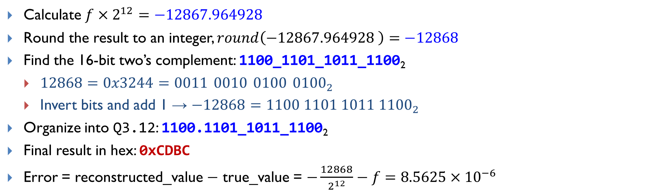

Convert Float to Fixed-point Q3.12
Qm.n for signed fixed-point
$$Representation=round(float × 2^{n})$$
Example: Convert $f = −3. 141593$ to Q3.12 (1 sign bit, 3 bits integer, 12 bits fraction)
Calculate $f×2^{12}=−12867.964928$
Round the result to an integer, $round\left(−12867.964928 \right)=−12868$
Find the 16-bit two’s complement: 1100_1101_1011_1100₂
$12868=0x3244=0011 0010 0100 {0100}_{2}$
Invert bits and add 1 → $−12868=1100 1101 1011 {1100}_{2}$
Organize into Q3.12: 1100.1101_1011_1100₂
Final result in hex: 0xCDBC
Error = reconstructed_value − true_value = $−\frac{12868}{2^{12}}−f=8.5625×{10}^{−6}$

Slide 10
Why use fixed-point?
Floating Point
Shorter Development Time
Wide Dynamic Range
Fixed Point
Higher Performance
Lower Product Cost
More bits for precision

Slide 11
Z. Gu
Embedded Systems with ARM Cortex-M Microcontrollers in Assembly Language and C
Chapter 13
Floating-point Numbers
Fall 2025
Acknowledgement: Lecture slides based on Embedded Systems with ARM Cortex-M Microcontrollers in Assembly Language and C, University of Maine https://web.eece.maine.edu/~zhu/book/

Slide 12
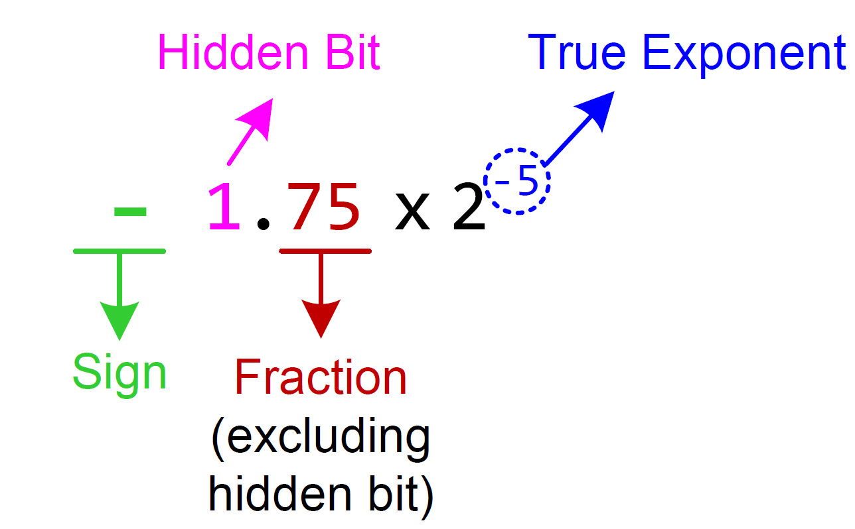
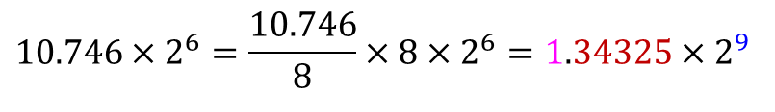
Normalization
We can convert 10.746×2⁶ to normalized format as follows:
$$10.746×2^{6}=\frac{10.746}{8}×8×2^{6}=1.34325×2^{9}$$

Slide 13
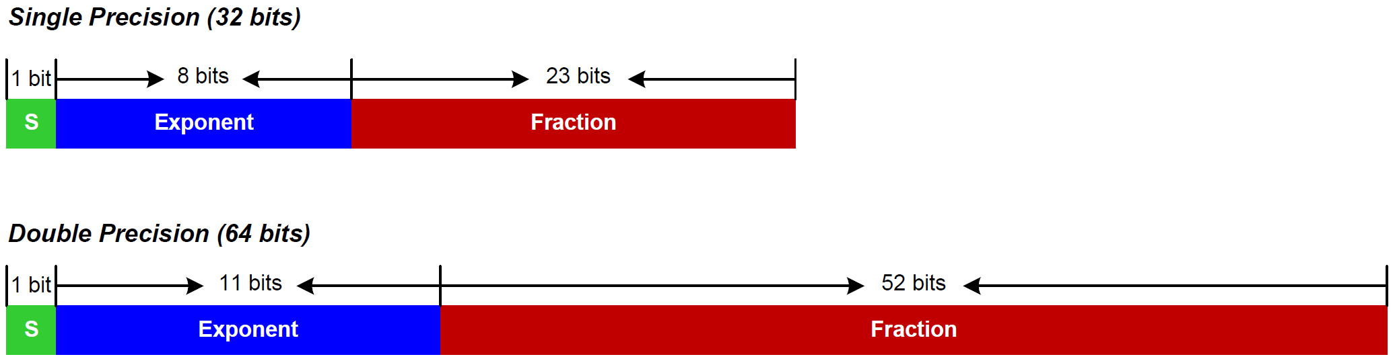
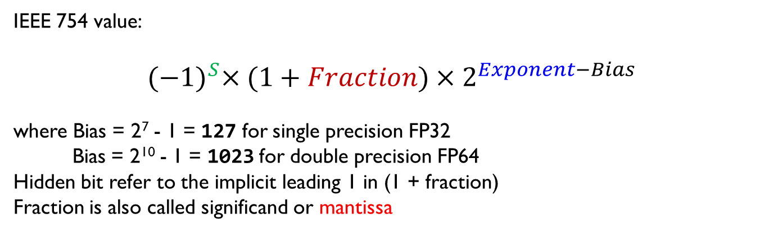
IEEE Standard 754 (Signed Floating Point)
IEEE 754 value:
$${(−1)}^{S}×(1+Fraction)×2^{Exponent−Bias}$$
where Bias = 2⁷ - 1 = 127 for single precision FP32
Bias = 2¹⁰ - 1 = 1023 for double precision FP64
Hidden bit refer to the implicit leading 1 in (1 + fraction)
Fraction is also called significand or mantissa
Notes:
https://mp.weixin.qq.com/s/LQgPT8opkjjZzbn0nUevUw

Slide 14
Why Bias?
FP32’s exponent field has 8 bits. So it can represent integers from 0 to 255. But real exponents in normalized floating-point numbers range roughly from –126 to +127. To store both negative and positive exponents in that 0–255 range, IEEE-754 adds a bias, shifting all values upward so they become non-negative.
For an exponent field of n bits, the bias is 2^{(n−1)}- 1.
For FP32, the bias is chosen as 2⁽⁸⁻¹⁾- 1 = 127, so half the range is allocated for negative exponents, and half for positive.
Actual Exponent = Stored Exponent -127
Stored exponent 0 → actual exponent = -127 (used for special/subnormal cases)
Stored exponent 127 → actual exponent = 0
Stored exponent 255 → reserved for special values (like infinity and NaN)
Notes:
8位有符号整数的范围是 -128 到 127。

Slide 15
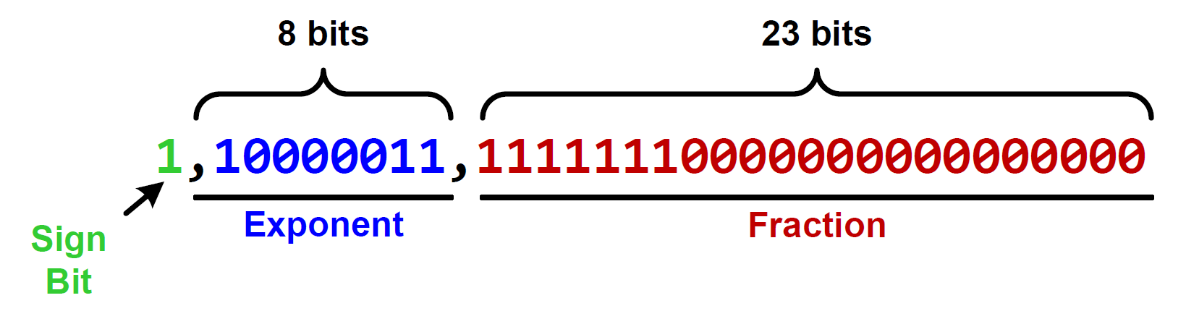
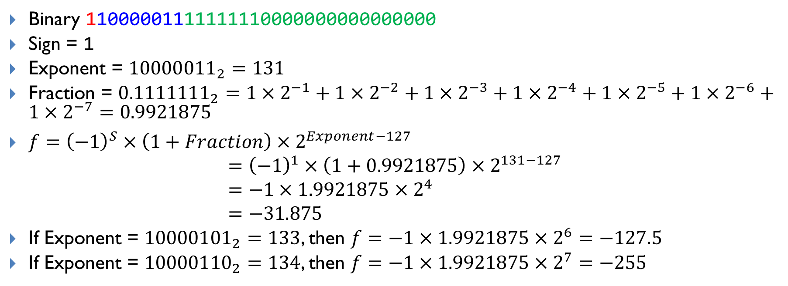
Decoding 0xC1FF0000 into a floating-point number
Binary 11000001111111110000000000000000
Sign = 1
Exponent = ${10000011}_{2}=131$
Fraction = ${0.1111111}_{2}=1×2^{−1}+1×2^{−2}+1×2^{−3}+1×2^{−4}+1×2^{−5}+1×2^{−6}+1×2^{−7}=0.9921875$
$f={\left(−1\right)}^{S}×\left(1+Fraction\right)×2^{Exponent−127}$
$$={\left(−1\right)}^{1}×\left(1+0.9921875\right)×2^{131−127} \\ =−1×1.9921875×2^{4} \\ =−31.875$$
If Exponent = ${10000101}_{2}=133$, then $f=−1×1.9921875×2^{6}=−127.5$
If Exponent = ${10000110}_{2}=134$, then $f=−1×1.9921875×2^{7}=−255$
Notes:
10000101

Slide 16
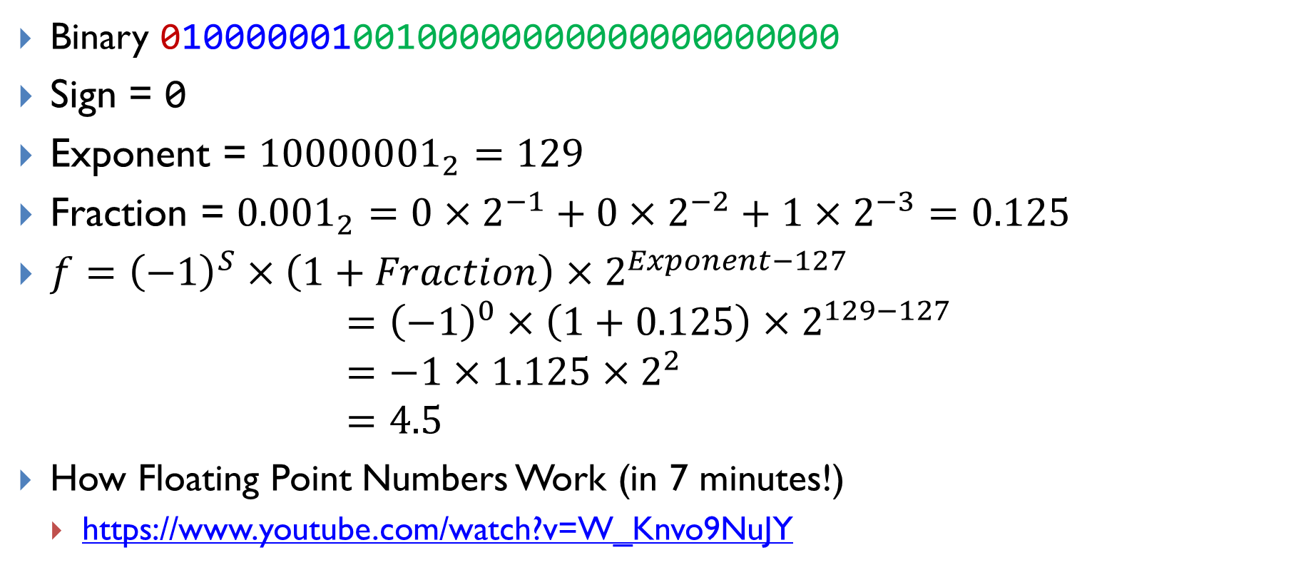
Decoding 0x40920000 into a floating-point number
Binary 01000000100100000000000000000000
Sign = 0
Exponent = ${10000001}_{2}=129$
Fraction = ${0.001}_{2}=0×2^{−1}+0×2^{−2}+1×2^{−3}=0.125$
$f={\left(−1\right)}^{S}×\left(1+Fraction\right)×2^{Exponent−127}$
$$={\left(−1\right)}^{0}×\left(1+0.125\right)×2^{129−127} \\ =−1×1.125×2^{2} \\ =4.5$$
How Floating Point Numbers Work (in 7 minutes!)
https://www.youtube.com/watch?v=W_Knvo9NuJY

Slide 17

Decoding 0x3F800000 into a floating-point number
Binary 00111111100000000000000000000000
Sign = 0
Exponent = ${01111111}_{2}=127$
Fraction = $0$
$f={\left(−1\right)}^{S}×\left(1+Fraction\right)×2^{Exponent−127}$
$$={\left(−1\right)}^{0}×\left(1+0\right)×2^{127−127} \\ =−1×1×2^{0} \\ =1.0$$
How Floating Point Numbers Work (in 7 minutes!)
https://www.youtube.com/watch?v=W_Knvo9NuJY

Slide 18
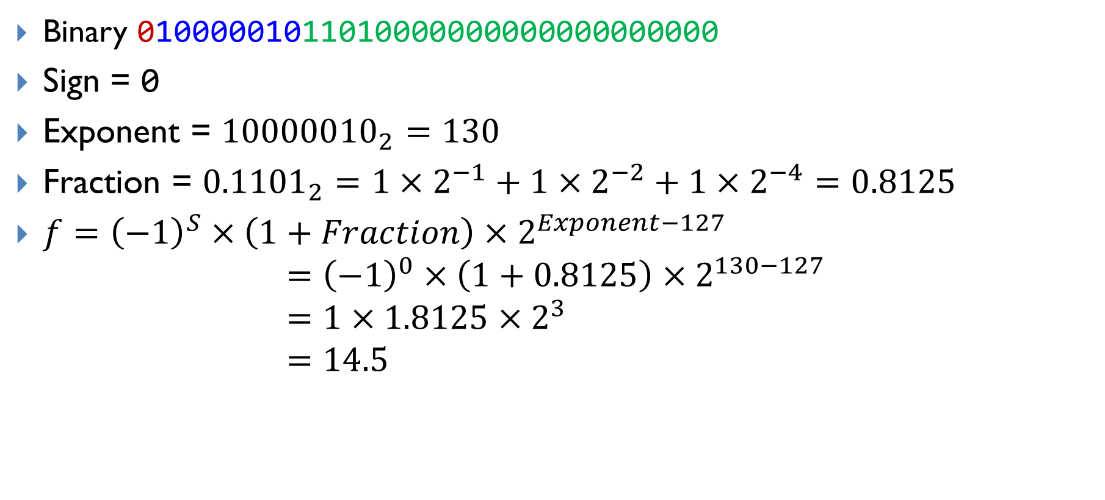
Decoding 0x41680000 into a floating-point number
Binary 01000001011010000000000000000000
Sign = 0
Exponent = ${10000010}_{2}=130$
Fraction = ${0.1101}_{2}=1×2^{−1}+1×2^{−2}+1×2^{−4}=0.8125$
$f={\left(−1\right)}^{S}×\left(1+Fraction\right)×2^{Exponent−127}$
$$={\left(−1\right)}^{0}×\left(1+0.8125\right)×2^{130−127} \\ =1×1.8125×2^{3} \\ =14.5$$

Slide 19
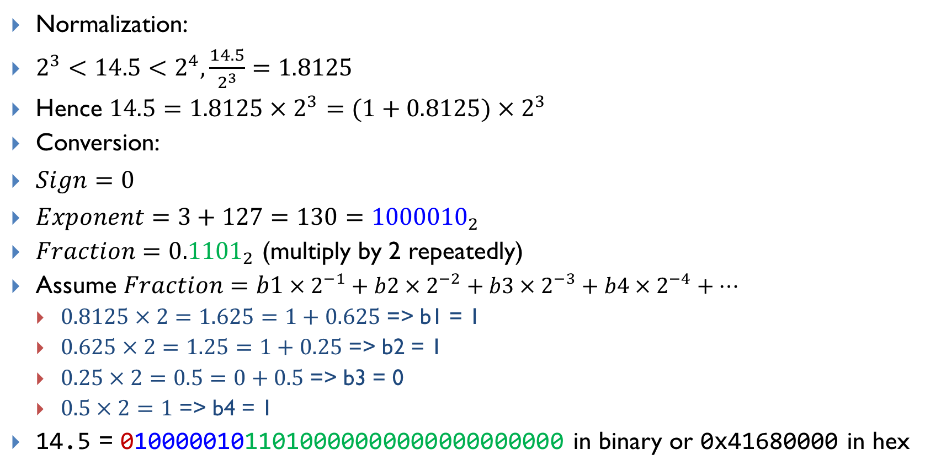
Encoding 14.5 into IEEE Std 754 Single-Precision
Normalization:
$2^{3}<14.5<2^{4},\frac{14.5}{2^{3}}=1.8125$
Hence $14.5=1.8125×2^{3}=(1+0.8125)×2^{3}$
Conversion:
$Sign=0$
$Exponent=3+127=130={1000010}_{2}$
$Fraction={0.1101}_{2}$ (multiply by 2 repeatedly)
Assume $Fraction=b1×2^{−1}+b2×2^{−2}+b3×2^{−3}+b4×2^{−4}+…$
$0.8125×2=1.625=1+0.625$ => b1 = 1
$0.625×2=1.25=1+0.25$ => b2 = 1
$0.25×2=0.5=0+0.5$ => b3 = 0
$0.5×2=1$ => b4 = 1
14.5 = 01000001011010000000000000000000 in binary or 0x41680000 in hex

Slide 20
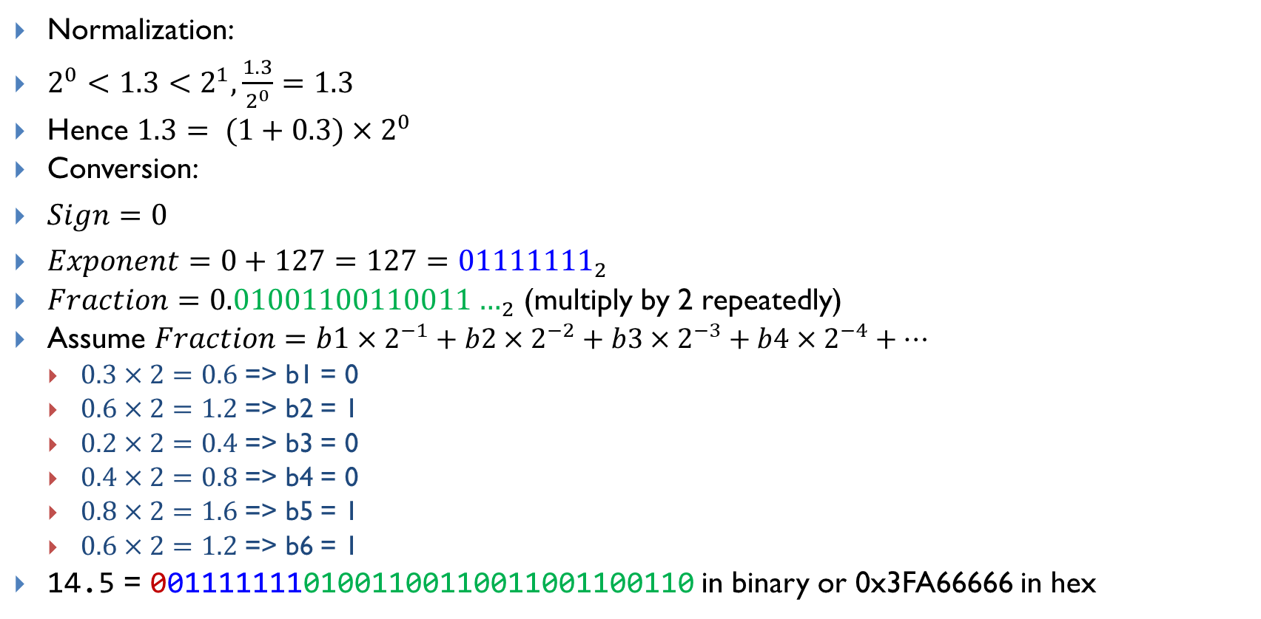
Encoding 1.3 into IEEE Std 754 Single-Precision
Normalization:
$2^{0}<1.3<2^{1},\frac{1.3}{2^{0}}=1.3$
Hence $1.3= (1+0.3)×2^{0}$
Conversion:
$Sign=0$
$Exponent=0+127=127={01111111}_{2}$
$Fraction={0.01001100110011…}_{2}$ (multiply by 2 repeatedly)
Assume $Fraction=b1×2^{−1}+b2×2^{−2}+b3×2^{−3}+b4×2^{−4}+…$
$0.3×2=0.6$ => b1 = 0
$0.6×2=1.2$ => b2 = 1
$0.2×2=0.4$ => b3 = 0
$0.4×2=0.8$ => b4 = 0
$0.8×2=1.6$ => b5 = 1
$0.6×2=1.2$ => b6 = 1
14.5 = 00111111101001100110011001100110 in binary or 0x3FA66666 in hex
Repeats infinitely
Notes:
32-9=23

Slide 21
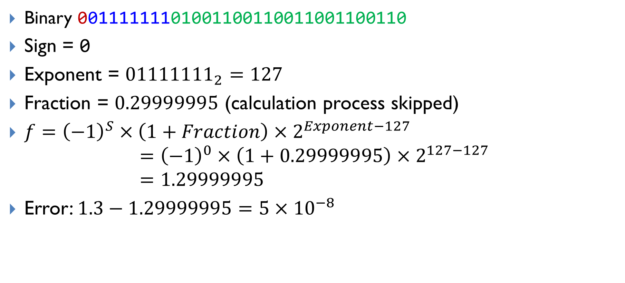
Decoding 0x3FA66666 into a floating-point number
Binary 00111111101001100110011001100110
Sign = 0
Exponent = ${01111111}_{2}=127$
Fraction = $0.29999995$ (calculation process skipped)
$f={\left(−1\right)}^{S}×\left(1+Fraction\right)×2^{Exponent−127}$
$$={\left(−1\right)}^{0}×\left(1+0.29999995\right)×2^{127−127} \\ =1.29999995$$
Error: $1.3−1.29999995=5×{10}^{−8}$
Why Is This Happening?! Floating Point Approximation4
https://www.youtube.com/watch?v=2gIxbTn7GSc

Slide 22
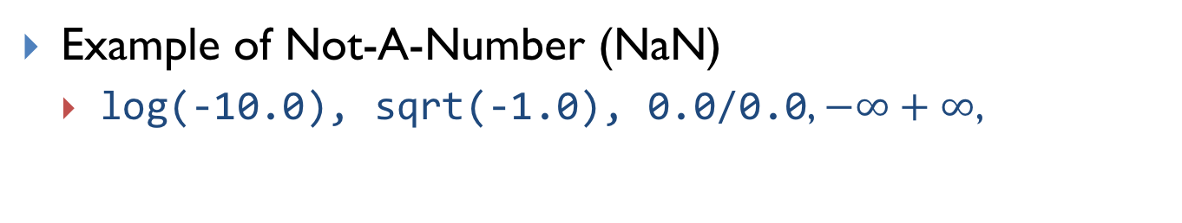
Special Values
Exponents 00000000 and 111111111 are reserved.
Example of Not-A-Number (NaN)
log(-10.0), sqrt(-1.0), 0.0/0.0, $−∞+∞$,

Slide 23

Subnormalized Float Number
To represent numbers between 0 and the minimum positive number that the normalized format can represent.
Normalized Format
Sub-normalized Format
$${\left(−1\right)}^{S}×(1+Fraction)×2^{Exponent−127}$$
$${\left(−1\right)}^{S}×Fraction×2^{−126}$$

Slide 24
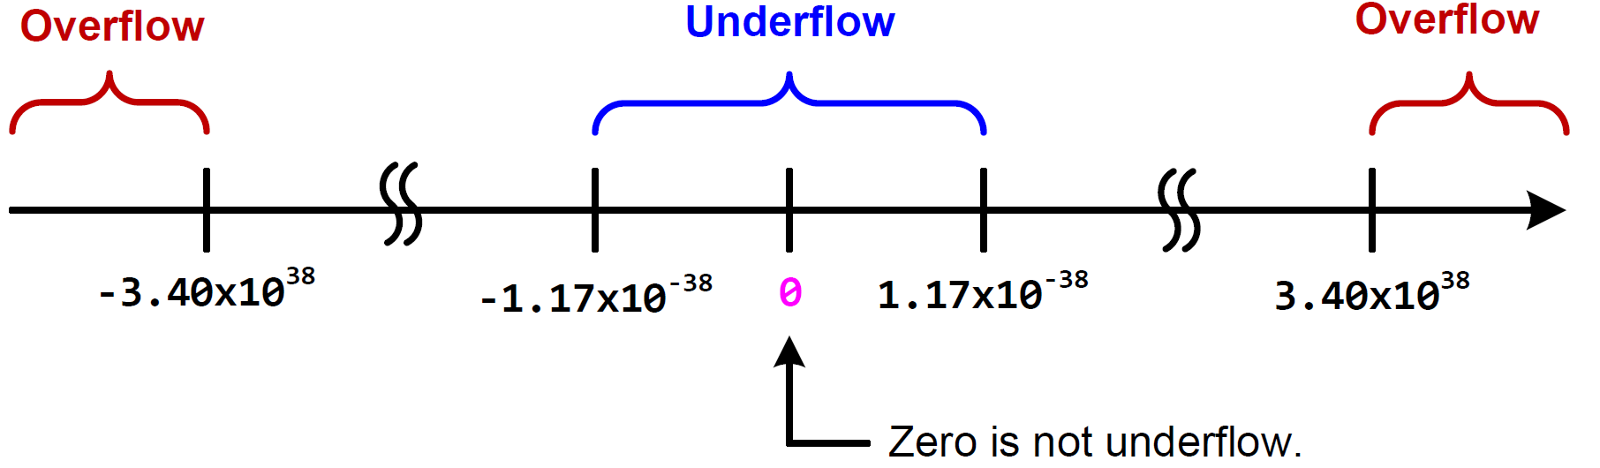
Overflow and Underflow
Smallest Positive Normal Number:
0 00000001 00000000000000000000000
$${(−1)}^{0}×\left(1+0\right)×2^{1−127}=2^{−126}≈1.18×{10}^{−38}$$
Smallest Positive Subnormal Number:
0 00000000 00000000000000000000001
$${(−1)}^{0}×\left(0+2^{−23}\right)×2^{1−127}=2^{−149}≈1.40×{10}^{−45}$$

Slide 25
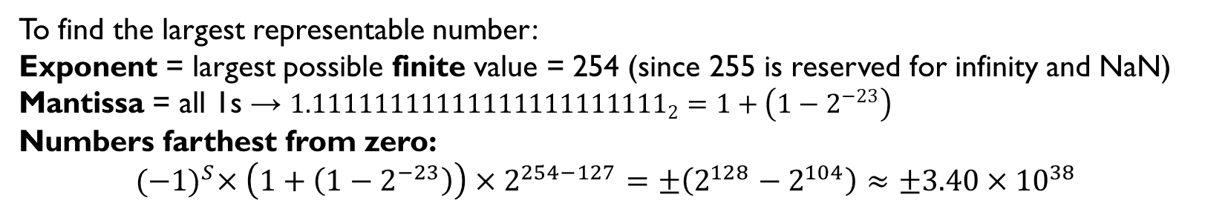
Overflow and Underflow
To find the largest representable number:
Exponent = largest possible finite value = 254 (since 255 is reserved for infinity and NaN)
Mantissa = all 1s → ${1.11111111111111111111111}_{2}=1+\left(1−2^{−23}\right)$
Numbers farthest from zero:
$${(−1)}^{S}×\left(1+\left(1−2^{−23}\right)\right)×2^{254−127}=±\left(2^{128}−2^{104}\right)≈±3.40×{10}^{38}$$
Notes:
Numbers farthest from zero

Slide 26
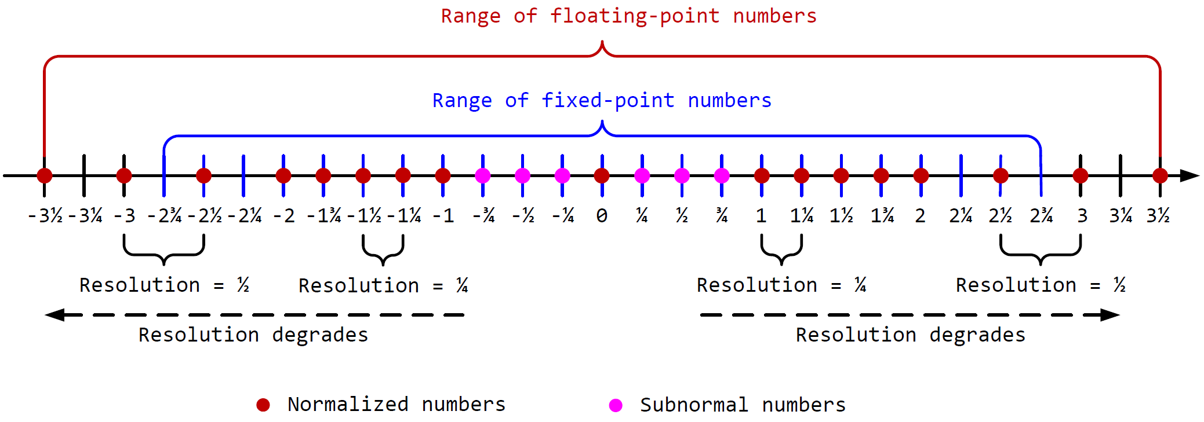
Resolution
Given a hypothetical five-bit floating-point system (similar to IEEE 754).
the sign bit, an exponent (2 bits), and a fraction (2 bits)

Slide 27
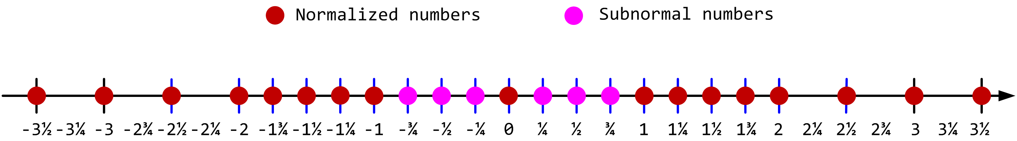
Tradeoff between Range and Precision
A simplified 5-bit floating-point (IEEE 754 style)
Floating-Point
Resolution: difference between two neighbor numbers
Precision decreases as the magnitude increases
Fixed-Point
Numbers are evenly distributed among the representable range
Precision is fixed

Slide 28
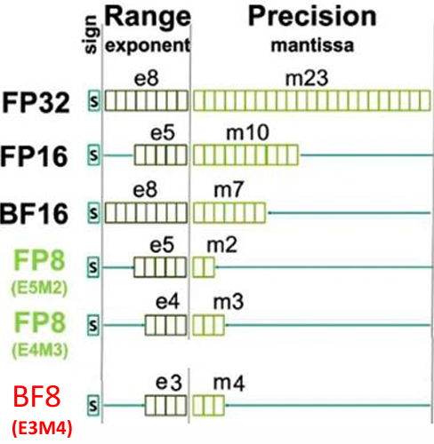
FP formats used in AI and machine learning
bf16 (bfloat16) and bf8 (bfloat8) are floating point formats used in AI and machine learning for efficient computation with lower precision while retaining useful range.
bf8 is cutting edge and experimental for very efficient AI deployment where accuracy can be slightly sacrificed for speed and lower memory footprints. bf16 is established as a good practical balance for many ML tasks
Notes:
https://www.edge-ai-vision.com/2025/08/introduction-to-data-types-for-ai-trade-offs-and-trends-a-presentation-from-synopsys/

Slide 29
References
How Floating Point Numbers Work (in 7 minutes!)
https://www.youtube.com/watch?v=W_Knvo9NuJY
HOW TO: Convert IEEE-754 Single-Precision Binary to Decimal, Steven Petryk
https://www.youtube.com/watch?v=4DfXdJdaNYs
Why Is This Happening?! Floating Point Approximation
https://www.youtube.com/watch?v=2gIxbTn7GSc
IEEE 754 Binary to Float Conversion
https://www.youtube.com/watch?v=9k5rdPUzij8&list=PL-ftFcielQtGxBUfzkbz9tWlRZb-rlJ2p&index=2
IEEE 754 Float to Binary Conversion
https://www.youtube.com/watch?v=9k5rdPUzij8&list=PL-ftFcielQtGxBUfzkbz9tWlRZb-rlJ2p&index=2

