Slide 1
Z. Gu
Embedded Systems with ARM Cortex-M Microcontrollers in Assembly Language and C
Chapter 10
Preserve Environment via Stack
Fall 2025

Slide 2
Overview
How to call a subroutine?
How to return the control back to the caller?
How to pass arguments into a subroutine?
How to return a value in a subroutine?
How to preserve the running environment for the caller?

Slide 3
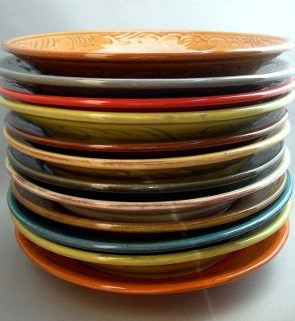
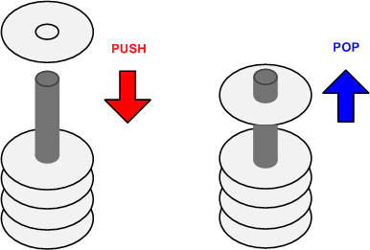
Stack
A Last-In-First-Out memory model
Only allow to access the most recently added item
Also called the top of the stack
Key operations:
push (add item to stack)
pop (remove top item from stack)

Slide 4
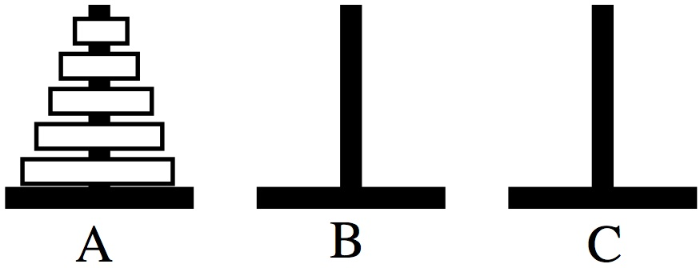
Tower of Hanoi
Only one disk may be moved at a time.
Each move consists of taking the upper disk from one of the rods and sliding it onto another rod, on top of the other disks that may already be present on that rod.
No disk may be placed on top of a smaller disk.

Slide 5
Tower of Hanoi
STACK: Last In First Out
Stack 1
Stack 2
Stack 3
http://en.wikipedia.org/wiki/File:Tower_of_Hanoi_4.gif

Slide 6
Stack Growth Convention: Ascending vs Descending
Descending stack: Stack grows towards low memory address
Ascending stack: Stack grows towards high memory address

Slide 7
Stack Growth Convention: Full vs Empty
Full stack: SP points to the last item pushed onto the stack
Empty stack: SP points to the next free space on the stack

Slide 8
Cortex-M Stack
Cortex-M uses full descending stack
Example:
PUSH/POP {r0,r6,r3}
Stack pointer (SP, aka R13)
decremented on PUSH
SP = SP – 4 * # of registers
incremented on POP
SP = SP + 4 * # of registers
SP starts at 0x20000200 for STM32-Discovery by default (can be changed in startup.s)

Slide 9
Load/Store Multiple Registers
Review
The following are synonyms.
STM = STMIA (Increment After) = STMEA (Empty Ascending)
LDM = LDMIA (Increment After) = LDMFD (Full Descending)
The order in which registers are listed does not matter
For STM/LDM, the lowest-numbered register is stored/loaded at the lowest memory address.

Slide 10
Store Multiple Registers
Review

Slide 11
Load Multiple Registers
Review

Slide 12
Full Descending Stack

Slide 13
Stack Implementation
Stock Name | Push |  | Pop
 | Equivalent | Alternative | Equivalent | Alternative
Full Descending(FD) | STMFD SP!,list | STMDB SP!,list | LDMFD SP!,list | LDMIA SP!,list
Empty Descending(ED) | STMED SP!,list | STMDA SP!,list | LDMED SP!,list | LDMIB SP!,list
Full Ascending(FA) | STMFA SP!,list | STMIB SP!,list | LDMFA SP!,list | LDMDA SP!,list
Empty Ascending(EA) | STMEA SP!,list | STMIA SP!,list | LDMEA SP!,list | LDMDB SP!,list

Slide 14
Typical Usage of Stack
Why need stack?
Saving the original contents of processor’s registers at the beginning a subroutine (Contents are restored at the end of a subroutine)
Storing local variables in a subroutine
Passing extra arguments to a subroutine
Saving processor’s registers upon an interrupt

Slide 15
Stack
PUSH {Rd}
SP = SP-4 ⟶ descending stack
(*SP) = Rd ⟶ full stack
Push multiple registers
They are equivalent.
PUSH {r8}
PUSH {r7}
PUSH {r6}
PUSH {r6, r7, r8}
PUSH {r8, r7, r6}
SP is decremented before PUSH (pre-decrement), and incremented after POP (post-increment).
The order in which registers listed in the register list does not matter.
When pushing multiple registers, these registers are automatically sorted by name and the lowest-numbered register is stored to the lowest memory address, i.e. is stored last.
Notes:
Yes. For a standard full-descending ARM/Thumb-2 stack, SP is decremented before each store during PUSH (pre-decrement), and incremented after each load during POP (post-increment); slides should reflect SP moving down before writing and up after reading.duetorun+1
Correct rule to apply
PUSH: STMDB/STMFD sp!, {...} semantics — SP moves down first, then values are stored starting at the new SP; lowest-numbered register goes to the lowest address.documentation-service.arm+1
POP: LDMIA/LDMFD sp!, {...} semantics — values are read starting at SP, then SP moves up after the block; lowest-numbered register is loaded from the lowest address.developer.arm+1
https://duetorun.com/blog/20230614/arm-stack-modes/
https://developer.arm.com/documentation/107656/latest/Registers/Registers-in-the-register-bank/R13--Stack-Pointer--SP-/Stack-memory
https://documentation-service.arm.com/static/65798111b52744113be5cda1?token=
https://developer.arm.com/documentation/dui0231/latest/thumb-instruction-reference/thumb-memory-access-instructions/push-and-pop
https://developer.arm.com/documentation/dui0801/a/Cacbgchh
https://stackoverflow.com/questions/70008529/i-cannot-understand-how-the-arm-stack-operations-work
https://www.scs.stanford.edu/~zyedidia/docs/arm/extras/annot/subroutines.hohl-arm-asm.pdf
https://stackoverflow.com/questions/47109767/push-and-pop-order-in-arm/47109995
https://shankarrajagopal.github.io/theory/Module_5_good_one.pdf
https://developer.arm.com/documentation/dui0489/e/arm-and-thumb-instructions/memory-access-instructions/push-and-pop
https://www.embeddedrelated.com/showthread/comp.arch.embedded/200819-1.php
http://www.cs.emory.edu/~cheung/Courses/255/Syllabus/7-ARM/SLIDES/s53.html
https://bob.cs.sonoma.edu/testing/sec-stack.html
https://stackoverflow.com/questions/57031401/why-push-first-decreases-the-stack-pointer
https://azeria-labs.com/functions-and-the-stack-part-7/
http://www-mdp.eng.cam.ac.uk/web/library/enginfo/mdp_micro/lecture5/lecture5-4-2.html
https://web.eecs.umich.edu/~prabal/teaching/eecs373-f10/readings/ARMv7-M_ARM.pdf
https://users.ece.utexas.edu/~valvano/mspm0/Arm_Architecture_v6m_Reference_Manual.pdf
http://homepage.cs.uiowa.edu/~jones/compiler/notes/27.shtml

Slide 16
Stack
POP {Rd}
Rd = (*SP) ⟶ full stack
SP = SP + 4 ⟶ Stack shrinks
Pop multiple registers
They are equivalent.
POP {r6}
POP {r7}
POP {r8}
POP {r6, r7, r8}
POP {r8, r7, r6}
SP is decremented before PUSH (pre-decrement), and incremented after POP (post-increment).
The order in which registers listed in the register list does not matter.
When popping multiple registers, these registers are automatically sorted by name and the lowest-numbered register is loaded from the lowest memory address, i.e. is loaded first.

Slide 17
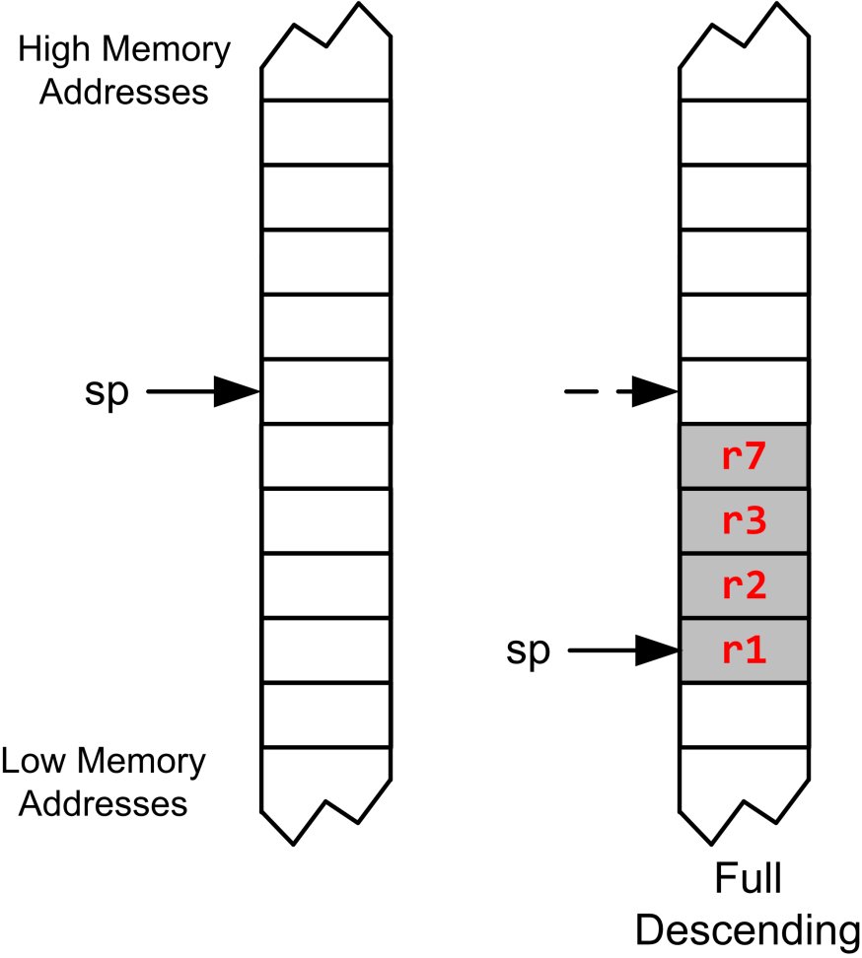
Full Descending Stack
PUSH {r3, r1, r7, r2}

Slide 18
Full Descending Stack
PUSH {r3, r1, r7, r2}
Largest-numbered register is pushed first.

Slide 19
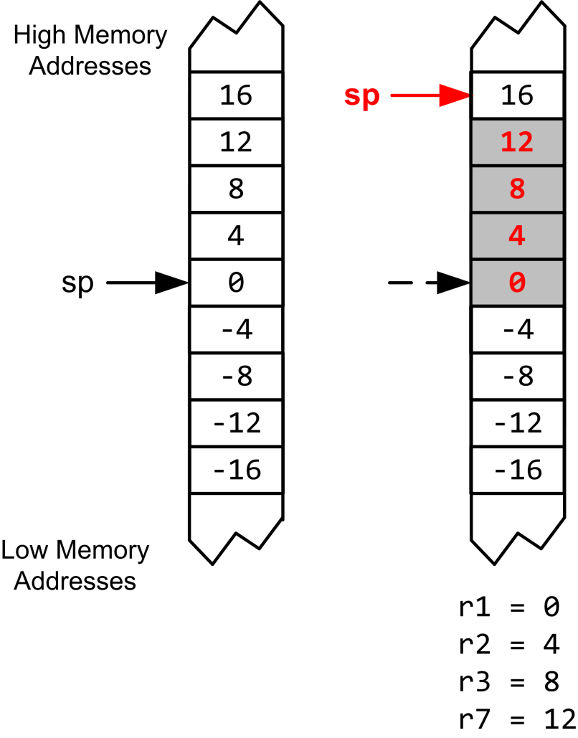
Full Descending Stack
PUSH {r3, r1, r7, r2}
POP {r3, r1, r7, r2}

Slide 20
Full Descending Stack
PUSH {r3, r1, r7, r2}
POP {r3, r1, r7, r2}
Smallest-numbered register is popped first.

Slide 21
Example: swap R1 & R2
R1
0x11111111
R2
0x22222222
PUSH {R1}
PUSH {R2}
POP {R1}
POP {R2}
Address
R13 (SP)
0x20000200
xxxxxxxx
0x20000200
xxxxxxxx
0x200001FC
xxxxxxxx
0x200001F8
memory

Slide 22
Example: swap R1 & R2
R1
0x11111111
R2
0x22222222
PUSH {R1}
PUSH {R2}
POP {R1}
POP {R2}
Address
PC
R13 (SP)
0x200001FC
xxxxxxxx
0x20000200
0x11111111
0x200001FC
xxxxxxxx
0x200001F8
memory

Slide 23
Example: swap R1 & R2
R1
0x11111111
R2
0x22222222
PUSH {R1}
PUSH {R2}
POP {R1}
POP {R2}
Address
R13 (SP)
0x200001F8
PC
xxxxxxxx
0x20000200
0x11111111
0x200001FC
0x22222222
0x200001F8
memory

Slide 24
Example: swap R1 & R2
R1
0x22222222
R2
0x22222222
PUSH {R1}
PUSH {R2}
POP {R1}
POP {R2}
Address
R13 (SP)
0x200001FC
xxxxxxxx
0x20000200
PC
0x11111111
0x200001FC
0x22222222
0x200001F8
memory

Slide 25
Example: swap R1 & R2
R1
0x22222222
R2
0x11111111
PUSH {R1}
PUSH {R2}
POP {R1}
POP {R2}
Address
R13 (SP)
0x20000200
xxxxxxxx
0x20000200
0x11111111
0x200001FC
PC
0x22222222
0x200001F8
memory

Slide 26
Quiz
Are the values of R1 and R2 swapped? Why?
PUSH {R1, R2}
POP {R2, R1}
Notes:
The reason is ARM stack push/pop for multiple registers stores registers in ascending order by register number for pushing (largest number pushed first) and pops registers also in ascending order by number (smallest register popped first), so the pop order must be correct to swap values. It

Slide 27
Quiz ANS
Are the values of R1 and R2 swapped? Why?
PUSH {R1, R2}
POP {R2, R1}
Answer: No. It is equivalent to below, which preserves values of R1 and R2.
PUSH {R2}
PUSH {R1}
POP {R1}
POP {R2}
These are correct:
PUSH {R1, R2}
POP {R2}
POP {R1}
or
PUSH {R1}
PUSH {R2}
POP {R1, R2}
PUSH {R2}
PUSH {R1}
POP {R2}
POP {R1}
or
PUSH {R1}
PUSH {R2}
POP {R1}
POP {R2}
equivalent
equivalent
Notes:
The reason is ARM stack push/pop for multiple registers stores registers in ascending order by register number for pushing (largest number pushed first) and pops registers also in ascending order by number (smallest register popped first), so the pop order must be correct to swap values. It

Slide 28
Subroutine
A subroutines, also called a function or a procedure,
single-entry, single-exit
Return to caller after it exits
When a subroutine is called, the Link Register (LR) holds the memory address of the next instruction to be executed after the subroutine exits.

Slide 29
Link Register
Link Register (LR) holds the return address of the current subroutine call.

Slide 30
Call a Subroutine
Caller Program | Subroutine/Callee
MOV r4, #100 ... BL foo ... ADD r4, r4, #1 ; r4 = 101, not 11 | foo PROC ... MOV r4, #10 ; foo changes r4 ... BX LR ENDP

Slide 31
Calling a Subroutine
BL label
Step 1: LR = PC + 4
Step 2: PC = label
Notes:
label is name of subroutine
Compiler translates label to memory address
After call, LR holds return address (the instruction following the call)
Caller Program
MOV r4, #100 ... BL foo ...
Subroutine/Callee
foo PROC ... MOV r4, #10 ... BX LR ENDP

Slide 32
Exiting a Subroutine
Caller Program
MOV r4, #100 ... BL foo ...
Subroutine/Callee
foo PROC ... MOV r4, #10 ... BX LR ENDP
Branch and Exchange
BX LR
PC = LR

Slide 33
ARM Procedure Call Standard
Register | Usage | Subroutine Preserved | Notes
r0 | Argument 1 and return value | No | If return has 64 bits, then r0:r1 hold it. If argument 1 has 64 bits, r0:r1 hold it.
r1 | Argument 2 | No
r2 | Argument 3 | No | If the return has 128 bits, r0-r3 hold it.
r3 | Argument 4 | No | If more than 4 arguments, use the stack
r4 | General-purpose V1 | Yes | Variable register 1 holds a local variable.
r5 | General-purpose V2 | Yes | Variable register 2 holds a local variable.
r6 | General-purpose V3 | Yes | Variable register 3 holds a local variable.
r7 | General-purpose V4 | Yes | Variable register 4 holds a local variable.
r8 | General-purpose V5 | YES | Variable register 5 holds a local variable.
r9 | Platform specific/V6 | Yes/No | Usage is platform-dependent.
r10 | General-purpose V7 | Yes | Variable register 7 holds a local variable.
r11 | General-purpose V8 | Yes | Variable register 8 holds a local variable.
r12 (IP) | Intra-procedure-call register | No | It holds intermediate values between a procedure and the sub-procedure it calls.
r13 (SP) | Stack pointer | Yes | SP has to be the same after a subroutine has completed.
r14 (LR) | Link register | No | LR does not have to contain the same value after a subroutine has completed.
r15 (PC) | Program counter | N/A | Do not directly change PC

Slide 34
Caller-saved Registers vs Callee-saved Registers
Caller-saved registers
Not saved by subroutine
Hold arguments/result
Caller expects their values are retained
Callee must save and store it if callee modifies it
Callee-saved registers
Callee-saved registers
Register Bank
Special Registers

Slide 35
Preserve Runtime Environment via Stack
Caller Program | Subroutine/Callee
MOV r4, #100 ... BL foo ... ADD r4, r4, #1 ; r4 = 101, not 11 | foo PROC PUSH {r4} ; preserve r4 ... MOV r4, #10 ; foo changes r4 ... POP {r4} ; Recover r4 BX LR ENDP
Caller expects callee does not modify r4!
Callee should preserve r4!

Slide 36
Preserve Runtime Environment via Stack
Caller Program | Subroutine/Callee
Caller should save these registers if callers needs to re-use their original values: R0 – R3 R12 CPSR | Callee should Preserve R4 – R11 R14 (LR) R13 (SP)

Slide 37
Preserve Runtime Environment via Stack
What is wrong in foo()?
Caller Program | Subroutine foo | Subroutine bar
MOV r4, #100 ... BL foo ... ADD r4, r4, #1 | foo PROC PUSH {r4} ... MOV r4, #10 ... BL bar ... POP {r4} BX LR ENDP | bar PROC ... BX LR ENDP

Slide 38
Preserve Runtime Environment via Stack
What is wrong in foo()?
Caller Program | Subroutine foo | Subroutine bar
MOV r4, #100 ... BL foo ... ADD r4, r4, #1 | foo PROC PUSH {r4} ... MOV r4, #10 ... BL bar ... POP {r4} BX LR ENDP | bar PROC ... BX LR ENDP
The code shows a caller program calling subroutine foo, which pushes register r4 to preserve its value, modifies r4, calls another subroutine bar, then restores r4 and returns.
The problem is that foo does not preserve LR, which holds the return address. When foo calls bar with BL bar, LR is overwritten. This means after bar returns, when foo tries to return with BX LR, it uses the LR value overwritten by bar, causing incorrect behavior.

Slide 39
Preserve Runtime Environment via Stack
What is wrong in foo()? Solution #1
Caller Program | Subroutine foo | Subroutine bar
MOV r4, #100 ... BL foo ... ADD r4, r4, #1 | foo PROC PUSH {r4, LR} ... MOV r4, #10 ... BL bar ... POP {r4, LR} BX LR ENDP | bar PROC ... BX LR ENDP
Here foo pushes both r4 and LR at the start and pop them before returning. This preserves the original return address in LR across the call to bar. The subroutine foo now: Saves r4 and LR on entry; Modifies r4, calls bar; Restores r4 and LR; Returns correctly via the restored LR. This ensures both the callee-saved register (r4) and the link register are preserved properly.

Slide 40
Preserve Runtime Environment via Stack
What is wrong in foo()? Solution #2
Caller Program | Subroutine foo | Subroutine bar
MOV r4, #100 ... BL foo ... ADD r4, r4, #1 | foo PROC PUSH {r4, LR} ... MOV r4, #10 ... BL bar ... POP {r4, PC} BX LR ENDP | bar PROC ... BX LR ENDP
Here foo pushes {r4, LR} but pops {r4, PC} instead of {r4, LR}. Popping into PC (Program Counter) directly performs the return by loading the return address into PC. This method eliminates the need for an explicit BX LR instruction because popping PC causes an immediate return.

Slide 41
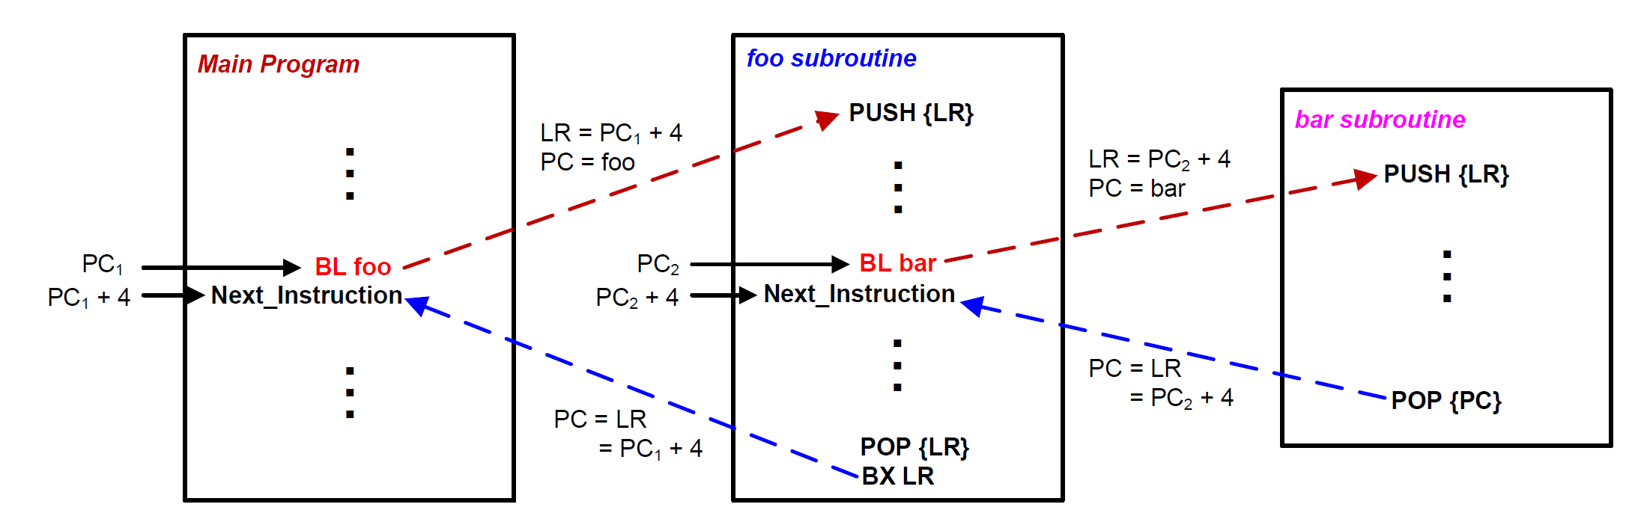
Stacks and Subroutines

Slide 42
Subroutine Calling Another Subroutine
MAIN
MOV R0,#2
BL QUAD
ENDL ...
QUAD PUSH {LR}
BL SQ
BL SQ
POP {LR}
BX LR
SQ MUL R0,R0
BX LR
Function SQ
Function MAIN
Function QUAD

Slide 43
Subroutine Calling Another Subroutine
MAIN PROC
MOV R0,#2
BL QUAD
ENDL ...
ENDP
QUAD PROC
PUSH {LR}
BL SQ
BL SQ
POP {LR}
BX LR
ENDP
SQ PROC
MUL R0,R0
BX LR
ENDP
Function MAIN
Function SQ
Function QUAD

Slide 44
Example: R0 = R0⁴
0x20000200
MOV R0,#2
BL QUAD
B ENDL
SQ MUL R0,R0
BX LR
QUAD PUSH {LR}
BL SQ
BL SQ
POP {LR}
BX LR
ENDL ...
0x200001FC
R0
0x200001F8
MOV R0,#2
0x08000138
SP
BL QUAD
0x0800013C
LR
B ENDL
0x08000140
PC
SQ
MUL R0,R0
0x08000144
BX LR
0x08000148
QUAD
PUSH {LR}
0x0800014C
BL SQ
0x08000150
Initially
SP = 0x20000200
PC = 0x08000138
BL SQ
0x08000154
POP {LR}
0x08000158
BX LR
0x0800015C

Slide 45
Example: R0 = R0⁴
MOV R0,#2
BL QUAD
B ENDL
SQ MUL R0,R0
BX LR
QUAD PUSH {LR}
BL SQ
BL SQ
POP {LR}
BX LR
ENDL ...
xxxxxxxx
0x20000200
0x200001FC
0x200001F8
R0
MOV R0,#2
0x08000138
BL QUAD
0x0800013C
B ENDL
0x08000140
SP
0x20000200
SQ
MUL R0,R0
0x08000144
LR
BX LR
0x08000148
PC
0x08000138
QUAD
PUSH {LR}
0x0800014C
BL SQ
0x08000150
BL SQ
0x08000154
POP {LR}
0x08000158
BX LR
0x0800015C

Slide 46
Example: R0 = R0⁴
MOV R0,#2
BL QUAD
B ENDL
SQ MUL R0,R0
BX LR
QUAD PUSH {LR}
BL SQ
BL SQ
POP {LR}
BX LR
ENDL ...
xxxxxxxx
0x20000200
0x200001FC
0x200001F8
R0
0x02
MOV R0,#2
0x08000138
BL QUAD
0x0800013C
B ENDL
0x08000140
SP
0x20000200
SQ
MUL R0,R0
0x08000144
LR
BX LR
0x08000148
PC
0x0800013C
QUAD
PUSH {LR}
0x0800014C
BL SQ
0x08000150
BL SQ
0x08000154
POP {LR}
0x08000158
BX LR
0x0800015C

Slide 47
Example: R0 = R0⁴
MOV R0,#2
BL QUAD
B ENDL
SQ MUL R0,R0
BX LR
QUAD PUSH {LR}
BL SQ
BL SQ
POP {LR}
BX LR
ENDL ...
xxxxxxxx
0x20000200
0x200001FC
0x200001F8
R0
0x02
MOV R0,#2
0x08000138
BL QUAD
0x0800013C
B ENDL
0x08000140
SP
0x20000200
SQ
MUL R0,R0
0x08000144
LR
0x08000140
BX LR
0x08000148
PC
0x0800014C
QUAD
PUSH {LR}
0x0800014C
BL SQ
0x08000150
PUSH(LR): Preserve Link Register (LR) 0x08000140 on the stack, which points to the next instruction after function call to QUAD
BL SQ
0x08000154
POP {LR}
0x08000158
BX LR
0x0800015C

Slide 48
Example: R0 = R0⁴
MOV R0,#2
BL QUAD
B ENDL
SQ MUL R0,R0
BX LR
QUAD PUSH {LR}
BL SQ
BL SQ
POP {LR}
BX LR
ENDL ...
xxxxxxxx
0x20000200
0x08000140
0x200001FC
0x200001F8
R0
0x02
MOV R0,#2
0x08000138
BL QUAD
0x0800013C
B ENDL
0x08000140
SP
0x200001FC
SQ
MUL R0,R0
0x08000144
LR
0x08000140
BX LR
0x08000148
PC
0x08000150
QUAD
PUSH {LR}
0x0800014C
BL SQ
0x08000150
BL SQ
0x08000154
POP {LR}
0x08000158
BX LR
0x0800015C

Slide 49
Example: R0 = R0⁴
MOV R0,#2
BL QUAD
B ENDL
SQ MUL R0,R0
BX LR
QUAD PUSH {LR}
BL SQ
BL SQ
POP {LR}
BX LR
ENDL ...
xxxxxxxx
0x20000200
0x08000140
0x200001FC
0x200001F8
R0
0x02
MOV R0,#2
0x08000138
BL QUAD
0x0800013C
B ENDL
0x08000140
SP
0x200001FC
SQ
MUL R0,R0
0x08000144
LR
0x08000154
BX LR
0x08000148
PC
0x08000144
QUAD
PUSH {LR}
0x0800014C
BL SQ
0x08000150
BL SQ
0x08000154
POP {LR}
0x08000158
BX LR
0x0800015C

Slide 50
Example: R0 = R0⁴
MOV R0,#2
BL QUAD
B ENDL
SQ MUL R0,R0
BX LR
QUAD PUSH {LR}
BL SQ
BL SQ
POP {LR}
BX LR
ENDL ...
xxxxxxxx
0x20000200
0x08000140
0x200001FC
0x200001F8
R0
0x04
MOV R0,#2
0x08000138
BL QUAD
0x0800013C
B ENDL
0x08000140
SP
0x200001FC
SQ
MUL R0,R0
0x08000144
LR
0x08000154
BX LR
0x08000148
PC
0x08000148
QUAD
PUSH {LR}
0x0800014C
BL SQ
0x08000150
BL SQ
0x08000154
POP {LR}
0x08000158
BX LR
0x0800015C

Slide 51
Example: R0 = R0⁴
MOV R0,#2
BL QUAD
B ENDL
SQ MUL R0,R0
BX LR
QUAD PUSH {LR}
BL SQ
BL SQ
POP {LR}
BX LR
ENDL ...
xxxxxxxx
0x20000200
0x08000140
0x200001FC
0x200001F8
R0
0x04
MOV R0,#2
0x08000138
BL QUAD
0x0800013C
B ENDL
0x08000140
SP
0x200001FC
SQ
MUL R0,R0
0x08000144
LR
0x08000154
BX LR
0x08000148
PC
0x08000154
QUAD
PUSH {LR}
0x0800014C
BL SQ
0x08000150
BL SQ
0x08000154
POP {LR}
0x08000158
BX LR
0x0800015C

Slide 52
Example: R0 = R0⁴
MOV R0,#2
BL QUAD
B ENDL
SQ MUL R0,R0
BX LR
QUAD PUSH {LR}
BL SQ
BL SQ
POP {LR}
BX LR
ENDL ...
xxxxxxxx
0x20000200
0x08000140
0x200001FC
0x200001F8
R0
0x04
MOV R0,#2
0x08000138
BL QUAD
0x0800013C
B ENDL
0x08000140
SP
0x200001FC
SQ
MUL R0,R0
0x08000144
LR
0x08000158
BX LR
0x08000148
PC
0x08000144
QUAD
PUSH {LR}
0x0800014C
BL SQ
0x08000150
BL SQ
0x08000154
POP {LR}
0x08000158
BX LR
0x0800015C

Slide 53
Example: R0 = R0⁴
MOV R0,#2
BL QUAD
B ENDL
SQ MUL R0,R0
BX LR
QUAD PUSH {LR}
BL SQ
BL SQ
POP {LR}
BX LR
ENDL ...
xxxxxxxx
0x20000200
0x08000140
0x200001FC
0x200001F8
R0
0x10
MOV R0,#2
0x08000138
BL QUAD
0x0800013C
B ENDL
0x08000140
SP
0x200001FC
SQ
MUL R0,R0
0x08000144
LR
0x08000158
BX LR
0x08000148
PC
0x08000148
QUAD
PUSH {LR}
0x0800014C
BL SQ
0x08000150
BL SQ
0x08000154
POP {LR}
0x08000158
BX LR
0x0800015C

Slide 54
Example: R0 = R0⁴
MOV R0,#2
BL QUAD
B ENDL
SQ MUL R0,R0
BX LR
QUAD PUSH {LR}
BL SQ
BL SQ
POP {LR}
BX LR
ENDL ...
xxxxxxxx
0x20000200
0x08000140
0x200001FC
0x200001F8
R0
0x10
MOV R0,#2
0x08000138
BL QUAD
0x0800013C
B ENDL
0x08000140
SP
0x200001FC
SQ
MUL R0,R0
0x08000144
LR
0x08000158
BX LR
0x08000148
PC
0x08000158
QUAD
PUSH {LR}
0x0800014C
BL SQ
0x08000150
BL SQ
0x08000154
POP {LR}
0x08000158
BX LR
0x0800015C

Slide 55
Example: R0 = R0⁴
MOV R0,#2
BL QUAD
B ENDL
SQ MUL R0,R0
BX LR
QUAD PUSH {LR}
BL SQ
BL SQ
POP {LR}
BX LR
ENDL ...
xxxxxxxx
0x20000200
0x08000140
0x200001FC
0x200001F8
R0
0x10
MOV R0,#2
0x08000138
BL QUAD
0x0800013C
B ENDL
0x08000140
SP
0x20000200
SQ
MUL R0,R0
0x08000144
LR
0x08000140
BX LR
0x08000148
PC
0x0800015C
QUAD
PUSH {LR}
0x0800014C
BL SQ
0x08000150
POP (LR): Restore Link Register (LR) 0x08000140 on the stack, which points to the next instruction after function call to QUAD
BL SQ
0x08000154
POP {LR}
0x08000158
BX LR
0x0800015C

Slide 56
Example: R0 = R0⁴
MOV R0,#2
BL QUAD
B ENDL
SQ MUL R0,R0
BX LR
QUAD PUSH {LR}
BL SQ
BL SQ
POP {LR}
BX LR
ENDL ...
xxxxxxxx
0x20000200
0x08000140
0x200001FC
0x200001F8
R0
0x10
MOV R0,#2
0x08000138
BL QUAD
0x0800013C
B ENDL
0x08000140
SP
0x20000200
SQ
MUL R0,R0
0x08000144
LR
0x08000140
BX LR
0x08000148
PC
0x08000140
QUAD
PUSH {LR}
0x0800014C
BL SQ
0x08000150
BL SQ
0x08000154
POP {LR}
0x08000158
BX LR
0x0800015C

Slide 57
Stack Pointer (SP)
SP is the shadow of MSP (Main SP) or PSP (Process SP)
If there is no embedded OS, PSP is not used
Determined by the ASP (Active SP) bit in the CONTROL register (ASP is always 0 in handler mode).
0 = MSP (default)
1 = PSP
Bit 31 - 3 | 2 | 1 | 0
Reserved |  | ASP
CONTROL Register
Register Bank
Special Registers

Slide 58
Initializing the stack pointer (SP)
Before using the stack, software has to define stack space and initialize the stack pointer (SP).
The assembly file startup.s defines stack space and initialize SP.

Slide 59
Passing Arguments into a Subroutine

Slide 60
Passing Arguments into a Subroutine
int32_t sum(int16_t a16, int16_t b16, int8_t c8, int32_t d32);
a16
b16
c8
d32
Register R0
Register R1
Register R2
Register R3
Subroutine
Return Value
Register R0

Slide 61
Passing 4 Arguments
int32_t sum(int16_t a16, int16_t b16, int8_t c8, int32_t d32);
s = sum(1, 2, 3, 4);
Caller
Callee
MOVS r0, #1 ; a16
MOVS r1, #2 ; b16
MOVS r2, #3 ; c8
MOVS r3, #4 ; d32
BL sum
sum PROC
ADD r0, r0, r1 ; a16 + b16
ADD r0, r0, r2 ; add c8
ADD r0, r0, r3 ; add d32
BX LR ; return
ENDP

Slide 62
Passing Extra Arguments via Stack: Simple Implementation
int32_t sum(int32_t a, int32_t b, int32_t c, int32_t d,
int32_t h, int32_t i, int32_t j, int32_t k);
s = sum(1, 2, 3, 4, 5, 6, 7, 8);
8 arguments are passed: Registers r0-r3 hold the first 4 arguments (a, b, c, d with values 1, 2, 3, 4). The last 4 arguments (h, i, j, k with values 5, 6, 7, 8) are pushed onto the stack by the caller before calling the function.
Caller
Callee
MOVS r0, #5
MOVS r1, #6
MOVS r2, #7
MOVS r3, #8
PUSH {r0, r1, r2, r3}
MOVS r0, #1
MOVS r1, #2
MOVS r2, #3
MOVS r3, #4
BL sum
...
POP {r0, r1, r2, r3}
sum PROC
EXPORT sum
ADD r0, r0, r1 ; add a + b
ADD r0, r0, r2 ; add c
ADD r0, r0, r3 ; add d
LDRD r1,r2, [sp] ; r1=mem[sp],r2=mem[sp+4]
ADD r0, r0, r1 ; add h
ADD r0, r0, r2 ; add i
LDRD r1,r2, [sp, #8] ; r1=mem[sp+8],r2=mem[sp+12]
ADD r0, r0, r1 ; add j
ADD r0, r0, r2 ; add k
BX LR
ENDP
LDRD: Load Register Doubleword

Slide 63
Passing Extra Arguments via Stack
int32_t sum(int32_t a, int32_t b, int32_t c, int32_t d,
int32_t h, int32_t i, int32_t j, int32_t k);
s = sum(1, 2, 3, 4, 5, 6, 7, 8);
Caller
Stack
MOVS r0, #5
MOVS r1, #6
MOVS r2, #7
MOVS r3, #8
PUSH {r0, r1, r2, r3}
MOVS r0, #1
MOVS r1, #2
MOVS r2, #3
MOVS r3, #4
BL sum
...
POP {r0, r1, r2, r3}
Old SP | <xxxxxxxx>
SP+12 | 0x00000008
SP+8 | 0x00000007
SP+4 | 0x00000006
SP | 0x00000005

Slide 64
Passing Extra Arguments via Stack
int32_t sum(int32_t a, int32_t b, int32_t c, int32_t d,
int32_t h, int32_t i, int32_t j, int32_t k);
s = sum(1, 2, 3, 4, 5, 6, 7, 8);
In callee (subroutine) code, the subroutine saves registers r5, r6, and the link register LR via push at the start. It adds the first 4 arguments from registers r0-r3. It then loads the extra arguments from specific stack offsets with LDRD instructions (load register double), adding these to the result. The subroutine ends by popping saved registers r5, r6 and PC (program counter) to return.
Caller
Callee
MOVS r0, #5
MOVS r1, #6
MOVS r2, #7
MOVS r3, #8
PUSH {r0, r1, r2, r3}
MOVS r0, #1
MOVS r1, #2
MOVS r2, #3
MOVS r3, #4
BL sum
...
POP {r0, r1, r2, r3}
sum PROC
EXPORT sum
PUSH {r5, r6, lr}
ADD r0, r0, r1 ; add a + b
ADD r0, r0, r2 ; add c
ADD r0, r0, r3 ; add d
LDRD r5,r6, [sp, #12] ;r5=mem[sp+12],r6=mem[sp+16]
ADD r0, r0, r5 ; add h
ADD r0, r0, r6 ; add i
LDRD r5,r6, [sp, #20] ;r5=mem[sp+20],r6=mem[sp+24]
ADD r0, r0, r5 ; add j
ADD r0, r0, r6 ; add k
POP {r5, r6, pc}
ENDP

Slide 65
Passing Extra Arguments via Stack: Better Implementation
int32_t sum(int32_t a, int32_t b, int32_t c, int32_t d,
int32_t h, int32_t i, int32_t j, int32_t k);
s = sum(1, 2, 3, 4, 5, 6, 7, 8);
Stack
Callee
Old SP | <xxxxxxxx>
SP+24 | 0x00000008
SP+20 | 0x00000007
SP+16 | 0x00000006
SP+12 | 0x00000005
SP+8 | lr
SP+4 | r6
SP | r5
sum PROC
EXPORT sum
PUSH {r5, r6, lr}
ADD r0, r0, r1 ; add a + b
ADD r0, r0, r2 ; add c
ADD r0, r0, r3 ; add d
LDRD r5,r6, [sp, #12] ; r5=mem[sp+12],r6=mem[sp+16]
ADD r0, r0, r5 ; add h
ADD r0, r0, r6 ; add i
LDRD r5,r6, [sp, #20] ; r5=mem[sp+20],r6=mem[sp+24]
ADD r0, r0, r5 ; add j
ADD r0, r0, r6 ; add k
POP {r5, r6, pc}
ENDP

Slide 66
Simple Implementation vs. Better implementation
Caller pushes extra arguments (5th to 8th) onto the stack before calling the function.
Simple Implementation: Callee accesses those extra arguments directly from the stack using LDRD instructions at specific offsets from SP. It demonstrates the basic mechanism for handling extra arguments on the stack.
Better implementation: Callee begins by pushing registers r5, r6, and the link register (LR) onto the stack to preserve them. After addition operations, it pops r5, r6, and the program counter (PC) to return, restoring the preserved registers and the return address. This ensures that the subroutine does not unintentionally overwrite or lose the caller's data and return address, maintaining program correctness during and after the function call.
Notes:
The callee does not explicitly push/pop any registers beyond handling arguments.
It then adds the first four arguments from registers r0-r3, loads the extra arguments from the stack offsets using LDRD into r5 and r6, and adds them. Finally,
The benefit of slide 63 is that it demonstrates a proper and safe callee function implementation that preserves the caller's environment by saving important registers (r5, r6, and LR) onto the stack at the start and restoring them before returning. This ensures that the subroutine does not unintentionally overwrite or lose the caller's data and return address, maintaining program correctness during and after the function call.
In contrast to slide 61, which only shows how extra arguments can be accessed from the stack, slide 63 adds critical register preservation and proper return handling, which is essential for reliable function calls in ARM assembly programming.
Thus, slide 63 exemplifies good programming practice for subroutines that modify registers and use stack-passed arguments, preventing bugs and data corruption in real applications

Slide 67
Summary
ARM Cortex-M uses full descending stack
How to pass arguments into a subroutine?
Each 8-, 16- or 32-bit variables is passed via r0, r1, r2, r3
Extra parameters are passed via stack
What registers should be preserved?
Caller-saved registers vs callee-saved registers
How to preserve the running environment for the caller?
Via stack

Slide 68
References
Lecture 31. Preserving registers in a Subroutine
https://www.youtube.com/watch?v=DGKjFKjxAYs&list=PLRJhV4hUhIymmp5CCeIFPyxbknsdcXCc8&index=31

