Slide 1
Dr. Yifeng Zhu
ARM Cortex-M
System Timer (SysTick)
Embedded Systems with ARM Cortex-M
Microcontrollers in Assembly Language and C
Visit book website: web.eece.maine.edu/~zhu/book/
Notes:
{{Pause=3}} This short video will explain how the system timer work.

Slide 2
System Timer (SysTick)
Generate SysTick interrupts at a fixed time interval
Example Usages:
Measuring time elapsed, such as time delay function
Executing tasks periodically, such as periodic polling, and OS CPU scheduling
SysTick interrupts
time
Fixed time interval
Notes:
{{Pause=2}} The system timer, also called System Tick, or, SysTick, is to generate SysTick interrupts at a fixed time interval. {{Pause=1}} Here I give two example applications of the system timer. {{Pause=1}} The first example is that, the system timer can measure time elapsed. For instance, software can use the system timer, to implement a time delay function. {{Pause=1}} The second example is that we can execute some specific tasks periodically. For instance, we can use system timer, to implement periodic polling, to check peripheral status, or read external inputs, with a regular timed interval. In addition, operating systems rely on the system timer to implement CPU scheduler. In order to support multitasking and improve the CPU utilization, the CPU scheduler periodically selects a new process, from the ready queue, to run next.

Slide 3
System Timer (SysTick)
SysTick_Handler()
main()
SysTick interrupts
time
0
T
2T
3T
4T
5T
6T
Fixed time interval

Slide 4
System Timer (SysTick)
System timer is a standard hardware component built into ARM Cortex-M.
This hardware periodically forces the processor to execute the following ISR:
Peripherals
IRQs
NVIC
Processor
Core
I/O pins
IRQs
System
Exceptions
void SysTick_Handler(void){
...
}
SysTick IRQ
System Timer
ARM Cortex-M
Microcontroller
Notes:
{{Pause=2}} The system timer is a standard hardware component, built into ARM Cortex processors. Almost all ARM Cortex processors have the system timer component. If enabled, the system timer can periodically generate SysTick interrupt requests. The Nested Vectored Interrupt Controller (NVIC) monitors and handles all interrupt requests based on their priority levels. For SysTick interrupts, N V I C forces the core to execute, the interrupt service routine named SysTick Handler.

Slide 5
Diagram of System Timer (SysTick)
Reload Value
copy
Yes
Hardware
Counter
Is it zero?
24-bit down counter
Notes:
{{Pause=2}} The system timer is a 24-bit, down counter. The counter decrements, from the reload value, to zero. After the counter reaches zero, the system timer copies, the reload value, stored in the reload value register. Then, the system timer starts to count down again.

Slide 6
System Timer
SysTick Interrupt
SysTick Interrupt
SysTick Interrupt
Notes:
{{Pause=2}} This diagram shows, how the counter value change, when the reload value is 6. The reload value is stored in the SysTick load register. The counter counts down, from 6, to 0. The counter has a total of, 7 unique values. When the counter makes transition from 1 to 0, the system timer generates an interrupt request. On the next clock cycle, the counter is re-initialized to 6. The counter counts down again on subsequent clock cycles. This counting process repeats. {{Pause=1}} The interval of the system timer interrupts equals to, the reload value plus 1, times the period of the source clock.

Slide 7
Diagram of System Timer (SysTick)
Reload Value
copy
Yes
Counter
Is it zero?
Set COUNTFLAG to 1
24-bit down counter
SysTick control and status register (SysTick_CTRL)
Notes:
{{Pause=2}} Let’s first take a look at the SysTick control and status register. In this register, only four bits are used, including one status bit, and three control bit. The status bit is the count flag bit. The three control bits include the clock source selection bit, {{Pause=0.5}} the tick interrupt enable bit, and{{Pause=0.5}} the timer enable bit. {{Pause=1}} As discussed previously, the 24-bit counter counters down, from the reload value, to 0. {{Pause=1}} When the counter decrements from 1 to 0, the count flag is set to 1.

Slide 8
Diagram of System Timer (SysTick)
Reload Value
External clock
copy
AHB Clock
/8
0
Yes
Counter
Is it zero?
Set COUNTFLAG to 1
1
AND
Processor clock
24-bit down counter
SysTick control and status register (SysTick_CTRL)
Notes:
{{Pause=2}} Now, let’s take a look at the control bits, in the SysTick control and status register. {{Pause=1}} First of all, the clock source bit, selects the clock source, for the counter. {{Pause=0.5}} If the clock source bit is 1, the processor clock is selected. If the clock source bit is 0, the external clock is selected. For STM32L4, the processor clock is the AHB clock. The external clock is the AHB clock slowed down by a frequency divider, 8. {{Pause=1}} Next, let's take a close look at the enable bit. Software can set or clear this bit to enable or disable the system timer. Specifically, the enable bit can enable or disable the clock signal, by using this ænd gate. If the enable bit is one, the system timer is enabled, because the signal of the clock source, can pass through the ænd gate. {{Pause=1}} The interrupt enable bit (Tick I N T) enables the interrupt. A SysTick interrupt request is generated, if, both the interrupt enable bit, and the Count flag bit, are 1. In other words, if the interrupt enable bit is 1, a SysTick interrupt request is generated, every time the time counter decrements from 1 to 0.

Slide 9
Registers of System Timer
SysTick control and status register (SysTick_CTRL)
SysTick reload value register (SysTick_LOAD)
SysTick calibration register (SysTick_CALIB)
SysTick current value register (SysTick_VAL)
Notes:
{{Pause=2}} The system timer is controlled by four registers, including the control and status register we just described, the reload value register (SysTick Load), the current-value register (SysTick V A L), and the calibration register (SysTick C A L I B). Next, we will take a close look at these registers.

Slide 10
Registers of System Timer
SysTick reload value register (SysTick_LOAD)
24 bits, maximum value 0x00FF.FFFF (16,777,215)
Counter counts down from RELOAD value to 0.
Writing RELOAD to 0 disables SysTick, independently of TICKINT
Time interval between two SysTick interrupts
If 100 clock periods between two SysTick interrupts
Interval = (RELOAD + 1) × Source_Clock_Period
RELOAD = 99
Notes:
{{Pause=2}} Even though the reload value register has 32 bits, the top, 8 bits are not used. It can hold a 24-bit value, with a maximum value of FFFFFF in hex, or 16777215 in decimal. {{Pause=0.5}} The counter counts down, from the reload value, to 0. {{Pause=0.5}} Writing 0 to the reload value register, disables the counter, on the next wrap, independently of the timer enable bit (TICK I N T). The SysTick counter logic maintains this counter value of zero after the wrap. {{Pause=0.5}} The interval of two consecutive SysTick interrupts is, reload plus 1, times, the source clock period. For example, if 100 clock cycles are needed between two consecutive SysTick interrupts, the reload value should be 99.

Slide 11
Registers of System Timer
SysTick current value register (SysTick_VAL)
Reading it returns the current value of the counter
When it transits from 1 to 0, it generates an interrupt
Writing to SysTick_VAL clears the counter and COUNTFLAG to zero
Cause the counter to reload on the next timer clock
But, does not trigger an SysTick interrupt
It has random value on reset.
Always clear it before enabling the timer
Notes:
{{Pause=2}} Here is the, current value register. Reading this register returns the value of the counter, at the time the register is accessed. When the counter makes a transistion from 1 to 0, the system timer generates a SysTick interrupt.
{{Pause=0.5}} Writing any value to the current value register, clears this register, and also clears the COUNTFLAG bit in the control and status register. This causes the system timer to reload from the reload value register, on the next timer clock. {{Pause=0.5}} Writing to the current value register does not trigger SysTick interrupts.
{{Pause=0.5}} Pay attention. The counter has a random value on reset. Therefore, software should always clear the counter to zero in the initialization code. This can be achieved, by writing 0 to the current value register.

Slide 12
Registers of System Timer
SysTick calibration register (SysTick_CALIB)
A read-only register
TENMS (10 ms) holds the reload value, which will yield a 10ms period
May not be implemented or may be defined differently by chip designers
Notes:
{{Pause=2}} The SysTick calibration register is a read-only register. It contains the value T E N M S, which holds the reload value yielding a period of 10 milliseconds. T E N M S stands for ten milliseconds. However, many chips do not implement this feature, or have a different definition in this field. For example, STM32L4 defines this field as the reload value for 1 millisecond, instead of 10 milliseconds.

Slide 13
Example Code
void SysTick_Initialize (uint32_t ticks) {
SysTick->CTRL = 0; // Disable SysTick
SysTick->LOAD = ticks - 1; // Set reload register
// Set interrupt priority of SysTick to least urgency (i.e., largest priority value)
NVIC_SetPriority (SysTick_IRQn, (1<<__NVIC_PRIO_BITS) - 1);
SysTick->VAL = 0; // Reset the SysTick counter value
// Select processor clock: 1 = processor clock; 0 = external clock
SysTick->CTRL |= SysTick_CTRL_CLKSOURCE;
// Enables SysTick interrupt, 1 = Enable, 0 = Disable
SysTick->CTRL |= SysTick_CTRL_TICKINT;
// Enable SysTick
SysTick->CTRL |= SysTick_CTRL_ENABLE;
}
Notes:
{{Pause=2}} Here is the example code, which initializes and enables the system timer. {{Pause=0.5}} First, software disables SysTick by clearing the control and status register. {{Pause=0.5}} Then, software initializes the reload value register, based on the function’s input argument, ticks. In order to have, N, ticks between two consecutive SysTick interrupts, the reload value should be, N minus 1. {{Pause=0.5}} Next, we give the SysTick interrupts the largest priority value, making the systick interrupt the least urgent. {{Pause=0.5}} Then, software clears the current value register. The SysTick counter has a random value on reset. Software should always clear the counter during the initialization. {{Pause=0.5}} Then, we select the processor clock as the source clock of the SysTick counter. We can use either the processor clock or the external clock. {{Pause=0.5}} After that, software has to enable the SysTick interrupts, by setting the TICK I N T bit, in the control and status register. {{Pause=0.5}} At the end, software enables SysTick, by setting the enable bit to 1, in the control and status register.

Slide 14
Implementing Delay Function
volatile int32_t TimeDelay;
int main (void {
SysTick_Initialize(1000); // Interrupt period = 1000 cycles
Delay(100); // Delay 100 ticks
...
}
void SysTick_Handler (void) { // SysTick interrupt service routine
if (TimeDelay > 0) // Prevent it from being negative
TimeDelay--; // TimeDelay is a global volatile variable
}
void Delay (uint32_t nTime) {
// nTime: specifies the delay time length
TimeDelay = nTime; // TimeDelay must be declared as volatile
while(TimeDelay != 0); // Busy wait
}
Notes:
{{Pause=2}} This example demos, how to use the SysTick to implement a delay function. We first define a global, volatile variable, named TimeDelay. {{Pause=1}} The interrupt service routine of system timer, SysTick Handler, decrements the TimeDelay variable by one, each time a SysTick interrupt takes place. {{Pause=1}} The Delay function initializes the TimeDelay variable, and waits until TimeDelay is decremented to zero by SysTick Handler.

Slide 15
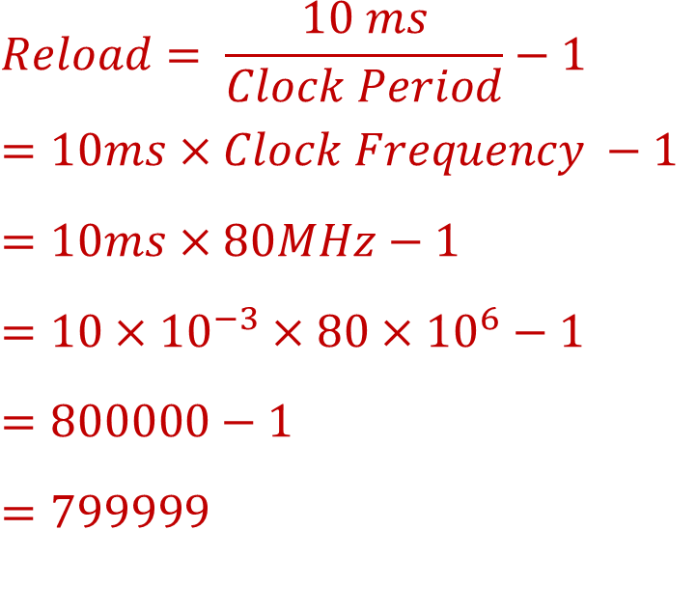
Calculating Reload Value
Suppose clock source = 80MHz
Goal: SysTick Interval = 10ms
What is RELOAD value?
$$Reload= \frac{10 ms}{Clock Period}−1$$
$$=10ms×Clock Frequency −1$$
$$=10ms×80MHz−1$$
$$=10×{10}^{−3}×80×{10}^{6}−1$$
$$=800000−1$$
$$=799999$$
Notes:
{{Pause=2}} Suppose the clock source that drives the timer counter has a frequency of 80 MHz. We want to generate a SysTick interrupt every 10 milliseconds. What is the reload value? {{Pause=2}} Here is the diagram of SysTicks. {{Pause=0.5}} This is the clock signal, which has a frequency of 80 MHz. A SysTick interrupt is generated every 10 milliseconds. {{Pause=0.5}} An interrupt is generated when the counter makes the transition from 1 to 0. {{Pause=1} It takes a total of, reload plus 1, cycles to count down from the reload value to 0. {{Pause=0.5}} The reload value is calculated in this way. Reload value equals to 10 milliseconds, divided by the clock period, minus 1. This is equivalent to 10 milliseconds, multiply the clock frequency, minus 1. {{Pause=0.5}} The final result is 799999.

