Slide 1
Zonghua Gu
Embedded Systems with ARM Cortex-M Microcontrollers in Assembly Language and C
Chapter 4
ARM Arithmetic and Logic Instructions
Fall 2025
Acknowledgement: Lecture slides based on Embedded Systems with ARM Cortex-M Microcontrollers in Assembly Language and C, University of Maine https://web.eece.maine.edu/~zhu/book/

Slide 2
Logic View of Memory
Can we store a word anywhere in memory?
NO on most computers!
A word can only be stored at an address that's divisible by 4.
8 bits
High Address
0x20000007
01110010
0x20000006
00100101
Word-address mod 4 = 0
0x20000005
11100010
0x20000004
10000100
We cannot store a word at address 0x20000002.
0x20000003
01100001
0x20000002
10001111
0x20000001
00010010
0x20000000
10010100
Low Address

Slide 3
Logic View of Memory
Can you store a halfword anywhere? NO.
A halfword can only be stored at an address that's divisible by 2.
Memory address of a halfword is the lowest address of its two bytes.
8 bits
High Address
0x20000007
01110010
Halfword-address mod 2 = 0
0x20000006
00100101
0x20000005
11100010
0x20000004
10000100
0x20000003
01100001
We cannot store a halfword at address 0x20000001.
0x20000002
10001111
0x20000001
00010010
0x20000000
10010100
Low Address

Slide 4
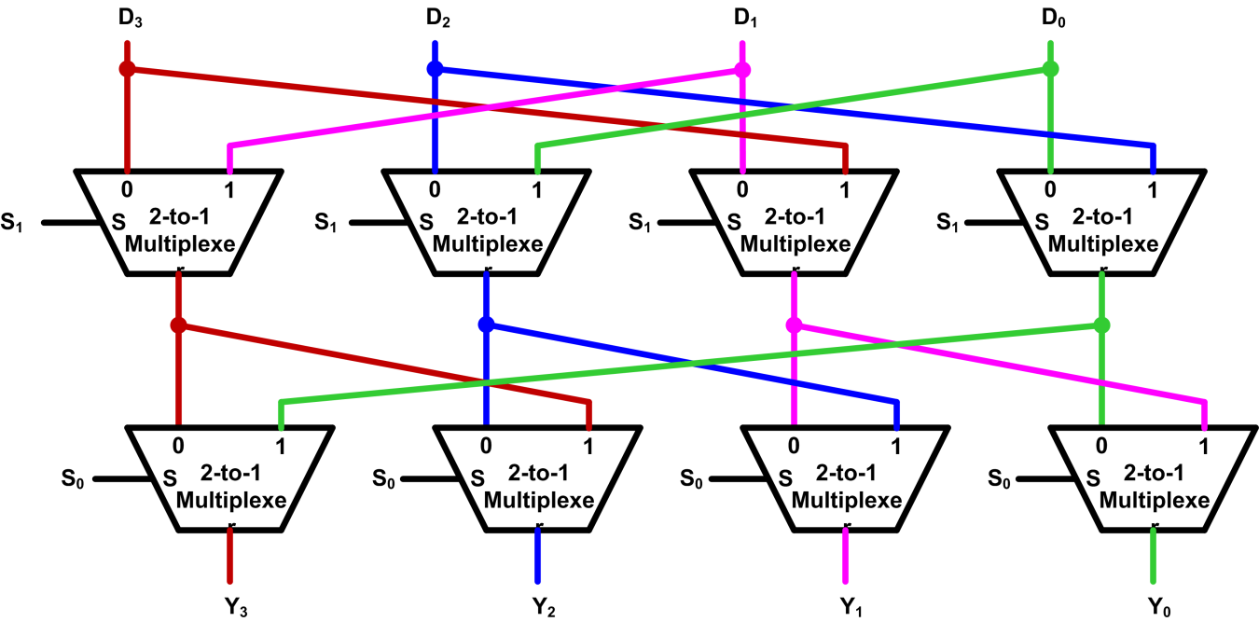
Implementation of Barrel Shifter
Typically, Barrel shifters are implemented as a cascade of parallel 2-to-1 multiplexers.
S₁ | S₀ | Y₃ | Y₂ | Y₁ | Y₀
0 | 0 | D₃ | D₂ | D₁ | D₀
0 | 1 | D₀ | D₃ | D₂ | D₁
1 | 0 | D₁ | D₀ | D₃ | D₂
1 | 1 | D₂ | D₁ | D₀ | D₃
Example four-bit Barrel shifter that performs rotate right

Slide 5
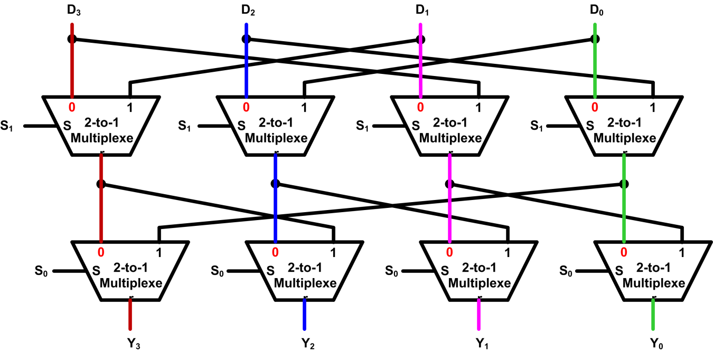
Implementation of Barrel Shifter
Example: S₁S₀ = 00
S₁ | S₀ | Y₃ | Y₂ | Y₁ | Y₀
0 | 0 | D₃ | D₂ | D₁ | D₀
0 | 1 | D₀ | D₃ | D₂ | D₁
1 | 0 | D₁ | D₀ | D₃ | D₂
1 | 1 | D₂ | D₁ | D₀ | D₃
Example four-bit Barrel shifter that performs rotate right

Slide 6
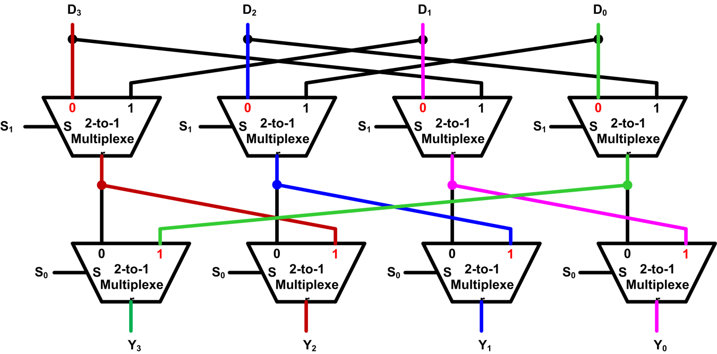
Implementation of Barrel Shifter
Example: S₁S₀ = 01
S₁ | S₀ | Y₃ | Y₂ | Y₁ | Y₀
0 | 0 | D₃ | D₂ | D₁ | D₀
0 | 1 | D₀ | D₃ | D₂ | D₁
1 | 0 | D₁ | D₀ | D₃ | D₂
1 | 1 | D₂ | D₁ | D₀ | D₃
Example four-bit Barrel shifter that performs rotate right

Slide 7
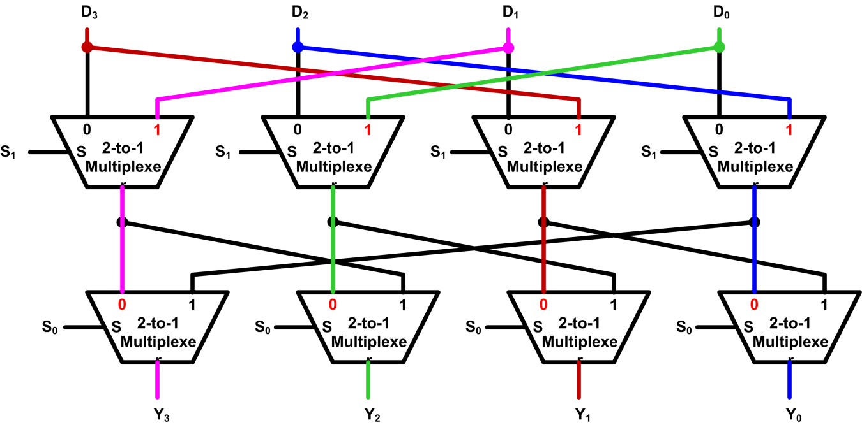
Implementation of Barrel Shifter
Example: S₁S₀ = 10
S₁ | S₀ | Y₃ | Y₂ | Y₁ | Y₀
0 | 0 | D₃ | D₂ | D₁ | D₀
0 | 1 | D₀ | D₃ | D₂ | D₁
1 | 0 | D₁ | D₀ | D₃ | D₂
1 | 1 | D₂ | D₁ | D₀ | D₃
Example four-bit Barrel shifter that performs rotate right

Slide 8
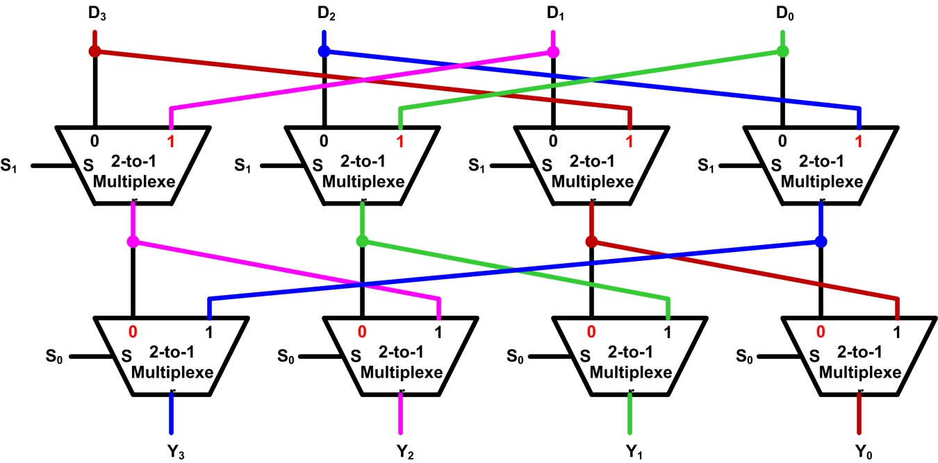
Implementation of Barrel Shifter
Example: S₁S₀ = 11
S₁ | S₀ | Y₃ | Y₂ | Y₁ | Y₀
0 | 0 | D₃ | D₂ | D₁ | D₀
0 | 1 | D₀ | D₃ | D₂ | D₁
1 | 0 | D₁ | D₀ | D₃ | D₂
1 | 1 | D₂ | D₁ | D₀ | D₃
Example four-bit Barrel shifter that performs rotate right

Slide 9
ADR Pseudo-instruction
ADR: loads a program-relative or register-relative address into a register
start MOV r0,#10 ; 32-bit instruction
ADR r4,start ; 32-bit instruction
; => SUB r4,pc,#0xc

Slide 10
64-bit Logic Shift Left

Slide 11
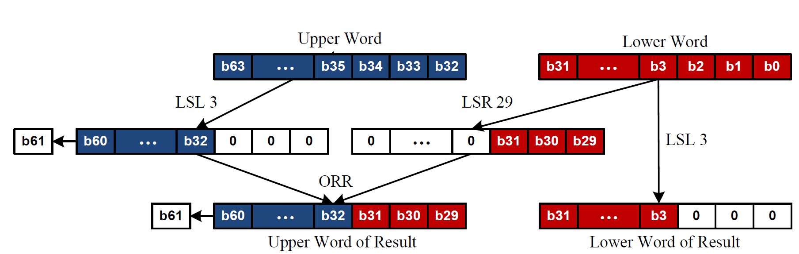
64-bit Logic Shift Left
Example of Logic Shift Left by 3

Slide 12
64-bit Logic Shift Right

Slide 13
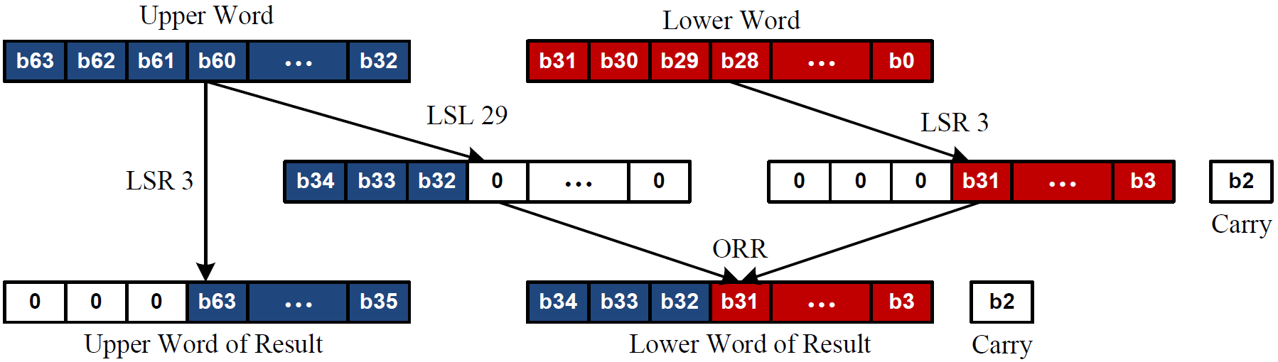
64-bit Logic Shift Right
Example of Logic Shift Right by 3

Slide 14
ARM Register Conventions (APCS-Application Procedure Call Standard)
Reg. # | APCS Name | Role in Procedure Calls | Comments
r0 - r3 | a1 - a4 | First 4 arguments into a procedure / Scratch pad / Return result(s) from a function (not preserved across call) | Caller-saved registers - subprogram can use them as scratch registers, but it must also save any needed values before calling another subprogram.
r4 - r8 | v1 - v5 | Register Variables (preserved across call | Callee-saved registers - it can rely on an subprogram it calls not to change them (so a subprogram wishing to use these registers must save them on entry and restore them before it exits)
r9 – r12 | Omitted | Details omitted | Details omitted
r11 | fp | Frame pointer (if used) / Register Variable (preserved across call) | Callee-saved register - pointer to bottom of call-frame
r13 | sp | Stack pointer - points to the top of the stack
r14 | lr | Link register - holds the return address | Receives return address on BL call to procedure
r15 | pc | Program counter

