Slide 1
Z. Gu
Embedded Systems with ARM Cortex-M Microcontrollers in Assembly Language and C
Chapter 4
ARM Arithmetic and Logic Instructions
Exercises
Fall 2025
Acknowledgement: Lecture slides based on Embedded Systems with ARM Cortex-M Microcontrollers in Assembly Language and C, University of Maine https://web.eece.maine.edu/~zhu/book/

Slide 2
Summary of Carry and Overflow Flags
Review
Bit | Name | Meaning after add or sub
N | negative | result is negative
Z | zero | result is zero
V | overflow | signed overflow
C | carry | unsigned overflow
Carry flag C = 1 upon an unsigned addition if the answer is wrong (true result > 2^{n}-1)
Carry flag C = 0 (Borrow flag = 1) upon an unsigned subtraction if the answer is wrong (true result < 0)
Overflow flag V =1 upon a signed addition if the answer is wrong (true result > 2^{n-1}-1 or true result < -2^{n-1})
31
0
N
Z
C
V
2
CPSR (Current Program Status Register)
Notes:
C is cleared upon an unsigned subtract if the answer is wrong

Slide 3
References
Review
Lecture 2: Carry flag for unsigned addition and subtraction
https://www.youtube.com/watch?v=MxGW2WurKuM&list=PLRJhV4hUhIymmp5CCeIFPyxbknsdcXCc8&index=2
Lecture 3: Overflow flag for signed addition and subtraction
https://www.youtube.com/watch?v=BIn6iyYIGio&list=PLRJhV4hUhIymmp5CCeIFPyxbknsdcXCc8&index=3

Slide 4
Flags ANDS
What are value of r2, and NZCV flags after execution, assuming all flags are initially 0.
LDR r0, =0xFFFFFFF00
LDR r1, =0x00000001
ANDS r2, r1, r0, LSL #1

Slide 5
Flags ADDS
What are value of r2, and NZCV flags after execution, assuming all flags are initially 0.
LDR r0, =0xFFFFFFF00
LDR r1, =0x00000001
ADDS r2, r1, r0, LSL #1

Slide 6
Flags
r0 | 0xffffffff
r1 | 0x00000001
r2 | 0x00000003
r3 | 0xfffffff0
Suppose registers have the following values:
What are value of r4, and NZCV flags after execution, assuming all flags are initially 0. (Each instruction runs individually.)
(a) ADD r4, r0, r2, ASR #3
(b) ADDS r4, r0, r1
(c) LSRS r4, r0, #1
(d) ANDS r4, r0, r3
(e) CMP r2, #3
Notes:
r0 = 0xffffffff
r1 = 0x00000001
r2 = 0x00000003
r3 = 0xfffffff0
The N, Z, C, and V flags start out as zero.
After the execution of the following instructions, fill in the flag values.

Slide 7
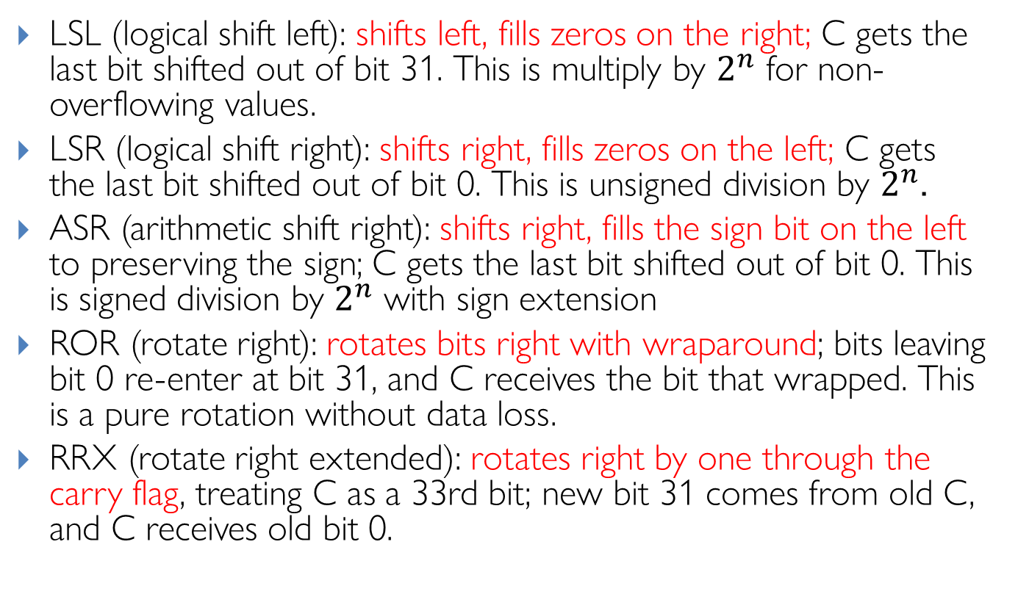
Barrel Shifter: Explanations
Review
LSL (logical shift left): shifts left, fills zeros on the right; C gets the last bit shifted out of bit 31. This is multiply by $2^{n}$ for non-overflowing values.
LSR (logical shift right): shifts right, fills zeros on the left; C gets the last bit shifted out of bit 0. This is unsigned division by $2^{n}$.
ASR (arithmetic shift right): shifts right, fills the sign bit on the left to preserving the sign; C gets the last bit shifted out of bit 0. This is signed division by $2^{n}$ with sign extension
ROR (rotate right): rotates bits right with wraparound; bits leaving bit 0 re-enter at bit 31, and C receives the bit that wrapped. This is a pure rotation without data loss.
RRX (rotate right extended): rotates right by one through the carry flag, treating C as a 33rd bit; new bit 31 comes from old C, and C receives old bit 0.
Notes:
Useful for multiword shifts and certain crypto/bit-manip patterns
LSR (used here): Always fills with zeros, converting the negative value to a large positive number
ASR: Would preserve the sign bit, maintaining the negative value (-4096)

Slide 8
Arithmetic with Shifts
Assuimg 32-bit registers:
Q1:
LDR r0, =0x00000007
MOV r0, r0, LSL 7
Q2:
LDR r0, =0x00000400
MOV r0, r0, LSR 2
Q3:
LDR r0, =0xFFFFC000
MOV r0, r0, LSR 2
Q4:
LDR r0, =0xFFFFC000
MOV r0, r0, ASR 2
Q5:
LDR r0, =0x00000007
MOV r0, r0, ROR 2

Slide 9
Assembly Programming
Write ARMv7 assembly for pseudocode
r1 = (r0 >> 4) & 15

