Slide 1
Z. Gu
Embedded Systems with ARM Cortex-M Microcontrollers in Assembly Language and C
Chapter 4
ARM Arithmetic and Logic Instructions
Exercises ANS
Fall 2025
Acknowledgement: Lecture slides based on Embedded Systems with ARM Cortex-M Microcontrollers in Assembly Language and C, University of Maine https://web.eece.maine.edu/~zhu/book/

Slide 2
Summary of Carry and Overflow Flags
Review
Bit | Name | Meaning after add or sub
N | negative | result is negative
Z | zero | result is zero
V | overflow | signed overflow
C | carry | unsigned overflow
Carry flag C = 1 upon an unsigned addition if the answer is wrong (true result > 2^{n}-1)
Carry flag C = 0 (Borrow flag = 1) upon an unsigned subtraction if the answer is wrong (true result < 0)
Overflow flag V =1 upon a signed addition if the answer is wrong (true result > 2^{n-1}-1 or true result < -2^{n-1})
31
0
N
Z
C
V
2
CPSR (Current Program Status Register)
Notes:
C is cleared upon an unsigned subtract if the answer is wrong

Slide 3
References
Review
Lecture 2: Carry flag for unsigned addition and subtraction
https://www.youtube.com/watch?v=MxGW2WurKuM&list=PLRJhV4hUhIymmp5CCeIFPyxbknsdcXCc8&index=2
Lecture 3: Overflow flag for signed addition and subtraction
https://www.youtube.com/watch?v=BIn6iyYIGio&list=PLRJhV4hUhIymmp5CCeIFPyxbknsdcXCc8&index=3

Slide 4
Flags ANDS
What are value of r2, and NZCV flags after execution, assuming all flags are initially 0.
LDR r0, =0xFFFFFFF00
LDR r1, =0x00000001
ANDS r2, r1, r0, LSL #1

Slide 5
Flags ANDS ANS
What are value of r2, and NZCV flags after execution, assuming all flags are initially 0.
ANS: r2 = 0x00000000
NZCV = 0110
LDR r0, =0xFFFFFFF00
LDR r1, =0x00000001
ANDS r2, r1, r0, LSL #1
Left shift (LSL #1) moves the bits in r0 left by 1 bit. The bitwise AND is then computed: r2 = r1 & (r0 << 1).
N (Negative flag): Set to 0 because result r2 = 0x00000000, which is not negative.
Z (Zero flag): Set to 1 because the result is zero (r2 = 0).
C (Carry flag): Set to 1. The carry flag is updated based on the last bit shifted out during the left shift operation on r0. Since the left shift of 0xFFFFFFF00 by 1 bit causes a '1' to be shifted out, the carry flag is set to 1.
V (Overflow flag): Unchanged by AND operation.

Slide 6
Flags ADDS
What are value of r2, and NZCV flags after execution, assuming all flags are initially 0.
LDR r0, =0xFFFFFFF00
LDR r1, =0x00000001
ADDS r2, r1, r0, LSL #1

Slide 7

Flags ADDS ANS
What are value of r2, and NZCV flags after execution, assuming all flags are initially 0.
ANS: r2 = 0xFFFFFFE01
NZCV = 1000
LDR r0, =0xFFFFFFF00
LDR r1, =0x00000001
ADDS r2, r1, r0, LSL #1
Left shift (LSL #1) moves the bits in r0 left by 1 bit, so r0 = 0xFFFFFFE00. The ADDS is then computed: r2 = r1 + (r0 << 1) = 0xFFFFFFE01
N (Negative): Since result r2 = 0xFFFFFFE01 when interpreted as signed 32-bit (two's complement) is negative (most significant bit is 1), N = 1.
Z (Zero): Result is not zero, Z = 0.
C (Carry): Carry is set if there is an unsigned overflow. Here carry flag C = 0.
V (Overflow): Overflow is set if there is a signed overflow. Here:
$r1$ is positive; $r0<<1$ is negative since high bit is set; 2 operands have different signs, no overflow, so V = 0.
Recall “Overflow cannot occur when adding 2 operands with different signs or when subtracting 2 operands with the same sign. ”
Notes:
Here, adding a small positive number $1$ to a large value didn't overflow beyond 32 bits. So
, i.e., signs of inputs are same, but result sign differs.

Slide 8
Flags
r0 | 0xffffffff
r1 | 0x00000001
r2 | 0x00000003
r3 | 0xfffffff0
Suppose registers have the following values:
What are value of r4, and NZCV flags after execution, assuming all flags are initially 0. (Each instruction runs individually.)
(a) ADD r4, r0, r2, ASR #3
(b) ADDS r4, r0, r1
(c) LSRS r4, r0, #1
(d) ANDS r4, r0, r3
(e) CMP r2, #3
Notes:
r0 = 0xffffffff
r1 = 0x00000001
r2 = 0x00000003
r3 = 0xfffffff0
The N, Z, C, and V flags start out as zero.
After the execution of the following instructions, fill in the flag values.

Slide 9
Flags ANS
r0 | 0xffffffff
r1 | 0x00000001
r2 | 0x00000003
r3 | 0xfffffff0
(a) ADD r4, r0, r2, ASR #3
First, r2 ASR #3: 0x00000003 >> 3 = 0x00000000 (arithmetic shift preserves sign)
Then: r4 = r0 + 0 = 0xffffffff + 0 = 0xffffffff
Result: r4 = 0xffffffff, NZCV = 0000 (ADD doesn't affect flags)
(b) ADDS r4, r0, r1
r4 = 0xffffffff + 0x00000001 = 0x00000000 (truncated to 32-bit)
N = 0 (result bit 31 = 0, not negative)
Z = 1 (result is zero)
C = 1 (carry out from bit 31: 0xffffffff + 1 produces carry)
V = 0 (no signed overflow: -1 + 1 = 0, valid in 32-bit signed range)
Result: r4 = 0x00000000, NZCV = 0110
(c) LSRS r4, r0, #1
Logical shift right with flag update: 0xffffffff >> 1 = 0x7fffffff
N = 0 (result bit 31 = 0)
Z = 0 (result is not zero)
C = 1 (last bit shifted out was 1)
V = 0 (logical shifts don't affect overflow flag)
Result: r4 = 0x7fffffff, NZCV = 0010

Slide 10
Flags ANS
r0 | 0xffffffff
r1 | 0x00000001
r2 | 0x00000003
r3 | 0xfffffff0
(d) ANDS r4, r0, r3
Bitwise AND with flag update: 0xffffffff & 0xfffffff0 = 0xfffffff0
N = 1 (result bit 31 = 1, negative)
Z = 0 (result is not zero)
C = 0 (logical operations clear carry flag)
V = 0 (logical operations don't affect overflow)
Result: r4 = 0xfffffff0, NZCV = 1000
(e) CMP r2, #3
Compare operation: r2 - 3 = 3 - 3 = 0 (result not stored, only flags updated)
N = 0 (subtraction result is 0, bit 31 = 0)
Z = 1 (subtraction result is 0)
C = 1 (no borrow: 3 ≥ 3, so C = 1 = not borrow)
V = 0 (no signed overflow in 3 - 3)
Result: NZCV = 0110

Slide 11
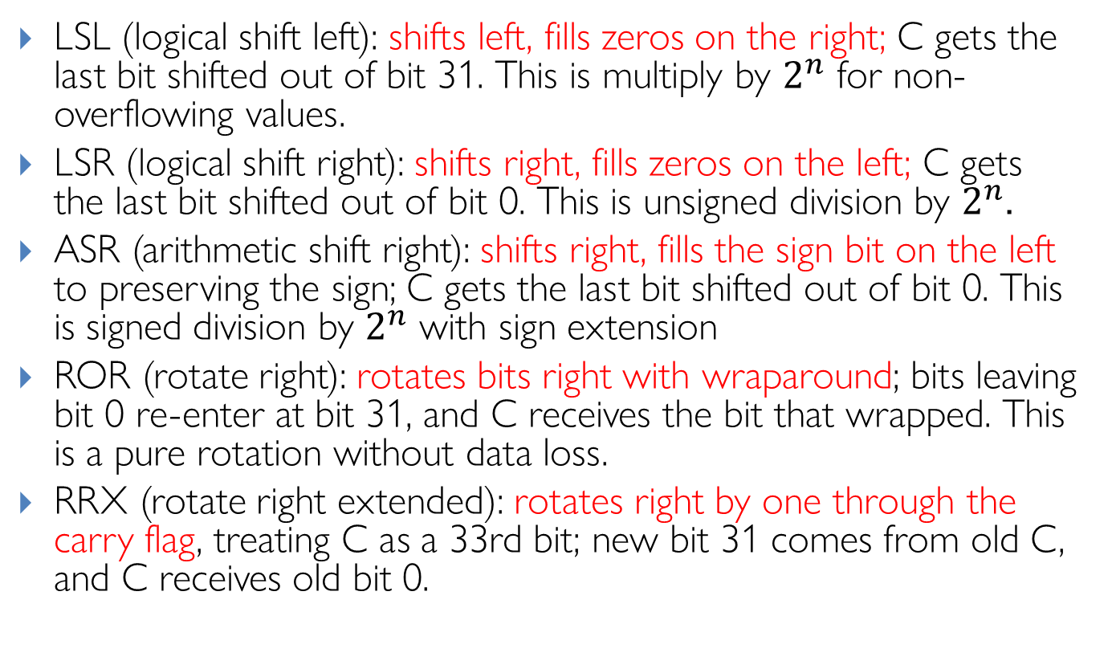
Barrel Shifter: Explanations
Review
LSL (logical shift left): shifts left, fills zeros on the right; C gets the last bit shifted out of bit 31. This is multiply by $2^{n}$ for non-overflowing values.
LSR (logical shift right): shifts right, fills zeros on the left; C gets the last bit shifted out of bit 0. This is unsigned division by $2^{n}$.
ASR (arithmetic shift right): shifts right, fills the sign bit on the left to preserving the sign; C gets the last bit shifted out of bit 0. This is signed division by $2^{n}$ with sign extension
ROR (rotate right): rotates bits right with wraparound; bits leaving bit 0 re-enter at bit 31, and C receives the bit that wrapped. This is a pure rotation without data loss.
RRX (rotate right extended): rotates right by one through the carry flag, treating C as a 33rd bit; new bit 31 comes from old C, and C receives old bit 0.
Notes:
Useful for multiword shifts and certain crypto/bit-manip patterns
LSR (used here): Always fills with zeros, converting the negative value to a large positive number
ASR: Would preserve the sign bit, maintaining the negative value (-4096)

Slide 12
Arithmetic with Shifts
Assuimg 32-bit registers:
Q1:
LDR r0, =0x00000007
MOV r0, r0, LSL 7
Q2:
LDR r0, =0x00000400
MOV r0, r0, LSR 2
Q3:
LDR r0, =0xFFFFC000
MOV r0, r0, LSR 2
Q4:
LDR r0, =0xFFFFC000
MOV r0, r0, ASR 2
Q5:
LDR r0, =0x00000007
MOV r0, r0, ROR 2

Slide 13
Q1 ANS
Q1:
LDR r0, =0x00000007
MOV r0, r0, LSL 7
ANS:
Original r0 = 0000 0000 0000 0000 0000 0000 0000 0111
After LSL 7, r0 = 0000 0000 0000 0000 0000 0011 1000 0000 = 0x0380 (896 in decimal)
In decimal: 7 × 2^7 = 7 × 128 = 896 (Not required for exam)

Slide 14
Q2 ANS
Q2:
LDR r0, =0x00000400
MOV r0, r0, LSR 2
ANS:
Original r0 = 0000 0000 0000 0000 0000 0100 0000 0000
After LSR 2, r0 = 0000 0000 0000 0000 0000 0001 0000 0000 = 0x00000100 (256 in decimal)
In decimal: 1024 ÷ 2² = 256 (Not required for exam)

Slide 15
Q3 ANS
Q3:
LDR r0, =0xFFFFC000
MOV r0, r0, LSR 2
ANS:
Original r0 = 1111 1111 1111 1111 1111 1100 0000 0000
After LSR 2, r0 = 0011 1111 1111 1111 1111 1111 0000 0000 = 0x3FFFF000
In decimal: 4,294,951,424 ÷ 4 = 1,073,737,728 (Not required for exam)

Slide 16
Q4 ANS
Q3:
LDR r0, =0xFFFFC000
MOV r0, r0, ASR 2
ANS:
Original r0 = 1111 1111 1111 1111 1111 1100 0000 0000
After ASR 2, r0 = 1111 1111 1111 1111 1111 1111 0000 0000 = 0xFFFFFF00 (-256 in decimal)
In decimal: -16384 ÷ 2² = -4096 (Not required for exam)

Slide 17
Q5 ANS
Q4:
LDR r0, =0x00000007
MOV r0, r0, ROR 2
ANS:
Original r0 = 0000 0000 0000 0000 0000 0000 0000 0111
After ROR r0 = 1100 0000 0000 0000 0000 0000 0000 0001 = 0xC0000001

Slide 18
Assembly Programming
Write ARMv7 assembly for pseudocode
r1 = (r0 >> 4) & 15

Slide 19
Assembly Programming ANS
Write ARMv7 assembly for pseudocode
r1 = (r0 >> 4) & 15
ANS:
MOV r1, r0, LSR #4
AND r1, r1, #15
Notes:
Alternative solution:
AND r1, r0, #0xF0
MOV r1, r1, LSR #4

