Slide 1
Z. Gu
ECE271
Final Review
Fall 2025

Slide 2
Character String
Memory Address | Memory Content | Letter
str + 12→ | 0x00 | \0
str + 11→ | 0x79 | y
str + 10→ | 0x6C | l
str + 9→ | 0x62 | b
str + 8→ | 0x6D | m
str + 7→ | 0x65 | e
str + 6→ | 0x73 | s
str + 5→ | 0x73 | s
str + 4→ | 0x41 | A
str + 3→ | 0x20 | space
str + 2→ | 0x4D | M
str + 1→ | 0x52 | R
str → | 0x41 | A
char str[13] = “ARM Assembly”;

Slide 3
Data Representation
Integers
Binary in different bases: binary, octal, hex, decimal
Signed Integers
Signed magnitude
One’s complement
Two’s complement
Arithmetic Operations
N, V, C, Z flags
Big Endian vs Little Endian
ASCII values
Null-terminated string
Converting between numbers and ASCII
Upper case, lower case
Fixed pointer numbers
Qm.n format
Addition, subtract, multiplication, division

Slide 4
Basic Assembly Programming
Load-modify-store sequence
Accessing nemory
Memory addressing mode
Pre-index
Post-index
Pre-index with update
Data processing
Arithmetic, Logic, Comparison, Data Movement
Barrel Shifter:
ADD r1, r0, r0, LSL 2
Bit operations
Set a bit, Reset a bit, Toggle a bit, Check a bit
LSL, LSR, ASR, ROR, RRX
Flow control: if, if-then-else, for loop, while loop
Unconditional Branch: B
Conditional Branch: CMP, TEQ,TST, BEQ, BNE, BMI, BLS, BHI, etc.
Conditional Execution: MOVEQ, MOVNE

Slide 5
Subroutine Without Floating Numbers
Calling Subroutine & Exiting Subroutine
BL and BX
How PC, LR, and SP registers are updated?
Embedded application binary interface (EABI) Protocol
Save and restore R4-R11,LR if your subroutine wishes to modify
Parameters passing in registers R0,R1,R2,R3
Extra parameters passing in stack
Return parameter in R0
Recursive functions
How does the stack work?
Pay special attention to LR register

Slide 6
Subroutine with Float Arguments
Each number is assigned in turn to the next free register of the corresponding type
Example:
double fun(double a1, float a2, double a3, float a4, float a5, double a6, float a7, double a8)

Slide 7
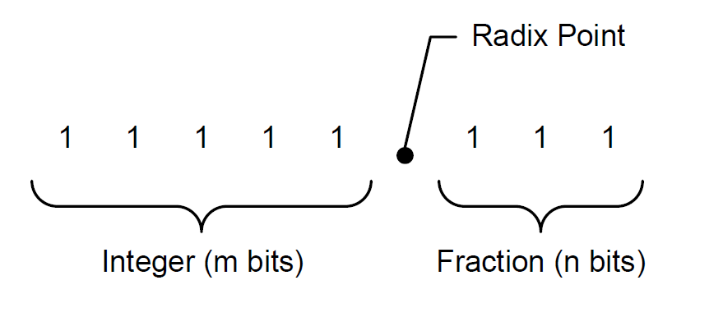
Unsigned Fixed-point Representation UQm.n
$$f=A_{h}+A_{l}×2^{−n}$$
$$10101.101_{2 }= A_{h}+A_{l}×2^{−3}$$
$$=21+5×2^{−3}$$
$$=21.625$$

Slide 8
Signed Fixed-point Representation Qm.n
$$A=−1×b_{N−1}×2^{N−1}+\sum_{i=0}^{N−2}{\left(b_{i}×2^{i}\right)}$$
$$f=\frac{A}{2^{n}}$$
where $N=m+n+1$

Slide 9
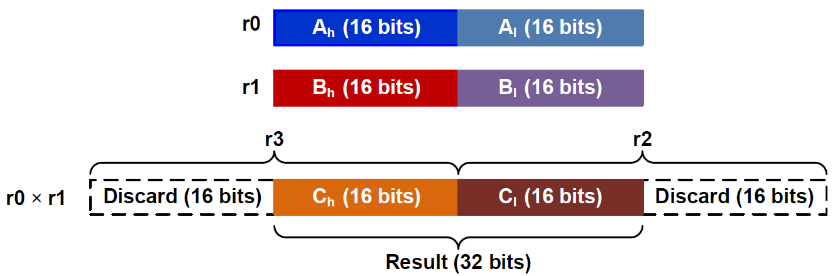
Fixed-point Multiplication in Q15.16
; r0 = fixed-point number A
; r1 = fixed-point number B
; r4 = fixed-point product = A × B
SMULL r2, r3, r0, r1 ; Unsigned long multiply
; r2 = low word, r3 = high word
LSLS r3, r3, #16 ; Shift left high word
LSRS r2, r2, #16 ; Shift right low word
ORR r4, r2, r3 ; Pack two halfwords into a word

Slide 10
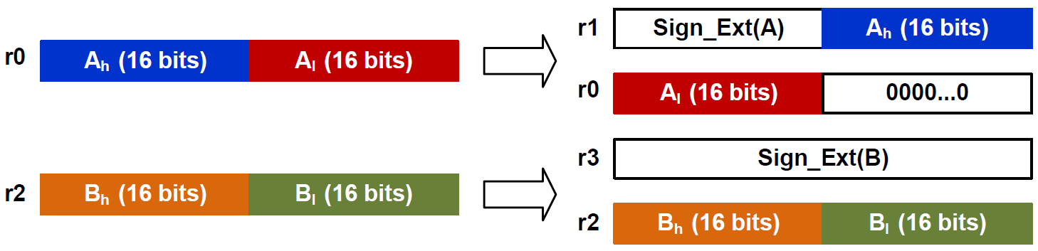
Fixed-point Division in UQ16.16 or Q15.16
r4 = fixed-point quotient
= A ÷ B
ASRS r1, r0, #31 ; r1[31:0] = sign bits of A
LSLS r1, r1, #16 ; put sign bits in upper half word
ORR r1, r1, r0, LSR #16
LSLS r0, r0, #16 ; [r1:r0] stores sign extended A
ASRS r3, r2, #31 ; [r4:r3] stores sign extended B
BL division_64_bits ; Take four input register (r0:r1, r3:r4)
MOV r4, r0 ; division_64_bits places result in r0

Slide 11
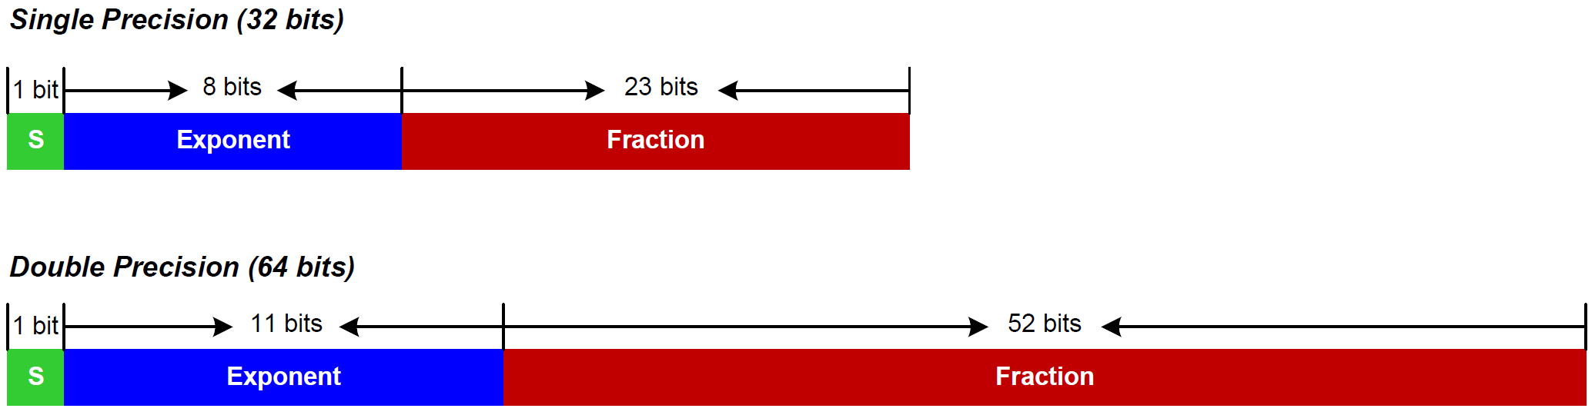
IEEE Std 754
IEEE 754 value:
$${(−1)}^{S}×(1+Fraction)×2^{Exponent−Bias}$$
where Bias = 127 for single precision
Bias = 1023 for double precision

Slide 12
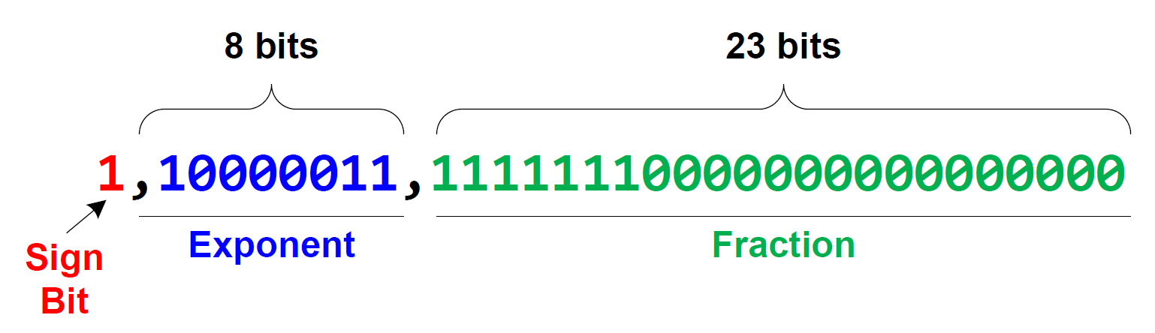
Decoding 0xC1FF0000 into a floating-point number
0.9921875
$$f={\left(−1\right)}^{S}×\left(1+Fraction\right)×2^{Exponent−127} \\ ={\left(−1\right)}^{1}×\left(1+0.9921875\right)×2^{131−127} \\ =−1×1.9921875×2^{4} \\ =−31.875$$

Slide 13
Encoding 14.5 into IEEE Std 754 Single-Precision
Normalization:
$$14.5=1.8125×2^{3}$$
$$=(1+0.8125)×2^{3}$$
$Sign=0$
$Exponent=3+127=130={1000010}_{2}$
$Fraction={0.1101}_{2}$
$0.8125×2=1.625=1+0.625$
$0.625×2=1.25=1+0.25$
$0.25×2=0.5=0+0.5$
$0.5×2=1$
14.5 = 01000001011010000000000000000000 in binary or 0x41680000 in hex

Slide 14

Timer’s Clock
Reload Value
TIMx_ARR
Reload
f_{CL_PSC}
f_{CL_CNT}
TIMx_CNT
TIMx_PSC
ISR
Resume
Interrupt
clock
Prescaler
Current Count
$$f_{CK_CNT}=\frac{f_{CL_PSC}}{PSC+1}$$

Slide 15
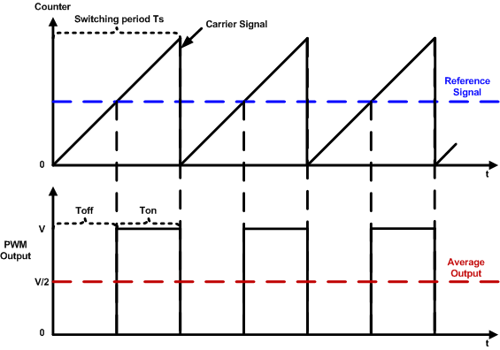
PWM Duty Cycle = Ton/Time Period
$$duty cycle=\frac{pulse on time}{pulse switching period}×100\%=\frac{T_{on}}{T_{s}}×100\%$$

