Slide 1
Z. Gu
Embedded Systems with ARM Cortex-M Microcontrollers in Assembly Language and C
Chapter 7
Structured Programming
Fall 2025
Acknowledgement: Lecture slides based on Embedded Systems with ARM Cortex-M Microcontrollers in Assembly Language and C, University of Maine https://web.eece.maine.edu/~zhu/book/

Slide 2
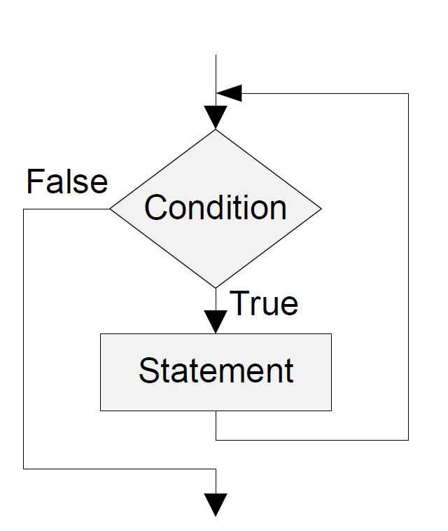
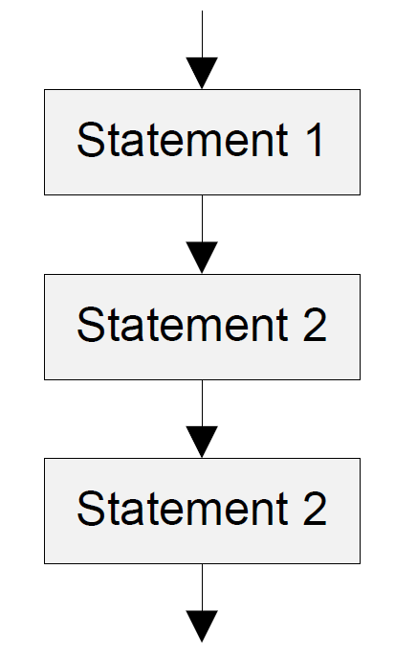
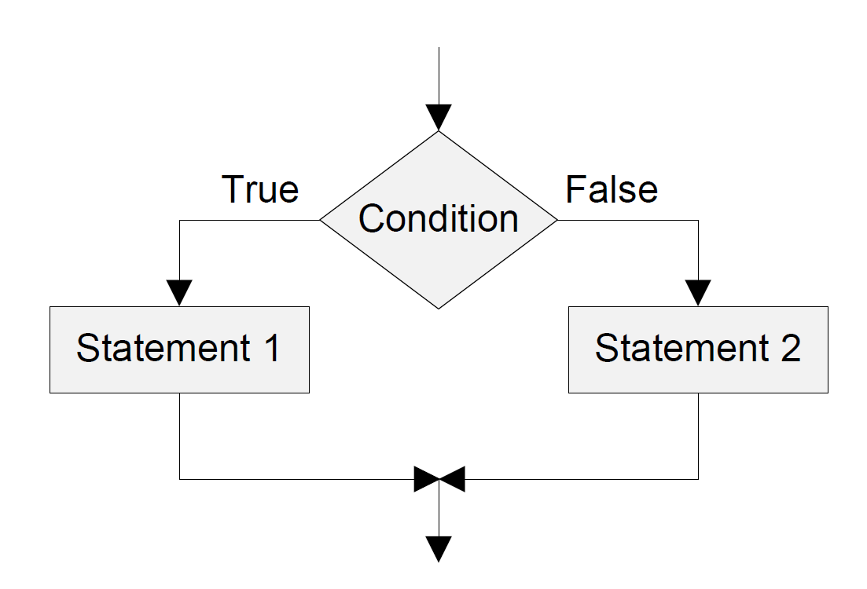
Basic Control Structures
Sequence Structure
Selection Structure
loop: Structure

Slide 3
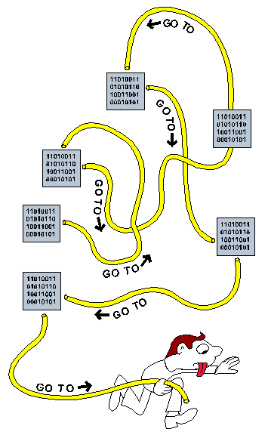
History
Spaghetti Code
Before the 1980s, program flow bounces around anywhere the programmer wanted.
Culprit: overusing “GOTO” statements
Spaghetti code in BASIC
1 i=0
2 i=i+1
3 PRINT i; "squared=";i*i
4 IF i>=100 THEN GOTO 6
5 GOTO 2
6 PRINT "Program Completed."
7 END
Structured programming in BASIC
1 FOR i=1 TO 100
2 PRINT i;"squared=";i*i
3 NEXT i 'termination of loop: body
4 PRINT "Program Completed."
5 END
https://en.wikipedia.org/wiki/Spaghetti_code
https://commons.wikimedia.org/wiki/File:Spagetti_code_structural_graphic.GIF

Slide 4
Importance of Structured Programming
Assembly is not a structured programming language
Does not directly support selection and loop:
Branch in assembly = “goto” in C
Break the single-entry single-exit rule
Easy to generate spaghetti code in assembly
Twisted and tangled
Difficult to debug & maintain
One strategy to alleviate the challenge
Use flowcharts to facilitate assembly programming
That is why textbook has many flowcharts
How to build flowcharts?

Slide 5
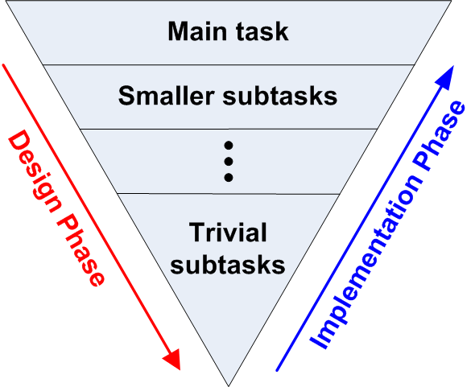
Software Design Strategy: Top-Down Design
Three common design strategies
Top-down, also known as stepwise refinement
Bottom up
Object oriented
Top-down: Repeatedly break down tasks into smaller and smaller pieces until they are easy to solve
Example: Planning a picnic
Task 1: Where
Task 2: When
Task 3: Who
Task 4: Food

Slide 6



Top-Down Design Example
Find all Armstrong numbers less than 10,000
Given a positive integer that has n digits, it is an Armstrong number if the sum of the n^{th} powers of its digits equals the number itself.
$$153=1^{3}+5^{3}+3^{3}$$
$$371=3^{3}+7^{3}+1^{3}$$
$$1634=1^{4}+6^{4}+3^{4}+4^{4}$$

Slide 7
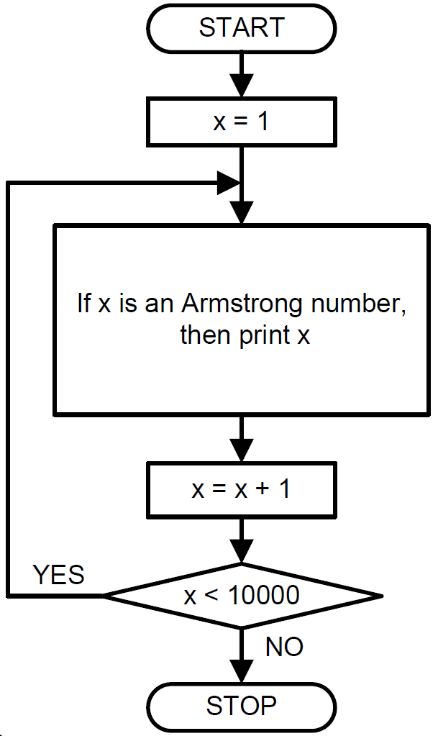
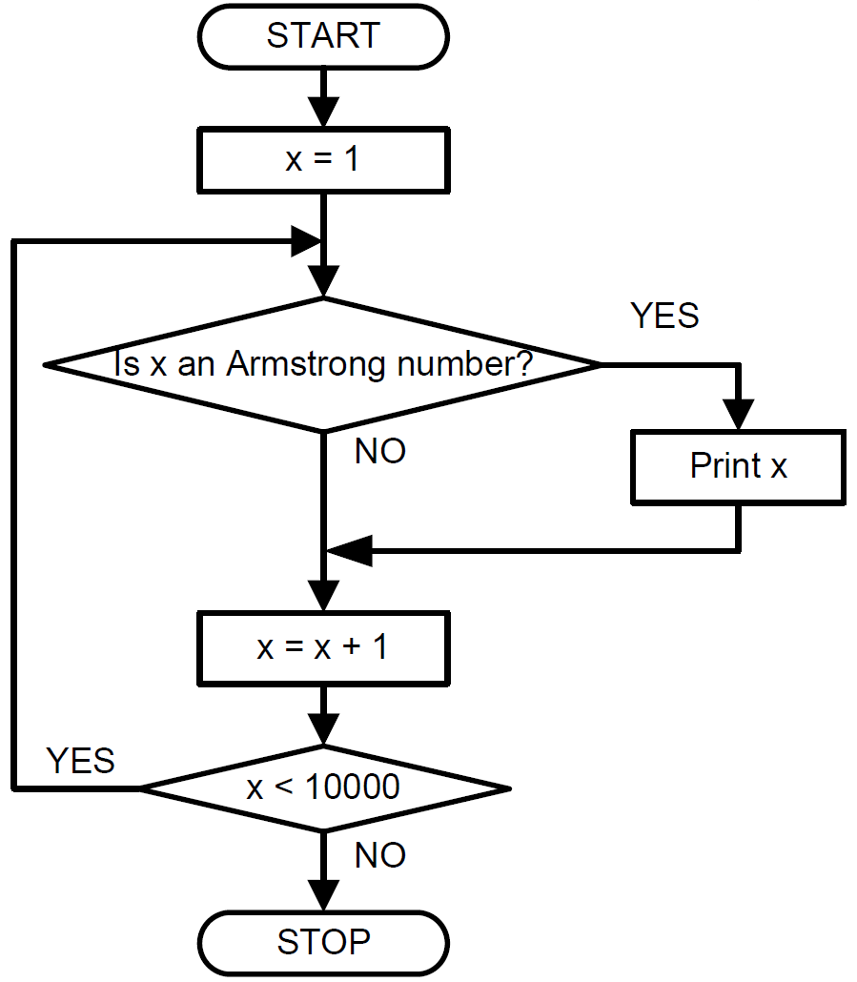
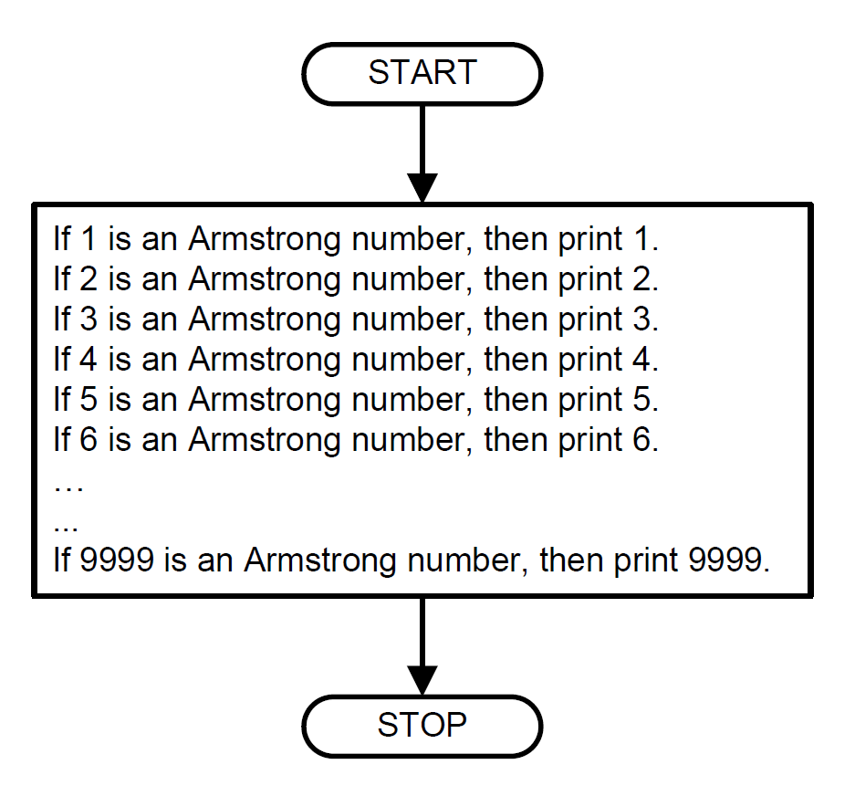
Top-Down Design Example
Step 1
Step 2
Step 3

Slide 8
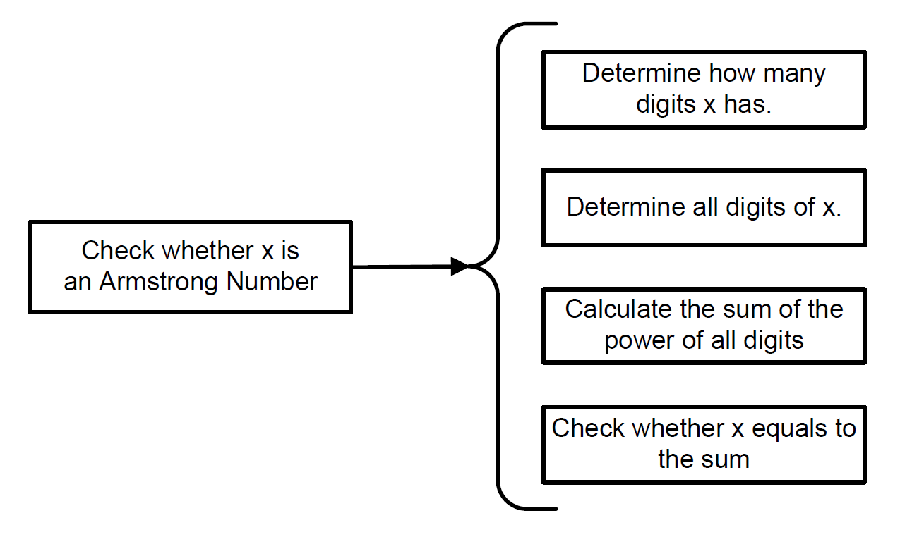
Top-Down Design Example

Slide 9
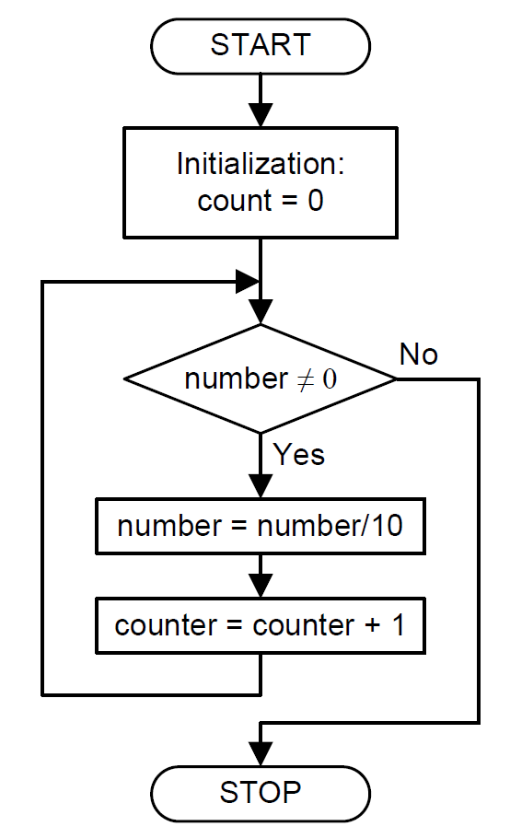
Top-Down Design Example: Counting digits

Slide 10
Reuse Registers
Little-Endian
int A = 0; // 0x00000000
int B = -1; // 0xFFFFFFFF
int C = -2; // 0xFFFFFFFE
int D = 2; // 0x00000002
void main(void){
A = B + C – D;
return;
}

Slide 11
Reuse Registers
AREA myCode, CODE
EXPORT __main
ENTRY
__main PROC
LDR r2, =B ; r2 = 0x2000,0004
LDR r3, [r2] ; r3 = B = -1
LDR r4, =C ; r4 = 0x2000,0008
LDR r5, [r4] ; r5 = C = -2
LDR r6, =D ; r6 = 0x2000,000B
LDR r7, [r6] ; r7 = D = 2
ADD r1, r3, r5 ; r1 = B + C
SUB r1, r1, r7 ; r1 = B + C - D
LDR r0, =A ; r0 = 0x2000,0000
STR r1, [r0] ; Save A
ENDP
AREA myData, DATA
A DCD 0
B DCD -1
C DCD -2
D DCD 2
END
int A = 0; // 0x00000000
int B = -1; // 0xFFFFFFFF
int C = -2; // 0xFFFFFFFE
int D = 2; // 0x00000002
void main(void){
A = B + C – D;
return;
}
Eight registers are used:
R0,r1,r2,r3,r4,r5,r6,r7

Slide 12
Reuse Registers
The lifetime of a value in a register starts when the value is written into the register and ends when that value is no longer needed (either overwritten or no longer used in future instructions).
LDR r2, [r2]: loads from memory address r2 into register value r2. It is OK since memory address r2 is never used again.

Slide 13
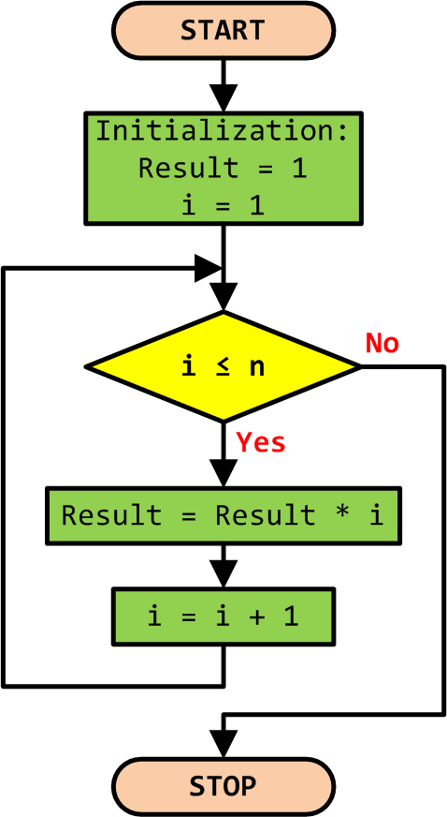
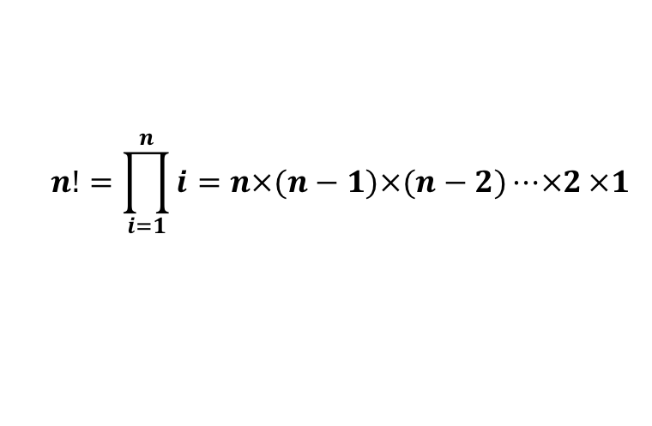
Example 1: Factorial Numbers
$$n!=\prod_{i=1}^{n}{i=n×(n−1)×(n−2)⋯×2}×1$$

Slide 14
Example 1: Factorial Numbers
C Program | Assembly Program 1 | Assembly Program 2
int main(void) { int result, n, i; | AREA factorial, CODE, READONLY EXPORT __main ENTRY __main PROC | AREA factorial, CODE, READONLY EXPORT __main ENTRY __main PROC
result = 1; n = 5; | MOV r1, #4 ; r1 = n MOV r0, #1 ; r0 = result. | MOV r1, #4 ; r1 = n MOVS r0, r1 ; r0 = n. Also sets flags based on r0 (so we can handle n==0) MOVEQ r0, #1 ; if n == 0, set r0 = 1
for (i = 1; i <= n; i++) result = result * i; | MOV r2, #1 ; r2 = i = 1 loop: CMP r2, r1 ;compare r2 and n BGT stop ; if i > n, stop MUL r0, r2, r0 ; result *= i ADD r2, r2, #1 ; i++ B loop | loop: SUBNES r1, r1, #1 ; if r1 != 0: r1 = r1 - 1 (and set flags) MULNE r0, r1, r0 ; if r1 != 0: r0 = r1 * r0 BNE loop ; if r1 != 0, jump to loop label
} | stop: B stop ENDP END | stop: B stop ENDP END

Slide 15
Worked example for N = 4
Assembly Program 1:
r2 is loop counter (i) initialized to 1, r0 is running product (result) initialized to 1, r1 holds n. Entry: r1 = 4 (input). MOV r0, #1 → r0 = 1 (initialize result). MOV r2, #1 → r2 = 1 (start i = 1).
Loop iteration 1: CMP r2, r1 compares 1 and 4 (1 ≤ 4), so continue. MUL r0, r2, r0 → r0 = 1 * 1 = 1. ADD r2, r2, #1 → r2 = 2. B loop branches back.
Iteration 2: CMP r2, r1 compares 2 and 4 (2 ≤ 4), continue. MUL r0, r2, r0 → r0 = 2 * 1 = 2. ADD r2, r2, #1 → r2 = 3. B loop.
Iteration 3: CMP r2, r1 compares 3 and 4 (3 ≤ 4), continue. MUL r0, r2, r0 → r0 = 3 * 2 = 6. ADD r2, r2, #1 → r2 = 4. B loop.
Iteration 4: CMP r2, r1 compares 4 and 4 (4 ≤ 4), continue. MUL r0, r2, r0 → r0 = 4 * 6 = 24. ADD r2, r2, #1 → r2 = 5. B loop.
Iteration 5 (exit test): CMP r2, r1 compares 5 and 4 (5 > 4), BGT stop taken, loop ends. Fall through to return.
Return: MOV pc, r14 (or BX lr), function returns with r0 = 24 (which is 4!). Final registers of interest: r0 = 24 (result), r1 = 4 (n), r2 = 5 (loop counter one past n).
Assembly Program 2:
r1 is loop counter initialized to 4, r0 is running product initialized to r1 = 4.
Entry: r0=4 (input). MOVS r1,r0 → r1=4, Z=0. MOVEQ skipped.
Loop iteration 1: SUBS r1,r1,#1 → r1=3 (Z=0). MUL r0 = r1 * r0 → r0 = 3*4 = 12. BNE true → repeat.
Iteration 2: SUBS → r1=2. MUL → r0 = 2*12 = 24. BNE true.
Iteration 3: SUBS → r1=1. MUL → r0 = 1*24 = 24. BNE true.
Iteration 4: SUBS → r1=0, sets Z=1. MULNE skipped (NE false), BNE not taken, fall through to MOV pc,r14. Return r0 = 24 (which is 4!).
Assembly Program 3 (omitted):
r0 is running product initialized to r1 = 1, and the loop counter counts up to n.

Slide 16
Stop B stop
“stop B stop” means an infinite loop: that repeatedly branches to the label "stop".
Literal translation to C is while(1);
B is the branch instruction in ARM, which causes the program to jump to the specified label or address.
Here, the label and destination are both "stop". This creates a loop: where execution never moves past this point.
It is commonly used to halt the program or wait indefinitely, often when the program completes or to prevent it from running into uninitialized memory.
Why? Bare-metal ARM code (no OS, no runtime, no C library) has nowhere to “exit” to. So the safest thing is to fall into a loop that guarantees the processor doesn’t wander off into uninitialized memory and start executing garbage. When working in a more civilized environment, such as Linux running on ARM, you really would return from main or call a system call like exit(0). Bare-metal code, though, tends to end with a little self-referential loop

Slide 17
Example 2: Counting Ones in a Word
After LDR: r0=10101010101010101010101010101010 (Load input data into r0) After MOV: r1=r0 >> 31 = 1 (Initialize r1 with the most significant bit of r0. r0 logical shift right by 31 bits, take the leftmost bit b31) After MOVS: r0 = r0 << 2 =10101010101010101010101010101000 (Logical shift left r0 by 2 bits and update C = 0, as the last shifted out bit b30) After ADC: r1 = r1 + r0 >> 31 + Carry = b31 + b29 + b30 =1 + 1 + 0 = 2 2nd iteration: r1 = r1 + b28 + b27 = 2 + 1 + 0 = 3 If after MOVS, the result in r0 is zero, (no more 1’s), Z flag is set to 1 and the loop: exits
Assembly Program
AREA Count_Ones, CODE
EXPORT __main
ALIGN
ENTRY
__main PROC
; r0 = Input = x
; r1 = Number of ones = counter
LDR r0, =0xAAAAAAAA
; r1 = r0 >> 31
MOV r1, r0, LSR #31
; r0 = r0 << 2 and change Carry
loop: MOVS r0, r0, LSL #2
; r1 = r1 + r0 >> 31 + Carry
ADC r1, r1, r0, LSR #31
BNE loop:
Stop: B stop
ENDP
END
At the end of the first loop:: r1 = b31 + b30 + b29

Slide 18
Example 2: Counting Ones in a Word: Explanations
Iteration | Shifted r0 value (MSB bit) | Carry bit (last shifted out) | r1 (accumulated count) | Notes
0 (init) | — | — | b31 = 1 | r1 initialized with b31
1 | b29 = 1 | b30 = 0 | 1 (b31) + 1 (b29) + 0 (b30) = 2 | r0 shifted left by 2 bits
2 | b27 = 1 | b28 = 0 | 2 + 1 (b27) + 0 (b28) = 3
3 | b25 = 1 | b26 = 0 | 3 + 1 (b25) + 0 (b26) = 4
4 | b23 = 1 | b24 = 0 | 4 + 1 (b23) + 0 (b24) = 5
In 0xAAAAAAAA, bits at odd positions (31, 29, 27, ..., 1) are all 1, bits at even positions (30, 28, 26, ..., 0) are all 0.
Carry bit is always the even bit index at each iteration.
At each iteration, r1 accumulates 1 (highest bit, odd index) + 0 (carry bit, even index).
The loop: ends when r0 becomes zero after the last shift, triggering the Zero flag and exiting the branch.
The count accumulates to 16, consistent with the fact that 0xAAAAAAAA has exactly 16 ones in 32 bits.
This program counts two bits per loop iteration, leveraging the Carry bit, and will take 16 iterations for a 32-bit word.

Slide 19
Example 2: Counting Ones in a Word: Simpler Programs
LDR r0, =0xAAAAAAAA ; Load input data into r0
MOV r2, #0 ; Initialize count (r2) to 0
loop:
MOV r1, r0, LSR #31 ; Extract leftmost bit (MSB) of r0 into r1 (0 or 1)
ADD r2, r2, r1 ; Add extracted bit to count in r2
MOVS r0, r0, LSL #1 ; Shift r0 left by 1 bit, update flags
BNE loop ; If r0 != 0, repeat loop(may loop less than 32 iters)
Algo 1
LDR r0, =0xAAAAAAAA ; Load input data into r0
MOV r2, #0 ; Initialize bit count accumulator (r2) to 0
loop:
MOVS r0, r0, LSL #1 ; Shift left by 1 bit, carry gets old MSB
ADC r2, r2, #0 ; Add carry (0 + carry) to r2
BNE loop ; Loop while r0 != 0 (Zero flag clear)
Algo 2
Algo 1: use MOV r1, r0, LSR #31 to extract the highest bit from r0 and accumulates the per-bit count. (Carry flag is set but ignored.)
Algo 2: use MOVS r0, r0, LSL #1 to shift left by 1 bit and update the carry flag with the bit shifted out (the leftmost bit of the original value). Use ADC (Add with Carry) to add the carry bit to accumulator r2 without needing to move the leftmost bit explicitly.
Both programs count one bit per loop iteration. Algo 1 uses r1 to store the MSB of intermediate values of r0, and Algo 2 uses C flag to store it.
Notes:
discarding the Carry bit, and will take 32 iterations for a 32-bit word.
LDR r0, =0xAAAAAAAA: Load the input data into r0.
MOV r1, r0, LSR #31: Initialize r1 with the most significant bit of r0.
MOVS r0, r0, LSL #2: Logical shift left r0 by 2 bits and update the carry flag.
ADC r1, r1, r0, LSR #31: Add with carry the count in r1 and the current bit from r0.
BNE loop: The loop ends when the result is zero (Zero flag set).

Slide 20
Quiz
Q: In Algo 1 and Algo 2, can we change MOVS r0, r0, LSL #1 to MOV r0, r0, LSL #1?
ANS: No, since the C carry flag, which captures the leftmost bit shifted out, is needed for bit counting in Algo 2, and for loop condition checking in both Algos (exit loop when Z flag set, and r0 is zero)
Q: In Algo 1, can we change MOV r1, r0, LSR #31 to MOVS r1, r0, LSR #31
ANS: Yes, MOVS sets flags, but they are not used by later instructions.
Q: In Algo 2, can we change ADC r2, r2, #0 to ADD r2, r2, #0?
ANS: No, ADC (Add with Carry) adds two operands plus the carry flag. ADD only adds the two operands without considering the carry flag
Q: In Algo 1, can we change ADD r2, r2, r1 to ADC r2, r2, r1?
ANS: No. ADC will add the C flag set by “MOVS r0, r0, LSL #1” in the previous iteration, resulting in double-counting of 1’s.
Notes:
If use “MOVS r1, r0, LSR #31” instead of MOV, it is also incorrect, since C flag captures the last bit shifted out from the right, resulting in doub
No, you cannot simply replace MOVS r0, r0, LSL #1 with MOV r0, r0, LSL #1 if you want to use the carry flag for bit counting, because:
MOVS shifts and updates the condition flags, including the carry flag (which captures the leftmost bit shifted out).
MOV just copies/moves the value without updating any status flags (Carry, Zero, Negative, etc.).
Without status flag updates, the carry flag won't track the bit shifted out, so the later ADC instruction would not add the correct carry bit.
Thus, for counting bits by carry from shifts, MOVS is required to update the carry flag each time shifting left.
The plain MOV can only move data without affecting flags and is insufficient for this purpose.
No, you cannot replace ADC r2, r2, #0 with ADD r2, r2, #0 if you want to add the carry bit from the previous operation.
Why?
ADC (Add with Carry) adds two operands plus the carry flag.
ADD only adds the two operands without considering the carry flag.
Since the bit count relies on the carry flag (set by the previous MOVS shift left), replacing ADC with ADD would ignore the carry bit, causing incorrect counting.
In ADC r2, r2, #0, the immediate #0 means the register r2 plus 0 plus carry are summed, effectively adding carry to r2.
Using ADD r2, r2, #0 adds zero and ignores carry, so no bit would be counted from the carry.
Hence, keep using ADC to accumulate the bits from the carry flag properly.

Slide 21
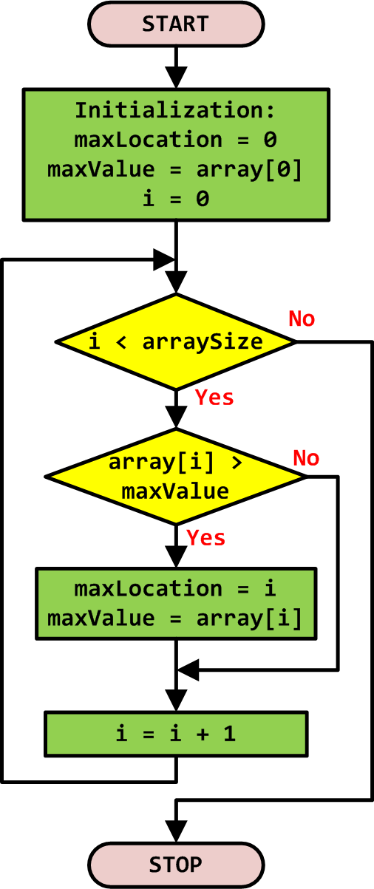
Example 3: Finding Max of an Array
// Initialize max and location maxLocation = 0; maxValue = array[0];
// loop: through the array for (i = 0; i < arraySize; i++) { if (array[i] > maxValue) { maxValue = array[i]; maxLocation = i; } }

Slide 22
Example 3: Finding Max of an Array
C Program | Assembly Program
int array[10] = {-1, 5, 3, 8, 10, 23, 6, 5, 2, -10}; int size = 10; | AREA myData, DATA ALIGN array DCD -1,5,3,8,10,23,6,5,2,-10 size DCD 10
int main(void) { int i, maxLocation, maxValue; | AREA findMax, CODE EXPORT __main ALIGN ENTRY __main PROC ; Identify the array size LDR r3, =size LDR r3, [r3] ; r3 = array size = 10
// Initialize max and location maxLocation = 0; maxValue = array[0]; | ; Initialize max value and location LDR r4, =array LDR r0, [r4] ; r0 = default max MOV r1, #0 ; r1 = max location
// loop: through the array for (i = 0; i < size; i++){ if (array[i] > maxValue) { maxValue = array[i]; maxLocation = i; } } | ; loop: over the array MOV r2, #0 ; loop: index i loop: CMP r2, r3 ; compare i & size BGE stop ; stop if i ≥ size LDR r5, [r4,r2,LSL #2] ; array[i] CMP r5, r0 ; compare with max MOVGT r0, r5 ; update max value MOVGT r1, r2 ; update location ADD r2, r2, #1 ; update index i B loop:
while(1); //dead loop: } | stop B stop ; dead loop: ENDP END

Slide 23
Quiz
Instruction LDR r5, [r4,r2,LSL #2] has the form:
LDR <destination register>, [<base register>, <index register>, LSL #<shift amount>]
Address=value in r4+(value in r2×2² )
The memory address is calculated by taking the value in the <base register> (here r4) plus the value in the <index register> (here r2) shifted left (logical shift left, LSL) by a certain number of bits (#2 means shifted by 2 bits, or multiplied by 4).
Q: why do we perform r2×2² here?
ANS: Since each element is a 32-bit integer (word), we need to multiply by 4 to convert from array index to memory address
Notes:
Since each element is a 32 bit word, we need to multiply by 4 to convert from array index to memory address

