Slide 1
Z. Gu
ECE 271 - Microcomputer Architecture and Applications
Final Review
Fall 2025
Acknowledgement: Lecture slides based on Embedded Systems with ARM Cortex-M Microcontrollers in Assembly Language and C, University of Maine https://web.eece.maine.edu/~zhu/book/
1

Slide 2
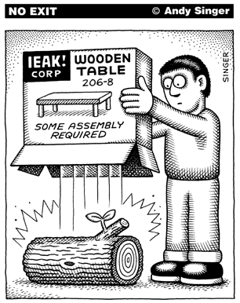
Assembly Programs
http://www.andysinger.com/

Slide 3
Why do we learn Assembly?
Assembly isn’t “just another language”.
  Help you understand how does the processor work
Assembly program runs faster than high-level language. Performance critical codes must be written in assembly.
  Use the profiling tools to find the performance bottle and rewrite that code section in assembly
  Latency-sensitive applications, such as aircraft controller
  Standard C compilers do not use some operations available on ARM processors, such ROR (Rotate Right) and RRX (Rotate Right Extended).
Hardware/processor specific code,
  Processor booting code
  Device drivers
  A test-and-set atomic assembly instruction can be used to implement locks and semaphores.
Cost-sensitive applications
  Embedded devices, where the size of code is limited, wash machine controller, automobile controllers
The best applications are written by those who've mastered assembly language or fully understand the low-level implementation of the high-level language statements they're choosing.

Slide 4
Character String
Memory Address | Memory Content | Letter
str + 12→ | 0x00 | \0
str + 11→ | 0x79 | y
str + 10→ | 0x6C | l
str + 9→ | 0x62 | b
str + 8→ | 0x6D | m
str + 7→ | 0x65 | e
str + 6→ | 0x73 | s
str + 5→ | 0x73 | s
str + 4→ | 0x41 | A
str + 3→ | 0x20 | space
str + 2→ | 0x4D | M
str + 1→ | 0x52 | R
str → | 0x41 | A
char str[13] = “ARM Assembly”;

Slide 5
Data Representation
Integers
  Binary in different bases: binary, octal, hex, decimal
  Signed Integers
    Two’s complement
  Arithmetic Operations
    NVCZ flags
  Big Endian vs Little Endian
ASCII values
  Null-terminated string
  Converting between numbers and ASCII
  Upper case, lower case
Fixed point numbers
  Qm.n, UQm.n
  Addition, subtract, multiplication, division
Floating point numbers
  IEEE 754 Standard
  Single Precision, Double Precision

Slide 6
Basic Assembly Programming
Load-modify-store sequence
Accessing memory
  Memory addressing mode
    Pre-index
    Post-index
    Pre-index with update
Data processing
  Arithmetic, Logic, Comparison, Data Movement
  Barrel Shifter:
    ADD r1, r0, r0, LSL 2
  Bit operations
    Set a bit, Reset a bit, Toggle a bit, Check a bit
  LSL, LSR, ASR, ROR, RRX
Flow control: if, if-then-else, for loop, while loop
  Unconditional Branch: B
  Conditional Branch: CMP, TEQ,TST, BEQ, BNE, BMI, BLS, BHI, etc.
  Conditional Execution: MOVEQ, MOVNE

Slide 7
Subroutine Without Floating Numbers
Calling Subroutine & Exiting Subroutine
  BL and BX
  How are PC, LR, and SP registers updated?
Caller-saved registers:
  R0–R3: Arguments/return registers.
  R12 (IP): Intra-procedure scratch register.
  CPSR: — caller must preserve its state if needed.
Callee-saved registers:
  R4–R11: Must be saved/restored by the callee if used.
  R14 (LR): Must be saved if the callee makes nested calls.
  R13 (SP): Stack pointer — must be preserved.
Extra parameters passed on stack:
  When more than four arguments exist.
Return value in R0
Recursive functions
  How does the stack work?
  Pay special attention to LR register
Notes:
Save and restore R4-R11,LR if your subroutine wishes to modify
Parameters passing in registers R0, R1, R2, R3
Extra parameters passing in stack
Return parameter in R0

Slide 8
Subroutine with Float/Double Arguments
Each number is assigned in turn to the next free register of the corresponding type
Example:
  double fun(double a1, float a2, double a3, float a4, float a5, double a6, float a7, double a8)

Slide 9


Interrupt
Interrupt vs Polling
Interrupt Service Routine
Interrupt Enable and Disable
Interrupt Stacking and Unstacking
  Eight registers (R0-R3, R12, LR, PC, PSR) are automatically pushed into the stack before the hander starts
  These registers are automatically popped when exiting the handler
http://www.istockphoto.com/

Slide 10
Stacking & Unstacking
Interrupt
Exit
Interrupt Handler
Interrupt
Signal
Unstacking
User Program
User Program
Stacking
Time
Thread Mode
Handler Mode
Thread Mode

Slide 11
Stacking & Unstacking
Old SP
SP + 0x20 | xxxxxxxx
SP + 0x1C | xPSP
SP + 0x18 | PC (r15)
SP + 0x14 | LR (r14)
SP + 0x10 | r12
SP + 0x0C | r3
SP + 0x08 | r2
SP + 0x04 | r1
SP + 0x00 | r0
The processor automatically pushes these eight registers into the main stack before an interrupt handler starts
The processor automatically pops these eight register out of the main stack when an interrupt hander exits.
Stack descends.
New SP
Two SPs: Main SP (MSP) and Process SP (PSP)
Determined by operating mode, and CONTROL[0]
  Thread mode ⟶ SP = PSP
  Handler mode ⟶ SP = MSP if CONTROL[0] = 0; Otherwise SP = PSP

Slide 12
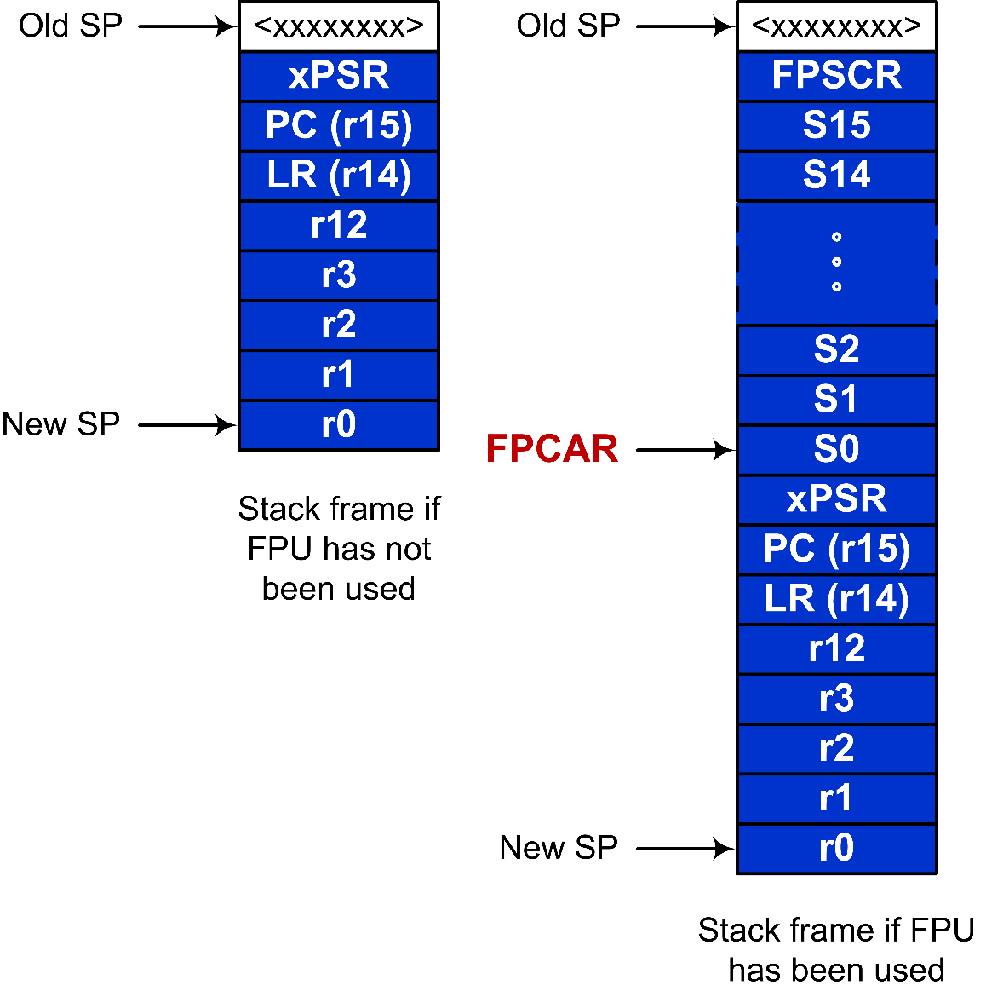
Stacking and Unstacking upon Interrupt with FPU

Slide 13
Mixing C and Assembly
Accessing C variables
  Struct & Data alignment
  Static variables
Inline Assembly
C calling assembly functions
  C: extern assembly functions and variables
  Assembly: Export
Assembly calling C functions
  Assembly: Import C function and variables
  Export variables to C functions

Slide 14
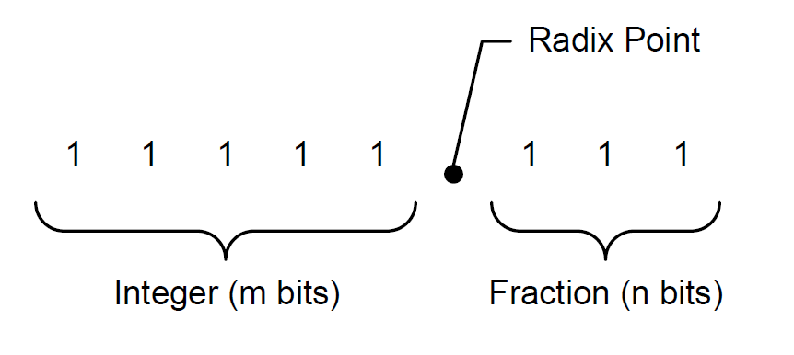
Unsigned Fixed-point Representation
UQm.n
$$f=A_{h}+A_{l}×2^{−n}$$
$$10101.101_{2 }= A_{h}+A_{l}×2^{−3}$$
$$=21+5×2^{−3}$$
$$=21.625$$

Slide 15
Signed Fixed-point Representation
Qm.n
$$A=−1×b_{N−1}×2^{N−1}+\sum_{i=0}^{N−2}{\left(b_{i}×2^{i}\right)}$$
$$f=\frac{A}{2^{n}}$$
where $N=m+n+1$

Slide 16
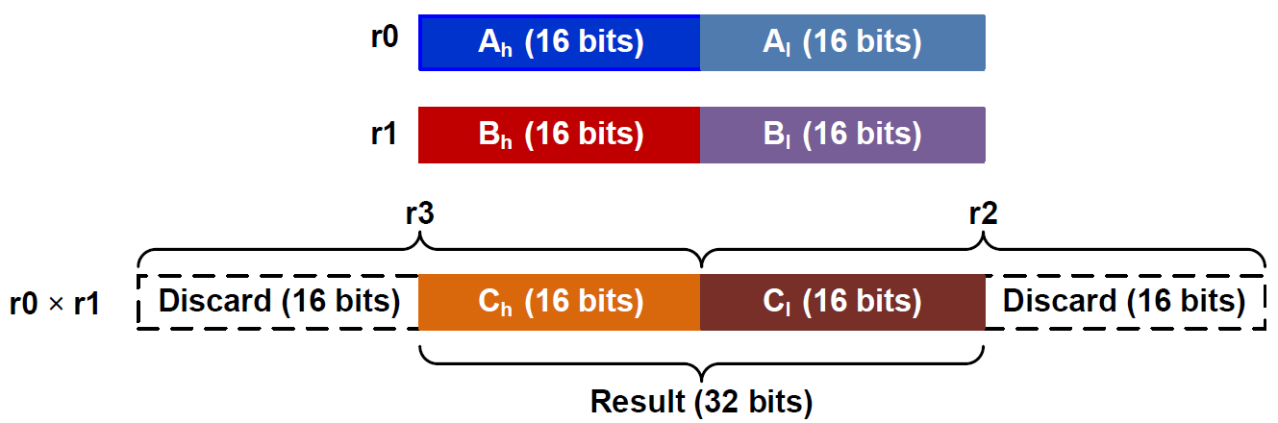
Fixed-point Multiplication in Q15.16
; r0 = fixed-point number A
; r1 = fixed-point number B
; r4 = fixed-point product = A × B
SMULL r2, r3, r0, r1 ; Unsigned long multiply
; r2 = low word, r3 = high word
LSLS r3, r3, #16 ; Shift left high word
LSRS r2, r2, #16 ; Shift right low word
ORR r4, r2, r3 ; Pack two halfwords into a word

Slide 17
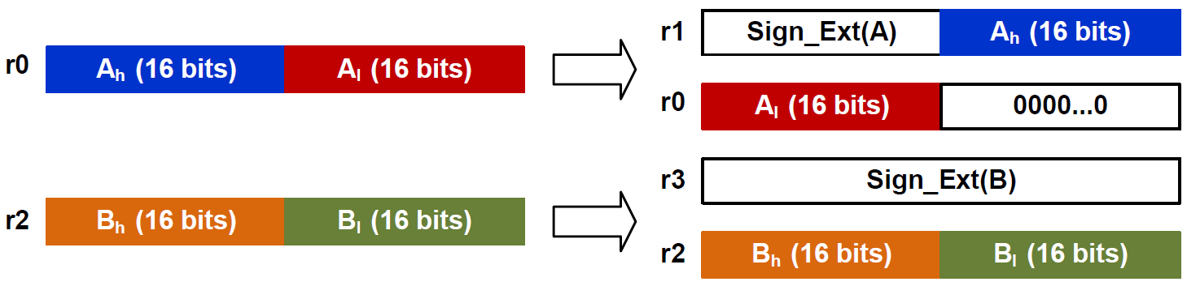
Fixed-point Division in UQ16.16 or Q15.16
r4 = fixed-point quotient
= A ÷ B
ASRS r1, r0, #31 ; r1[31:0] = sign bits of A
LSLS r1, r1, #16 ; put sign bits in upper half word
ORR r1, r1, r0, LSR #16
LSLS r0, r0, #16 ; [r1:r0] stores sign extended A
ASRS r3, r2, #31 ; [r4:r3] stores sign extended B
BL division_64_bits ; Take four input register (r0:r1, r3:r4)
MOV r4, r0 ; division_64_bits places result in r0

Slide 18
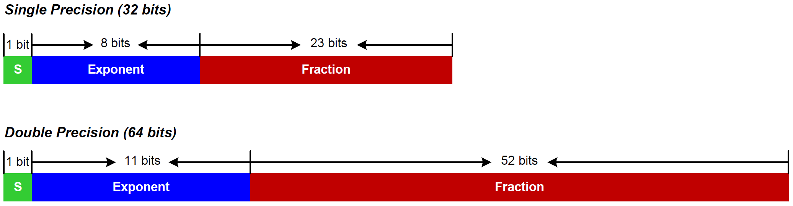
IEEE Std 754
IEEE 754 value:
$${(−1)}^{S}×(1+Fraction)×2^{Exponent−Bias}$$
where Bias = 127 for single precision
Bias = 1023 for double precision

Slide 19
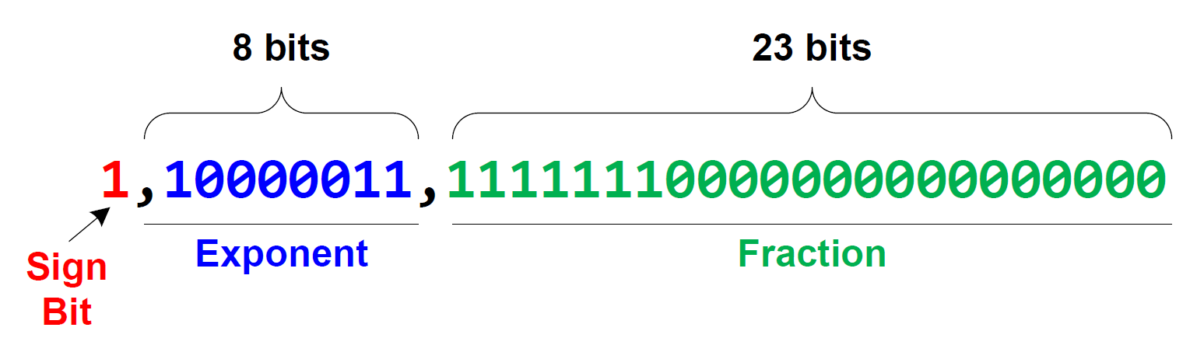
Decoding 0xC1FF0000 into a floating-point number
0.9921875
$$f={\left(−1\right)}^{S}×\left(1+Fraction\right)×2^{Exponent−127} \\ ={\left(−1\right)}^{1}×\left(1+0.9921875\right)×2^{131−127} \\ =−1×1.9921875×2^{4} \\ =−31.875$$

Slide 20
Encoding 14.5 into IEEE Std 754 Single-Precision
Normalization:
$$14.5=1.8125×2^{3}$$
$$=(1+0.8125)×2^{3}$$
$Sign=0$
$Exponent=3+127=130={1000010}_{2}$
$Fraction={0.1101}_{2}$
  $0.8125×2=1.625=1+0.625$
  $0.625×2=1.25=1+0.25$
  $0.25×2=0.5=0+0.5$
  $0.5×2=1$
14.5 = 01000001011010000000000000000000 in binary or 0x41680000 in hex

Slide 21
Single-precision comparisons
VCMP.F32 Sd, <Sm | #0.0> | Compare two floating-point registers, or one floating-point register and zero
VCMPE.F32 Sd, <Sm | #0.0> | Compare two floating-point registers, or one floating-point register and zero, and raise exception for a signaling NaN
C Program | Assembly Program
float max(float a, float b){ if (a > b) return a; else return b; } | max_of_two PROC VCMPE.F32 s0, s1 ; Copy NZCV flags to APSR VMRS APSR_nzcv, FPSCR BGT exit VMOV.F32 s0, s1 exit BX LR ENDP

Slide 22
Lab Components
GPIO Input, Output, Alternative Function
  Push pull, open drain, pull up, pull down
Timer Configuration (PSC, ARR, CCR)
  Compare output
  Input capture
  PWM output: Duty Ratio
  Trigger
System Timer
  Processor clock
  External clock: Processor clock/8
ADC & DAC
  Successive-approximation (SAR) ADC
  Resolution, Speed
Step motors
  Full stepping, half stepping

Slide 23
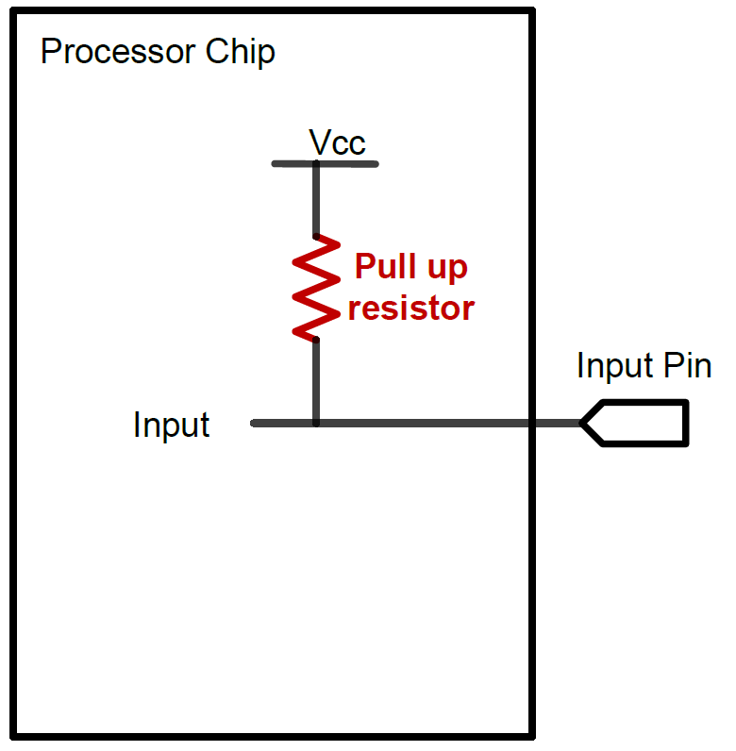
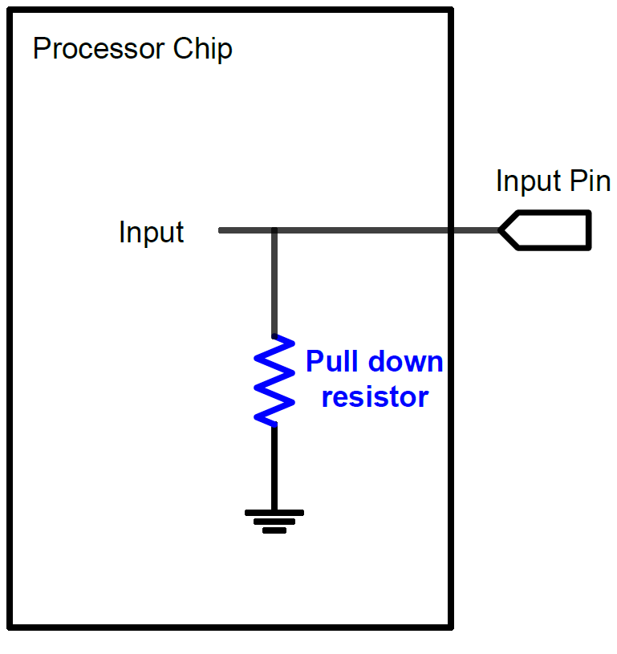
GPIO Input:
Pull Up and Pull Down
A digital input can have three states: High, Low, and High-Impedance (also called floating, tri-stated, HiZ)
Pull-Up
Pull-Down
If external input is HiZ, the input is read as a valid HIGH.
If external input is HiZ, the input is read as a valid LOW.

Slide 24
GPIO Output Modes:
Push-Pull and Open-Drain
Push-Pull
If 0, connect to ground
If 1, connect to Vcc

Slide 25
GPIO Output Modes:
Push-Pull and Open-Drain
Open-Drain
If 0, connect to ground
If 1, connect to Vcc

Slide 26
Timer’s Clock
Reload Value
TIMx_ARR
Reload
f_{CL_PSC}
f_{CL_CNT}
TIMx_CNT
TIMx_PSC
ISR
Resume
Interrupt
clock
Prescaler
Current Count
$$f_{CK_CNT}=\frac{f_{CL_PSC}}{Prescaler+1}$$

Slide 27
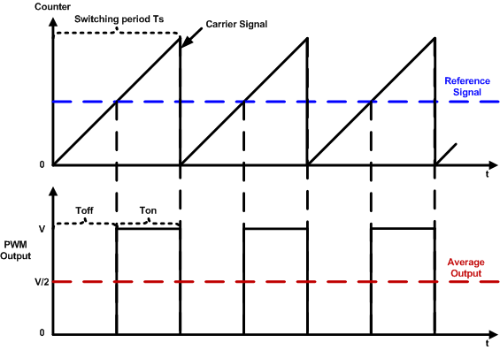
PWM Duty Cycle = Ton/Time Period
$$duty cycle=\frac{pulse on time}{pulse switching period}×100\%=\frac{T_{on}}{T_{s}}×100\%$$

Slide 28
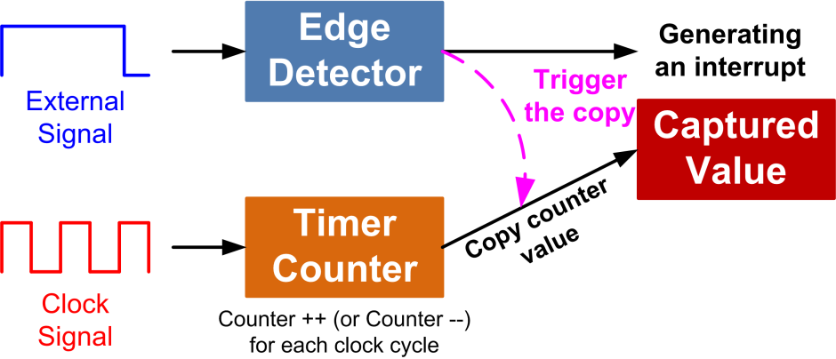
Input Capture

Slide 29
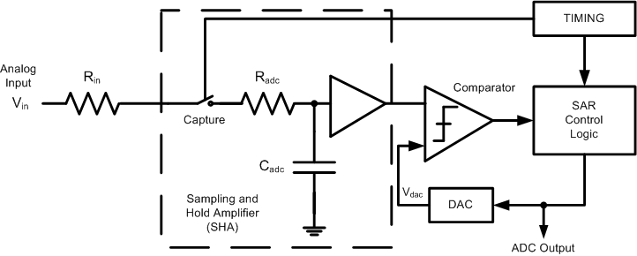
Successive-approximation (SAR) ADC

Slide 30
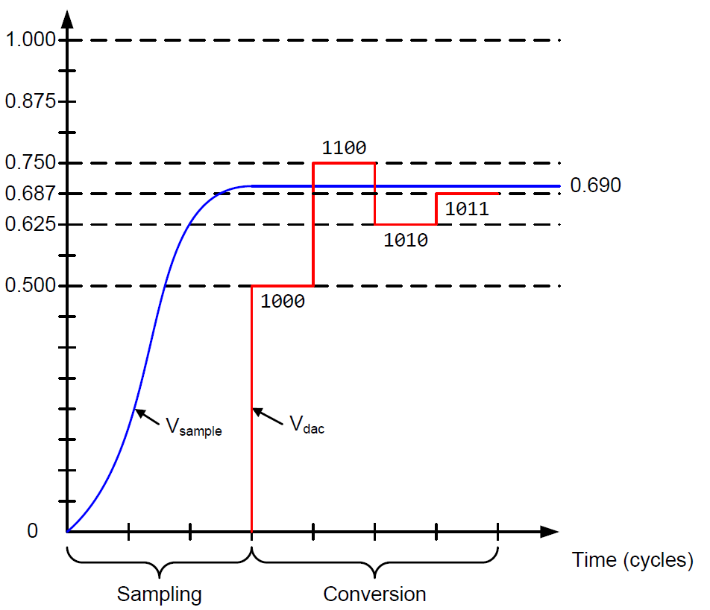
Successive-approximation (SAR) ADC
Binary search algorithm to gradually approaches the input voltage
Settle into ±½ LSB bound within the time allowed
$$T_{ADC}=T_{sampling}+T_{Conversion}$$
$$T_{Conversion}=N×T_{ADC_Clock}$$
$$T_{sampling}$$
is software configurable

