Slide 1
Z. Gu
Embedded Systems with ARM Cortex-M Microcontrollers in Assembly Language and C
Chapter 10
Preserve Environment via Stack
Fall 2025
Acknowledgement: Lecture slides based on Embedded Systems with ARM Cortex-M Microcontrollers in Assembly Language and C, University of Maine https://web.eece.maine.edu/~zhu/book/
Notes:
Embedded application binary interface (EABI) Protocol

Slide 2
Overview
How to call a subroutine?
How to return the control back to the caller?
How to pass arguments into a subroutine?
How to return a value in a subroutine?
How to preserve the running environment for the caller?

Slide 3
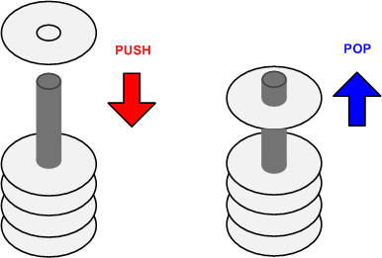
Stack
A Last-In-First-Out memory model
Only allow to access the most recently added item
Also called the top of the stack
Key operations:
push (add item to stack)
pop (remove top item from stack)
Example: Tower of Hanoi
Only one disk may be moved at a time.
Each move consists of taking the upper disk from one of the rods and sliding it onto another rod, on top of the other disks that may already be present on that rod.
No disk may be placed on top of a smaller disk.
http://en.wikipedia.org/wiki/File:Tower_of_Hanoi_4.gif

Slide 4
Typical Usage of Stack
Why need stack?
Saving the original contents of processor’s registers at the beginning a subroutine (Contents are restored at the end of a subroutine)
Storing local variables in a subroutine
Passing extra arguments to a subroutine
Saving processor’s registers upon an interrupt

Slide 5
Stack Growth Convention: Ascending vs Descending
Descending stack: Stack grows towards low memory address
Ascending stack: Stack grows towards high memory address

Slide 6
Stack Growth Convention: Full vs Empty
Full stack: SP points to the last item pushed onto the stack
Empty stack: SP points to the next free space on the stack (empty stack refers to stack type, the stack itself is not empty)

Slide 7
Cortex-M Stack
Cortex-M uses full descending stack
Example:
PUSH/POP {r0,r6,r3}
Stack pointer (SP, aka R13)
decremented on PUSH
SP = SP – 4 * # of registers
incremented on POP
SP = SP + 4 * # of registers
SP starts at 0x20000200 for STM32-Discovery by default (can be changed in startup.s)

Slide 8
Addressing Modes for Load/Store Multiple Registers
Review
STMxx rn{!}, {register_list}
LDMxx rn{!}, {register_list}
xx = IA, IB, DA, or DB. The order in which registers are listed does not matter
For STM/LDM, the lowest-numbered register is stored/loaded at the lowest memory address.
Addressing Modes | Description | Instructions
IA | Increment After | STMIA, LDMIA
IB | Increment Before | STMIB, LDMIB
DA | Decrement After | STMDA, LDMDA
DB | Decrement Before | STMDB, LDMDB
Cortex-M Stack
IA: address is incremented by 4 after a word is loaded or stored.
IB: address is incremented by 4 before a word is loaded or stored.
DA: address is decremented by 4 after a word is loaded or stored.
DB: address is decremented by 4 before a word is loaded or stored.
Notes:
The following are synonyms.
STM = STMIA (Increment After) = STMEA (Empty Ascending)
LDM = LDMIA (Increment After) = LDMFD (Full Descending)

Slide 9
Store Multiple Registers
Review
Cortex-M Stack

Slide 10
Load Multiple Registers
Review
Cortex-M Stack

Slide 11
Full Descending Stack

Slide 12
Stack Implementation (red text is Cortex-M stack)
Stock Name | Push |  | Pop
 | Equivalent | Alternative | Equivalent | Alternative
Full Descending(FD) | STMFD SP!,list | STMDB SP!,list | LDMFD SP!,list | LDMIA SP!,list
Empty Descending(ED) | STMED SP!,list | STMDA SP!,list | LDMED SP!,list | LDMIB SP!,list
Full Ascending(FA) | STMFA SP!,list | STMIB SP!,list | LDMFA SP!,list | LDMDA SP!,list
Empty Ascending(EA) | STMEA SP!,list | STMIA SP!,list | LDMEA SP!,list | LDMDB SP!,list
Notes:
Assembler aliases: STMFD = STMDB, LDMFD = LDMIA; STMEA = STMIA; LDMEA = LDMDB,

Slide 13
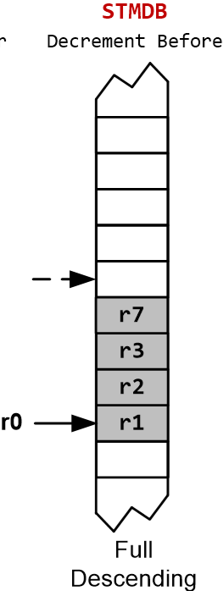
Stack
PUSH {Rd} == STMDB SP!, {Rd} == STMFD SP!, {Rd}
SUB SP, SP, #4 @ SP = SP-4 (descending stack)
STR Rd, [SP] @ (*SP) = Rd (full stack)
Push multiple registers
They are equivalent.
PUSH {r7}
PUSH {r3}
PUSH {r2}
PUSH {r1}
PUSH {r1, r2, r3, r7}
PUSH {r7, r2, r3, r1}
SP is decremented before PUSH (pre-decrement).
The order in which registers listed in the register list does not matter.
When pushing multiple registers, these registers are automatically sorted by name and the lowest-numbered register is stored to the lowest memory address, i.e. r1 is stored last.
Notes:
PUSH => SUB SP, SP, #4 STR RN, [SP]
POP => LDR RN, [SP] ADD SP, #4
PUSH {R1, R2} ==
STMFD SP!, {R1, R2} ; or STMDB SP!, {R1, R2}
SP is decremented before PUSH (pre-decrement), and incremented after POP (post-increment).

Slide 14
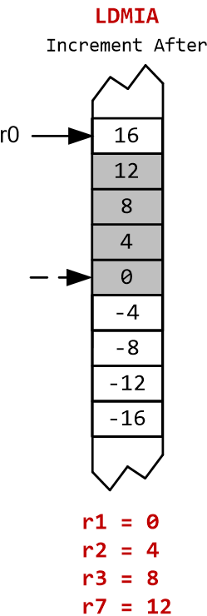
Stack
POP {Rd} == LDMIA SP!, {Rd} == LDMFD SP!, {Rd}
LDR Rd, [SP] @ Rd = (*SP) (full stack)
ADD SP, #4 @ SP = SP + 4 (Stack shrinks)
Pop multiple registers
They are equivalent.
POP {r1}
POP {r2}
POP {r3}
POP {r7}
POP {r1, r2, r3, r7}
POP {r7, r3, r2, r1}
SP is incremented after POP (post-increment).
The order in which registers listed in the register list does not matter.
When popping multiple registers, these registers are automatically sorted by name and the lowest-numbered register is loaded from the lowest memory address, i.e. r1 is loaded first.

Slide 15
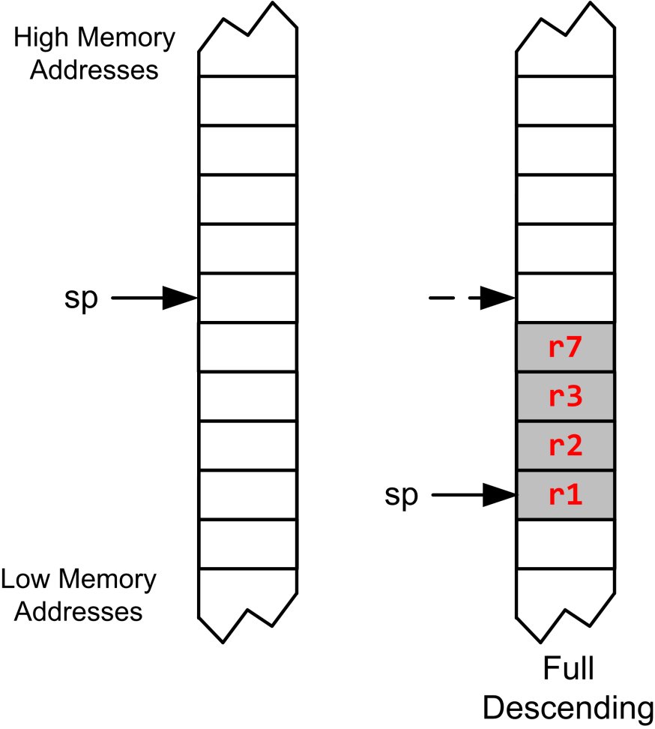
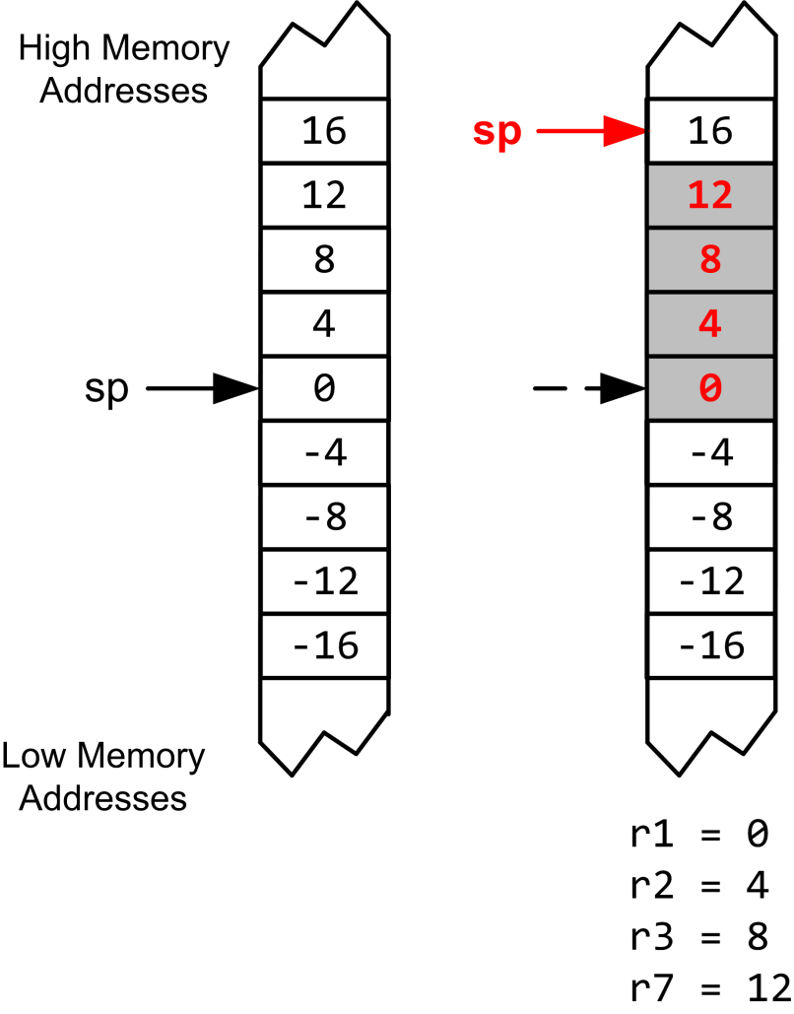
Stack Recap
Largest-numbered register is pushed first but popped last.
PUSH {r3, r1, r7, r2}
POP {r3, r1, r7, r2}
Pop to the smallest-numbered register first.

Slide 16
Cortex-M Stack
Register
r0
r1
r2
r3
r4
r5
r6
r7
r8
r9
r10
r11
r12
r13 (SP)
r14 (LR)
r15 (PC)
PUSH {register list}
POP {register list}
Eligible registers for PUSH: r0 – r12, LR
Eligible registers for POP: r0 – r12, LR, PC
Order specified in the list does not matter
Largest-numbered register is always pushed first and popped last
Smallest-numbered register is always pushed last and popped first
Smallest-numbered register is stored at lowest memory address after PUSH
Instruction format for PUSH:

Slide 17
Example: swap R1 & R2
R1
0x11111111
R2
0x22222222
PUSH {R1}
PUSH {R2}
POP {R1}
POP {R2}
Address
R13 (SP)
0x20000200
xxxxxxxx
0x20000200
xxxxxxxx
0x200001FC
xxxxxxxx
0x200001F8
memory

Slide 18
Example: swap R1 & R2
R1
0x11111111
R2
0x22222222
PUSH {R1}
PUSH {R2}
POP {R1}
POP {R2}
Address
PC
R13 (SP)
0x200001FC
xxxxxxxx
0x20000200
0x11111111
0x200001FC
xxxxxxxx
0x200001F8
memory

Slide 19
Example: swap R1 & R2
R1
0x11111111
R2
0x22222222
PUSH {R1}
PUSH {R2}
POP {R1}
POP {R2}
Address
R13 (SP)
0x200001F8
PC
xxxxxxxx
0x20000200
0x11111111
0x200001FC
0x22222222
0x200001F8
memory

Slide 20
Example: swap R1 & R2
R1
0x22222222
R2
0x22222222
PUSH {R1}
PUSH {R2}
POP {R1}
POP {R2}
Address
R13 (SP)
0x200001FC
xxxxxxxx
0x20000200
PC
0x11111111
0x200001FC
0x22222222
0x200001F8
memory

Slide 21
Example: swap R1 & R2
R1
0x22222222
R2
0x11111111
PUSH {R1}
PUSH {R2}
POP {R1}
POP {R2}
Address
R13 (SP)
0x20000200
xxxxxxxx
0x20000200
0x11111111
0x200001FC
PC
0x22222222
0x200001F8
memory
Values of R1 and R2 are swapped

Slide 22
Quiz
Are the values of R1 and R2 swapped?
PUSH {R1, R2}; POP {R2, R1}
Or
PUSH {R1, R2}; POP {R2}; POP {R1}
Or
PUSH {R1}; PUSH {R2}; POP {R1, R2}

Slide 23
Quiz ANS
Are the values of R1 and R2 swapped? (not valid assembly syntax; need to put instructions on different lines, not using ; to separate them)
PUSH {R1, R2}; POP {R2, R1}
Or
PUSH {R1, R2}; POP {R2}; POP {R1}
Or
PUSH {R1}; PUSH {R2}; POP {R1, R2}
PUSH {R1, R2}; POP {R2, R1}
is equivalent to
PUSH {R2}; PUSH {R1}; POP{R1}; POP{R2}
Values of R1 and R2 are unchanged
PUSH {R1, R2}; POP {R2}; POP {R1}
is equivalent to
PUSH {R2}; PUSH {R1}; POP{R2}; POP{R1}
Values of R1 and R2 are swapped
PUSH {R1}; PUSH {R2}; POP {R1, R2}
is equivalent to
PUSH {R1}; PUSH {R2}; POP{R1}; POP{R2}
Values of R1 and R2 are swapped

Slide 24
Subroutine
A subroutines, also called a function or a procedure,
single-entry, single-exit
Return to caller after it exits
When a subroutine is called, the Link Register (LR) holds the return address of the current subroutine call, i.e., memory address of the next instruction to be executed after the subroutine exits.
Notes:
Link Register (LR) holds the return address of the current subroutine call.

Slide 25
Calling a Subroutine
Caller: BL label (Branch and Link)
Step 1: LR = PC + 4
Step 2: PC = label
label is name of subroutine
Compiler translates label to memory address
After call, LR holds return address (the instruction following the call)
Callee: BX LR (Branch and Exchange) at end of procedure
PC = LR
Return to caller by setting PC to LR
Equivalently:
PUSH {LR} at start of procedure
POP {PC} at end of procedure
Caller Program | Subroutine/Callee
... BL foo ... | foo PROC ... BX LR EDP | foo PROC PUSH {LR} ... POP {PC} ; pops LR into PC (returns) EDP

Slide 26
ARM Procedure Call Standard
Register | Usage | Subroutine Preserved | Notes
r0 | Argument 1 and return value | No | If return has 64 bits, then r0:r1 hold it. If argument 1 has 64 bits, r0:r1 hold it.
r1 | Argument 2 | No
r2 | Argument 3 | No | If the return has 128 bits, r0-r3 hold it.
r3 | Argument 4 | No | If more than 4 arguments, use the stack
r4 | General-purpose V1 | Yes | Variable register 1 holds a local variable.
r5 | General-purpose V2 | Yes | Variable register 2 holds a local variable.
r6 | General-purpose V3 | Yes | Variable register 3 holds a local variable.
r7 | General-purpose V4 | Yes | Variable register 4 holds a local variable.
r8 | General-purpose V5 | YES | Variable register 5 holds a local variable.
r9 | Platform specific/V6 | Yes/No | Usage is platform-dependent.
r10 | General-purpose V7 | Yes | Variable register 7 holds a local variable.
r11 | General-purpose V8 | Yes | Variable register 8 holds a local variable.
r12 (IP) | Intra-procedure-call register | No | It holds intermediate values between a procedure and the sub-procedure it calls.
r13 (SP) | Stack pointer | Yes | SP has to be the same after a subroutine has completed.
r14 (LR) | Link register | No | LR does not have to contain the same value after a subroutine has completed.
r15 (PC) | Program counter | N/A | Do not directly change PC

Slide 27
Caller-saved Registers vs Callee-saved Registers
Caller-saved registers
Not saved by subroutine
Hold arguments/result
Callee-saved registers
Caller expects their values are retained
Callee must save and store it if callee modifies it
Callee-saved registers
Register Bank
Special Registers

Slide 28
Embedded Application Binary Interface (EABI) Protocol
Caller-saved registers:
R0–R3: Arguments/return registers.
R12 (IP): Intra-procedure scratch register.
CPSR: — caller must preserve its state if needed.
Callee-saved registers:
R4–R11: Must be saved/restored by the callee if used.
R14 (LR): Must be saved if the callee makes nested calls.
R13 (SP): Stack pointer — must be preserved.
Extra parameters passed on stack:
When more than four arguments exist.
Return value in R0
Role | Must Preserve | Notes
Caller | R0–R3, R12, CPSR (if needed) | Caller-saved (scratch)
Callee | R4–R11, R13 (SP), R14 (LR) | Must be saved/restored if modified
Return | R0 | Return value
Notes:
Caller should save these registers if callers needs to re-use their original values:

Slide 29
Top code (not good):
Callee foo does MOV R4, #10 → this overwrites whatever the caller had in R4.
foo does BX LR → returns to caller, and R4=10 after call return.
Middle code:
Caller expects callee to not modify r4.
Callee should preserve r4 by saving and restores R4 by PUSH and POP on the stack
Bottom code:
Callee saves and restores R4 by PUSH and POP
Callee uses PUSH{LR} and POP{PC}, equivalent to BX LR
Caller Program | Subroutine/Callee
MOV r4, #100 ... BL foo ... ADD r4, r4, #1 ; r4 = 11 | foo PROC ... MOV r4, #10 ; foo changes r4 ... BX LR EDP
Caller Program | Subroutine/Callee
MOV r4, #100 ... BL foo ... ADD r4, r4, #1 ; r4 = 101 | foo PROC PUSH {r4} ; save caller's R4 MOV r4, #10 POP {r4} ; restore caller's R4 BX LR EDP
Caller Program | Subroutine/Callee
MOV r4, #100 ... BL foo ... ADD r4, r4, #1 ; r4 = 101 | foo PROC PUSH {r4, LR} ; pushes LR before r4 MOV r4, #10 POP {r4, PC} ; pops R4 before LR, so now PC = LR (returns) EDP
Notes:
TOFix either R1 or r1

Slide 30
Example Program
__main PROC
MOV R1, #0
MOV R4, #1
PUSH {R1}
BL func1
POP {R1}
ADD R2, R1, R4
ADD R3, R2, R0
loop B loop
ENDP
func1 PROC
PUSH {R4, LR}
MOV R0, #2
BL func2
MOV R4, R0
ADD R1, R0, R4
POP {R4, LR}
BX LR
ENDP
func2 PROC
ADD R0, R0, #1
BX LR
ENDP
Caller is responsible for preserving R1.
Callee func1 is responsible for preserving R4 and LR.
Func1 is both a callee and a caller. Here func1 does not need to preserve R0, since:
We overwrite R0 with “MOV R0, #2” before calling func2. We then rely on the return value in R0 after func2 updates R0, and we do not need the old R0 anymore.
If func1 had needed the original value of R0 (say, it wanted to use both the original and the returned value), then it would need to preserve it by PUSH and POP before and after “BL func2”

Slide 31
Nested Subroutines: What is wrong?
Caller (main function) does BL foo → LR = return address back into the caller.
foo does PUSH {r4} (saves r4) but does not save LR.
foo does BL bar → this instruction overwrites LR with the return address back into foo (i.e. the instruction after BL bar).
bar returns (BX LR) into foo (normal), but the original LR that pointed back to the caller was lost.
foo does POP {r4} then BX LR — but LR now points to the instruction inside foo (not to the caller), so foo does not return to the caller (main function)
Caller Program | Subroutine foo | Subroutine bar
MOV r4, #100 ... BL foo ... ADD r4, r4, #1 | foo PROC PUSH {r4} ... MOV r4, #10 ... BL bar ... POP {r4} BX LR ENDP | bar PROC ... BX LR ENDP

Slide 32
Nested Subroutines: Solution #1
foo saves and restores its LR for returning to its caller, before calling bar.
(Without saving and restoring LR in foo, “BX LR” in foo will jump to instruction after
“BL bar” in foo, and program is stuck in an infinite loop within foo.)
Caller Program | Subroutine foo | Subroutine bar
MOV r4, #100 ... BL foo ... ADD r4, r4, #1 | foo PROC PUSH {r4, LR} ... MOV r4, #10 ... BL bar ... POP {r4, LR} BX LR ENDP | bar PROC ... BX LR ENDP

Slide 33
Nested Subroutines: Solution #2
POP {r4, PC} is equivalent to POP {r4, LR} followed by BX LR.
Caller Program | Subroutine foo | Subroutine bar
MOV r4, #100 ... BL foo ... ADD r4, r4, #1 | foo PROC PUSH {r4, LR} ... MOV r4, #10 ... BL bar ... POP {r4, PC} BX LR ENDP | bar PROC ... BX LR ENDP

Slide 34
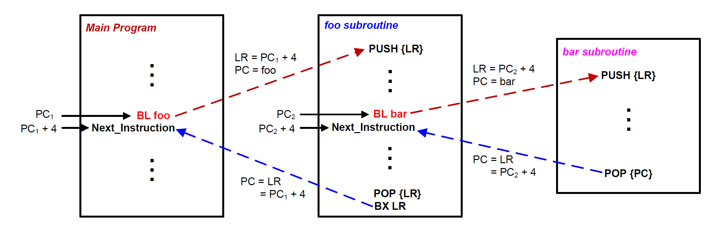
Nested Subroutines: Solution #1

Slide 35
Subroutine Calling Another Subroutine
MAIN
MOV R0,#2
BL QUAD
ENDL ...
QUAD PUSH {LR}
BL SQ
BL SQ
POP {LR}
BX LR
SQ MUL R0,R0
BX LR
Function SQ
Function MAIN
Function QUAD

Slide 36
Subroutine Calling Another Subroutine
MAIN PROC
MOV R0,#2
BL QUAD
ENDL ...
ENDP
QUAD PROC
PUSH {LR}
BL SQ
BL SQ
POP {LR}
BX LR
EDP
SQ PROC
MUL R0,R0
BX LR
EDP
Function MAIN
Function SQ
Function QUAD

Slide 37
Example: R0 = R0⁴
Stack
MOV R0,#2
BL QUAD
B ENDL
SQ MUL R0,R0
BX LR
QUAD PUSH {LR}
BL SQ
BL SQ
POP {LR}
BX LR
ENDL ...
xxxxxxxx
0x20000200
0x200001FC
0x200001F8
R0
MOV R0,#2
0x08000138
BL QUAD
0x0800013C
B ENDL
0x08000140
SP
0x20000200
SQ
MUL R0,R0
0x08000144
LR
BX LR
0x08000148
PC
0x08000138
QUAD
PUSH {LR}
0x0800014C
BL SQ
0x08000150
BL SQ
0x08000154
POP {LR}
0x08000158
BX LR
0x0800015C

Slide 38
Example: R0 = R0⁴
Stack
MOV R0,#2
BL QUAD
B ENDL
SQ MUL R0,R0
BX LR
QUAD PUSH {LR}
BL SQ
BL SQ
POP {LR}
BX LR
ENDL ...
xxxxxxxx
0x20000200
0x200001FC
0x200001F8
R0
0x02
MOV R0,#2
0x08000138
BL QUAD
0x0800013C
B ENDL
0x08000140
SP
0x20000200
SQ
MUL R0,R0
0x08000144
LR
BX LR
0x08000148
PC
0x0800013C
QUAD
PUSH {LR}
0x0800014C
BL SQ
0x08000150
BL SQ
0x08000154
POP {LR}
0x08000158
BX LR
0x0800015C

Slide 39
Example: R0 = R0⁴
Stack
MOV R0,#2
BL QUAD
B ENDL
SQ MUL R0,R0
BX LR
QUAD PUSH {LR}
BL SQ
BL SQ
POP {LR}
BX LR
ENDL ...
xxxxxxxx
0x20000200
0x200001FC
0x200001F8
R0
0x02
MOV R0,#2
0x08000138
BL QUAD
0x0800013C
B ENDL
0x08000140
SP
0x20000200
SQ
MUL R0,R0
0x08000144
LR
0x08000140
BX LR
0x08000148
PC
0x0800014C
QUAD
PUSH {LR}
0x0800014C
BL SQ
0x08000150
BL SQ
0x08000154
Preserve
Link Register (LR)
POP {LR}
0x08000158
BX LR
0x0800015C

Slide 40
Example: R0 = R0⁴
Stack
MOV R0,#2
BL QUAD
B ENDL
SQ MUL R0,R0
BX LR
QUAD PUSH {LR}
BL SQ
BL SQ
POP {LR}
BX LR
ENDL ...
xxxxxxxx
0x20000200
0x08000140
0x200001FC
0x200001F8
R0
0x02
MOV R0,#2
0x08000138
BL QUAD
0x0800013C
B ENDL
0x08000140
SP
0x200001FC
SQ
MUL R0,R0
0x08000144
LR
0x08000140
BX LR
0x08000148
PC
0x08000150
QUAD
PUSH {LR}
0x0800014C
BL SQ
0x08000150
BL SQ
0x08000154
POP {LR}
0x08000158
BX LR
0x0800015C

Slide 41
Example: R0 = R0⁴
Stack
MOV R0,#2
BL QUAD
B ENDL
SQ MUL R0,R0
BX LR
QUAD PUSH {LR}
BL SQ
BL SQ
POP {LR}
BX LR
ENDL ...
xxxxxxxx
0x20000200
0x08000140
0x200001FC
0x200001F8
R0
0x02
MOV R0,#2
0x08000138
BL QUAD
0x0800013C
B ENDL
0x08000140
SP
0x200001FC
SQ
MUL R0,R0
0x08000144
LR
0x08000154
BX LR
0x08000148
PC
0x08000144
QUAD
PUSH {LR}
0x0800014C
BL SQ
0x08000150
BL SQ
0x08000154
POP {LR}
0x08000158
BX LR
0x0800015C

Slide 42
Example: R0 = R0⁴
Stack
MOV R0,#2
BL QUAD
B ENDL
SQ MUL R0,R0
BX LR
QUAD PUSH {LR}
BL SQ
BL SQ
POP {LR}
BX LR
ENDL ...
xxxxxxxx
0x20000200
0x08000140
0x200001FC
0x200001F8
R0
0x04
MOV R0,#2
0x08000138
BL QUAD
0x0800013C
B ENDL
0x08000140
SP
0x200001FC
SQ
MUL R0,R0
0x08000144
LR
0x08000154
BX LR
0x08000148
PC
0x08000148
QUAD
PUSH {LR}
0x0800014C
BL SQ
0x08000150
BL SQ
0x08000154
POP {LR}
0x08000158
BX LR
0x0800015C

Slide 43
Example: R0 = R0⁴
Stack
MOV R0,#2
BL QUAD
B ENDL
SQ MUL R0,R0
BX LR
QUAD PUSH {LR}
BL SQ
BL SQ
POP {LR}
BX LR
ENDL ...
xxxxxxxx
0x20000200
0x08000140
0x200001FC
0x200001F8
R0
0x04
MOV R0,#2
0x08000138
BL QUAD
0x0800013C
B ENDL
0x08000140
SP
0x200001FC
SQ
MUL R0,R0
0x08000144
LR
0x08000154
BX LR
0x08000148
PC
0x08000154
QUAD
PUSH {LR}
0x0800014C
BL SQ
0x08000150
BL SQ
0x08000154
POP {LR}
0x08000158
BX LR
0x0800015C

Slide 44
Example: R0 = R0⁴
Stack
MOV R0,#2
BL QUAD
B ENDL
SQ MUL R0,R0
BX LR
QUAD PUSH {LR}
BL SQ
BL SQ
POP {LR}
BX LR
ENDL ...
xxxxxxxx
0x20000200
0x08000140
0x200001FC
0x200001F8
R0
0x04
MOV R0,#2
0x08000138
BL QUAD
0x0800013C
B ENDL
0x08000140
SP
0x200001FC
SQ
MUL R0,R0
0x08000144
LR
0x08000158
BX LR
0x08000148
PC
0x08000144
QUAD
PUSH {LR}
0x0800014C
BL SQ
0x08000150
BL SQ
0x08000154
POP {LR}
0x08000158
BX LR
0x0800015C

Slide 45
Example: R0 = R0⁴
Stack
MOV R0,#2
BL QUAD
B ENDL
SQ MUL R0,R0
BX LR
QUAD PUSH {LR}
BL SQ
BL SQ
POP {LR}
BX LR
ENDL ...
xxxxxxxx
0x20000200
0x08000140
0x200001FC
0x200001F8
R0
0x10
MOV R0,#2
0x08000138
BL QUAD
0x0800013C
B ENDL
0x08000140
SP
0x200001FC
SQ
MUL R0,R0
0x08000144
LR
0x08000158
BX LR
0x08000148
PC
0x08000148
QUAD
PUSH {LR}
0x0800014C
BL SQ
0x08000150
BL SQ
0x08000154
POP {LR}
0x08000158
BX LR
0x0800015C

Slide 46
Example: R0 = R0⁴
Stack
MOV R0,#2
BL QUAD
B ENDL
SQ MUL R0,R0
BX LR
QUAD PUSH {LR}
BL SQ
BL SQ
POP {LR}
BX LR
ENDL ...
xxxxxxxx
0x20000200
0x08000140
0x200001FC
0x200001F8
R0
0x10
MOV R0,#2
0x08000138
BL QUAD
0x0800013C
B ENDL
0x08000140
SP
0x200001FC
SQ
MUL R0,R0
0x08000144
LR
0x08000158
BX LR
0x08000148
PC
0x08000158
QUAD
PUSH {LR}
0x0800014C
BL SQ
0x08000150
BL SQ
0x08000154
POP {LR}
0x08000158
BX LR
0x0800015C

Slide 47
Example: R0 = R0⁴
Stack
MOV R0,#2
BL QUAD
B ENDL
SQ MUL R0,R0
BX LR
QUAD PUSH {LR}
BL SQ
BL SQ
POP {LR}
BX LR
ENDL ...
xxxxxxxx
0x20000200
0x08000140
0x200001FC
0x200001F8
R0
0x10
MOV R0,#2
0x08000138
BL QUAD
0x0800013C
B ENDL
0x08000140
SP
0x20000200
SQ
MUL R0,R0
0x08000144
LR
0x08000140
BX LR
0x08000148
PC
0x0800015C
QUAD
PUSH {LR}
0x0800014C
BL SQ
0x08000150
BL SQ
0x08000154
Restore
Link Register (LR)
POP {LR}
0x08000158
BX LR
0x0800015C

Slide 48
Example: R0 = R0⁴
Stack
MOV R0,#2
BL QUAD
B ENDL
SQ MUL R0,R0
BX LR
QUAD PUSH {LR}
BL SQ
BL SQ
POP {LR}
BX LR
ENDL ...
xxxxxxxx
0x20000200
0x08000140
0x200001FC
0x200001F8
R0
0x10
MOV R0,#2
0x08000138
BL QUAD
0x0800013C
B ENDL
0x08000140
SP
0x20000200
SQ
MUL R0,R0
0x08000144
LR
0x08000140
BX LR
0x08000148
PC
0x08000140
QUAD
PUSH {LR}
0x0800014C
BL SQ
0x08000150
BL SQ
0x08000154
POP {LR}
0x08000158
BX LR
0x0800015C

Slide 49
Stack Pointer (SP)
SP is the shadow of MSP (Main SP) or PSP (Process SP)
If there is no embedded OS, PSP is not used
Determined by the ASP (Active SP) bit in the CONTROL register (ASP is always 0 in handler mode).
0 = MSP (default)
1 = PSP
Before using the stack, software has to define stack space and initialize the stack pointer (SP).
The program startup.s defines stack space and initializes SP.
Bit 31 - 3 | 2 | 1 | 0
Reserved |  | ASP
CONTROL Register
Register Bank
Special Registers

Slide 50
Passing Arguments into a Subroutine
Review

Slide 51
Passing Arguments into a Subroutine
Review
int32_t sum(int16_t a16, int16_t b16, int8_t c8, int32_t d32);
a16
b16
c8
d32
Register R0
Register R1
Register R2
Register R3
Subroutine
Return Value
Register R0

Slide 52
Passing 4 Arguments
Review
int32_t sum(int16_t a16, int16_t b16, int8_t c8, int32_t d32);
s = sum(1, 2, 3, 4);
Caller
Callee
MOVS r0, #1 ; a16
MOVS r1, #2 ; b16
MOVS r2, #3 ; c8
MOVS r3, #4 ; d32
BL sum
sum PROC
ADD r0, r0, r1 ; a16 + b16
ADD r0, r0, r2 ; add c8
ADD r0, r0, r3 ; add d32
BX LR ; return
ENDP

Slide 53
Passing Extra Arguments via Stack
Version 1
sum PROC
EXPORT sum
ADD r0, r0, r1 ; add a + b
ADD r0, r0, r2 ; add c
ADD r0, r0, r3 ; add d
LDRD r1,r2, [sp] ; r1=mem[sp],r2=mem[sp+4]
ADD r0, r0, r1 ; add h
ADD r0, r0, r2 ; add i
LDRD r1,r2, [sp, #8] ; r1=mem[sp+8],r2=mem[sp+12]
ADD r0, r0, r1 ; add j
ADD r0, r0, r2 ; add k
BX LR
ENDP
int32_t sum(int32_t a, int32_t b, int32_t c, int32_t d, int32_t h, int32_t i, int32_t j, int32_t k);
s = sum(1, 2, 3, 4, 5, 6, 7, 8);
Caller
MOVS r0, #5
MOVS r1, #6
MOVS r2, #7
MOVS r3, #8
PUSH {r0, r1, r2, r3}
MOVS r0, #1
MOVS r1, #2
MOVS r2, #3
MOVS r3, #4
BL sum
...
POP {r0, r1, r2, r3}
Version 2
sum PROC
EXPORT sum
PUSH {r5, r6, lr}
ADD r0, r0, r1 ; add a + b
ADD r0, r0, r2 ; add c
ADD r0, r0, r3 ; add d
LDRD r5,r6, [sp, #12] ;r5=mem[sp+12],r6=mem[sp+16]
ADD r0, r0, r5 ; add h
ADD r0, r0, r6 ; add i
LDRD r5,r6, [sp, #20] ;r5=mem[sp+20],r6=mem[sp+24]
ADD r0, r0, r5 ; add j
ADD r0, r0, r6 ; add k
POP {r5, r6, pc}
ENDP

Slide 54
Explanations
Version 1:
Callee reads the extra args directly from the caller’s push with LDRD: Load Register Doubleword:
LDRD r1,r2, [sp] → loads 5th & 6th args (h, i)
LDRD r1,r2, [sp,#8] → loads 7th & 8th args (j, k)
It returns with BX LR.
Version 2:
Callee pushes r5, r6, and lr on entry: PUSH {r5, r6, lr}.
Because it pushed, the extra-argument addresses are shifted, so it uses offsets like [sp,#12] and [sp,#20] to read the caller’s arguments into r5,r6.
LDRD r5,r6, [sp, #12]
LDRD r5,r6, [sp, #20]
It returns via POP {r5, r6, pc} (popping lr into pc returns directly).
Ladder analogy:
Think of the stack like a ladder: The ladder = one shared stack in memory.
The rung each function stands on = its current SP value.
When a function “pushes,” it steps down a few rungs (SP decreases).
The caller’s pushed data remains up above — just higher up the same ladder.
Address | Contents | Access
0x0FFC | arg8 (k=8) | [sp,#12]
0x0FF8 | arg7 (j=7) | [sp,#8]
0x0FF4 | arg6 (i=6) | [sp,#4]
0x0FF0 | arg5 (h=5) | [sp] ← SP
Version 1 stack after Caller PUSH
Address | Contents | Access
0x0FFC | arg8 (k=8) | [sp,#24]
0x0FF8 | arg7 (j=7) | [sp,#20]
0x0FF4 | arg6 (i=6) | [sp,#16]
0x0FF0 | arg5 (h=5) | [sp,#12]
0x0FEC | saved lr | [sp,#8]
0x0FE8 | saved r6 | [sp,#4]
0x0FE4 | saved r5 | [sp] ← SP
Version 2 stack after Caller PUSH and Callee PUSH
Notes:
Callee does no PUSH on entry.
Returns with BX LR (it never changed LR).

Slide 55
Version 2 is Better Programming Practice
Caller pushes extra arguments (5th to 8th) onto the stack before calling the function.
Version 1: Callee accesses those extra arguments directly from the stack using LDRD instructions at specific offsets from SP. It demonstrates the basic mechanism for handling extra arguments on the stack.
Version 2: Callee begins by pushing registers r5, r6, and the link register (LR) (the callee-saved registers) onto the stack to preserve them. After addition operations, it pops r5, r6, and the program counter (PC) to return, restoring the preserved registers and the return address. This ensures that the subroutine does not unintentionally overwrite or lose the caller's data and return address, maintaining program correctness during and after the function call.
Notes:
8 arguments are passed: Registers r0-r3 hold the first 4 arguments (a, b, c, d with values 1, 2, 3, 4). The last 4 arguments (h, i, j, k with values 5, 6, 7, 8) are pushed onto the stack by the caller before calling the function.
In callee (subroutine) code, the subroutine saves registers r5, r6, and the link register LR via push at the start. It adds the first 4 arguments from registers r0-r3. It then loads the extra arguments from specific stack offsets with LDRD instructions (load register double), adding these to the result. The subroutine ends by popping saved registers r5, r6 and PC (program counter) to return.

Slide 56
Summary
ARM Cortex-M uses full descending stack
How to pass arguments into a subroutine?
Each 8-, 16- or 32-bit parameter is passed via r0, r1, r2, r3
Extra parameters are passed via the stack
What registers should be preserved?
Caller-saved registers vs callee-saved registers
How to preserve the running environment for the caller?
Via stack

Slide 57
References
Lecture 31. Preserving registers in a Subroutine
https://www.youtube.com/watch?v=DGKjFKjxAYs&list=PLRJhV4hUhIymmp5CCeIFPyxbknsdcXCc8&index=31

