Slide 1
Dr. Yifeng Zhu Electrical and Computer Engineering University of Maine
Embedded Systems with ARM Cortex-M Microcontrollers in Assembly Language and C
Chapter 10
Preserve Environment via Stack
Spring 2020

Slide 2
Overview
How to call a subroutine?
How to return the control back to the caller?
How to pass arguments into a subroutine?
How to return a value in a subroutine?
How to preserve the running environment for the caller?

Slide 3
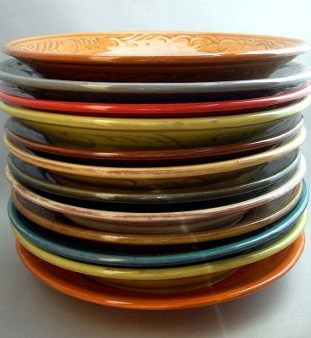
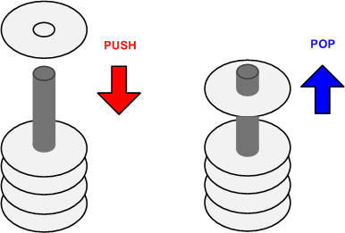
Stack
A Last-In-First-Out memory model
Only allow to access the most recently added item
Also called the top of the stack
Key operations:
push (add item to stack)
pop (remove top item from stack)

Slide 4
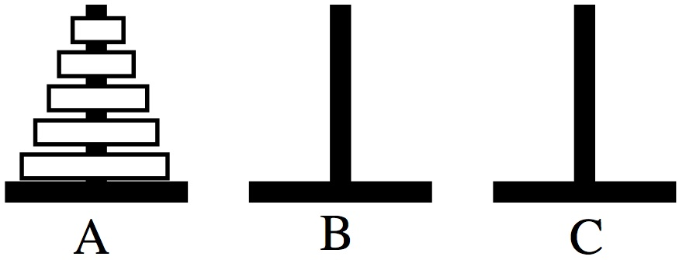
Tower of Hanoi
Only one disk may be moved at a time.
Each move consists of taking the upper disk from one of the rods and sliding it onto another rod, on top of the other disks that may already be present on that rod.
No disk may be placed on top of a smaller disk.

Slide 5
Tower of Hanoi
STACK: Last In First Out
Stack 1
Stack 2
Stack 3
http://en.wikipedia.org/wiki/File:Tower_of_Hanoi_4.gif

Slide 6
Stack Growth Convention: Ascending vs Descending
Descending stack: Stack grows towards low memory address
Ascending stack: Stack grows towards high memory address

Slide 7
Stack Growth Convention: Full vs Empty
Full stack: SP points to the last item pushed onto the stack
Empty stack: SP points to the next free space on the stack

Slide 8
Cortex-M Stack
Cortex-M uses full descending stack
Example:
PUSH/POP {r0,r6,r3}
Stack pointer (SP, aka R13)
decremented on PUSH
SP = SP – 4 * # of registers
incremented on POP
SP = SP + 4 * # of registers
SP starts at 0x20000200 for STM32-Discovery by default (can be changed in startup.s)

Slide 9
Full Descending Stack

Slide 10
Stack Implementation
Stock Name | Push |  | Pop
 | Equivalent | Alternative | Equivalent | Alternative
Full Descending(FD) | STMFD SP!,list | STMDB SP!,list | LDMFD SP!,list | LDMIA SP!,list
Empty Descending(ED) | STMED SP!,list | STMDA SP!,list | LDMED SP!,list | LDMIB SP!,list
Full Ascending(FA) | STMFA SP!,list | STMIB SP!,list | LDMFA SP!,list | LDMDA SP!,list
Empty Ascending(EA) | STMEA SP!,list | STMIA SP!,list | LDMEA SP!,list | LDMDB SP!,list

Slide 11
Typical Usage of Stack
Why need stack?
Saving the original contents of processor’s registers at the beginning a subroutine (Contents are restored at the end of a subroutine)
Storing local variables in a subroutine
Passing extra arguments to a subroutine
Saving processor’s registers upon an interrupt
Sound complex? No worry! We will learn them.

Slide 12
Stack
PUSH {Rd}
SP = SP-4 ⟶ descending stack
(*SP) = Rd ⟶ full stack
Push multiple registers
They are equivalent.
PUSH {r8}
PUSH {r7}
PUSH {r6}
PUSH {r6, r7, r8}
PUSH {r8, r7, r6}
The order in which registers listed in the register list does not matter.
When pushing multiple registers, these registers are automatically sorted by name and the lowest-numbered register is stored to the lowest memory address, i.e. is stored last.

Slide 13
Stack
POP {Rd}
Rd = (*SP) ⟶ full stack
SP = SP + 4 ⟶ Stack shrinks
Pop multiple registers
They are equivalent.
POP {r6}
POP {r7}
POP {r8}
POP {r6, r7, r8}
POP {r8, r7, r6}
The order in which registers listed in the register list does not matter.
When popping multiple registers, these registers are automatically sorted by name and the lowest-numbered register is loaded from the lowest memory address, i.e. is loaded first.

Slide 14
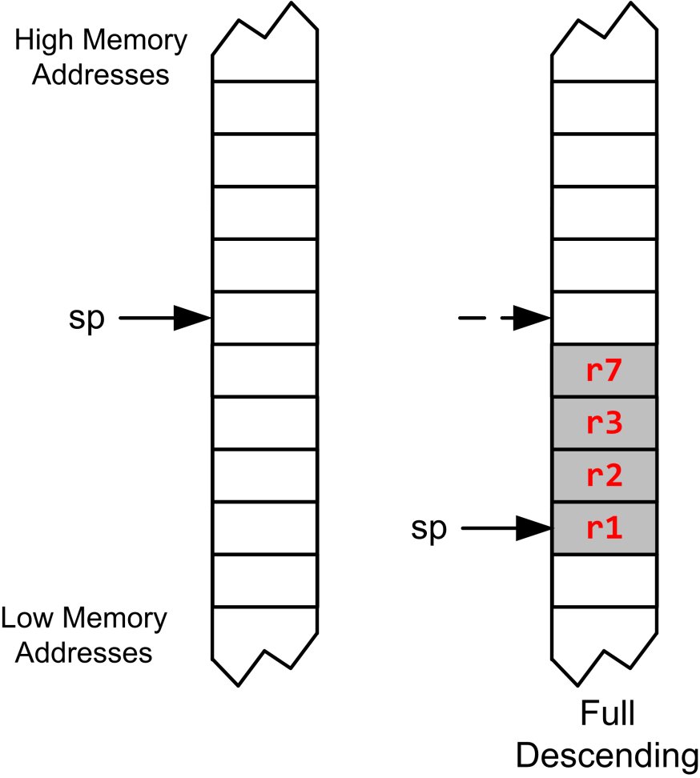
Full Descending Stack
PUSH {r3, r1, r7, r2}

Slide 15
Full Descending Stack
PUSH {r3, r1, r7, r2}
Largest-numbered register is pushed first.

Slide 16
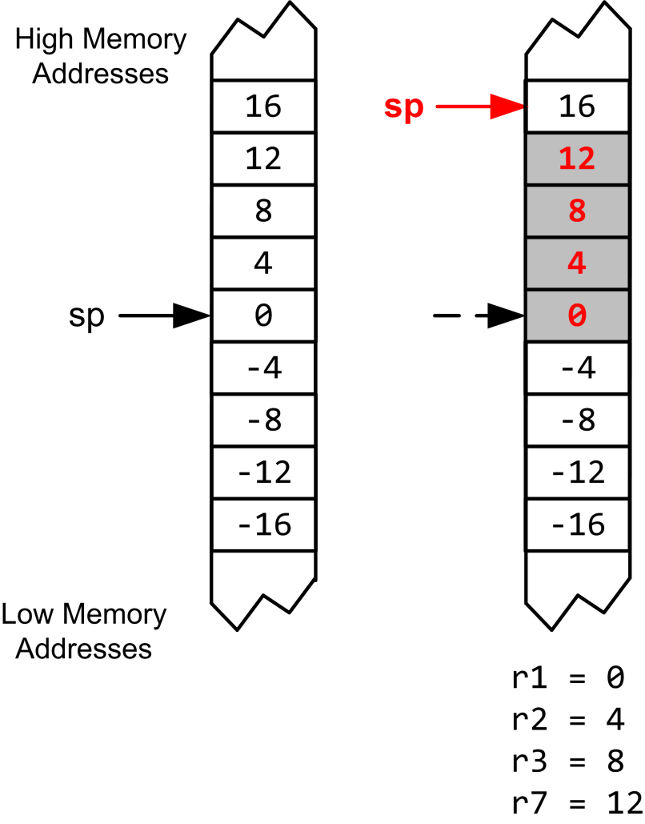
Full Descending Stack
PUSH {r3, r1, r7, r2}
POP {r3, r1, r7, r2}

Slide 17
Full Descending Stack
PUSH {r3, r1, r7, r2}
POP {r3, r1, r7, r2}
Smallest-numbered register is popped first.

Slide 18
Example: swap R1 & R2
R1
0x11111111
R2
0x22222222
PUSH {R1}
PUSH {R2}
POP {R1}
POP {R2}
Address
R13 (SP)
0x20000200
xxxxxxxx
0x20000200
xxxxxxxx
0x200001FC
xxxxxxxx
0x200001F8
memory

Slide 19
Example: swap R1 & R2
R1
0x11111111
R2
0x22222222
PUSH {R1}
PUSH {R2}
POP {R1}
POP {R2}
Address
PC
R13 (SP)
0x200001FC
xxxxxxxx
0x20000200
0x11111111
0x200001FC
xxxxxxxx
0x200001F8
memory

Slide 20
Example: swap R1 & R2
R1
0x11111111
R2
0x22222222
PUSH {R1}
PUSH {R2}
POP {R1}
POP {R2}
Address
R13 (SP)
0x200001F8
PC
xxxxxxxx
0x20000200
0x11111111
0x200001FC
0x22222222
0x200001F8
memory

Slide 21
Example: swap R1 & R2
R1
0x22222222
R2
0x22222222
PUSH {R1}
PUSH {R2}
POP {R1}
POP {R2}
Address
R13 (SP)
0x200001FC
xxxxxxxx
0x20000200
PC
0x11111111
0x200001FC
0x22222222
0x200001F8
memory

Slide 22
Example: swap R1 & R2
R1
0x22222222
R2
0x11111111
PUSH {R1}
PUSH {R2}
POP {R1}
POP {R2}
Address
R13 (SP)
0x20000200
xxxxxxxx
0x20000200
0x11111111
0x200001FC
PC
0x22222222
0x200001F8
memory

Slide 23
Quiz
Are the values of R1 and R2 swapped?
PUSH {R1, R2}
POP {R2, R1}
Answer: No.
But you can:
PUSH {R1, R2}
POP {R2}
POP {R1}
or
PUSH {R1}
PUSH {R2}
POP {R1, R2}

Slide 24
Subroutine
A subroutines, also called a function or a procedure,
single-entry, single-exit
Return to caller after it exits
When a subroutine is called, the Link Register (LR) holds the memory address of the next instruction to be executed after the subroutine exits.

Slide 25
Link Register
Link Register (LR) holds the return address of the current subroutine call.

Slide 26
Call a Subroutine
Caller Program | Subroutine/Callee
MOV r4, #100 ... BL foo ... ADD r4, r4, #1 ; r4 = 101, not 11 | foo PROC ... MOV r4, #10 ; foo changes r4 ... BX LR ENDP

Slide 27
Calling a Subroutine
BL label
Step 1: LR = PC + 4
Step 2: PC = label
Notes:
label is name of subroutine
Compiler translates label to memory address
After call, LR holds return address (the instruction following the call)
Caller Program
MOV r4, #100 ... BL foo ...
Subroutine/Callee
foo PROC ... MOV r4, #10 ... BX LR ENDP

Slide 28
Exiting a Subroutine
Caller Program
MOV r4, #100 ... BL foo ...
Subroutine/Callee
foo PROC ... MOV r4, #10 ... BX LR ENDP
Branch and Exchange
BX LR
PC = LR

Slide 29
ARM Procedure Call Standard
Register | Usage | Subroutine Preserved | Notes
r0 | Argument 1 and return value | No | If return has 64 bits, then r0:r1 hold it. If argument 1 has 64 bits, r0:r1 hold it.
r1 | Argument 2 | No
r2 | Argument 3 | No | If the return has 128 bits, r0-r3 hold it.
r3 | Argument 4 | No | If more than 4 arguments, use the stack
r4 | General-purpose V1 | Yes | Variable register 1 holds a local variable.
r5 | General-purpose V2 | Yes | Variable register 2 holds a local variable.
r6 | General-purpose V3 | Yes | Variable register 3 holds a local variable.
r7 | General-purpose V4 | Yes | Variable register 4 holds a local variable.
r8 | General-purpose V5 | YES | Variable register 5 holds a local variable.
r9 | Platform specific/V6 | Yes/No | Usage is platform-dependent.
r10 | General-purpose V7 | Yes | Variable register 7 holds a local variable.
r11 | General-purpose V8 | Yes | Variable register 8 holds a local variable.
r12 (IP) | Intra-procedure-call register | No | It holds intermediate values between a procedure and the sub-procedure it calls.
r13 (SP) | Stack pointer | Yes | SP has to be the same after a subroutine has completed.
r14 (LR) | Link register | No | LR does not have to contain the same value after a subroutine has completed.
r15 (PC) | Program counter | N/A | Do not directly change PC

Slide 30
Caller-saved Registers vs Callee-saved Registers
Caller-saved registers
Not saved by subroutine
Hold arguments/result
Caller expects their values are retained
Callee must save and store it if callee modifies it
Callee-saved registers
Callee-saved registers
Register Bank
Special Registers

Slide 31
Preserve Runtime Environment via Stack
Caller Program | Subroutine/Callee
MOV r4, #100 ... BL foo ... ADD r4, r4, #1 ; r4 = 101, not 11 | foo PROC PUSH {r4} ; preserve r4 ... MOV r4, #10 ; foo changes r4 ... POP {r4} ; Recover r4 BX LR ENDP
Caller expects callee does not modify r4!
Callee should preserve r4!

Slide 32
Preserve Runtime Environment via Stack
Caller Program | Subroutine/Callee
Caller should save these registers if callers needs to re-use their original values: R0 – R3 R12 CPSR | Callee should Preserve R4 – R11 R14 (LR) R13 (SP)

Slide 33
Preserve Runtime Environment via Stack
What is wrong in foo()?
Caller Program | Subroutine foo | Subroutine bar
MOV r4, #100 ... BL foo ... ADD r4, r4, #1 | foo PROC PUSH {r4} ... MOV r4, #10 ... BL bar ... POP {r4} BX LR ENDP | bar PROC ... BX LR ENDP

Slide 34
Preserve Runtime Environment via Stack
What is wrong in foo()?
Caller Program | Subroutine foo | Subroutine bar
MOV r4, #100 ... BL foo ... ADD r4, r4, #1 | foo PROC PUSH {r4} ... MOV r4, #10 ... BL bar ... POP {r4} BX LR ENDP | bar PROC ... BX LR ENDP

Slide 35
Preserve Runtime Environment via Stack
What is wrong in foo()? Solution #1
Caller Program | Subroutine foo | Subroutine bar
MOV r4, #100 ... BL foo ... ADD r4, r4, #1 | foo PROC PUSH {r4, LR} ... MOV r4, #10 ... BL bar ... POP {r4, LR} BX LR ENDP | bar PROC ... BX LR ENDP

Slide 36
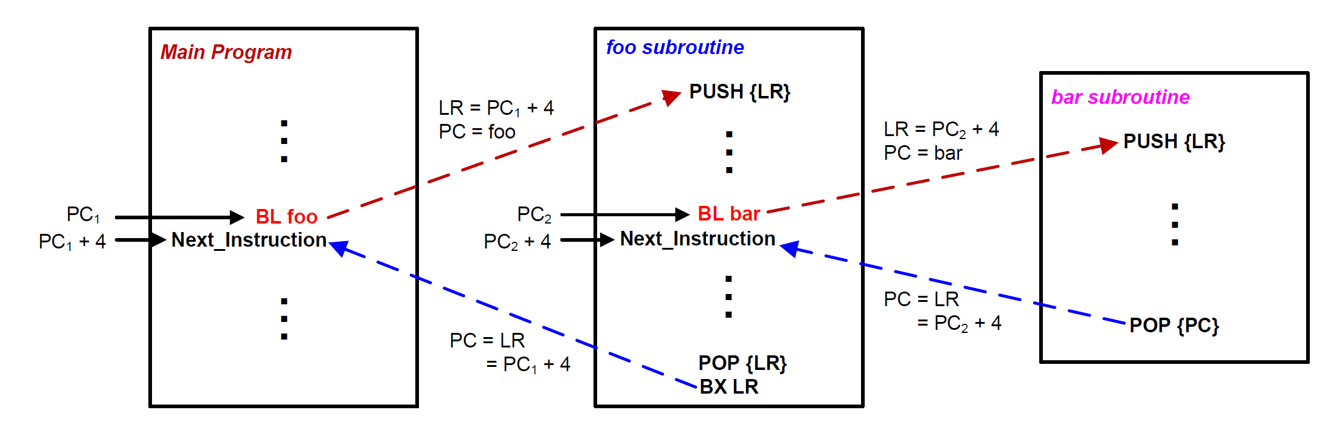
Stacks and Subroutines

Slide 37
Preserve Runtime Environment via Stack
What is wrong in foo()? Solution #2
Caller Program | Subroutine foo | Subroutine bar
MOV r4, #100 ... BL foo ... ADD r4, r4, #1 | foo PROC PUSH {r4, LR} ... MOV r4, #10 ... BL bar ... POP {r4, PC} BX LR ENDP | bar PROC ... BX LR ENDP

Slide 38
Subroutine Calling Another Subroutine
MAIN
MOV R0,#2
BL QUAD
ENDL ...
QUAD PUSH {LR}
BL SQ
BL SQ
POP {LR}
BX LR
SQ MUL R0,R0
BX LR
Function SQ
Function MAIN
Function QUAD

Slide 39
Subroutine Calling Another Subroutine
MAIN PROC
MOV R0,#2
BL QUAD
ENDL ...
ENDP
QUAD PROC
PUSH {LR}
BL SQ
BL SQ
POP {LR}
BX LR
ENDP
SQ PROC
MUL R0,R0
BX LR
ENDP
Function MAIN
Function SQ
Function QUAD

Slide 40
Example: R0 = R0⁴
MOV R0,#2
BL QUAD
B ENDL
SQ MUL R0,R0
BX LR
QUAD PUSH {LR}
BL SQ
BL SQ
POP {LR}
BX LR
ENDL ...
xxxxxxxx
0x20000200
0x200001FC
0x200001F8
R0
MOV R0,#2
0x08000138
BL QUAD
0x0800013C
B ENDL
0x08000140
SP
0x20000200
SQ
MUL R0,R0
0x08000144
LR
BX LR
0x08000148
PC
0x08000138
QUAD
PUSH {LR}
0x0800014C
BL SQ
0x08000150
BL SQ
0x08000154
POP {LR}
0x08000158
BX LR
0x0800015C

Slide 41
Example: R0 = R0⁴
MOV R0,#2
BL QUAD
B ENDL
SQ MUL R0,R0
BX LR
QUAD PUSH {LR}
BL SQ
BL SQ
POP {LR}
BX LR
ENDL ...
xxxxxxxx
0x20000200
0x200001FC
0x200001F8
R0
0x02
MOV R0,#2
0x08000138
BL QUAD
0x0800013C
B ENDL
0x08000140
SP
0x20000200
SQ
MUL R0,R0
0x08000144
LR
BX LR
0x08000148
PC
0x0800013C
QUAD
PUSH {LR}
0x0800014C
BL SQ
0x08000150
BL SQ
0x08000154
POP {LR}
0x08000158
BX LR
0x0800015C

Slide 42
Example: R0 = R0⁴
MOV R0,#2
BL QUAD
B ENDL
SQ MUL R0,R0
BX LR
QUAD PUSH {LR}
BL SQ
BL SQ
POP {LR}
BX LR
ENDL ...
xxxxxxxx
0x20000200
0x200001FC
0x200001F8
R0
0x02
MOV R0,#2
0x08000138
BL QUAD
0x0800013C
B ENDL
0x08000140
SP
0x20000200
SQ
MUL R0,R0
0x08000144
LR
0x08000140
BX LR
0x08000148
PC
0x0800014C
QUAD
PUSH {LR}
0x0800014C
BL SQ
0x08000150
BL SQ
0x08000154
Preserve
Link Register (LR)
POP {LR}
0x08000158
BX LR
0x0800015C

Slide 43
Example: R0 = R0⁴
MOV R0,#2
BL QUAD
B ENDL
SQ MUL R0,R0
BX LR
QUAD PUSH {LR}
BL SQ
BL SQ
POP {LR}
BX LR
ENDL ...
xxxxxxxx
0x20000200
0x08000140
0x200001FC
0x200001F8
R0
0x02
MOV R0,#2
0x08000138
BL QUAD
0x0800013C
B ENDL
0x08000140
SP
0x200001FC
SQ
MUL R0,R0
0x08000144
LR
0x08000140
BX LR
0x08000148
PC
0x08000150
QUAD
PUSH {LR}
0x0800014C
BL SQ
0x08000150
BL SQ
0x08000154
POP {LR}
0x08000158
BX LR
0x0800015C

Slide 44
Example: R0 = R0⁴
MOV R0,#2
BL QUAD
B ENDL
SQ MUL R0,R0
BX LR
QUAD PUSH {LR}
BL SQ
BL SQ
POP {LR}
BX LR
ENDL ...
xxxxxxxx
0x20000200
0x08000140
0x200001FC
0x200001F8
R0
0x02
MOV R0,#2
0x08000138
BL QUAD
0x0800013C
B ENDL
0x08000140
SP
0x200001FC
SQ
MUL R0,R0
0x08000144
LR
0x08000154
BX LR
0x08000148
PC
0x08000144
QUAD
PUSH {LR}
0x0800014C
BL SQ
0x08000150
BL SQ
0x08000154
POP {LR}
0x08000158
BX LR
0x0800015C

Slide 45
Example: R0 = R0⁴
MOV R0,#2
BL QUAD
B ENDL
SQ MUL R0,R0
BX LR
QUAD PUSH {LR}
BL SQ
BL SQ
POP {LR}
BX LR
ENDL ...
xxxxxxxx
0x20000200
0x08000140
0x200001FC
0x200001F8
R0
0x04
MOV R0,#2
0x08000138
BL QUAD
0x0800013C
B ENDL
0x08000140
SP
0x200001FC
SQ
MUL R0,R0
0x08000144
LR
0x08000154
BX LR
0x08000148
PC
0x08000148
QUAD
PUSH {LR}
0x0800014C
BL SQ
0x08000150
BL SQ
0x08000154
POP {LR}
0x08000158
BX LR
0x0800015C

Slide 46
Example: R0 = R0⁴
MOV R0,#2
BL QUAD
B ENDL
SQ MUL R0,R0
BX LR
QUAD PUSH {LR}
BL SQ
BL SQ
POP {LR}
BX LR
ENDL ...
xxxxxxxx
0x20000200
0x08000140
0x200001FC
0x200001F8
R0
0x04
MOV R0,#2
0x08000138
BL QUAD
0x0800013C
B ENDL
0x08000140
SP
0x200001FC
SQ
MUL R0,R0
0x08000144
LR
0x08000154
BX LR
0x08000148
PC
0x08000154
QUAD
PUSH {LR}
0x0800014C
BL SQ
0x08000150
BL SQ
0x08000154
POP {LR}
0x08000158
BX LR
0x0800015C

Slide 47
Example: R0 = R0⁴
MOV R0,#2
BL QUAD
B ENDL
SQ MUL R0,R0
BX LR
QUAD PUSH {LR}
BL SQ
BL SQ
POP {LR}
BX LR
ENDL ...
xxxxxxxx
0x20000200
0x08000140
0x200001FC
0x200001F8
R0
0x04
MOV R0,#2
0x08000138
BL QUAD
0x0800013C
B ENDL
0x08000140
SP
0x200001FC
SQ
MUL R0,R0
0x08000144
LR
0x08000158
BX LR
0x08000148
PC
0x08000144
QUAD
PUSH {LR}
0x0800014C
BL SQ
0x08000150
BL SQ
0x08000154
POP {LR}
0x08000158
BX LR
0x0800015C

Slide 48
Example: R0 = R0⁴
MOV R0,#2
BL QUAD
B ENDL
SQ MUL R0,R0
BX LR
QUAD PUSH {LR}
BL SQ
BL SQ
POP {LR}
BX LR
ENDL ...
xxxxxxxx
0x20000200
0x08000140
0x200001FC
0x200001F8
R0
0x10
MOV R0,#2
0x08000138
BL QUAD
0x0800013C
B ENDL
0x08000140
SP
0x200001FC
SQ
MUL R0,R0
0x08000144
LR
0x08000158
BX LR
0x08000148
PC
0x08000148
QUAD
PUSH {LR}
0x0800014C
BL SQ
0x08000150
BL SQ
0x08000154
POP {LR}
0x08000158
BX LR
0x0800015C

Slide 49
Example: R0 = R0⁴
MOV R0,#2
BL QUAD
B ENDL
SQ MUL R0,R0
BX LR
QUAD PUSH {LR}
BL SQ
BL SQ
POP {LR}
BX LR
ENDL ...
xxxxxxxx
0x20000200
0x08000140
0x200001FC
0x200001F8
R0
0x10
MOV R0,#2
0x08000138
BL QUAD
0x0800013C
B ENDL
0x08000140
SP
0x200001FC
SQ
MUL R0,R0
0x08000144
LR
0x08000158
BX LR
0x08000148
PC
0x08000158
QUAD
PUSH {LR}
0x0800014C
BL SQ
0x08000150
BL SQ
0x08000154
POP {LR}
0x08000158
BX LR
0x0800015C

Slide 50
Example: R0 = R0⁴
MOV R0,#2
BL QUAD
B ENDL
SQ MUL R0,R0
BX LR
QUAD PUSH {LR}
BL SQ
BL SQ
POP {LR}
BX LR
ENDL ...
xxxxxxxx
0x20000200
0x08000140
0x200001FC
0x200001F8
R0
0x10
MOV R0,#2
0x08000138
BL QUAD
0x0800013C
B ENDL
0x08000140
SP
0x20000200
SQ
MUL R0,R0
0x08000144
LR
0x08000140
BX LR
0x08000148
PC
0x0800015C
QUAD
PUSH {LR}
0x0800014C
BL SQ
0x08000150
BL SQ
0x08000154
Restore
Link Register (LR)
POP {LR}
0x08000158
BX LR
0x0800015C

Slide 51
Example: R0 = R0⁴
MOV R0,#2
BL QUAD
B ENDL
SQ MUL R0,R0
BX LR
QUAD PUSH {LR}
BL SQ
BL SQ
POP {LR}
BX LR
ENDL ...
xxxxxxxx
0x20000200
0x08000140
0x200001FC
0x200001F8
R0
0x10
MOV R0,#2
0x08000138
BL QUAD
0x0800013C
B ENDL
0x08000140
SP
0x20000200
SQ
MUL R0,R0
0x08000144
LR
0x08000140
BX LR
0x08000148
PC
0x08000140
QUAD
PUSH {LR}
0x0800014C
BL SQ
0x08000150
BL SQ
0x08000154
POP {LR}
0x08000158
BX LR
0x0800015C

Slide 52
Stack Pointer (SP)
SP is the shadow of MSP (Main SP) or PSP (Process SP)
If there is no embedded OS, PSP is not used
Determined by the ASP (Active SP) bit in the CONTROL register (ASP is always 0 in handler mode).
0 = MSP (default)
1 = PSP
Bit 31 - 3 | 2 | 1 | 0
Reserved |  | ASP
CONTROL Register
Register Bank
Special Registers

Slide 53
Initializing the stack pointer (SP)
Before using the stack, software has to define stack space and initialize the stack pointer (SP).
The assembly file startup.s defines stack space and initialize SP.

Slide 54
Passing Arguments into a Subroutine

Slide 55
Passing Arguments into a Subroutine
int32_t sum(int16_t a16, int16_t b16, int8_t c8, int32_t d32);
a16
b16
c8
d32
Register R0
Register R1
Register R2
Register R3
Subroutine
Return Value
Register R0

Slide 56
Passing 4 Arguments
int32_t sum(int16_t a16, int16_t b16, int8_t c8, int32_t d32);
s = sum(1, 2, 3, 4);
Caller
Callee
MOVS r0, #1 ; a16
MOVS r1, #2 ; b16
MOVS r2, #3 ; c8
MOVS r3, #4 ; d32
BL sum
sum PROC
ADD r0, r0, r1 ; a16 + b16
ADD r0, r0, r2 ; add c8
ADD r0, r0, r3 ; add d32
BX LR ; return
ENDP

Slide 57
Passing Extra Arguments via Stack
int32_t sum(int32_t a, int32_t b, int32_t c, int32_t d,
int32_t h, int32_t i, int32_t j, int32_t k);
s = sum(1, 2, 3, 4, 5, 6, 7, 8);
Caller
Callee
MOVS r0, #5
MOVS r1, #6
MOVS r2, #7
MOVS r3, #8
PUSH {r0, r1, r2, r3}
MOVS r0, #1
MOVS r1, #2
MOVS r2, #3
MOVS r3, #4
BL sum
...
POP {r0, r1, r2, r3}
sum PROC
EXPORT sum
ADD r0, r0, r1 ; add a + b
ADD r0, r0, r2 ; add c
ADD r0, r0, r3 ; add d
LDRD r1,r2, [sp] ; r1=mem[sp],r2=mem[sp+4]
ADD r0, r0, r1 ; add h
ADD r0, r0, r2 ; add i
LDRD r1,r2, [sp, #8] ; r1=mem[sp+8],r2=mem[sp+12]
ADD r0, r0, r1 ; add j
ADD r0, r0, r2 ; add k
BX LR
ENDP
LDRD: Load Register Doubleword

Slide 58
Passing Extra Arguments via Stack
int32_t sum(int32_t a, int32_t b, int32_t c, int32_t d,
int32_t h, int32_t i, int32_t j, int32_t k);
s = sum(1, 2, 3, 4, 5, 6, 7, 8);
Caller
Callee
MOVS r0, #5
MOVS r1, #6
MOVS r2, #7
MOVS r3, #8
PUSH {r0, r1, r2, r3}
MOVS r0, #1
MOVS r1, #2
MOVS r2, #3
MOVS r3, #4
BL sum
...
POP {r0, r1, r2, r3}
sum PROC
EXPORT sum
PUSH {r5, r6, lr}
ADD r0, r0, r1 ; add a + b
ADD r0, r0, r2 ; add c
ADD r0, r0, r3 ; add d
LDRD r5,r6, [sp, #12] ;r5=mem[sp+12],r6=mem[sp+16]
ADD r0, r0, r5 ; add h
ADD r0, r0, r6 ; add i
LDRD r5,r6, [sp, #20] ;r5=mem[sp+20],r6=mem[sp+24]
ADD r0, r0, r5 ; add j
ADD r0, r0, r6 ; add k
POP {r5, r6, pc}
ENDP

Slide 59
Passing Extra Arguments via Stack
int32_t sum(int32_t a, int32_t b, int32_t c, int32_t d,
int32_t h, int32_t i, int32_t j, int32_t k);
s = sum(1, 2, 3, 4, 5, 6, 7, 8);
Caller
Stack
MOVS r0, #5
MOVS r1, #6
MOVS r2, #7
MOVS r3, #8
PUSH {r0, r1, r2, r3}
MOVS r0, #1
MOVS r1, #2
MOVS r2, #3
MOVS r3, #4
BL sum
...
POP {r0, r1, r2, r3}
Old SP | <xxxxxxxx>
SP+12 | 0x00000008
SP+8 | 0x00000007
SP+4 | 0x00000006
SP | 0x00000005

Slide 60
Passing Extra Arguments via Stack
int32_t sum(int32_t a, int32_t b, int32_t c, int32_t d,
int32_t h, int32_t i, int32_t j, int32_t k);
s = sum(1, 2, 3, 4, 5, 6, 7, 8);
Stack
Callee
Old SP | <xxxxxxxx>
SP+24 | 0x00000008
SP+20 | 0x00000007
SP+16 | 0x00000006
SP+12 | 0x00000005
SP+8 | lr
SP+4 | r6
SP | r5
sum PROC
EXPORT sum
PUSH {r5, r6, lr}
ADD r0, r0, r1 ; add a + b
ADD r0, r0, r2 ; add c
ADD r0, r0, r3 ; add d
LDRD r5,r6, [sp, #12] ; r5=mem[sp+12],r6=mem[sp+16]
ADD r0, r0, r5 ; add h
ADD r0, r0, r6 ; add i
LDRD r5,r6, [sp, #20] ; r5=mem[sp+20],r6=mem[sp+24]
ADD r0, r0, r5 ; add j
ADD r0, r0, r6 ; add k
POP {r5, r6, pc}
ENDP

Slide 61
Summary
ARM Cortex-M uses full descending stack
How to pass arguments into a subroutine?
Each 8-, 16- or 32-bit variables is passed via r0, r1, r2, r3
Extra parameters are passed via stack
What registers should be preserved?
Caller-saved registers vs callee-saved registers
How to preserve the running environment for the caller?
Via stack

