Slide 1
Dr. Yifeng Zhu Electrical and Computer Engineering University of Maine
Embedded Systems with ARM Cortex-M Microcontrollers in Assembly Language and C
Chapter 14
General-Purpose Input/Output (GPIO)
Spring 2020

Slide 2
Interfacing Peripherals
Port-mapped I/O
Use special CPU instructions: Special_instruction Reg, Port
Memory-mapped I/O
Most CPUs these days do I/O via memory mapped I/O
A simpler and more convenient way to interface I/O devices
Each device registers is assigned to a memory address in the address space of the microprocessor
Use native load/store instructions to input or output data: LDR/STR Reg, [Reg, #imm]
0x48000024
0x48000020
0x4800001C
0x48000018
0x48000014 | GPIO Data Output Register
0x48000010
Core
STR
Pin output
GPIO Output
Memory Space
ARM Cortex-M microprocessors use memory-mapped I/O.
Notes:
Usually, each on-chip peripheral device has a few registers, such as control registers, status registers, data input registers, and data output registers. In general, there are two approaches to exchange data between the processor core, and a peripheral device, including {{Pause=0.5}} port-mapped I/O, and {{Pause=0.5}} memory-mapped I/O. Port-mapped I/O uses special CPU instructions, which are designed specifically for I/O operations. {{Pause=0.5}} On the other hand, memory-mapped I/O does not need any special instructions. Each register is assigned to a memory address, in the memory address space of the microprocessor. Memory-mapped I/O is performed by the native load and store instructions of the processor. Therefore, memory-mapped I/O is a more convenient way to interface I/O devices.
Here is an example of memory mapped I/O. Suppose we want to set the output of a G P I O pin to high, software can use the store instruction STR to set the corresponding bit in G P I O data output register to 1. When you write to this “special memory location”, the data you write, is sent to, the corresponding I/O device. {{Pause=0.5}} ARM Cortex-M microprocessors use memory-mapped I/O.

Slide 3
Memory Map of Cortex-M4
0xFFFFFFFF
NVIC, System Timer, SCB, vendor-specific memory
System
0.5 GB
0xE0000000
External Device
1 GB
Such as SD card
0xA0000000
External RAM
1 GB
4 GB
Off-chip memory for data
0x60000000
Peripheral
0.5 GB
AHB & APB, such as timers, GPIO
0x40000000
SRAM
On-chip RAM, for heap, stack, & code
0.5 GB
0x20000000
0.5 GB
Code
On-chip Flash, for code & data
0x00000000
One Byte (8 bits)
Notes:
The memory address of ARM Cortex-M has a total of 32 bits, supporting 4 gigabytes of memory space. The memory space is divided into six different pre-defined regions. Each region is given for recommended usage. {{Pause=0.5}} The first region is code region. It is primarily used to store program code. It can also store data. The code region is on-chip memory, typically on-chip flash. The size of on-chip flash is limited to half a gigabyte. The actual size of the on-chip flash varies based on different venders and different chips. {{Pause=0.5}} The second region is SRAM. It is primarily used to store data, such as heaps and stacks. We can also put code here. It supports half a gigabyte. {{Pause=0.5}} The third region is peripheral. These peripherals include Advanced High Performance Bus peripherals, such as G P I O, and A D C, or Advanced Peripheral Bus peripherals, such as timers, and USART. {{Pause=0.5}} The next region is for external device, such as SD card. {{Pause=0.5}} The next is external RAM, which is executable region for data. It is off-chip memory, primarily used to store large data blocks. It has a total of 1 gigabyte. {{Pause=0.5}} The last region is system region, which includes the N V I C, system timer, system control block, and vendor-specific memory.

Slide 4
Memory Map of STM32L4
0xFFFFFFFF
System
0.5 GB
0xE0000000
External Device
1 GB
0xA0000000
0x60000000
External RAM
…
1 GB
0x48001000
GPIO D (1 KB)
0x60000000
Peripheral
0x48000C00
0.5 GB
GPIO C (1 KB)
0x40000000
0x48000800
SRAM
GPIO B (1 KB)
0.5 GB
0x48000400
0x20000000
GPIO A (1 KB)
0.5 GB
Code
0x48000000
…
0x00000000
0x40000000
One Byte (8 bits)
Notes:
{{Pause=0.5}} Let’s take a look at the peripheral region. This region covers the memory addresses of all on-chip peripherals, such as G P I O, timers, USART, S P I, and A D C. {{Pause=0.5}} Specific mapping addresses are dependent on vendors and chips. We will use G P I O on STM 32 L4 as an example to illustrate the concept of memory-mapped I/O. For instance, on STM 32 L4, the registers of G P I O Port A, are mapped to a small memory region starting at, 48000000 in hex.

Slide 5
GPIO Memory Map
0x48000400
ASCR
0x4800002C
BRR
0x48000028
0x48000024
AFR[1]
AFR[0]
0x48000020
0x48000400
LCKR
GPIO A (1 KB)
0x4800001C
BSRR
48 bytes
0x48000000
0x48000018
0x48000014
ODR
IDR
0x48000010
PUPDR
0x4800000C
OSPEEDR
0x48000008
0x48000004
OTYPER
MODER
0x48000000
Each register has 4 bytes.
Notes:
Let’s take a closer look at the memory map, for G P I O Port A. {{Pause=0.5}} Each port has 12 registers, and each register has 4 bytes. While a total of 1 kilobyte space is reserved for Port A, only 48 bytes are used. Within this 48-byte memory region, the G P I O mode register MODE R, is mapped to the lowest memory address, and the G P I O analog switch control register, A S C R, is mapped to the highest memory address.

Slide 6
GPIO Memory Map
0x48000400
Set pin A.14 to high
ASCR
0x4800002C
BRR
0x48000028
0x48000024
AFR[1]
AFR[0]
0x48000020
0x48000400
LCKR
GPIO A (1 KB)
0x4800001C
BSRR
48 bytes
0x48000000
0x48000018
0x48000014
ODR
IDR
0x48000010
PUPDR
0x4800000C
Set bit 14 of ODR to high
OSPEEDR
0x48000008
0x48000004
OTYPER
MODER
0x48000000
Notes:
Suppose we want to set the output of pin 14 of Port A to high. To achieve this, we need to set bit 14 of the output data register (ODR) of G P I O, A, to 1.

Slide 7
Output Data Register (ODR)
0x48000017
1 word (i.e. 32 bits)
ODR
0x48000014
0x48000017
0x48000016
4 bytes
0x48000015
0x48000014
Little Endian
31 | 30 | 29 | 28 | 27 | 26 | 25 | 24 | 23 | 22 | 21 | 20 | 19 | 18 | 17 | 16 | 15 | 14 | 13 | 12 | 11 | 10 | 9 | 8 | 7 | 6 | 5 | 4 | 3 | 2 | 1 | 0
Notes:
As discussed previously, each register has 32 bits, that is, 4 bytes. The output data register (ODR) of Port, A, on STM 32 L4, are mapped to the memory addresses from 48000014 to 48000017, in hex. If little endian is used, the highest memory address holds the most significant 8 bits, and the lowest memory address holds the least significant 8 bits.

Slide 8
Output Data Register (ODR)
0x48000017
1 word (i.e. 32 bits)
ODR
0x48000014
0x48000017
0x48000016
4 bytes
0x48000015
0x48000014
Little Endian
31 | 30 | 29 | 28 | 27 | 26 | 25 | 24 | 23 | 22 | 21 | 20 | 19 | 18 | 17 | 16 | 15 | 14 | 13 | 12 | 11 | 10 | 9 | 8 | 7 | 6 | 5 | 4 | 3 | 2 | 1 | 0
 |  |  |  |  |  |  |  |  |  |  |  |  |  |  |  |  | 1
*((uint32_t *) 0x48000014) |= 1UL<<14;
Dereferencing a pointer
Bitwise OR
Notes:
We use this C statement to set, bit 14, of ODR to 1, by using bitwise OR. This C statement also uses dereferencing to access the memory. Dereferencing a pointer means, getting the value that is stored in the memory location pointed by the pointer. The operator asterisk is used to do this. The asterisk is called the dereferencing operator. A sequence of load, modify, and store operations are performed in this statement. This statement casts the memory address to a memory pointer, which points to an 32-bit unsigned integer. First, the dereference operator retrieves the ODR register value, as a 32-bit unsigned integer. Then, a bit-wise operation is performed to modify this unsigned integer value. Finally, the updated value is stored back to the ODR register, via the dereferencing operation. However, directly dereferencing a numeric memory address, is inconvenient to use in practice. The code uses numeric addresses directly. Accordingly, it is not very readable. The next slide will present a new approach, which uses register names instead of memory addresses, thus greatly improving the code readability.

Slide 9
Dereferencing a Memory Address
ASCR
0x4800002C
BRR
typedef struct {
volatile uint32_t MODER; // Mode register
volatile uint32_t OTYPER; // Output type register
volatile uint32_t OSPEEDR; // Output speed register
volatile uint32_t PUPDR; // Pull-up/pull-down register
volatile uint32_t IDR; // Input data register
volatile uint32_t ODR; // Output data register
volatile uint32_t BSRR; // Bit set/reset register
volatile uint32_t LCKR; // Configuration lock register
volatile uint32_t AFR[2]; // Alternate function registers
volatile uint32_t BRR; // Bit Reset register
volatile uint32_t ASCR; // Analog switch control register
} GPIO_TypeDef;
// Casting memory address to a pointer
#define GPIOA ((GPIO_TypeDef *) 0x48000000)
0x48000028
0x48000024
AFR[1]
AFR[0]
0x48000020
0x4800001C
LCKR
BSRR
0x48000018
0x48000014
ODR
IDR
0x48000010
PUPDR
0x4800000C
OSPEEDR
0x48000008
0x48000004
OTYPER
MODER
0x48000000
GPIOA->ODR |= 1UL<<14;
or
(*GPIOA).ODR |= 1UL<<14;
Notes:
In memory-mapped I/O, all registers of a G P I O port, are mapped to a contiguous block of physical memory. This memory block can be represented by using a struct, as defined in this slide. A struct in C defines a physically grouped list of variables under one name. Note that we put volatile qualifier on each register. It informs the compiler that the variable might change spontaneously. When a variable is declared as volatile, the compiler is informed that even though no statements in the program appear to change it, the value might still change. Typically, compilers minimize the number of memory accesses, by storing the memory value in a register, and then repeatedly using it without accessing the memory. The volatile qualifier on a variable, prevents the compiler from making such optimization, on this variable.
{{Pause=0.5}} We use a macro definition here to give a name to the struct pointer. Let's name the macro G P I O A. {{Pause=0.5}} To set bit 14, we can use the membership operator to access the data output register ODR. We can either use the arrow operator, or the dot operator, to access the output data register ODR. These two C statements are equivalent. The asterisk G P I O A gets the structure that G P I O A points to.

Slide 10
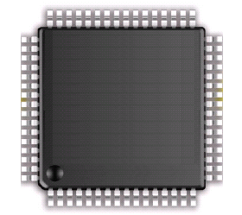
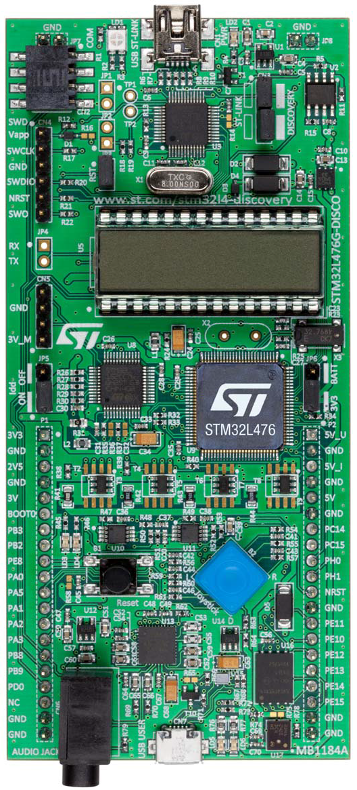
Red LED (PB.2)
STM32L4 Discovery Kit
PB.2
STM32L4
ARM
Cortex-M4
PE.8
PB.2 | Red LED
High | On
Low | Off
Red & Green LEDs
Notes:
{{Pause=2}} This is the STM32L4 discovery kit. Software can control two L E Ds on board, including one red LED, and one green LED. The red LED is connected to the microprocessor pin P B 2 via a resistor. The green LED is connected to the pin P E 8 via another resistor. In this tutorial, we only focus on lighting up the red LED. The process of lighting up the green LED is very similar. To turn on the red LED, software has to set the pin P B 2 to high. To turn off the red LED, software has to set the pin PB 2 to low. In this tutorial, I will show you how to set pin PB 2 to high.

Slide 11
General Purpose Input/Output (GPIO)
8 GPIO Ports:
A, B, C, D, E, F, G, H
Up to 16 pins in each port
Port E
Port A
Port F
Port B
Port G
Port C
Port H
Port D
STM32L4
Notes:
{{Pause=2}} Each STM32L4 chip has eight G P I O ports, including port A, B, C, et cetera. Each G P I O port can have up to 16 pins. All pins in a G P I O port are controlled as a group. Each pin can be configured by software at runtime to perform various functions.

Slide 12
General Purpose Input/Output (GPIO)
D Bus
FLASH
ARM Cortex-M4
FPU
I Bus
AHB Bus Matrix
SRAM
S Bus
GPIO A
GPIO B
APB Bus Matrix
GPIO C
GPIO D
GPIO E
UART
GPIO F
GPIO G
SPI
GPIO H
Timer
…
STM32L4
Notes:
{{Pause=2}} The ARM Cortex-M4 processor core, is connected to the other components via three buses, include the data bus, the instruction bus, and the system bus. These buses are connected to the Advanced high performance bus (AHB) matrix. AHB is the backbone bus. It is used for high-performance, high clock frequency system modules, such as on-chip flash, on-chip SRAM, as well as G P I O modules. The chip also has a bridge that connects AHB to Advanced Peripheral Bus (APB). APB is for low bandwidth peripherals. APB connects most of the peripheral devices in the system, such as UART, S P I, and timer.
{{Pause=1}} Here is the basic structure of a G P I O module. I will explain the details of this module in the next slide.

Slide 13
General Purpose Input/Output (GPIO)
D Bus
FLASH
ARM Cortex-M4
FPU
I Bus
AHB Bus Matrix
SRAM
S Bus
GPIO A
GPIO B
APB Bus Matrix
GPIO C
GPIO D
GPIO E
UART
GPIO F
GPIO G
SPI
GPIO H
Timer
…
STM32L4
Notes:
{{Pause=2}} The ARM Cortex-M4 processor core, is connected to the other components via three buses, include the data bus, the instruction bus, and the system bus. These buses are connected to the Advanced high performance bus (AHB) matrix. AHB is the backbone bus. It is used for high-performance, high clock frequency system modules, such as on-chip flash, on-chip SRAM, as well as G P I O modules. The chip also has a bridge that connects AHB to Advanced Peripheral Bus (APB). APB is for low bandwidth peripherals. APB connects most of the peripheral devices in the system, such as UART, S P I, and timer.
{{Pause=1}} Here is the basic structure of a G P I O module. I will explain the details of this module in the next slide.

Slide 14
Basic Structure of an I/O Port Bit Input and Output
Schmitt
trigger
Notes:
{{Pause=2}} Most G P I O ports have 16 pins. This diagram shows the standard structure of one G P I O pin. It includes the basic structure for both digital input, and digital output. In this lecture, I will only focus on the digital output part. We will discuss the digital input in a separate lecture.

Slide 15
Basic Structure of an I/O Port Bit: Output
GPIO Pull-up/Pull-down Register (PUPDR)
00 = No pull-up, pull-down 01 = Pull-up
10 = Pull-down 11 = Reserved
Output Data Register
Schmitt
trigger
GPIO Output Type Register (OTYPER)
0 = Output push-pull (default)
1 = Output open-drain
GPIO MODE Register
00 = Input, 01 = Output,
10 = AF, 11 = Analog (default)
Notes:
{{Pause=2}} Here is the basic structure, that is designed for digital output, on one G P I O pin. There are four important registers related to output, including the output data register, {{Pause=1}} the mode register, {{Pause=1}} the data output type register, {{Pause=1}} and the pull-up pull-down register. In this slide, I only give a short overview of each registers. Detailed discussion will be presented in the next few slides. {{Pause=1}} We can use the mode register to configure the pin as output. {{Pause=1}} The output type register, sets the output pin as, either push-pull or open-drain. {{Pause=1}} The pull-up pull down register, specifies, whether the pin is pulled up to a high voltage by a resister, or the pin is pulled down to the ground via another resister.
{{Pause=1}} When the pin is configured as output, the value written to the output data register is output on the G P I O pin. {{Pause=1}} However, whether the pin has a high voltage output, a low voltage output, or a high impedance output, depends on the configuration of the output type register, and the pull-up pull-down register.

Slide 16
Enable Clock
AHB2 peripheral clock enable register (RCC_AHB2ENR)
SYSCLK
Clock for Port B
1
GPIOEN
AND Gate
#define RCC_AHB2ENR_GPIOBEN ((uint32_t)0x00000002U)
RCC->AHB2ENR |= RCC_AHB2ENR_GPIOBEN;
Notes:
{{Pause=2}} To improve energy-efficiency, the clock of most peripherals, is turned off. As presented previously, the red LED is connected to the pin 2 of port B. {{Pause=1}} First of all, we need to enable the clock of G P I O Port B. The clock can be turned on or off by configuring the reset and clock control module (RCC). Specifically, the clock of port B is controlled by the AHB2, peripheral clock enable register (A H B 2 E N R). We need to set bit 1, that is, G P I O B Enable Bit, of this register to 1. When G P I O B Enable bit is 1, the clock signal can pass through this logic {{Pause=0.1}} AND gate to drive the port B. On the other hand, if G P I O B Enable it is zero, the output of the logic {{Pause=0.1}} AND gate is always zero. Accordingly, the port B has no clock input.
{{Pause=1}} Software can set G P I O B Enable bit to 1 by using bitwise OR. In order to make the code more readable, we use this macro to define this constant. In fact, this macro has already been defined in the device header file.

Slide 17
GPIO Mode Register (MODER)
32 bits (16 pins, 2 bits per pin)
Pin 2
Pin 1
Pin 0
GPIOB->MODER &= ~(3UL<<4); // Clear bits 4 and 5 for Pin 2
GPIOB->MODER |= 1UL<<4; // Set bit 4, set Pin 2 as output
Notes:
{{Pause=2}} Software can program each {{Pause=0.1}} G P I O pin as one of the following four different functions. First, digital input, which detects, whether an external voltage signal, is higher or lower than a predetermined threshold. Second, digital output, which controls the voltage on the pin. Third, analog functions, which perform digital-to-analog, or analog-to-digital conversion. Last, other complex functions, such as S P I data pin, and timer PWM output. We call the last category of functions as alternative functions. {{Pause=1}}
The function of a pin is controlled by the MODE register of this port. Each mode register has 32 bits. Port B has a total of 16 pins. The function of each pin is determined by two bits of the mode register. For example, bit 5 and bit 4 control the function of pin 2. When these two bits are zero zero, the pin is set as digital input. When these bits are zero one, this pin is used for digital output. When they are one zero, the pin has alternative function. Specific alternative function will be determined by the alternative function register of this port. When these two bits are one one, the pin will be used for analog-to-digital conversion (ADC), or digital-to-analog conversion (DAC). {{Pause=1}}
In this example, pin PB 2 will be used as output to turn on the red LED. Therefore, we need to set bit 5 and bit 4 to zero and one, respectively. {{Pause=2}} Here is the C code. First, we clear bit 4 and 5. Then we set bit 4 by using bitwise OR.

Slide 18
GPIO Output Type Register (OTYPE)
16 bits reserved, 16 data bits, 1 bit for each pin
GPIOB->OTYPE &= ~(1UL<<2); // Clear bit 2
Notes:
{{Pause=2}} Next, we need to set the output of mode of Pin 2 as push-pull, instead of open drain. Therefore, software has to clear bit 2 of the output type register. In the following few slides, I will explain what is the difference between push pull, and open drain.

Slide 19
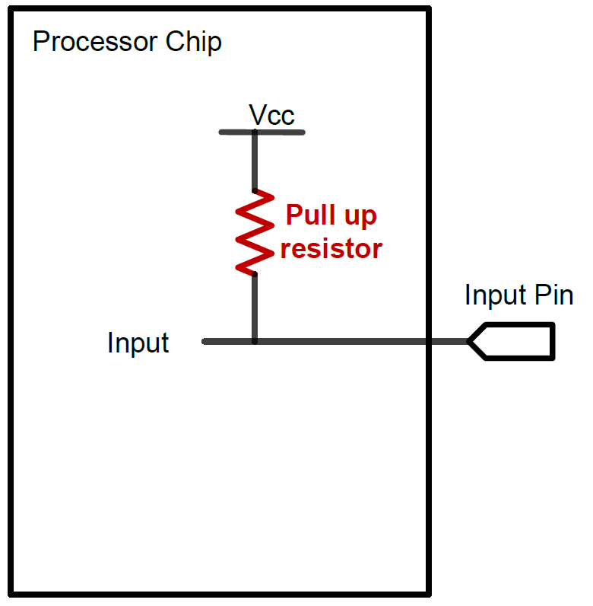
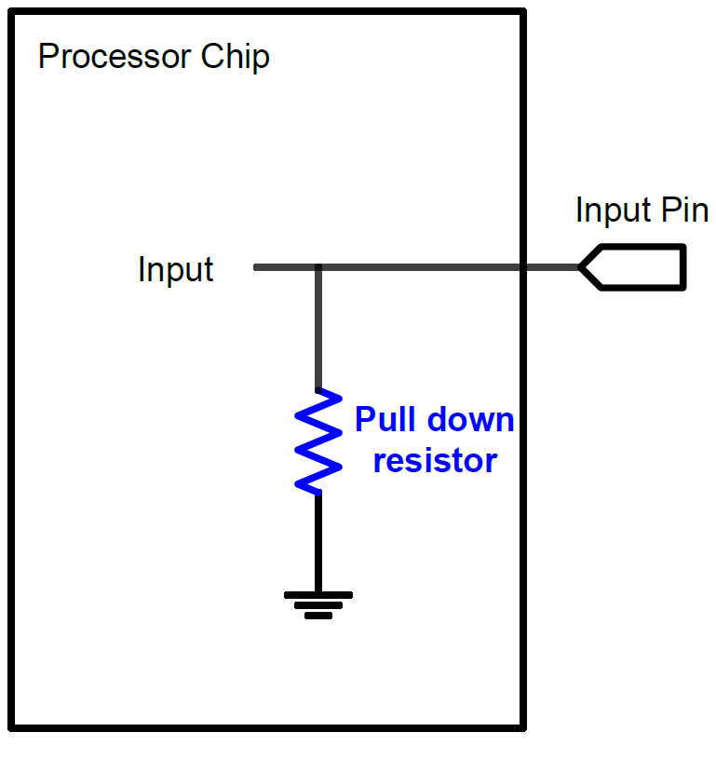
GPIO Input: Pull Up and Pull Down
A digital input can have three states: High, Low, and High-Impedance (also called floating, tri-stated, HiZ)
Pull-Up
Pull-Down
If external input is HiZ, the input is read as a valid HIGH.
If external input is HiZ, the input is read as a valid LOW.

Slide 20
GPIO Output: Push-Pull
GPIO Output = 1
Source current to external circuit

Slide 21
GPIO Output: Push-Pull
GPIO Output = 0
Drain current from external circuit

Slide 22
GPIO Output: Open-Drain
GPIO Output = 0
Drain current from external circuit

Slide 23
GPIO Output: Open-Drain
Output = 1
GPIO Pin has high-impedance to external circuit

Slide 24
GPIO Output Speed
Output Speed:
Speed of rising and falling
Four speeds: Low, Medium, Fast, High
Tradeoff
Higher GPIO speed increases EMI noise and power consumption
Configure based on peripheral speed
Low speed for toggling LEDs
High speed for SPI
Speed of Rising
Low
Medium
Fast
High

Slide 25
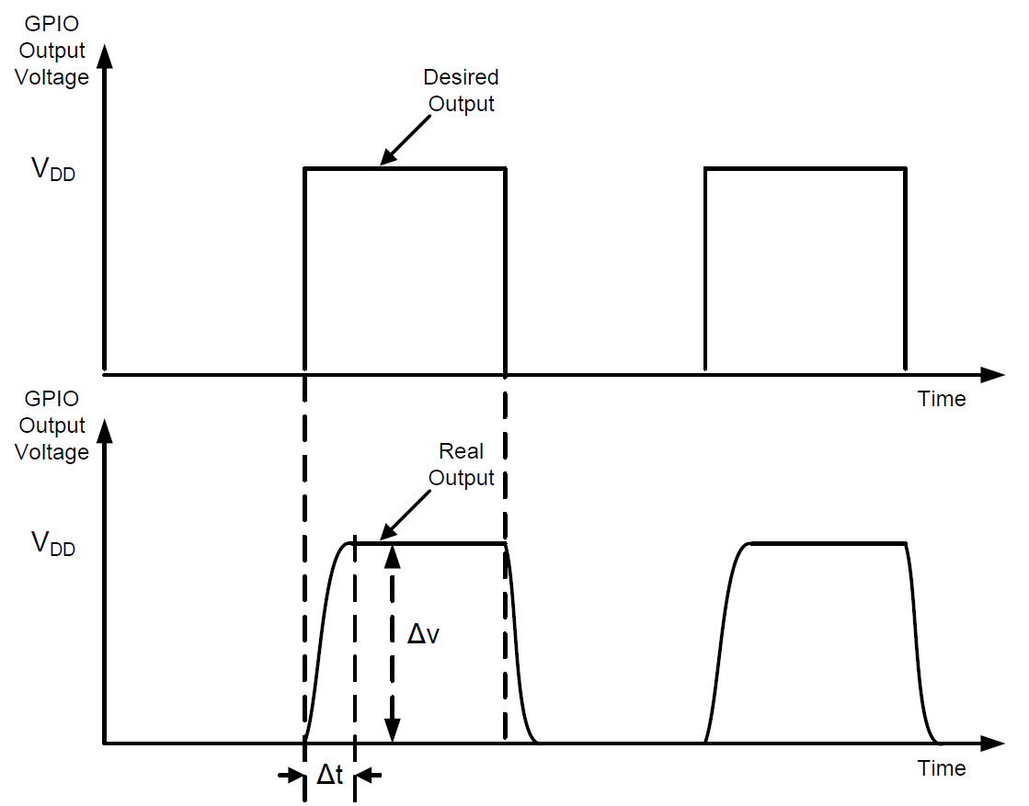

Slew Rate
Slew Rate
Maximum rate of change of the output voltage
$$Slew Rate=max\left(\frac{∆V}{∆t}\right)$$
A high slew rate allows the output to be toggled at a fast speed.

Slide 26
GPIO Output: Push-Pull vs Open-Drain
Output Bit | Push-Pull | Open-Drain
1 | High | HiZ
0 | Low | Low
Use push-pull output, instead of open-drain output!
Notes:
{{Pause=2}} This table summarizes the difference between push pull, and open drain. Their difference is that, in the push-pull output, when the output data bit is one, the output pin has a high voltage. However, in the open-drain output, when the output data bit is one, the output pin is floating, or has high impedance. {{Pause=1}} In this example, we need to provide a high voltage on the output pin, in order to turn on the LED. Therefore, we have select the push-pull output, instead of the open-drain output.

Slide 27
GPIO Output Data Register (ODR)
16 bits reserved, 16 data bits, 1 bit for each pin
Pin 2
GPIOB->ODR |= 1UL << 2; // Set bit 2
Notes:
{{Pause=2}} The output data register is easy to understand. This register has the upper 16 bits reserved. It has 16 data bits, with one bit for each pin. Because the red LED is connected to pin 2, to turn on the LED, we need to set, bit 2, of the output data register, to 1.

Slide 28
Light up the Red LED (PB.2)
RCC->AHB2ENR |= RCC_AHB2ENR_GPIOBEN; // Enable clock of Port B
GPIOB->MODER &= ~(3UL<<4); // Clear mode bits
GPIOB->MODER |= 1UL<<4; // Set mode to output
GPIOB->OTYPE &= ~(1UL<<2); // Select push-pull output
GPIOB->ODR |= 1UL << 2; // Output 1 to turn on red LED
Notes:
{{Pause=2}} This slide summarizes the software code, which can turn on the red LED. The red LED is connected to pin 2 of port B. The software involves four steps. First, we turn on the clock to enable port B. Then, we set the mode of pin 2 of port B as digital output. Next, we select push-pull output, instead of open-drain output. Finally, we set, bit 2, of the output data register to light up the red LED.

Slide 29
GPIO Initialization
Turn on the clock to the GPIO Port (e.g. Port B)
RCC->AHBENR |= RCC_AHBENR_GPIOBEN; Reset and Clock Control (RCC)
Configure GPIO mode, output type, speed, pull-up/pull-down
typedef struct
{
__IO uint32_t MODER;
__IO uint16_t OTYPER;
uint16_t RESERVED0;
__IO uint32_t OSPEEDR;
__IO uint32_t PUPDR;
__IO uint16_t IDR;
uint16_t RESERVED1;
__IO uint16_t ODR;
uint16_t RESERVED2;
__IO uint16_t BSRRL; /* BSRR register is split to 2 * 16-bit fields BSRRL */
__IO uint16_t BSRRH; /* BSRR register is split to 2 * 16-bit fields BSRRH */
__IO uint32_t LCKR;
__IO uint32_t AFR[2];
} GPIO_TypeDef;
#define PERIPH_BASE ((uint32_t)0x40000000)
#define AHBPERIPH_BASE (PERIPH_BASE + 0x20000)
#define GPIOB_BASE (AHBPERIPH_BASE + 0x0400)
#define GPIOB ((GPIO_TypeDef *) GPIOB_BASE)

Slide 30
Joystick
STM32L4
STM32L4 Discovery Kit
Up
Left
Center
Right
Joystick with 4-direction control and selector
Down
Notes:
{{Pause=2}} The STM32L4 discovery kit has a four-direction joystick. The user may push in one of four directions at a time : up, down, left, and right. The user may also press the center of the joystick. The center is often used as a selector.

Slide 31
Joystick
PA0
+3V
Internal diagram of joystick
Notes:
{{Pause=2}} Here is the schematic diagram, which shows the connections between the processor pins and the joystick. G P I O pins PA 0, PA 1, PA 5, PA 2, PA 3 are connected to the center, left, down, right, and up pin of the joystick, respectively. Each pin is connected to the ground, via a capacitor. The purpose of these capacitors is to perform hardware debouncing. When pressed, the switch within the joystick may bounce back and forth a few times before settling down. The bounces usually settle within 20 milliseconds. A capacitor can filter out any quick changes in a signal. Therefore, the capacitor can remove the bounces or glitches associated with switch transitions.
{{Pause=1}} Here is the internal diagram of the joystick. It has five switches. The common terminal is connected to the positive 3 volt. In this lecture, we will write a software program, to detect whether the center of the joystick is pressed. When the user presses the center of the joystick, this center switch is then closed. As result, pin PA 0 is then connected to the 3 volt. Note that, the joystick center terminal, is pulled down to ground, via a 10K resistor. Therefore, the default voltage on the joystick center terminal is zero. However, the other four joystick terminals are not pulled down.

Slide 32
Basic Structure of an I/O Port Bit Input and Output
Schmitt
trigger
Notes:
{{Pause=2}} Most G P I O ports have 16 pins. This diagram shows, the standard structure of one G P I O pin. It includes the basic structure for both digital input, and digital output. In this lecture, I will only focus on the digital input. I have discussed the digital output in the previous lecture video.

Slide 33
Basic Structure of an I/O Port Bit: Output
GPIO Pull-up/Pull-down Register (PUPDR)
00 = No pull-up, pull-down 01 = Pull-up
10 = Pull-down 11 = Reserved
Output Data Register
Schmitt
trigger
GPIO Output Type Register (OTYPER)
0 = Output push-pull (default)
1 = Output open-drain
GPIO MODE Register
00 = Input, 01 = Output,
10 = AF, 11 = Analog (default)
Notes:
{{Pause=2}} Let’s quickly review G P I O output. There are four important registers related to output, including the output data register, {{Pause=1}} the mode register, {{Pause=1}} the data output type register, {{Pause=1}} and the pull-up pull-down register. {{Pause=1}} We can use the mode register to configure the function of the pin. If the pin is used as G P I O output, the mode bits should be 0 1. If the pin is used as G P I O input, the mode bits should be 0 0. {{Pause=1}} The output type register, sets the output pin as, either push-pull or open-drain. {{Pause=1}} The pull-up pull down register, specifies, whether the pin is pulled up to a high voltage, or the pin is pulled down to the ground.

Slide 34
Basic Structure of an I/O Port Bit Input and Output
Notes:
{{Pause=2}} Again, here is the overall diagram of the G P I O module for one I/O pin. In this lecture, we will only focus on G P I O input.

Slide 35
Basic Structure of an I/O Port Bit: Input
Schmitt
trigger
Reduce noise
Increase slew rate
Input Data Register (IDR)
Input is sampled into IDR every AHB clock cycle!
GPIO Pull-up/Pull-down Register (PUPDR)
00 = No pull-up, pull-down 01 = Pull-up
10 = Pull-down 11 = Reserved
Notes:
{{Pause=2}} Except the G P I O mode register, there are two other registers, which are related to G P I O input. They are the input data register (IDR), and the pull-up pull-down register (P U P D R).
{{Pause=1}} The input module, includes one important electronic component, called, Schmitt Trigger. The Schmitt trigger circuit is a special voltage comparator. It has two functions. First, it reduces noises, and provides a cleaner and more reliable signal. Second, it converts a slow signal edge, into a clean edge with instantaneous transition. Thus, it can increase the slew rate of signals.

Slide 36
Schmitt Trigger
Threshold
Analog signals
Noisy
Rise and fall slowly (small slew rate)
Notes:
{{Pause=2}} Let me explain the motivations of the Schmitt trigger. In practice, an analog signal often has electronic noise, introduced by various electronic components. The noise makes the signal fluctuate frequently. In addition, analog signal tends to rise or fall slowly, because of inherent parasitic capacitance, resistance, or induction in electronic circuits. Accordingly, analog signals tend to have small slew rates. The slew rate describes how fast a voltage changes. It is usually measured in volts per microsecond.

Slide 37
Schmitt Trigger
Threshold
Notes:
Let’s see what will happen, if we use a simple comparator, to convert the analog input signal, to a binary digital signal. The simple comparator compares the input voltage with a pre-defined threshold. If the input is larger than the threshold, then the comparator outputs high level. Otherwise, the comparator outputs low level. Here is the output of the simple comparator.

Slide 38
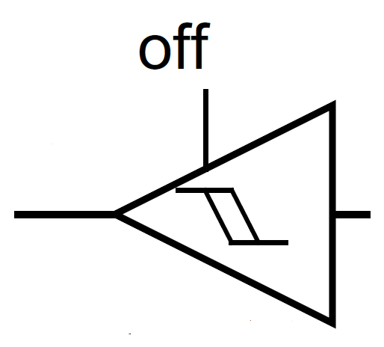
Schmitt Trigger
V_{out}
V_{in}
Schmitt-trigger gives cleaner signal on input
Notes:
{{Pause=2}} Different from the simple comparator, the Schmitt Trigger is a special circuit, which switches the output, based on two different thresholds. They are called the trigger high threshold, and the trigger low threshold. The output of a Schmitt Trigger depends on the current input, and the history of the input. When the input voltage increases from zero, the output remains low, until the input becomes larger than the high threshold. {{Pause=1}} Similarly, when the voltage decreases gradually, the output remains high, until the input becomes smaller than the low threshold. {{Pause=1}} Any fluctuation in the range between the high and low thresholds is ignored by the Schmitt trigger.
{{Pause=2}} This figure compares the output of the Schmitt Trigger, and the simple comparator. When the input signal fluctuates slightly, the output of the Schmitt Trigger does not switch its output level. For example, at the beginning, the output of Schmitt Trigger is low. When the input signal fluctuates, the output remains low as long as the input signal is lower than the high threshold. Similarly, if the current output is high, even thought the input fluctuates, the output remains high as long as the input is higher than the low threshold.
{{Pause=1}} From this simple example, we can see that, the Schmitt Trigger switches its output, much less frequently than the simple comparator. Accordingly, the Schmitt trigger helps eliminate noise in the input signal.

Slide 39
Enable Clock
AHB2 peripheral clock enable register (RCC_AHB2ENR)
SYSCLK
Clock for Port A
1
GPIOAEN
AND Gate
#define RCC_AHB2ENR_GPIOAEN ((uint32_t)0x00000001U)
RCC->AHB2ENR |= RCC_AHB2ENR_GPIOAEN; // Enable clock of Port A
Notes:
{{Pause=2}} As introduced in the lecture G P I O output, the clock of most peripherals, is turned off, in order to achieve the maximum energy efficiency. The joystick terminals are connected to five different pins in G P I O port A.
First of all, we need to enable the clock of port A. The clock can be turned on, or turned off, by configuring the reset and clock control module (RCC). We need to set the G P I O ei {{Pause=0.1}} Enable Bit to 1. When the G P I O ey {{Pause=0.1}} Enable bit is 1, the clock signal can pass through this {{Pause=0.1}} AND {{Pause=0.1}} gate, to drive the port A. On the other hand, if the G P I O ey {{Pause=0.1}} Enable bit is zero, the output of the logic {{Pause=0.1}} AND {{Pause=0.1}} is always zero. Accordingly, port A has no clock input.
{{Pause=1}} Software can set the G P I O ey {{Pause=0.1}} Enable bit to 1 by using bitwise OR. In order to make the code more readable, we use this macro to define this constant. In fact, this macro has already been defined in the device header file.

Slide 40
GPIO Mode Register (MODER)
32 bits (16 pins, 2 bits per pin)
Pin 2
Pin 1
Pin 0
// Set Pin 0 as input
GPIOA->MODER &= ~3UL; // Clear bits 1 and 2 for Pin 0
Notes:
{{Pause=2}} Next, we need to program pin 0 {{Pause=0.1}} of Port A, as digital input. The function of each pin is determined by two bits in the mode register. For example, bit 1 and bit 0 control the function of pin 0. When these two bits are zero zero, the pin is set as digital input. {{Pause=1}} Here is the C statement, which clears bit 1 and bit 0. This statement sets pin 0 of port A as digital input.

Slide 41
GPIO Pull-up/Pull-down Register (PUPDR)
16 pins per port, 2 bits per pin
Pin 2
Pin 1
Pin 0
// No pull-up, pull-down
GPIOA->PUPDR &= ~3UL;
Pull-Down
Pull-Up
Notes:
{{Pause=2}} When a G P I O pin is used for digital input, the default state of a pin can be high voltage, low voltage, or high impedance. The high impedance state is also called floating or tri-stated. Pull-up and pull-down are used to ensure the input pin has a valid input, either logic 1 or logic 0, when the external circuit does not drive the pin. {{Pause=1}} When a pin is configured as pull-down, the pin is then internally connected to the ground via a resistor. Similarly, when software configures a pin as pull-up, the pin is internally connected to the power supply via a resistor. When a pin is neither pulled up nor pulled down internally, then the pin has high impedance. {{Pause=1}} Note that the internal pull-up and pull-down resistors have large impedance, typically large than 10K ohms. When external circuit, connected to a G P I O pin, has a fair amount of capacitance, the process of, pulling the pin voltage to the level of logic high or logic low, takes a long time. This is because the impedance of, the internal pull-up and pull-down resistors, is too large. To meet the speed requirements, external pull-up or pull-down with small resistors, are often needed.
{{Pause=1}} Here is the C code that sets pin 0 as no pull-up, no pull-down. It clears bit 1 and bit 0 of the P U P D R register by bitwise AND. Note that that pin 0 has already been pulled down externally. Therefore, we do not have to pull it down internally.

Slide 42
GPIO Input Data Register (IDR)
16 bits reserved, 16 data bits (1 bit per pin)
// Demo of reading pin 7
uint32_t mask = 1UL<<7;
uint32_t input = (GPIOA->IDR & mask) == mask;
or
uint32_t input = (GPIOA->IDR & mask) >> 7;
Notes:
{{Pause=2}} The digital input is sampled every APB cycle. If the input is high, then the corresponding bit, in the input data register (IDR), is set. We can use a mask to read the read the individual bit of the input data register. as shown in this C code. For example, in order to read the input on pin 7, we first define a mask. Then, we use bit-wise operation AND. We compare the bit-wise result with the mask. If they are the same, the input on pin 7 is 1. Otherwise, the input is 0.

Slide 43
Read Input of Pin PA.0
uint32_t input;
RCC->AHB2ENR |= RCC_AHB2ENR_GPIOAEN; // Enable clock of Port A
GPIOA->MODER &= ~3UL; // Set PA.0 as digital input
GPIOA->PUPDR &= ~3UL; // No pull-up, no pull-down
// Read pin 0
input = (GPIOA->IDR & 1UL);
if (input == 0) {
// Center of joystick is not pressed
...
} else {
// Center of joystick is pressed
...
}
Notes:
{{Pause=2}} This slide summarizes the software code, which read the input of the center switch of the joystick. Note that the center terminal of the joystick is connected to pin 0 of port A. The software involves four steps. First, we turn on the clock to enable port A. Then, we set the mode of pin 0 as digital input. Next, we select no pull-up and no pull-down for pin 0. Finally, we read bit 0 by using bit-wise AND. If the bit-wise result is zero, then the center of the joystick is not pressed. Otherwise, it is pressed.

Slide 44
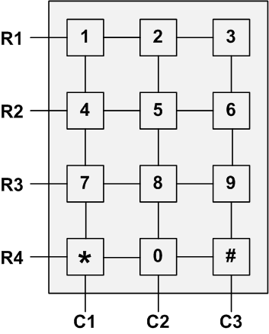
Keypad Scanning

Slide 45
Keypad Scanning
Any key pressed?
If so, find out:
Which column?
Which row?
Go back step 1

Slide 46
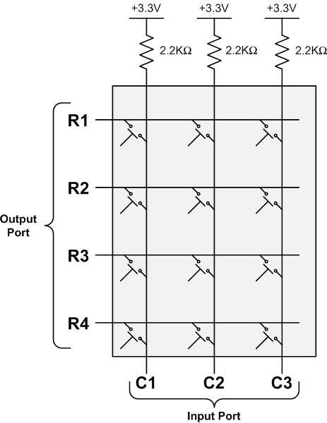
Keypad Scanning

Slide 47
Keypad Scanning
0
Step 1: Set Output
R1,R2,R3,R4 = 0000
Step 2: Read Input
C1,C2,C3 = 111
0
0
⟹ No key pressed
0
1
1
1

Slide 48
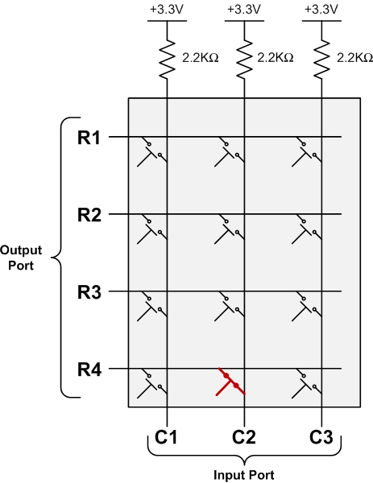
Keypad Scanning
Key “0” is pressed

Slide 49
Keypad Scanning
0
Step 1: Set Output
R1,R2,R3,R4 = 0000
Step 2: Read Input
C1,C2,C3 = 101
⟹ Some key in 2nd column is pressed down
0
0
0
1
0
1

Slide 50
Keypad Scanning
Scan 1st row
0
Step 1: Set Output
R1,R2,R3,R4 = 0000
Step 2: Read Input
C1,C2,C3 = 101
Step 3a: Scan 1st row
R1,R2,R3,R4 = 0111
C1,C2,C3 = 111
⟹ No key in 1st row
is pressed down
1
1
1
1
1
1

Slide 51
Keypad Scanning
Scan 2nd row
1
Step 1: Set Output
R1,R2,R3,R4 = 0000
Step 2: Read Input
C1,C2,C3 = 101
Step 3b: Scan 2nd row
R1,R2,R3,R4 = 1011
C1,C2,C3 = 111
⟹ No key in 2nd row
is pressed down
0
1
1
1
1
1

Slide 52
Keypad Scanning
Scan 3rd row
1
Step 1: Set Output
R1,R2,R3,R4 = 0000
Step 2: Read Input
C1,C2,C3 = 101
Step 3c: Scan 3rd row
R1,R2,R3,R4 = 1101
C1,C2,C3 = 111
⟹ No key in 3rd row
is pressed down
1
0
1
1
1
1

Slide 53
Keypad Scanning
Scan 4th row
1
Step 1: Set Output
R1,R2,R3,R4 = 0000
Step 2: Read Input
C1,C2,C3 = 101
Step 3d: Scan 4th row
R1,R2,R3,R4 = 1110
C1,C2,C3 = 101
⟹ key in 4th row
is pressed down
1
1
0
1
0
1

Slide 54
Keypad Scanning
1
⟹ Key pressed is located at the second column and the fourth row.
1
1
0
1
0
1

Slide 55
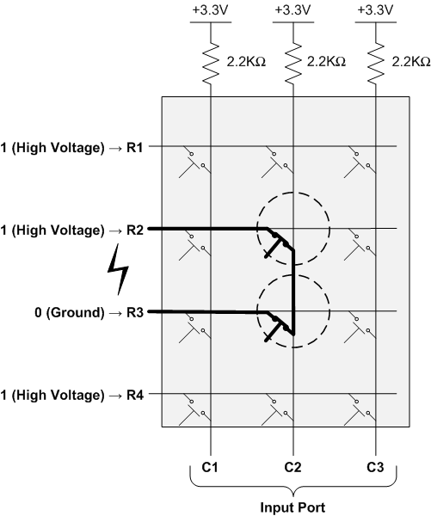
Keypad Scanning

Slide 56
I/O Debouncing
Example signal when a button is pressed

Slide 57
De-Bouncing
Hardware De-bouncers
Simple RC circuit as a low-pass filter
Software De-bouncing
Solution A: Read the switch after a sufficient delay to allow the bounces to settle down
Solution B: Reading periodically and use a counter as a filter
Reset the counter when the signal is “unpressed”
Counts up if “pressed”
If counter > threshold, the contacts has stopped bouncing

