Slide 1
Dr. Yifeng Zhu Electrical and Computer Engineering University of Maine
Embedded Systems with ARM Cortex-M Microcontrollers in Assembly Language and C
Chapter 22
I2C: Inter-Integrated Circuit
Spring 2020

Slide 2
Inter-Integrated Circuit (I2C)
Designed for low-cost, medium data rate applications by Philips in the early 1980’s
Original purpose: connect a CPU to peripheral chips in a TV-set
Today: a de-facto standard for 2-wire communications
Since October 10, 2006, no licensing fees are required to implement the I²C protocol. However, fees are still required to obtain I²C slave addresses allocated by NXP (acquired Philips).
Characteristics
Serial, byte-oriented
Multi-master, multi-slave
Two bidirectional open-drain lines, plus ground
Serial Data Line (SDA)
Serial Clock Line (SCL)
SDA and SCL need to pull up with resistors

Slide 3
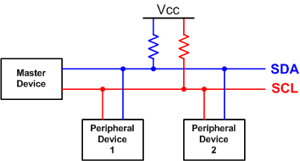
Inter-Integrated Circuit (I2C)
Serial data line
Serial clock line
Up to 100 kbit/s in the standard mode, up to 400 kbit/s in the fast mode, and up to 3.4 Mbit/s in the high-speed mode.
SDA and SCL have to be open-drain
Connected to positive if the output is 1
In high impedance state if the output is 0
Each Device has an unique address (7, 10 or 16 bits). Address 0 used for broadcast
STM32L’s internal pull-up is too weak (internal 100KΩ)
External pull-up (4.7 kΩ for low speed, 3 kΩ for standard mode, and 1 kΩ for fast mode).

Slide 4
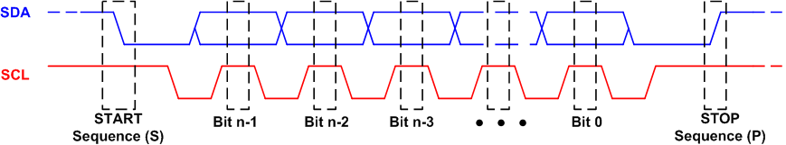
Timing Diagram
A START condition is a high-to-low transition on SDA when SCL is high.
A STOP condition is a low to high transition on SDA when SCL is high.
The address and the data bytes are sent most significant bit first.
Master generates the clock signal and sends it to the slave during data transfer
Data on SDA can be changed only when SCL is low.

Slide 5
Multiple Masters
“Wired-AND” bus: A sender can pull the lines to low, even if other senders are trying to drive the lines to high
In single master systems, arbitration is not needed.
Arbitration for multiple masters:
During data transfer, the master constantly checks whether the SDA voltage level matches what it has sent.
When two masters generate a START setting concurrently, the first master which detects SDA low while it has actually intended to set SDA high will lose the arbitration and let the other master complete the data transfer.

Slide 6

Slave Addressing
7-bit, 8-bit, 10-bit I2C slave addressing
Slave’s address is often programmable
Some reserved for special function
Slave Address | R/W bit | Description
0000 000 | 0 | General call address
0000 000 | 1 | START byte
0000 001 | X | CBUS address
0000 010 | X | Reserved for different bus format
0000 011 | X | Reserved for future purposes
0000 1xx | X | Hs-mode master code
1111 1xx | X | Reserved for future purposes
1111 0xx | X | 10-bit slave addressing
0 = write to slave
1 = read from slave

Slide 7
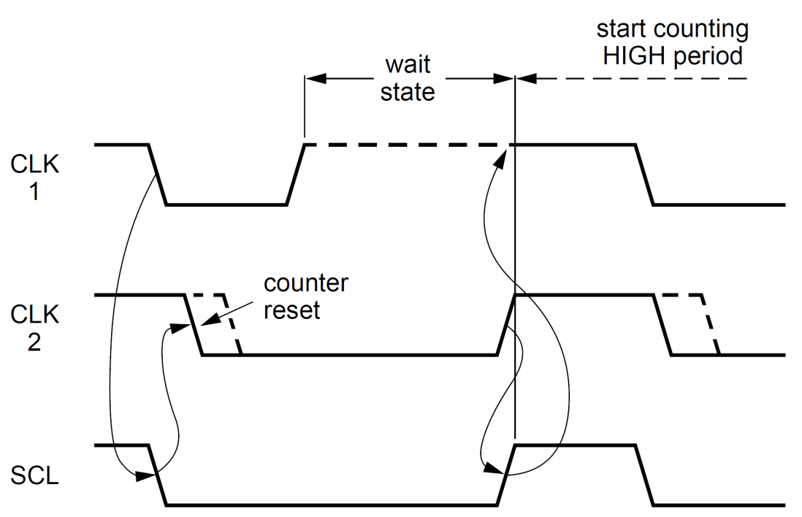
Clock Synchronization
Source: I2C Specifications
Clock synchronization is needed when there are multiple masters.
Wired-AND connection for clock synchronization
Each master has a counter. Counter resets if SCL goes LOW. When the counter counts down to zero, the master releases SCL and thus SCL goes high.
SCL remains LOW if any master pulls it LOW.
When all masters concerned have counted off their LOW period, the clock line is released and goes HIGH.
After going high, all masters start counting their HIGH periods. The first master to complete its HIGH period pulls the SCL line LOW again.
Notes:
This means that a HIGH to LOW transition on the SCL line causes the
masters concerned to start counting off their LOW period and, once a master clock has
gone LOW, it holds the SCL line in that state until the clock HIGH state is reached (see
Figure). However, if another clock is still within its LOW period, the LOW to HIGH
transition of this clock may not change the state of the SCL line. The SCL line is therefore
held LOW by the master with the longest LOW period. Masters with shorter LOW periods
enter a HIGH wait-state during this time.
When all masters concerned have counted off their LOW period, the clock line is released
and goes HIGH. There is then no difference between the master clocks and the state of
the SCL line, and all the masters start counting their HIGH periods. The first master to
complete its HIGH period pulls the SCL line LOW again.
In this way, a synchronized SCL clock is generated with its LOW period determined by the
master with the longest clock LOW period, and its HIGH period determined by the one
with the shortest clock HIGH period.

Slide 8
Working Modes
Master-sender
Master issues START and ADDRESS, and then transmits data to the addressed slave device
Master-receiver
Master issues START and ADDRESS, and receives data from the addressed slave device
Slave-sender
Master issues START and the ADDRESS of the slave, and then the slave sends data to the master
Slave-receiver
Master issues START and the ADDRESS of the slave, and then the slave receives data from the master.

Slide 9
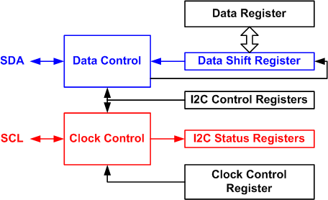
STM32L I2C Module
During sending, the I²C hardware automatically sets the TxE flag in the status register if an acknowledge pulse is received from the slave.
During receiving, the I²C hardware then automatically sets the RxNE flag in the status register if a byte has been successfully received.

Slide 10
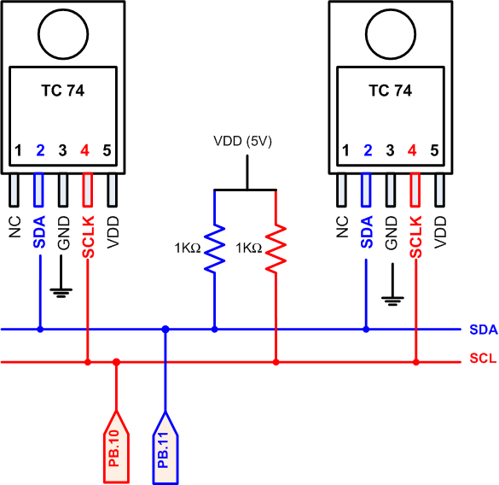
Interfacing Serial Digital Thermal Sensor

Slide 11
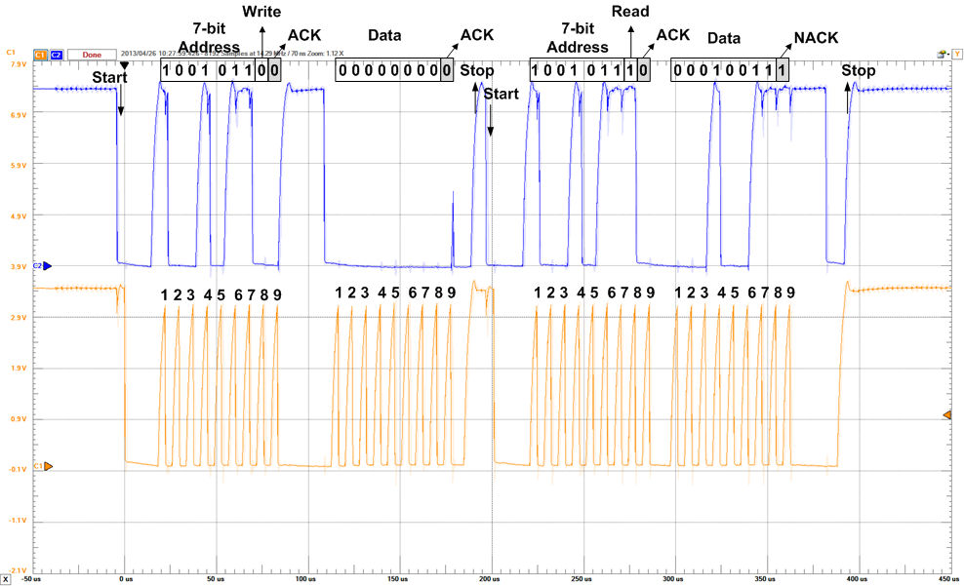
I2C Data

Slide 12
I2C Timing Register

Slide 13
I2C Timing Register

Slide 14
I2C DMA

Slide 15
I2C Initialization
void I2C_Initialization(void){
// Enable the clock of I2C
RCC->APB1ENR |= RCC_APB1ENR_I2C2EN; // I2C2 clock enable
// Reset the I2C (set and reset by software)
RCC->APB1RSTR |= RCC_APB1RSTR_I2C2RST;
RCC->APB1RSTR &= ~RCC_APB1RSTR_I2C2RST;
// I2C Control register. ACK is set and cleared by software, and cleared by hardware when PE=0.
I2C2->CR1 |= I2C_CR1_ACK; // Acknowledge after a byte is received
I2C2->CR1 &= ~I2C_CR1_SMBUS; // SMBus Mode: 0 = I2C mode; 1 = SMBus mode
I2C2->CR2 &= ~I2C_CR2_FREQ; // Clear Peripheral CLK frequency FREQ[5:0]
I2C2->CR2 |= I2C_CR2_FREQ_1; // Set Peripheral clock frequency as 2 MHz
I2C2->CR2 |= I2C_CR2_ITEVTEN; // Event Interrupt Enable
I2C2->CR1 &= ~I2C_CR1_PE; // Disable I2C to configure TRISE
I2C2->TRISE &= ~I2C_TRISE_TRISE; // Clear Maximum Rise Time
I2C2->TRISE |= 17; // Set Maximum Rise Time for standard mode
// I2C own address registers
// Before the STM32 sends its start sequence it sits listening to the I2C lines waiting for its address
// This is helpful if STM32 is used as slave
I2C2->OAR1 %= ~(0x01);
I2C2->OAR1 = 0x00; // Set up the address byte to select the slave device
I2C2->OAR2 = 0x00; // Set up the I2C own address2
// I2C Clock control register
I2C2->CCR &= ~I2C_CCR_FS; // 0 = Standard Mode ((up to 100 kHz));
// 1 = Fast Mode (up to 400 kHz)
I2C2->CCR &= ~I2C_CCR_CCR;
I2C2->CCR |= 0x08;
I2C2->CR1 |= I2C_CR1_PE; // Enable I2C1
}

Slide 16
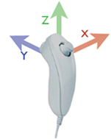
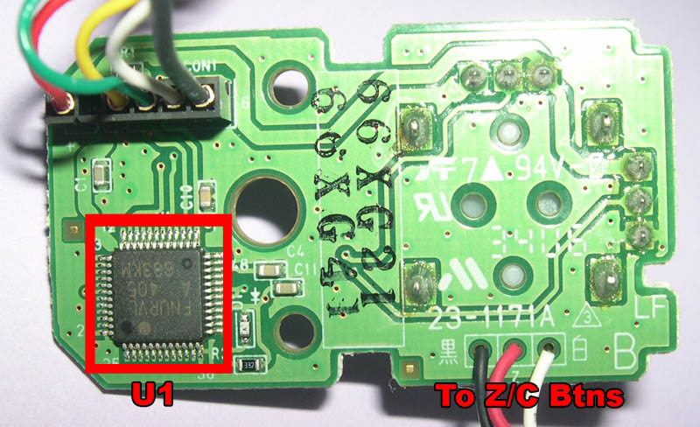
Wii Nunchuck
3 Axis accelerometer.
Can capture X, Y and Z motion
STMicroelectronics LIS3L02AL
3.0 V to 3.6 V supply voltage
~2 mW power consumption
±2 g full-scale
3 acceleration channels plus multiplexed analog output
Ratiometric output voltage
Power-down mode
Embedded self-test
10000 g high shock survivability

Slide 17
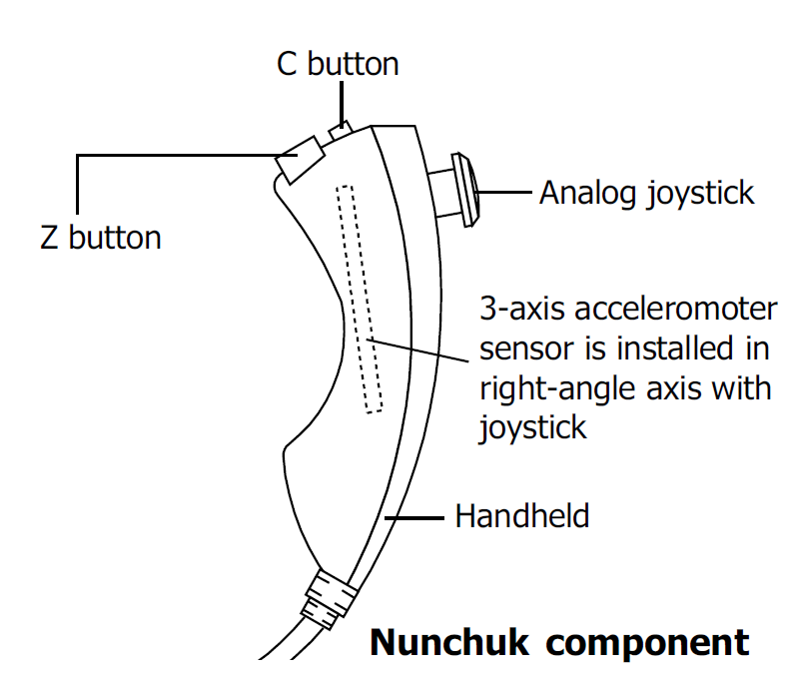
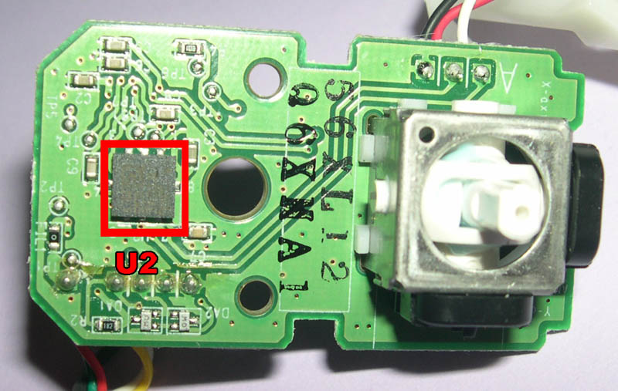
Wii Nunchuck
Offset | Data
0x00 | Joystick X
0x01 | Joystick Y
0x02 | Accelerometer X (bit 9 to bit 2)
0x03 | Accelerometer Y (bit 9 to bit 2)
0x04 | Accelerometer Z (bit 9 to bit 2)
0x05 | Accel. Z (bit 1) | Accel. Z (bit 0) | Accel. Y (bit 1) | Accel. Y (bit 0) | Accel. X (bit 1) | Accel. X (bit 0) | C button | Z button
Two push buttons (labeled as C and Z)
An 8-bit 2-axis analog joystick (X, Y) and
A 10-bit 3-axis accelerometer sensor (X, Y, and Z)
Communication is encrypted.
One possible decoding is
Data = (Received data XOR 0x17) + 0x17
Joystick X | 0x80 = Center, 0x00 = Full left, 0xFF = Full right
Joystick Y | 0x80 = Center, 0x00 = Full up, 0xFF = Full down
Acceleration | 0 – 1023.
Button | 0 = pressed, 1 = released
I2C Standard Mode (100Kbps)

Slide 18
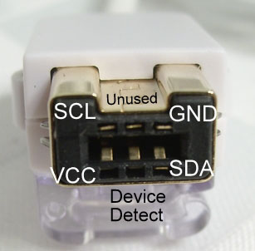
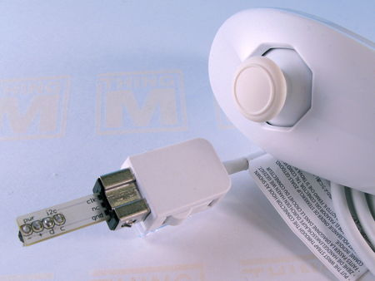
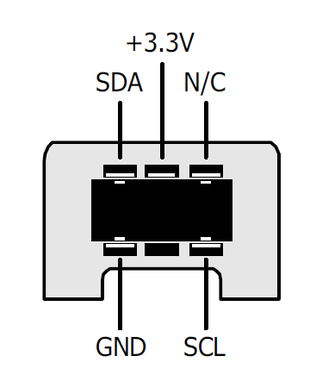
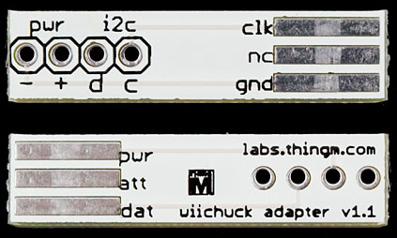
Interfacing Wii Nunchuck

Slide 19
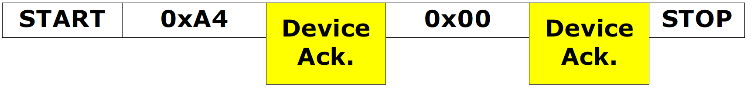
Nunchuck Commands
Initialization Command
Conversion Command
Each Nunchuck has Two Slave Addresses
Slave command address: 0xA4
Slave data address: 0xA5
Notes:
I2C>[0xa4 0x40 0x00]<<<Wii Nunchuck initialize I2C START CONDITION WRITE: 0xA4 GOT ACK: YES<<<write address WRITE: 0x40 GOT ACK: YES<<<write location (?) WRITE: 0x00 GOT ACK: YES<<<write 0 to location 0x40 (?) I2C STOP CONDITION I2C>
I2C>[0xa4 0x00]<<<setup the read pointer I2C START CONDITION WRITE: 0xA4 GOT ACK: YES<<<write address WRITE: 0x00 GOT ACK: YES<<<pointer to 0 I2C STOP CONDITION I2C>[0xa5 r:6]<<<read nunchuck measurements I2C START CONDITION WRITE: 0xA5 GOT ACK: YES<<<read address BULK READ 0x06 BYTES:<<read back 6 bytes 0x78 ACK 0x7A ACK 0x2F ACK 0x7D ACK 0x6E ACK 0x17 NACK I2C STOP CONDITION I2C>

Slide 20
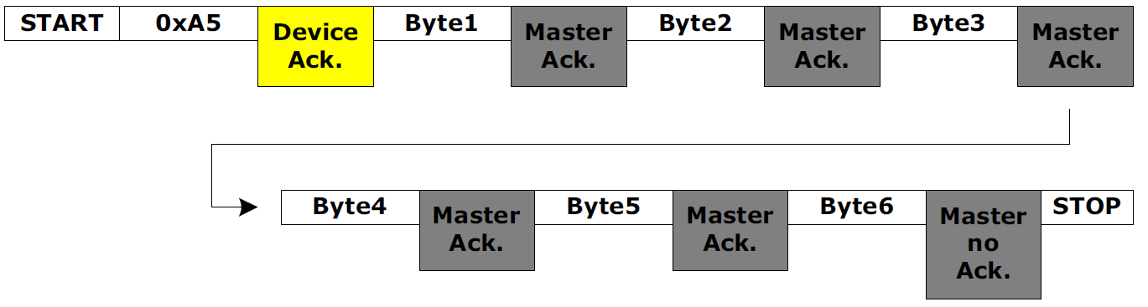
Nunchuck Read Data
Offset | Data
0x00 | Joystick X
0x01 | Joystick Y
0x02 | Accelerometer X (bit 9 to bit 2)
0x03 | Accelerometer Y (bit 9 to bit 2)
0x04 | Accelerometer Z (bit 9 to bit 2)
0x05 | Accel. Z (bit 1) | Accel. Z (bit 0) | Accel. Y (bit 1) | Accel. Y (bit 0) | Accel. X (bit 1) | Accel. X (bit 0) | C button | Z button

Slide 21
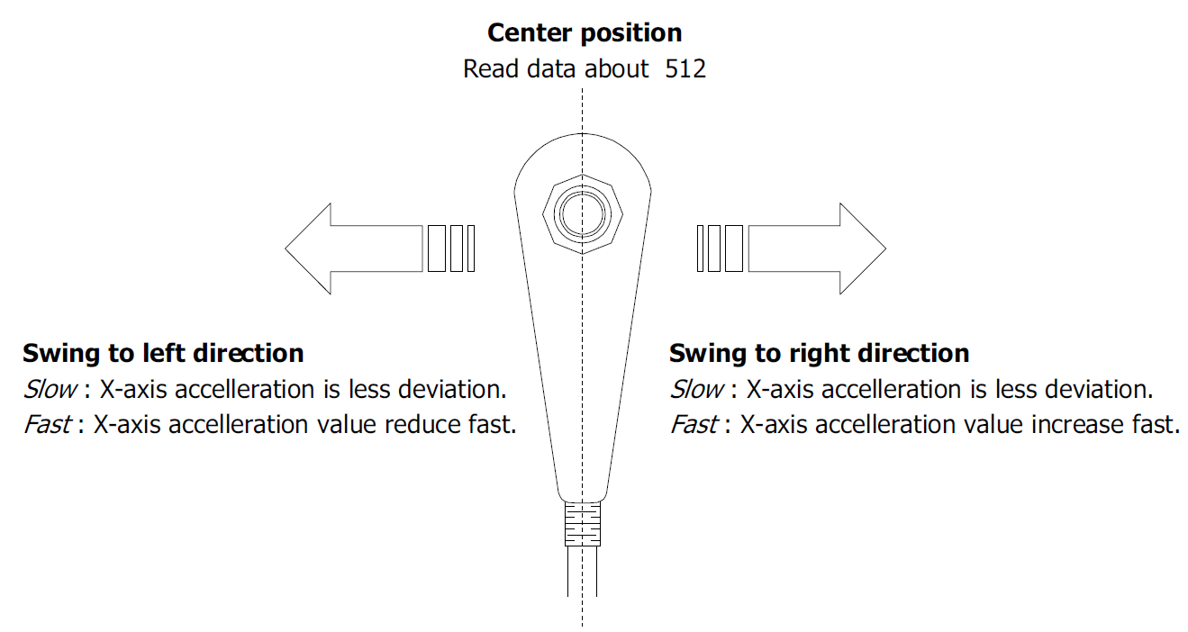
Left and Right
Image from ZX-NUMCHUK (#800339)

Slide 22
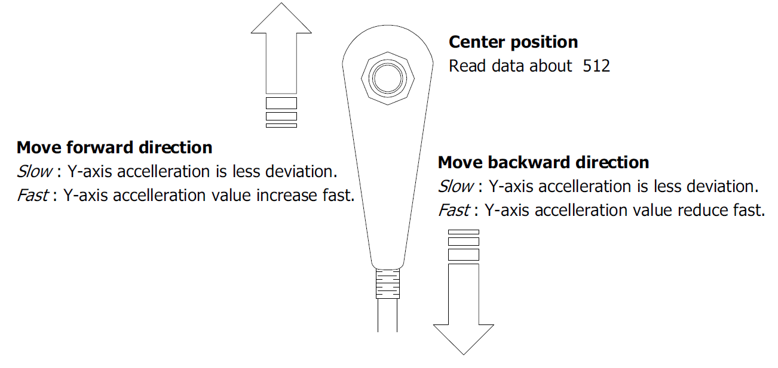
Forward and Backward
Image from ZX-NUMCHUK (#800339)

Slide 23
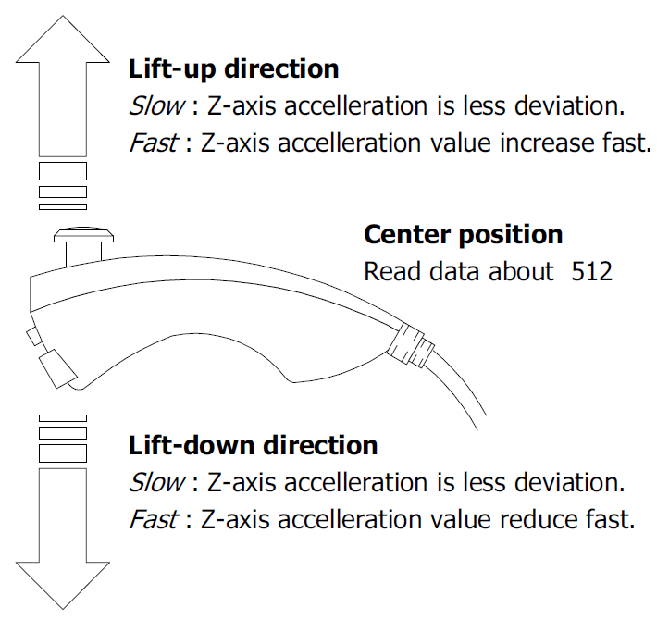
Up and Down
Image from ZX-NUMCHUK (#800339)

Slide 24
References
Materials are adopted from:
ZX-NUNCHUK Wii-Nunchuk interface board
Chad - Wii Nunchuk/Wiichuck Adapter

